Slide 1
INO-ICAL trigger system : A tale of its evolution
ASET Colloquium
Tata Institute of Fundamental Research
INO/HBNI
Sudeshna Dasgupta

Slide 2
Outline
1
Introduction
2
ICAL trigger scheme and validation results
3
Trigger module for prototype detector
4
Implementation layout
5
Design of trigger boards
6
Summary and future scope

Slide 3
Introduction

Slide 4
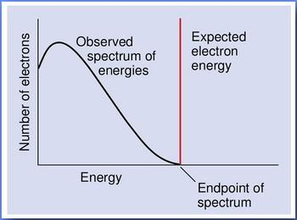
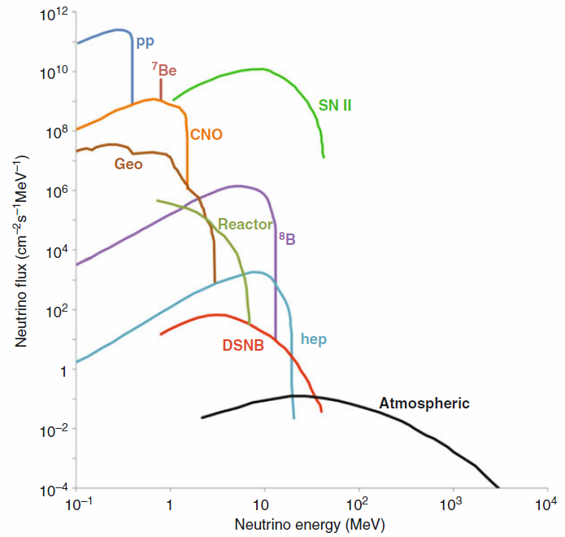
The elusive neutrino
Existence postulated by W. Pauli in 1930 to explain continuous energy spectrum in nuclear β–decay.
Experimental detection by Reines and Cowan in 1956.
Complete picture of three lepton families with three charged leptons (e, µ, τ) and associated neutral leptons (ν_{e}, ν_{µ}, ν_{τ}).
Available in wide energy range from various sources like the Sun, supernova, cosmic rays, reactors, accelerators etc.
An excellent probe in understanding laws of nature in particle physics, nuclear physics, astronomy and cosmology.

Slide 5
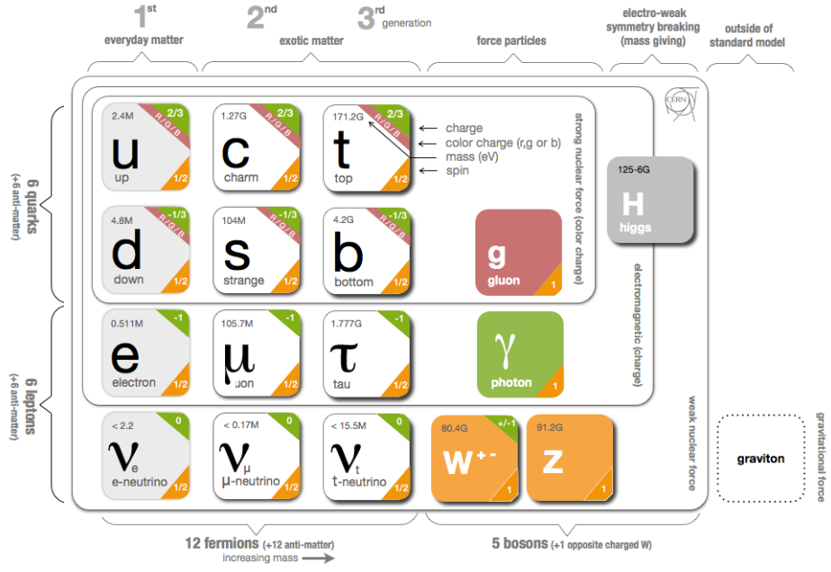
Neutrino oscillation
Standard model describes neutrinos as massless, electrically neutral and advocates lepton flavour conservation.
Experiments like, Homestake, SNO, SuperK, KamLAND etc., have detected neutrino oscillation.
Evidence in support of neutrino mass.
First indication of Physics beyond the Standard Model.

Slide 6
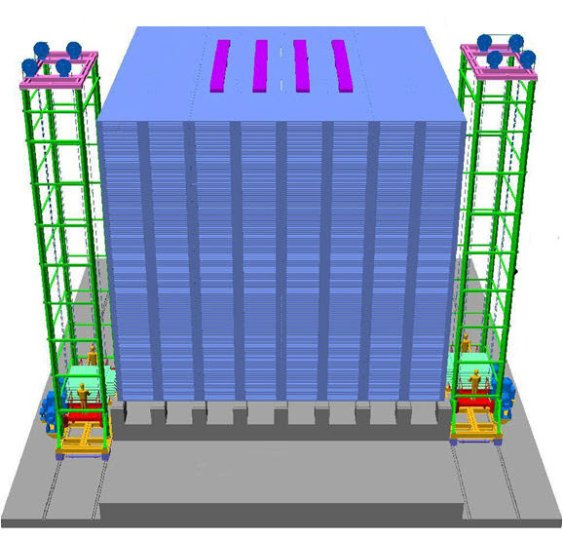
The ICAL detector
Modules | 3
Module dimension | 16 m x 16 m x 14.5 m
Detector dimension | 48 m x 16 m x 14.5 m
Iron layers | 151
Iron plate thickness | 56 mm
RPC layers | 150
Gap for RPC units | 40 mm
RPC unit dimension | 1800 mm x 1910 mm x 20 mm
RPC units/ layer/ module | 64
RPC units/ module | 9600
Total RPC units | 28,800
Total readout channels | > 3.6 x 10⁶
Magnetic field | 1.3 T
Rock overburden | > 1 km

Slide 7
Physics potential
Reconfirm atmospheric neutrino oscillation.
Unambiguous and more precise estimation of neutrino oscillation parameters.
Determination of neutrino mass hierarchy by studying matter effect for neutrinos and anti-neutrinos.
Study of CP violation in the leptonic sector and possible CPT violation.
Exploring possible existence of sterile neutrinos.
Studying multi-TeV cosmic ray muons.

Slide 8
Fundamentals of trigger system
Identify events of interest
Judicious consumption of data storage space.
The event signature
Physics requirements translated in terms of the detector parameters to define the trigger criteria.
Should not be prone to accidental coincidence of random noise hits.
Varies from signal in certain number of channels within a time-window to a specific mass of the end-products in a collision.
Event detection
Initiates data acquisition system to record the event data.
Determines the dead time of the data acquisition system.
Avoid loss of desired event due to limited bandwidth.

Slide 9
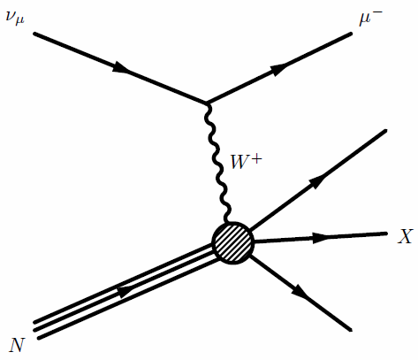

Trigger system for ICAL
Neutrino interactions in iron produce muon and/ or hadrons.
Choice of trigger criteria based on characteristic hit pattern of the events of interest.
Should achieve minimal detection threshold while ensuring negligible chance coincidence rates.

Slide 10
ICAL trigger scheme & validation results

Slide 11
Design goals
High detection efficiency
Admissible chance trigger rate
Feasibility of hardware implementation

Slide 12
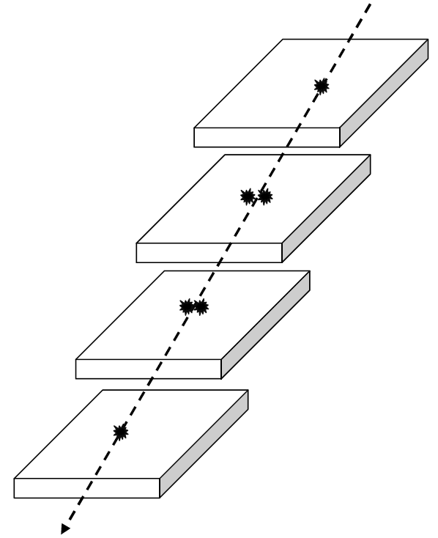
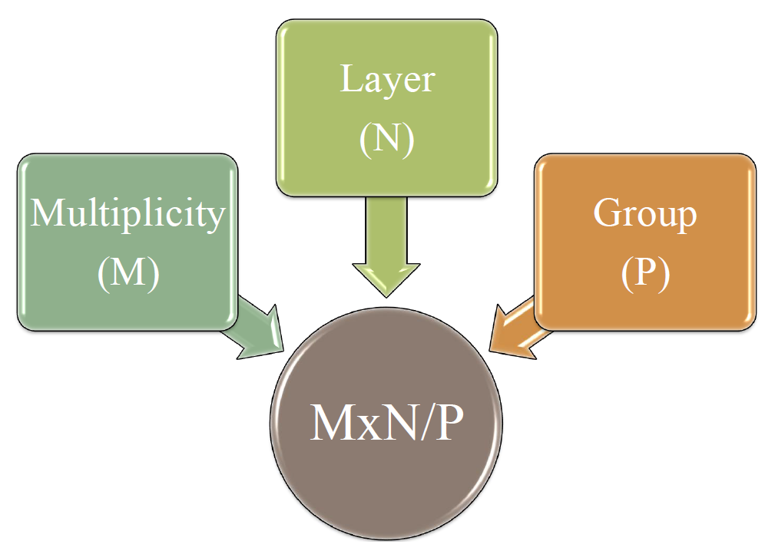
Trigger criteria

Slide 13
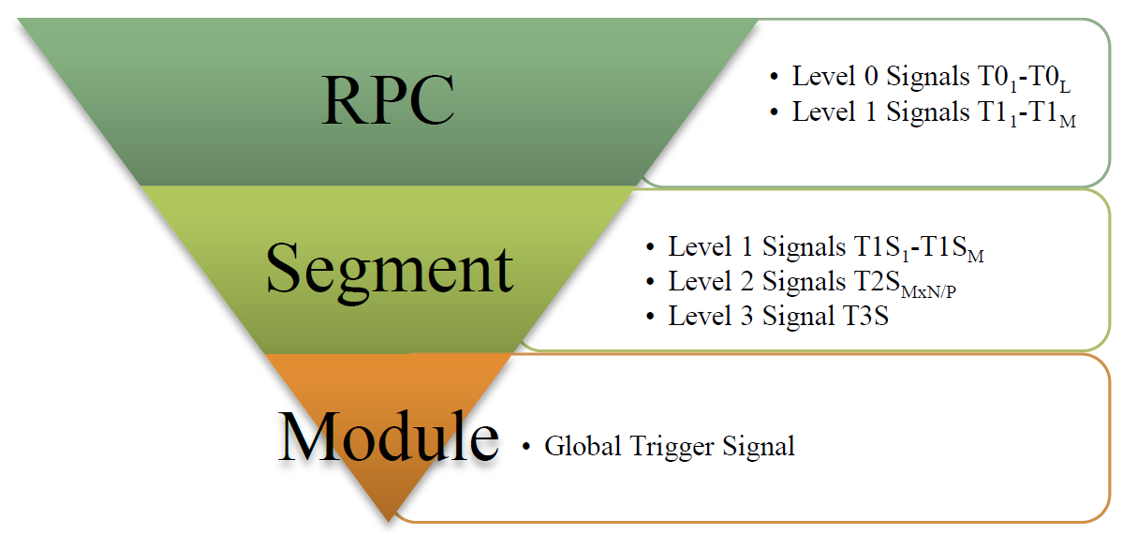
The trigger pyramid
S. Dasgupta et al., NIM A 678 (2012) 105-113

Slide 14
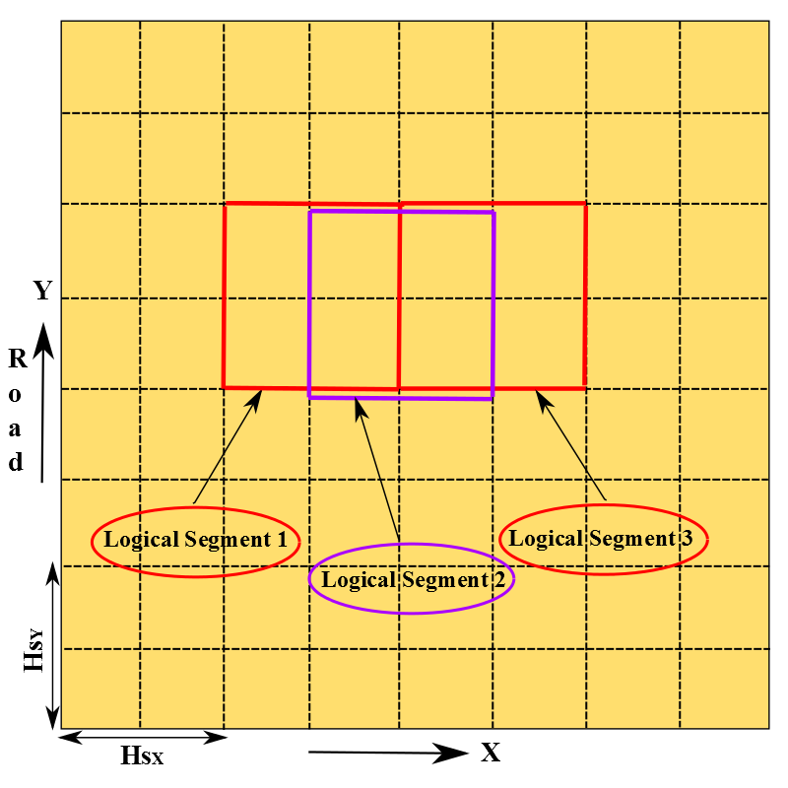
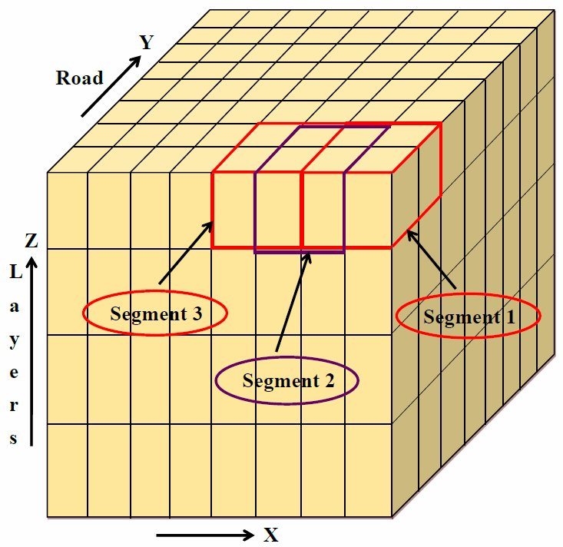
Segmentation

Slide 15
Hierarchy of trigger scheme
Level 0 Signals
T0₁ = S₀₀ + S₀₈ + S₁₆ + S₂₄ + S₃₂ + S₄₀ + S₄₈ + S₅₆
T0₂ = S₀₁ + S₀₉ + S₁₇ + S₂₅ + S₃₃ + S₄₁ + S₄₉ + S₅₇
Level 1 Signals
T1₁ = T0₁ + T0₂ + … + T0₈
Level 2 Signals
T2S_{MxN/P}
T1₂ = T0₁.T0₂ + T0₂.T0₃ + … + T0₈.T0₁
T1₃ = T0₁.T0₂.T0₃ + T0₂.T0₃.T0₄ + … + T0₈.T0₁.T0₂
T1₄ = T0₁.T0₂.T0₃.T0₄ + … + T0₈.T0₁.T0₂.T0₃
T0₈ = S₀₇ + S₁₅ + S₂₃ + S₃₁ + S₃₉ + S₄₇ + S₅₅ + S₆₃
Global Trigger
Level 3 Signals
T3S = Σ T2S_{MxN/P}
T1S_{M} = Σ T1_{M}
GT_{X} = Σ T3S_{X} , GT_{Y} = ΣT3S_{Y}
GT = GT_{X} OR GT_{Y}
..

Slide 16
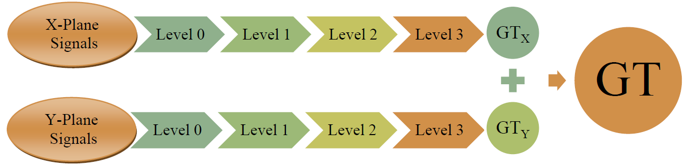
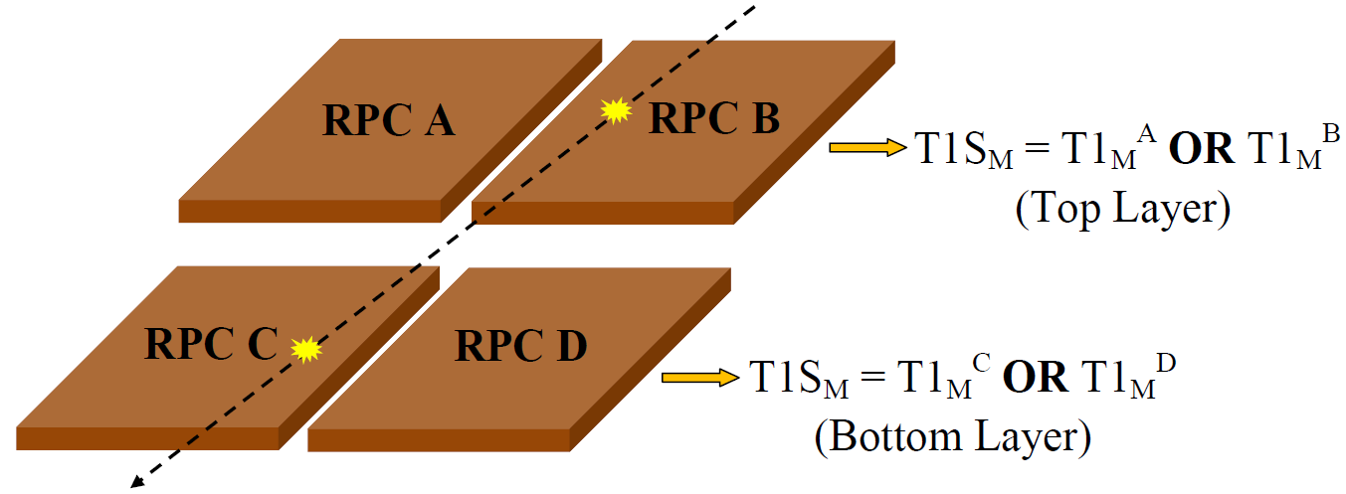

Slide 17
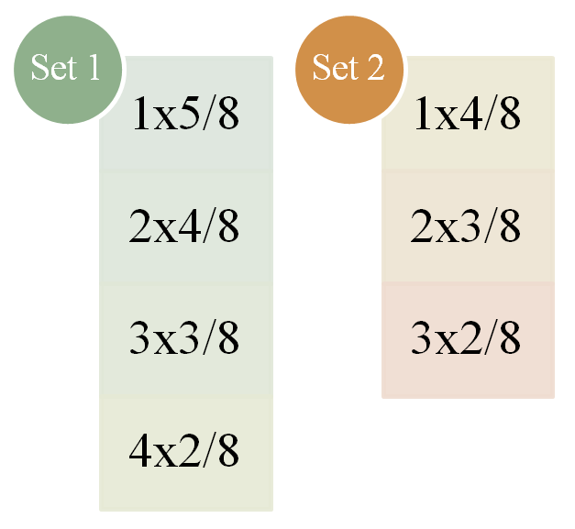
Chance coincidence rates
Average noise rate/ RPC strip (200 cm x 3 cm) |  | Coincidence Window (ns)
Surface Rate (Hz) | Underground Rate (Hz)
200 | 10* | 100
*A. Garfagnini et al., NIM A 572 (1) (2007) 177-180
H_{S} | V_{S} | Segment Dimension | Total Segments | Trigger Criteria Set 1 |  | Trigger Criteria Set 2
 |  |  |  | Surface Rate (Hz) | Underground Rate (Hz) | Surface Rate (Hz) | Underground Rate (Hz)
4 (2x2) | 10 | 4 m x 4 m x 1 m | 735 | 87 | 2.7 x 10⁻⁵ | 1.4 x 10⁴ | 8.5 x 10⁻²
 | 20 | 4 m x 4 m x 2 m | 392 | 87 | 2.7 x 10⁻⁵ | 1.4 x 10⁴ | 8.5 x 10⁻²
 | 40 | 4 m x 4 m x 4 m | 196 | 87 | 2.7 x 10⁻⁵ | 1.4 x 10⁴ | 8.5 x 10⁻²
9 (3x3) | 30 | 6 m x 6 m x 3 m | 180 | 3.7 x 10³ | 1.1 x 10⁻³ | 2.6 x 10⁵ | 1.6
 | 40 | 6 m x 6 m x 4 m | 144 | 3.7 x 10³ | 1.1 x 10⁻³ | 2.6 x 10⁵ | 1.6
 | 60 | 6 m x 6 m x 6 m | 108 | 3.7 x 10³ | 1.1 x 10⁻³ | 2.6 x 10⁵ | 1.6
16 (4x4) | 40 | 8 m x 8 m x 4 m | 100 | 4.5 x 10⁴ | 1.4 x 10⁻² | 1.8 x 10⁶ | 11.1
 | 60 | 8 m x 8 m x 6 m | 75 | 4.5 x 10⁴ | 1.4 x 10⁻² | 1.8 x 10⁶ | 11.1
 | 80 | 8 m x 8 m x 8 m | 50 | 4.5 x 10⁴ | 1.4 x 10⁻² | 1.8 x 10⁶ | 11.1

Slide 18
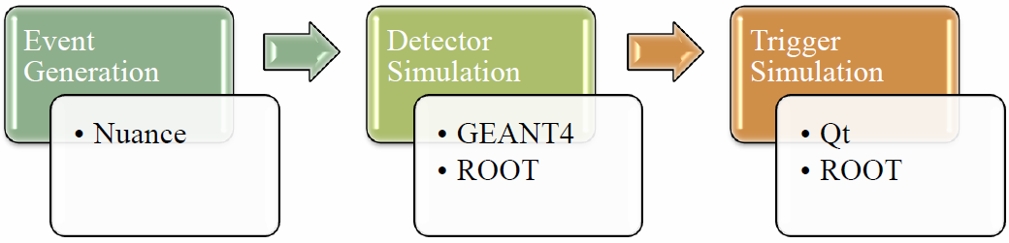
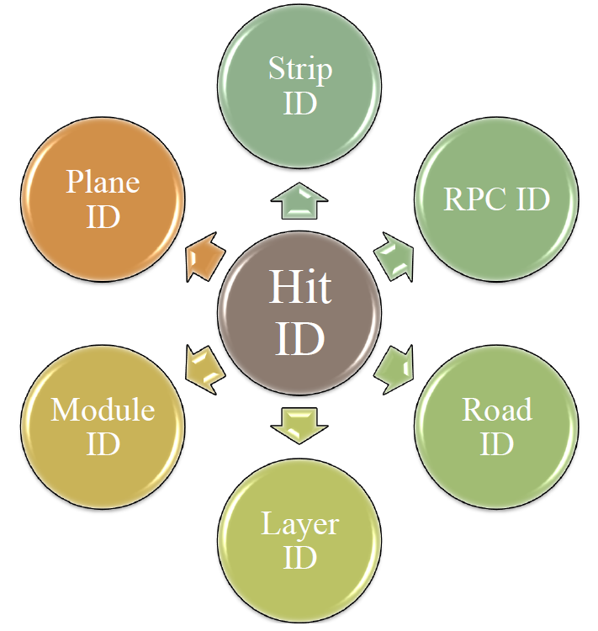
Analysis input

Slide 19
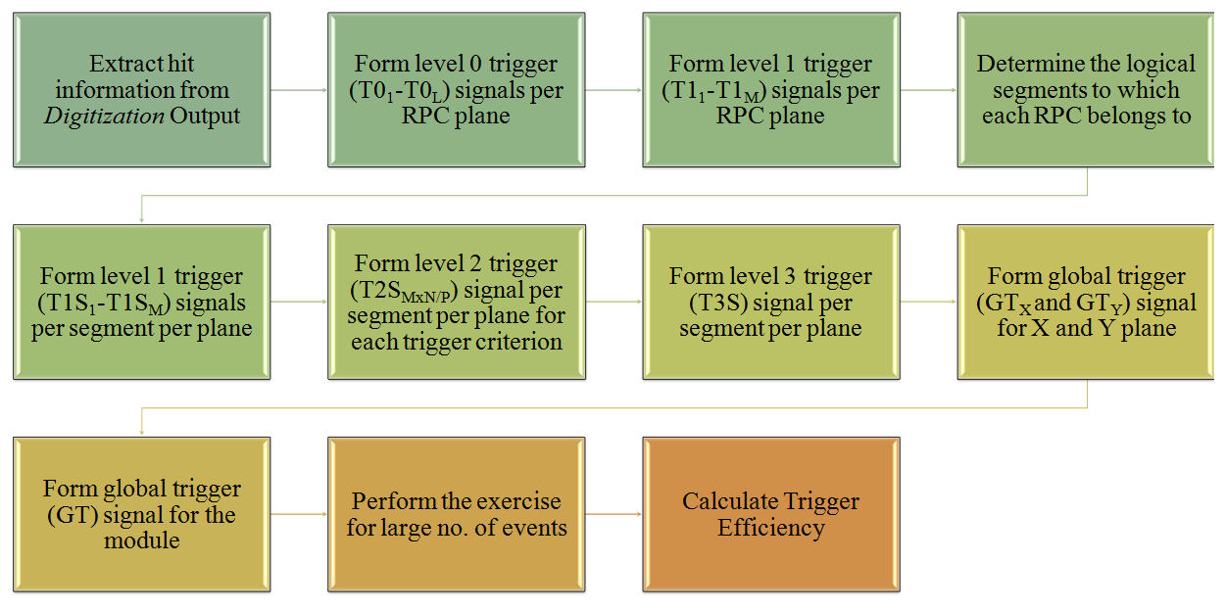
Algorithm

Slide 20
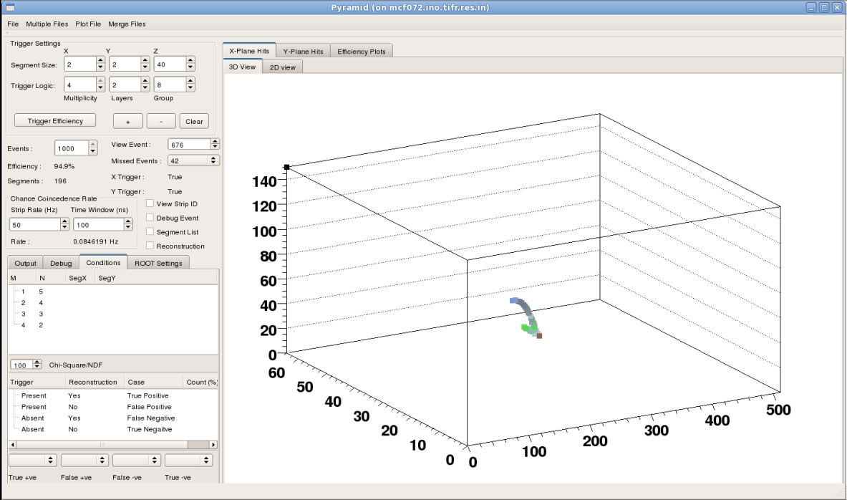
The simulation framework

Slide 21
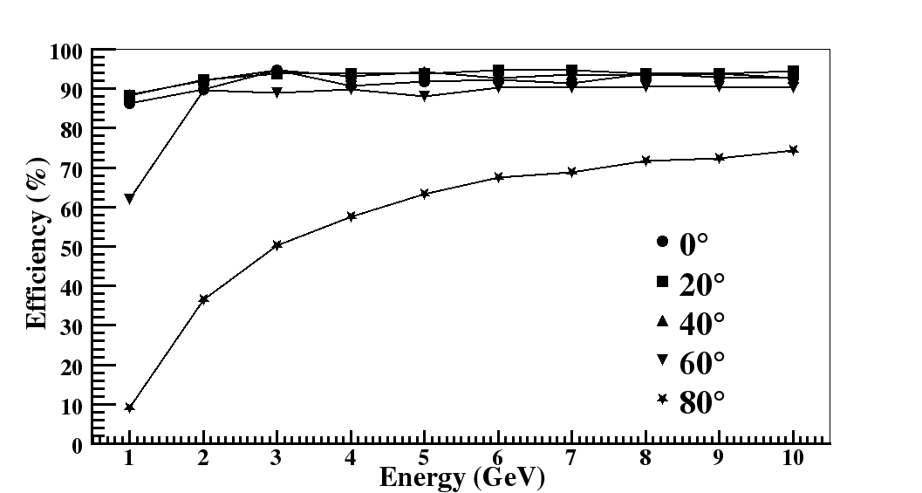
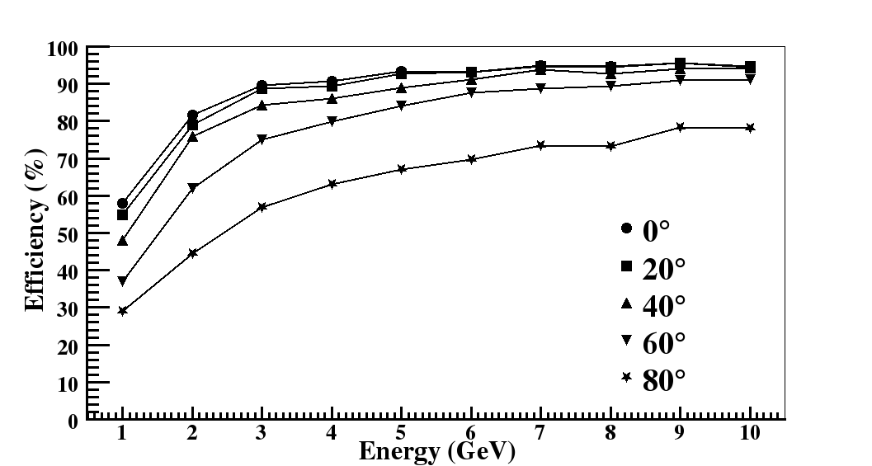
Trigger efficiency Vs. event parameters
µ Events
Trigger efficiency increases with increase in energy of the incident particle.
CC ν Events
Trigger efficiency decreases with increase in the angle of incidence.

Slide 22
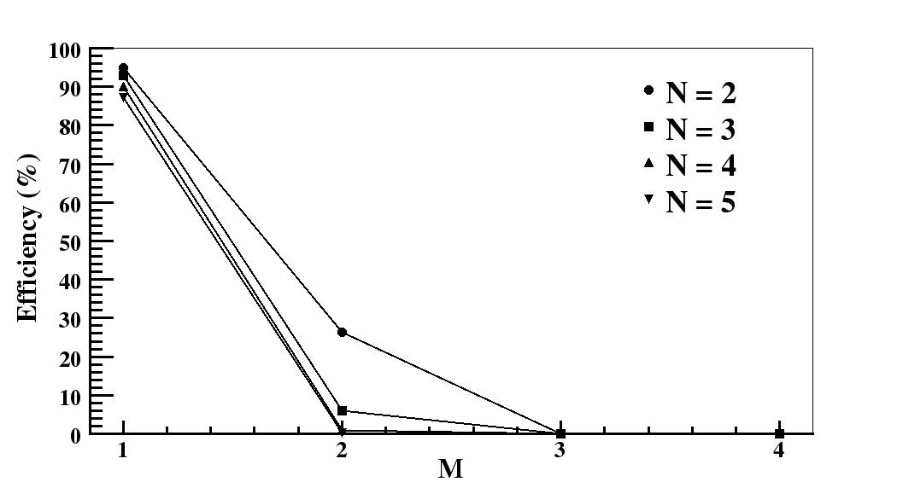
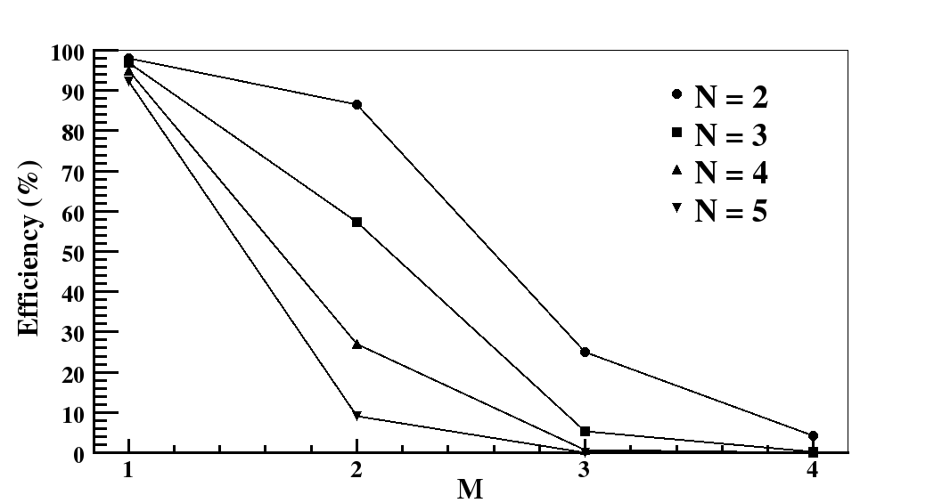
Trigger efficiency Vs. trigger parameters (M, N)
µ Events
Trigger efficiency is dominated by the 1-Fold and the 2-Fold criteria for muon events.
CC ν Events
Trigger criteria with M>2 are significant for neutrino events compared to muon events.

Slide 23
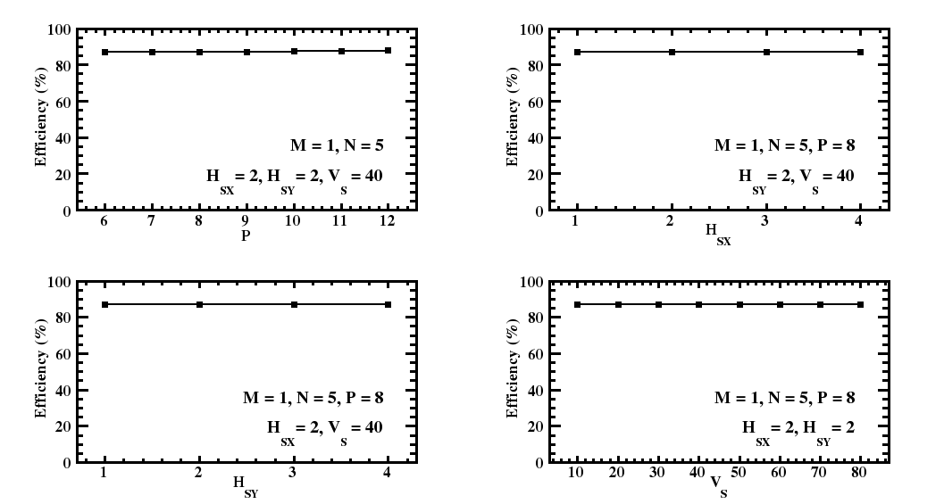
Trigger efficiency Vs. trigger parameters (P, segment dimensions)
µ Events

Slide 24
Trigger module for prototype detector

Slide 25
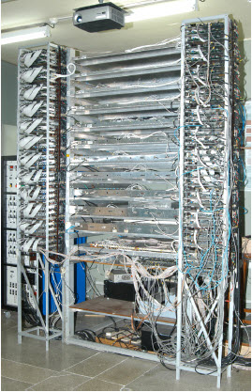
The prototype detector
Detector
Data acquisition
12 layers of 1 m x 1 m RPCs.
Front-end electronics: custom-made.
Back-end standard: VME.
Event data acquired on trigger.
Noise rate data recorded periodically.
Trigger system
Conforms to ICAL trigger scheme.
32 pick-up strips per RPC plane.
Level 0, Level 1 trigger signals generated in front-end electronics.
Trigger module produces the final trigger signal for DAQ.

Slide 26
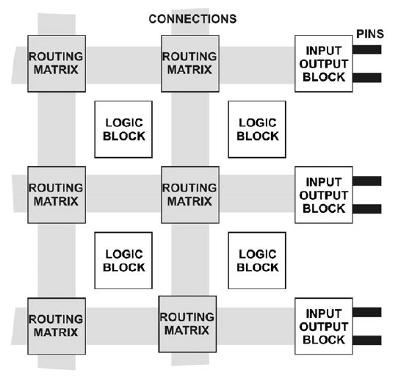
FPGA primer
Field Programmable Gate Array
  2-D array of logic blocks with
    Configurable logic blocks
    Programmable interconnect
  Logic block = LUT + Flip-flop
  Additional resources
    RAM blocks
    PLLs
    DSP blocks
    Delay chains
    High speed transceivers
  Circuit design decided by the end-user, not the chip designer.
  Fast development cycle.

Slide 27
Design of Final Trigger Module (FTM) for TIFR prototype
FPGAs will play key role in the hardware implementation of the trigger scheme.
Trigger logic to be implemented using the classical look-up table based approach.
  Inner hardware remains same irrespective of the input pattern.
Look-up tables designed using the internal block RAMs of the FPGA.
Trigger module developed for the existing prototype to validate the design concept.
CAEN V1495 general purpose module with Altera Cyclone FPGA programmed to generate the final trigger signal for the prototype detector.
S. Dasgupta et al., NIM A 694 (2012) 126-132

Slide 28
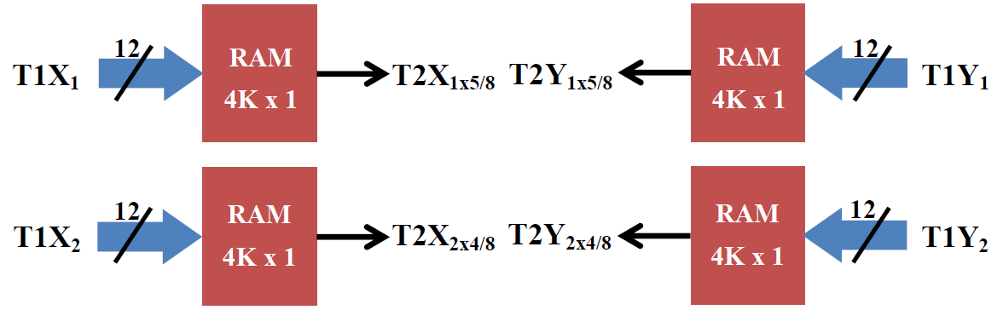
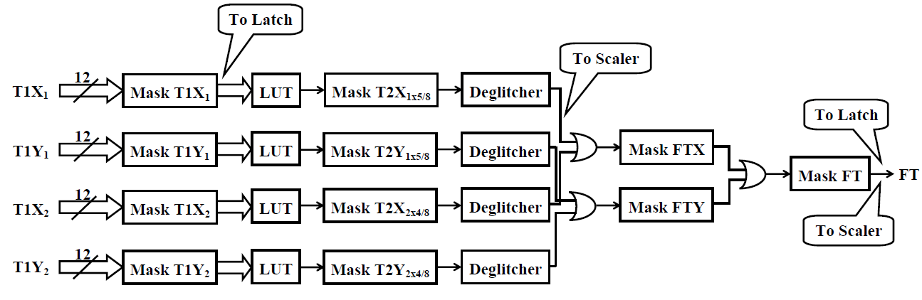
Design schematic
Design employs 4 4K RAM blocks (6% of memory resource)

Slide 29
False trigger rates
FTM used to generate trigger for the prototype detector.
Trigger criteria
  1x5/8
  2x4/8
Event data analyzed offline to look for false triggers.
False trigger rate < 1% for a system operating in stable condition (RPC strip noise rate ~60 Hz).
False trigger rate increases to ~8-10% for a noisy system (4 out of 12 RPCs with strip noise rate ~ 1 MHz).

Slide 30
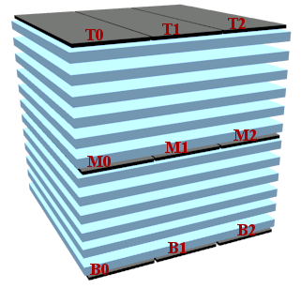
Missed trigger rates
DAQ trigger generated using a set of scintillator paddles.
Particle trajectory covers the entire fiducial volume of the detector.
Average trigger rate ~6-8 Hz.
Negligible chance coincidence rate (~10⁻⁵ Hz).
The event data and the FTM latch data analyzed offline to check for missed triggers.
Missed trigger rate ~0.01%.
Paddle trigger also generated for diagonal tracks only with the missed trigger rate increasing to ~0.04%.
DAQ trigger = (T0 OR T1 OR T2)
AND (M0 OR M1 OR M2)
AND (B0 OR B1 OR B2)

Slide 31
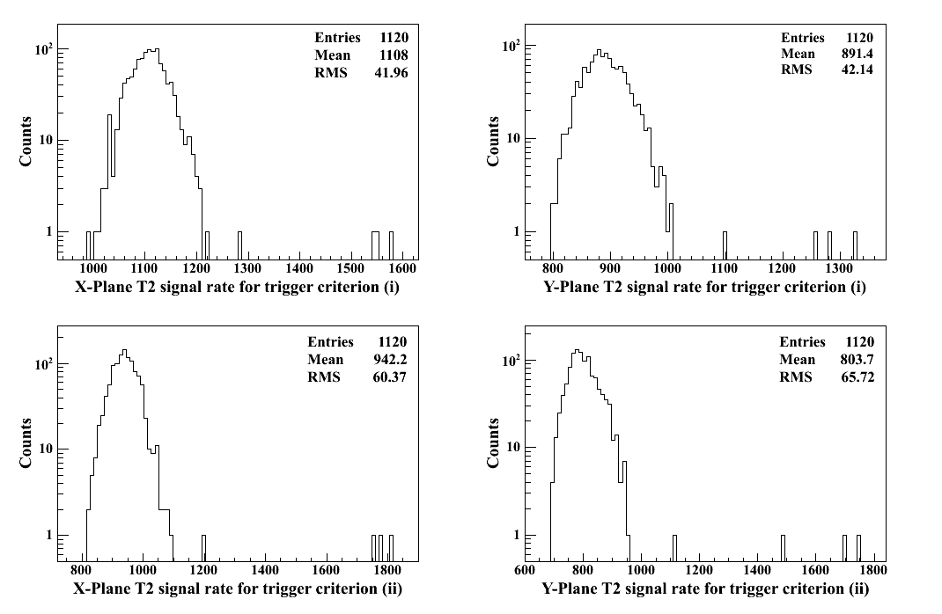
Coincidence rates

Slide 32
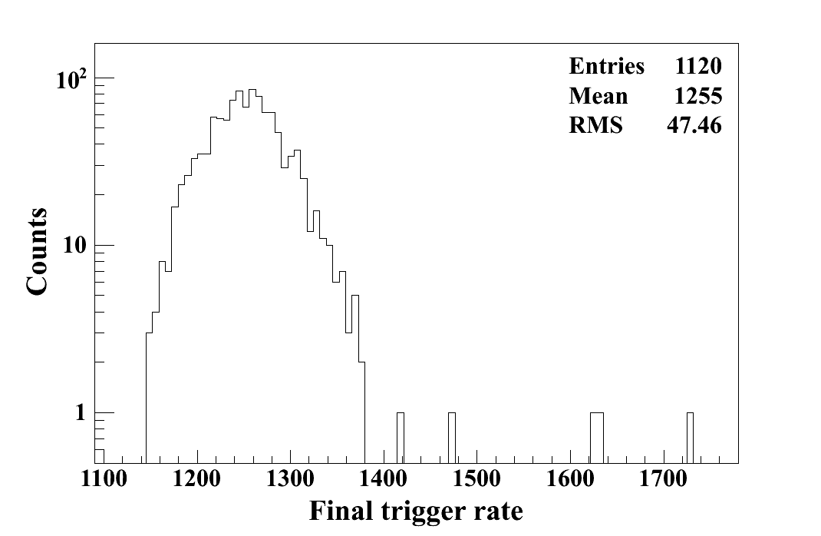
Final trigger rate

Slide 33
Implementation layout

Slide 34
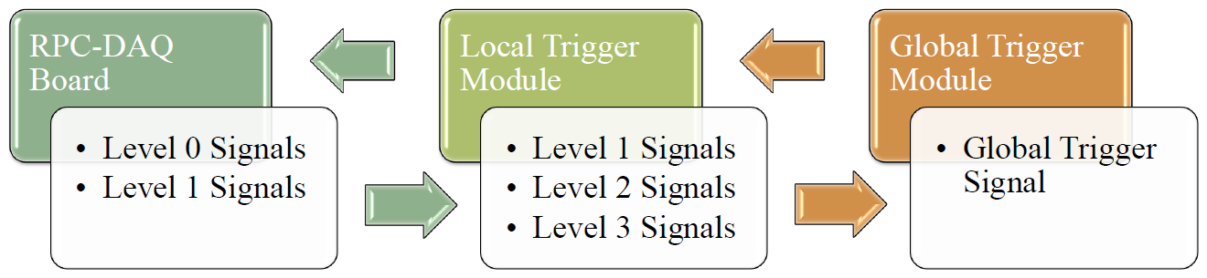
Implementation layout
Placement of the trigger modules should comply with integration constraints.
Alternate approaches considered for latching event data and placement of LTMs.
Trigger latency and coincidence window estimated.

Slide 35
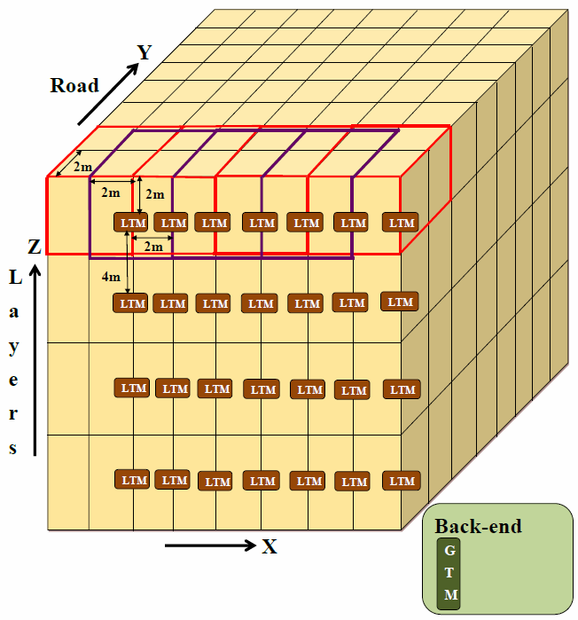
Layout - I
Local trigger latency ~600 ns
Global trigger latency ~1000 ns
Coincidence window ~200 ns
Placement of the LTM has to meet stringent space requirements.
Mechanical issues in handling the segments lying across half-road.

Slide 36
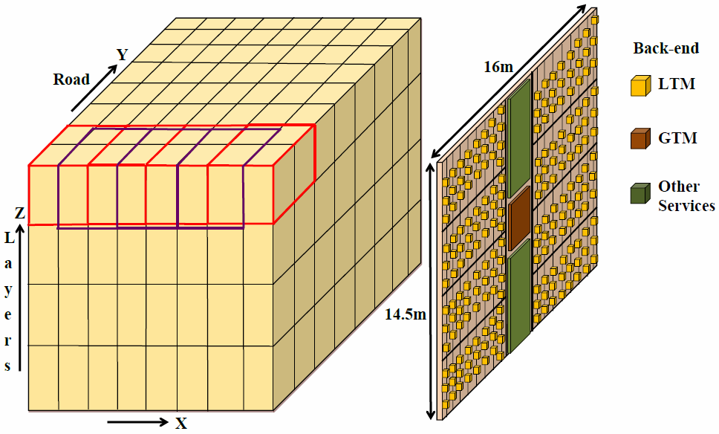
Layout - II
Local trigger latency ~865 ns
Global trigger latency ~1040 ns
Coincidence window ~200 ns
Lesser constraints on LTM placement.
Easier handling of segments across half-road.
Pre-trigger signals to be driven over longer distance.

Slide 37
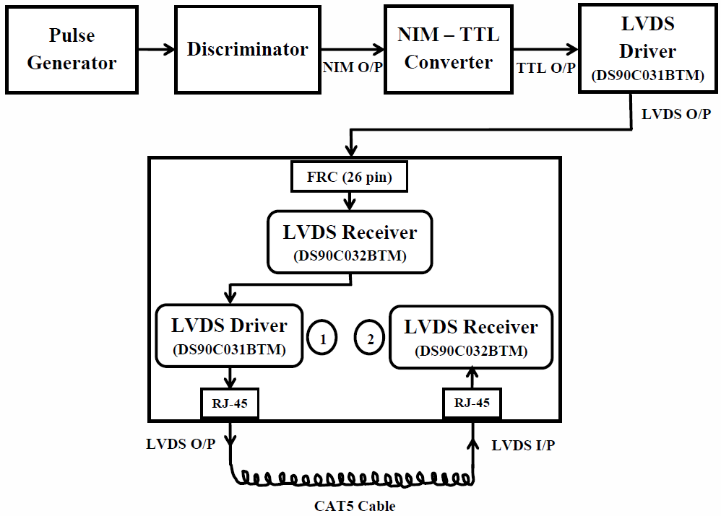
Study of LVDS transmission
Amplitude
Pulse width
Rise time
Baseline
I/O delay
Parameter | Values
Cable length (m) | 25, 30, 35, 40, 45, 50
Input pulse width (ns) | 10, 25, 50, 75, 100, 125, 150

Slide 38
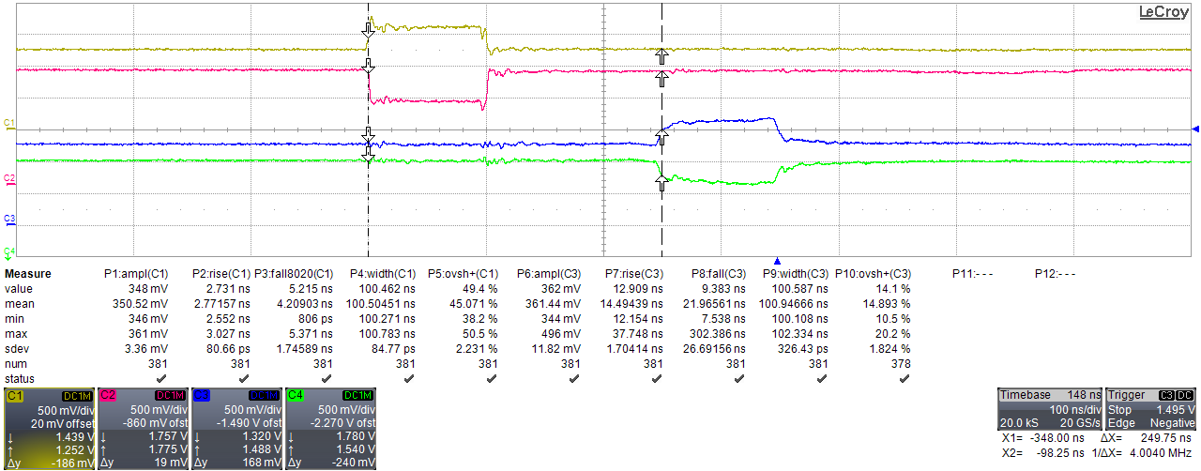
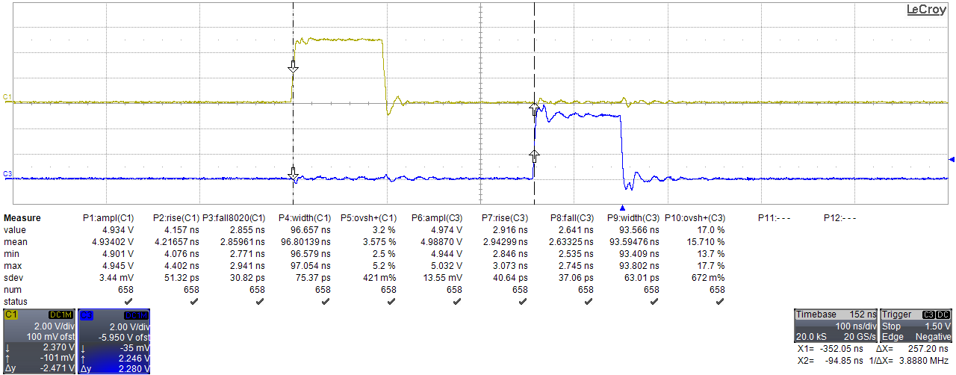
Input-output pulses - I
Cable length = 50 m
Input pulse width = 100 ns

Slide 39
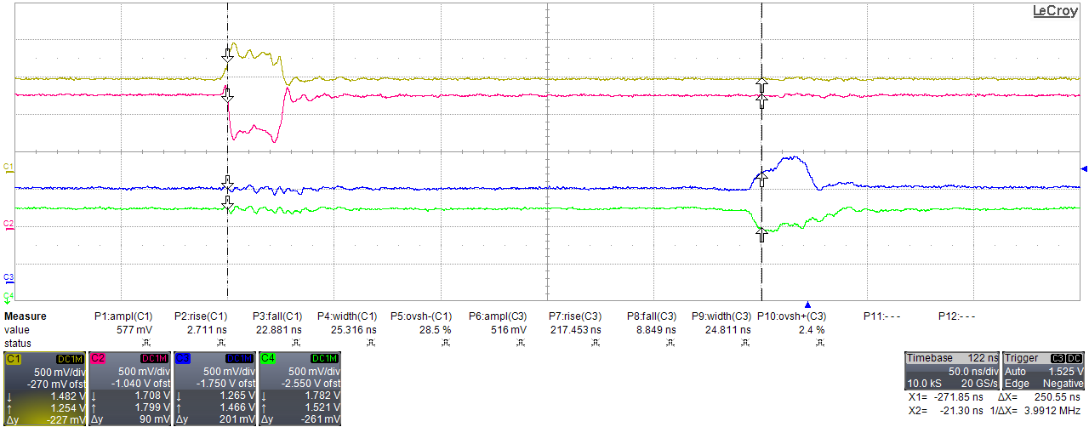
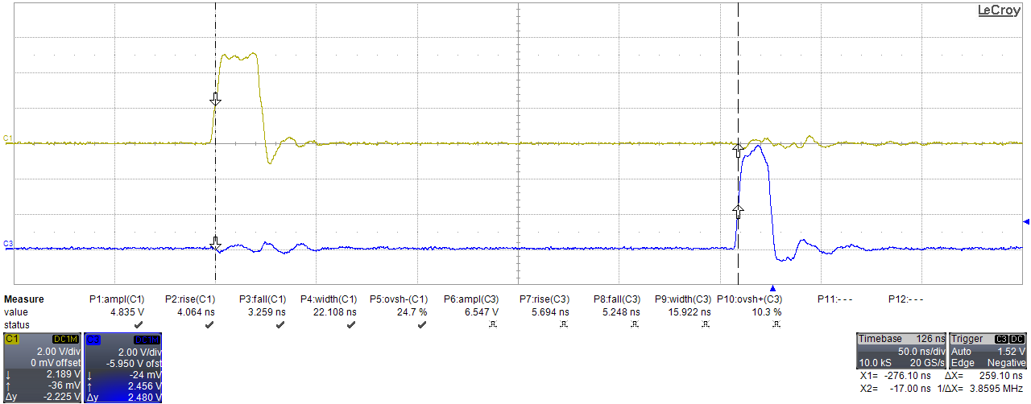
Input-output pulses - II
Cable length = 50 m
Input pulse width = 25 ns

Slide 40
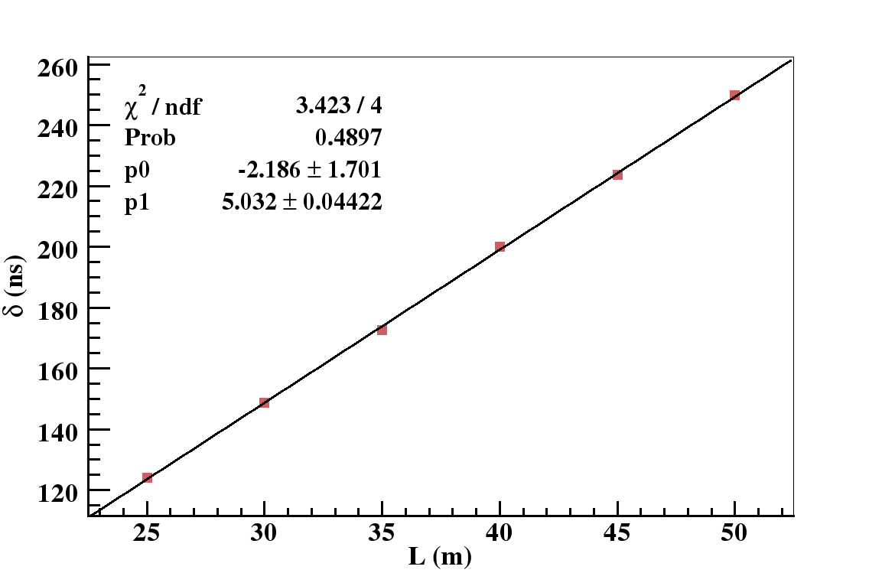
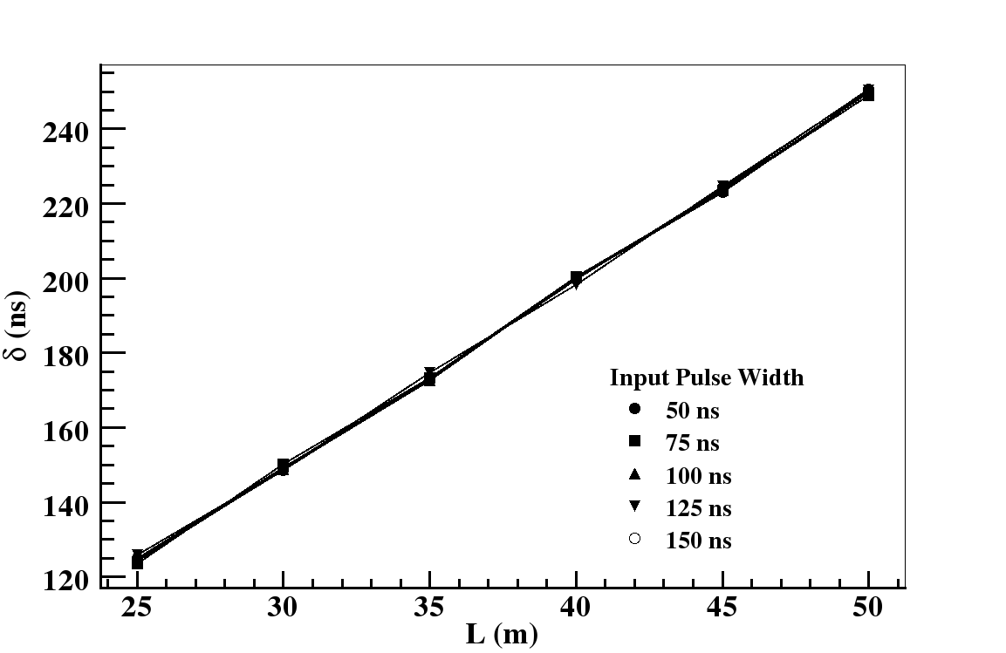
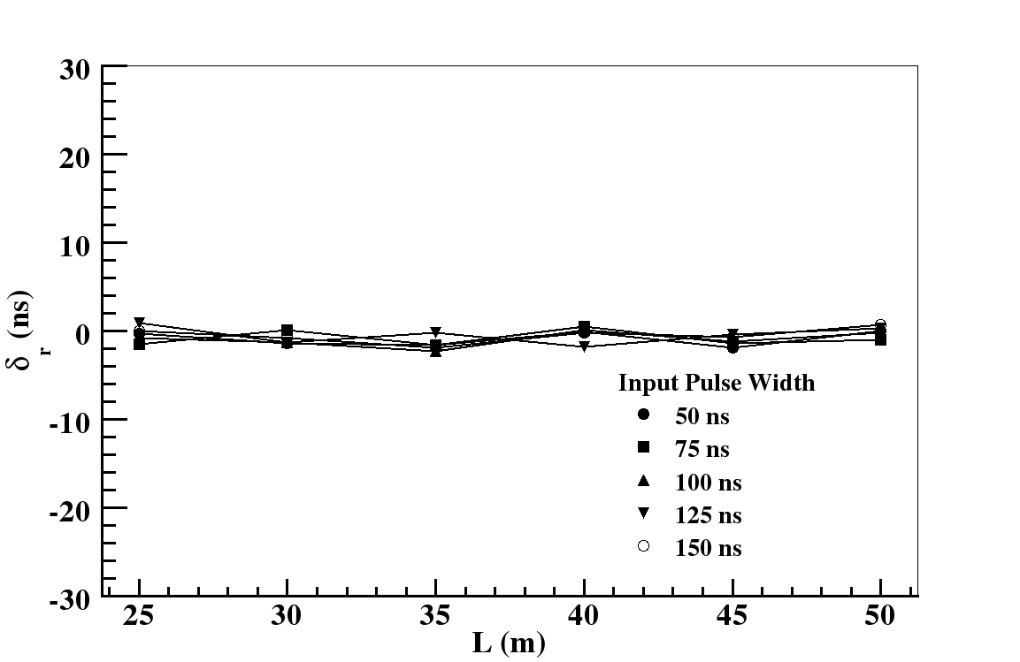
Results - I
Average i/o delay per unit cable length ~ 5 ns/m.
Maximum deviation of i/o delay from estimated value ~ ±2 ns.

Slide 41
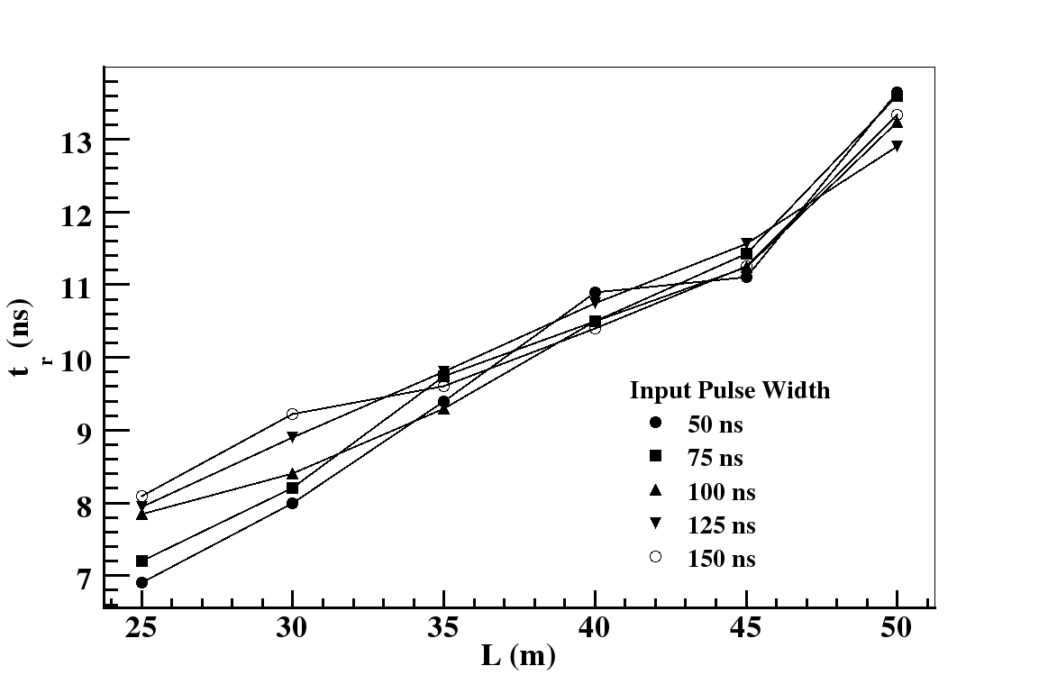
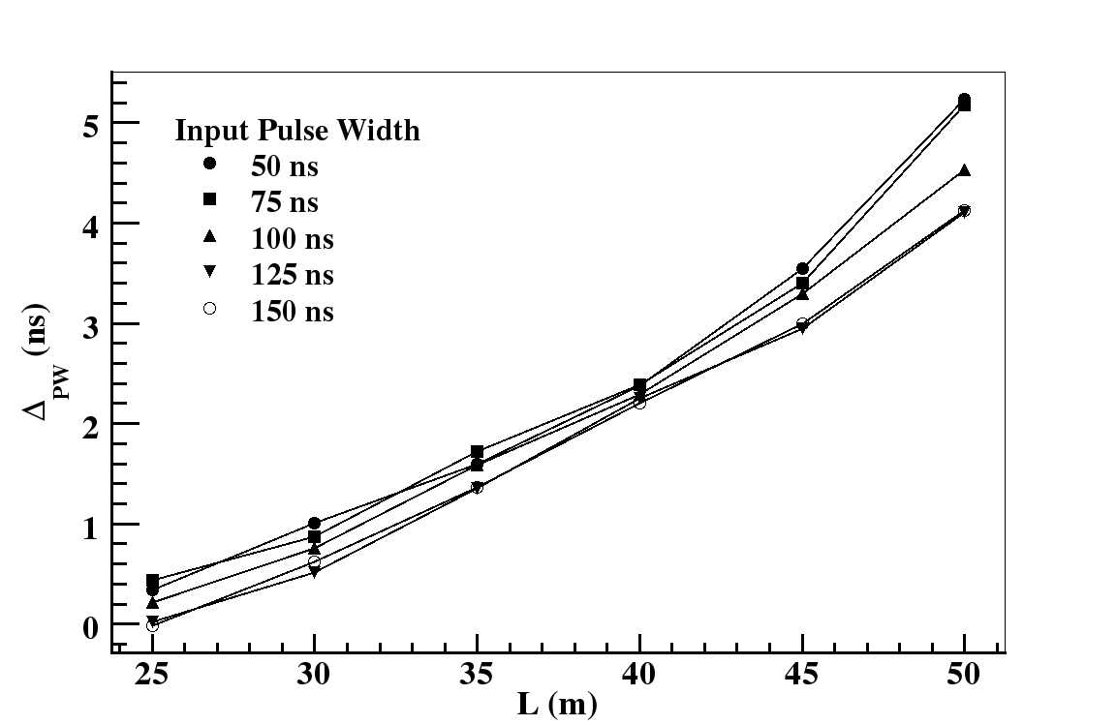
Results - II
Rise time of LVDS output increases with increase in cable length.
Pulse width of TTL output decreases with increase in cable length.

Slide 42
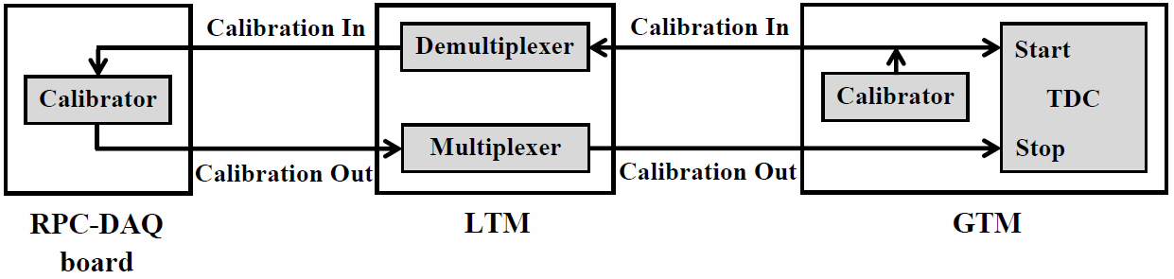
Delay offset calibration
Precise estimation of the delay offset of the return-path of the global trigger signal essential for accurate timing measurement.
Delay offset calibrated for one RPC per LTM at a time.
Repetitive cycles complete the calibration process for the entire detector.

Slide 43
Design of trigger boards

Slide 44
ICAL detector Vs.
Engineering Module
Parameter | ICAL detector | Engineering Module
Modules | 3 | 1
Module dimension | 16 m x 16 m x 14.5 m | 8 m x 8 m x 2 m
RPC layers | 150 | 20
RPC units/ layer/ module | 64 | 16
RPC units/ module | 9600 | 320
Segment dimension | 4 m x 4 m x 2 m | 4 m x 4 m x 2 m
RPC units/ segment | 108 | 108
Segments/ module | 392 | 9
LTMs/ module | 392 | 9
GTM/ module | 1 | 1
Trigger latency | 1040 ns | 650 ns
Coincidence window | 200 ns | 200 ns

Slide 45
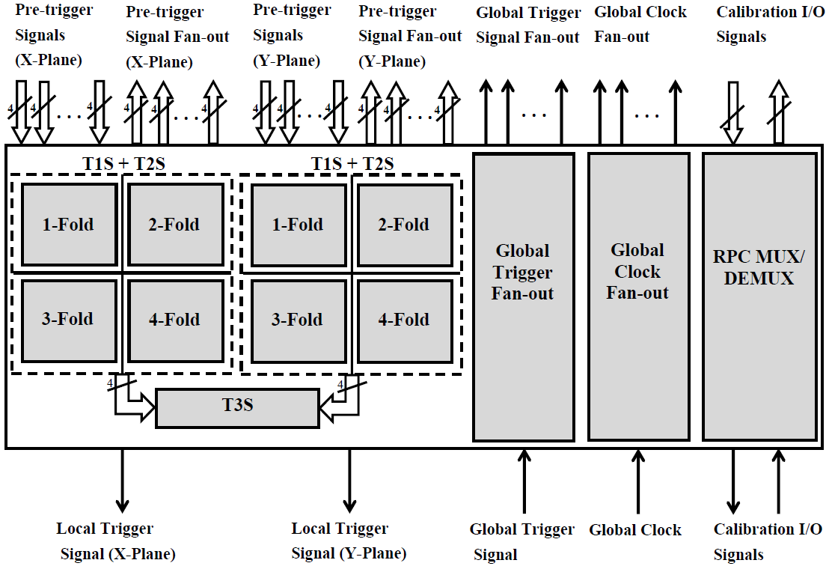
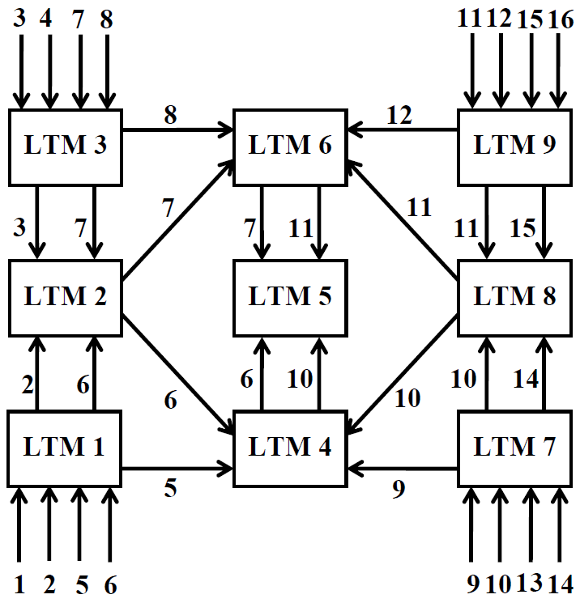
Local Trigger Module (LTM)
I/O signals/ T1ST2S block | 217
I/O signals/ T3S block | 10
Global trigger & global clock fan-out | 1:80
I/O signals/ calibration block | 162
Total i/o signals | 2054

Slide 46
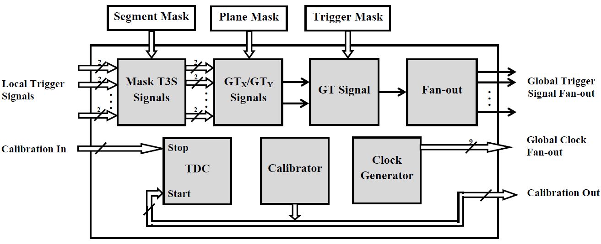
Global Trigger Module (GTM)
Parameter | ICAL detector module | Engineering Module
Global trigger fan-out | 1:128 | 1:4
Clock fan-out | 1:392 | 1:9
Calibration i/o signals | 256 | 8
Total i/o signals | 1560 | 39

Slide 47
FPGA selection
Number of LVDS I/Os
Logic Capacity
Block RAM Capacity
Power Consumption
Cost
Physical dimension

Slide 48
Family | Device | Package | Dimension | Logic cells (K) | Block RAM (KBits) | Total block RAM | LVDS I/Os | Power (W)
Altera Stratix 4 | EP4SE230 | FBGA780 | 29 mm x 29 mm | 228 | 9 | 1235 | 244 | 3.9
Altera Stratix 4 | EP4SE530 | FBGA1517 | 40 mm x 40 mm | 531 | 9 | 1280 | 488
Altera Arria 5 | 5AGXA5 | FBGA1152 | 35 mm x 35 mm | 190 | 10 | 1180 | 256
Altera Cyclone 5 | 5CEA7 | FBGA896 | 31 mm x 31 mm | 150 | 10 | 686 | 240 | 1.6
Xilinx Spartan 6 | XC6SLX150 | FG(G)900 | 31 mm x 31 mm | 147 | 18 | 268 | 288 | 1.85
Xilinx Virtex 6 | XC6VLX130T | FF1156 | 35 mm x 35 mm | 128 | 36 | 264 | 300 | 6.4
Xilinx Artix 7 | XC7A200T | FFG1156 | 35 mm x 35 mm | 215 | 36 | 365 | 240 | 3.5
Xilinx Virtex 7 | XC7V585T | FFG1157 | 35 mm x 35 mm | 583 | 36 | 795 | 288 | 2.2

Slide 49
LVDS drivers
FPGAs can drive LVDS signals up to 5-10 m.
LTM needs to drive the global trigger, global clock and calibration signals over a distance of 50-100 m.
LVDS fan-out (1:10) and driver (16 channel) chips selected.
Also reduces consumption of FPGA I/O resources.
Vendor | Type | Device | Pins | Dimension | Signal
Texas Instruments | LVDS fan-out (1:10) | DS90LV110T | 28 | 9.8 mm x 6.6 mm | Global trigger, Global clock
Texas Instruments | LVDS driver (16) | SN75LVDS387DGG | 64 | 17.1 mm x 8.3 mm | Calibration

Slide 50
Connectors
Pre-trigger signals to be received by LTM from RPC-DAQ board using 50 pin connectors.
114 pin connectors for interconnection between adjacent LTMs.
16 pin connector for connection between LTM and GTM.
Vendor | Connector | Pins | Pitch (mm) | Dimension | Signal
Samtech | SHF-125-01-X-D-SM | 50 | 1.27 | 9 mm x 46.3 mm | RPC-DAQ board I/O
Samtech | SHF-108-01-X-D-SM | 16 | 1.27 | 9 mm x 24.7 mm | GTM I/O
Tyco Electronics | 1-5767096-0 | 114 | 0.64 | 5.4 mm x 50.8 mm | LTM fan-out I/O

Slide 51
Back-end interface
Bus structure for trigger back-end
  Configuration of the LTM FPGAs to implement new trigger criteria.
  User specifications
    Selective masking of signals at different levels of trigger generation.
  Data readout
    Trigger rates at different levels.
    Latch information.
Crate structure necessary to accommodate large number of trigger boards.
Standard specifications and protocol offered by commercial bus systems.
  VME – familiarity and expertise
  µTCA – an emerging option

Slide 52
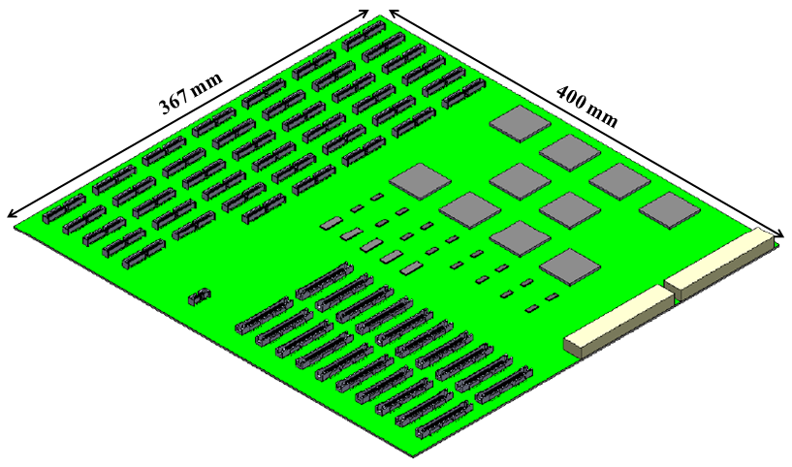
LTM board type I
FPGA
LVDS fan-out
50 pin connector
16 pin connector
Backplane connector
114 pin connector
LVDS driver

Slide 53
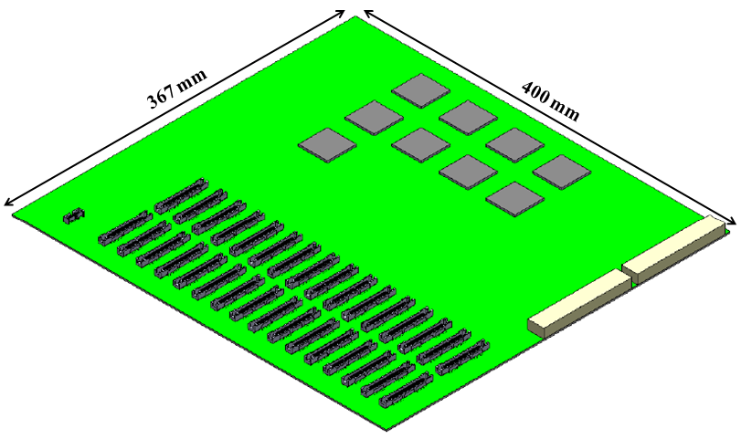
LTM board type II
FPGA
16 pin connector
Backplane connector
114 pin connector

Slide 54
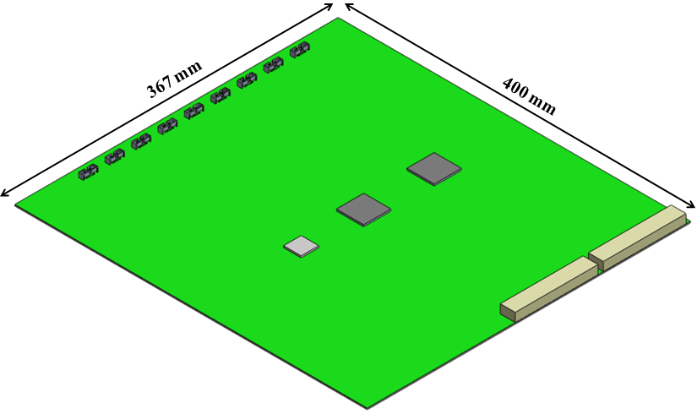
GTM board
FPGA
Oscillator
Backplane connector
TDC

Slide 55
Summary and future scope

Slide 56
Summary
Architecture of the ICAL trigger scheme has been developed and validated.
An FPGA-based trigger module is designed and has delivered satisfactory performance in the prototype detector.
The overall layout for the implementation of the proposed trigger scheme has been devised.
The design of the trigger boards, proposed to constitute the trigger system for the final ICAL detector, are contemplated.

Slide 57
Future scope
Performance validation of trigger boards
Back-end interface, inter-FPGA communication, remote configuration.
Validation of delay offset calibration technique
Possible coupling with software calibration.
Integration of the trigger system with the ICAL detector system
Mechanical constraints associated with detector structure.
Essential functionalities.
Exploring the ‘triggerless’ option
Readout initiated by clock, trigger boards replaced by fast processors.
Simplifies system integration, fast evolution of components.
Pipelining, optimization of trigger algorithms, parallel processing on GPUs, data transfer through high speed network interfaces, etc.
Layout design and fabrication using high-end design tools.

Slide 58
Acknowledgements

Slide 59
The patrons
Prof. N.K. Mondal
Dr. M.S. Bhatia
Dr. B. Satyanarayana
Prof. B.S. Acharya
Prof. G. Majumder
Prof. V.M. Datar
Teachers of INO Graduate School coursework
Present and past colleagues in the ICAL Detector and Electronics R&D team
INO collaboration members
Friends and juniors

Slide 60
Back-up slides

Slide 61
Chance coincidence rates
R = T0 rate, T = Coincidence window

Slide 62
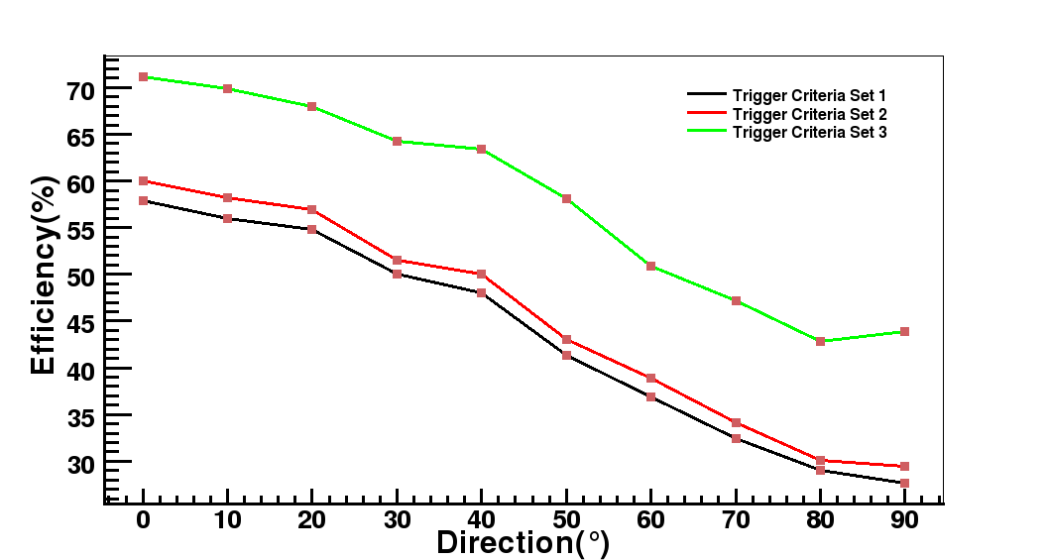
Efficiency Vs. trigger criteria
Set 1
1x5/8
2x4/8
Set 2
1x5/8
2x3/8
Set 3
3x3/8
4x2/8
3x2/8
1x4/8
2x3/8
3x2/8
CC ν Events

Slide 63



Trigger efficiency Vs. event parameters
QE ν Events
RS ν Events
DIS ν Events

Slide 64



Trigger efficiency Vs. trigger parameters (M, N)
QE ν Events
RS ν Events
DIS ν Events

Slide 65


µ Events

Slide 66

Trigger efficiency w.r.t. reconstructed events
CC ν Events

Slide 67


False trigger rates
Stable system
Noisy system

Slide 68


Missed trigger rates
Normal paddle trigger
Diagonal paddle trigger

Slide 69

Design of GTM for ICAL detector module

Slide 70
Data rate estimation
No. of RPCs per module | 64 x 150 = 9600
Hit data per RPC (X-plane and Y-plane) | 64 + 64 = 128 bits
TDC data (16 channels, dual edge, 16 hits/channel, 16 bits/hit) per RPC | 16 x 2 x 8 x 16 = 4096 bits
RPC data packet ID | 16 bits
Event ID | 32 bits
Monitor data (Rate data, channel ID) | 32 + 8 = 40 bits
Ambient sensor (TPH) data per RPC | 3 x 16 = 48 bits
Event rate | 10 Hz
Monitoring rate | 1 Hz
Event data rate per RPC = Event data per RPC x Event rate
= (128 + 4096 + 16 + 32) x 10 = 42720 bits/s.
Monitor data rate per RPC = (Monitor data per strip x No. of strips + TPH data) x Monitor Rate
= (40 x 8 x 2 + 48) x 1 = 688 bits/s.
Net data rate per RPC = Event data rate + Monitor data rate = 43408 bits/s ~ 50 kbits/s
Net data rate per module = Net data rate per RPC x No. of RPCs per module
= 50 x 10³ x 9600 = 480 Mbits/s.

