Slide 1
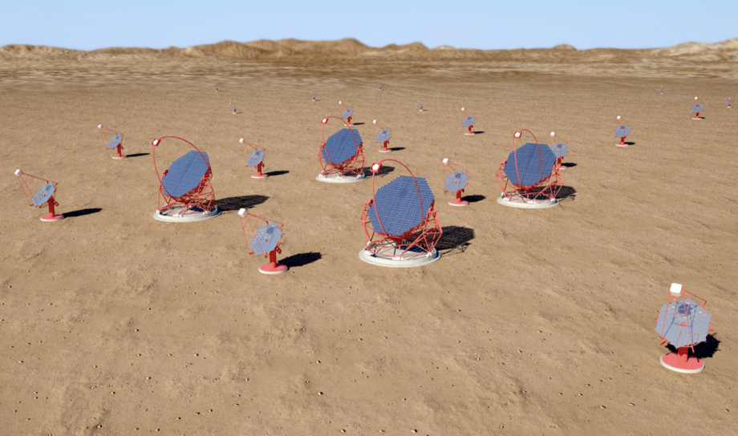
OPC UA Solutions for Device Control and Integration
Kiran Gothe
Reference:
1. https://opcfoundation.org
2. Documents on C++ based OPC-UA Server Development by Unified Automation
3. E-Book “OPC Unified Architechture” by Wolfgang et. al.
4. CTA Documents, Presentations etc.
Jan 30, 2015
ASET Colloquium

Slide 2
Outline of the talk
Motivation
What is OPC UA?
Why does OPC-UA matter?
Implementation
Summary

Slide 3
Motivation

Slide 4
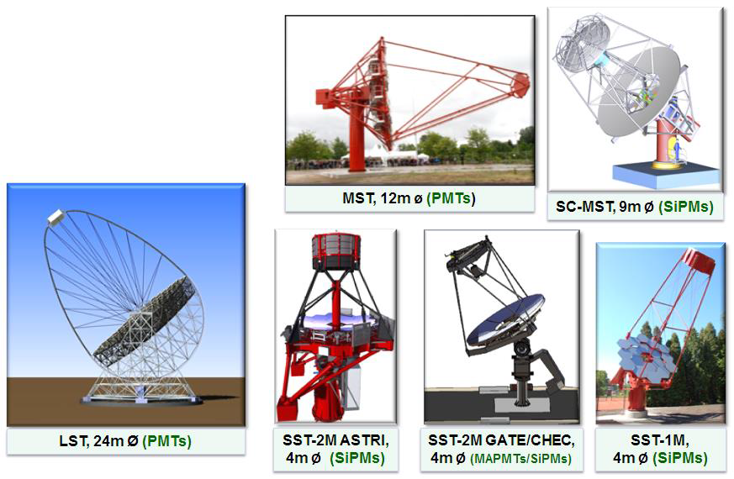
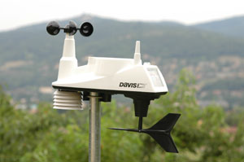
Need to integrate and control this …
The CTA prototyped technological ‘zoo’:
•6 telescope structures
•3 optical configurations
•7 cameras
•several different front-end and
read-out electronics
Many
Many
+ LIDAR etc.
Few
Many
Many
Many

Slide 5
Components to be controlled
Camera | Telescope | Array
Electronics High Voltage System Array Trigger Interface Camera Lid Local Clock | Drive Systems Safety System Camera Lock/Shelters CCD camera(s) Radiometer Calibration Devices (LED pulsers, Lasers) Active Mirror Control | Array Trigger/GPS clock LIDAR(s) Weather Station(s) Optical Telescope(s)
The actual components might differ depending on the telescope type

Slide 6
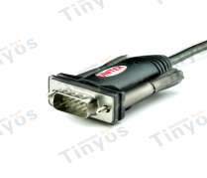
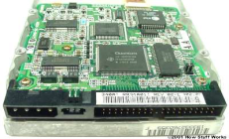
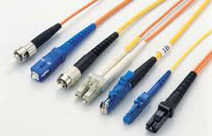
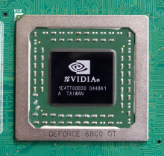
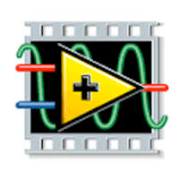
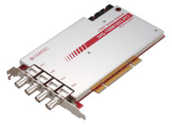
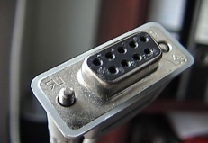
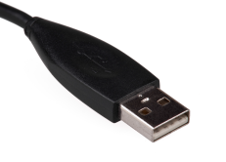


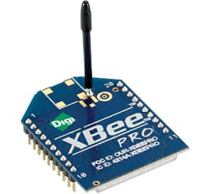
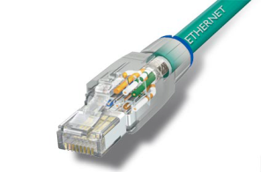
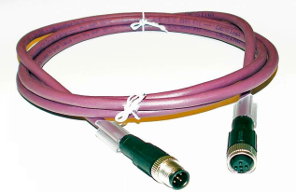
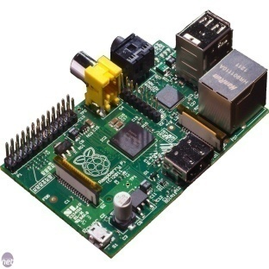
… including different interfaces and environments…
Hardware/Software environment
Interfaces

Slide 7



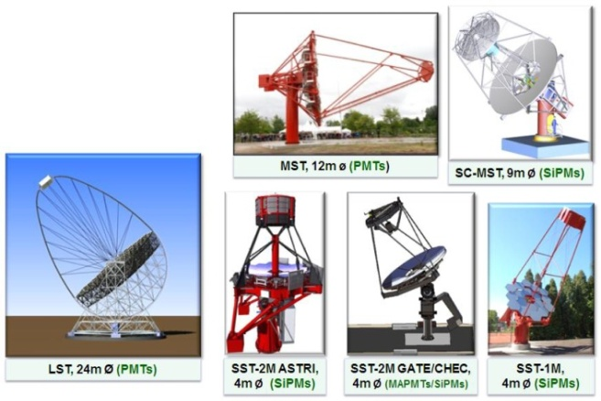





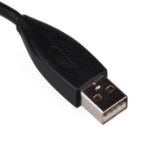



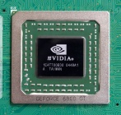
ACTL Solution
Device Teams’ responsibility
ACTL responsibility
ACTL Machines
Framework:
ALMA Common Software (ACS)
OPC UA
Scientific Linux
• Device teams are expected to
provide the low-level software
• ACTL will help in writing the
software as much as possible
(keeping limited manpower of ACTL
in mind)
+ LIDAR etc.

Slide 8
What is OPC-UA?

Slide 9
OPC
OPC (Open Platform Communications ): a standard interface defined by the OPC Foundation that provides rules and information about how software applications and devices can send and receive different kinds of data between each other.
Released in mid-nineties
By 2009 (roughly), the total OPC market has over 2,500 vendors providing over 15,000 OPC-enabled products.
Utilizes the Microsoft-based COM/DCOM technology to provide standard specifications for data
access , historical data access, and alarms and events .
Limitations because of this reliance on the Microsoft Windows platform

Slide 10
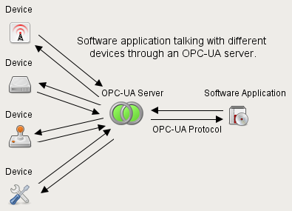
OPC-UA
OPC-UA (Open Platform Communications Unified Architecture) is a next generation OPC specification released in 2008 by OPC foundation.
OPC-UA is not an incremental change to the existing family of OPC specifications but a brand new standard representing a profound change.
Internationally recognized (IEC 62541)
Lots of products on market place: >4200 companies create products based on OPC UA with +25000 OPC-UA enabled products
The purpose of OPC-UA is to provide a way for software applications to communicate with different brands of devices without having to implement proprietary device-specific communication protocols used by those devices.
This is achieved through the use of an OPC-UA server. An OPC-UA server handles communication between software applications and devices.

Slide 11
Why does OPC-UA matter?

Slide 12
Headline benefits of OPC-UA
Platform Independence : COM/DCOM dependency dropped; OPC UA functions on any of the following or more:
  Hardware platforms: traditional PC hardware, cloud-based servers, PLCs, micro-controllers (ARM etc.)
  Operating Systems: Microsoft Windows, Apple OSX, Android, or any distribution of Linux, etc.
• High scalability
  from smart sensors and smart actuators to mainframes. The device need only to implement a subset of total OPC UA functionality the client need.
• Improved Security: classic OPC had no intrinsic security. It was delegated to COM/DCOM layer
OPC UA security model is based on:
  Public Key Infrastructure
  User Authentication
  User Authorization
• Improved Modeling
  Extensive vocabulary for device modeling
    Type information (allowing clients to establish semantic information)
    Express relationship between components (allowing clients easier browsing thro’ related components)
• Enterprise Level Data Publishing
  Standard SOAP web service (can get through firewall) with high level of security. Even non OPC-UA clients can consume output published by an OPC-UA server.

Slide 13
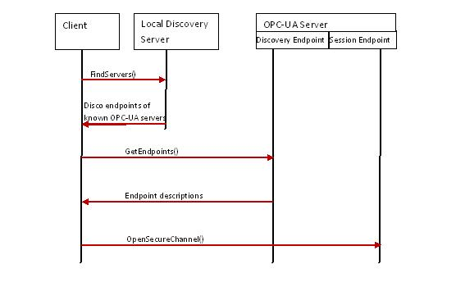
Service Discovery and Session Initiation
A platform independent approach to server discovery.
An Endpoint description contains all information that is necessary to establish a Secure Channel and a Session between the client and the server. The main parts are the network address of the server and the security settings like the server instance certificate, the security policy defining the used algorithms, and the type of user authentication used to create a Session.
The client can try a direct connection using a cached endpoint description from a previous browse of the OPC-UA server discovery.

Slide 14
Improved Security
One of the most important benefits of eliminating the reliance on COM/DCOM technology is the expanded security features. Classic OPC systems rely on difficult and complex configuration of DCOM to provide inter-process security. Too commonly, vendors overlook this step in testing stages, which resulted into difficult configuration for users. This often leads to security being disabled all together and thus, large security gaps in the network.
In contrast, OPC UA uses standard web technologies as a security foundation. It is based on a Public Key Infrastructure (PKI) using industry standard x.509 digital certificates and addresses authentication, authorization, encryption and data integrity.
Authentication: OPC-UA application instances are uniquely identified by their x509 certificates,
a session can only be created between two OPC-UA applications if each trusts
the other's certificate. A client, for example, cannot initiate a session with a
server providing a certificate that the client does not trust.
Authorization: an endpoint can demand user id like User name and password , user’s x509
certificate etc:
Data Encryption : It is intended to prevent a 3rd party reading messages passed between client and server (snooping on a network with a packet sniffer for example). OPC-UA uses public/private key encryption.
Data integrity: Signing messages prevent a 3rd party tampering with messages passed between client and server (injecting malicious content to the message for example).
Clients and servers must implement for scrambling the data (encryption) and signing messages (data integrity) in order to guarantee a secure channel.

Slide 15
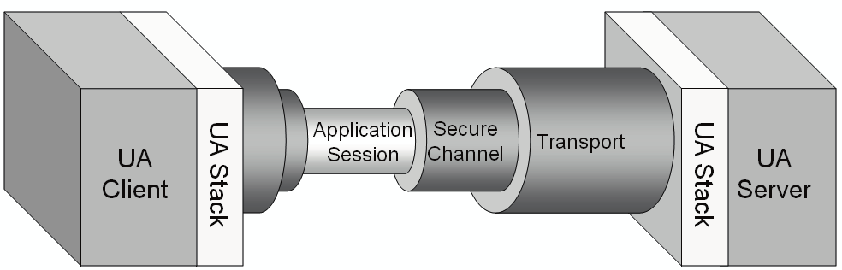
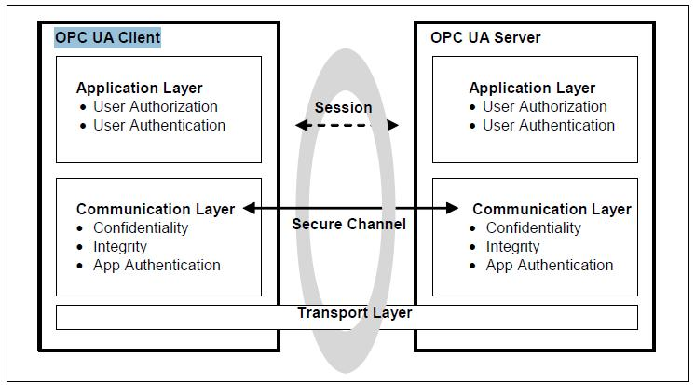
Improved Security … contd.

Slide 16
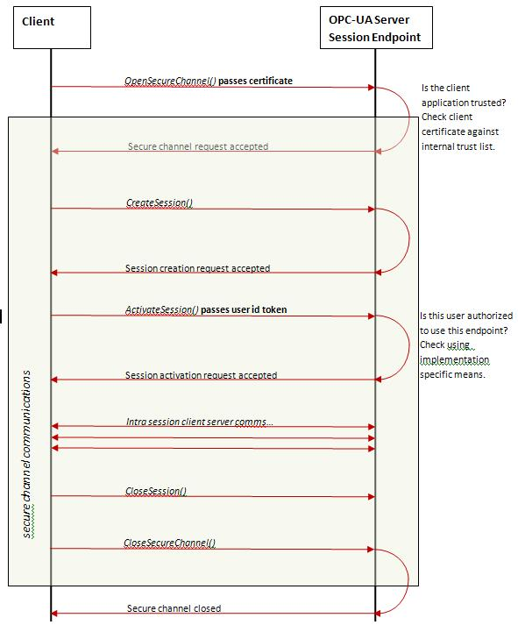
Setting secure session between an OPC-UA client and server

Slide 17
Message Formats
OPC-UA supports two message formats: UA Binary and XML. The format defines how the message data is encoded.
UA Binary: This message format encodes the data serialized into a byte array. UA Binary offers reduced computational cost in terms of encoding and decoding but can only be interpreted by OPC-UA compliant clients. UA Binary is more likely to be used in device level communications where processing power is limited and performance is a high priority.
XML: XML documents are the ubiquitous method of high level data exchange. XML encoded messages can be interpreted by OPC-UA clients and also by generic clients using the XML schema contract (generic clients being clients with no intrinsic knowledge of OPC-UA).
Serializing and deserializing data into XML format is computationally more expensive than the UA Binary format and so XML encoding is more likely to be used towards the enterprise end of the communication spectrum.

Slide 18
Transport Protocols
OPC-UA supports two transport protocols: OPC TCP and SOAP/HTTP(S). The transmission protocol defines
the means by which messages are passed between client and server.
OPC TCP: This is a TCP (sockets) based protocol providing a full duplex channel between client and server.
Messages are packaged into a structure specified by the OPC TCP binary protocol and the structure is
transmitted using a socket or secure socket (depending on the endpoint’s security requirements). As
OPC TCP is specific to the OPC-UA specification only OPC-UA clients are capable of receiving data
transmitted with OPC TCP.
SOAP/HTTP(S): Using this transmission protocol, messages are packaged into the body of a SOAP message
and transmitted over HTTP(S). SOAP/HTTP is an established industry standard and is widely used for enterprise level information exchange, a generic web service client could receive SOAP messages transmitted over HTTP/S

Slide 19
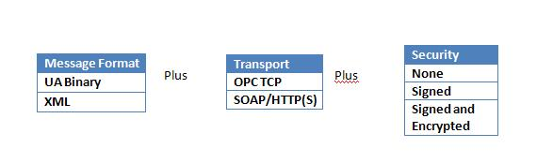
Sending Messages
In order to pass messages between OPC-UA clients and servers three pieces of information are required:
The message format.
The transport protocol.
The channel security measures.
The most likely format and transport pairings are as follows:
UA Binary + OPC TCP –the leanest method of formatting and transmitting data and is therefore the most likely combination used at the device level. Only OPC-UA clients and OPC-UA servers can exchange information in this form.
XML + SOAP/HTTP(S) – most firewall friendly and most easily consumed from the perspective of generic clients and is therefore the most likely combination used at the enterprise level.

Slide 20
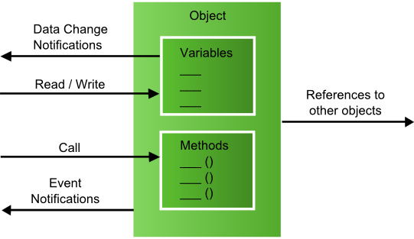
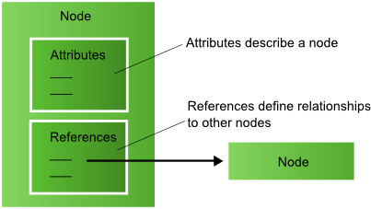
Address Space Concept
Objective:
To expose the information of the device to clients in standardized way.
  Objects
  Variables
  methods
  their types.
  Relationship between these entities
Client uses standard services to access the objects and its components.
Implementation:
Each of these entities represented as an addressable piece of information (attributes and relation with other entities) called a node.
Set of all nodes define address space of the server.

Slide 21
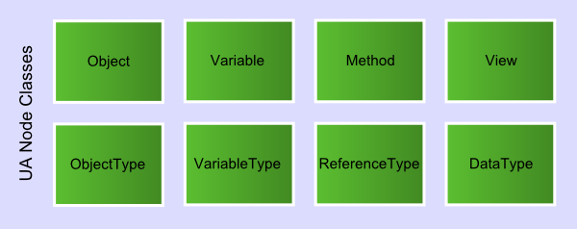
Node Classes
A node class defines a type of node.
OPC UA defines 8 node classes.
Some node classes represent instances. Other node classes represent their types
Any node in an address space has to be an instance of one of these node classes.
Depending on the NodeClass a Node can have a different set of Attributes.
Knowing the node class of a node helps the client which attributes of the node to look at.
Object : represents systems, system components, real-world objects and software objects
: does not provide a value
: contains references to the variables and methods.
Variable : provides a value. The data type of the value (such as int, char etc.) is specified by a
node of the DataType node class.
Method : provides only a signature of the method. Developer is free to implement in his own
way.
View : restrict the number of visible Nodes and References in a large Address Space.
ObjectType: Type Definition of objects; similar to a class in OOP.
VariableType : different from DataType. Examples- countertype, analogtype etc. It gives
specific semantic to its instances.
ReferenceType : defines the semantic of a Reference

Slide 22
Reading Device Data
The OPC-UA specification describes two services by which OPC-UA clients access device data
via OPC-UA servers.
Read Service (Poll): The parameters for this service include
  A list of node IDs, indicating which nodes and which attributes of the nodes are to be read
  The maximum age of the data the client expects If the data corresponding to the node IDs
  in the server's cache is too old to satisfy the stipulated maximum age, then the server
  should try to retrieve the data direct from the underlying device
Subscription Service (Publish Subscribe): This service allows an OPC-UA client to subscribe
to OPC-UA server data updates and request that it receive update notifications with a specified
periodicity.

Slide 23
Implementation

Slide 24
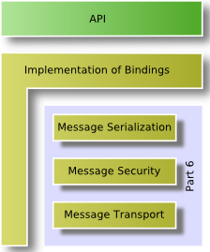
UA communication stack layers
An OPC UA Stack developed by the OPC Foundation implements the different OPC UA transport mappings and provide language-dependent APIs for client/server applications. It is available in ANSI C/C++, Java and Microsoft .Net
OPC UA defines three Stack layers.
  The message encoding layer defines the serialization of message in a binary or XML format.
  The message security layer specifies how the messages must be secured by using the Web Service security standards .
  The message transport layer defines the used network protocol, which could be UA TCP or HTTP /SOAP for Web Services.

Slide 25
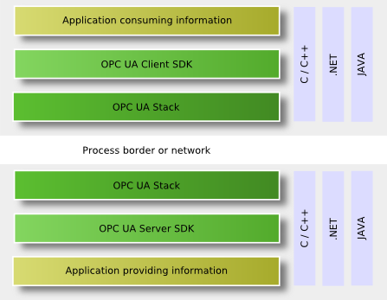
OPC UA Software Layers
Third party OPC UA toolkits tend to be based on the OPC foundation stack.
Currently 3 language/environments are used for implementing the OPC Foundation UA Stack deliverables viz. . C/C++, .NET, or JAVA.
An OPC UA Application contains the specific functionality for the application and the mapping of this functionality to OPC UA by using an OPC UA Stack and an OPC UA Software Development Kit (SDK).
An OPC UA client or server SDK implements common OPC UA functionality that is part of the application layer. An OPC UA SDK reduces the development effort for an OPC UA application.

Slide 26
Example of OPC-UA Server development for weather station
Creating Address Space
Connecting Nodes with Real Time data
Adding support for Methods
Adding support for Events
The server application was developed using the Evaluation version of C++ based UA Server SDK library supplied by Unified Automation (C++ based OPC UA Client/Server SDK Bundle v1.4.0).

Slide 27
Salient features of the Server
The server provides the simulated weather station data to the clients.
Weather station provides following simulated data.
Temperature in degree celcius, Humidity in %, Wind Speed in m/s, Wind Direction in degree azimuth and aggregate Rainfall in mm
The xml configuration file sets the server configuration. It describes the settings such as end point configuration, User Identity Tokens, Discovery Registration etc.
The server offers
-> reading data from the underlying simulated weather station.
-> reading the state of the weather station.
-> the methods 'Start' & 'Stop' the weather station device.
-> simple event generation triggered by change of state of the weather station. The change of state itself is effected by the server defined 'start' or 'stop' method call.

Slide 28
Partial view of the Address Space
BaseEventType
UaVariable
BaseObjectType
BaseDataVariableType
PropertyType
WeatherStationObject::
WeatherStationType
WeatherStationEventType
Generates
WeatherStationType
Event
State::
BaseDataVariableType
State
AnalogItemType
State::
UaPropertyCache Type
UaPropertyCacheType
Temperature::
AnalogItemType
Temperature
Temperature::
UaPropertyCacheType
Range::
PropertyType
Range::PropertyType
EngineeringUnit::
PropertyType
EngineeringUnit::PropertyType
Start
Start
ReferenceTypes
HasTypeDefinition
Node Classes
Stop
ObjectType
Stop
HasComponent
Object
HasProperty
Nodes created by SDK
VariableType
HasSubtype
Nodes created by the server developer
Variable
InstanceDeclaration Nodes created by Server Developer
Method
GeneratesEvent

Slide 29
Classes Used for Creating Nodes
Note:
The entities in this slide are not nodes in address space although they may carry same names. They are classes in OOP sense.
UaNode
UaObject
UaObjectType
UaVariable
UaMethod
UaObjectBase
UaObjectTypeSimple
(for
WeatherStationtype)
BaseDataVariableType
(for State variable )
UaMethodGeneric
(for start & stop)
WeatherStationObject
AnalogItemType
(for Temperature)
UaPropertyCache
(for event fields:
State & temperature )
UaProperty
(for properties:
Range & Unit
of Temperature )
Notations:
Interface classes for OPC UA NodeClasses provided by SDK
Derived Class
Base Class
Implementations of the interface classes provided by SDK
A new Class implemented by the server developer

Slide 30
Node Manager Implementation
NodeManager
NodeManagerConfig
IOManager
EventManager
NodeManagerUaNode
IOManagerUaNode
EventManagerUaNode
NodeManger: browsing and managing the address space.
NodeManagerConfig: add/remove nodes and references
IOManagerUaNode: Read/Write/Monitor Device Data
EventManagerUaNode: EventManager interface for
NodeManagerUaNode based node
manager. It handles all active event
monitored items, event filtering
and event field selection.
NodeManagerBase
NmBuildingAutomation
+afterStartUp()
+beforeShutDown()
+createTypeNodes()
+getInstanceDeclarationVariable()
Interface classes provided by SDK
Notations:
Implementations of the interface classes provided by SDK
Derived Class
Base Class
A new Class implemented by the server developer

Slide 31
Connecting Nodes to Real Time Data
Client is interested in values of UaVariable Nodes and uses service calls like read, write or subscription to Monitored Items for value changes.
On server side the SDK provides IOManagerUaNode (base: IOManager) Class which accesses UaNode interfaces like UaVariable or UaObject to finish these services.
UaVariable_value_None:
Custom implementation of IOManager.
The NodeManager should supply the details of the new
IOManager to the Consumer of the data in the Server through a
Method NodeManagerUaNode::getIOManager()
UaVariable_value_Cache: (polling mechanism)
The variable has a cached value which in not updated by SDK.
read and write access for this variable will be implemented by overwriting the methods IOManagerUaNode::readValues() and IOManagerUaNode::writeValues() in the node manager implementation.
Temperature.
valueHandling
UaVariable_value_Cache | UaVariable_Value_CacheIsSource (Default setting) :
The variable has a cached value which in not updated by SDK.
the value in the variable node is the data source and all read, data monitoring and write operations are using the value without requiring any custom code.
used if the variable represents internal configuration data or the data source is event based and delivers data changes automatically.
Value changes can be provided with the method UaVariable::setValue().

Slide 32
Connecting Nodes to Real Time Data ... contd.
Three things needed for server developer.
1. Set the valueHandling of a UaVariable to the option UaVariable_value_Cache
2. Overwrite the methods IOManagerUaNode::readValues() and
IOManagerUaNode::writeValues() to read/write the values from/to the underlying
device
3. These methods need information (called UserData) like address, sub-address etc to access the the underlying device data. So store this information in the corresponding UaVariable for ex. Temperature. Use UaVariable::setUserData() for this purpose.

Slide 33
Summary
The OPC-UA standard provides a comprehensive and secure way to build and operate multi-vendor clients and servers.
OPC-UA’s platform independence is a major advantage over classic OPC. OPC UA provides the necessary infrastructure for interoperability across the enterprise, from machine-to-machine, machine-to-enterprise and everything in-between.
OPC foundation has so far made available the communication stack layer that handles the communication between clients and servers. Currently 3 language/environments are used for implementing the OPC Foundation UA Stack deliverables viz. . C/C++, .NET, or JAVA.
The application developer’s task is made a bit simpler by use of SDKs developed by 3rd party. These SDKs build upon the OPC foundation’s communication stack layer.
Reference:
1. https://opcfoundation.org
2. Documents on C++ based OPC-UA Server Development by Unified Automation
3. E-Book “OPC Unified Architechture” by Wolfgang et. al.
4. CTA Documents, Presentations etc.

Slide 34
Thanks!

Slide 35
Back-up slides

Slide 36
Supporting Methods
UAModule (Consumer of the call results)
MethodManagerCallback::finishCall()
Data Base: [callbackHandle-1]
(ObjectNode
MethodNode)
NodeManager::getMethodHandle()
MethodHandle-n
methodHandle-n
MethodManagerCallback, methodHandle-n, callbackHandle-n & other arguments
MethodManager-n::beginCall()
MethodManagerCallback::finishCall()
Data Base: [CallbackHandle-1
.
.
callbackHandle-n]
Check methodHandle
and
start the correct method
.
.
MethodManagerCallback::
finishCall()
callbackHandle-n &
results of the method
MethodManagerCallback::finishCall()
Data base: [CallbackHandle-1
.
.
callbackHandle-n]
The Object containing the method can inherit from MethodManager
MethodManagerCallback::finishCall()
Data base: [callbackHandle-1]

Slide 37
Adding Event Support
Events and EventTypes
Event represents data changes on a set of nodes (called Event Fields) as defined by the server.
Events are typed and based on the type the Event has different Event fields.
OPC UA address space contains a base hierarchy of EventTypes that can be extended.
Expose the EventType hierarchy in the Address Space so that clients can choose the required eventType

Slide 38
Adding Event Support ... contd.
Create and add EventType node to Address Space
BaseEventType
BaseObjectType
WeatherStationEventType
Generates
WeatherStationType
Event
Event Field-1: State
Event Field-2: Temperature
HasSubType
Nodes created by SDK
Nodes created by the server developer

Slide 39
Adding Event Support ... contd.
Create an Event data class to store the Event Field data values. It is not visible in address space as a node.
Register the Event Fields with EventManager
Use NodeManager's method fireEvent() passing values of Event Fields.
UaEventData
EventManager
BaseEventTypeData
EventManagerUaNode
WeatherStationEventTypeData::
EventType = WeatherStationEventType;
Event Field-1: State;
Event Field-2: Temperature;
GetFieldData();
registerEventFields();
NodeManagerBase
NmBuildingAutomation
+afterStartUp()
+beforeShutDown()
+createTypeNodes()
+getInstanceDeclarationVariable()
-------------------------------------
Inherited from base class
fireEvent(WeatherStationEventTypeData UaEventData)
Notations:
Interface classes for OPC UA NodeClasses provided by SDK
Derived Class
Base Class
Implementations of the interface classes provided by SDK
A new Class implemented by the server developer

Slide 40
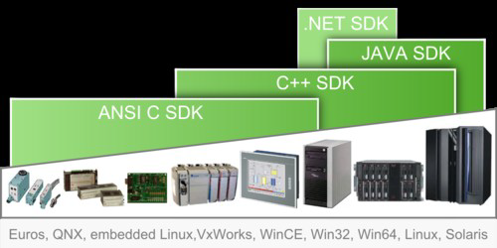

Slide 41
OPC UA Services
Services are methods used by an OPC UA client to access the data of the Information
Model provided by an OPC UA server.
Use case | Service sets or services
Find servers | Discovery Services Set
Connection management between clients and servers | Secure Channel Service Set Session Service Set
Find information in the Address Space | View Service Set
Read and write data and metadata | Read and Write Service
Subscribe for data changes and Events | Subscription Service Set Monitored Item Service Set
Calling Methods defined by the server | Call Service
Access history of data and Events | HistoryRead and HistoryUpdate Service
Find information in a complex Address Space | Query Service Set
Modify the structure of the server Address Space | Node Management Service Set

Slide 42
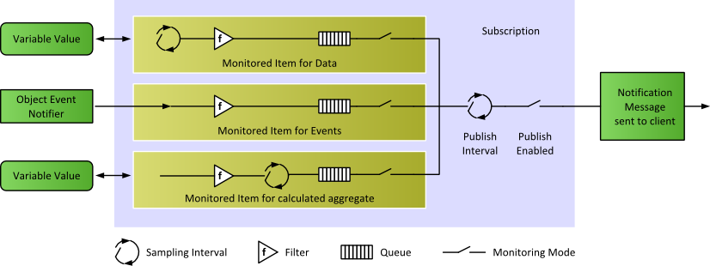
Subscription and Monitored Items
Subscription: an alternative to Polling (like read/write services) has advantages like reduction of required bandwidth.
A Client can subscribe to the Nodes of interest and let the server monitor these items.
Only in case of changes, e.g. to their values, the server notifies the client about such changes

Slide 43
IT Integration
As a direct result of the standardized security model, OPC UA allows for easy integration into pre-existing IT networks which limits configuration costs. OPC UA can communicate through any standard HTTP or UA TCP port. Through this standardization, OPC UA can connect securely over a VPN and through firewalls to allow seamless, remote client-to-server connectivity. As previously mentioned, OPC UA also implements standard network protocols including authentication with certification and data encryption.
Classic OPC COM-based Clients require a UA Proxy to communicate with UA Servers.

Slide 44
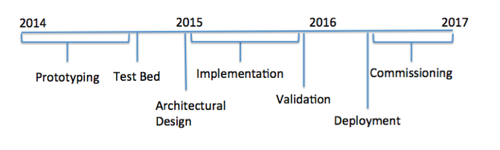
Timeline

Slide 45
 | MST | SST-2M ASTRI | SST-2M GATE
Telescope Type | Davies-Cotton | Schwarzschild-Couder | Schwarzschild-Couder
Prototype Location | Berlin-Adlershof | Serra La Nave (Mt. Etna), Sicily | Meudon, near Paris
Schedule | Spring 2013 | 2014 | 2014
Drive System | Bosch Rexroth | Beckhoff/Siemens | TBD
Devices | Drive System, CCD Cameras, Weather Station, Active Mirror Control, Sensors, Dummy Camera | Drive System, CCD Cameras, Weather Station, Active Mirror Control, Cherenkov Camera | Drive System, CCD Cameras, Weather Station, Active Mirror Control, Sensors, Cherenkov Camera
Software Framework, Common Layers | ACS, OPC UA | ACS, OPC UA | OPC UA

Slide 46
 | qSCT | SST-1m | LST
Telescope Type | Schwarzschild-Couder | Davies-Cotton | Parabolic
Prototype Location | Mt. Hopkins, Arizona (VERITAS site) | CTA site | CTA site
Schedule | Summer 2014
Drive System | Bosch Rexroth | Bosch Rexroth | Siemens
Devices | Drive System, CCD Cameras, Active Mirror Control, Sensors, Cherenkov Camera | Drive System, CCD Cameras, Active Mirror Control, Cherenkov Camera | Drive System, CCD Cameras, Active Mirror Control, Sensors, Cherenkov Camera
Software Framework, Common Layers | ACS, OPC UA | ACS, OPC UA | ACS, OPC UA

Slide 47
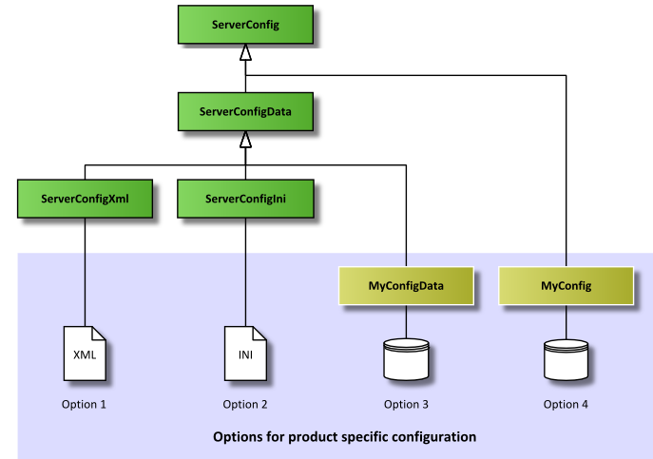
Server Configuration
The SDK provides the following classes:
ServerConfig: It is an interface class used by the SDK to access product specific configuration settings.
ServerConfigData: Implements the interface ServerConfig and provides configuration settings through the settings stored in the member variables of the class.
ServerConfigXml: Loads the settings from an XML file and stores them in the members of ServerConfigData.
ServerConfigIni: Loads the settings from an INI file and stores them in the members of ServerConfigData.
These classes offer the following options for integrating product specific configuration settings.
Option 1 : A Product specific XML configuration file is loaded by the helper class ServerConfigXml. For more information, see XML Configuration File. An example for this file is included with the SDK: [Installation Directory]/bin/ServerConfig.xml
Option 2 : A Product specific INI configuration file is loaded by the helper class ServerConfigIni. For more information, see INI Configuration File. An example for this file is included with the SDK: [Installation Directory]/bin/ServerConfig.ini
Option 3 : The settings are loaded from an existing product configuration data base and stored in ServerConfigData members. This requires the implementation of a product specific class for loading the configuration settings, which is derived from ServerConfigData.
Option 4 : A Product specific implementation of the ServerConfig interface is accessing a product specific configuration data base for every access to the interface ServerConfig.

Slide 48
XML Configuration File
Trace: The element <Trace> stores the trace settings for the OPC UA Stack and OPC UA Application.
Endpoint Configuration: This part of the configuration defines the OPC UA communication endpoints for the server and their security configurations.
Server Settings
Build Information for the Server Application
Server Instance Information: These elements provide server instance information defined for the server installation. [NodeName] can be used as a place-holder for the computer name.
User Identity Tokens: The configuration of supported user identity tokens is stored in the element <UserIdentityTokens>.
Discovery Registration: The configuration for the registration with discovery server(s) is stored in the element <DiscoveryRegistration>.
Redundancy Support and Additional Server Entries

Slide 49
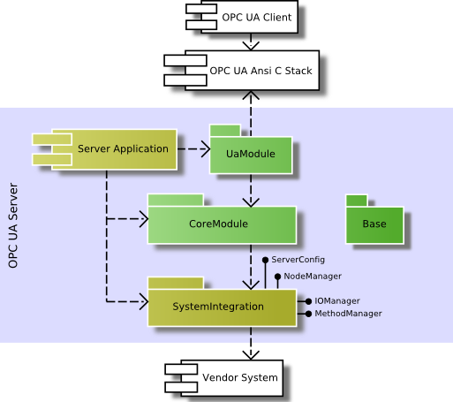

Slide 50
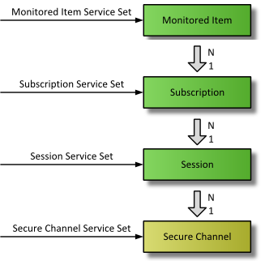

Slide 51
OPC is a standard interface to communicate between numerous data sources, including devices on a factory floor, laboratory equipment, test system fixtures, and databases. The OPC Foundation defined a set of standard interfaces that allow any client to access any OPC-compatible device using a protocol now referred to as Classic OPC. This protocol utilizes the Microsoft-based COM/DCOM technology to provide standard specifications for data access (DA), historical data access (HDA), and alarms and events (A&E). Although basing a protocol on this technology made sense in the 1990s, Classic OPC has several limitations because of this reliance on the Microsoft Windows platform, in the form of security issues and platform dependency.
OPC Unified Architecture (UA) is a new communication technology standard which was first released by the OPC Foundation in 2006 as an improvement upon its predecessor, Classic OPC. OPC UA includes all of the functionality found in Classic OPC. This is done by bringing together the different specifications of Classic OPC into a single entry point to a system offering current data access, alarms and events, combined with the history of both.
Furthermore, OPC UA is based on a cross-platform, business-optimized Service-Oriented Architecture (SOA), which expands on the security and functionality found in Classic OPC, instead of the Microsoft-based COM/DCOM technology. OPC UA supports two protocols: a binary protocol that employs minimal resources, allowing for easy enablement through a firewall; and a Web Service protocol (SOAP) which uses standard HTTP/HTTPS ports. Because of the benefits of this new protocol, an increasing trend of industrial applications have adopted the UA protocol both in the traditional OPC-centric Industrial Automation space and emerging areas, such as energy.

Slide 52
An OPC-UA server uses device-specific protocols to communicate with different brands and kinds of devices and an OPC-UA protocol to communicate with software applications.
Software applications only need to implement a single OPC-UA communication protocol to talk to an OPC-UA server. A software application sends data to an OPC-UA server using an OPC-UA protocol. The OPC-UA server receives the data and sends the data to a device using the device's specific communication protocol. Communication back to the software application works the same in reverse - data is received by the OPC-UA server using the device-specific protocol and sent to the software application using the OPC-UA protocol.
OPC-UA was created by and is maintained by the OPC Foundation.
OPC-UA is the successor of the OPC standard. OPC is a Microsoft-based technology that is used only on Windows computers. One of the benefits of OPC-UA over OPC is that OPC-UA is operating system independent - can be used on Windows, Linux, OS X, Android etc.
OPC-UA specifies a binary TCP-based communication protocol and a SOAP, HTTP-based protocol. These two communication protocols can be used by software applications to communicate with OPC-UA servers.

Slide 53
Redundancy : the inclusion of extra components which are not strictly necessary to functioning,
in case of failure in other components.
robustness is the ability of a computer system to cope with errors during execution.
Robustness can also be defined as the ability of an algorithm to continue operating despite
abnormalities in input, calculations, etc
scalability is necessary to be able to integrate OPC interfaces directly into the systems running
on many different platforms.
Interoperability is the ability of making systems and organizations work together (inter-operate).
While the term was initially defined for Information technology or systems engg. services to
allow for information exchange.

