Slide 1
Date: 14-Oct-2014
LINUX and Vi Editor
Vinit S Bhosle
(vinit@tifr.res.in)

Slide 2
Topics Covered
Introduction to Linux
File Structure
File System commands
File Permissions
Vi Editor and its modes
How to Enter Edit and Exit from Vi mode
Working around Vi

Slide 3
Introduction
Linux creator– Linus Torvalds
Its an Open Source Operating System
Source Code Available.
User can customized Kernel as per their needs.

Slide 4
File Structure
/bin , /usr/bin , /usr/local/bin:- User executables
/etc :- Configuration files
/root , /home/users:- Home directories
/var, /srv, /usr :- Server data
/lib, /lib64, /usr/lib , /usr/local/lib:- Shared libraries
/boot :- Kernel , Boot loaders
/tmp:- Temporary files
/proc , /sys :- System information
/media , /mnt :- Mount points

Slide 5
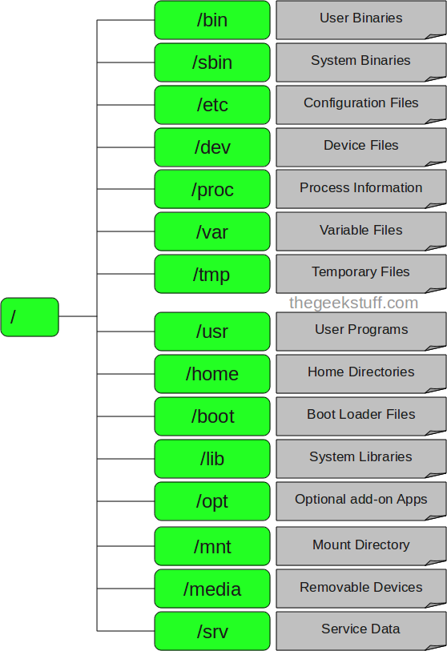
Diagram

Slide 6
Description
1. / – Root
Every single file and directory starts from the root directory.
Only root user has write privilege under this directory.
Please note that /root is root user’s home directory, which is not same as /.
2. /bin – User Binaries
Contains binary executables.
Common linux commands you need to use in single-user modes are located under this directory.
Commands used by all the users of the system are located here.
For example: ps, ls, ping, grep, cp.
3. /sbin – System Binaries
Just like /bin, /sbin also contains binary executables.
But, the linux commands located under this directory are used typically by system administrator, for system maintenance purpose.
For example: iptables, reboot, fdisk, ifconfig.

Slide 7
Description
4. /etc – Configuration Files
Contains configuration files required by all programs.
This also contains startup and shutdown shell scripts used to start/stop individual programs.
For example: /etc/resolv.conf, /etc/logrotate.conf
5. /dev – Device Files
Contains device files.
These include terminal devices, usb, or any device attached to the system.
For example: /dev/tty1, /dev/usbmon0
6. /proc – Process Information
Contains information about system process.
This is a pseudo filesystem contains information about running process. For example: /proc/{pid} directory contains information about the process with that particular pid.
This is a virtual filesystem with text information about system resources. For example: /proc/uptime

Slide 8
Description
7. /var – Variable Files
var stands for variable files.
Content of the files that are expected to grow can be found under this directory.
This includes — system log files (/var/log); packages and database files (/var/lib); emails (/var/mail); print queues (/var/spool); lock files (/var/lock); temp files needed across reboots (/var/tmp);
8. /tmp – Temporary Files
Directory that contains temporary files created by system and users.
Files under this directory are deleted when system is rebooted.
9. /usr – User Programs
Contains binaries, libraries, documentation, and source-code for second level programs.
/usr/bin contains binary files for user programs. If you can’t find a user binary under /bin, look under /usr/bin. For example: at, awk, cc, less, scp
/usr/sbin contains binary files for system administrators. If you can’t find a system binary under /sbin, look under /usr/sbin. For example: atd, cron, sshd, useradd, userdel
/usr/lib contains libraries for /usr/bin and /usr/sbin
/usr/local contains users programs that you install from source. For example, when you install apache from source, it goes under /usr/local/apache2

Slide 9
Description
10. /home – Home Directories
Home directories for all users to store their personal files.
For example: /home/john, /home/nikita
11. /boot – Boot Loader Files
Contains boot loader related files.
Kernel initrd, vmlinux, grub files are located under /boot
For example: initrd.img-2.6.32-24-generic, vmlinuz-2.6.32-24-generic
12. /lib – System Libraries
Contains library files that supports the binaries located under /bin and /sbin
Library filenames are either ld* or lib*.so.*
For example: ld-2.11.1.so, libncurses.so.5.7
13. /opt – Optional add-on Applications
opt stands for optional.
Contains add-on applications from individual vendors.
add-on applications should be installed under either /opt/ or /opt/ sub-directory.

Slide 10
Description
14. /mnt – Mount Directory
Temporary mount directory where sysadmins can mount filesystems.
15. /media – Removable Media Devices
Temporary mount directory for removable devices.
For examples, /media/cdrom for CD-ROM; /media/floppy for floppy drives; /media/cdrecorder for CD writer
16. /srv – Service Data
srv stands for service.
Contains server specific services related data.
For example, /srv/cvs contains CVS related data.

Slide 11
File System commands
pwd - report your current directory
cd <to where> - change your current directory
ls <directory> -list contents of directory
cp <old file> <new file> - copy
mv <old file> <new file> - move (or rename)
rm <file> -delete file(s)
mkdir <new directory name> -make a directory
mkdir -p /home/vinit/test(Creates a sub directory)
rmdir <directory> -remove an empty directory
man <command name>
man command gives you help on that command.

Slide 12
ls command
ls - list directory contents
Usage : ls [OPTIONS] [FILE]
OPTIONS
-l Use a long listing format
-a Do not ignore entries starting with . (for e.g .forward)
-h Print sizes in human readable format (e.g., 3K 389M 3G)
-d List directory entries instead of contents
-R List subdirectories recursively
-r Reverse order while sorting
-S Sort by file size
-t Sort by modification time
-1 List one file per line
Mostly used options in ls
ls -l, ls –la, ls -1, ls -lh, ls -ltr, ls -lS

Slide 13
File Permissions
There are 3 kinds of users in linux : UGO
UGO : user, group and others.
r - Read permissions
w - Write permissions
x - Execute permissions
rwx = 111 in binary = 7
rw- = 110 in binary = 6
r-x = 101 in binary = 5
r-- = 100 in binary = 4

Slide 14
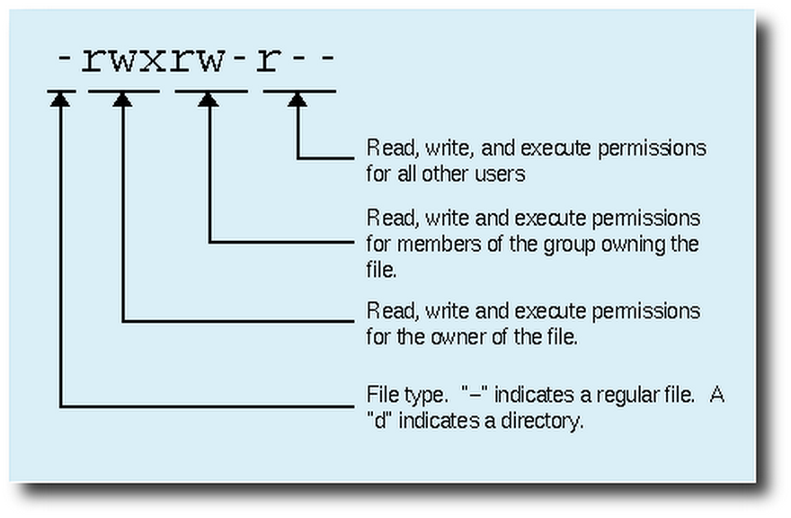
Permission Diagram

Slide 15
777(rwxrwxrwx) No restrictions on permissions. Anybody may do anything. Generally not a desirable setting.
755(rwxr-xr-x) The file's owner may read, write, and execute the file. All others may read and execute the file. This setting is common for programs that are used by all users.
700(rwx------) The file's owner may read, write, and execute the file. Nobody else has any rights. This setting is useful for programs that only the owner may use and must be kept private from others.
666(rw-rw-rw-) All users may read and write the file.
644(rw-r--r--) The owner may read and write a file, while all others may only read the file. A common setting for data files that everybody may read, but only the owner may change.
600(rw-------) The owner may read and write a file. All others have no rights. A common setting for data files that the owner wants to keep private.

Slide 16
Changing File Permissions
Make a file readable :
$ chmod 765 abc.txt
7 -> 111 -> rwx
6 -> 110 -> rw-
5 -> 101 -> r-x
-rwx rw- r-x 1 vinit cccf 224 Oct 14 10:00 abc.txt
OR
$ chmod +w abc.xt
$ chmod o+w abc.xt
$ chmod g+x,o+w abc.txt

Slide 17
Changing File Ownership
Change who owns a file:
$ chown <user> <filename>
chown vinit:cccf abc.txt
chown –R vinit:cccf test
Change to which group the file belongs:
$ chgrp <group> <filename>
chgrp cccf abc.txt

Slide 18
Getting Recursive
copy a directory and its contents to other hosts ID:
$ scp -r <directory> vinit@tifr.res.in:
copy a directory and its contents:
$ cp -r <directory> <destination_dir>
Find a pattern in a directory and its subdirectories:
$ grep -r <pattern> <destination_dir>

Slide 19
Redirecting output to a file with >
Redirecting input from a file with <
Redirection Symbols
>file Make file the standard output
<file Make file the standard input
>>file Make file the standard output, appending to it if already exists

Slide 20
Redirecting examples
ls –l > abc.txt Redirects output to abc.txt
sort < test.txt Accepts the input from test.txt
mail -s “Test subject" vinit@tifr.res.in <body.txt
ls –l vinit.txt 2> error.txt Redirects error to error.txt
ls –l vinit.txt 2>&1 error.txt Redirect output and error to error.txt
ls –l &> file
ls -l &>> test

Slide 21
Piping
Pipes take the output of the first program and feed that output into the input of the next program.
The output of a command can be piped to another command for further processing
Also sometimes known as “filters”.
Examples:
ls –l | wc –l
cat test.txt | more

Slide 22
Login using ssh
ssh – remote login program
$ ssh –l vinit mailhost.tifr.res.in
$ ssh vinit@mailhost.tifr.res.in

Slide 23
Copy to remote machine : scp
copy local to remote
$ scp <source file> user@machine:<path>
copy remote to local
$ scp user@machine:<path> <source file>
-p Preserves mode, time stamps
-r Recursively copy entire directories.
-v Verbose mode.

Slide 24
More commands
grep - grep is global / regular expression / print
  grep –i vinit /etc/passwd
find - search for files in a directory hierarchy report uniq lines
find ./ -name “*.txt” # Find *.txt files present directory
date - date command prints or sets the system date and time
date #Tue Oct 14 10:00:10 IST 2014
date -s “14 OCT 2010 11:00:00"
touch – creates the file if it doesn’t exists or changes date stamp to current if exists
touch abc.txt #creates empty abc.txt
ln - Reference to another file or directory
ln –s abc.txt link.txt # creates symbolic link of abc.txt

Slide 25
More commands
sort <filename> - sort lines of text files
sort -nr +0 -1 <filename> # sorts according to first field
uniq <filename> - report uniq lines
uniq –c <filename> # display the uniq entries with count
tee - read from standard input and write to standard output and files
find / “abc*.*” 2>&1 | tee –a log.txt
#finds files and displays output and erro and tees to log.txt
tar – backup / archiving utility
tar –cvf abc.tar /usr #create a tar file of /usr directory
head - output the first part of files
head -10 abc.txt #displays top 10 lines of abc.txt

Slide 26
More commands
tail - output the last part of files
tail -5 abc.txt # displays last 5 lines of abcd.txt
tail –f maillog.log # displays continuously the new appending data.
cat - concatenate files and print on the standard output
cat a.txt b.txt >>z.txt #appends a.txt and b.txt to z.txt
more – view the contents of a text file one screen at a time
echo - display a line of text\
tr - translate or delete characters
echo “Hello world” | tr '[a-z]' '[A-Z]' # will display HELLO WORLD
expr - Evaluate an expression
expr 5 \* 2 # multiplies 5 and 2

Slide 27
Starting vi
Type vi <filename> at the shell prompt
After pressing enter the command prompt disappears and you see tilde(~) characters on all the lines
These tilde characters indicate that the line is blank

Slide 28
Vi modes
There are two modes in vi
  Command mode
  Input mode
When you start vi by default it is in command mode
You enter the input mode through various commands
You exit the input mode by pressing the Esc key to get back to the command mode

Slide 29
Entering text
To enter the text in vi you should first switch to input mode
To switch to input mode there are several different commands
a - Append mode places the insertion point after the current character
i - Insert mode places the insertion point before the current character

Slide 30
Entering text
I - places the insertion point at the beginning of current line
o - is for open mode and places the insertion point after the current line
O - places the insertion point before the current line
R - starts the replace (overwrite) mode

Slide 31
Editing text
x - deletes the current character
d - is the delete command but pressing only d will not delete anything you need to press a second key
dw - deletes to end of word
dd - deletes the current line
d0 - deletes to beginning of line

Slide 32
Copy, cut and paste
yy - (yank) copy current line to buffer
nyy - Where n is number of lines
p - Paste the yanked lines from buffer to the line below
P - Paste the yanked lines from buffer to the line above

Slide 33
Undo and repeat command
u - undo the changes made by editing commands
. (dot or period) repeats the last edit command

Slide 34
How to exit from vi
First go to command mode
press Esc There is no harm in pressing Esc even if you are in command mode. Your terminal will just beep and/or or flash if you press Esc in command mode
There are different ways to exit when you are in the command mode

Slide 35
How to exit from vi (command mode)
:q <enter> is to exit, if you have not made any changes to the file
:q! <enter> is the forced quit, it will discard the changes and quit
:wq <enter> is for save and Exit
:x <enter> is same as above command
The ! Character forces over writes, etc. :wq!

Slide 36
Working around
You can move around only when you are in the command mode.
Arrow keys usually works.
The standard keys for moving cursor are:
h - for left
l - for right
j - for down
k - for up

Slide 37
Working around
w - to move one word forward
b - to move one word backward
$ - takes you to the end of line
<enter> takes the cursor to the beginning of next line

Slide 38
Working around
- - (minus) moves the cursor to the first character in the current line
H -takes the cursor to the beginning of the current screen(Home position)
L -moves to the Lower last line
M -moves to the middle line on the current screen

Slide 39
Working Around
) - moves cursor to the next sentence
} - move the cursor to the beginning of next paragraph
( - moves the cursor backward to the beginning of the current sentence
{ - moves the cursor backward to the beginning of the current paragraph

Slide 40
Working Around
Control-d scrolls the screen down (half screen)
Control-u scrolls the screen up (half screen)
Control-f scrolls the screen forward (full screen)
Control-b scrolls the screen backward (full screen).
xG- to go at x line
G- takes you to bottom line of file
gg- takes you to first line

Slide 41
Creating a shell script using vi
Create a directory class
Change into class
vi myscript.sh
inside the file enter following commands
clear
echo "==========="
echo "Hello World"
echo "==========="
sleep 3
clear
echo Host is $HOSTNAME
echo User is $USER

Slide 42
Creating a shell script using vi
Save the file
Change the permissions on myscript.sh
chmod 700 myscript.sh <enter>
Now execute myscript.sh
./myscript.sh <enter>
The ./ mean right here in this directory!

Slide 43
          THANK YOU

