Slide 1
Network Traffic Monitoring and Analysis
- Shisheer Teli
CCCF

Slide 2
Daily Network Security Problems:
Frequent security violations.
Need to detect unauthorized services installed by users.
Who is generating suspicious traffic?
Identification of misconfigured and faulty hosts.

Slide 3
What Do We Need ?
Traffic measurement.
Traffic characterization and monitoring.
Detection of network security violations.
Network optimization and planning.

Slide 4
Importance of Network Monitoring and Analysis:
Network monitoring is a difficult and demanding task that is a vital part of a Network Administrators job.
Network Administrators are constantly striving to maintain smooth operation of their networks. If a network were to be down even for a small period of time productivity within a company would decline.
In order to be proactive rather than reactive, administrators need to monitor traffic movement and performance throughout the network and verify that security breeches do not occur within the network.

Slide 5
Monitoring and Analysis Techniques:
Router Based : Monitoring functionalities that are built-into the routers themselves and do not require additional installation of hardware or software are referred to as Router Based techniques.
Non-Router based : techniques require additional hardware and software to be installed and provide greater flexibility.

Slide 6
Router Based Monitoring Techniques
Router Based Monitoring Techniques are hard-coded into the routers and therefore offer little flexibility. A brief explanation of the most commonly used monitoring techniques is given below.
Simple Network Monitoring Protocol (SNMP)
Sflow / Netflow

Slide 7
Simple Network Monitoring Protocol (SNMP)
SNMP is an application layer protocol that is part of the TCP/IP protocol suite. It allows Administrators to manage network performance, find and solve network problems, and plan for network growth. While two versions exist, SNMPv1 and SNMPv2.
There are 3 key components to SNMP:
Managed Devices
Agents
Network Management Systems (NMSs)

Slide 8
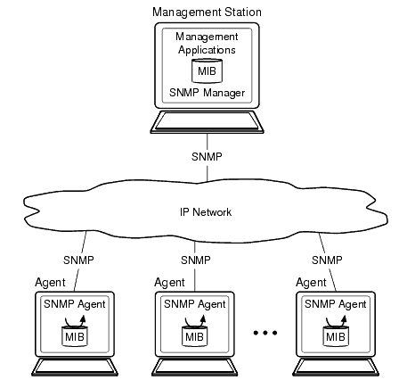

Slide 9
The Managed Devices contain the SNMP Agent and can consist of routers, switches, hubs, printers. They are responsible for collecting information and making it available to the NMSs.
The Agents contain software that have knowledge of management information and translates this information into a form compatible with SNMP. They are located on a managed device.
SNMP uses four protocol operations in order to operate: Get, GetNext, Set, and Trap. The Get command is used when the NMS issues a request for information to managed devices. The SNMPv1 message (request) that is sent consists of a message header and a Protocol Data Unit (PDU). The PDU of the message contains the information that is needed to successfully complete a request that will either retrieve information from the agent or set a value within the agent

Slide 10
Sflow:
sFlow is a multi-vendor sampling technology embedded within switches and routers. It provides the ability to continuously monitor application level traffic flows at wire speed on all interfaces simultaneously.
Parameters:
Polling interval: If you set the polling interval for 60 seconds, the switch is counting all of the packets that have gone through that interface in the past 60 seconds.
Sample rate: You are telling the switch to sample one out of every X amount of packets that pass through the interface.

Slide 11
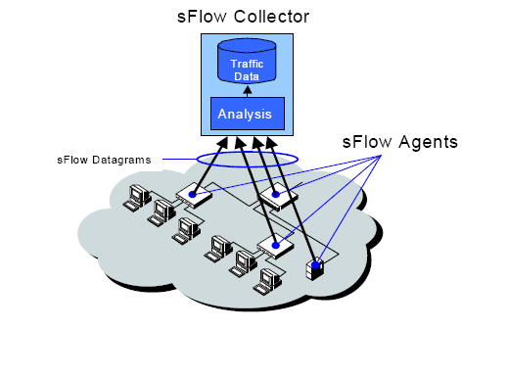
sFlow Agents and Collector:
sFlow Agents throughout the network continuously send a stream of sFlow Datagrams to a central sFlow Collector where they are analyzed to produce a rich, real-time, network-wide view of traffic flows.

Slide 12
sFlow monitoring of high-speed, routed and switched networks has the following properties:
Accurate: Because sampling is simple enough to be performed in hardware, it operates at wire speed. In addition, the sFlow system is designed so that the accuracy of any measurement can be determined. Other traffic flow measurement technologies ìclipî under heavy loads resulting errors that are difficult to quantify.
Detailed: Complete packet header and switching/routing information permits detailed analysis of L2-L7 traffic flows.
Scalable: The sFlow system is scalable in both the size and speed of the network it can monitor. sFlow is capable of monitoring networks at 10Gbps, 100Gbps and beyond. Thousands of devices can be monitored by a single sFlow Collector

Slide 13
IPTraf:
IPTraf : IPTraf is a console-based network statistics utility for Linux. It gathers a variety of figures such as TCP connection packet and byte counts, interface statistics and activity indicators, TCP/UDP traffic breakdowns, and LAN station packet and byte count.
Protocols Recognized:
IP
TCP
UDP
ICMP
IGMP
IGP
IGRP
OSPF
ARP
RARP

Slide 14
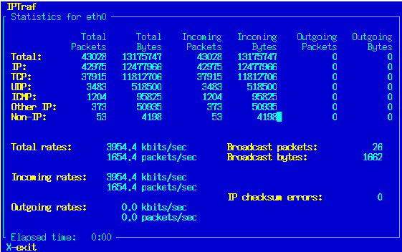

Slide 15
Thank You

