Slide 1
Observation of the critical end point in the phase diagram for hot and dense nuclear matter
Roy A. Lacey
Stony Brook University
Happy Birthday Rajiv
Two Reminders:
We turn not older with years, but newer every day.
- Emily Dickinson
“We don’t stop playing because we grow old; we grow old because we stop playing.”
- George Bernard Shaw
Courtesy Frithjof Karsch
We look forward to many more years of invaluable contributions to the field

Slide 2
Observation of the critical end point in the phase diagram for hot and dense nuclear matter
Roy A. Lacey
Stony Brook University
Outline
Introduction
  Known’s & unknowns
Search strategy
  Guiding principles
The probe
  HBT
Measurements
  Scaling properties
How the CEP is located
  Finite-Size-Scaling
Summary
  Epilogue
Feel free to interrupt
at any time
“Those who dance are considered insane by those who cannot hear the music.”
George Carlin

Slide 3
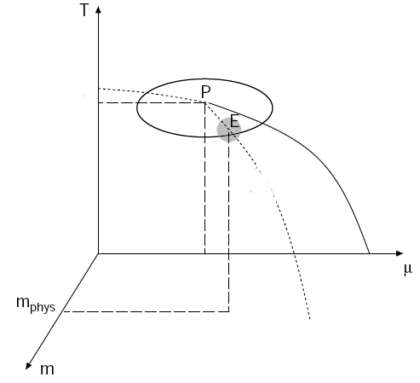

The phase diagram for nuclear matter is a central current focus of our field
2nd Order O(4)
Known knowns
Spectacular achievement:
Validation of the crossover
transition leading to the QGP
Initial estimates for the
transport properties of the QGP
Crossover
2nd Order Z(2)
1st Order
m_{s} > m_{s3}
Known unknowns
Location of the critical End point (CEP)?
  Order of the transition?
  Value of the critical exponents?
Location of phase coexistence regions?
Detailed properties of each phase?
All are fundamental to charting the phase diagram
Conjectured Phase Diagram
Measurements which probe a broad range of the (${\text{T},μ}_{B}$)-plane are
essential to fully unravel the unknowns!

Slide 4
Ongoing studies in search of the CEP
Systematic study of various probes
as a function of √s:
  Collapse of directed flow - v₁
  Critical fluctuations
  Emission Source radii
  Viscous coefficients for flow
  …
  …
Focus of this talk
These are all guided by a variety of search strategies'

Slide 5
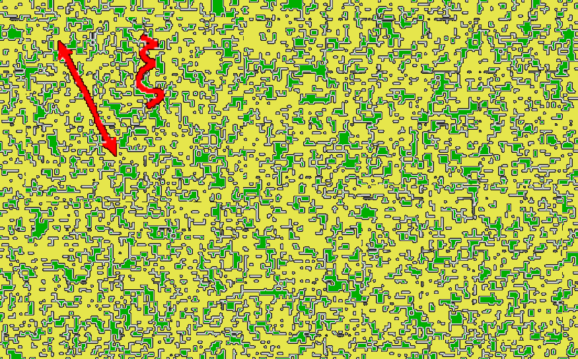
Anatomy of search strategy
The correlation length diverges
  Renders microscopic details (largely) irrelevant
This leads to universal power laws and scaling functions for static and dynamic properties
Ising model
Approaching the critical point of a 2nd order phase transitions
Search for “critical fluctuations” in HIC
Stephanov, Rajagopal, Shuryak
PRL.81, 4816 (98)
The critical end point is characterized by several (power law) divergences

Slide 6

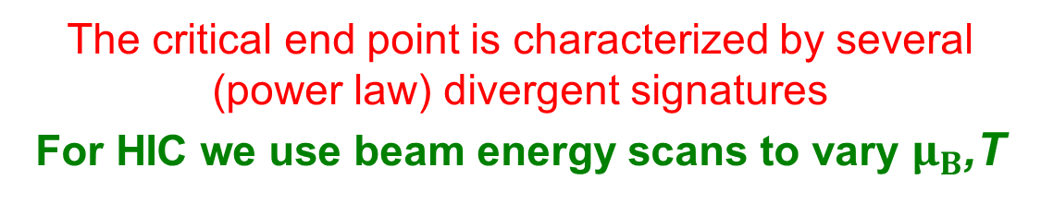
Anatomy of search strategy
$H_{2}$O
The critical end point is characterized by several (power law) divergent signatures
For HIC we use beam energy scans to vary $μ_{B}$,T

Slide 7
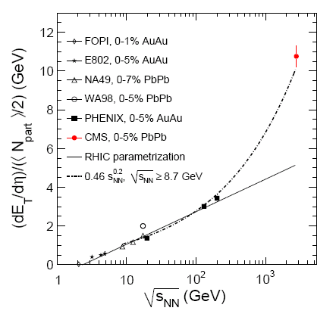
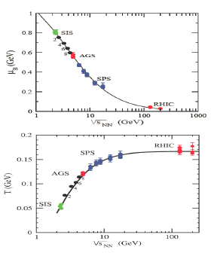
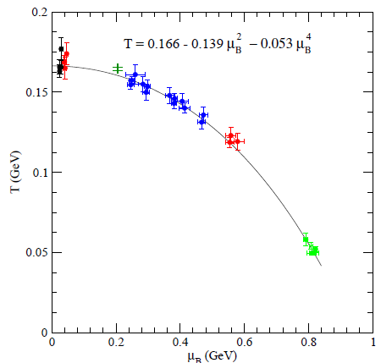



Search Strategy
Exploit the RHIC-LHC beam energy lever arm
($μ_{B}$,T) at chemical freeze-out
Energy scan
M. Malek, CIPANP (2012)
J. Cleymans et al.
Phys. Rev. C73, 034905
LHC → access to high T and small $μ_{B}$
RHIC → access to different systems and
a broad domain of the ($μ_{B}$,T)-plane
RHIC_{BES} to LHC → $\sim$360 $\sqrt{s_{NN}}$ increase
$\sqrt{s_{NN}}$ is a good proxy for (${T, μ}_{B}$) combinations!
Challenge → identification of robust signals

Slide 8
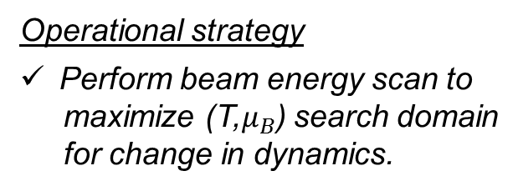
Signal Strategy
Locating the deconfinement phase transition and the critical end point?
Operational strategy
Perform beam energy scan to
maximize (T,$μ_{B}$) search domain
for change in dynamics.
Trajectories close to the CEP result in non-monotonic signatures in the excitation functions due to divergences
Search for non-monotonic behavior which signal
an important change in the reaction dynamics

Slide 9
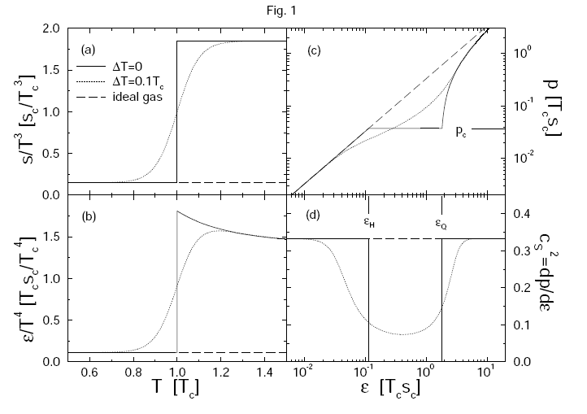
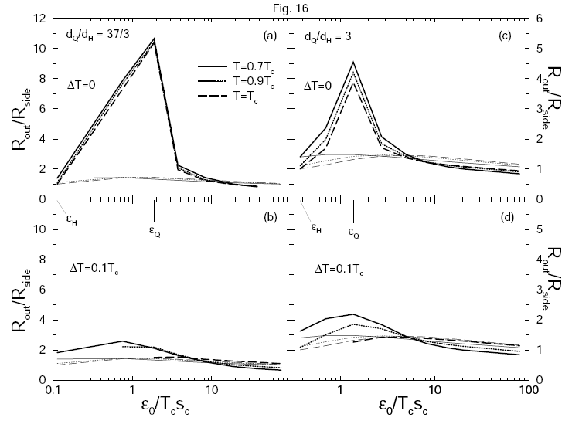
Possible signals
Collapse of directed flow
H. Stoecker, NPA 750, 121 (2005)
Dirk Rischke and Miklos Gyulassy
Nucl.Phys.A608:479-512,1996
Dirk Rischke and Miklos Gyulassy
Nucl.Phys.A608:479-512,1996
In the vicinity of a phase transition or the CEP, the sound speed is expected
to soften considerably.
In the vicinity of a phase transition
or the CEP, the divergence of the compressibility leads to anomalies
in the expansion dynamics
Modifications to the space-time extent of emission sources

Slide 10
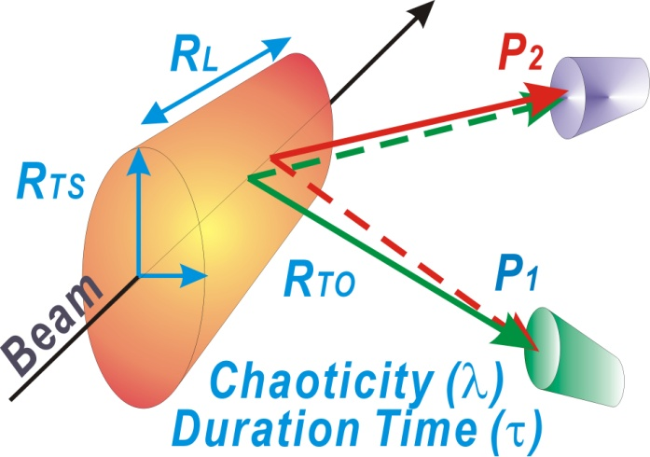
Interferometry Probe
Alias (HBT)
Hanbury Brown & Twist
Two particle Interferometry Studies
Two-particle correlation function
S. Afanasiev et al. (PHENIX)
PRL 100 (2008) 232301
3D Koonin Pratt Eqn.
Correlation
function
Encodes FSI
Source function
(Distribution of pair separations)
Inversion of this integral equation
➔ Source Function

Slide 11
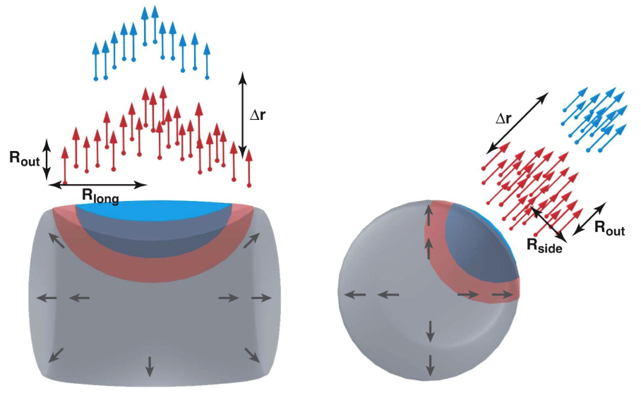
Interferometry Probe
Hung, Shuryak, PRL. 75,4003 (95)
Chapman, Scotto, Heinz, PRL.74.4400 (95)
Makhlin, Sinyukov, ZPC.39.69 (88)
(R²_{out}-R²_{side}) sensitive to the susceptibility
Anticipate extended emission duration with
phase transition/CEP

Slide 12
Interferometry signal
A. Adare et. al. (PHENIX)
arXiv:1410.2559

Slide 13
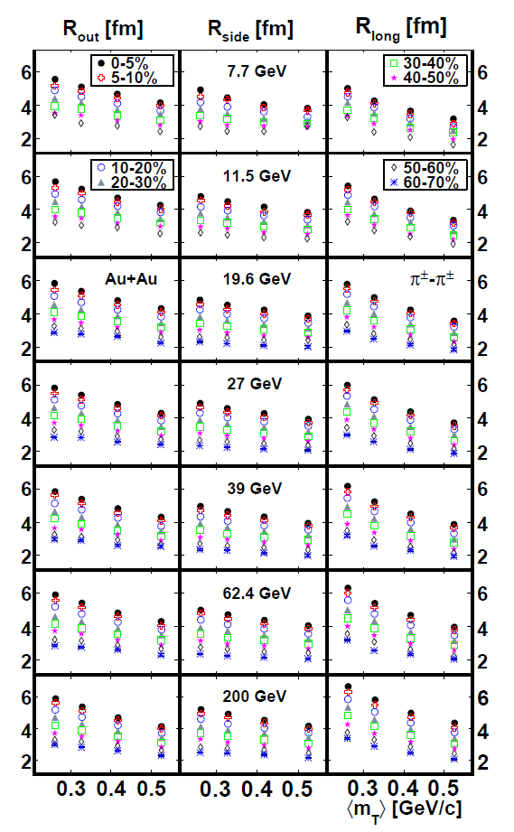
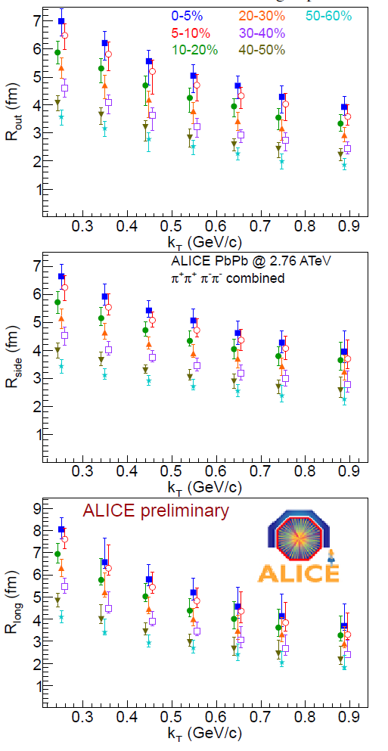
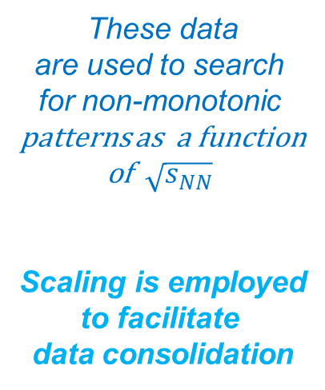
HBT Measurements
STAR - 1403.4972
ALICE -PoSWPCF2011
These data
are used to search
for non-monotonic
patterns as a function
of $\sqrt{s_{NN}}$
Scaling is employed
to facilitate
data consolidation
Exquisite data set for combined RHIC-LHC results?

Slide 14
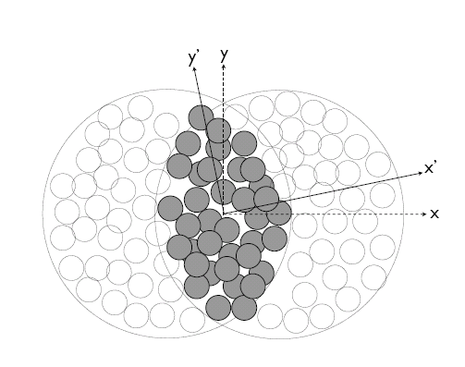
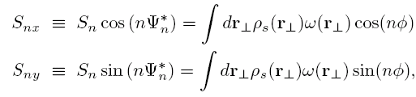
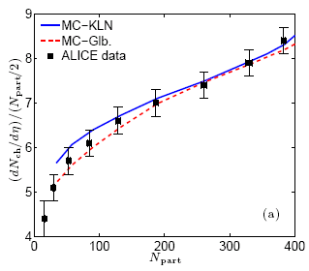


Geometric quantities for scaling
Geometry
Phys. Rev. C 81, 061901(R) (2010)
A
B
arXiv:1203.3605
σ_{x} & σ_{y} → RMS widths of density distribution
Geometric fluctuations included
Geometric quantities constrained by multiplicity density.

Slide 15
Scaling properties of HBT
Viscous Hydrodynamics – B. Schenke
Freezeout size reflects;
  Initial size
  + expanded size
Characteristic acoustic
Scaling validated in
Viscous hydrodynamics
E. Shuryak, I. Zahed
Phys.Rev. D89 (2014) 094001
Freeze-out time varies
with initial size
Freeze-out transverse size proportional to initial transverse size

Slide 16
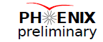
Acoustic Scaling of HBT Radii
Femtoscopic measurements
arXiv:1404.5291
Larger expansion
rate at the LHC
  exquisitely demonstrated via HBT measurement for several systems

Slide 17
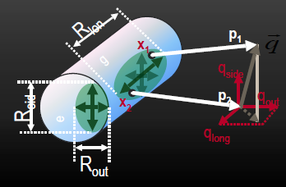
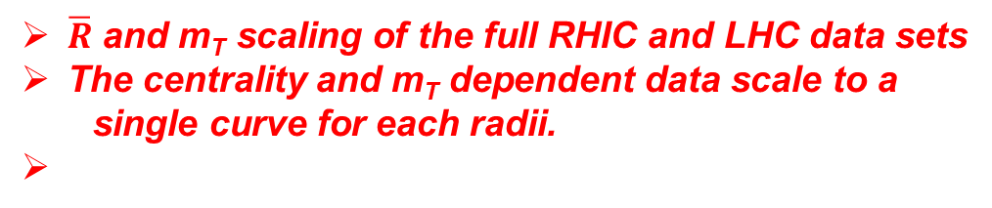
Acoustic Scaling of HBT Radii
$\overline{R}$ and m_{T} scaling of the full RHIC and LHC data sets
The centrality and m_{T} dependent data scale to a
single curve for each radii.

Slide 18

$√s_{NN}$ dependence of interferometry signal
A. Adare et. al. (PHENIX)
arXiv:1410.2559
These characteristic non-monotonic patterns signal
a suggestive change in the reaction dynamics
→ Deconfinement Phase transition? CEP?
How to pinpoint the onset of the Deconfinement Phase transition? and the CEP?

Slide 19
Pinpointing the location of the CEP!
from partition function
The critical end point can be probed via measurements of critical fluctuations and proxies for the susceptibility, heat capacity, etc.
→ Divergences are modulated by the effects of finite-size

Slide 20
The curse of Finite-Size effects
(note change in peak heights,
positions & widths)
The precise location of the critical end point is influenced by Finite-size effects
→ Only a pseudocritical point is observed – shifted from the genuine CEP

Slide 21
The curse of Finite-Size effects
E. Fraga et. al.
J. Phys.G 38:085101, 2011
Displacement of pseudo-first-order transition lines and CEP due to finite-size
Finite-size shifts both the pseudocritical endpoint
and the transition line
Even flawless measurements Can Not give the precise
location of the CEP in finite-size systems

Slide 22
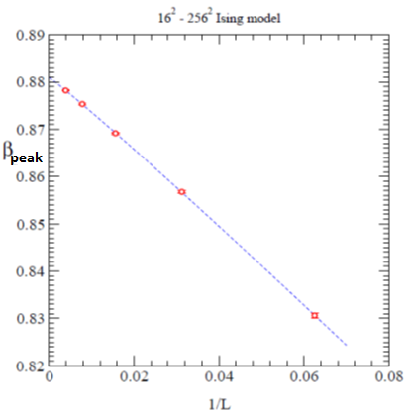
The blessings of Finite-Size Scaling
Finite-Size Scaling can be used to extract the location of the deconfinement transition and the critical exponents

Slide 23
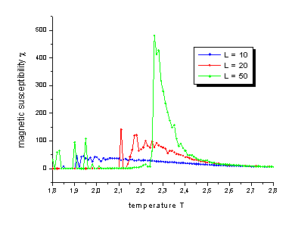
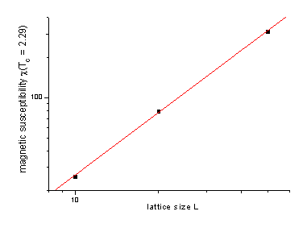
The blessings of Finite-Size Scaling
Finite-Size Scaling can be used to extract the location of the
deconfinement transition and the
critical exponents
Critical exponents reflect the
universality class and the order
of the phase transition

Slide 24
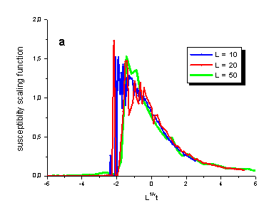
The blessings of Finite-Size Scaling
Cross Check
Extracted critical exponents and CEP values should lead to data collapse onto a single curve
Essential Message
Search for & utilize finite-size scaling!

Slide 25
$$Size dependence of HBT excitation functions$$
Max values decreases with decrease in system size
Peaks shift with decreasing system size
Widths increase with decreasing system size
These characteristic patterns signal the effects
of finite-size

Slide 26
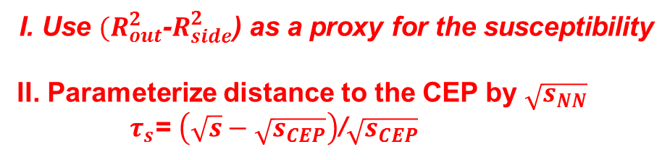
$$Size dependence of the excitation functions$$
I. Use ${(R}_{out}^{2}$-$R_{side}^{2}$) as a proxy for the susceptibility
II. Parameterize distance to the CEP by $\sqrt{s_{NN}}$
$τ_{s}$= $\left(\sqrt{s}−\sqrt{s_{CEP}}\right)$/$\sqrt{s_{CEP}}$
characteristic patterns signal the effects of finite-size
→ Perform Finite-Size Scaling analysis

Slide 27
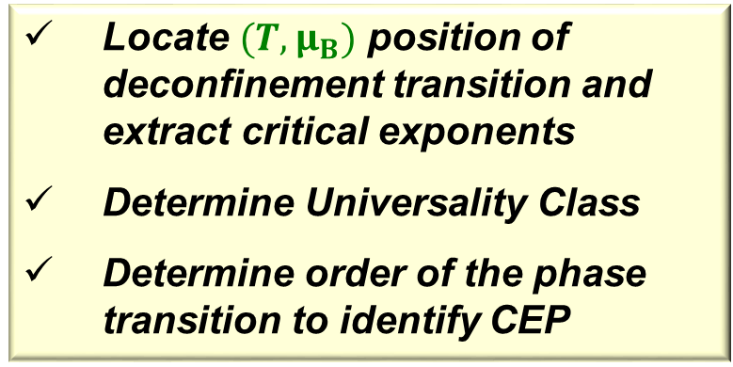

$Finite−Size Scaling$ Analysis
(only two exponents are independent )
Note that is not strongly dependent on V
Locate ${(T,μ}_{B})$ position of deconfinement transition and extract critical exponents
Determine Universality Class
Determine order of the phase transition to identify CEP

Slide 28

$$Finite−Size Scaling$$
Finite-Size Scaling gives
Critical exponents compatible with 3D Ising model universality class
2nd order phase transition for CEP
(Chemical freeze-out
systematics)

Slide 29
$$Finite−Size Scaling$$
2nd order phase transition
3D Ising Model Universality class for CEP
Finite-Size
Scaling validation
Finite-Size Scaling validated
**A Clear initial indication for the CEP**

Slide 30

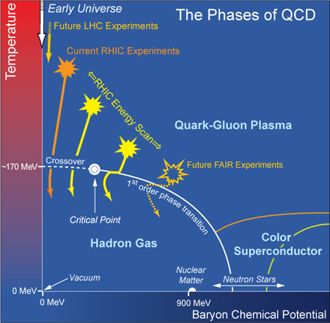

Epilogue
  Additional Data from RHIC (BES-II) together with mature and sophisticated theoretical modeling now required!
Strong experimental indication for the CEP and its location
Finite-Size Analysis with ${(R}_{out}^{2}$-$R_{side}^{2}$)
2nd order phase transition
3D Ising Model Universality class for CEP
Landmark validated
Crossover validated
Deconfinement
Validated
m_{s} > m_{s3}
Other implications!
Lots of work still
to be done to fully chart the QCD phase diagram!!

Slide 31
End

Slide 32
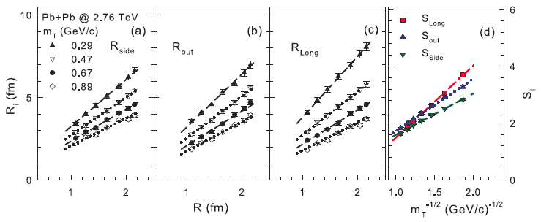

Acoustic Scaling of HBT Radii - LHC
$\overline{R}$ and m_{T} scaling of the full LHC data set
The centrality and m_{T} dependent data scale to a
single curve for each radii.
Larger expansion rates at the LHC
Qualitatively similar expansion dynamics at RHIC & LHC

Slide 33
Anatomy of search strategy
There are striking similarities
between the phase diagrams for
Liquid-gas
Ising Ferromagnet
Same universality class
for the CEP
No stable homogeneous
thermodynamic phase
Liquid-gas
Ferromagnet

Slide 34
m_{T} Scaling of HBT Radii
PHENIX and STAR consistent arxiv:1403.4972
all radii linear
  R_{i}=a+b/√m_{T}
Useful to interpolate to common m_{T}

