Slide 1
Historical and philosophical perspectives of ionizing radiation protection
Sunil C
Accelerator Radiation Safety Section
Health Physics Division

Slide 2
Life and Radiation
Life on earth has developed with an ever present background of radiation. It is not something new, invented by the wit of man: radiation has always been there.
Eric J Hall, Professor of Radiology, College of Physicians and Surgeons, Columbia University, New York, in his book "Radiation and Life

Slide 3
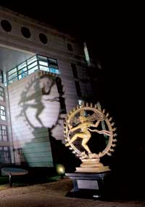
Source of natural radiation
Primordial
from before the creation of the Earth
Uranium, thorium, ⁴⁰K
Cosmogenic
formed as a result of cosmic ray interactions
¹⁴C, ³H, ⁷Be
Terrestrial
Remember man, that thou are dust and unto dust thou shalt return (Genesis 3.19)
Radon in Air, dissolved U,Th
Human produced
(TENORM)Technically Enhanced NORM (naturally occurring radioactive materials)
²³⁸U, ²²⁶Ra, ²¹⁴Pb
Technology produced
⁹⁰Sr, ¹³⁷Cs, ⁹⁹Tc, ²³⁹Pu
For the modern physicists, Shiva’s dance is the dance of subatomic matter (Fritjof Capra)

Slide 4
TNORM
Geothermal Energy Production Wastes
Oil and Gas Production Wastes
Drinking Water Treatment Wastes
Coal Fly Ash and Bottom Ash
Fertilizer and Fertilizer Production Wastes
Phosphate rocks contain more than average U, Th..
Rare Earths (Monazite, Xenotime) Extraction Waste
Mining Wastes

Slide 5
Radiation due to technology
Medical
Diagnostics
X-rays
Artificial sources
PET Isotopes
Therapy
X-rays, electrons, neutrons, protons, Heavy ions
Nuclear Activities
Air and space travel
Air crew ~ 2-3 mSv y⁻¹.
Industrial products
Food irradiation

Slide 6
Radioactivity
Radioactivity
is a nuclear phenomenon occurring due to the instability of the nucleus.
is a spontaneous, continuous and irreversible process.
is independent of external factors such as pressure, temperature, state of substance, electrical field, magnetic field, catalyst etc.
reduces with a certain characteristic half life.
The physical and chemical properties of daughter element are different than that of the parent element.

Slide 7
Ionizing Radiation
++
Alpha particles (α)
Beta particles (β)
Gamma rays (γ)
Neutrons
Notes:
IONIZING RADIATION
When ionizing radiation is absorbed by our bodies, it can cause changes to our cells. Small amounts can be tolerated; larger amounts can be harmful.
For our purposes, this radiation can be classified as:
a. alpha particles
b. beta particles
c. gamma radiation
d. neutrons
Again, for our purposes, we’re not so concerned with the mechanism of radiation as we are with the hazard, the detection of it and protection from it.

Slide 8
Half Life
Total number of atoms
1
2
3
4
5
6
Half Life
&
Parent & Daughter radionuclides
Stable

Slide 9
Penetrating Power
α
β
γ
Neutron
Paper sheet
Lead
Paraffin
Aluminum
Notes:
Charged particles are characterized by their definite range. Changeless particles including photons are stopped in an exponential manner. Lead though a good shield for Gamma and X-rays, is extremely inefficient in stopping neutrons. Paraffin or polyethylene or hydrogenous materials are good shield for neutrons but bad shield for photons

Slide 10
Units of Measurements
Roentgen It is the amount of ionizing X-ray exposure that would liberate 1 electrostatic unit of charge per cubic centimeter of air at STP. S.I unit is C/Kg.
RAD (Radiation Absorbed Dose), is equal to deposition of 100 ergs of ionizing energy per gram of target material. The S.I. unit is Gray (J/Kg) and is equivalent to 100 Rads.
REM (Roentgen Equivalent Man) (erg/g) is the product of Rad and a radiation weighting Quality Factor (unit less) which accounts for the varying radiation damage caused by different types of radiation. S.I. Unit is Sievert (J/Kg) and is equivalent to 100 Rem.
Notes:
It

Slide 11
High Background Areas
Coastal regions of Kerala and Tamilnadu in India and certain pockets of Brazil have high content of thorium in sand, Ramsar in Iran has high radium concentration in the hot springs.
This give rise to an average exposure 400 mRem per year.
Peak values have been noted to be as high as 70⁽¹⁾ mSvy⁻¹ (Kerala) and 260⁽²⁾ mSvy⁻¹(Ramsar).
The limit for occupational workers in nuclear industry is 20 mSvy⁻¹.
Nair RR et al., Background radiation and cancer incidence in Kerala, India-Karanagappally cohort study, Health Phys. 2009 Jan;96(1):55-66.
Ghiassi-nejad et al. Very high background radiation areas of Ramsar, Iran: preliminary biological studies., Health Phys. 2002 Jan;82(1):87-93.

Slide 12
Dose Rate from some Sources
Source | Exposure
Natural Background | 1 mSv/year
Eye Glasses | 0.1 mSv/year
Potassium -40 in body | 0.4 mSv/year
Chest X-ray | 0.007-0.24 mSv
Mammography | 0.1-0.6 mSv
Annual limit of exposure to nuclear workers | 20 mSv
CT Head | 0.9-4 mSv
CT Chest | 4-40 mSv
Coronary Angiogram | 5-30 mSv
Annual limit of exposure to the public | 1.0 mSv
Dose due to long haul flight (30,000-60,000 ft) | 3-10 µSvh⁻¹
Dose rate outside shield in a nuclear facility | 1.0 µSvh⁻¹

Slide 13
Man As a Source of Radiation?
Natural Radioactivity in your body
Nuclide | Total Mass | Total Activity | Daily Intake
Uranium | 90 µg | 30pCi (1.1Bq) | 1.9 µg
Thorium | 30 µg | 3pCi (0.11Bq) | 3 µg
Potassium | 17 mg | 120nCi (4.4kBq) | 0.39 mg
Radium | 31 pg | 30pCi (1.1Bq) | 2.3 pg
Carbon | 95 µg | 0.4 µCi (15 kBq) | 1.8 µg
Tritium | 0.06 pg | 0.6 nCi (23 Bq) | 0.003 pg
Polonium | 0.2 pg | 1 nCi (37 Bq) | ~0.6 µg
Notes:
Since we are a product of our environment, anything in it will find a way into our body too.

Slide 14
Total From Natural Sources
Internal Exposure
mRem /Year
Total exposure from natural sources (India) 2.4mSv.
Notes:
The total exposure to the general public in India (per caput), from natural sources is 240 mRem.

Slide 15
Average Dose Comparison
mRem /Year

Slide 16
Radiation Dose From All Sources
Medical
1.9%
External (30%)
Nuclear
Activities
0.3%
Internal 67.7%
Misc.0.1%
Total per caput dose to Indian population is 2.5 mSv/year.

Slide 17
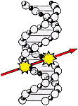
Biological Effects (Direct Action)
Dissociation of the molecule by excitation or ionization of atoms in DNA.
Results in single strand or double strand breaks.
Could lead to cell death or mutation that may be passed on.

Slide 18
Indirect Effect
H₂O → H₂O⁺+e⁻
H₂O⁺ → H⁺+OH
H₂O+e⁻ → H₂O⁻
H₂O⁻ → H+OH⁻
OH+OH → H₂O₂
H+ and OH- are of little consequence as our body has plenty of them always. The free radicals and hydrogen peroxide are highly oxidizing agents that cause harm to the cell.
Notes:
H+ and OH- are of little consequence as our body has plenty of them always. The free radicals and hydrogen peroxide ate highly oxidising agents that cause harm to the cell.

Slide 19
Damage to the DNA and repair mechanisms
Attack on the DNA.
UVA, UVB in sunlight leads to skin cancer
Oxidative damage from the by-products of metabolism, such as free radicals.
Tobacco smoke leads to mutations in lung cells and cancer.
Repair mechanisms.
Nucleotide Excision Repair (“dark repair”)
Photoreactivation (“light repair”)
Double strand damage can be repaired by nonhomologous end joining or homologous recombination repair.
It is estimated that an individual cell can suffer up to one million DNA changes per day.
Branze, D., & Foiani, M., Regulation of DNA repair throughout the cell cycle, Nature Reviews Molecular Cell Biology 9, 297–308 (2008).
Clancy, S. (2008) DNA damage & repair: mechanisms for maintaining DNA integrity. Nature Education 1(1):103

Slide 20
Cell Sensitivity
"Law of Bergonie and Tribondeau“ states that; "the radiosensitivity of a tissue is directly proportional to the reproductive activity and inversely proportional to the degree of differentiation”.
The susceptibility of the cells in decreasing order
Blood forming organs, (lymph nodes, thymus, spleen, bone marrow)
Reproductive Organs (Males and Females)
Digestive Organs (small intestine, lower intestine, pharynx, esophagus)
Vascular System
Skin
Bone and teeth
Respiratory System
Muscle and Connective Tissues
Nervous Tissue

Slide 21
Time line of biological effects
Chemical Damage
Free Radicals
Biological Molecular Damage
Proteins, Membrane, DNA
Cells, tissues
Hours to years
Critical Target
Seconds to hours
Repair or Damage
10⁻¹⁰ Seconds

Slide 22
Deterministic Effects
Exposure (Rad) | Effect
0 - 10 | No Observable effects
10 - 100 | Slight Blood changes
100 - 200 | Hematopoietic syndrome Reduction in platelets and White Blood cells
200 - 500 | Gastrointestinal syndrome Severe blood damage, epilation, NVD
500-1000 | Central Nervous syndrome death in 1-2 days

Slide 23
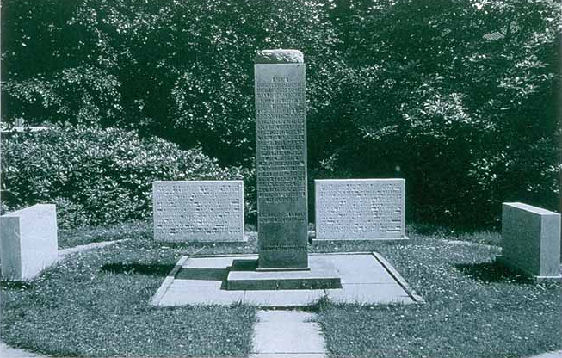
Radiation Protection in early days
X-rays were invented in 1895.
Within months, radiation injuries were reported.
Many were gruesome and even lethal.
It also gave rise to the idea of treatment by radiation.
Present day philosophy of time, distance and shielding was first espoused by an American engineer Wolfram Fuchs;
Monument to the early radiation martyrs erected by the German Rontgen Society in Hamburg (1936)
In 1896, he gave what is generally recognized as the first protection advices:
Make the exposure as short as possible;
Do not stand within 12 inches (30 cm) of the X-ray tube; and
Coat the skin with Vaseline (a petroleum jelly) and leave an extra layer on the most exposed area.

Slide 24
Radiation Effects on Embryo/Fetus
Embryo/fetus is rapidly developing so is more sensitive to a possible radiation effect than an adult.
Effects vary with amount of radiation and stage of development of the embryo/fetus.
Principal effects are loss of pregnancy, malformations, and mental retardation.¹
Without radiation exposure, risk of spontaneous abortion is 15 percent.
Without radiation exposure, risk of genetic disease is 11 percent.
Without radiation exposure, risk of major malformation is 3 percent.
Without radiation exposure, risk of growth retardation is 3 percent.
Malformations are identical to those occurring naturally.
More than 100 mSv is required to increase the rate of malformations.
¹Brent RL. Utilization of developmental basic science principles in the evaluation of reproductive risks from pre- and postconception environmental radiation exposure. Teratology 59:182; 1999.
From www.hps.org

Slide 25
Threshold model
1.0
Limit
Probability of occurrence
Dose

Slide 26
Linear No Threshold model
Epidemiological data
Risk (Excess radiation induced cancer)
Dose above background
For stochastic effects, extrapolation from high dose and dose rates as seen by A bomb survivors.

Slide 27
Risk
Subjective and objective risks showcases the way risks are perceived.
Subjective (as perceived by common man)
Nuclear Industry
Motor vehicles
Handguns
Smoking
Motor cycles
………..
Prescription antibiotics
Objective risks (as perceived by professionals)
Prescription painkillers
Handguns
Motor vehicles
Smoking
Alcohol
……..
Nuclear Industry
Perception of Risk, Paul Slovic, Science, 236,4799 (1987), pp. 280-285.
The National Safety Council www.nsc.org

Slide 28
Estimation of risk
A Bomb survivors
Medical exposures
High background areas
Occupational workers
Risk Coefficient
Biological studies
UNSCEAR, BEIR, ICRP
Epidemiological studies
Repair Mechanism
DNA Mutation
Delayed effects
By stander effects
Cancer
Hereditary effects
Non Cancer effects

Slide 29
Evolution of risk coefficient
Risk | 1990 | 2007
Cancer | 6.0 x 10⁻² Sv⁻¹ | 5.5 x 10⁻² Sv⁻¹
Hereditary | 1.3 x 10⁻² Sv⁻¹ | 0.2 x 10⁻² Sv⁻¹
Total | 7.3 x 10⁻² Sv⁻¹ | 5.7 x 10⁻² Sv⁻¹
The risk is 25% lower in the 2007 Recommendations compared to 1990.
The cancer risk estimates in 2007 were derived from incidence data whereas in 1990 the starting point was mortality data.
The total hereditary risk is 0.3-0.5% per gray to the first generation following irradiation. This is less than one tenth of the risk of fatal carcinogenesis following irradiation. Since it is now believed to take some hundreds of generations for defects to reach equilibrium, the risk to the first few generations is still about 10% of the carcinogenic risk to the parents.
Because of the decrease in the estimates of fatal cancer and detriment the level of protection increases by 25%.

Slide 30
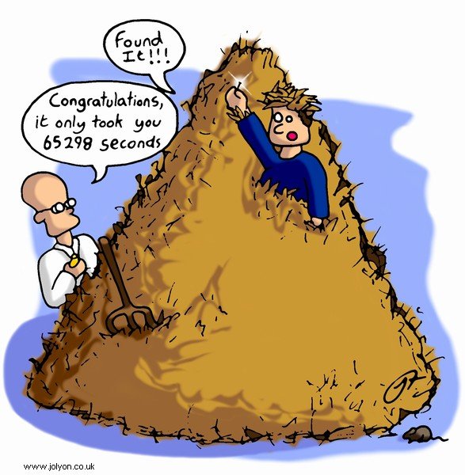
Risk Coefficient
Cancer risk is estimated to be ~0.05Sv⁻¹. That is, 5 excess cancers among 10⁴ people exposed to 1 Sv.
For 20 mSv, this scales down linearly (LNT model).
The natural cancer occurrence in the USA is about 42% and in India it is believed to be higher.
Occupational exposures to ionising radiation occur normally at low-dose rate and may sum up to moderate doses in the order of 100 mGy.
The risk due to radiation is neither distinguishable nor directly measurable from the cancer risk caused by other sources (environmental, chemical, biological, etc.).

Slide 31
Evolution of Protection principles
Physical protection (1928)
Guarded against injuries to superficial tissues, derangements of internal organs and changes in the blood’.
Remedy suggested was a prolonged holiday and limitation of working hours .
No dose limit was proposed, but is estimated to be about 1000 mSv/year.
First quantitative recommendation of tolerance dose (1931)
Same recommendation but tolerance limit of 0.2 R per day (~ 500 mSv/year).
X-ray, and particularly radium workers, should be systematically submitted, both on entry and subsequently at least twice a year, to expert medical, general and blood examinations. These examinations will determine the acceptance, refusal, limitation or termination of such occupation’.
R.H. Clarke and J.Valentin, The History of ICRP and the Evolution of its Policies, ICRP 109

Slide 32
Evolution of Protection principles
Post war (1951)
0.5 Rontgen in any 1 week in the case of whole-body exposure to x and gamma radiation (at the surface, corresponding to 0.3 Rontgen in ‘free air’), and 1.5 Rontgen in any 1 week in the case of exposure of hands and forearms. (~150 mSv/year).
New set of rules were drafted and the thrust was to decide on;
permissible dose for external radiation;
permissible dose for internal radiation;
protection against X rays generated at potentials up to 2 million volts;
protection against X rays above 2 million volts, and βrays and γ rays;
protection against heavy particles, including neutrons and protons;
disposal of radioactive wastes and handling of radioisotopes.
R.H. Clarke and J.Valentin, The History of ICRP and the Evolution of its Policies, ICRP 109

Slide 33
Evolution of Protection principles
Protection of public (1954)
Whilst the values proposed for maximum permissible doses are such as to involve a risk which is small compared to the other hazards of life, nevertheless, in view of the incomplete evidence on which the values are based, coupled with the knowledge that certain radiation effects are irreversible and cumulative, it is strongly recommended that every effort be made to reduce exposure to all types of ionizing radiation to the lowest possible level.
The Commission recommends that, in the case of the prolonged exposure of a large population, the maximum permissible levels should be reduced by a factor of ten below those accepted for occupational exposures.
R.H. Clarke and J.Valentin, The History of ICRP and the Evolution of its Policies, ICRP 109

Slide 34
Evolution of Protection principles
1958 (starting to recognize of stochastic and deterministic effects)
The weekly dose limit of 0.3 rem was replaced by a limit of the accumulated dose equivalent, D = 5 (N-18) where D is dose in rems and N is age in years, corresponding to an average annual occupational effective dose of 5 rem (50 mSv). For individual members of the public, the dose limit was set at 0.5 rem (5 mSv)/year and, in addition, a genetic dose limit of 5 rem/generation was suggested.
Deterministic effects were separated form stochastic effects.
In the 60s the focus was on;
The radiation effects
To asses the risk and severity of stochastic effects and the induction rates of the non-stochastic effects of irradiation along with modifying influences such as the RBE and any synergistic effects of chemical and physical factors.
Develop values of secondary limits based on the Commission’s recommended dose-equivalent limits.
R.H. Clarke and J.Valentin, The History of ICRP and the Evolution of its Policies, ICRP 109

Slide 35
Evolution of Protection principles
1977 (environmental concerns)
The Commission believed that if man is adequately protected then other living things are also likely to be sufficiently protected.
Dose limit to occupational workers set at 50 mSv/year
Dose limits to public set at 5 mSv/year.
1980s
The re-evaluations of the risk estimates derived from the survivors of the atomic bombing at Hiroshima and Nagasaki, partly due to revisions in the dosimetry. The risks of exposure were claimed to be higher than those used by ICRP, and pressures began to appear for a reduction in dose limits.
1990
Dose limit to occupational workers is 20 mSv/year.
Dose limit to the public reduced to 1 mSv/year
R.H. Clarke and J.Valentin, The History of ICRP and the Evolution of its Policies, ICRP 109

Slide 36
Protection principle for stochastic processes
Justification of activities.
Any action that changes the radiation exposure should being in net positive benefit. Individual or societal benefits should outweigh the detriments.
Optimization of radiation protection
the exposures to persons, the number of people exposed and the magnitude of their individual and collective doses should all be kept “As low as reasonably achievable (ALARA)”, taking into account economic and societal factors.
Limitation of individual risk
The dose constraint puts restriction on the individual dose from a source thus proving a basic level of protection for the most highly exposed individuals or population from a source, and compliments the dose optimization.

Slide 37
Evolution of dose limits
Categories | 1977 | 1990 | 2007
Occupational exposure | 50 mSv/year | 20 mSv/y averaged over 5 years | No change
Individual organ | 500 mSv/y | dropped | No change
Lens of the eye | 300 mSv | 150 mSv | No change
Pregnant women (remainder of the pregnancy) | < 15 mSv/y | 2mSv to the surface of the abdomen | dropped
Public | 5 mSv/y | 1 mSv/y | No change
Evolution of ICRP Recommendations 1977, 1990 and 2007, NEA report 6920 (2011)
https://www.oecd-nea.org/rp/reports/2011/nea6920-ICRP-recommendations.pdf

Slide 38
Summary
Effects of radiation has been studied for several decades now. Some populations are being studied over a few generations.
All known effects are observed at high exposures.
No effects are observed at low exposures.
The radiation protection principle is to avoid deterministic effects and to minimize stochastic effects.
The evolution of the ICRP recommendations have used the prevailing knowledge of radiation to prescribe the limits so that radiation can be used safely for the betterment of society and human beings.

Slide 39
Thanks for your patience !

