Slide 1

QUALITY CONTROL IN THE PATHOLOGY LABORATORY
PART I
Mr Laxmikant B Sawant
Pathology Laboratory

Slide 2
Why quality control is required ?
The main role of pathology laboratory is to measure the substances in the body fluids or tissues for the purpose of : -
1) Diagnosis of disease
2) Prevention of disease
3) Treatment of disease
4) Understanding of the disease process
Therefore the results given by the Pathology Laboratory has to be accurate and reliable.
Quality control plays an important role to achieve this.

Slide 3
What is quality control ?
Quality control is part of quality management focused on fulfilling quality requirements.
The goal of quality control is to detect the errors and minimize them.
These errors includes all the errors arising from sample collection to the dispatch of the report.
Quality Assurance
Sum total of all lab activities which are undertaken to ensure the generation of accurate and reliable results.

Slide 4
TYPES OF ERRORS
Pre analytical Errors
before the analysis
Analytical Errors
Post analytical Errors
after the analysis
during the analysis
Errors at any of these stage can lead to serious patient misdiagnosis.

Slide 5
PRE-ANALYTICAL ERRORS
PATIENT PREPARATION
TYPE OF ERROR | PREVENTIVE ACTION
Wrong patient preparation | Enquiry before sample collection
SAMPLE COLLECTION
TYPE OF ERROR | PREVENTIVE ACTION
Wrong container of collection | Appropriate container is selected
Wrong order of draw | Follow proper order of draw
Mixing error | Blood samples are mixed properly
Hemolysis | Care is taken during blood collection
Wrong labeling | Patient’s Name with laboratory no.

Slide 6
ANALYTICAL ERRORS
1) INTERNAL QUALITY CONTROL
2) EXTERNAL QUALITY CONTROL
Quality reagents
Maintenance of all the equipments and machines
Calibration of the machines

Slide 7
INTERNAL QUALITY CONTROL (IQC)
CONTROL
Values are already known
Available in lyophilized form
Reconstitution, Separation and Storage at - 20°C
Different levels
Reference range
ROLE OF CONTROLS IN THE ANALYTICAL PROCESS
Analyzed everyday for the every test performed
Acceptance or rejection of the pathology results
Accuracy and precision of the laboratory testing

Slide 8

ACCURACY AND PRECISION

Slide 9
POST ANALYTICAL ERRORS
TYPE OF ERROR | PREVENTIVE ACTION
Transcriptional(Human) errors | Cross checking the reports
Communication error | Abnormal & urgent reports informed

Slide 10
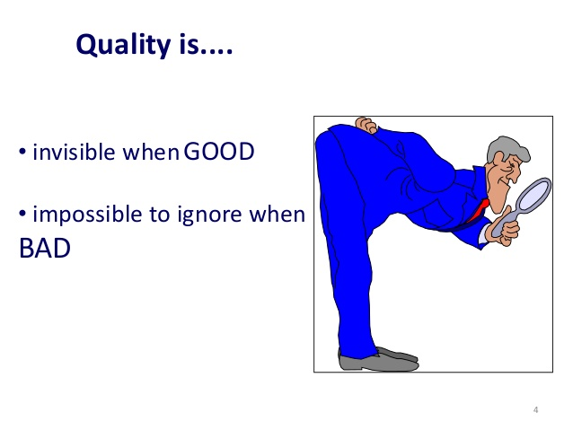

Slide 11
Continuous quality improvement or the performance improvement is required to improve the patient care.
Managing the errors effectively is the corner stone of continual improvement.
Emphasis is given not to make the mistakes at the first point.

Slide 12

TEAM WORK

Slide 13


