Slide 1
High-speed Communications using Multimode Fibres
Joseph John
Professor, Dept of Electrical Engg.,
IIT Bombay

Slide 2
Overview
Brief introduction to Optical Fibre communication
Single mode fibre (SMF) based FO links
Multimode fibre (MMF) based FO links
Short haul, high speed applications
Modern trends in MMF based communications
  Glass optical fibres (GOF)
  Plastic optical fibres (POF)

Slide 3
Introduction: Major milestones in Electrical Communication
1838 – Samuel F.B. Morse invented Telegraphy
1866 – first transatlantic telegraph cable
1876 – Alexander Graham Bell invented Telephone
1905 – Triode based Electronic amplifier
1940 – first coaxial-cable system (3 MHz – 3,000 voice channels or ONE television channel)
1948 – first microwave system (4 GHz)
1975 – the most advanced coaxial system with a bit rate of 274 Mb/s

Slide 4
Communication Systems of the 20th Century
Wire – Telegraphy (2 wires for telegraph transmission – simplex & duplex)
Wire – Telephony (2 wires for telephone transmission of 1 channel)
Carrier telephony (long-distance telephony for multiple channels – 4,8,16)
Coaxial cable systems (for 32 channel PCM systems – 32x64kb/s = 2.048 Mb/s)

Slide 5
Problems of Electrical Communication systems
Affected by EMI
Low bandwidth (4 kHz – telephone,
100-500 MHz per km – coaxial cable )
High attenuation (20 dB/km – typically)
High system cost
  due to too many repeaters for a given Bandwidth/ data rate
  Eg. 32 channel (2.048 Mbps) PCM link required one repeater every 2 km
Prone to tapping
Bulky

Slide 6
History of Optical Fibre Communications
1966 – suggestion to use optical fiber (Kao & Hockham)
1970 – Corning Glass optical fiber with 20 dB/km near 1 μm
1970 - Semiconductor Laser with CW operation at room temp.
1980 onwards – wide spread use of Optical Fiber Communication using SMF and MMF
1990 – used Optical amplification (for increased repeater spacing) and Wavelength-division multiplexing (WDM) for increased data rate.
  Resulted in a data rate of 10 Tb/s by 2001.

Slide 7
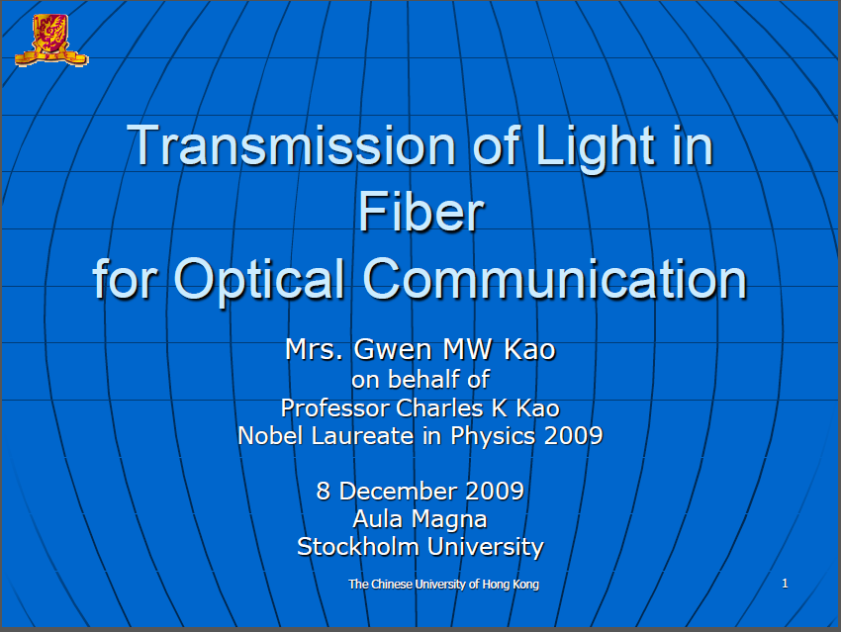
Source: Nobel Lecture, 2009, CK Kao, “Transmission of Light in Fiber for Optical Communication”

Slide 8
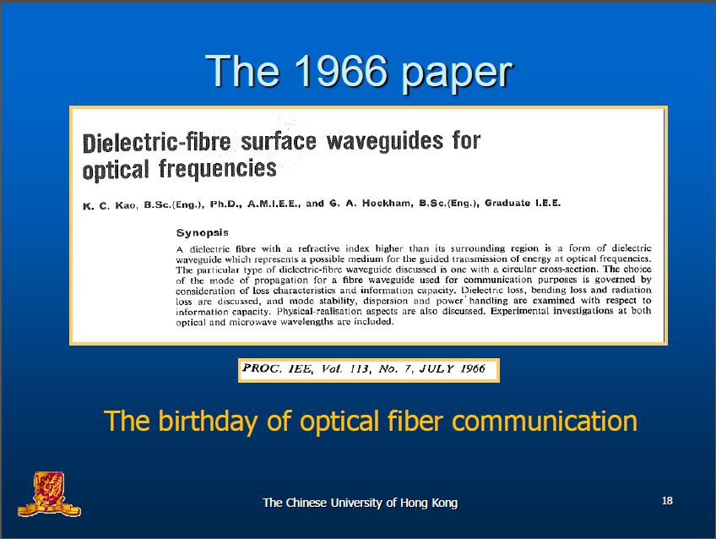
Source: Nobel Lecture, 2009, CK Kao, “Transmission of Light in Fiber for Optical Communication”

Slide 9
Advantages of Optical Fiber Communication (Fiber Optics)
Very high bandwidth (10 - 500 GHz, typ.)
Very low attenuation (lowest 0.16 dB/km)
Immune to EMI
Data security (almost impossible to tap information)
Lower system cost (fewer repeaters due to low attenuation of fibers)
Small size and low weight
Very low Bit Error Rate ( < 10⁻¹⁰ typically)

Slide 10
Basics of Optical Fibre Communication
An Optical Fiber Communication System consists of
Transmitter
  Optical source (LED or Laser diode) + driver circuit
Optical Fibre
  Single mode fibre, or
  Multimode fibre
Receiver
  Photodetector PIN or APD + receiver circuit

Slide 11
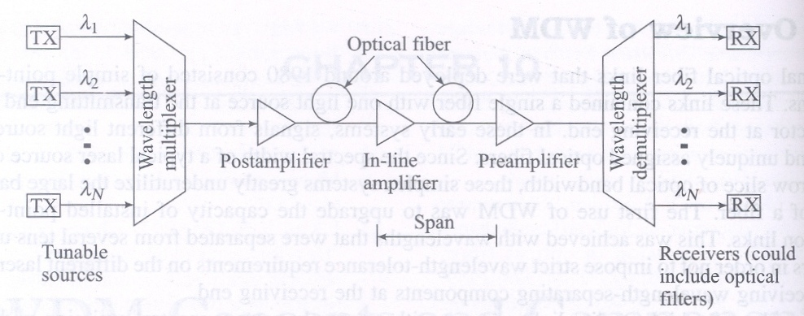
A Modern Optical Communication System for Telecom with WDM and Optical Amplifiers
Source: Gerd Keiser, Optical Fiber Communications, 4th ed., McGraw-Hill, 2008: Chapter 10.

Slide 12
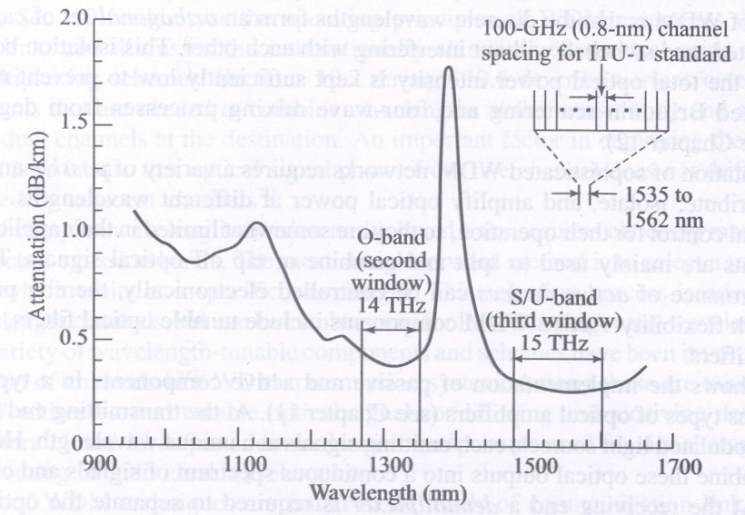
Transmission windows and bandwidths
Transmission-bandwidths in the O (1300nm)- and C(1550nm)-bands
Source: Gerd Keiser, Optical Fiber Communications, 4th ed., McGraw-Hill, 2008: Chapter 10.

Slide 13
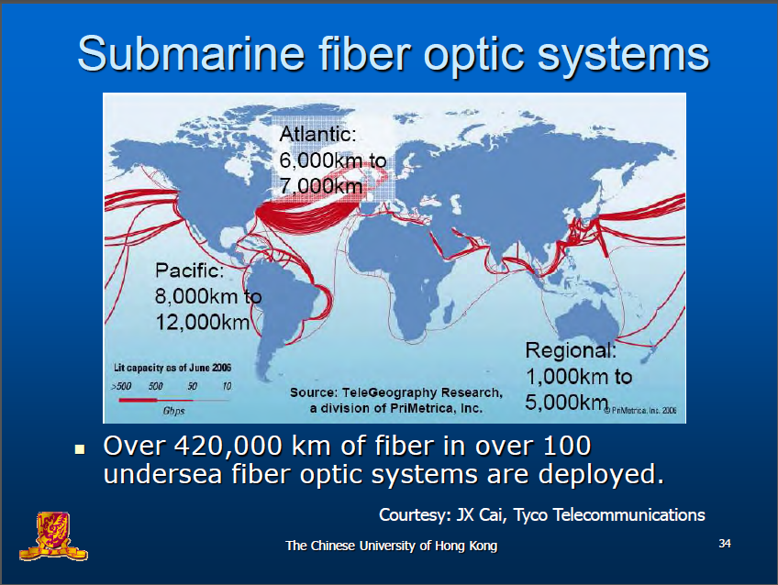
Source: Nobel Lecture, 2009, CK Kao, “Transmission of Light in Fiber for Optical Communication”

Slide 14
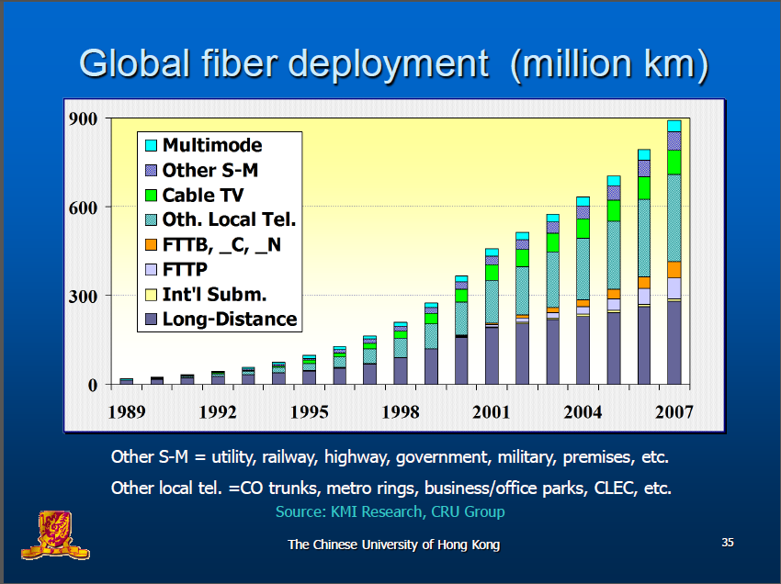
Source: Nobel Lecture, 2009, CK Kao, “Transmission of Light in Fiber for Optical Communication”

Slide 15
Fibre Optics
Telecom applications
  Primarily SMFs
Networking applications
  Mostly SMFs (FTTH)
Fibre optic Sensing
  SMF and MMF
Medical applications
  Mostly MMF, or bundle fibres (light pipes
Industrial applications
  Mostly MMF

Slide 16
SMF vs MMF
Single mode fibres – today’s work horse for long haul telecom as well as optical networks
Multimode fibres – not widely used for communications as single mode fibres. any advantages?

Slide 17
Capacity of Today’s SMF Links
Typically for one SMF
  40 Gb/s x (20 to 40) wavelengths - DWDM
  Repeater spacing, 200 km (with EDFA)
  Could be up to 1000 km with Raman amplifiers
One SMF cable can have
  24 to 144 SMFs
Most of the SMFs in a cable are left un used as spare
A major revolution waiting to happen to tap the huge unused bandwidth already available
  Optical networks – FTTH services yet to become widespread, esp in our country

Slide 18
Why MMF?
Easy to use and couple light
Large alignment tolerances ( typically a few µm) compared to SMF (sub µm)
Cost effective (cheaper tools, and connectors)
Lot of interest today for short-haul communications

Slide 19
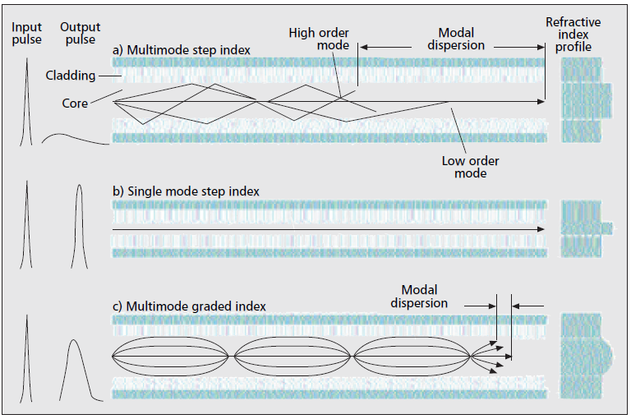
Fibre types – how do they differ?
Source: P.Polishuk, “Plastic Optical Fibers Branch Out”, IEEE Commn. Mag., Sep.2006, pp. 140-148.

Slide 20
MMF Types
Glass Optical Fibres (Graded-index)
  50/125 µm, 62.5/125 µm, 100/140 µm
Plastic Optical Fibres
  PMMA or PF
  Step index or Graded index
  A variety of dimensions

Slide 21
MMF – Glass (GOF)
Very extensively used for short haul (up to 10 km) high data rate (up to 10 Gb/s) links
The preferred choice for LAN applications (1300nm, 62.5/125 µm GI MMF)
Many other MMF experiments have been reported with much higher data rates

Slide 22
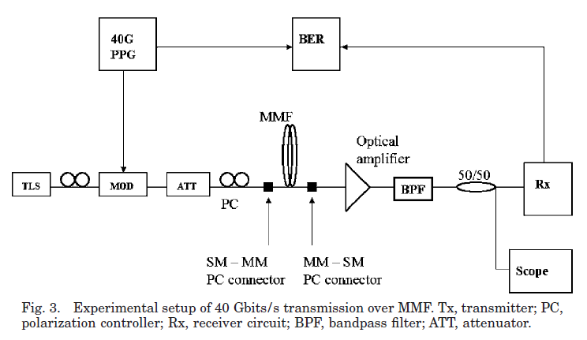
2007: 40 Gb/s, 3.4 km, BL product of 136 Gb/s km
Scott S-H. Yam1, and Frank Achten, Toward 100 Gbits/s Ethernet with broad wavelength window multimode fiber, J.Opt.Netw., Vol. 6, No. 5, pp.527-534, May 2007.

Slide 23
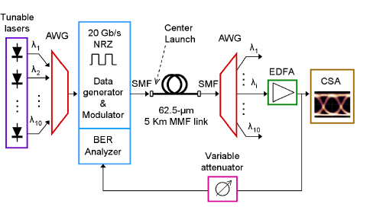
2008: 10x 20 Gb/s, 62.5/125 μm silica MMF, WDM using 10 DFB lasers.
I. Gasulla, J. Capmany, 1 Tb/s·km WDM Transmission over Multimode Fibre Link, ECOC, 2008, Paper Tu.3.E.5.

Slide 24
Use of MMFs with different bandwidth grades for 10 Gb/s
OM1 grade fiber
  62.5/125 µm; called legacy or original fiber that was designed for use with LEDs (larger core dia); typically up to 100 Mb/s
OM2 grade fiber
  50/125 µm; improved bandwidth over OM1; used for 1Gb/s (750m) or 10 Gb/s (82m)
OM3 grade fiber
  50/125 µm; higher bandwidth than OM2; can support 10Gb/s up to 300m; used with VCSELs
OM4 grade fiber
  50/125 µm; bandwidth much higher than OM3; can be used for both 1 Gb/s and 10 Gb/s with 850 nm VCSELs for distances up to 550 m; suitable for future 40 and 100 Gb/s

Slide 25
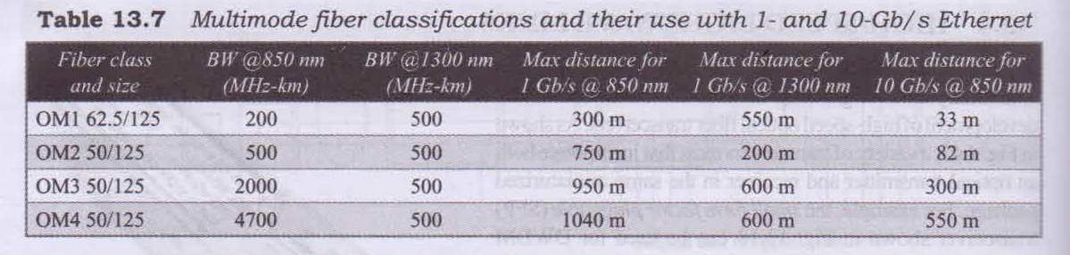
Source: Gerd Keiser, Optical Fiber Communications, 5e, Chap 13, McGraw Hill, New Delhi

Slide 26
MMF – Plastic (POF)
Emerging as a lower-cost alternative to glass fiber or copper at medium distances and bit rates of 10 Gb/s.
Manufacturers form POFs out of plastic materials such as polystyrene, polycarbonates, and polymethyl methacrylate (PMMA).
These materials have transmission windows in the visible range (520–780 nm).
The loss of light transmitted at these wavelengths is high, ranging from 150 dB/km for PMMA to 1000 dB/km for polystyrene and polycarbonates.

Slide 27
POF
Glass fibres have losses
  of 0.2 dB/km for a single-mode fiber and
  less than 3 dB/km for multimode fibers.
  Used extensively for long length applications
Plastic fibers have been relegated to short-distance applications, typically of a few hundred meters or less

Slide 28
Typical POF Applications
Data applications
  Industrial control
  automobiles,
  Home networks
  Short data links
Non-data applications
  sensors for detecting high energy particles
  Signs
  illumination,
Today, the surge in POF production and use stems from its use in data transmission.

Slide 29
Advantages of POF (over Glass Fibre or Copper Wire)
Simpler and less expensive components.
Lighter weight.
Operation in the visible spectrum.
Greater flexibility, and resilience to bending, shock, and vibration.
Immunity to electromagnetic interference (EMI).
Ease in handling and connecting (POF diameters are 1 mm compared with 8–100 μm for glass).
Use of simple and inexpensive test equipment.
Greater safety than glass fibers or fiber slivers;
glass requires a laser light source
Transceivers require less power than copper transceivers.

Slide 30
Disadvantages
High loss during transmission
Bandwidths lower than SMFs
A small number of providers of total systems
A lack of standards
A lack of awareness among users of how to install and design with POFs
Limited production, and Small number of systems and suppliers
Applications research is incomplete
Incomplete certification programs from POF installers
Lack of high temperature fibers (125°C)

Slide 31
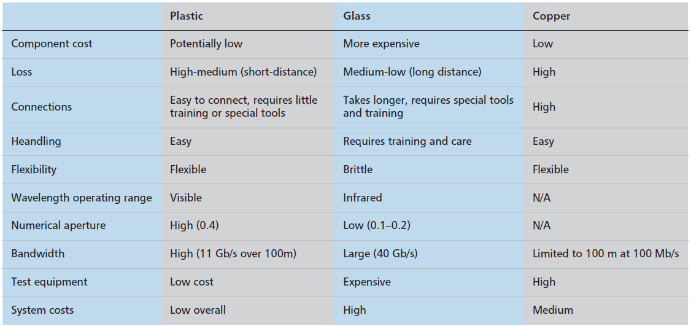
Source: P.Polishuk, “Plastic Optical Fibers Branch Out”, IEEE Commn. Mag., Sep.2006, pp. 140-148.

Slide 32
History of POF
POFs using poly methacrylates (PMMA) had their origin in the early 1960s
Losses in the 70s: 1000 dB/km
Late 80s: PMMA fibers to close to the theoretical limit of 150 dB/km at 650 nm.
  This was a step index fiber with a bandwidth of 50 Mb/s over 100 m.
1990: graded index POFs (GI-POFs) using PMMA material (Prof Koike - Keio Univ)
  bandwidth of 3 GHz-km with losses of 150 dB/km at 650 nm.
1995: Graded index – POFs using perfluorinated polymer 50 dB/km over a range of 650–1300 nm (theoretical limit 10 dB/km)

Slide 33
POF Data Link Developments
The first commercially available data link using graded index fiber
  by Fuji Photo Film in 2005.
  30 m DVI link operating at 1 Gb/s using a 780 nm VCSEL
  Used PMMA GI-POF
TWO major considerations in any data link
  Attenuation (loss spectrum)
  Bandwidth (pulse spread or dispersion)

Slide 34
Loss Curve for a PMMA Fibre
Three transmission windows
  530, 570, and 650 nm (all in the visible range).
The window at 650 nm is narrow, and hence could cause problems if a 650-nm source shifted with temperature.
The windows at 530 and 570 nm are broader, and thus less sensitive to shifts in source wavelength resulting from temperature changes.
Losses
  at 650 nm , 125 dB/km
  at 530 and 570 nm, less than 90 dB/km
PMMA plastic fiber based data links have lengths less than 100 m.

Slide 35
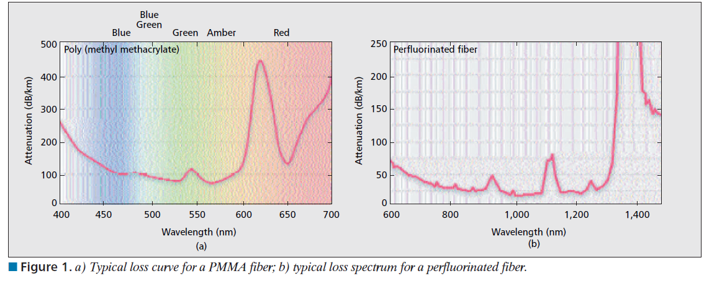
Source: P.Polishuk, “Plastic Optical Fibers Branch Out”, IEEE Commn. Mag., Sep.2006, pp. 140-148.

Slide 36
Loss Curve of Perfluorinated (PF)
Polymers
PF polymers exhibit greater transmission of light over a wider wavelength range
Two notable features of PF fibres compared with the loss spectrum of PMMA
  its spectrum ranges from 650 to 1300 nm;
  the loss is less than 50 dB/km over this wavelength range.
This reduction in loss allows fiber links of up to several hundred meters
Perfluorinated fiber overcomes the distance limitation of PMMA,
Can operate using the less expensive components developed for glass optical fibers at 850–1300 nm

Slide 37
Fibre Bandwidth
An optical fiber’s bandwidth can be thought of roughly as the highest number of pulses from a modulated light source that a receiver can detect.
Light pulses can suffer broadening (modal dispersion) because of the different paths that light rays can take as they move along the fiber.
There are two ways to characterize light transmission in a fiber:
  classical ray tracing, and
  the wave nature of light.

Slide 38
Fibre Bandwidth
Containment of light in a fiber results from the reflection of light at the core cladding interface.
Each ray is considered a mode.
Fiber bandwidth can be increased by reducing the number of modes or by changing the index of refraction profile.
Reducing the diameter of a fiber allows it to transmit only a few modes,
a single-mode fiber, has very small core diameter, and has zero modal dispersion, and hence the largest bandwidth.

Slide 39
POF Types
Most POFs have a uniform, or step, index of refraction that is the same across the width of the fiber,
  step index fibers have the lowest bandwidth among multimode fibers.
In a graded index fiber, the index of refraction is highest at the center of the fiber, and thus, its profile has a parabolic shape.
A graded-index fiber has a medium bandwidth.
Various types of POF can be manufactured with
  step index or graded index cores
  using PMMA or perfluorinated (PF) polymers

Slide 40
Light Sources for POF
LEDs
  light emitting diodes (LEDs) – edge emitting and surface emitting,
  resonant cavity LEDs (RCLEDs),
Laser diodes
  laser diodes, (Fabry-Perot and Distributed Feedback)
  vertical-cavity surface emitting laser diodes (VCSELs).
Source comparison for use with PMMA fibres shown in Table

Slide 41
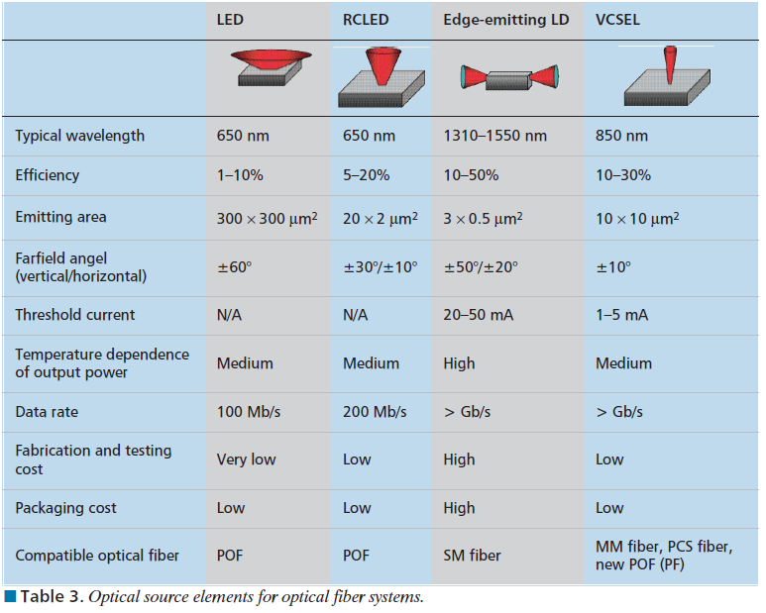
Source: P.Polishuk, “Plastic Optical Fibers Branch Out”, IEEE Commn. Mag., Sep.2006, pp. 140-148.

Slide 42
Typical Data rates with PMMA Fibres
The three transmission windows are 530, 570, and 650 nm.
LEDs,
  can be modulated at speeds of up to 250 Mb/s and
  laser diodes up to 4 Gb/s.
VCSELs at 650 nm are still in the development stage,
Resonant cavity sources
  can be modulated at speeds 600 Mb/s to 1.2 Gb/s

Slide 43
Typical Data rates with PF Fibres
Wavelength of operation: 650 to 1300 nm,
Can work with
  the light sources developed for 650 nm POFs and
  the 850 and 1300 nm laser diodes used with glass optical fibers,
Data rates up to 10 Gb/s.

Slide 44
POF over GOF
POFs have larger diameters (~1 mm) than glass fibers (8–100 μm),
POF connectors
  less complex,
  cost less, and
  less likely to suffer damage than connectors for glass optical fibers.
POF allows larger angular and lateral misalignments
POF connectors can be made from inexpensive plastics rather than the precision- machined stainless steel or ceramics that glass fibers require.

Slide 45
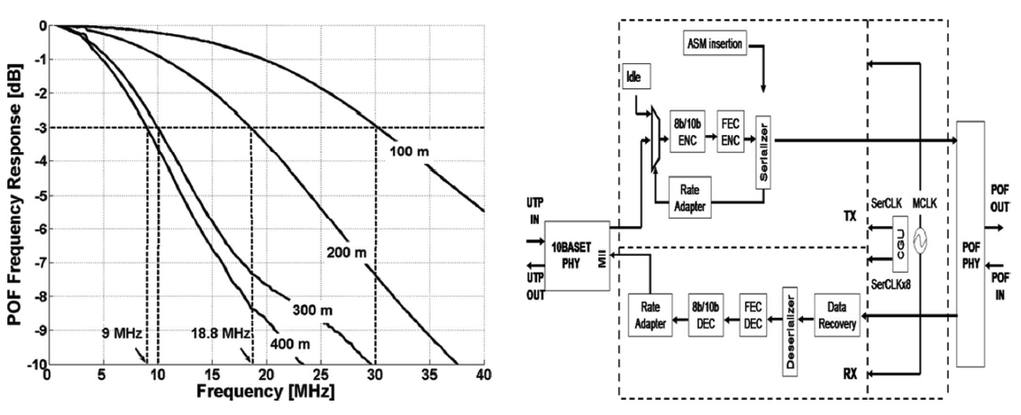
2006: 425 m, 10-Mb/s Ethernet/IEEE 802.3 data over a large-core (1 mm) step-index polymer optical fiber (SI-POF)
Daniel Cárdenas, et al., A Media Converter Prototype for 10-Mb/s Ethernet Transmission Over 425 m of Large-Core Step-Index Polymer Optical Fiber, J. Lightw. Technol., vol. 24, no. 12, pp. 2923–4951, Dec. 2006.

Slide 46
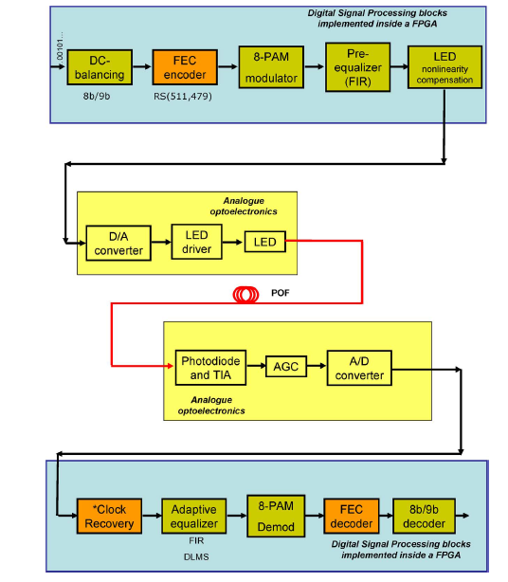
2010: 300 m, 100 Mb/s , 8-PAM, Green 520 nm, 1 mm SI-POF, PIN photodiode
8B-9B Line coding/decoding
FEC Encoder and decoder
8-PAM
Pre-equalizer and adaptive post equalizer
A.Nespola, et al., High-Speed Communications Over Polymer Optical Fibers for In-Building Cabling and Home Networking, IEEE Photonics Journal, Vol.2, No.3, pp.347-358, June 2010.

Slide 47
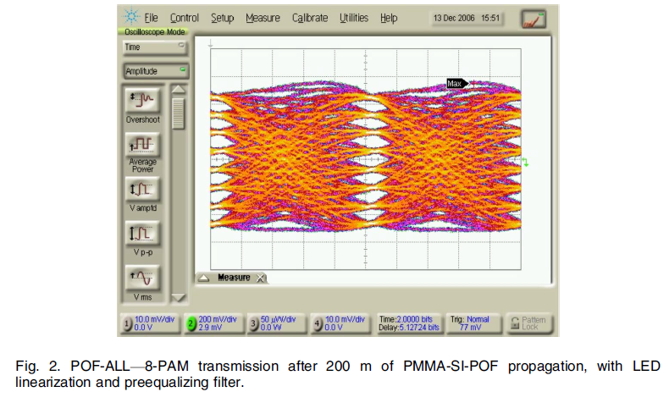
A.Nespola, et al., High-Speed Communications Over Polymer Optical Fibers for In-Building Cabling and Home Networking, IEEE Photonics Journal, Vol.2, No.3, pp.347-358, June 2010.

Slide 48
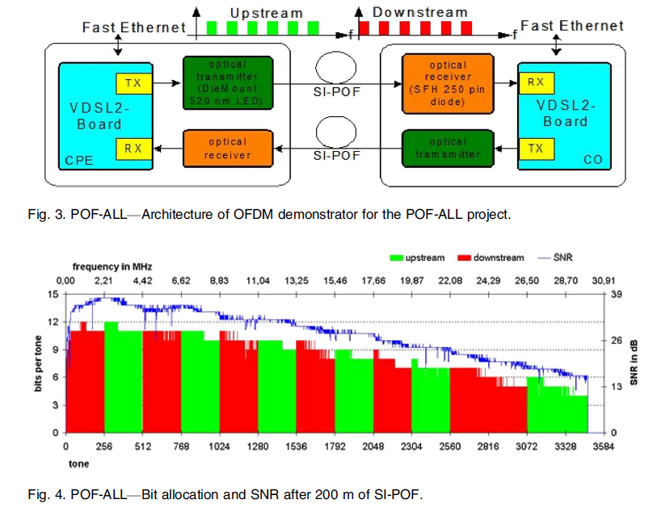
2010: 200m, 200 Mbps, 1 mm SI-POF, PIN photodiode
Discrete Multitone (OFDM) approach
A.Nespola, et al., High-Speed Communications Over Polymer Optical Fibers for In-Building Cabling and Home Networking, IEEE Photonics Journal, Vol.2, No.3, pp.347-358, June 2010.

Slide 49
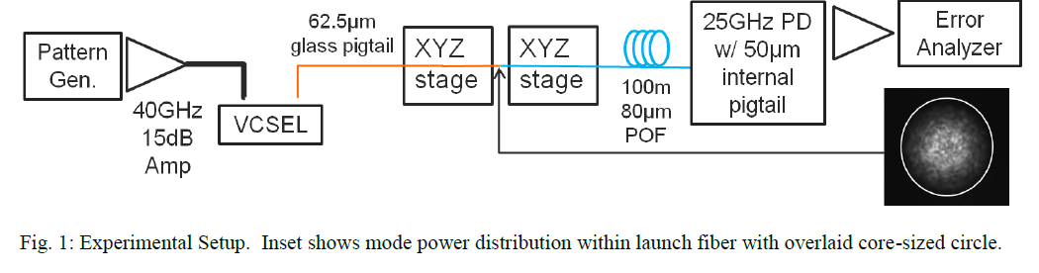
2011: 100m, 25 Gbps, 80 µm GI-POF, 850 nm VCSELPIN photodiode
Directly modulated
Good launch offset tolerance
C. C. Caputo, et al. VCSEL-based 100m 25Gb/s Plastic Optical Fiber Links, OSA/OFC 2011, Paper OWB2.

Slide 50
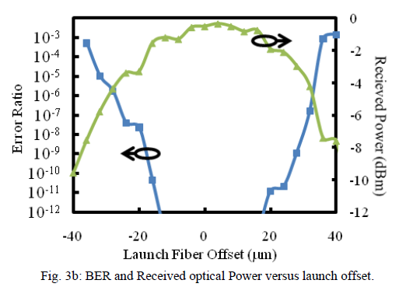
C. C. Caputo, et al. VCSEL-based 100m 25Gb/s Plastic Optical Fiber Links, OSA/OFC 2011, Paper OWB2.

Slide 51
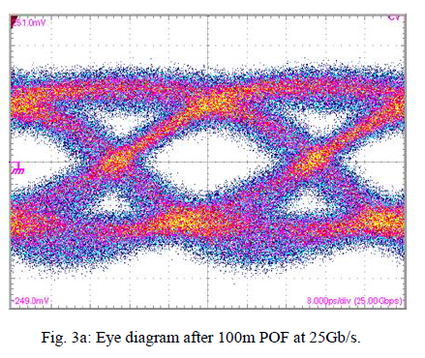
C. C. Caputo, et al. VCSEL-based 100m 25Gb/s Plastic Optical Fiber Links, OSA/OFC 2011, Paper OWB2.

Slide 52
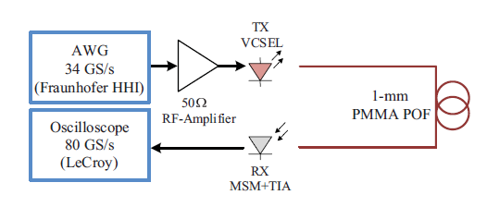
2013: 1mm PMMA POF, 1 to 10m, 42 – 36 Gb/s
4-PAM
400 µm GaAs MSM photodetector
4-PAM preferred over DMT
S Loquai, et al. 42-Gb/s Transmission Over Large-Core 1-mm PMMA Graded-Index Polymer Optical Fiber, IEEE Phot. Tech. Lett., Vol. 25, N0. 6, pp. 602-605, March 2013.

Slide 53
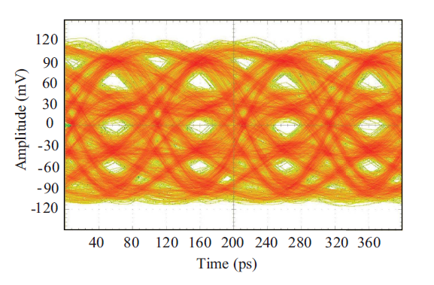
S Loquai, et al. 42-Gb/s Transmission Over Large-Core 1-mm PMMA Graded-Index Polymer Optical Fiber, IEEE Phot. Tech. Lett., Vol. 25, N0. 6, pp. 602-605, March 2013.

Slide 54
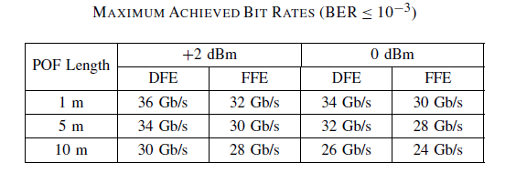
S Loquai, et al. 42-Gb/s Transmission Over Large-Core 1-mm PMMA Graded-Index Polymer Optical Fiber, IEEE Phot. Tech. Lett., Vol. 25, N0. 6, pp. 602-605, March 2013.

Slide 55
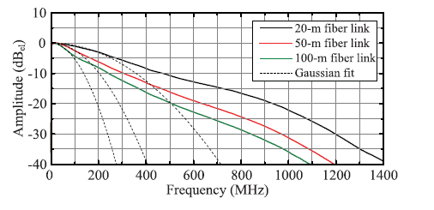
Normalized frequency response of the POF link
R Kruglov, et al., Comparison of PAM and CAP Modulation Schemes for Data Transmission Over SI-POFIEEE Phot. Tech. Lett., Vol.25, No.23, pp. 2293-2296, Dec 2013

Slide 56
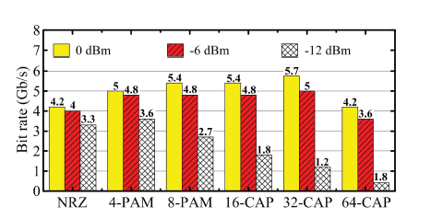
Maximal bit rates at BER of 10−3 achieved over 20-m fiber link and measured at different levels of the fiber-coupled power.
R Kruglov, et al., Comparison of PAM and CAP Modulation Schemes for Data Transmission Over SI-POFIEEE Phot. Tech. Lett., Vol.25, No.23, pp. 2293-2296, Dec 2013

Slide 57
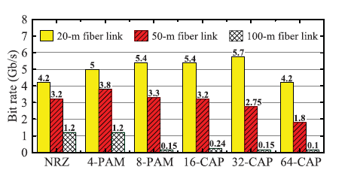
Maximal bit rates at BER of 10−3 achieved over the fiber link with a constant fiber-coupled power of 0 dBm.
R Kruglov, et al., Comparison of PAM and CAP Modulation Schemes for Data Transmission Over SI-POFIEEE Phot. Tech. Lett., Vol.25, No.23, pp. 2293-2296, Dec 2013

Slide 58
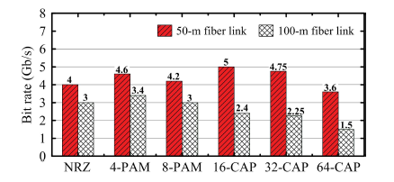
Maximal bit rates at BER of 10−3 achieved over the fiber link with a constant fiber-coupled power of +6 dBm.
R Kruglov, et al., Comparison of PAM and CAP Modulation Schemes for Data Transmission Over SI-POFIEEE Phot. Tech. Lett., Vol.25, No.23, pp. 2293-2296, Dec 2013

Slide 59
Thank you

