Slide 1
Role of Experiments in the Progress of Science: Lessons from our History D. P. Roy Homi Bhabha Centre for Science Education (TIFR)
I shall discuss the history of Indian Astronomy, Ayurveda, Chemistry and Metallurgy to illustrate how downgrading experiments from scientific learning lead to the decline of ancient Indian science and civilization.

Slide 2
In his address as the Sectional President in Physics and Mathematics of the Indian national Science Congress (1926) Meghnad Saha quoted the following lines from a 9th century Sanskrit text on Chemistry, called ‘Rasendra Chintamani’ by Dhunduknath, brought to his notice by his teacher P. C. Ray:
I have heard much from the lips of savants, I have seen many formulae well-established in scriptures, but I am not recording any which I have not done myself. I am fearlessly recording only those that I have carried out before my elders with my own hand. Only they are to be regarded as real teachers who can show by experiments what they teach. They are the deserving pupils who can actually perform them after having learned from their teachers. The rest are merely stage actors.

Slide 3
Indian Chemistry after the 9th Century: P. C. Ray (History of Chemistry in Ancient & Medieval India)
Indian chemistry continued to develop for a few centuries after this mainly as the empirical science of alchemy.
Alchemy was practiced by men regardless of caste, but shunned by Brahmins.
There were many pioneers in alchemy; and an outstanding figure named Nagarjuna has been respectfully referred in Al Beruni’s India of early 11th century to have lived a century earlier. (But there are several Nagarjunas in history?)
Alchemy was taught in Nalanda , Vikramshila & Udantapura monasteries till their destruction around 1200 AD.
After this the alchemists fled to Tibet and Deccan.
P. C. Ray traces back the development of chemistry in India to this subaltern culture of alchemy.

Slide 4
Review of the Indian calendar Reforms Committee under M. N. Saha on the three periods of ancient Indian Astronomy: Vedic(->1300BC), Vedanga(1300BC-400AD), Siddhanta(400-900AD)
During the Vedanga period emphasis had shifted from collecting observed data to achieving more computational precision. The Sakas and Kusanas brought the contemporaneous knowledge of Astronomy from Bactria to north-west India. This latest exposure initiated the great spurt of activities in the Siddhanta era. Surya Siddhanta is assigned to 3rd century AD, followed by blazing luminaries: Aryabhatta & Varahamihira (500 AD), Brahmagupta & Bhaskara I (600 AD). Aryabhatta authored Aryabhatiya and a revised version of Surya Siddhanta. He also had a profound influence on the development of Islamic Astronomy. So there was a two-way interaction with other civilizations.

Slide 5
Scientific Influence from other Civilizations (Wikipedia)
The Yavanajataka was translated from Greek to Sanskrit by Yavanesvara during 2nd century AD under Saka king Rudradaman. His capital Ujjain was the “Greenwich of Indian Astronomy”.
Later in the 6th century, Romaka Siddhanta and Paulisa Siddhanta were 2 of the 5 main treatises of Varahamihira called Pancha-Siddhanta.
He wrote “The Greeks, though impure, must be honoured since they were trained in sciences and therein excelled others”. Gargi-Samhita says “The Yavanas are barbarians, yet the science of Astronomy originated with them and for this they must be revered like Gods”.

Slide 6
Scientific Influence on other Civilizations (Wikipedia)
∙ Indian Astronomy reached China with the expansion of Buddhism during Han dynasty (25-220 AD). Further translation of Indian works on Astronomy was completed in China during the Three Kingdoms era (220-265 AD). However, most detailed incorporation of Indian Astronomy occurred only during the Tang dynasty (618-907 AD).
Arabs adopted the sine function (inherited from Indian mathematics) instead of chords of arc used in Hellenistic mathematics. Another Indian influence was an approximate formula used for timekeeping by Muslim astronomers. Indian Astronomy had an influence on European Astronomy via Arabic translations.

Slide 7
Decline of Siddhanta Astronomy after 900 AD: Bhaskara II (12th cent.), Kerala School (15-16th cent), Samanta Chandra Sekhar (19th cent.)
The last exponent of Siddhanta Astronomy, Samata Chandra Sekhar, lived in Orissa from 1835 to 1904. He constructed his own instruments, acquired great skill in using them for accurate observations of sun, moon, planets and stars. When he found by repeated observations that the measured positions in most cases do not agree with results computed using the famous Siddhantas, he boldly concluded that the latter are in error, not his experimental determinations. He wrote his findings in Siddhanta Darpana on palm leaves in Sanskrit using Oriya script. Prof. J. C. Ray of Ravenshaw College, Cuttack, arranged to publish it in Devanagari script through a Calcutta press thirty years later, in 1899.
– Prof. M. K. Pal

Slide 8
Determination of the 4 Cardinal Points (Wikipedia): Summer and Winter Solstice (Makar Samkranti), Autumn and Vernal Equinox (Vishuv Samkranti).
The simplest device used in astronomy was Gnomon, called Sanku, in which the direction and length of the shadow of a vertical rod were measured to find the cardinal directions, the latitude and time.
In the tropical region, the 2 days of the longest midday shadows along north and south mark winter and summer solstices respectively.
The 2 midpoints of the summer and winter solstices mark the 2 equinoxes.
At the time of this calibration around 500 AD, the Helial (Sun synchronous) rising of the constellation Capricorn (Makar) corresponded to winter solstice day (Makar Samkranti).
But precession of earth’s rotation axis has resulted in a 23 days gap between these terrestrial and celestial markers over the past 1500 years!
This is a glaring example of how blind following of text without experimental recalibration leads to wrong solstice and equinox times.

Slide 9
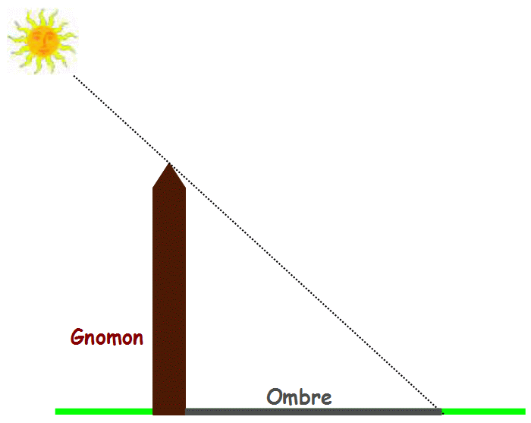
Minimum shadow length marks mid-day.
Largest mid-day shadow length along north (south) marks winter (summer) Solstice.

Slide 10
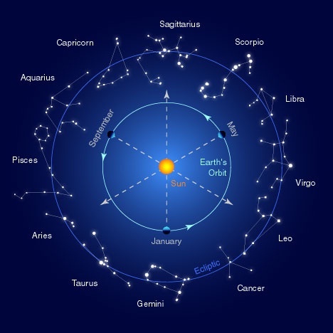
Mayank Vahia
DNA, 9 March 2014

Slide 11
Non-recording of purely Empirical Phenomena in Indian Astronomical Texts
The Chinese have kept data of meteoric showers, 29 appearances of Halley’s comet, 90 novae and supernovae and intense sun spot activities.
Yet there is no Indian record of these purely empirical phenomena.
In particular the spectacular Crab supernova explosion of 11th century appeared as the 2nd brightest object of night sky after the moon for several weeks. It is recorded by Chinese, Arab and even Mayan astronomers of Mexico.
Yet there is no credible evidence of Indian astronomical record of this event, presumably because it was not amenable to any theoretical explanation at that time.

Slide 12
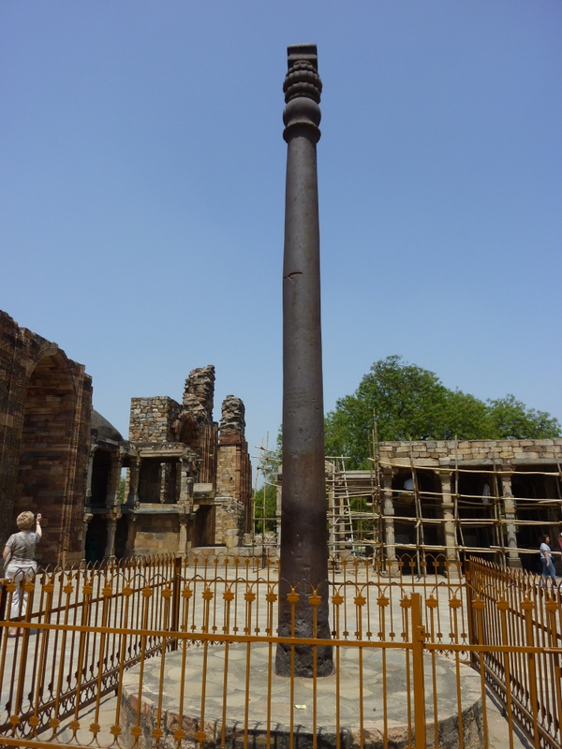
Ancient Indian Metallurgy - Wikipedia
India was a major exporter of Ferrous metals throughout ancient History.
Iron Pillars of Delhi/Vidisha (400 AD), and Dhar (1000 AD) stand living testimony to the skills of
ancient Indian metallurgists.
The Delhi pillar is 7 m high and weighs 6.5
tons. It is 98% pure Iron with a high
Phosphorous content to make it rust-free.
No other country had the capability
to produce an iron mass of this size and
purity till the Industrial Revolution of 18th
century.
Production of steel by carbonization of iron originated in Deccan around 600 BC and globally exported throughout this period.

Slide 13
Metallurgy after 1000 AD B. Prakash : Ind. J. of History of Science (2011)
Ghaznavid & Ghorian invasions during 11th-12th centuries destroyed the Indian iron industry and took away many thousands of skilled metal workers as slaves to bolster their own armament production.
During the Mughal period, however, a subaltern culture of iron metallurgy was revived for large scale production of armaments and construction of very large cannons.
Deccan steel export to the Arab countries for making quality armaments (famous Damascus swords) continued.
Both of these declined towards the end of 17th century.
Indian metal industry died following the BI Govt. policy of shipping iron ore to British iron mills at the cost of the Indian foundries.

Slide 14
Aurvedic Biology – M. S. Valiathan
The Samhita phase from 1st to 8th century AD is generally regarded as the golden age of Ayurveda.
It had three major texts called the Brihadtrayi.
Caraka Samhita (1st cent.) is a redaction by Caraka of a treatise composed by Agnives several centuries earlier.
Susruta Samhita (2nd -3rd cent.) is a redaction by Nagarjuna of the surgical treatise of Susruta, who is said to have lived around 700 BC!
Astanga Samgraha & Astanga Hrdaya (8th-9th cent.) are composed by Vagbhata.

Slide 15
Charaka Samhita (1st century AD)
Caraka’s redaction was so highly creative that the new text was acclaimed as Caraka Samhita.
Here Ayurveda got its name for the first time, and it moved from a faith-based to a reason based platform.
It was encyclopedic in the coverage of medicines, and recognized as the last word in internal medicine.
It was translated into Persian, Arabic and Tibetan within 2-3 centuries and spread its influence to central Asia, where Bower Manuscript of 400 AD with numerous quotes from Caraka was discovered in 1890.
It was translated into English in 19th century.
Its popularity continues in the 21st century, when a digital version was prepared by Prof. Yamashita of Kyoto Univ.

Slide 16
Susruta Samhita (3rd - 4th century AD)
Susruta’s name is forever associated with Rhinoplasty (nose repair), the only surgical procedure from India to have won global recognition in 3 millennia!
Susruta Samhita is a comprehensive medical treatise with heavy surgical orientation, dealing with surgical procedures, instruments, care of trauma, medications etc.
Compared to Caraka Samhita it has simpler language and lower emphasis on the philosophical dimensions of medical practice.
Susruta Samhita enjoyed great authority even beyond Indian borders because it was translated into Arabic under the Caliphate, when Indian physicians were believed to have lived in Baghdad.

Slide 17
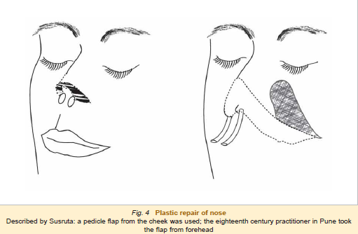

Slide 18
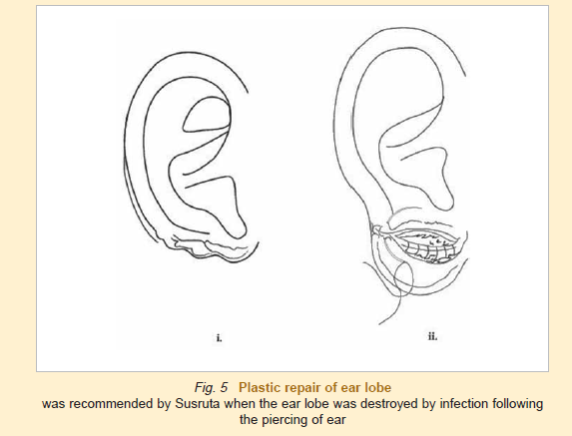

Slide 19
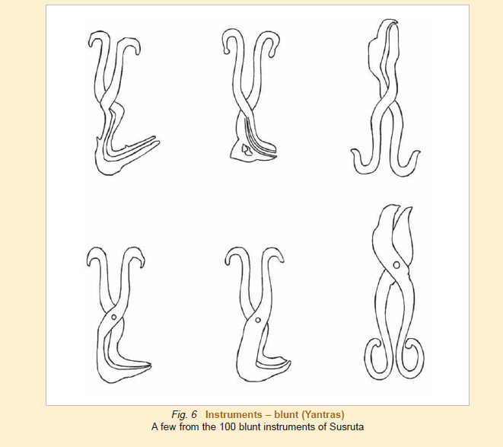

Slide 20
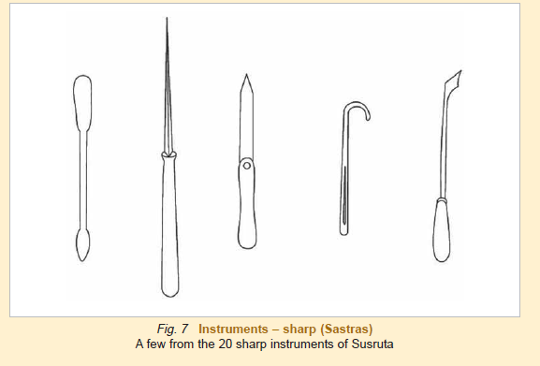

Slide 21
Susruta and Carak Samhitas (cont.)
There is little doubt that the Susruta and Carak Samhitas were taught at Nalanda; and the large number of students from Tibet, China and other countries of East Asia would have carried home their copies and translations.
Transfer of knowledge was also facilitated by Indian teachers accompanying these home-bound disciples.
Even today several texts in medicine, philosophy etc, which are no longer available in the Sanskrit original, are available in their Chinese and Tibetan translations.
What the barbarians destroyed in India had a resurrection in other countries. ( Destruction of Nalanda, Vikramshila and Udantapura by Bakhtiar Khilzi in 1200 AD)

Slide 22
Astanga Samgraha & Astanga Hrdaya (Vagbhata)
Acharya P. C. Ray estimated the date of composition of these texts to be 8th – 9th century, when Ayurveda was on the threshold of Stagnation.
The texts accepts the authority of Caraka and Susruta in no uncertain terms and present their teachings in a simple and abridged manner for average students.
Astanga Hrdaya accomplished this objective admirably and became a popular favourite , thanks to the gift of poetic excellence that no other text could claim.
After Vagbhata, the springs of creativity ran dry and a long phase of stagnation ensued for a thousand years in the history of Ayurveda.

Slide 23
Stagnant Phase of Ayurveda (10th cent. ->)
There were no more Carakas and Susrutas, nor the advent of power-houses of learning like Nalanda in this phase.
Muslim rulers preferred Unani over Ayurveda.
But the malady had roots deeper in the social history of India, because the surgical techniques of Susruta had more or less disappeared from the mainstream of Ayurveda already by the time of Vagbhata.
Cadaveric dissections was no more mentioned; and the training of disciples did not include exercises on cucumber, jackfruit, animal skin etc for learning incision, extraction, scraping and other surgical procedures.
So Muslim conquest of India and destruction of Nalanda in 1200 AD were not the causes but the consequences of the decline of Indian science and civilization.

Slide 24
Alberuni’s India (1000 AD)
The Hindus believe that there is no country but theirs, no nation like theirs, no king like theirs, no religion like theirs, no science like theirs.
They are haughty, foolishly vain, self-conceited, and stolid.
They are by nature niggardly in communicating that which they know, and they take the greatest possible care to withhold it from men of another caste among their own people, still much more, of course, from any foreigner.
Their haughtiness is such that, if you tell them of any science or scholar in Khorasan or Persia, they will think you to be both an ignoramus and a liar.
If they traveled and mixed with other nations, they would soon change their mind, for their ancestors were not as narrow-mined as the present generation is.

Slide 25
Subculture of Surgical Skills in Lower castes Valiathan
The surgical procedure that disappeared from the main stream surfaced however among castes, which were low in the social hierarchy.
Susruta’s nose repair is an interesting example.
Barring a perfunctory reference, it received no serious attention in the Aurvedic texts; nor was it performed by reputed Vaidyas.
Its survival was “discovered” accidentally by British observers in Pune towards the end of 18th century.

Slide 26
Pune nose repair episode
Dr. Scott, a sympathetic British doctor residing in Mumbai, had heard from one Capt. Irvine in 1793 about the practice among “gentoos of putting new noses on people who have had them cut off”!
He assured Dr. Scott that all the employees of the East India Company in Pune were witnesses to the operation which gave the man a “pretty good nose”.
Dr. Scott wrote to Mr. Findlay, the company surgeon in Pune, to ascertain the veracity of this report because such an operation was unknown in Europe.
Mr. Findley sent a detailed report on the basis of eyewitness observation by himself and Mr. Cruso on 1st January 1794.

Slide 27
The report described how a “koomar” caste man had borrowed an old razor for the occasion, dissected a flap from the forehead of the patient with much composure, freshened the edges of the nasal defect and applied the flap thereon by rotation with a cement “without the aid of stitches, sticking plaster or bandages”. The flap healed and “an adhesion has taken place seemingly in every part”.
It was a report of this procedure, published in the “Gentleman’s Magazine” of London in 1794, which caught the attention of a surgeon, Dr. J. C. Carpue, FRS.
He performed the operation for the 1st time in the West and published a full length paper on “An account of two successful operations for restoring a lost nose from the integuments of the forehead” in 1816 (H. Scott, Bombay, India Office Library, London).

Slide 28
Other Surgical Skills
A similar eyewitness report on Susruta’s couching for cataract was given by Dr. Ekambaram of Coimbatore in 1910. He found that the procedure was done by itinerant Mohammedan vaidyas who followed the steps of Susruta’s method.
Note that the procedure in Pune and Coimbatore were done not by Ayurvedic physicians but by illiterate men, who had learned the techniques from an earlier generation.
Treatment of fracture by bonesetters, child delivery by dais and many other procedures involving “dirtying of hand” were relegated to lower caste persons, who did not understand their anatomical basis or rationale.
It was as if the nation’s brain was decoupled from its hand, which ensured that there could never be innovation based on true understanding.

Slide 29
Subculture of Metallurgical Skills in Lower Castes Dharampal: Indian Science & Technology in the 18th Century
On the request of the Govt. of Bengal in 1828, James Franklin FRS, made a thorough study of the ore, charcoal and furnaces used by the natives of Central India for making iron.
He wrote “ the smelting furnaces, though crude in appearance, are never the less very exact in the interior proportions, and it has often surprised me to see men who are unquestionably ignorant of their principle, construct them with such precision”.
He went on to describe in detail the geometrical and practical construction of the furnace, the construction and use of bellows, construction of two refineries for each furnace, mode of smelting and refining etc.

Slide 30
On getting the product evaluated at the Sagar mint he wrote ”the bar iron was of the most excellent quality, possessing all the desirable properties of malleability, ductility at different temperatures and of tenacity of which I think it cannot be surpassed by the best Swedish iron”.
Though the workmen could not answer Franklin’s questions or explain the procedures used for hundreds of years by their forefathers, he commented that the “original plan of this singular furnace must have been the work of advanced intelligence”.
Actually this was the relic of a civilization that had produced the iron pillars of Delhi/Vidisha in 400AD and Dhar in 1000 AD.

Slide 31
Reflections of Valiathan
The workmen doing nose repair in Pune, cataract couching in Coimbatore and ore smelting in Jabalpur were condemned to illiteracy, low social status, poor self-esteem and little hope of self advancement.
Since this grim prospect claimed hundreds of thousands of citizens, who used their hands to make a living, ruin could be the only destination of their nation.

Slide 32
Reflections of P. C. Ray (History of Chemistry in ancient and medieval India)
According to Susruta, the dissection of the dead bodies is indispensible to the students of surgery, and this high authority lays particular stress on knowledge gained from experiments and observations. But Manu would have none of it. According to Manu, the very touch of corpse is enough to contaminate the sacred person of a Brahmin. Thus we find shortly after Vagbhata, the handling of a lancet was discouraged and anatomy and surgery fell to disuse. They became for all practical purposes, lost sciences for the Hindus. It was considered equally undignified to sweat away at the metal furnaces.

Slide 33
The sciences being thus relegated to the lower castes, and the professions made hereditary, a certain degree of fineness, delicacy and deftness in manipulation was no doubt secured. But this was accomplished at a terrible cost. The intellectual portion of the community being thus withdrawn from active participation in these sciences, the how and why of phenomenon – the coordination of cause and effect – were lost sight of. The spirit of enquiry gradually died out among the nation (naturally prone to speculation and metaphysical subtleties), and India for once bade adieu to experimental and inductive sciences. Her soil was made morally unfit for the birth of a Boyle, a Descartes, or a Newton; and her very name was expunged from the map of the scientific world for a time.
Under these circumstances, India’s rout at the East-West encounter of the 18th century was a foregone conclusion.

