Slide 1
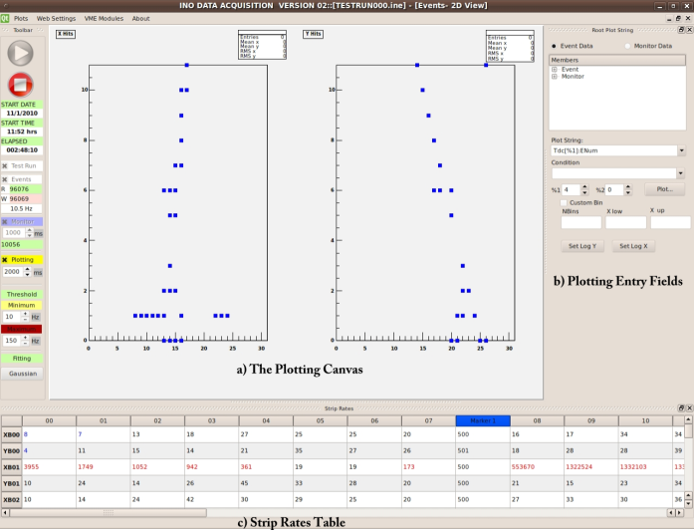
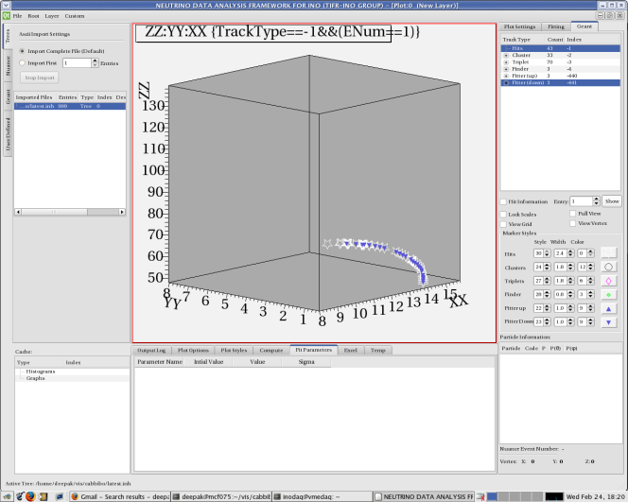
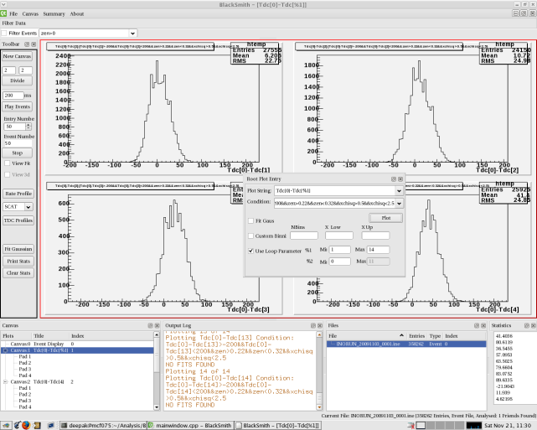
Design and Development of Software Tools
An experience from the TIFR-INO team
Deepak Samuel

Slide 2
INO-ASET Series
Overview and status of INO and ICAL: N.K.Mondal
Mechanical structure of ICAL detector: Piyush Verma
Magnet design: Vivek Datar
Gas systems for the ICAL detector: Suresh Kalmani
DAQ system for the ICAL prototype: Suresha Upadhya
Generator, simulations and reconstruction: Gobinda Mujumder
Today’s Talk: Deepak Samuel
VLSI and ASIC designs: V.B.Chandratre
DAQ system for the ICAL detector: B.Satyanarayana
Web utilities and on-line tools: P.Nagaraj

Slide 3
“Each one of us adds a little to our understanding of nature and from all the facts assembled arises a certain grandeur”
-Aristotle

Slide 4
Overview
Introduction to INO
Role of Software in HEP
Software Design Philosophy in INO
Applications for INO

Slide 5
Main Objectives of INO
Reconfirm Neutrino Oscillations
Sign of δ₃₂
Dirac or
Majorana ?
Long Base-line
Neutrino Detector
Template for Future Experiments

Slide 6
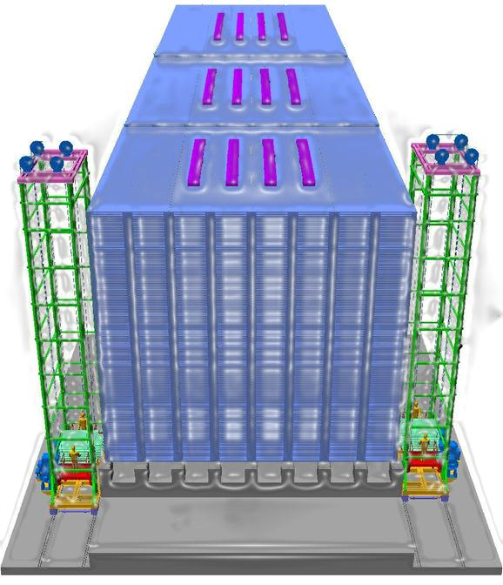
INO-ICAL
28,000 RPC’s
50 k ton Iron
1.3 Tesla Magnetic Field
3.6 Million Channels

Slide 7
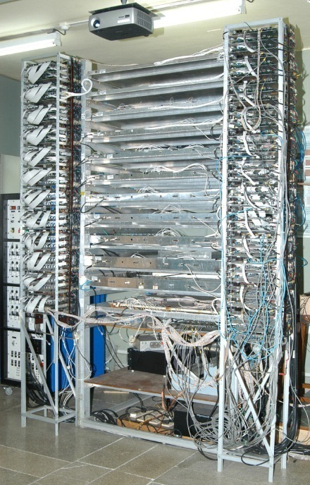
Prototype Stack at TIFR
12 Layers
1m x 1m RPC’s
32 Strips/Plane
No Iron Layers

Slide 8
Role of Software in HEP
Experiment
Simulation
Data Acquisition
Analysis, Graphing
Hardware Control, Monitoring

Slide 9
Software used in HEP
GEANT
Simulation Package
MATLAB
OPENSCIENTIST
ROOT
Data Analysis Framework
Data Analysis Framework
Graphical programming environment
LABVIEW
Numerical/Symbolic computing environment

Slide 10
Design Philosophy
Latest Technologies
Portability of Codes across platforms
Simplicity of Coding/Debugging
Simplicity of Use
All complexities invisible to the user
Always Scope for Improvement
Comments/ Documentation

Slide 11
Basic Elements of INO Software
Programming Language
C, C++, Java?
Graphing/Analysis
Integrated Plotting and Analysis
Data Structure
OS independent, universal
Graphical User Interface
Simplicity of Use
C++
ROOT
QT

Slide 12
ROOT
Statistical and Graphing Package
Freely available in CERN’s website
C++
Widely used in HEP
C++ interpreter CINT
Well documented
User Support available

Slide 13
Graphing
ROOT Canvases (TCanvas Class)
Graphing/Analysis easier if native data structures used (root files)
Easily available fitting menus, Analysis tools
supports histograms, 2D, 3D graphs.

Slide 14
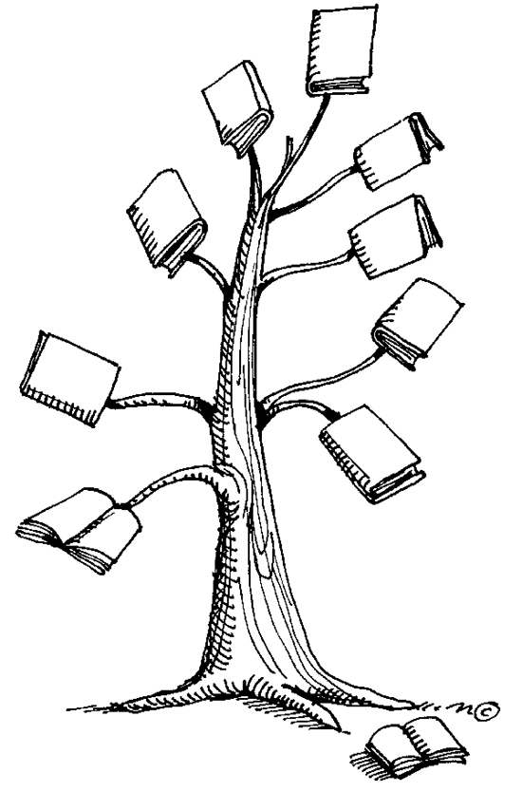
Data Structure
Usual scenario: Storage of large quantities of same type of Structures.
Pz
Vertex
Py
Reaction
Px
E
Time
Particle Type
Event Number
EVENT TREE

Slide 15
ROOT’s TTree Class
Key to an integrated Graphing and Analysis framework
Offers good compression (up to factor 10)
Optimized data access:
Example compute E²-P²

Slide 16
Optimized Data Access with TTree
Without TTrees
With TTrees
Read Entire Event n
Extract E, Px, Py, Pz
Compute
Read Branches E,Px,Py,Pz only, from Event n
Compute

Slide 17
Plotting/Analysis with TTree
Just need the branch name
Histogram : Tree->Draw(“E”)
Graphs: Tree->Draw(E: (px²+py²+pz²))
Conditional Plotting:
Tree->Draw(“E”,”EventNumber>25”)

Slide 18
Additional Features
Friends
For example- Comparison of results from two different algorithms
Storing a selection
Cuts

Slide 19

Software Development Tool
Cross-platform application and UI framework
Intuitive C++ class library
Integrated Development Tools
Available for Linux, Windows & Mac
FREE!!!

Slide 20
Graphical User Interface
Designed using Qt Designer

Slide 21
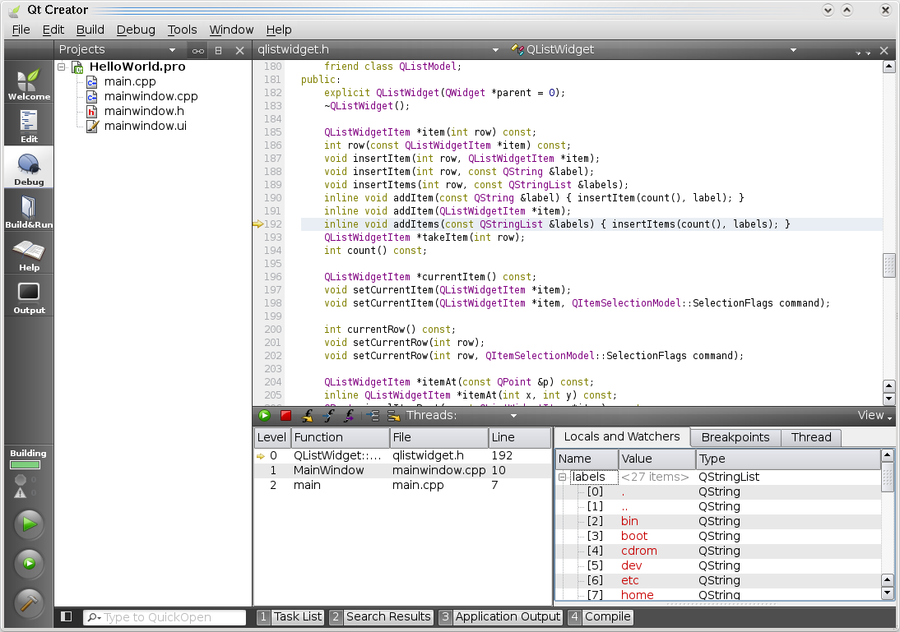
Integrated Development Tool

Slide 22
Integrating ROOT and QT – QTROOT Plugin
Need to embed ROOT canvas into our GUI
A complete plotting and analysis environment inside our applications
QtROOT developed by BNL
Still in its nascent stage
TIFR- one of first few groups to use it for a large scale experiment

Slide 23
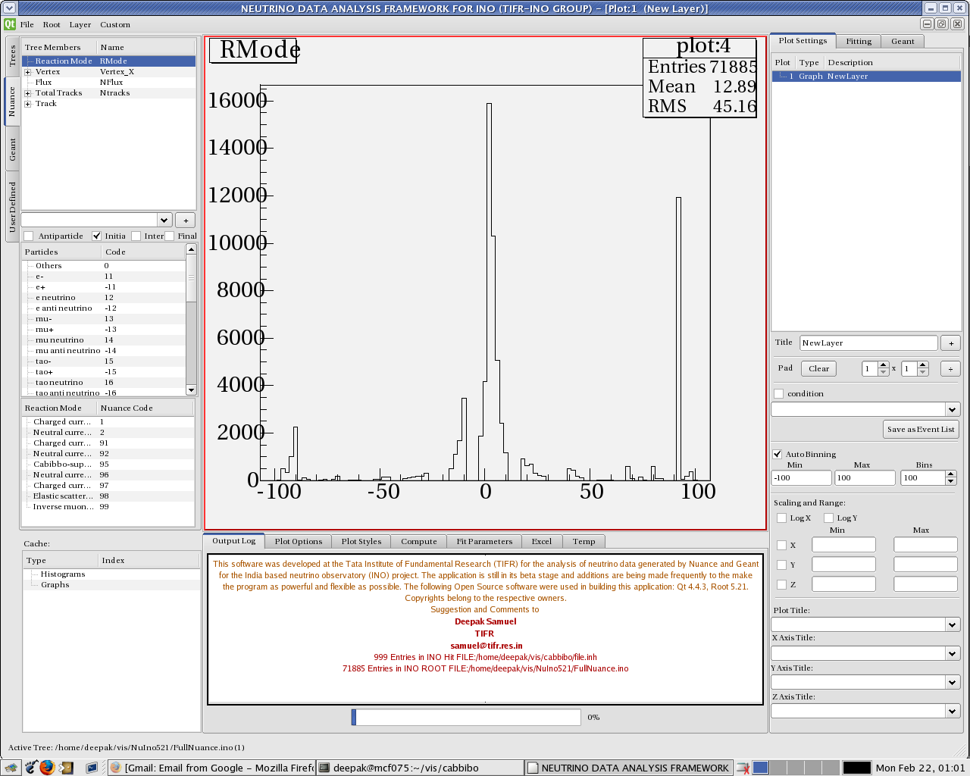
Data Analysis Framework for NUANCE

Slide 24
A modern visualization interface for GEANT

Slide 25
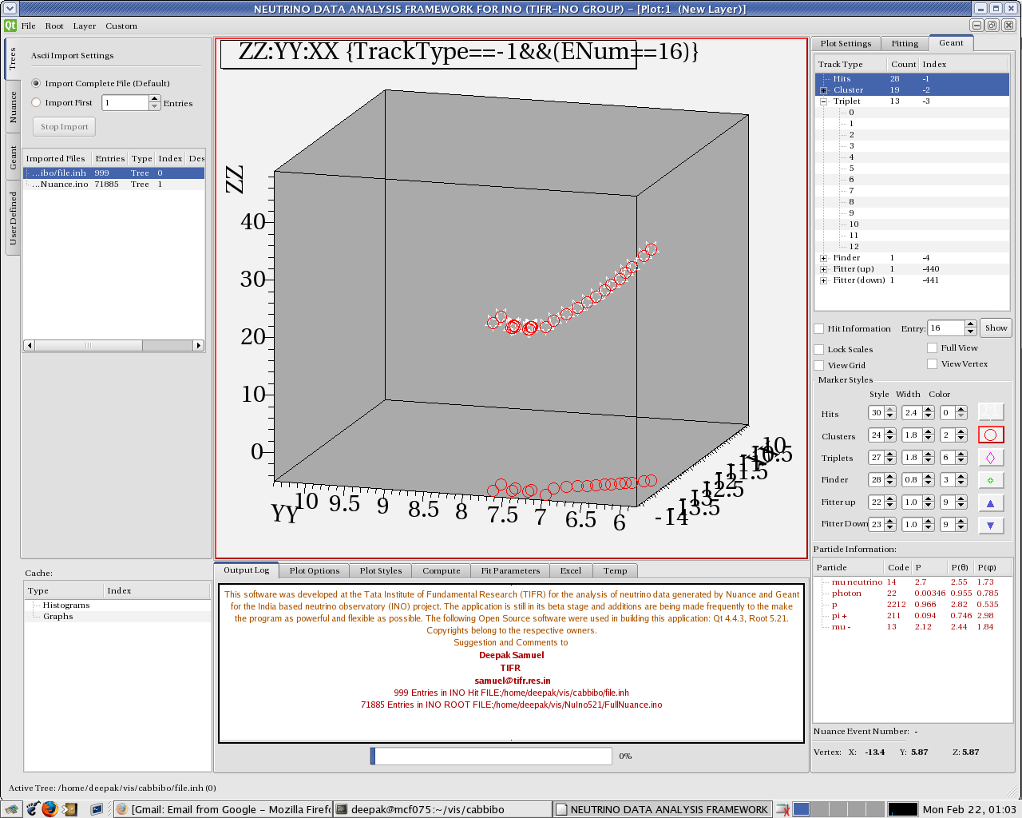
Track display for GEANT simulation*

Slide 26
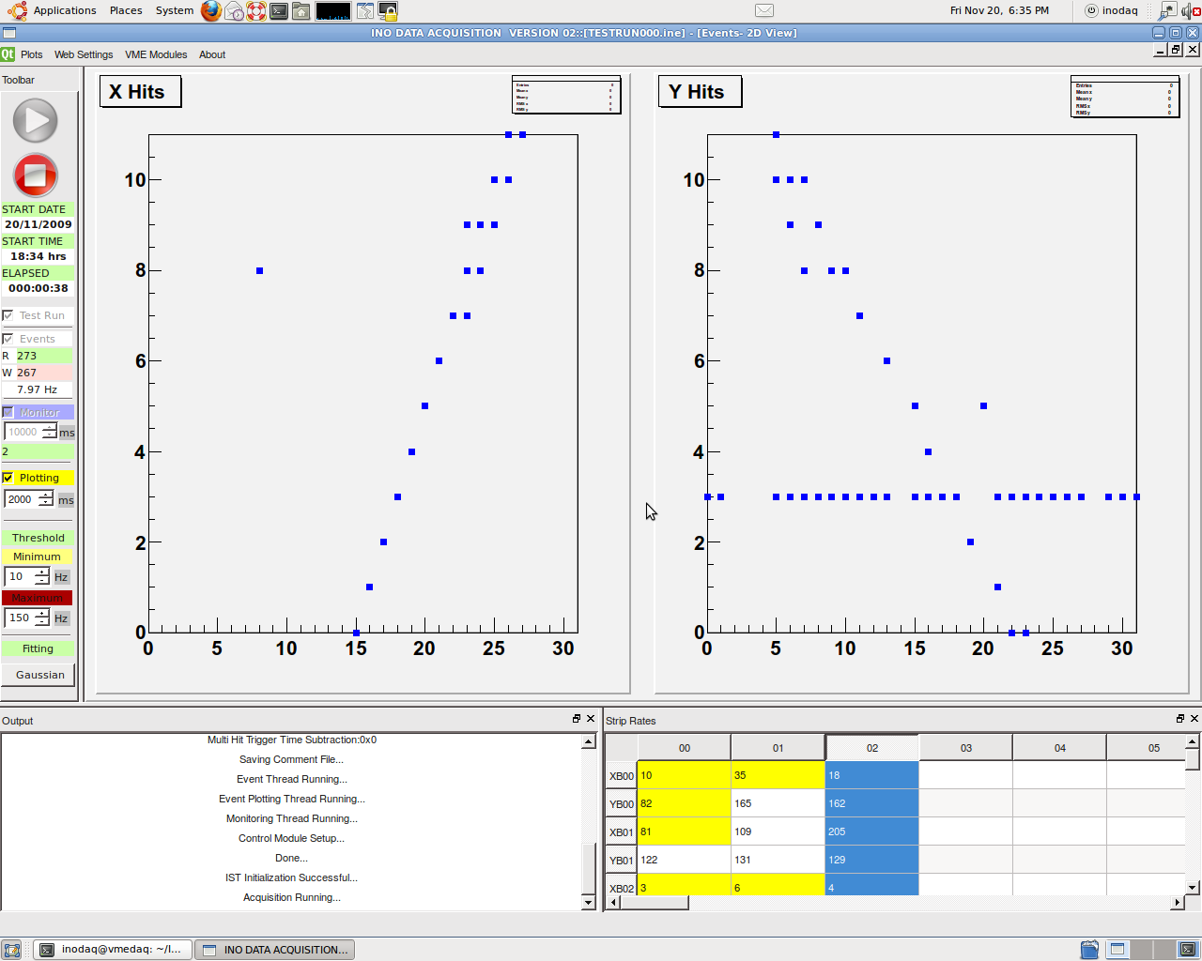
VME Based DAQ Software*

Slide 27

Offline Data Analysis Tool**

Slide 28
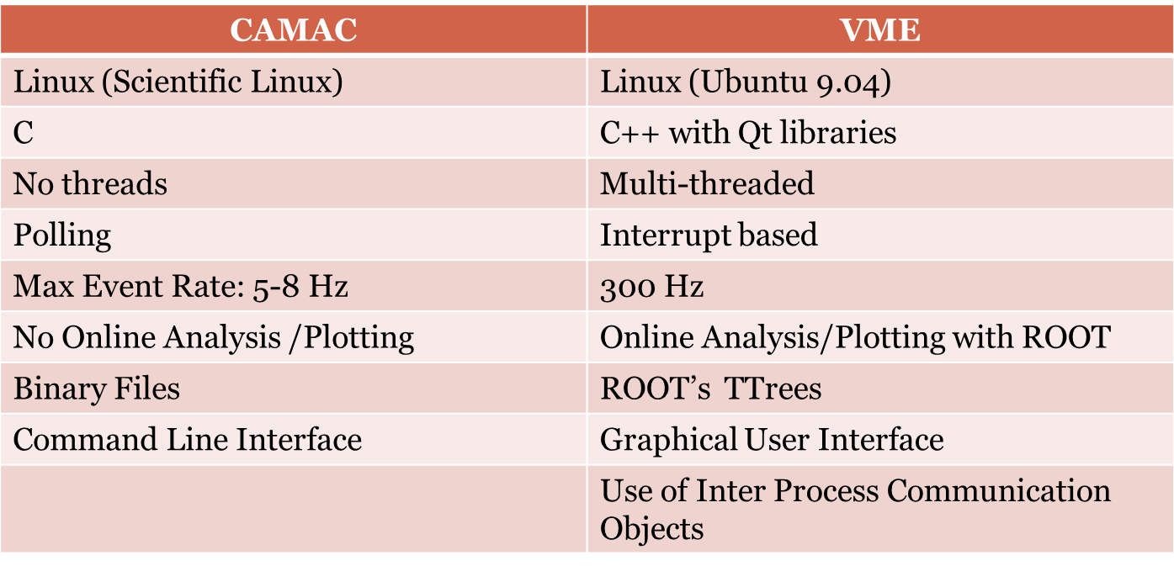
VME DAQ Software-Comparison

Slide 29
Design of VME DAQ Software
Muon
Signal
Y Strip
X Strip

Slide 30

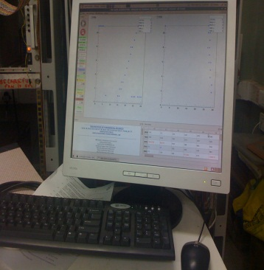
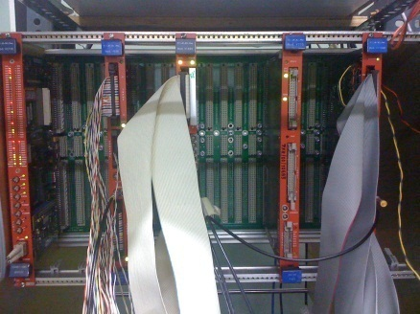
Design of VME DAQ Software
Trigger
Event (Hit Info + Timing)
Data
Noise Rate Monitor

Slide 31
Back-End: VME Module Access
Each Module Type (Scaler, TDC etc.,) represented by a C++ class
All VME Classes inherit another general class “vmefunctions”
Seamless integration of VME Read/Write functions into our application
class v830CAEN:public vmefunctions // SCALER V830 CAEN
{
public:
unsigned long CHENBL; //Channel Enable
unsigned long CTRLREG; // control reg
unsigned long STATREG;// status register
unsigned long GEOREG;// GEO register
unsigned long INTLVL;// interrupt level
unsigned long INTVEC;// interrupt vector
unsigned long RESET; //reset
unsigned long SOFTTRG;//software trigger
unsigned long TRGCNTR;//trigger counter
unsigned long FULL;// almost full level
unsigned long CONFROM;// configuration rom
unsigned long FIRMWARE;// firmware
v830CAEN(unsigned long base, int modindx, QString modtyp); // constructor
void Reset(); //reset module
void Initialize();
};
If(Square)
a=b
If(Triangle)
b=b/2
Area = (a*b)
Square
Rectangle
Customized Class
Common Method (Library)
Shapes
Triangle
GUI Framework
Read/Write
TDC
Scaler
vmefunctions
VME Library
Modules
Control/RO

Slide 32
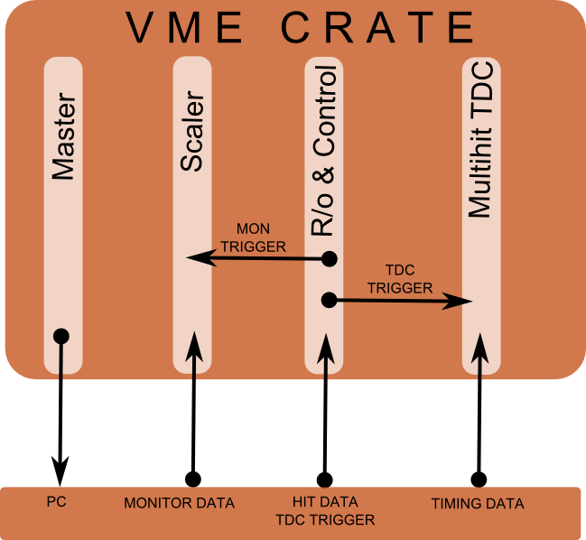
Back-End: Interrupt Sources
Interrupt Sources
Scaler
(Monitor)
Periodic
Least Priority
TDC
(Event)
Random
Highest Priority

Slide 33
Back-End : Threads
Threads allow a single program to have concurrently executing parts.
Threads can be thought of as mini-programs within a program.
Each thread will execute independently and concurrently with its own sequence of instructions.
Threads require synchronization (IPC) for concurrent read/write access to memory.
One Bad Thread Can Kill the Entire Program.
Parallel and Distributed Programming Using C++ By Cameron Hughes, Tracey Hughes

Slide 34
Back-End : Multithreading
Start
Interrupt
Service
Thread
Event Thread
Monitor Thread
Event Plot Thread
Time Critical Priority
Highest Priority
Least Priority

Slide 35
Interrupt Service Thread
Wait on Interrupts
Read IRQ Vector
Read Scaler/ TDC, Event Data
Write Data to Shared Circular Buffer
IPC-Trigger
Event Thread
Monitor Thread

Slide 36
Event/Monitor Thread
Wait on event (IPC)
Read data from circular buffer
Check if file is free
Write data to file
Pass Hit Data to Plotting Thread and Web Update

Slide 37
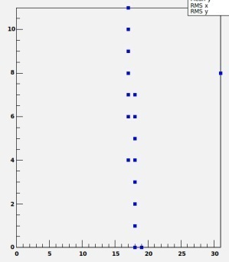
Inter-Process Communication (IPC)-Event
Event Thread
IST
Monitor
Thread
Event Plot
Thread
Thread Synchronization using “Event” (IPC object).
Event: A software trigger.
Threads wait (passive) on a Event.
A Thread can miss an Event !

Slide 38
Inter-Process Communication (IPC)-Mutex
Mutex Lock
Thread A (Event Thread)
a=5
int a = 0
(FILE)
Thread C
(User Plot)
Read a
Thread B
a=6
Mutually Exclusive access to shared resources
Threads first check if a mutex is unlocked
If unlocked, locks the mutex
After accessing the resource the thread should unlock mutex

Slide 39
Front End- GUI-Layout
MAINWINDOW
MENU BAR (Miscellaneous Options)
TOOL BAR
(Often used)
i) VME Modules Settings
ii) Plotting Canvas Area
Event
Timing
Others
Each accessible via Menu Bar also
Plotting Input Area (Dock Widget)
TEXT OUTPUT AREA (Dock Widget)
(Error/Status Messages)
MONITOR TABLE (Dock Widget)
(STRIP RATE)

Slide 40
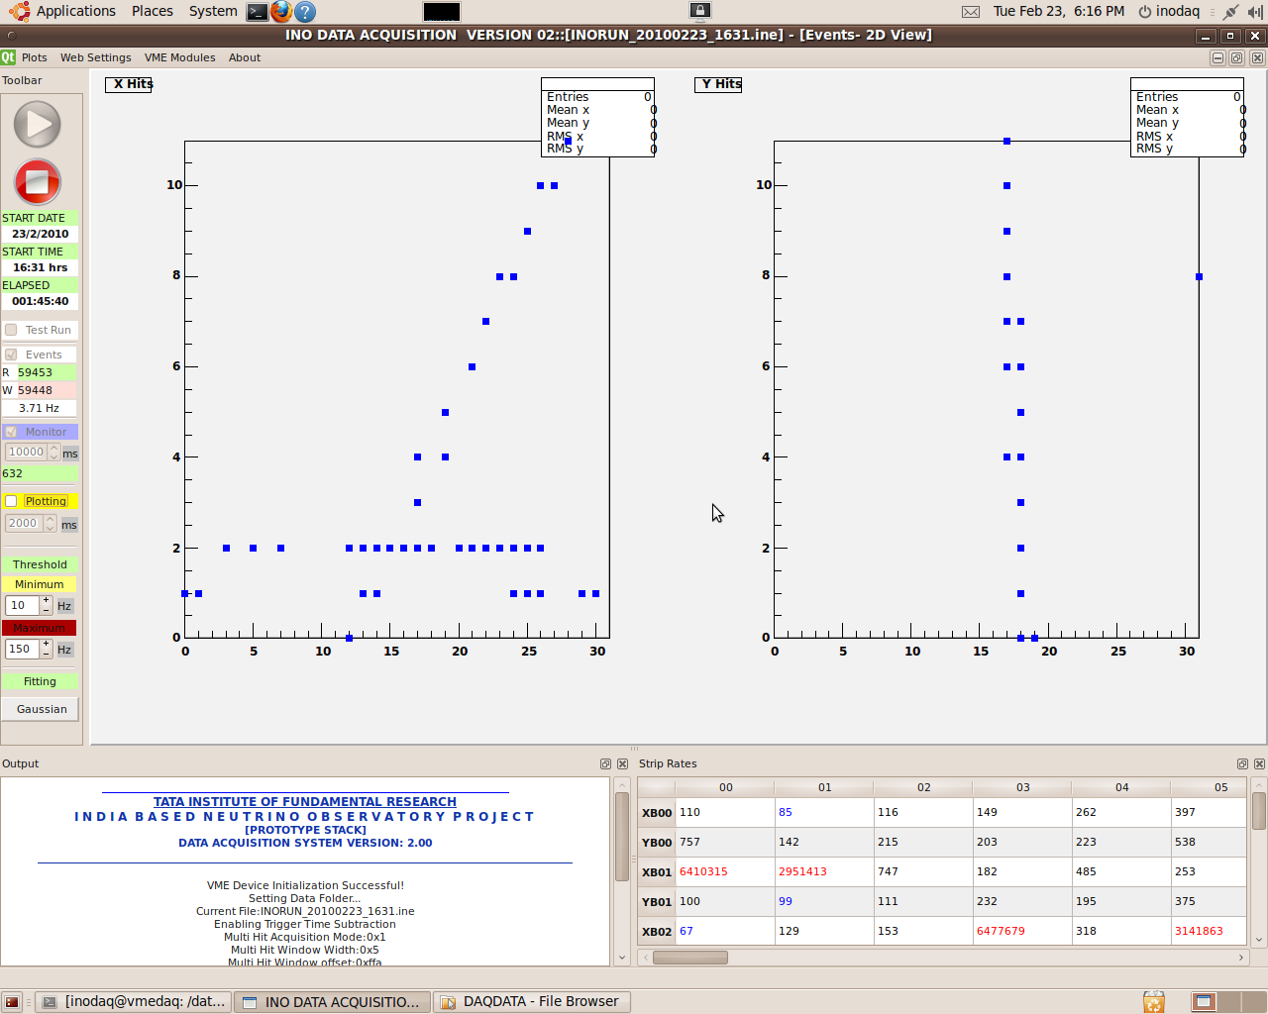
The Graphical User Interface

Slide 41
Offline Analysis Tool
Analysis using CERN’s ROOT framework
GUI based tool
Fit parameters of tracks
Layer Multiplicity
Custom plotting without entering ROOT terminal
Is being currently upgraded to have extra features like custom fitting and better algorithms

Slide 42
Offline Analysis Tool - GUI

Slide 43
Track Viewer- A GEANT Simulation Add-on
Nuance: Event Generation: Neutrino + Iron = A + B +C + …
GEANT: Propagation of A+B+C+ … in the detector
Reconstruction: From E,P of A+B+C + … Get E,P of Neutrino
Track Finding and Fitting algorithms

Slide 44
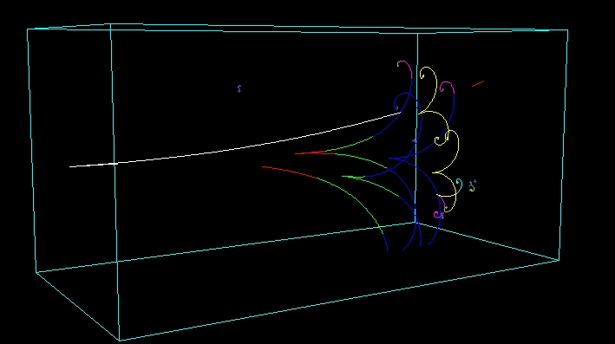
Sample Simulation Tracks

Slide 45
Fitting and Finding of Tracks
Hits
Clusters
Triplets
Find Track
Fit Tracks
Reconstruction is a complex algorithm (Kalman Filter, Fitting Models etc.,) – [Prof. Gobinda Majumder]
GEANT : (x,y,z,t) coordinates of the hits of particles in the detector.
Output of these algorithms are plain numbers
Debugging a messy job !

Slide 46
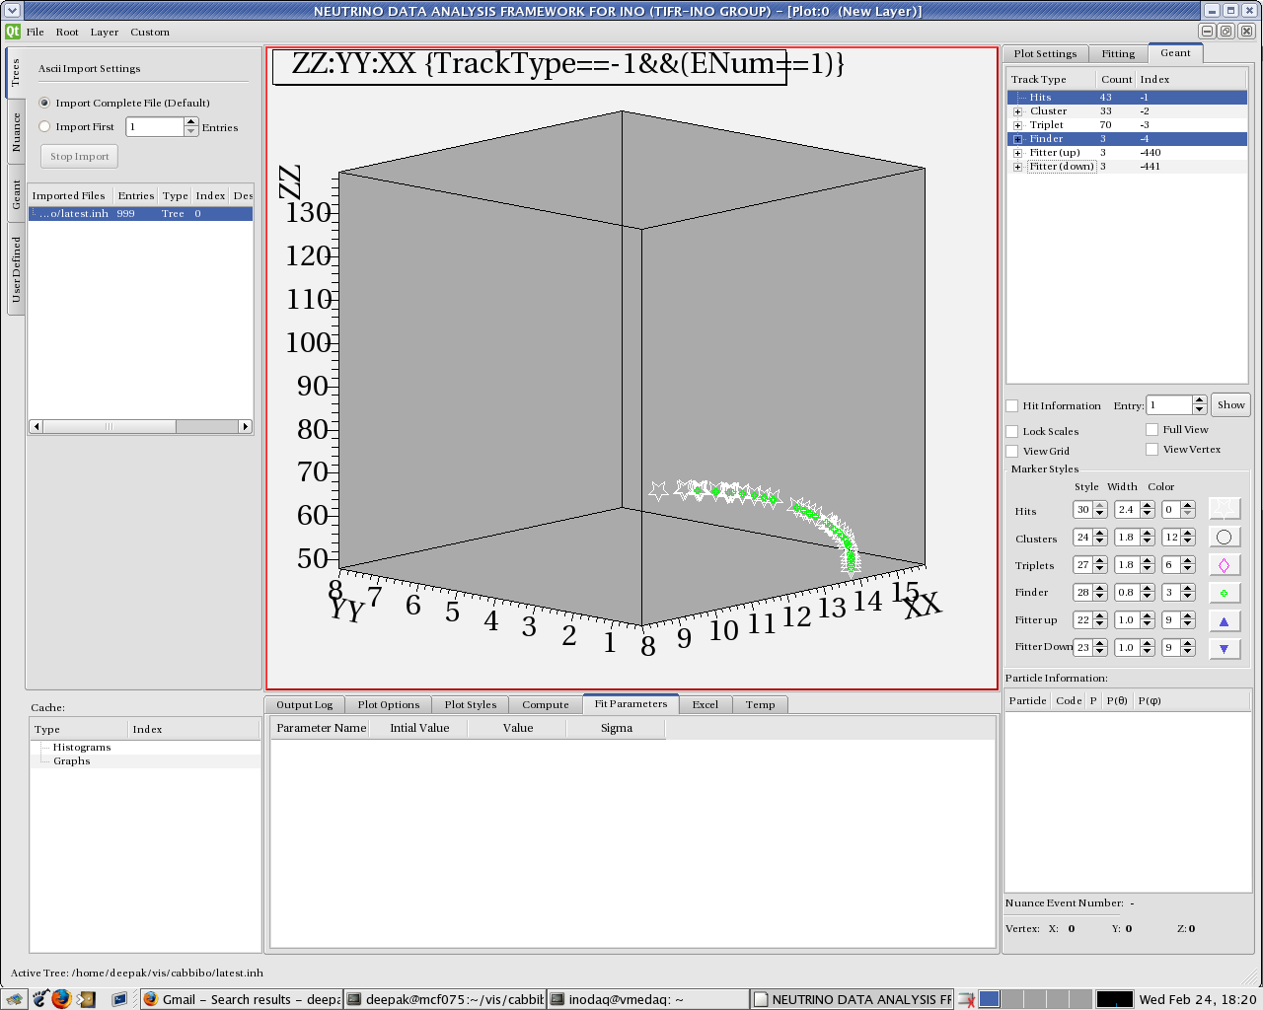
Track Viewer Tool

Slide 47
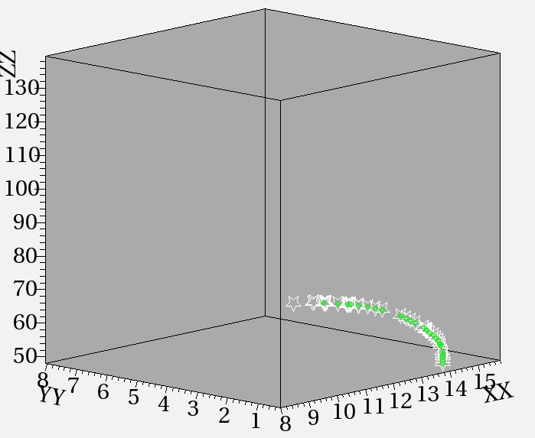
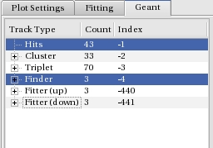
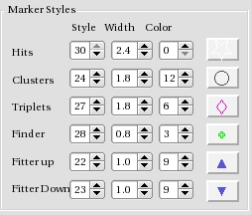
View Options

Slide 48
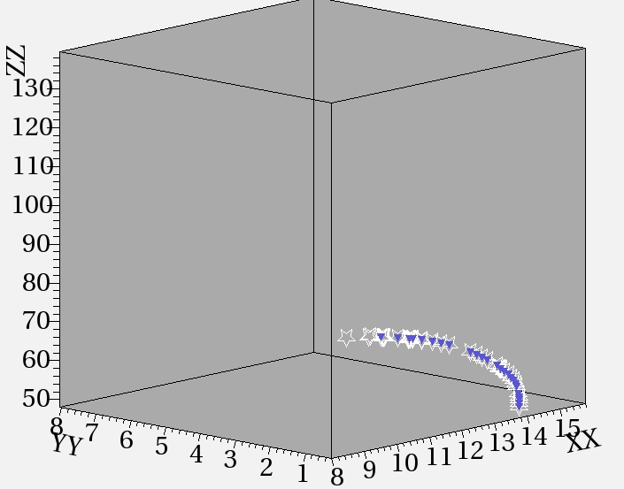
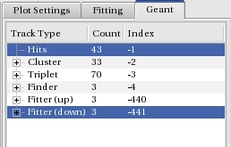
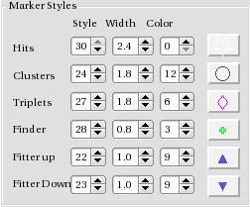
View Options

Slide 49
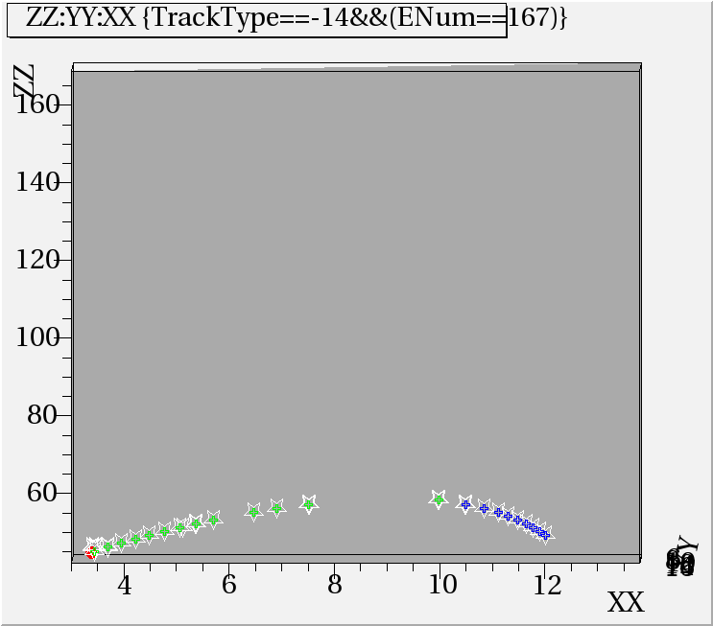
Track Viewer- Debugging

Slide 50
Track Viewer-Summary
Exposed the hitherto hidden bugs in the Reconstruction Algorithm
A powerful tool to individually sort out issues at every part of the reconstruction
Integrated with NUANCE analysis framework
Soon to be converted into a complete analysis framework for INO

Slide 51
Qt- How to ?
Design your window using Qt Designer
Write your code in Qt Creator
Connect Signals to Slots

Slide 52
Signal Slot Mechanism
Each Widget (Push Button, Text Box etc.,) emits different signals (Clicked, Double Clicked, Text Entered etc.,)
A slot is a function to which a signal is connected.
Connecting Signals to Slots done by “connect function”
connect(pushbutton, SIGNAL(Clicked()), mainwindow, SLOT(Close()));

Slide 53
Summary
TIFR – INO team has developed a wide range of customized software applications.
Gained an experience in developing advanced software applications
This experience is a strong base for developing many other applications not only for INO but for other groups as well.
Happy to share our experiences!

Slide 54
Acknowledgements
Prof. N. K. Mondal
Prof. G. Majumder [Simulation Group]:
Asmita, Sudeshna Dasgupta
Mr.B. Satyanarayana [Electronics, Detector R&D and DAQ team]:
Upadhya, Nagesh.
Mandar, Shinde, Shekhar, Manas, Sumanta, Salim.

