Slide 1
Neutral Naturalness
Zackaria Chacko,
University of Maryland, College Park

Slide 2
Introduction

Slide 3
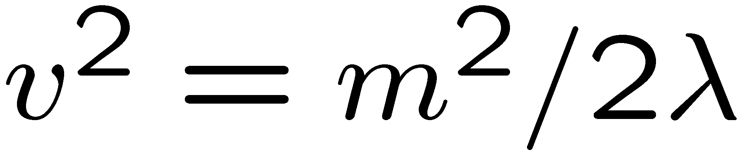
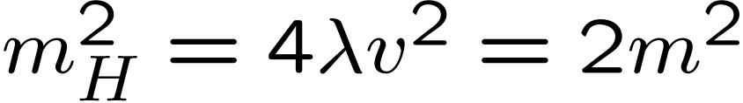
Theories in which electroweak symmetry is broken by a scalar Higgs suffer from a fine-tuning problem. Let us understand the issue in greater detail.
The Higgs potential in the Standard Model takes the following form.
Minimizing this potential we find for the electroweak VEV
and for the mass of the physical Higgs

Slide 4
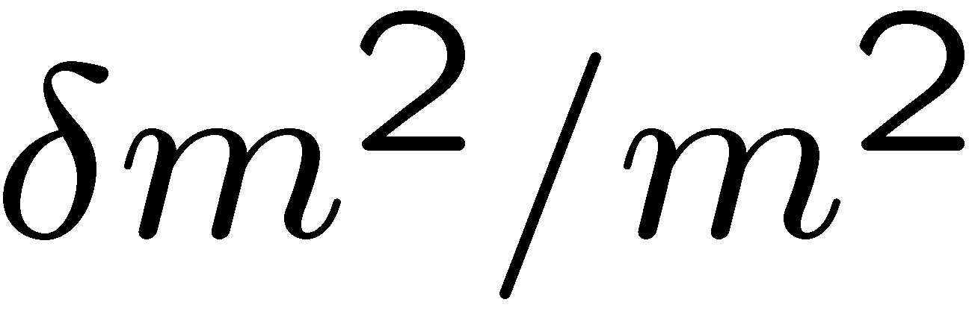

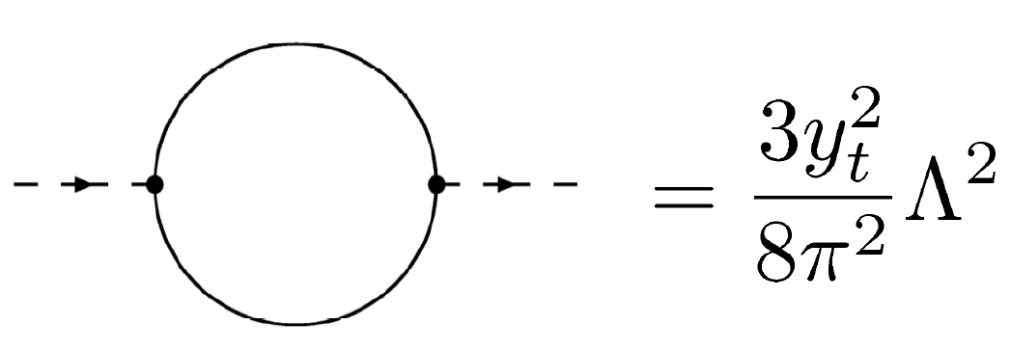
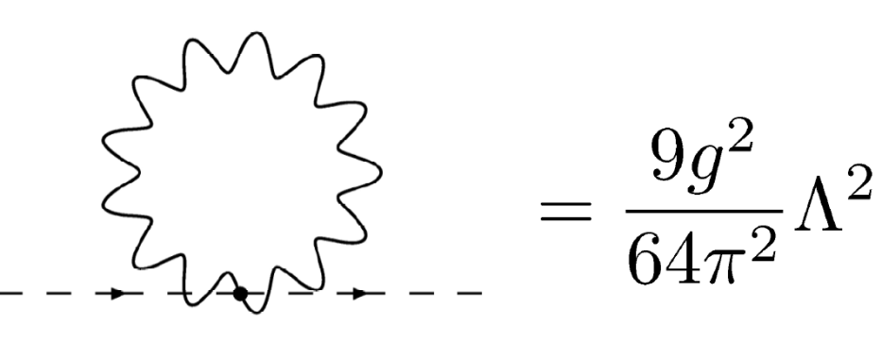
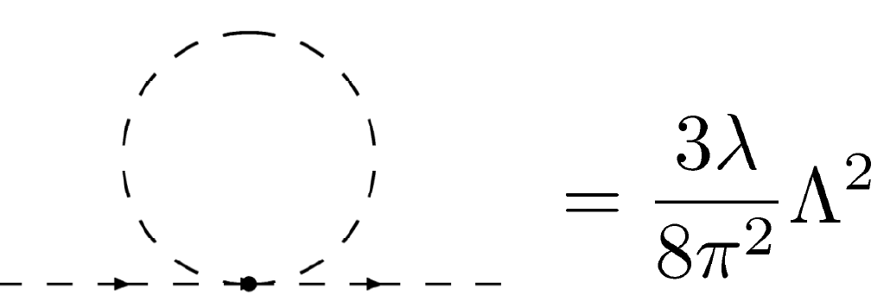
We can estimate the fine-tuning as
where
is the radiative correction to the mass squared parameter.
For a physical Higgs mass of 125 GeV, the precision electroweak upper bound,
we can estimate the fine-tuning from the top, gauge and Higgs self couplings.
Fine Tuning < 10% for Λ > 1.5 TeV.
Fine Tuning < 10% for Λ > 4 TeV.
Fine tuning < 10% for Λ > 3 TeV.

Slide 5
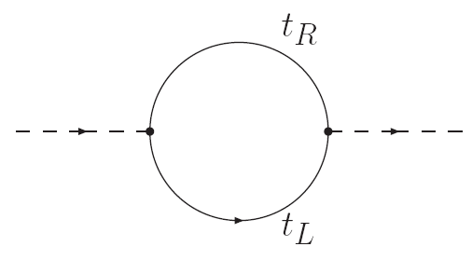
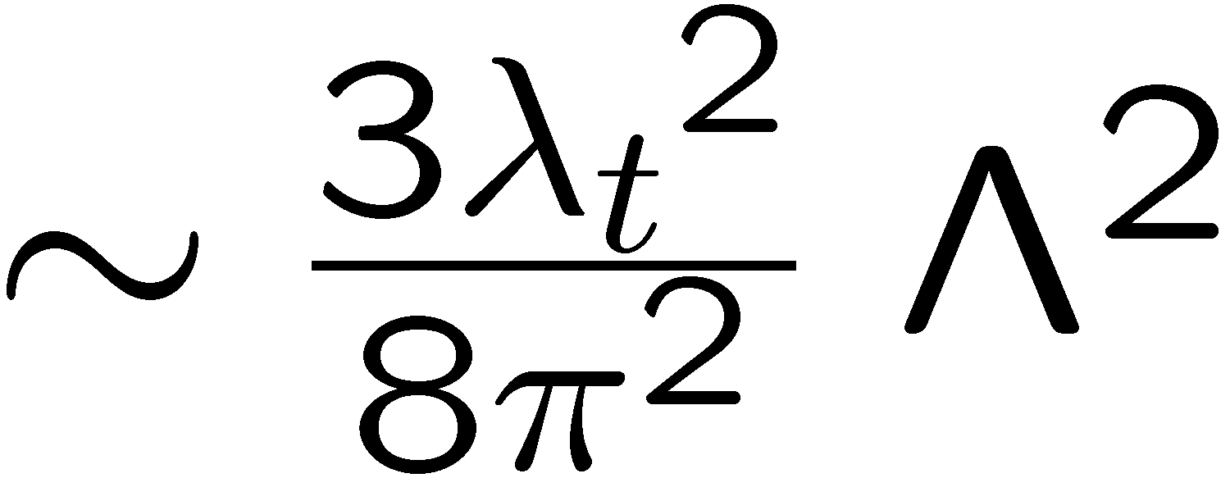
We see that unless the Standard Model is severely fine-tuned, we should
expect new physics at or close to a TeV.
The biggest contribution to the Higgs mass in the Standard Model is from the top loop, and this is therefore the leading source of fine-tuning.
Naturalness requires new particles below a TeV or so to cancel this.

Slide 6
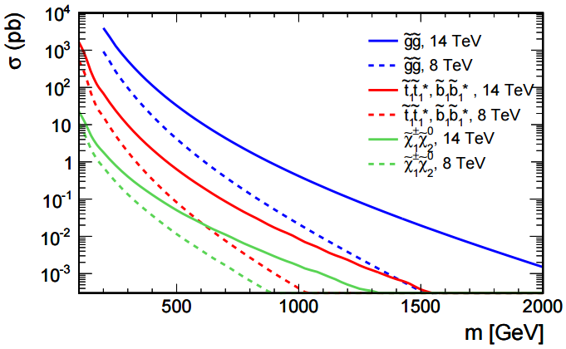
The new particles, the `top partners’ must be related to the top quark by a symmetry for the cancellation to work.
Since top quark is colored, naively one would expect that the top partners would also be colored.
If the top partners are colored, discovery at the LHC is much easier.
CMS

Slide 7
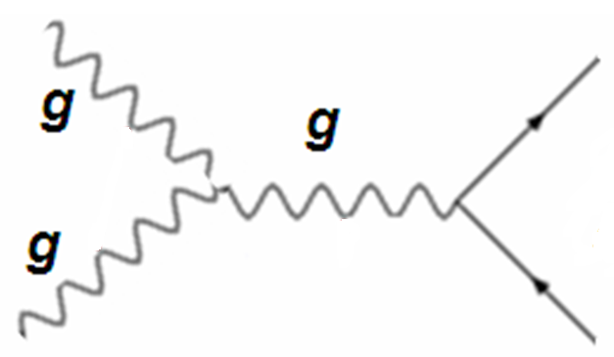
proton
top partners
the crucial vertex
proton

Slide 8
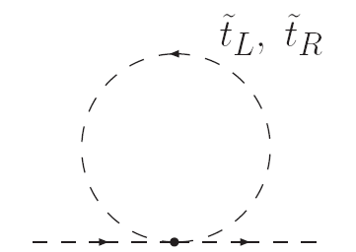
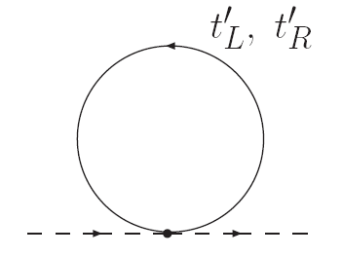
However, in general the top partners need not be colored! This can happen in scenarios where the top and the top partners are related only by a discrete symmetry.
ZC, Goh & Harnik (2005)
Mirror Twin Higgs and Folded Supersymmetry are the first known examples.
Let us understand this.
In general, there are two classes of diagrams that have been found which can cancel the top loop. These two classes correspond to generalizations of the following diagrams.
SUSY cancellation with the third
generation (scalar) squarks in loop
Little Higgs cancellation with
(fermionic) top partners in loop

Slide 9
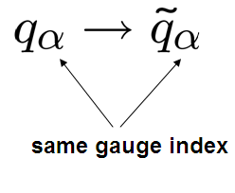
In SUSY the scalar quarks are charged under Standard Model color.
Consider a SUSY rotation.
SUSY commutes with the gauge interactions. If top quark is colored, its
scalar superpartner is also colored.

Slide 10
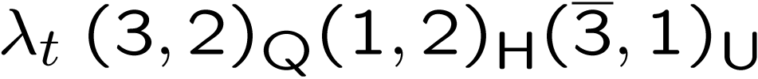
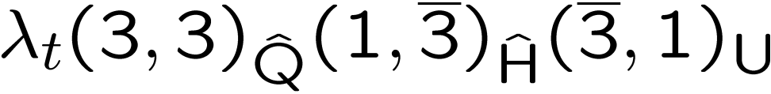
In little Higgs theories the fermionic top partners are charged under color.
Consider the SM top Yukawa coupling,
where Q and U are third generation quark and anti-quark, and H is the Higgs.
The brackets indicate quantum numbers under SU(3) and SU(2).
If we extend the SU(2) symmetry to an SU(3) symmetry this becomes
When this SU(3) symmetry is broken down to SU(2) the Higgs field H becomes
the Goldstone boson associated with the breaking of the symmetry.
When this structure is embedded into a little Higgs theory, the extra state in $\hat{Q}$
becomes the top partner. Notice that it is necessarily charged under color.
The global symmetries protecting Higgs mass commute with color.

Slide 11
A toy example of uncolored top partners.
2 copies of the top quark, A and B
A carries charge under QCD, B under a hidden QCD.
There is an interchange symmetry A $→$ B , QCD $→$ QCD’.
Supersymmetrize.
A
B
Self energy contributions cancel because of supersymmetry.

Slide 12
(Orbifold) project out scalars from A and fermions from B.
A
B
The cancellation still goes through because of Folded Supersymmetry.
Burdman, ZC, Goh & Harnik
A
B

Slide 13
proton
top partners
proton
The crucial vertex is now absent. No strong production of top partners.
The top partners carry electroweak charge. Can still be produced, but at much lower rates.

Slide 14
The cancellation of the top loop takes pace through a diagram of exactly the
same form as in supersymmetry. The major difference is that the scalars
running in the loop, the top partners, carry no charge under SM color.
A
B
In this cancellation, color is simply a multiplicative factor of 3 with no
further significance! What really matters is that the vertices in the two
diagrams be related in a specific way by symmetry.
In this scenario, the discrete A → B symmetry that protects the Higgs mass does not commute with SM color.

Slide 15
This class of models protect the weak scale against radiative corrections up to the precision electroweak scale, of order 5 – 10 TeV.
partial neutral naturalness – top partners carry electroweak charges
Folded Supersymmetry
Burdman, ZC, Goh and Harnik
Quirky Little Higgs
Cai, Cheng and Terning
complete neutral naturalness – top partners neutral under all SM forces
Mirror Twin Higgs
ZC, Goh & Harnik
Fraternal Twin Higgs
Craig, Katz, Strassler & Sundrum
Beyond 5 -10 TeV, a UV completion such as compositeness or supersymmetry is required to complete the solution the hierarchy problem.
However, the physics of the UV completion may be inaccessible to the LHC.

Slide 16
The Mirror Twin Higgs Model
ZC, Goh & Harnik

Slide 17
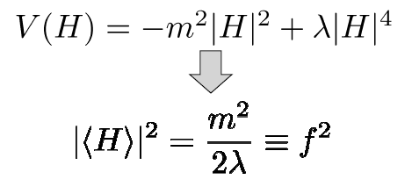
To illustrate the twin Higgs mechanism, consider a scalar field H which
transforms as a fundamental under a global U(4) symmetry.
The potential for H takes the form
The U(4) symmetry is broken to U(3), giving rise to 7 Goldstone bosons.
The theory possesses an accidental O(8) symmetry, which is broken to
O(7). The 7 Goldstones can also be thought of as arising from this
breaking pattern.

Slide 18
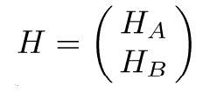
Now gauge an SU(2)_{A} X SU(2)_{B} subgroup of the global U(4).
Eventually we will identify SU(2)_{A} with SU(2)_{L} of the Standard Model,
while SU(2)_{B} will correspond to a `twin’ SU(2).
Under the gauge symmetry,
where H_{A} will eventually be identified with the Standard Model Higgs,
while H_{B} is its `twin partner’.

Slide 19


Now the Higgs potential receives radiative corrections from gauge fields
Impose a Z₂ `twin’ symmetry under which A $⟺$B, so that g_{A} = g_{B} = g.
Then the radiative corrections take the form,
This is U(4) invariant, and can be completely absorbed into the U(4) symmetric mass term. It cannot give a mass to the Goldstones!
As a consequence of the discrete twin symmetry, the quadratic terms in
the Higgs potential respect a global symmetry. Even though the gauge
interactions constitute a hard breaking of the global symmetry the
Goldstones are prevented from acquiring a quadratically divergent mass.

Slide 20
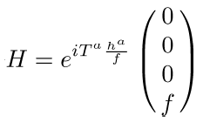
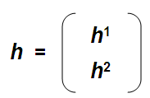

Let us focus on the case where the symmetry breaking pattern is realized non-linearly. This will enable us to show that the low-energy behaviour is universal, and is independent of any specific ultra-violet completion.
Require O(8) for custodial SU(2), but keep only SU(4) subgroup manifest.
We parametrize the Goldstones h in
terms of H which transforms linearly.
Here
is the SM Higgs field.
The cut-off
where upper bound is at strong coupling.
In general the theory will contain arbitrary non-renormalizable operators
suppressed by Λ consistent with the global O(8) symmetry.

Slide 21
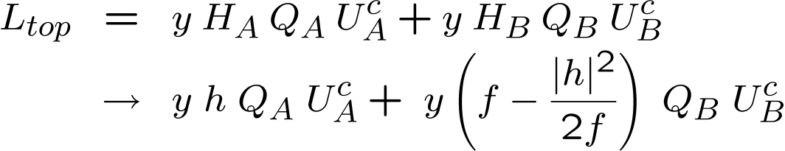
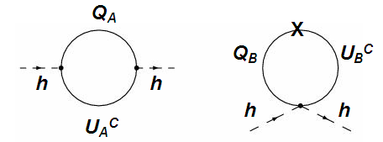
Let us now understand the cancellation of quadratic divergences in
the non-linear model, at one loop. Start with the top Yukawa,
The quadratic divergences of these two diagrams cancel exactly! The cancellation takes exactly the same form as in little Higgs theories. The states which cancel top loop need not be colored!
Can be generalized to all loop orders using a spurion analysis.

Slide 22
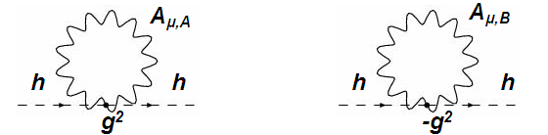
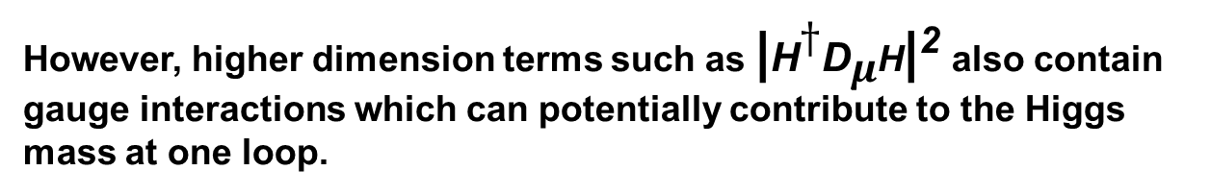
Cancellation of gauge loops also takes same form as in little Higgs.
However, higher dimension terms such as |H$†$D$μ$H|² also contain gauge interactions which can potentially contribute to the Higgs mass at one loop.
Therefore, for strongly coupled UV completions, a more careful analysis is needed to establish this result.
Provided the symmetry breaking pattern is O(8) → O(7), the quadratic divergences from the gauge sector are canceled, even if UV completion is strongly coupled.
ZC, Goh & Harnik
Barbieri, Greco, Rattazzi & Wulzer

Slide 23
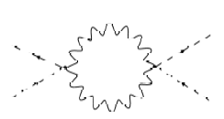


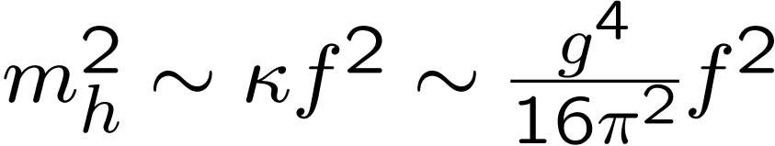
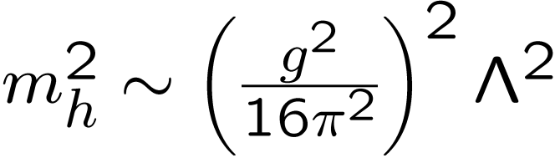

However, logarithmically divergent terms are radiatively generated which
are not U(4) invariant and contribute a mass to the pseudo-Goldstones.
The resulting mass for the pseudo-Goldstones is of order
In the strong coupling limit,
so that
Then for Λ of order 5 TeV, the Higgs mass is of order the weak scale.

Slide 24
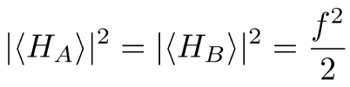
Now the flat direction has been lifted, we must determine the vacuum
alignment.
If we minimize
we find
Therefore, although the mass m_{h} of the pseudo-Goldstone is small compared to f , the electroweak VEV is not. Also, the pseudo-Goldstone
is an equal mixture of the Standard Model Higgs and the twin Higgs.
We would like to create a (mild) hierarchy between f and the electroweak
VEV that would allow the pseudo-Goldstone to be more like a SM Higgs, and accommodate a higher cutoff.

Slide 25


Add a term to the Higgs potential which softly breaks twin symmetry
Such a term does not reintroduce quadratic divergences. Values of
μ much less than Λ are technically natural.
This approach allows the generation of this hierarchy at the expense
of mild fine-tuning.
How large is the residual tuning in this model?
For m_{T} ~ y f of order 500 GeV, $Λ$ ~ 4$π f$ of order 5 TeV, the tuning is only of order 1 part in 5.

Slide 26
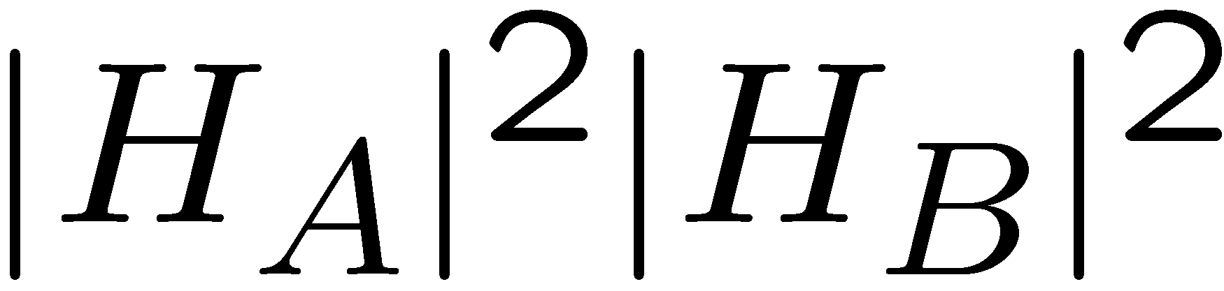
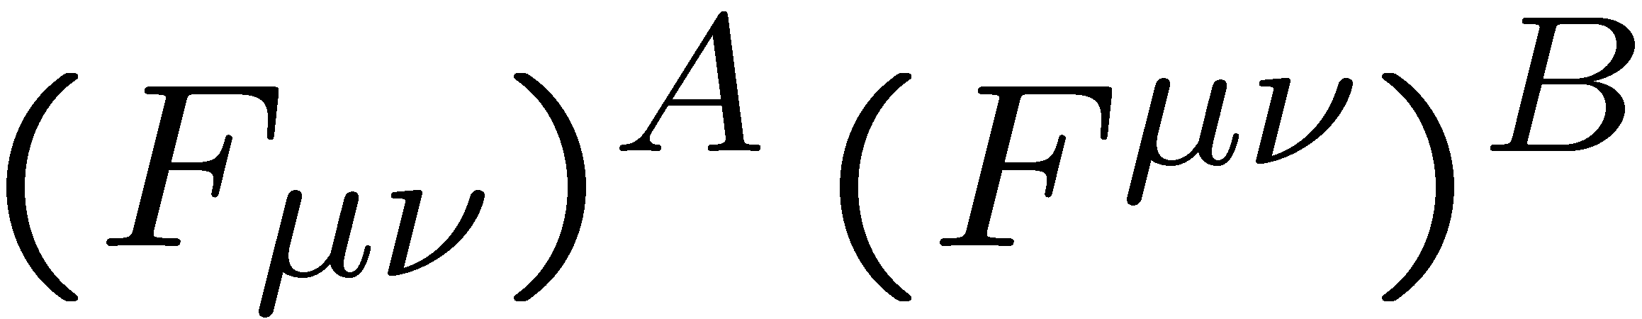
The discrete symmetry must be extended to all the interactions of the SM.
The simplest possibility is to identify the discrete symmetry with parity.
Mirror Symmetric Twin Higgs Models
There is a mirror copy of the Standard Model, with exactly the same field
content and interactions. The parity symmetry interchanges every
Standard Model field with the corresponding field in the mirror Standard
Model. Although the mirror fields are light they have not been observed
because they carry no charge under the Standard Model gauge groups.
Gauge invariance allows only two renormalizable couplings between the
Standard Model and the mirror Standard Model. (Foot, Lew & Volkas)
part of U(4) invariant Higgs quartic
photon-mirror photon mixing
Photon-mirror photon mixing is very tightly constrained. We set it to zero (not radiatively generated till high loop order).

Slide 27
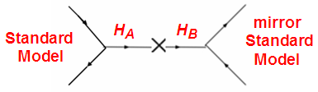
The SM sector communicates with the mirror world only through the Higgs portal. Very difficult to test.
part of U(4) invariant Higgs quartic
After electroweak symmetry breaking the SM Higgs and twin Higgs mix, leading to corrections to Higgs physics.
The tightest constraints on this class of theories come from the cosmological bounds on dark radiation.
The Higgs portal interaction keeps the mirror sector in thermal equilibrium with the SM until temperatures of order a few GeV. We require that between
this temperature and 5 MeV, when the weak interactions decouple, some
entropy is added to the Standard Model sector, but not to the mirror sector.

Slide 28
Fraternal Twin Higgs Models
Craig, Katz, Strassler & Sundrum
Below 5 TeV, the only light twin states present in the theory are those essential for naturalness or consistency (anomaly cancellation).
3rd generation fermions.
SU(2) gauge bosons (but not hypercharge)
mirror color gauge bosons
The absence of light mirror states associated with the light quarks means that the lightest hadrons in mirror sector can be glueballs.
These can be accessed through the Higgs portal and can give rise to exotic phenomenology such as displaced vertices.
Cosmological constraints are more easily satisfied. The mirror b and $τ$ are dark matter candidates.
Garcia, Lasenby & March-Russell
Craig & Katz

Slide 29
Signals of Neutral Naturalness

Slide 30
How can these theories be tested at colliders?
Precision Higgs studies.
Hidden sector must have large couplings to the Higgs. Can affect
its properties.
Mirror and Fraternal Twin Higgs
Folded Supersymmetry
Quirky Little Higgs
Exotic Higgs decays.
Mirror QCD is a characteristic feature of these theories. Higgs can
decay to mirror glueballs, which can decay back to SM particles.
Fraternal Twin Higgs
Folded Supersymmetry
Quirky Little Higgs
If top partners carry electroweak charge, direct production.
Decay products may be SM particles.
Folded Supersymmetry
Quirky Little Higgs

Slide 31
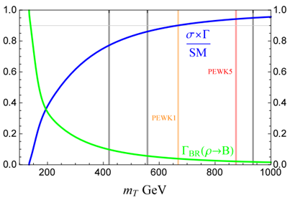
Precision Higgs Studies
(Burdman, ZC, Harnik, de Lima & Verhaaren)
In Mirror Twin Higgs, a net reduction in Higgs events compared to the SM.
At present, the cross section is known to be within 20% of the standard model prediction. Mirror Top must be heavier than about 500 GeV.
Expected to improve only to about 10%.
The LHC will not be able to conclusively disfavor naturalness!
A linear collider (`Higgs Factory’) may be needed to exclude this theory.

Slide 32
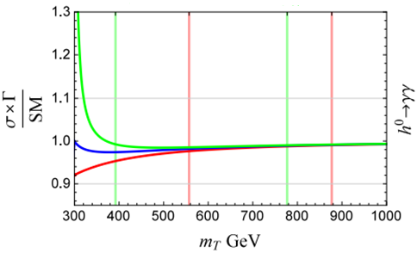
In Folded Supersymmetry, Higgs production is largely unchanged.
But Higgs decay rate into two photons is affected.
The current LHC limits from this are weak. Will not improve very much.
Precision electroweak measurements at a future lepton collider would be able to better constrain this scenario.
Fan, Reece & Wang

Slide 33
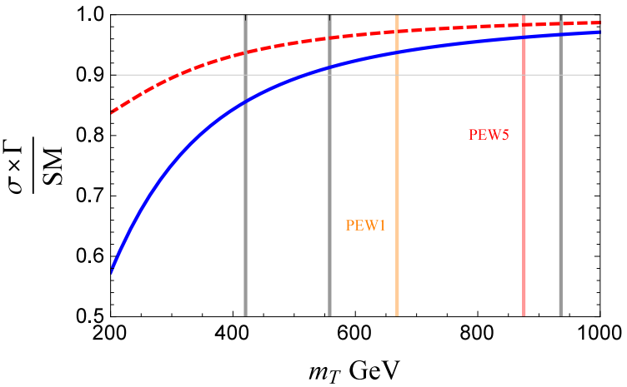
In Quirky Little Higgs, there is a net reduction in Higgs events compared to the SM, but also a correction to the decay rate of Higgs to two photons.
At present, the overall Higgs rate (in blue) gives the stronger bound.
This yields a bound on the top partner mass of order 350 GeV.

Slide 34
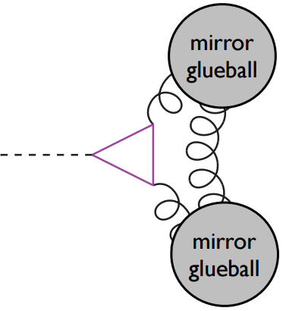
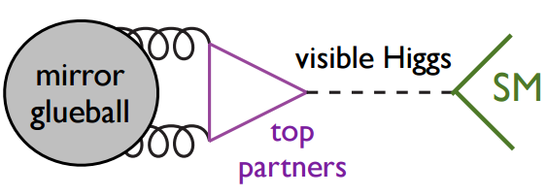
Exotic Higgs Decays
In Folded Supersymmetry, Fraternal Twin Higgs and Quirky Little Higgs, mirror QCD has no light quarks, only gluons. The lightest hadrons are glueballs.
The Higgs can decay into two mirror gluons, resulting in glueballs.
Juknevich
The 0⁺⁺ glueballs mix with the Higgs, and can therefore decay back to SM particles. This decay is typically slow, resulting in displaced vertices.
Craig, Katz, Strassler & Sundrum

Slide 35
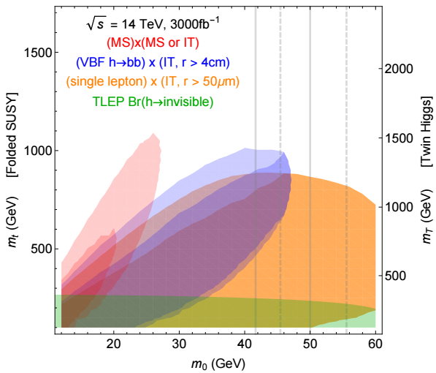
The LHC can use exotic Higgs decays to place useful limits on this scenario.
Curtin & Verhaaren
Csaki, Kuflik, Lomardo & Slone
In some cases, this may be the most effective probe of neutral naturalness.
Limits may eventually be comparable to bounds on colored top partners.

Slide 36
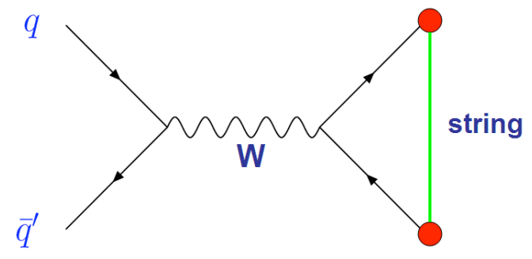
Direct Production
Top (and bottom) partners that carry electroweak charges can be pair produced at the LHC.
Their hidden color charge prevents them from decaying to SM particles.
Instead they can form a “quirky” bound state that de-excites through the emission of photons and hidden glueballs.
Eventually these particles pair-annihillate, resulting in final states that can potentially be detected.

Slide 37
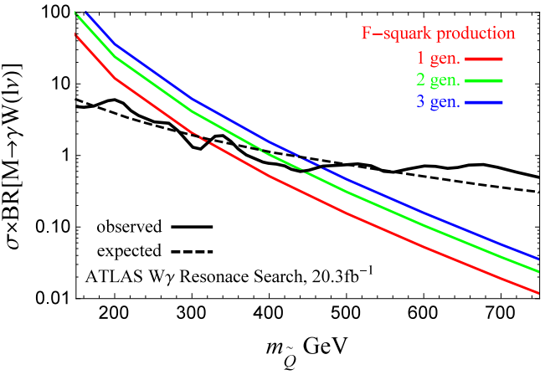
In folded supersymmetry a top and bottom partner can be produced through a W boson.
They can pair annihilate back into W + $γ$. A resonance in this channel!
At present, the limits are weak. Expected to improve significantly.
(Burdman, ZC, Harnik, de Lima & Verhaaren)

Slide 38
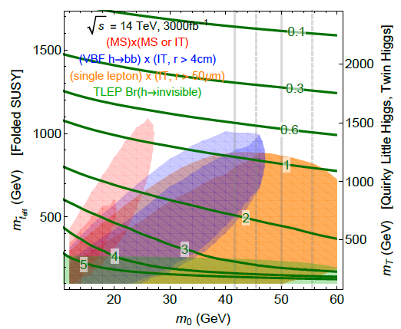
If instead top partners are pair produced, their primary annihillation channel is to a pair of gluons, resulting in jets of hidden glueballs.
The 0⁺⁺ glueballs decay back to SM, with displaced vertices. Striking signal!
Curtin, ZC & Verhaaren
For the Quirky Little Higgs, this is the most promising signal!
For Folded Supersymmetry, this is also the most promising signal in most, but not all, of parameter space.

Slide 39
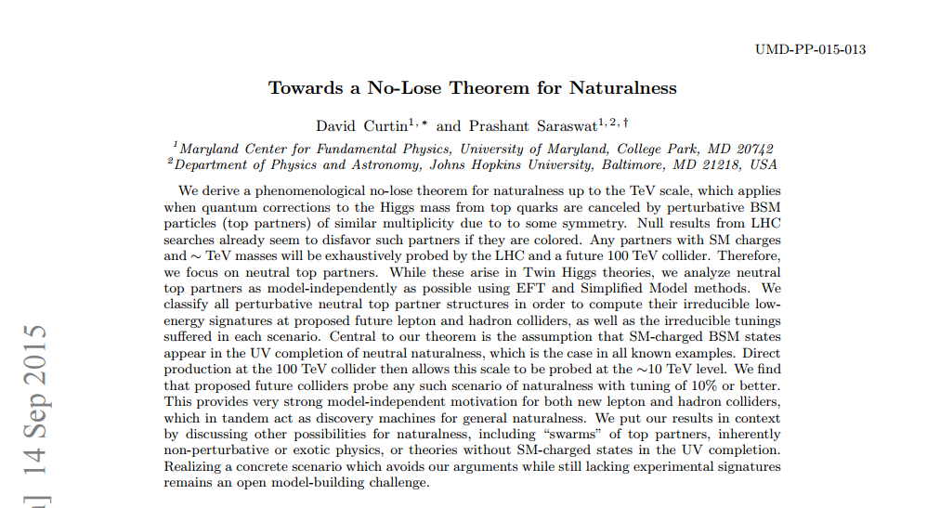
Can future lepton colliders, in combination with a 100 TeV hadron collider, conclusively settle the naturalness argument? Tentatively, yes.

Slide 40
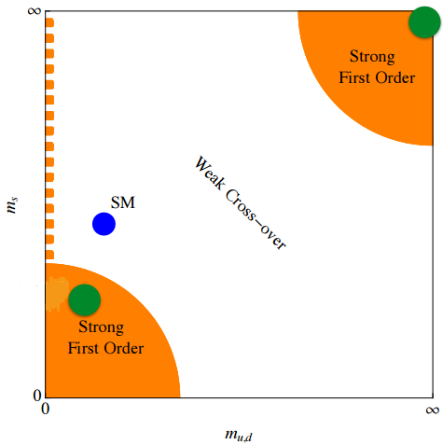
Cosmological Signals
Mirror QCD undergoes a transition to a confining phase.
If this transition is first order, gravitational wave signal. (Schwaller)
fraternal twin Higgs folded supersymmetry
identical twin Higgs
Several realizations of mirror dark matter in twin Higgs framework.

Slide 41
Conclusions

Slide 42
Solutions to the hierarchy problem based on symmetry may only involve particles that are neutral under some, perhaps even all, of the forces in the standard model.
The experimental signals of such a scenario tend to be very different from conventional solutions to the hierarchy problem. Motivates several new searches.
The LHC will probably not be able to conclusively exclude symmetry based solutions to the hierarchy problem.

Slide 43
Backup Slides

Slide 44
Folded Supersymmetry

Slide 45
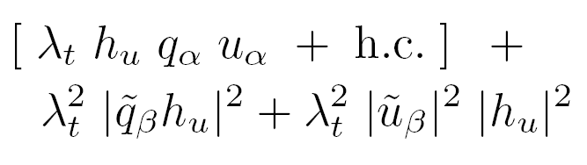
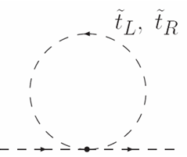
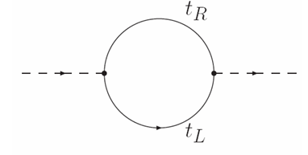
In Folded Supersymmetry, the cancellation of one loop quadratic divergences associated with the top Yukawa coupling takes place exactly as in supersymmetric theories, but the top and the its scalar partners, the `F-stops’, are charged under different color groups.
The SM quarks are charged under the SM color group, labelled SU(3)_{A}, while the F-stops are charged under SU(3)_{B}.

Slide 46
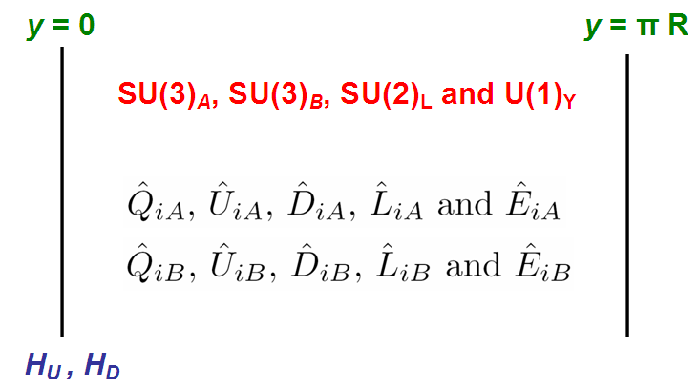
This scenario can be realized in a 5D supersymmetric construction, with the extra dimension compactified on S¹/Z₂. Choose 1/R ~ 5 TeV.
The boundary conditions on the bulk fields are chosen to break SUSY by
the Scherk-Schwarz mechanism in such a way that each Standard Model
hypermultiplet has a fermionic zero mode while their `F-partners’ each have
a bosonic zero mode. In this way the Standard Model fermions and their
`F-spartners’ are kept light while all the other modes are heavy.

Slide 47

A combination of boundary conditions and discrete symmetries ensures that the spectrum of light states includes the SM particles, the scalar F-spartners and the up- and down-type Higgs bosons.
The gauginos are projected out by the boundary conditions and are not part of the low energy spectrum below the compactification scale.
The top Yukawa interaction and the corresponding scalar term arise from the brane localized superpotential terms
A discrete A ←→ B symmetry ensures the equality of the couplings that enforces the cancellation.
The F-spartners acquire positive masses radiatively at one loop.
The gluons of mirror color remain light and confine into `F-glueballs’ at a
mass scale of order a few GeV.

