Slide 1
A versatile FPGA based photon counter and correlator

Slide 2
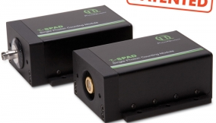
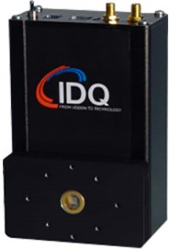
Detectors
τ-SPAD single photon detector
by PicoQuant
      Spectral range 400 nm - 1100 nm
      Active area 150 µm
      Dead time <70ns
      Quantum Efficiency ~ 70%
      Dark Count Rate <100Hz
      Pulse width ~30 ns
      NIM and TTL output
ID-120 single photon detector
by IDQuantique
    Spectral range 350-1000nm range
    Active area 500 µm, active quenching circuit integrated
    Dead time 1µs
    Quantum Efficiency ~ 80%
    Dark Count Rate 200Hz
    NIM and LVTTL outputs
    USB connection and a LabVIEW interface for user to change the bias voltage, dead time and temperature of the diode. Thus the user is able to control quantum efficiency, dark count rate, and after-pulsing rate

Slide 3
Features and Various VHDL components:
Programmable pulse width
Coincidence window as low as 8 ns
Counts up to 87 MHz with out blind-cycle
device control state-machine
LabVIEW / Visual C++ interface
for data read write
Programmable counting bin & duration
Individual and coincidence counting
FT245-R interface
Multiplexed data display
Linear Feedback Shift Register for
pseudo random pulses

Slide 4
Photon counter & correlator
FROM SPAD
PROGRAMMABLE PULSE WIDTH
LEVEL TRANSLATOR
LVTTL
CLK_50
TTL
32-bit
INDIVIDUAL COUNTER
10/20/40 MHz
t_cycle,t_exp,reset
COINCIDENCE
LOGIC
LINE
DRIVER
74ALVC125
32-BIT
COINCIDENCE COUNTER
Internal clock generator
FIFO 32-bit 20 Kw
2,3,& 4 fold
Baud rate clock
CLK_50
DATA COMMUNICATION/
LABVIEW INTERFACE
Disp_address
Wrclk/rdclk
Wrreq/rdreq/
fifo_full
FT-245R interface
DEVICE CONTROL STATE- MACHINE
Baud rate clock
RXF,TXE,DATA
On-board
display
RX_DATA/TX_DATA
RD,WR
FT-245R
parallel to USB
RX_DATA
CLK_50
t_exp
t_cycle
reset
DATA BUS
Display data
VETO and RESET generation
VETO to
Inputs/10MHz
PC
LABVIEW/ VISUAL STUDIO
Display data
BINARY to BCD &
DISPLAY MUTIPLEX
disp_address
RX_DATA,clk,reset
COUNT ENABLE LOGIC
t_cycle, t_exp

Slide 5
Pseudo-random pulse generator(LFSR)
clk
32-bit External arbitrary Seed value
Serial
out
0 | 1 |  |  |  |  |  |  |  |  |  |  |  |  |  |  |  |  |  |  |  | 21 |  |  |  |  | 26 | 27 |  | 29 | 30 | 31
32-bit shift register
FEED-BACK LOGIC
FPGA
reset
Test Pattern Generator
Maximum-length sequence is pseudo-random
Frequency: ~ 437.5 MHz max.(EP4CE115)

Slide 6
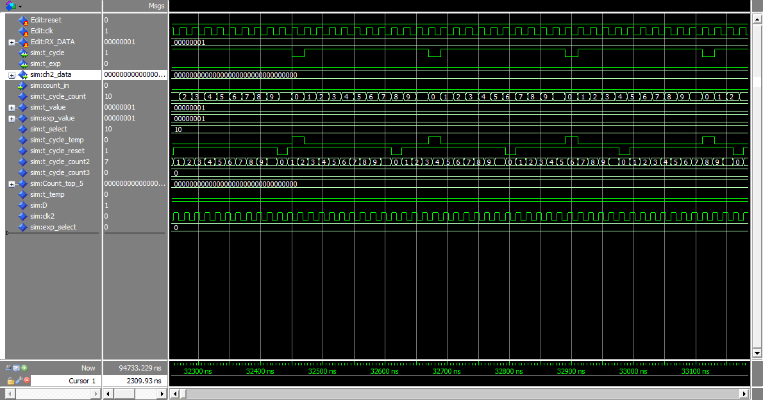
Counting bin and reset generation

Slide 7
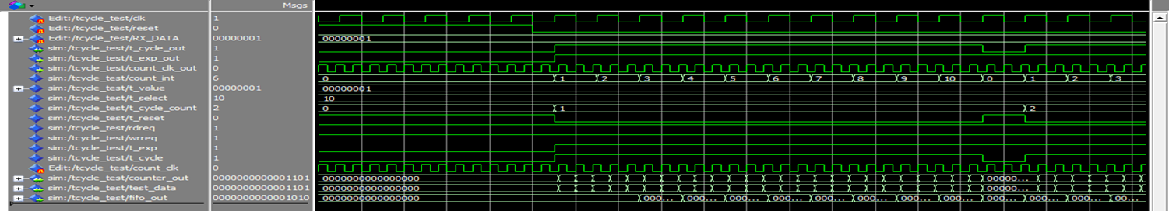
Device control signals and data outputs

Slide 8
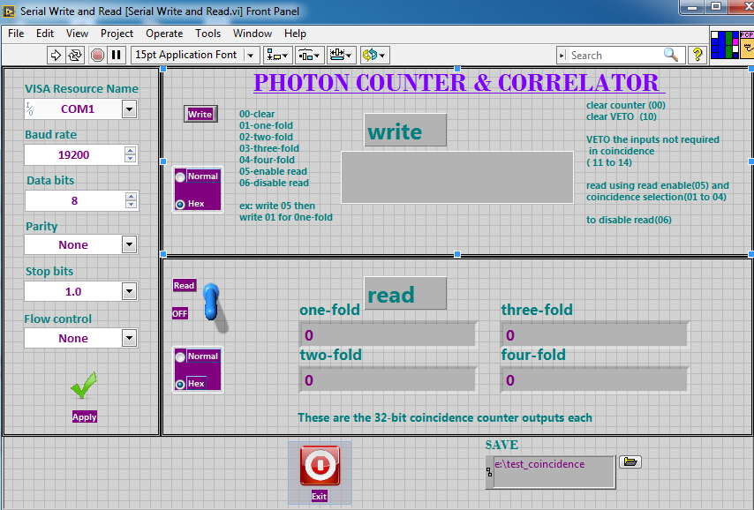
LabVIEW front panel

Slide 9
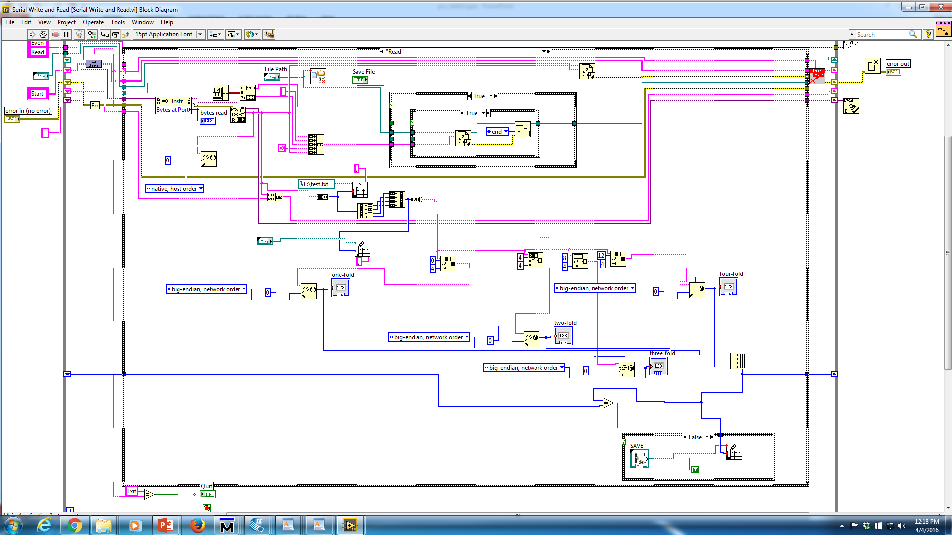
LabVIEW block diagram

Slide 10


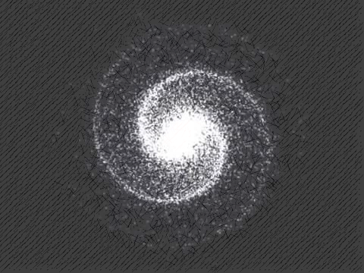
Gravitation group
THANKS
Unni
Ninad
Rodrigues
Guram
Meenakshi
Vaishali
Deepti
&
Acharya
Notes:
Animated 3-D bouncing ball
(Intermediate)
Tip: Some shape effects on this slide are created with the Combine Shapes commands. To access this command, you must add it to the Quick Access Toolbar, located above the File tab. To customize the Quick Access Toolbar, do the following:
Click the arrow next to the Quick Access Toolbar, and then under Customize Quick Access Toolbar click More Commands.
In the PowerPoint Options dialog box, in the Choose commands from list, select All Commands.
In the list of commands, click Combine Shapes, and then click Add.
To reproduce the square shape on this slide, do the following:
On the Home tab, in the Slides group, click Layout, and then click Blank.
On the Home tab, in the Drawing group, click Shapes, and then under Rectangles click Rectangle (first row).
On the slide, drag to draw a rectangle.
Select the rectangle. Under Drawing Tools, on the Format tab, in the Size group, enter 3.67” into the Height box and 3.67” into the Width box.
Also on the Format tab, in the Shape Styles group, click Shape Fill, and then under Theme Colors, click Black, Text, Lighter 50%.
Also on the Format tab, in the Shape Styles group, click Shape Outline, and then click No Outline.
On the Home tab, in the Drawing group, click Shapes, and then under Basic Shapes click Oval (first row).
On the slide, drag to draw an oval.
Select the oval. Under Drawing Tools, on the Format tab, in the Size group, enter 2.85” in the Height box and 2.85” in the Width box.
Press and hold CTRL, and select the rectangle and the oval. On the Home tab, in the Drawing group, click Arrange, point to Align, and then do the following:
Click Align to Slide.
Click Align Center.
Click Align Middle.
Press and hold CTRL, select the square, and then select the circle. On the Quick Access Toolbar, click Combine Shapes, and then click Shape Subtract.
Select the freeform shape. On the Home tab, in the Clipboard group, click the arrow to the right of Copy, and then click Duplicate.
Also on the Home tab, in the Drawing group, click Shapes, and then under Rectangles click Rectangle.
On the slide, drag to draw a rectangle.
Select the new rectangle. Under Drawing Tools, on the Format tab, in the Size group, enter 1.84” in the Height box and 3.67” in the Width box.
Select the rectangle. On the Home tab, in the Clipboard group, click the arrow to the right of Copy, and then click Duplicate.
Press and hold CTRL, select one freeform shape, and then select the rectangle. On the Home tab, in the Drawing group, click Arrange, point to Align, and then do the following:
Click Align Selected Objects.
Click Align Center.
Click Align Bottom.
On the Quick Access Toolbar, click Combine Shapes, and then click Shape Subtract.
Press and hold CTRL, select the second freeform shape, and then select the second rectangle. On the Home tab, in the Drawing group, click Arrange, point to Align, and then do the following:
Click Align Selected Objects.
Click Align Center.
Click Align Top.
On the Quick Access Toolbar, click Combine Shapes, and then click Shape Subtract.
Position the new shape so that the top edge touches the bottom edge of the other shape.
Press and hold CTRL, select the two freeform shapes. On the Home tab, in the Drawing group, click Arrange, point to Align, and then click Align Center.
Also on the Home tab, in the Drawing group, click Arrange, and then click Group.
Select the group. Under Drawing Tools, on the Format tab, in the Shape Styles group, click the Format Shape dialog box launcher. In the Format Shape dialog box, click 3-D Rotation in the left pane, and in the 3-D Rotation pane, in the Presets list, under , under Parallel, click Off Axis 2 Top.
Also in the Format Shape dialog box, click 3-D Format in the left pane, and then in the 3-D Format pane, do the following:
Under Depth, in the Depth box, enter 17.5 pt.
Under Surface, click the button next to Material, and then under Special Effect click Dark Edge.
Select the group. On the Home tab, in the Drawing group, click Arrange, and then click Ungroup.
Select the bottom half of the square. Under Drawing Tools, on the Format tab, in the Size group, click the Size and Position dialog box launcher. In the Format Shape dialog box, click Position in the left pane, and in the Position pane, under Position on slide, do the following:
In the Horizontal list, enter 2.93”.
Next to Horizontal, in the From list, select Top Left Corner.
In the Vertical list, enter 4.01”.
Next to Vertical, in the From list, select Top Left Corner.
Select the top half of the square. Under Drawing Tools, on the Format tab, in the Size group, click the Size and Position dialog box launcher. In the Format Shape dialog box, click Position in the left pane, and in the Position pane, under Position on slide, do the following:
In the Horizontal list, enter 3.72”.
Next to Horizontal, in the From list, select Top Left Corner.
In the Vertical list, enter 3.51”.
Next to Vertical, in the From list, select Top Left Corner.
To reproduce the circle effect on this slide, do the following:
On the Home tab, in the Drawing group, click Shapes, and then under Basic Shapes click Oval (first row).
On the slide, drag to draw a shape.
Select the oval. Under Drawing Tools, on the Format tab, in the Size group, enter 2” in the Height box and 2” in the Width box.
Also on the Format tab, in the Shape Styles group, click Shape Outline, and then click No Outline.
Also on the Format tab, in the Shape Styles group, click Shape Fill, point to Gradients, and then click More Gradients. In the Format Shape dialog box, click Fill in the left pane, in the Fill pane, click Gradient fill, and then do the following:
In the Type list, click Radial.
In the Direction list, click From Center.
Under Gradient stops, click Add gradient stops and Remove gradient stops, until four stops appear in the slider.
Also under Gradient stops, customize the gradient stops as follows:
Select the first stop in the slider, and then do the following:
In the Position box, enter 0%.
Click the button next to Color, and then under Theme Colors click White, Background 1 (first row, first option from the left).
Select the next stop in the slider, and then do the following:
In the Position box, enter 32%.
Click the button next to Color, and then under Theme Colors click Orange, Accent 6 (first row).
Select the next stop in the slider, and then do the following:
In the Position box, enter 85%.
Click the button next to Color, click More Colors, and then in the Colors dialog box, on the Custom tab, enter values for Red: 111, Green: 53, and Blue: 5.
Select the final stop in the slider, and then do the following:
In the Position box, enter 100%.
Click the button next to Color, and then under Theme Colors click Orange, Accent 6, Darker 50% (sixth row).
Select the bottom half of the square. On the Home tab, in the Drawing group, click Arrange, and then click Bring to Front.
To reproduce the animation effects on this slide, do the following:
Select the oval. Position the oval off the top edge of the slide.
On the Animations tab, in the Advanced Animation group, click Add Animation, under Motion Paths, click Lines.
Press and hold SHIFT, and select the red end point of the motion path. Drag the end point of the motion path to the center of the square shape.
Also on the Animations tab, in the Timing group, do the following:
In the Start list, select After Previous.
In the Duration box, enter 02.50.
Also on the Animations tab, in the Advanced Animation group, click Animation Pane. In the Animation Pane, click the arrow next to the motion path animation, and then click Effect Options. In the Down dialog box, on the Effect tab, under Settings, do the following:
In the Smooth start box, enter 0.25.
In the Smooth end box, enter 0.00.
In the Bounce end box, enter 2.00
To reproduce the background effects on this slide, do the following:
On the Design tab, in the Background group, click Background Styles, and then click Style 9 (third row).

Slide 11
1 PPM SPI DAC
SYNC_BAR,SCLK_BAR,SDIN,LDAC_BAR,CLR_BAR,RESET_BAR
20-BIT
PRECISION DAC
AD 5791
ULTRA PRECISION
OUTPUT OP-AMP
AD8675
ANALOG O/P
VHDL
3-WIRE
SPI INTERFACE
AND CONTROL
PRECISION
+/-10V
Ultra precision rail to rail output op-amp buffer AD 8676
PRECISION DUAL VOLTAGE (+/- 10V) REFERENCE AMPLIFIER
+/-15 V
24-BIT DIGITAL DATA

Slide 12
Other activities:
MEMS transducer based interferometer
Square wave generator with variable amplitude, duty cycle and frequency
Students projects
Future plans:
Fpga based lock in amplifier
DSP
STK-600 based voltage monitor
LIGO-INDIA

