Slide 1
Physics at the LHC
M. Guchait
DHEP Annual Meeting
7-8th April, 2016

Slide 2
Outline
Physics @CMS
Inclusive Jets and related measurement(Sanmay)
Z pt measurements(Rajdeep)
Implication: Constraining PDF(Rajdeep).
Higgs Physics (S. Banerjee and Ramkrishna Dewanjee)
Theoretical Studies
NMSSM studies
Invisible Higgs in VBF and ZH
Stop searches
Future Plan

Slide 3

Inclusive Jets
PP → Jets + X
A sensitive probe
Calculation of the cross section
to constrain parton distribution functions(PDFs)
to constrain strong coupling constant and its variation
to look for New Physics searches
Ratio of cross section 7 TeV/8 TeV, reduced scale uncertainty
A powerful constraint to PDFs.

Slide 4

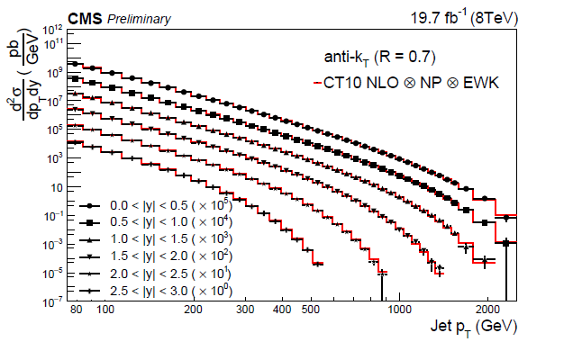
Inclusive Jet cross section
6 rapidity bins:
∆|y|=0.5 ,
0<|y|<3
Theory predictions:
NLOjet++ via
FastNLO
Data is unfolded
SMP-14-001-PAS
Sanmay Ganguly ,
MG + others

Slide 5
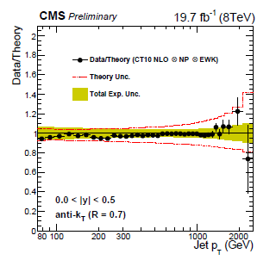
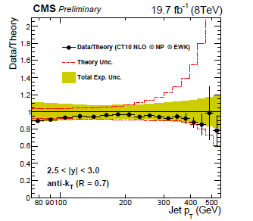
Inclusive Jet cross section
Data and Theory comparison: CT10 PDF sets
Uncertainty: ̴5-8 %
SMP-14-001-PAS
Sanmay Ganguly , MG +
Checked with NNPDF, MSTW, ABM11

Slide 6

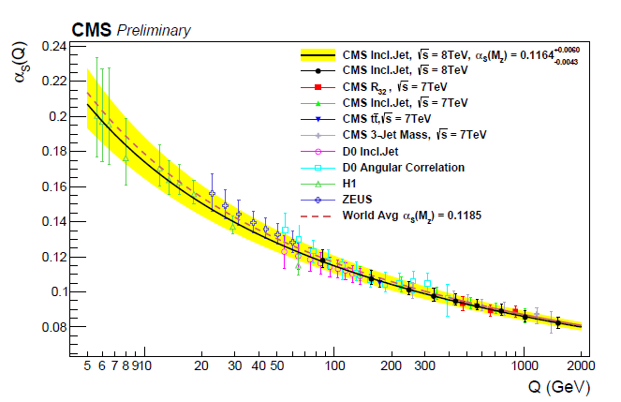
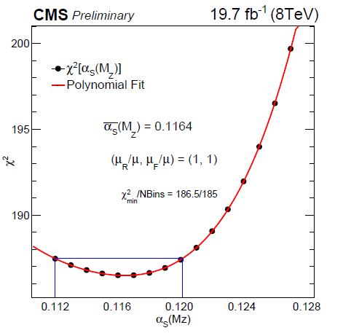
Strong Coupling Constant
= 0.1185 ±0.0006 (World average)
SMP-14-001-PAS
Sanmay Ganguly , MG +

Slide 7
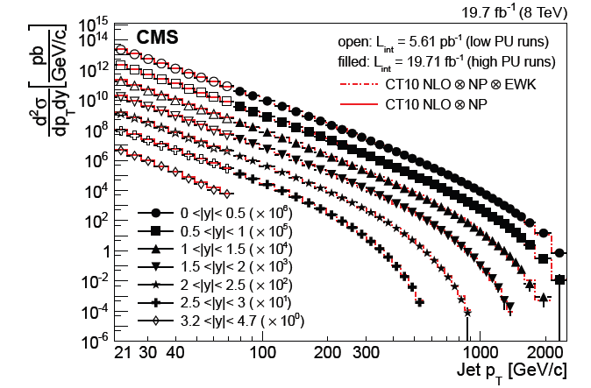
Inclusive Jet: High and Low pT
SMP-14-001-paper
CWR is ended

Slide 8
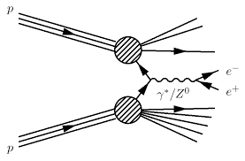
Measurement of Z boson cross section
Z →μ μ
A precision test of the SM:
Testing of QCD via higher order
calculations
Constraining Gluon PDF
Detector calibration, JEC…

Slide 9
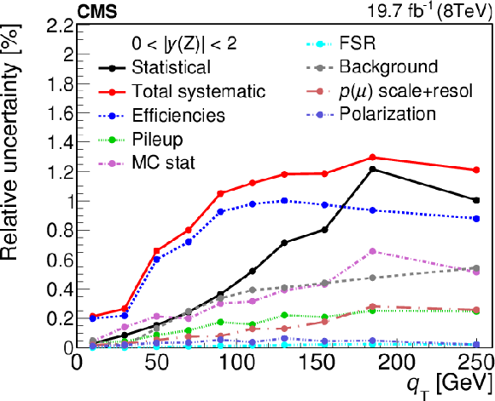
Measurement of Z boson cross section
81 < M(μμ) <101 GeV, PT(μ)>25(10) GeV, |η(μ)| <2.1(2.4)
2D measurements in terms of PT(Z) and Y(Z)

Slide 10
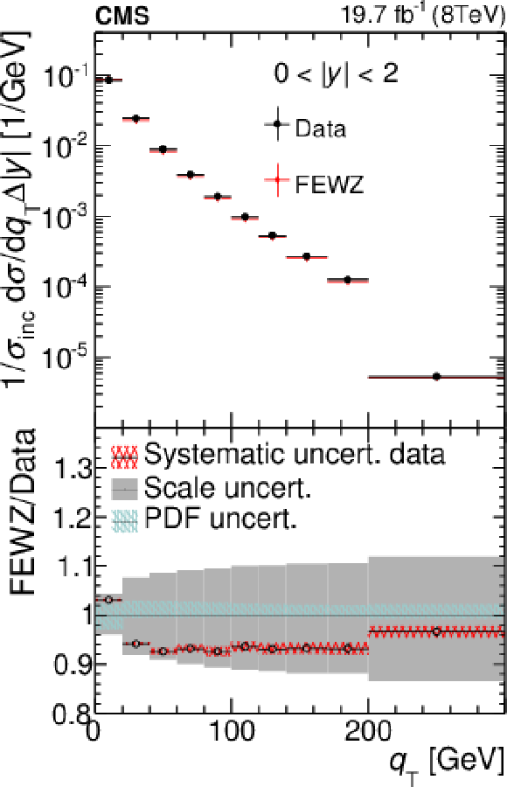
Measurement of Z boson cross section
NNLO FEWZ
NNLO NNPDF2.3
Rajdeep, MG, Markus,
Heiner, P. Sphicas
1504.03511,
PLB, 2015

Slide 11
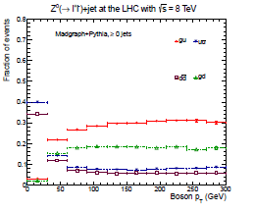
Constraining PDFs
At High Pt(Z),
Gluon initiated
sub-process
Is dominated.
Gluon PDF is sensitive to
this channel.
S.A Malik, G. Watt, 2015

Slide 12
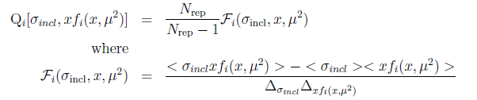
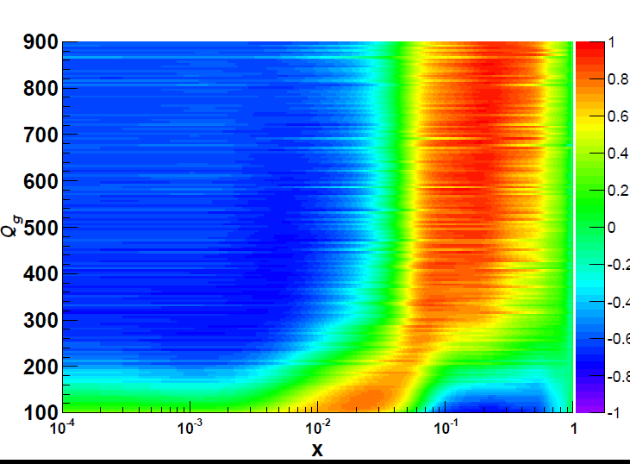
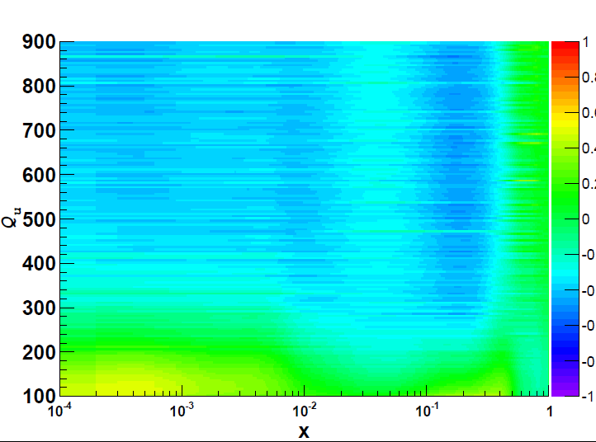
PDFs Sensitivity
MCFM
NNPDF2.3
Gluon
Up valence quarks

Slide 13
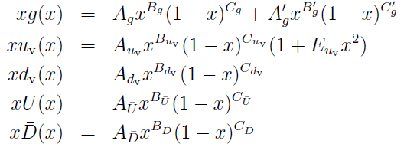
QCD Analysis: Chain
HERAFitter Framework
14 parameters fitting

Slide 14
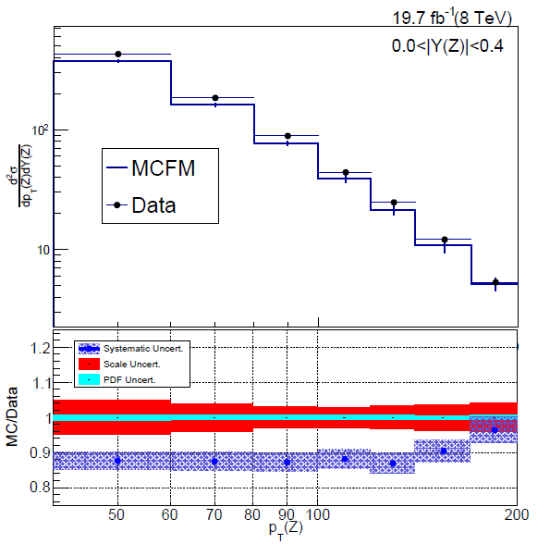
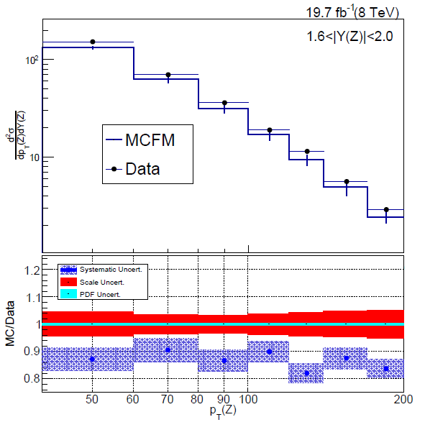
Data and MCFM comparison
PP → Z + 1 jets
NLO, CT10nloPDF,
Agreement ̴ 8-10%

Slide 15
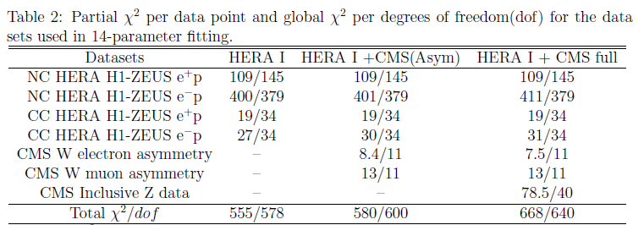
QCD Analysis
Data Sets:
HERA DIS(NC and CC),
CMS W charge Asymmetry
CMS Z boson data
Theory
MCFM NLO via
APPlGrid

Slide 16
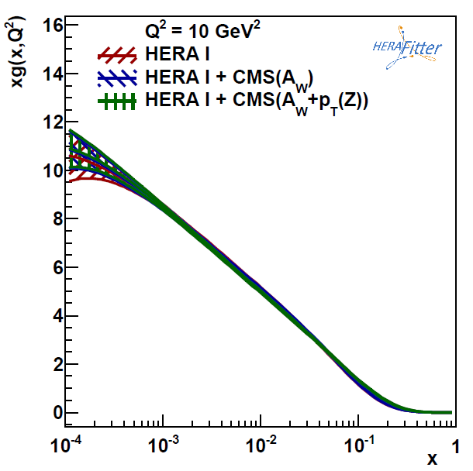
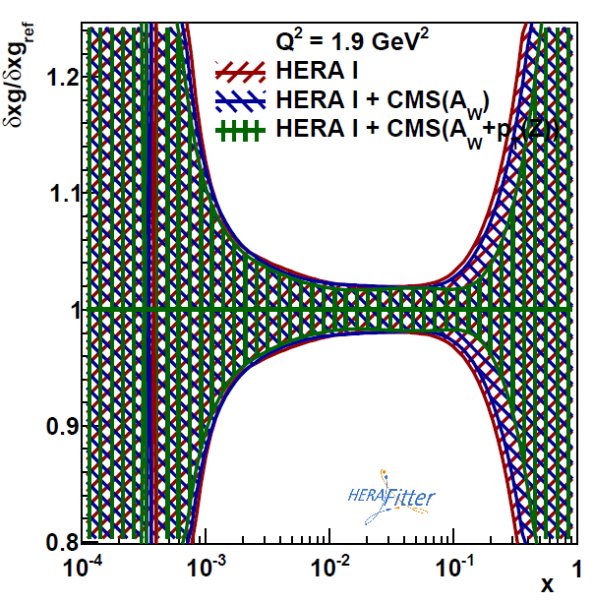
QCD Analysis: PDFs
Gluon PDFs
5-6% effect at x ̴ 0.1

Slide 17
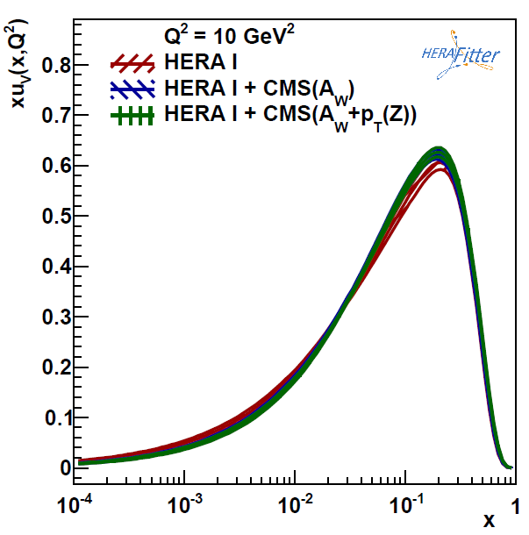
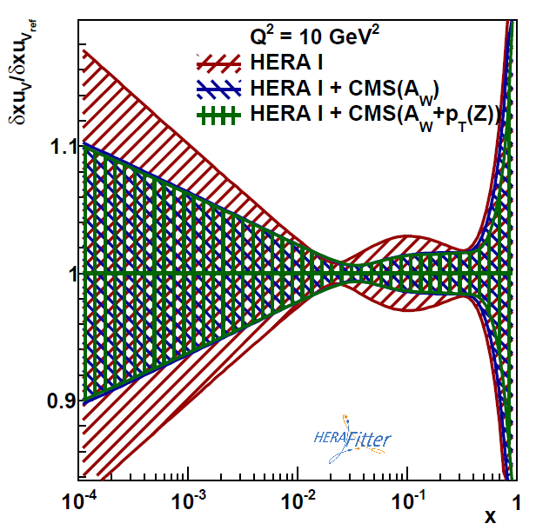
QCD Analysis: PDFs
Up valance quark: PDFs

Slide 18
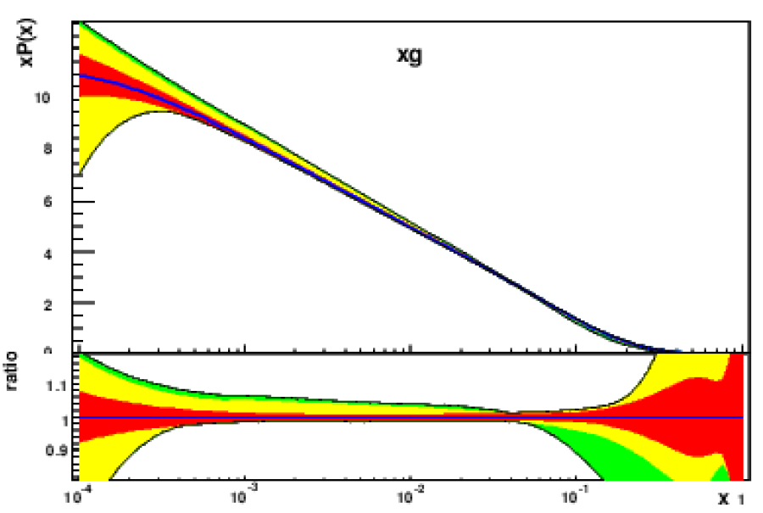
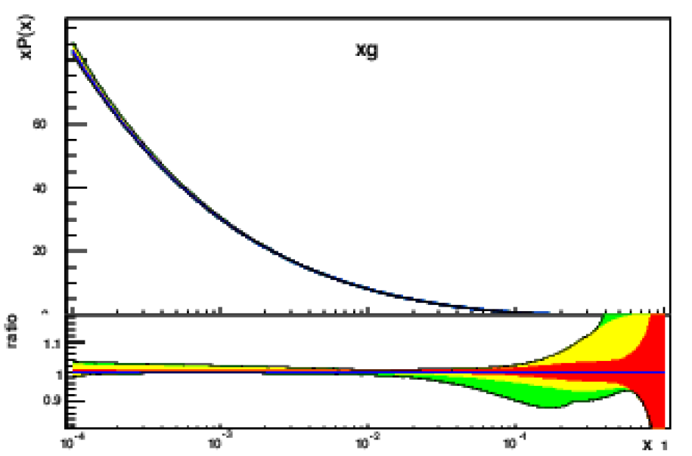
Constrained PDFs
Gluon PDFs
Rajdeep, MG, R. Placakyte
1603.09619
10 GeV²
8317 GeV²
5-6% effect at x ̴ 0.1
More precise theory calculations are required.

Slide 19
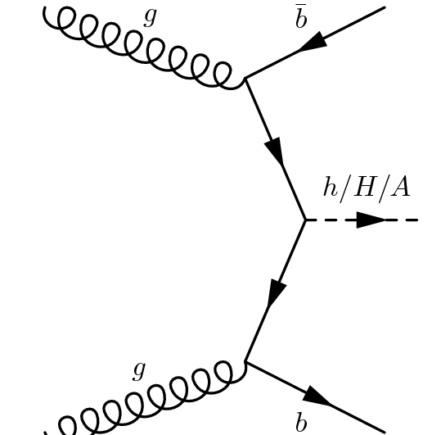
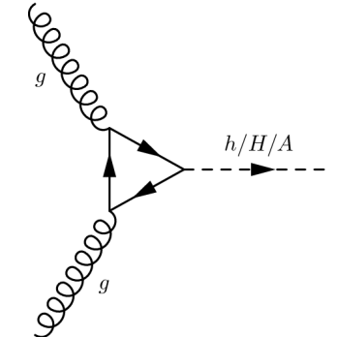
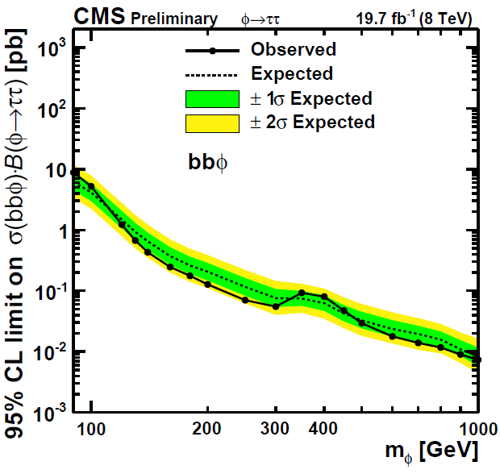
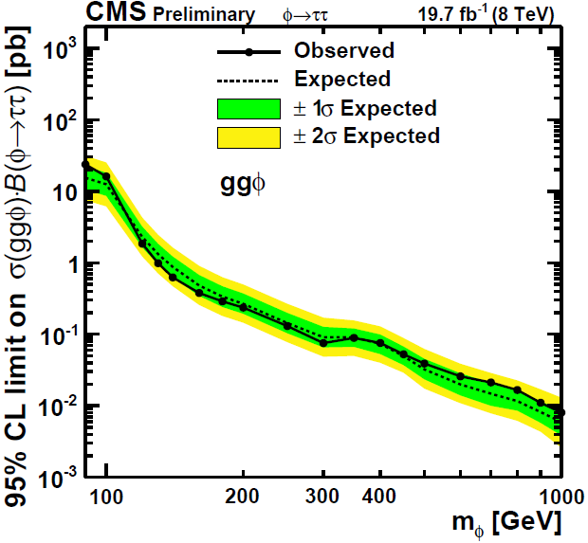
MSSM φ→ττ Search
S. Banerjee and R. Dewanjee
Φ=h,H,A
Sensitive to tanβ
Model
Independent
limit
σ X Br

Slide 20
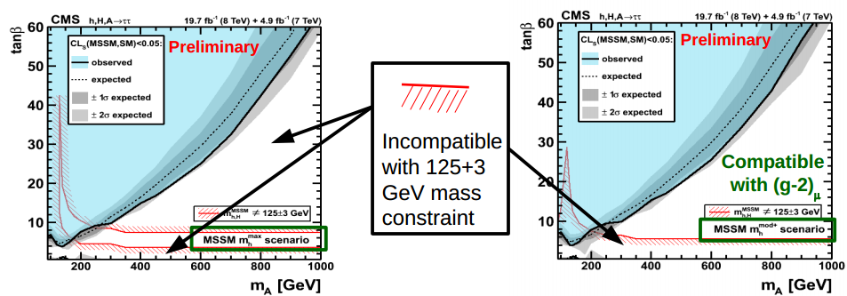
MSSM φ→ττ Search
MSSM limit

Slide 21
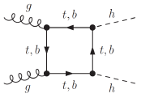
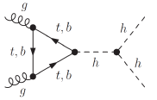
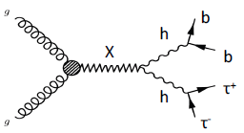
hh →bbτ_{h} τ_{h}
Tri linear couplings
PRL 111 (2013) 201801
New Physics contribution
PRL. 83,(1999)
0705.3844v1

Slide 22
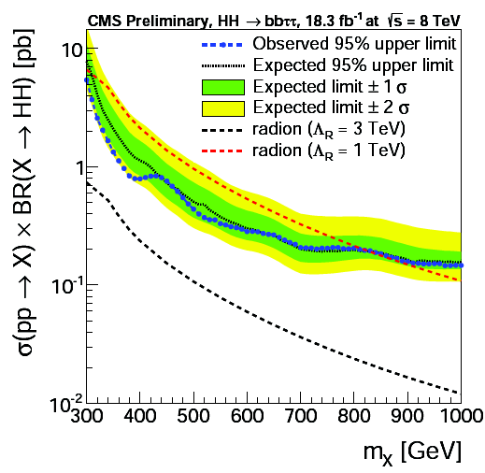
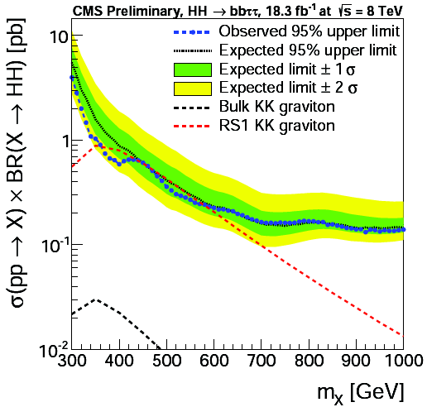
Results: hh →bbτ_{h} τ_{h}
R. Dewanjee and S. Banerjee

Slide 23
Theoretical Studies

Slide 24



Light Higgs Bosons in NMSSM
In MSSM : h, H, A, H±
M_{A} , tanβ
Need special region of parameters to interpret h as the
125 GeV Higgs
In NMSSM, extra Singlet (μ problem)
Higgs Bosons
Parameters :
Higgs Boson Mass
Implications ?

Slide 25
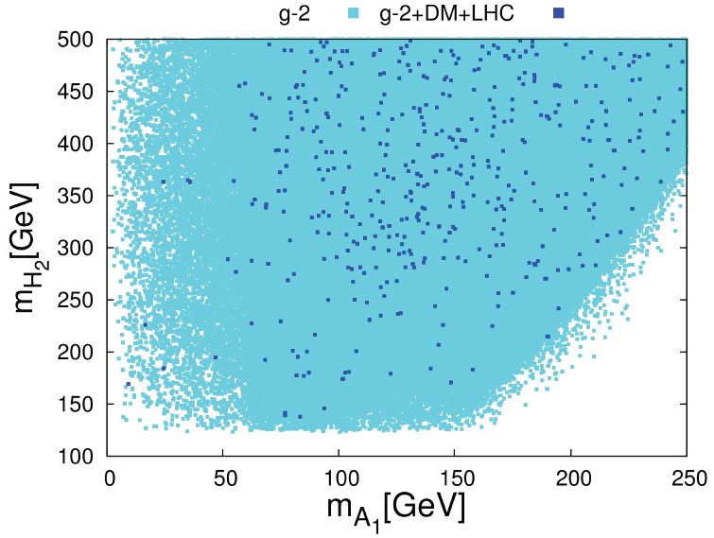
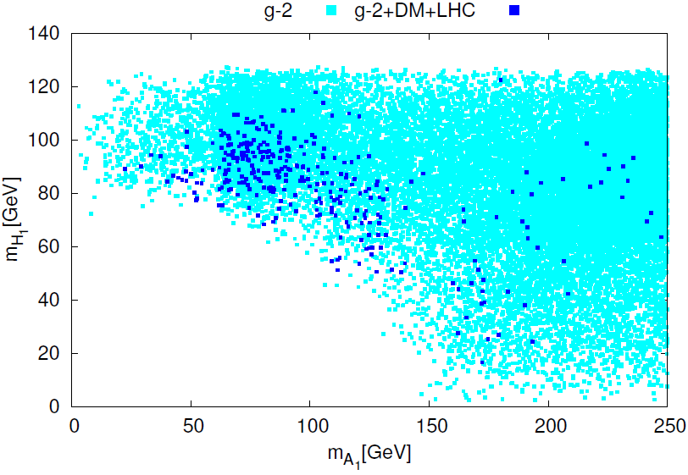
Light Higgs Bosons in NMSSM
Scanning the parameter space with all constraints..
H₁ ̴ H_{SM}
H₂ ̴ H_{SM}
Non SM-like Higgs bosons can be light
Jacky Kumar, MG

Slide 26
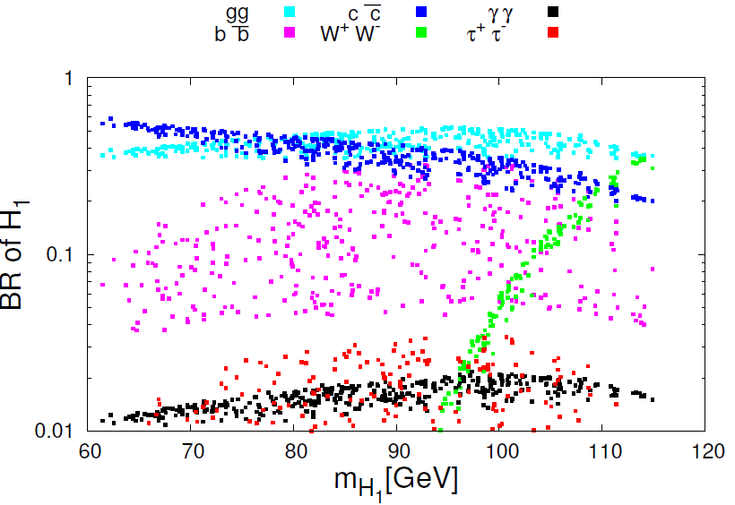
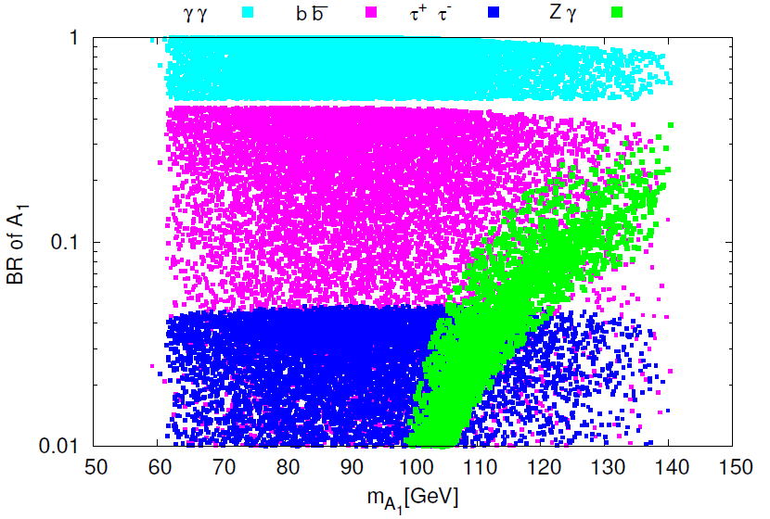
Light Higgs Bosons in NMSSM
BR of Non SM like Higgs bosons
Di-photon mode is very large: Distinct feature…

Slide 27

Light Higgs Bosons in NMSSM: Signal
Signal of Non SM like Higgs bosons
f,, V, γ, X
f, V, γ, X
A₁ mass ̴̴ 20 (60)GeV, 100 (30) γγ events are expected or L=100/fb
Cross section X Br for various final states are computed…
Variety of Signals are possible, in particular, h → φ φ
Jacky Kumar, MG, 1509.02452
To be published, IJMP

Slide 28
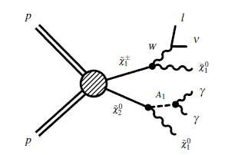
NMSSM: Di photon Signal
Di photon + lepton + Missing energy
PYTHIA8 + Delphes:
Detail background and Signal simulation
Gaugino mass ̴ 350 GeV
Signal Sensitivity
̴5-7σ for L =100/fb
9-11σ for L =300/fb
Jacky Kumar, MG
Work in progress

Slide 29
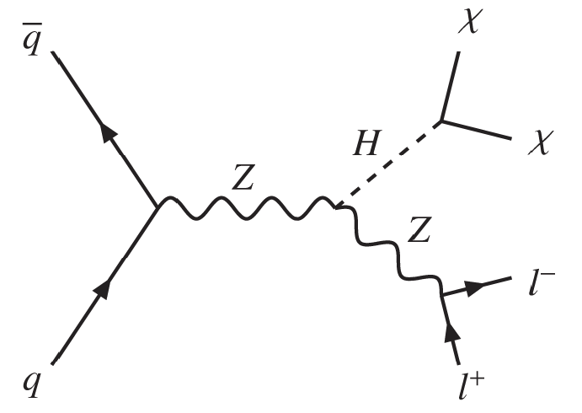
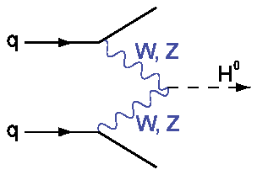

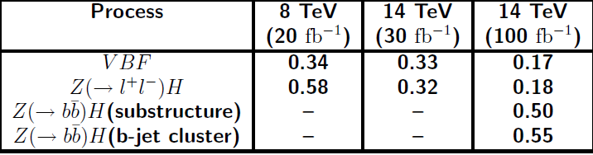
Invisible Higgs and Top squarks
Dipan, MG and others, PLB 2013
Ref. by CMS and ATLAS

Slide 30


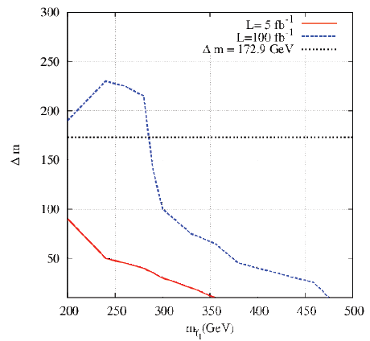

Top squark(FCNC mode)
Use of α_{T} , MT2
ISR jets useful..
Dipan, MG and others..
PRD, 2013

Slide 31
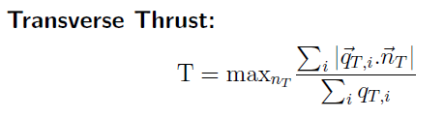


Supersymmetry Searches: Shape variable
SUSY signal is very tiny….can be missed under SM events
Alternative search strategy should be developed..
For large multiplicity T <<1 , Useful to kill QCD, W/Z+jets Background
Suppress top background
Improvement is established
Dipan, Rajdeep, MG, PRD, 2013
CMS AN 2013

Slide 32
Future Plan
CMS Physics:
SUSY searches in tau final states at 13 TeV
Boosted objects in the context of New Physics
Charged Higgs:
Huge background from top pair production;
sensitivity is too low.
Developing search strategy
Boosted top reconstruction
MVA method.
NUGM and SUSY searches at 13 TeV ..on going
LFV and SUSY, A. Iyer, R Samanta, MG, PRD 2015

