Slide 1
Physics and HCAL Detector Performance at CMS experiment
Hadronic Event shape variable to tune QCD MC event generators and measurement of α_{S}
  Madgraph event generator : How to use that at CMS
  Technique to correct the bias in Jet Energy Scale (JES)
  Trigger efficiency of Jets at collider
W+X charge asymmetry to improve Parton Distribution function of proton
  MET smearing in W-asymmetry analysis, double ratio for QCD sample
Phi modulation of Missing Transverse Energy at the CMS experiment
Tools for the monitoring of HCAL gain
  Same for the upgraded CMS HCAL system
HO in the CMSSW Particle flow algorithm and upgraded software
  (Inter)calibration and it’s usefulness in CMS physics analysis
Various work/responsibilities on HCAL DPG
Misconception of muon charge misID

Slide 2
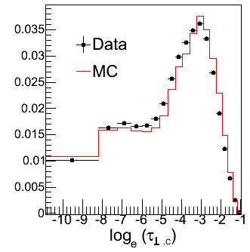
Hadronic Event Shape variable
Experiment : Normalised Event Shape variables are expected to be robust against jet energy scale uncertainties and jet energy resolution effects
Theory : Calculations of Event Shape variables are carried out in perturbative QCD to O(α_{S}²) resumed LL & NLL term to all orders. Variables are defined in terms of four momenta of jets in the transverse plane, in analogy to e⁺e⁻ collider, Banfi, Salam, Zanderighi, JHEP 1006 (2010) 038
Event Shape variables can be used to distinguish different models of QCD multijet production
Possibility : measurement of α_{s}
Central Transverse Thrust,

Slide 3
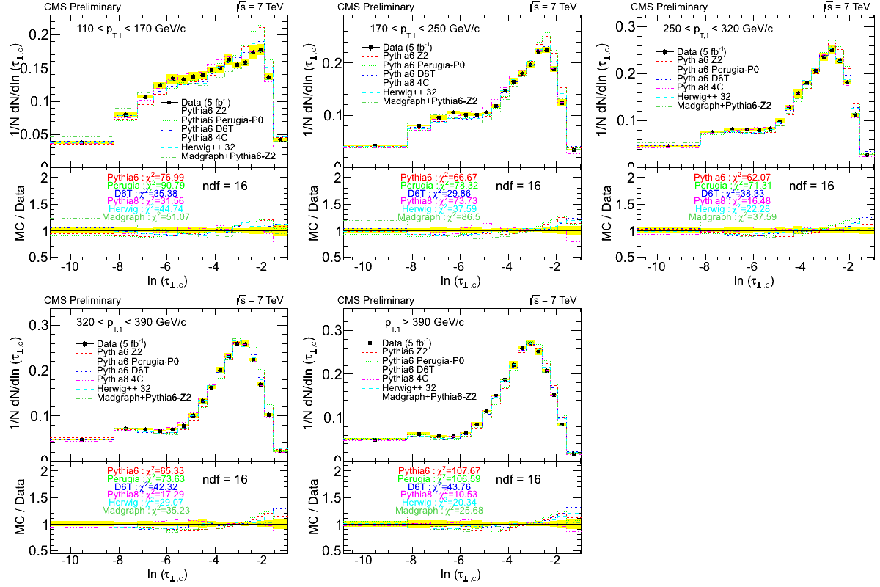
Transverse Thrust
Consistent with 2010 measurement
Sensitive to Transverse energy flow
Insensitive to longitudinal component of momentum, colour connection
Agreement within 5-10% except high value of τ _{⊥,C}
Worst in P_{T}-ordered PS in Pythia6

Slide 4
Tuning of parameter in Madgraph
CMS AN-2014/106
Need tuning parameters, xqcut, pTj and Qcut same for all HT bins

Slide 5
Improper in Jet Energy correction
Ratio
PT of leading Jet
PT of 2nd leading Jet
Problem with correction without considering the subdetector information independently.
Changed the CMS Jet physics result a lot (delayed of many the SM physics publication)

Slide 6
Bias in Jet Trigger
HLT_Jet60, 110, 190, 240, 370
Efficiency measurements
HLT_Jet90/HLT_Jet70 …, give higher efficiency due to mis-measurement of track pt in HLT level
  Use muon triggered events, low statistics for lower threshold (high prescale)
  Tag one jet with HLT criteria and look for jets in opposite hemisphere with an associated HLT object.
    Commonly used for leptons, tag & probe
    Need not to worry about prescale factor

Slide 7
Conclusion of Even Shape analysis
Measurements are compared with several QCD inspired models and their tunings.
  Madgraph, shows the best matching with data.
  Reasonable agreement with different tunes with PYTHIA8 and Herwig++.
  PYTHIA6 with CMS default tunes shows significant disagreement with the data, whereas D6T tune with virtually ordered parton showers shows better agreement with data.
  Colour connection between soft scatters and beam remnants, transverse energy flow, ISR are major source of discrepancies.
Present status
  Tune QCD MC sample. Already parameters of Madgraph are tuned with this event shape variable
  Looking for 13 TeV data
  Main goal is α_{S}, though do not expect much precession, but this will give weight along with other measurements.
CMS AN-2013/079, 2016/xxx

Slide 8
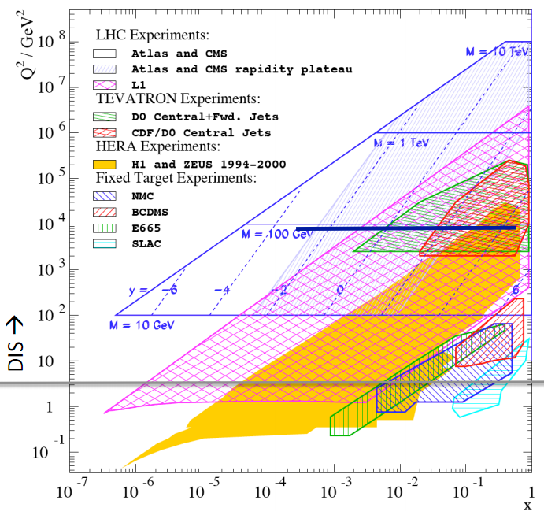
Parton distribution function : W asymmetry
W and Z production : Leading order process,
For measurable rapidity range, |Y|<2.5, x remains within 5×10⁻⁴ < x < 5 ×10⁻²
At high Q², gluon is dominant parton ⇨ sea quarks are generated by flavour blind g→qq splitting. Production rate is related to gluon distribution function
With the assumption

Slide 9
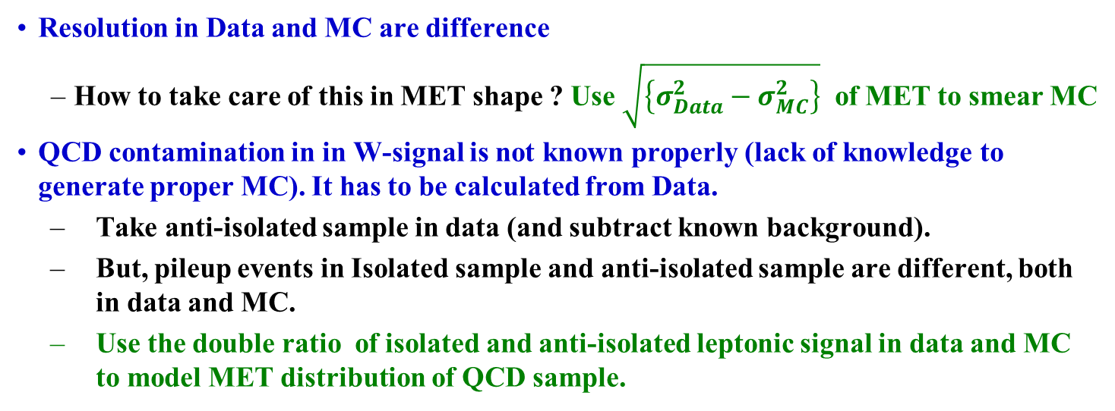
W-charge asymmetry at 7&8TeV
Resolution in Data and MC are difference
  How to take care of this in MET shape ? Use $\sqrt{\left\{σ_{Data}^{2}−σ_{MC}^{2}\right\}}$ of MET to smear MC
QCD contamination in in W-signal is not known properly (lack of knowledge to generate proper MC). It has to be calculated from Data.
  Take anti-isolated sample in data (and subtract known background).
  But, pileup events in Isolated sample and anti-isolated sample are different, both in data and MC.
  Use the double ratio of isolated and anti-isolated leptonic signal in data and MC to model MET distribution of QCD sample.

Slide 10
CMS W-asymmetry and PDF
HERA+CMS/ATLAS measurement is giving better pdf.
CMS AN-2012/153, 2014/114

Slide 11
Missing Transverse Energy
CMS AN -2013/115
Azimuthal angle should be flat, but in reality this was not
CMS has point out that HF alignment was the source of it
Correct the HF alignment to make it smooth (or use adhoc correction)
Decided to have rerun whole dataset with this correction
But, it was pointed out that HF is not the source of it, main source is beam position, dead channels in calorimeter noise level (function of pile up)
2013, re-reconstruction was done without this HF correction
Now we know what is the exact sources of this modulation
https://indico.cern.ch/event/226677/contribution/2/material/slides/0.pdf

Slide 12
Sources of MET-Phi modulation
CMS AN -2014/262
OOT PU + HCAL : The largest effect of OOT PU is in the HCAL and is related to the QPLL issue (wider signal window).
Tracker : The largest effect in the Tracker comes for the beamspot position with respect to the pixel detector, especially in the forward region.
  Inefficiencies also have a large effect.
ECAL : The modulation in ECAL is affected by PU, beamspot position (for EE) and also inefficiencies.
HF : In MC, the largest effect is of beamspot position followed by inefficiencies. The beamspot position in
  Data is different, giving rise to large Data - MC difference.
General :
  Combined effects of noise, pedestal width, gain etc play a significant role for this modulation.
  In MC, beamspot position has a large effect in forward regions such as HF and the endcaps, apart from inefficiencies.
Instead of any adhoc correction, now CMS software is taking care of these individual effects separately to reduce the modulation, better comparison of Data and MC

Slide 13
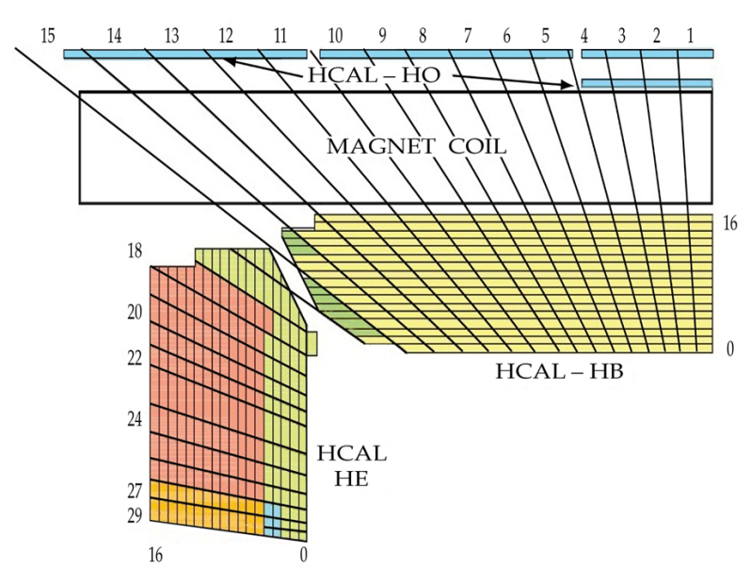
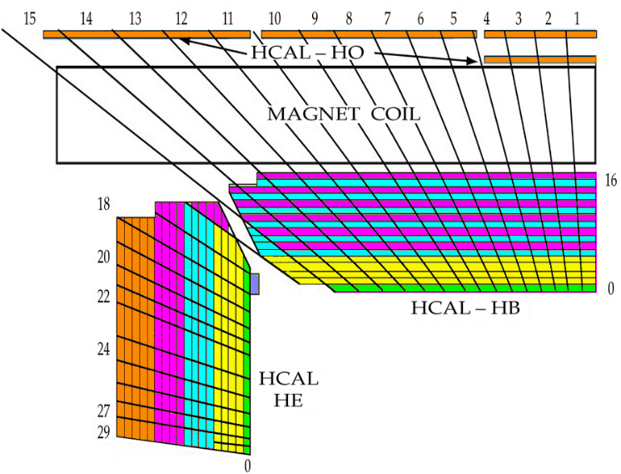
CMS HCAL System
Upgraded HCAL

Slide 14
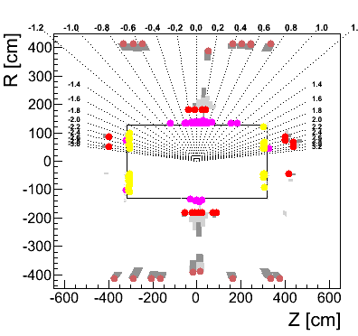
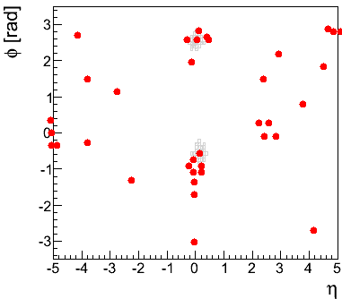
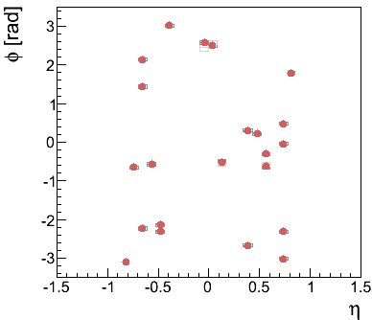
HO in PFJet Algorithm
HO hits/clusters are included in PFCluster object
Included also in PFRootEvent Visualisation code
CMS DN-2013/001
HCAL
HO
Associate (Link) HO with tracks and HB towers, which automatically include associated HO energy in PFCandidate of HB towers/Tracks
  Isolated HO towers will not use for Jet/MET calculation
  This is an integral part of the CMS event reconstruction code
  This concept is propagated in upgraded CMS software
https://indico.cern.ch/event/187073/session/11/contribution/44/material/slides/1.pdf
Recalculate all weight factors again, including wt factor for EB, HB
Compare Jet/MET resolution with and without HO
With better Readout (SiPM), this is being done again

Slide 15
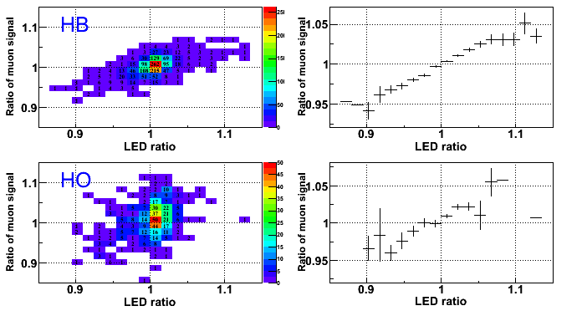
Correlation of LED and muon signal in HPD
The LED system : Proper/malfunction
Muon signal ratio : (Oct) vs (May-June)
LED ratio : Oct vs May 2011
|iη|<15
|iη|<5
Perfect correlations in the shift in LED signal and Muon signals in HCAL.
In 2015 this technique is also used for consistency check of LED signal.
https://indico.cern.ch/event/254240/contribution/4/material/slides/0.pdf

Slide 16
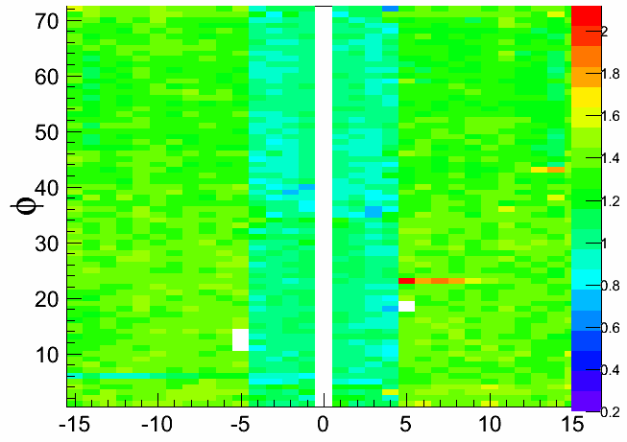
HO response correction using 2015 collision data
CMS DN-2015/029
iη
These correction was updated in database and ReRECO of 2015 data were done with this correction

Slide 17
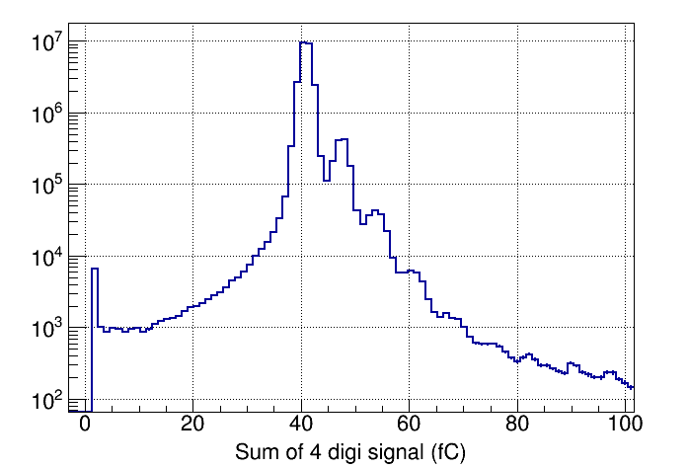
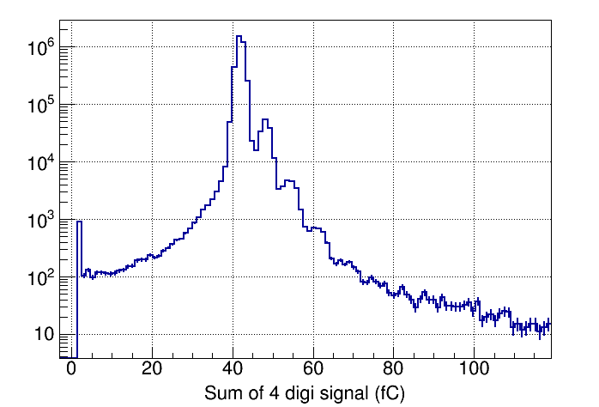
Monitoring of HO SiPM gain and plan for upgraded HBHE
Concept is known since 2005, but yet to implement in the CMS experiment
Thermal noise gives signal of one/two/three electrons.
Due to large gain and low noise, in SiPM, we see the peak of many individual peaks of photo-electrons.
Main problem is to model the signal and automated input to fit all 2154 channels without divergence.
Better than 0.5% accuracy with data of 1 minutes
Looked in HO sample to establish this technique for HBHE also in coming years.
Sum of four consecutive TS
Certainly take care of any hardware failure and is one of the main calibration mode in phase-II CMS HCAL system.

Slide 18
Looking for Beam Flush event : 29th March 2016
Timing !!
Low Gain
Dead Channels.
HF channels was assumed to be fine. Valid pedestal, but no signal/low gain.

Slide 19
Other HCAL activities
Since 2011, difference L3/L4 position in HCAL DPG
  Main job is to guide students of CMS collaboration for HCAL Data quality monitoring and developed software to identify unexpected problems.
Personally looked for many of them, e.g., in last year,
  Using 2012 data predict the HCAL performance with 200PU and 25ns
  Radiation damage study in HE and HF using collision data,
  Correlated HPD noise for whole period of 2015,
  Effect of NZS and shift in HCAL pedestal in early 2015 collision data.
  ………………….

Slide 20
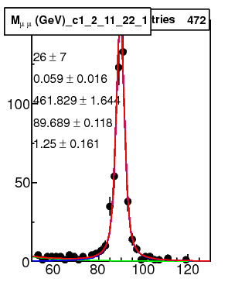
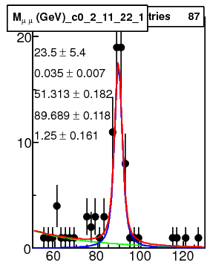
Tag and Probe method for muon efficiency
Calculate muon energy scale, trigger, offline selection efficiency using Tag and Probe method.
Choose first muon after all selection criteria (Tag) and apply other criteria on second muon (Probe), Fit Mµµ for these selected and rejected events with a exponential (+polynomial) function for background and Gaussian convoluted Breit-Wigner function (for signal).
Use ratio of events in signal peak for efficiency etc. Peak position for scale.
Rejected
Selected
An example of mass fit
Mµµ (GeV/c²)
Mµµ (GeV/c²)

Slide 21
Muon charge misidentification
Misconception to measure charge misidentification of muon using Z/(J/ψ)/ϒ→μμ events.
This is possible for electron in Z /(J/ψ)/ ϒ→ee channel.
What is difference in μμ and ee channel ?
  In the case of electron energy is measured in EM calorimeter, not in tracking devices
  If electron energy use information of tracker, then also misidentification rate is wrong.
Another misconception, comparison of charge in tracker/global muon, where muon 4-vector is mainly dominated by tracker

Slide 22
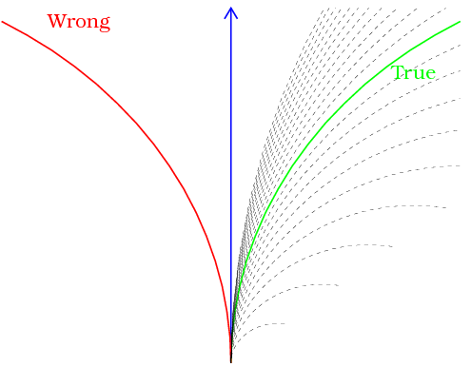
Reconstruction of muon with opposite charge
Same momentum, but opposite in sign to have Z-peak
What’s the probability to have this scenario (same momentum, but opposite in sign) ?
Negligible change to have peak
There is NO correlation of measured and true momentum, when muon charge measurement is wrong and do not expect any Z / (J/ψ) / ϒ peak from dimuon channel

Slide 23
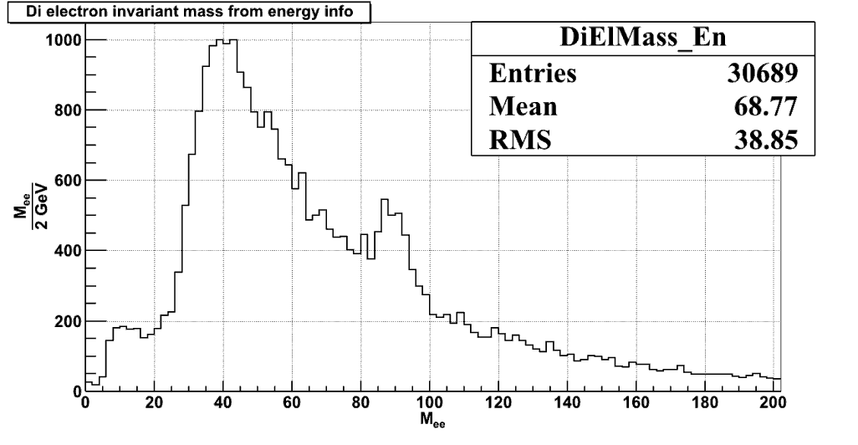
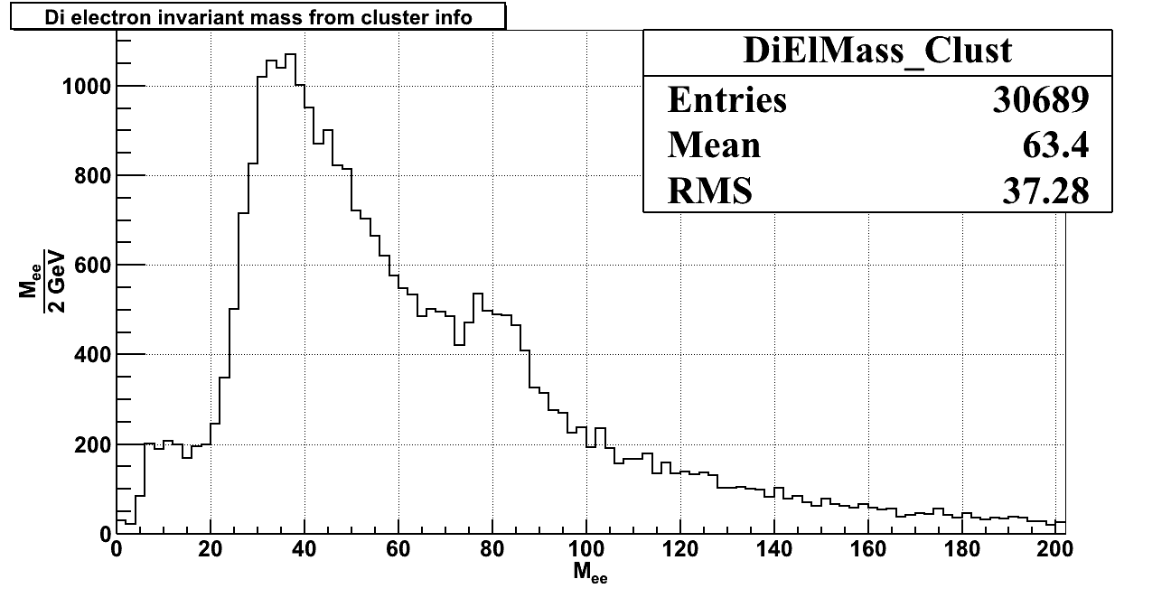
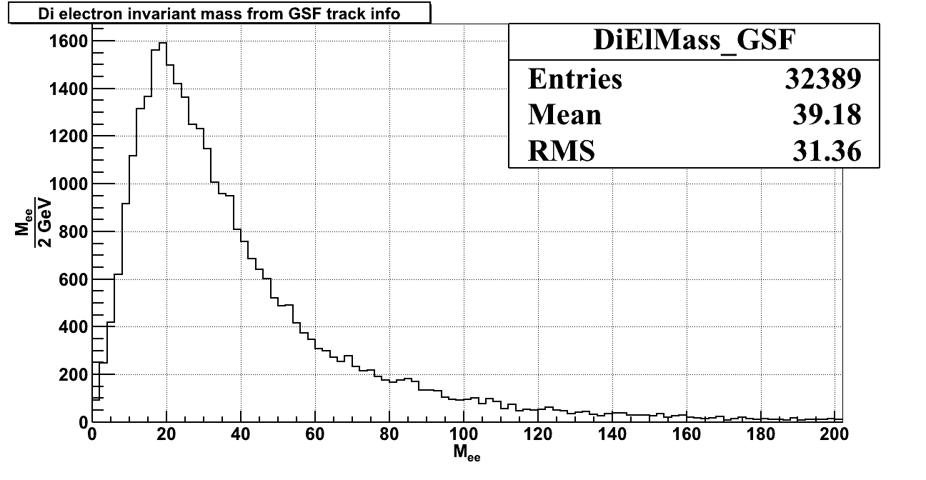

Same sign electron
  GsfElectron (Information from Electromagnetic cluster)
Associated super cluster (EM information)
  GsfTrack (Charge track)
No peak at all for same sign tracks
Electron energy is the combination of GSF momentum and cluster energy. GsfTrack momentum gives bias in the estimation of misidentification, while use electron momentum for charge misId

Slide 24
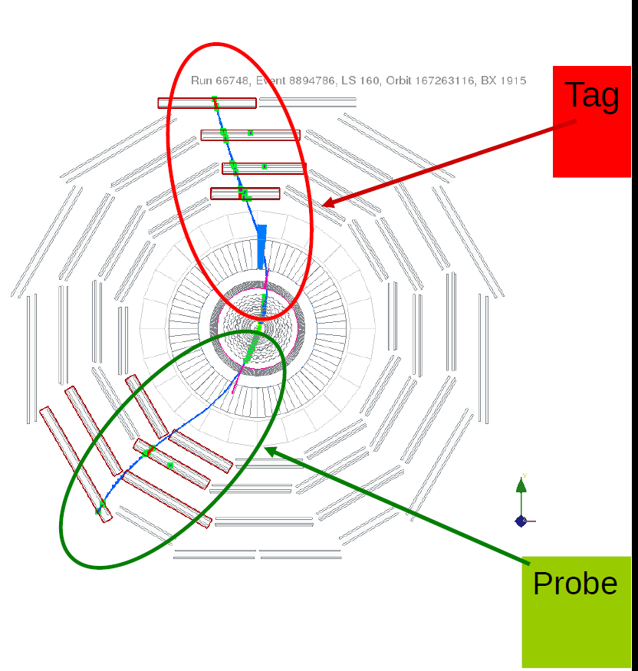
Muon charge misidentification
Either assume that MC does the job or
Use cosmic muon event: Reconstruction of two legs in cosmic muon
But the environment are very much different in cosmic event and physics events, where many more tracks, which deteriorate performance of reconstruction/resolution
Had one-to-one conversations with
Ex-spokesperson of the CMS collab
Top level physics co-ordinators
Sub group co-ordinators
https://indico.cern.ch/event/182195/contribution/1/material/slides/1.pdf

Slide 25
Immediate plan
Hadronic Event Shape at 13 TeV + Other Physics with Jets
Relative weight factor of HO (Absolute Calibration)
Participation in HGCL Test Beam activities (Poster)
Developed HGCAL sensor (with BARC) and took it to TestBeam and verify the its physics potential
Continue activities in HCAL DPG

Slide 26
Introduction
Central Transverse Thrust,
Total Jet broadening,
Total Jet mass,
Also in transverse plane.
Three jet resolution parameter,
Kt-algorithm with R=0.6

Slide 27
A practical example : Z→ee in CMS
Take the direction of electron from GsfElectron, but momentum from
  GsfElectron (Information from Electromagnetic cluster)
  Associated super cluster (EM information)
  GsfTrack (Charge track)
  Nearest track (Charge track)
Now, reconstruct invariant mass with same sign and opposite sign of electron (for first two cases), GsfTrack and Tracks

Slide 28
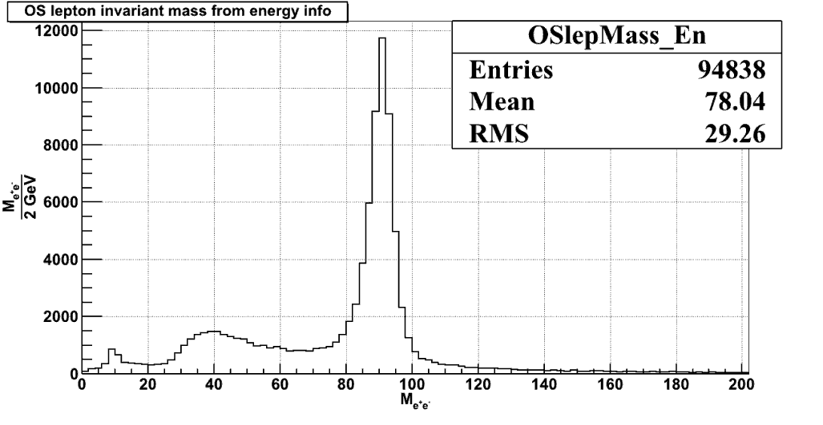
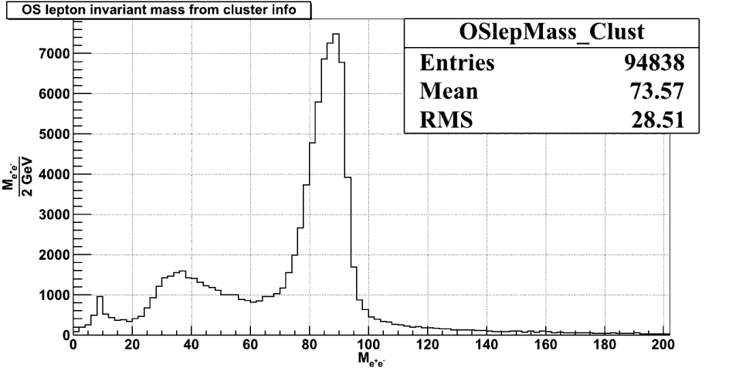
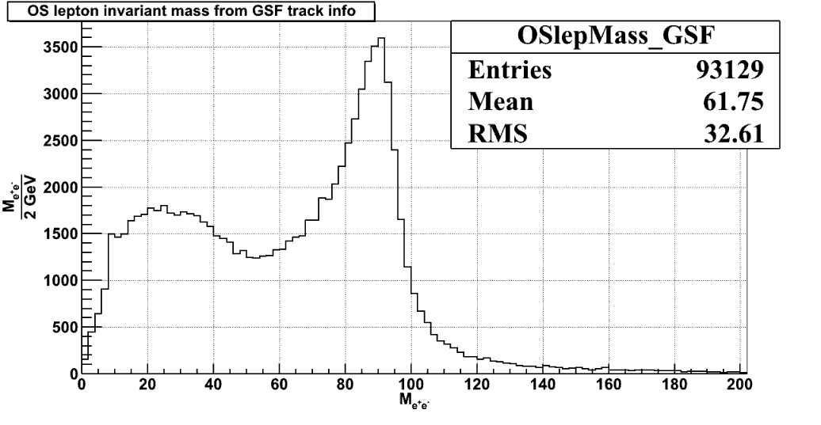
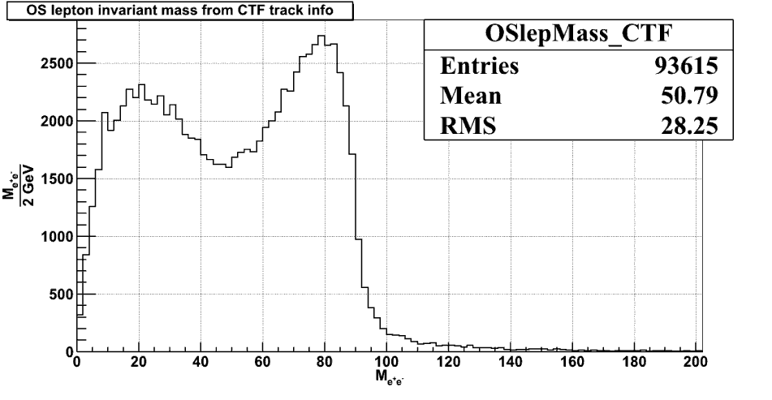
Opposite sign electron
Tracks momentum is poorer, which reflects in the width of mass peak

Slide 29
Fit results : (−15,5) & (−15,6)
Main problem is to model the signal and automated input to fit all 2154 channels without divergence.
All these channel shows clear five peaks
Only 1000 events is required to achieve accuracy of about 2% and
Better than 0.5% accuracy with data of 1 minutes
Certainly take care of any hardware failure and is one of the main calibration mode in phase-II CMS HCAL system.

Slide 30
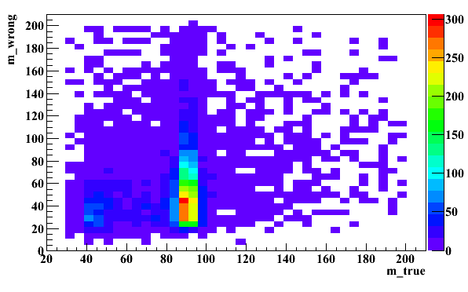
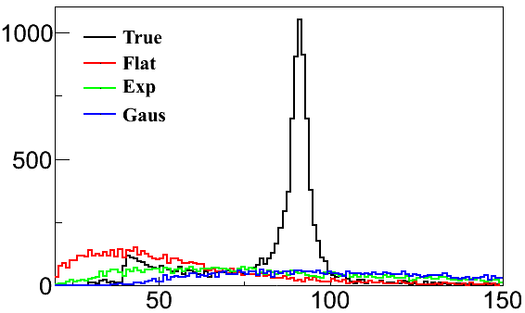
Reconstruction of muon with opposite charge
Smeared momentum (1/Pt) assuming measured momentum varies from 10 GeV to 1TeV.
  Uniform smearing
  Exponential tail
  Gaussian tail
Mμμ (Smeared)
Mμμ (True)
As expected, there is no peak while momentum is smeared to have opposite sign muon wrt to true value
Mμμ

