Slide 1

TECHNOLOGY
2035
VISION
- AN INSIGHT
Dr. Gautam Goswami
Scientist F & Head, Technology Vision 2035 Exercise
Technology Information, Forecasting & Assessment Council
(Autonomous body under Dept. of Science & Technology, New Delhi)

Slide 2
OUTLINE
TIFAC – Introduction & Activities
Philosophy of Vision
Technology Vision 2035 document
Making of TV 2035

Slide 3
TIFAC – Introduction & Activities

Slide 4
TIFAC
Autonomous organization under DST; established in 1988
Mandated to be a technology think tank that keeps an eye on future technology trends and delineates technology trajectories for the nation
Governed by a Council of eminent experts from Government, R&D institutions, Academia and Industry
  Chairman - Dr. Anil Kakodkar

Slide 5
TIFAC ACTIVITIES
- a glimpse
  Technology Foresight (Visioning exercise, Road mapping, Horizon Scanning, Technology Assessment, Techno Market Survey reports, Training etc.)
  Nurturing Innovation & Industry support (Patent facilitation, Commercialization of technological innovations and Technology infusion in MSMEs)
  International linkages: International Institute for Applied Systems Analysis (IIASA), Government organizations- Foresight Network (GFN)…

Slide 6
PHILOSOPHY OF VISION

Slide 7
PHILOSOPHY OF VISION
Refuses to take a distinct shape with sharp outlines in mind space
TV 2035
Not a foresight exercise
Nebulous & amorphous
Dream for Future India
Not a prediction exercise
Not a forecasting exercise

Slide 8
TECHNOLOGY VISION 2035

Slide 9
KEY COMPONENTS
Retrospection
TV 2035
Where are we now?
Where would we like to go?
What is the best way to get from here to there?
What impediments will technology throw up along the way?
Critical challenges towards transformation of the country
Grand Challenges
Aspirations & Prerogatives
Technology interventions
Capabilities & Constraints

Slide 10
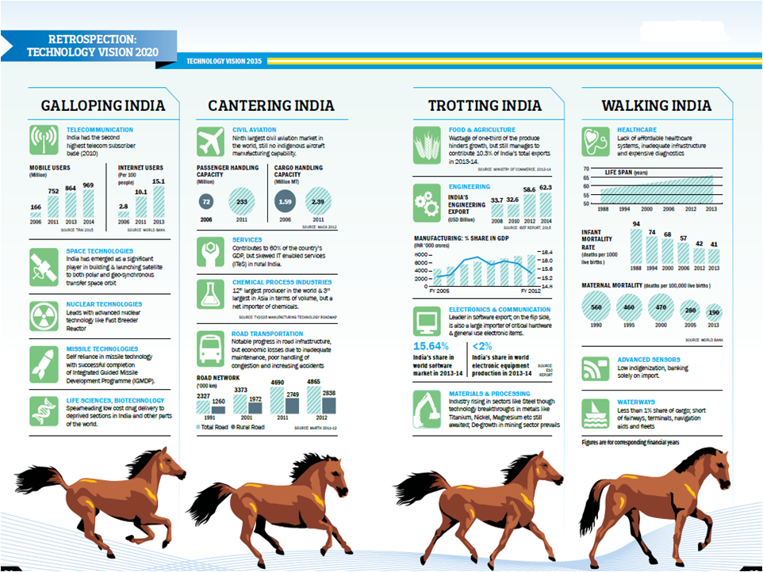

Slide 11
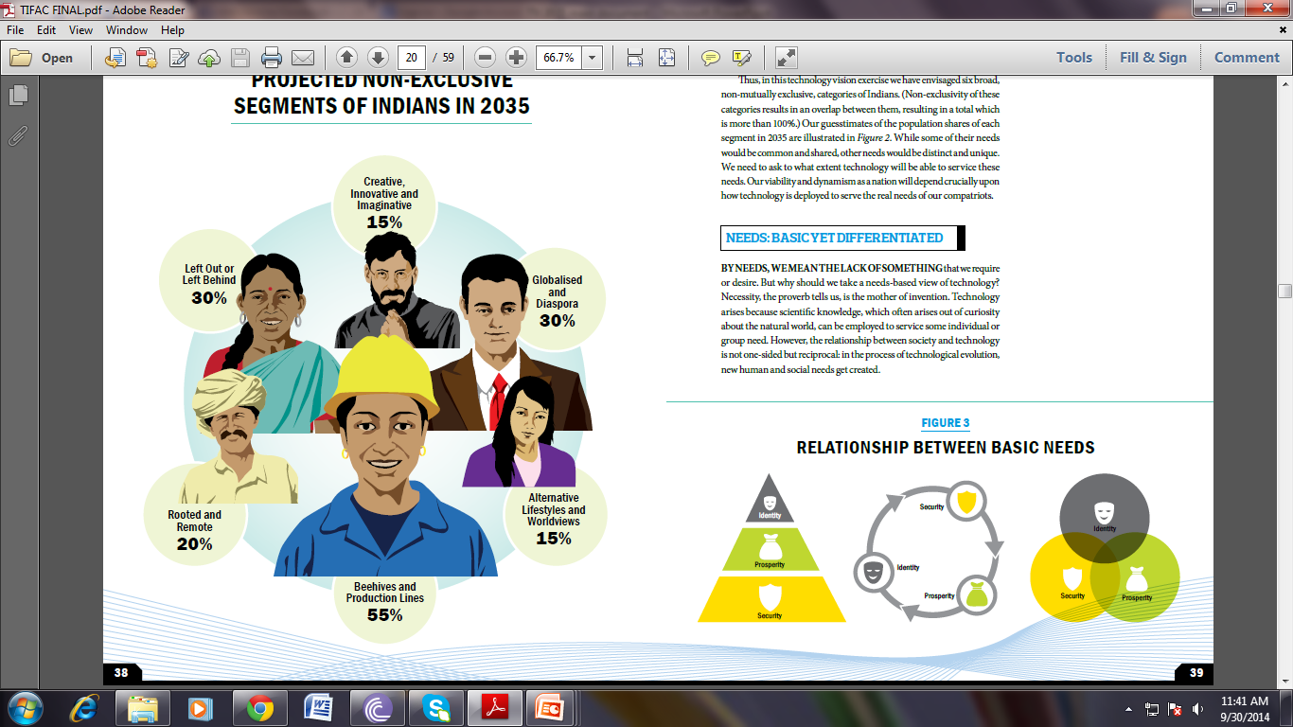
INDIAN IN 2035
Projected
non-exclusive segments of Indians
©TIFAC
Notes:
Percentage is based on guesstimates by TIFAC

Slide 12
ASPIRATIONS
Ensured Security
Strengthened Identity
Universal availability of legal protection and speedy justice delivery.
Genuine e-governance albeit with a human face.
Every expectant mother enjoys healthy and incident-free period of gestation and delivers a hale and hearty child.
Every new born child would be free from any deliberating or life threatening disease or disorder.
Equal opportunity to be assured to all citizens to nurture their talents.

Slide 13
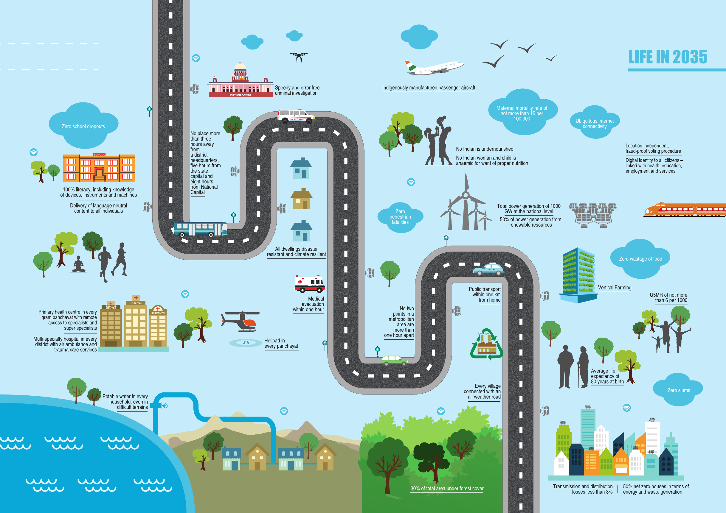

Slide 14
VISION FOR 2035
Technology in the service of India: ensuring the security, enhancing the prosperity and strengthening the identity of every Indian.

Slide 15
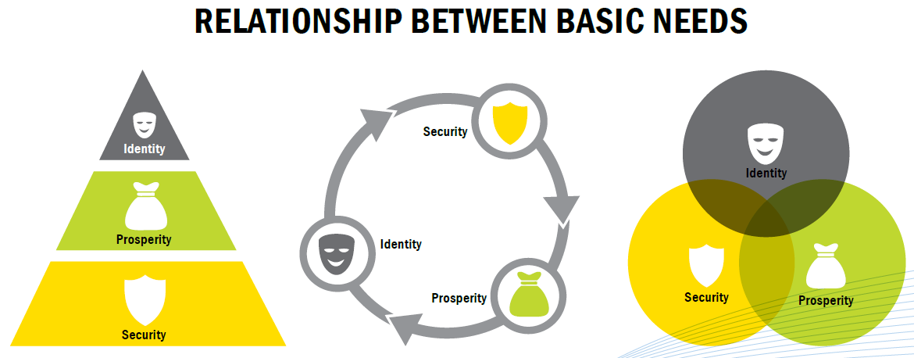
NEEDS
©TIFAC

Slide 16
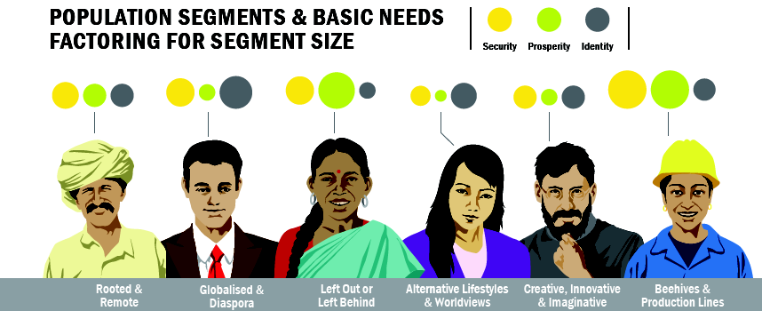
INDIANS IN 2035
©TIFAC

Slide 17
INDIANS IN 2035
©TIFAC

Slide 18
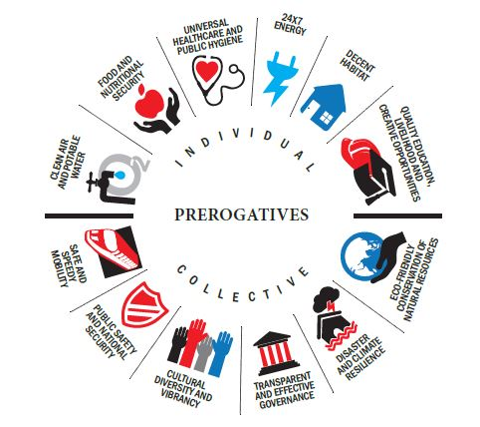
PREROGATIVES
Prerogatives/ Entitlements/ Aspirations/ Wishlist/ Targets/ Goals
PREROGATIVES

Slide 19
UNIVERSAL HEALTHCARE & PUBLIC HYGIENE
Primary health centre in every gram Panchayat with remote access to specialists and super-specialists
Multi-speciality hospital in every district with air ambulance and trauma care services
Average life expectancy of 80 years at birth
Maternal mortality rate of not more than 15 per 100,000
U5MR of not more than 06 per 1,000
Decentralization of healthcare system
At least one toilet in every household

Slide 20
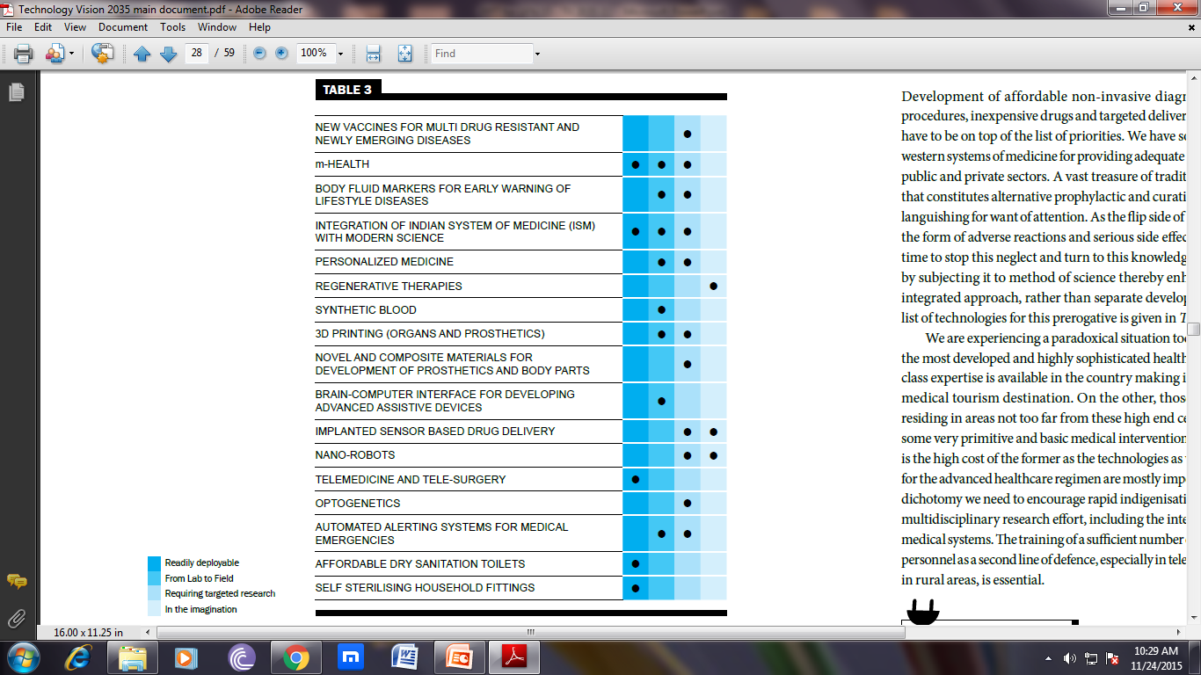
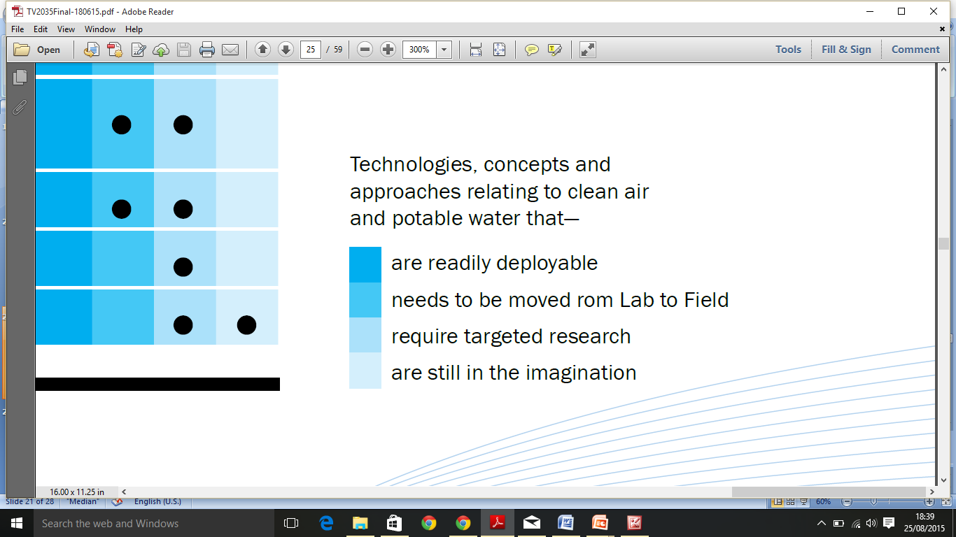
Universal Healthcare & Public Hygiene
emerging and future technologies
Ready for deployment
From lab to field
Requiring targeted research
In the imagination

Slide 21
DECENT HABITAT
Affordable decent habitat for all
India to be a country of zero slums
50% of the houses to be net zero in terms of energy use and waste generation with zero maintenance
Make all dwellings disaster resistant and climate resilient
Faster and more efficient construction with maximum use of recycled materials
Development of alternative building materials to reduce the use of scarce materials such as sand

Slide 22
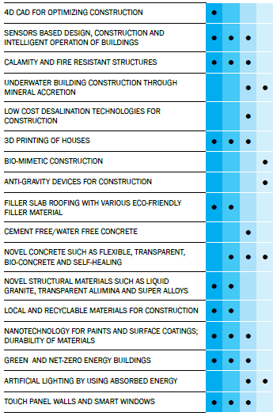
Technologies, concepts and approaches relating to Decent Habitat
Ready for deployment
From lab to field
Requiring targeted research
In the imagination

Slide 23


CAPABILITIES & CONSTRAINTS
Technology leadership (attained in)
  Nuclear energy
  Space technologies
  FBR
  Remote sensing systems
  IT based systems
  Traditional knowledgebase
Technology independence (required in)
  Strategic technologies
  Computerised management of water resources, communication networks, transport systems, energy grids
  Increasing productivity of crop plants
  Self sufficiency in oil seeds & pulses
  Manufacture of essential life saving drugs

Slide 24

CAPABILITIES & CONSTRAINTS
Technology adoption (desirable in)
  Food storage and preservation
  Waste water treatment
  Desalination technologies
  Climate change mitigation
  Micro-level weather forecast
  Effective rainwater harvesting

Slide 25
GRAND CHALLENGES
- that we should confront as a nation
  Guaranteeing nutritional security and eliminating female & child anaemia
  Ensuring quantity and quality of water in all rivers and aquatic bodies
  Securing critical resources commensurate with the size of our country
  Providing learner centric, language neutral and holistic education to all
  Understanding national climate patterns and adapting to them
  Making India non-fossil fuel based
  Taking the railway to Leh and Tawang
  Ensuring location & ability independent electoral & financial empowerment
  Developing commercially viable decentralised & distributed energy for all
  Ensuring universal eco-friendly waste management

Slide 26
Making of TV 2035

Slide 27
APPROACH
1
3
4
2
5
6
7
Selection of a Team Leader and right team
Collection of people’s aspiration
Identification of sectors
Collection of inputs (sector-wise)
Analysis of inputs
Writing of vision document through authors’ workshop
Final release of TV 2035 document
8
Validation of draft document by experts

Slide 28
INPUT COLLECTION
Brainstorming
Questionnaire/ survey
Idea collection
Delphi
Cross- cutting analysis
Students interaction meeting
Started with a brainstorming meeting with Swarnajayanti Fellows and Bhatnagar Awardees
Regional brainstorming meetings were conducted in Jammu Univ., IITM, IITB, BHU, IITG, Raipur Univ., Bose Institute, Kolkata
12 Sector-specific brainstorming meetings were conducted involving domain experts and other stakeholders
Total 2000 (Approx.) experts participated in the process

Slide 29
INPUT COLLECTION
Brainstorming
Questionnaire/ survey
Idea Collection
Delphi
Scenario
Students interaction meeting
Cross- cutting analysis
Structured questionnaires were circulated to about 50,000 experts across sectors for wider consultation.
Types of questionnaires:
Part – A : General questionnaire (common for respondents of all the thematic areas)
Part – B : Sector specific questionnaire each separate for 12 identified sectors

Slide 30
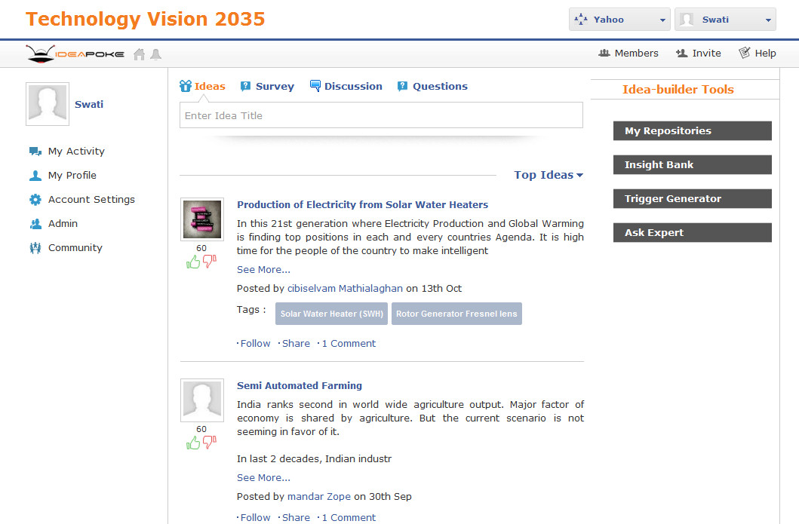
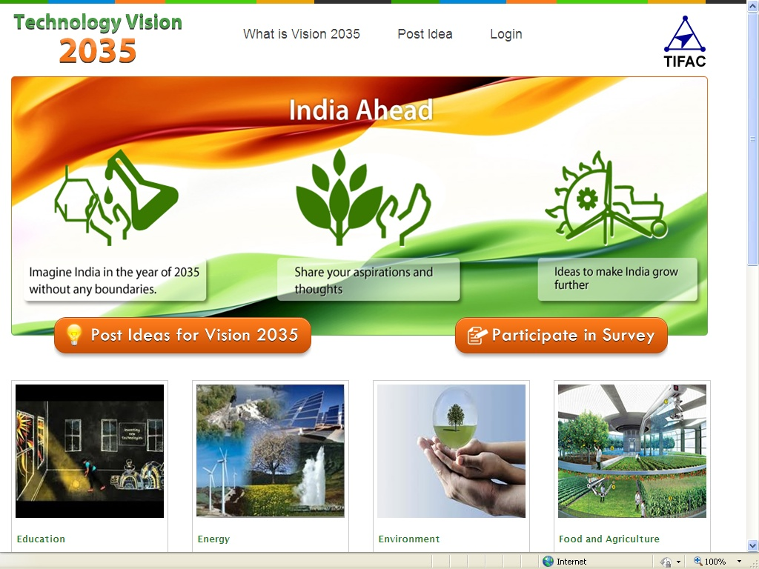
INPUT COLLECTION
Brainstorming
Questionnaire/ survey
Idea collection
Delphi
Cross- cutting analysis
Students interaction meeting
Cross- cutting analysis
Ideapoke.com :
Already developed a web-portal www.indiatechvision2035.com for generating ideas and conducting survey
TIFAC website www.tifac.org.in :

Slide 31
INPUT COLLECTION
Brainstorming
Idea Collection
Delphi
Scenario
Students interaction meeting
Questionnaire/ survey
Cross- cutting analysis
A process to converge opinion on a certain issue/topic
Carried out in series of rounds, each of which is modified by the results of the previous one. It produces a collective view about likely developments
Conducted for education sector

Slide 32
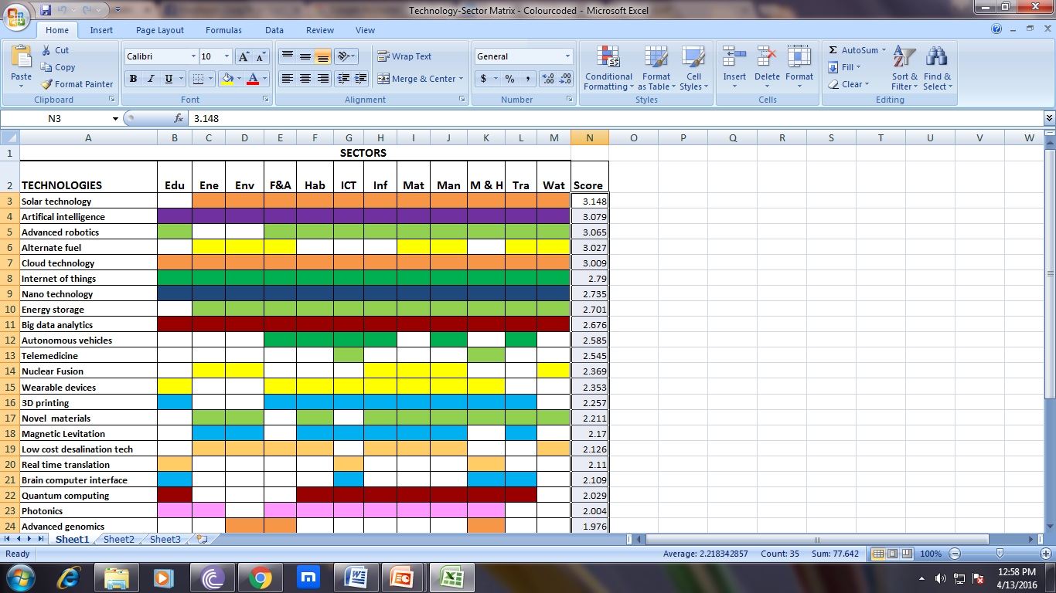
INPUT COLLECTION
Brainstorming
Questionnaire/ survey
Idea Collection
Delphi
Cross- cutting analysis
Students interaction meeting

Slide 33
INPUT COLLECTION
Brainstorming
Questionnaire/ survey
Idea Collection
Delphi
Scenario
Students interaction meeting
Cross- cutting analysis
Various student interaction meetings were organized to collect the out of the box ideas from students.
An interaction meeting was organized with the students from 10 IITs
More than 2500 students were involved in this exercise.
Students of IITB created a website www.etvision2035.in, more than 2000 students from 40 colleges participated and gave ideas.

Slide 34

FOLLOW UP ACTIONS
Setting agenda for basic research, targeted research, translational research and deployment, to be taken up with stakeholders
Bringing out a series of foresight reports on identified technologies
Development and demonstration of select cross-sectoral technologies
Preparation of customised report for different stakeholders to ensure smooth deployment

Slide 35
for Indians a desirable future towards creating a step
THANK YOU
TV
2035
www.tifac.org.in

