Slide 1
MEASURING AND ManagING GLOBAL SYSTEMIC RISK
Viral V Acharya
NYU Stern, CEPR and NBER
Based on NYU-Stern VLAB (vlab.stern.nyu.edu)
July 2016

Slide 2
SYSTEMIC RISK

Slide 3
FAILURE OF FINANCIAL INSTITUTIONS
September 15, 2008 Lehman declared bankruptcy and the most severe events of the financial crisis began.
The U.S. had arranged an orderly rescue of Fannie Mae and Freddie Mac the week before and then saved AIG, Merrill Lynch, Citigroup, Bank of America, Morgan Stanley, Goldman Sachs, Washington Mutual and Wachovia in the following days and weeks
Should we rescue such firms? Should we have rescued Lehman?
If firms count on being rescued, they will take on too much risk.
Is there a third choice?

Slide 4
SYSTEMIC RISK
WHEN THE FAILURE OF AN INSTITUTION TO MEET ITS OBLIGATIONS HAS SERIOUS CONSEQUENCES FOR THE REAL ECONOMY
FAILURE OF ONE INSTITUTION WILL BE MUCH MORE DANGEROUS IF THE WHOLE FINANCIAL SECTOR IS WEAK.

Slide 5
REGULATORY CHALLENGE
ENSURE THAT FINANCIAL INSTITUTIONS HAVE SUFFICIENT CAPITAL SO THAT THEY CAN NOT ONLY SURVIVE A FINANCIAL CRISIS, BUT CONTINUE TO INTERMEDIATE AND PROVIDE FINANCIAL SERVICES TO THE REAL ECONOMY.
GOOD REGULATION IS PREVENTION – NOT RESCUE

Slide 7
DEFINITION of SRISK
How much capital would a financial institution need to raise in order to function normally if we have another financial crisis?
We measure this econometrically based on market data on equities and balance sheet data on liabilities. We update weekly on V-LAB for US and Global financial firms. We call this SRISK.
Principle investigators: Viral Acharya, Rob Engle and Matt Richardson at the Volatility Institute at NYU’s Stern School. Collaboration with HEC Lausanne and the Institute for Global Finance at University of New South Wales. Contributions by Christian Brownlees, Rob Capellini, Diane Perriet, Emil Siriwardane.
References: Acharya, Pedersen, Phillipon, Richardson “Measuring Systemic Risk (2010); Acharya, Engle, Richardson “Capital Shortfall, A New Approach to Ranking and Regulating Systemic Risks, AEAPP (2012), Brownlees and Engle, “Volatilities, Correlations and Tails for Systemic Risk Measurement”,2010

Slide 8
SRISK
SRISK is computed from:
Where k is a prudential level of equity relative to assets.
LRMES is the decline in equity values to be expected if there is another financial crisis.
SRISK depends upon size, leverage and risk.

Slide 9
FOR EXAMPLE
Suppose Bank of America has a market cap of $141billion. Its accounting liabilities are $2.0 trillion for a leverage ratio of 14.9
If we have another financial crisis which is assumed to be a fall of 40% in broad US equities over six months, then we estimate shares in BAC will fall by 50%.
This is based on an estimate of Dynamic Conditional Beta today that will move in the future due to mean reversion in volatilities and correlations and also will rise with downside returns.
SRISK = $91 billion.
  It is undercapitalized somewhat today and this will be more severe under the stress of an equity decline.

Slide 10
SRISK IS A STRESS TEST
The stress scenario is a 40% collapse in the global equity market over six months.
The capital requirement is that, under stress, equity exceed 8% of total assets
Total Assets are measured as Quasi Assets which are accounting liabilities plus market equity

Slide 11
WHY IS THIS A MEASURE
OF SYSTEMIC RISK?
If we have a financial crisis, then all firms with positive SRISK will try simultaneously to raise capital and the only source is likely to be taxpayers.
The bigger SRISK, the more serious the threat to financial stability.

Slide 12
IF TAXPAYERS STEP UP
The spiral can be arrested before the bottom.
However, this will erode market discipline and may impose huge regulatory costs on the financial sector going forward.
Thus regulation is needed in advance. Ideally it would be countercyclical.

Slide 13
ANALYSIS OF THE RESULTS
How can you validate a systemic risk model?

Slide 14


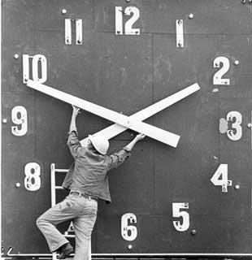
Global Systemic Risk Rankings
“A Look Back”
Notes:
14

Slide 15
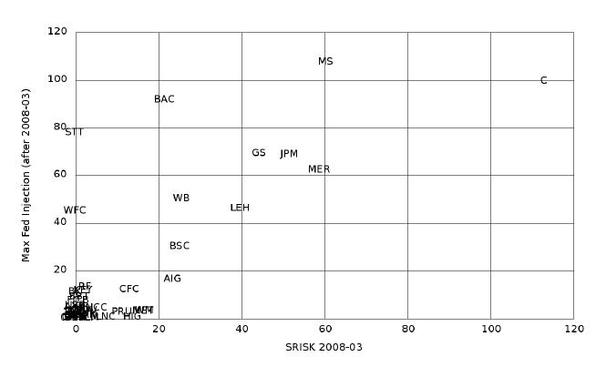
BAILOUT PREDICTION

Slide 16
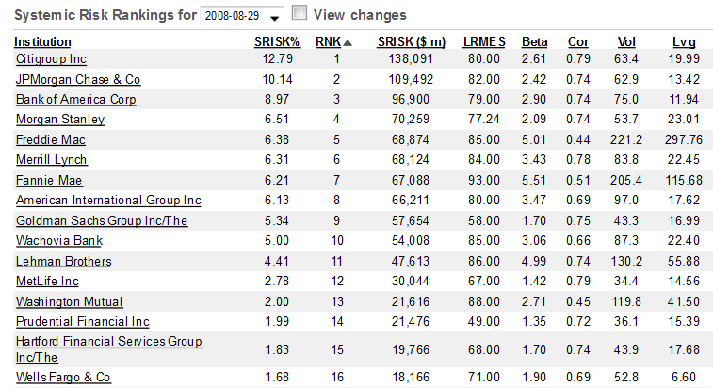
AUGUST 29,2008 US

Slide 17
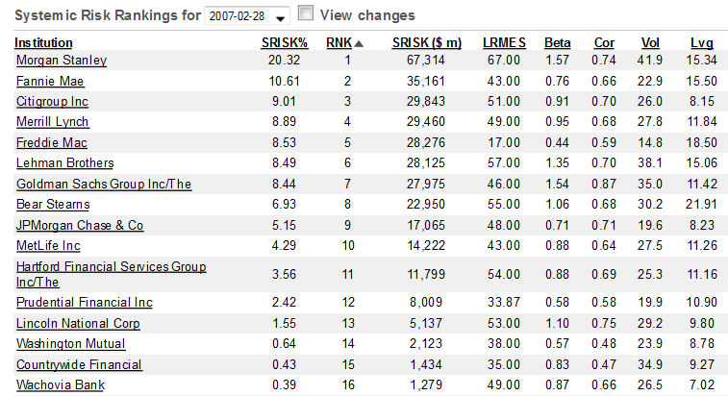
FEB 28, 2007 US

Slide 18
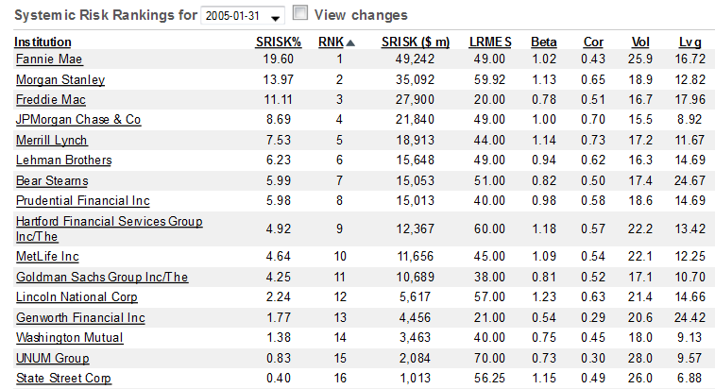
JAN 31, 2005

Slide 19
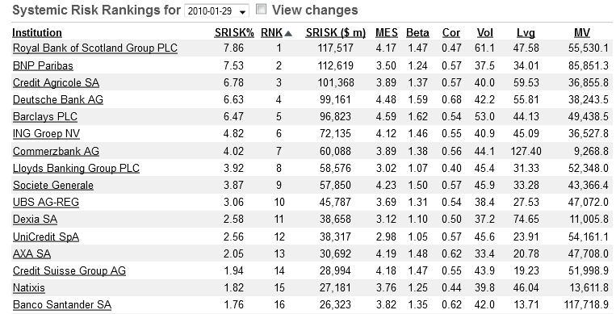
JAN 2010 IN EUROPE
PRIOR TO SOVEREIGN DEBT CRISIS

Slide 20
Global Financial sector health –
A Comparative analysis

Slide 21
Srisk
Capital Shortfall of a Financial Firm in a Crisis
A Measure of Systemic Risk Contribution of a Firm
Aggregate SRISK: A Barometer for Financial Sector Health

Slide 22
SUMMARY
How have financial sectors in different regions of the world behaved in terms of vulnerability to a future crisis since 2007?
Compare United States, Europe and Asia using SRISK, a measure of vulnerability to a future crisis
Diverging patterns:
  US financial sector has been de-leveraging steadily
  Europe looked as bad in 2011 as in 2008/9, but is somewhat on the mend
  Asia has been leveraging steadily, especially China
Conjectures on what explains these differences
The effect of Brexit

Slide 23
Aggregate SRISK ($’000s)

Slide 24
SRISK Normalized by GDP

Slide 25
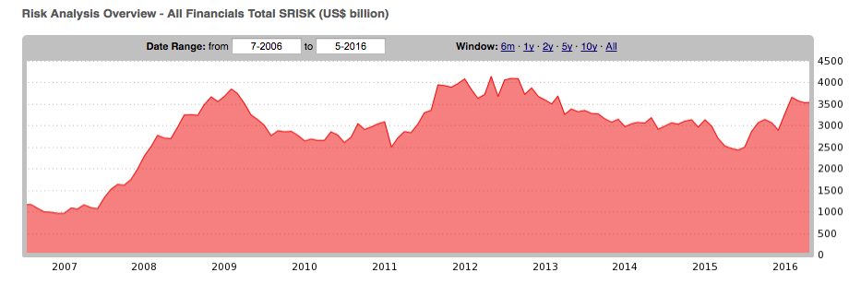
WORLD SRISK – LAST 10 YEARS

Slide 26
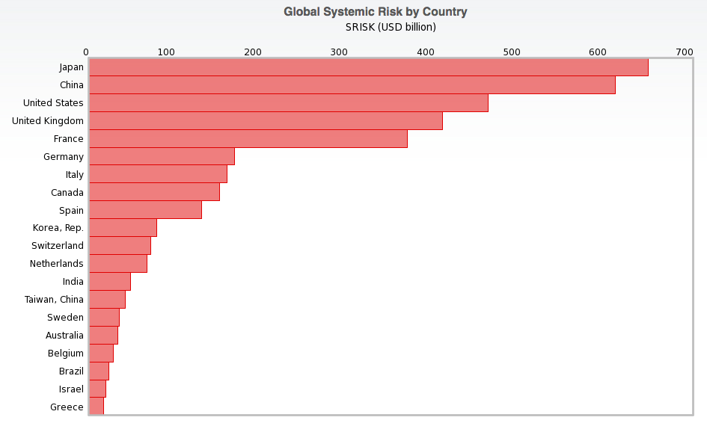
WHERE IS THE RISK today?

Slide 27
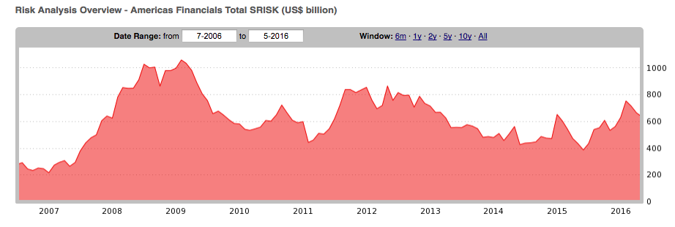
AMERICAS’ SRISK

Slide 28
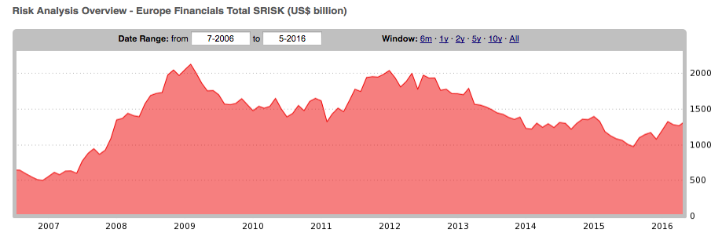
EUROPE SINCE 2005

Slide 29
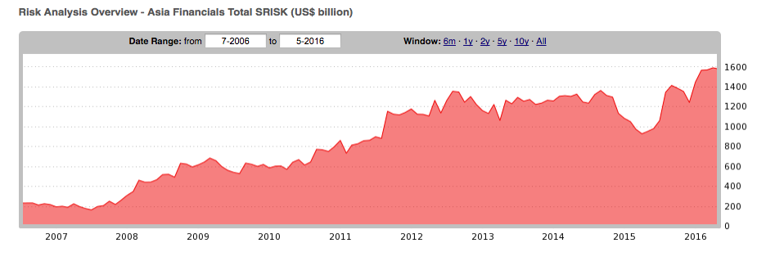
ASIA SINCE 2005

Slide 30
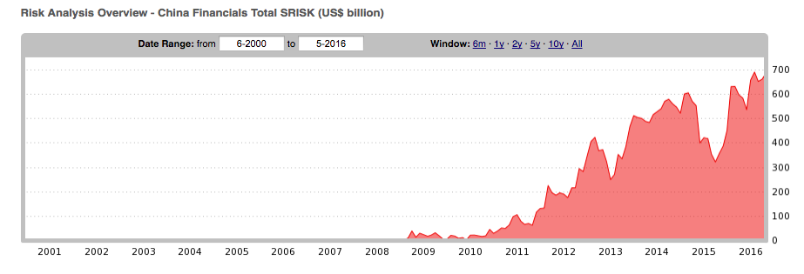
CHINA SRISK to date

Slide 31
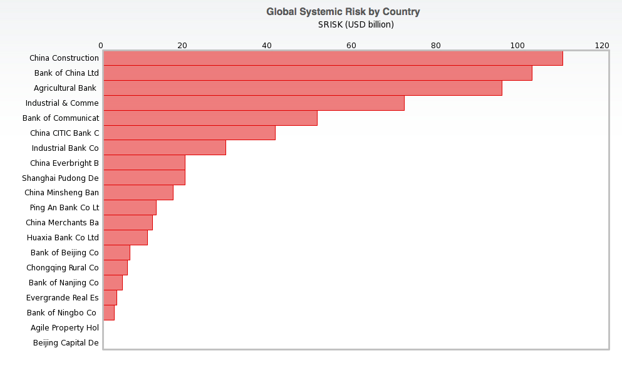
WHERE IS THE RISK IN CHINA?

Slide 32
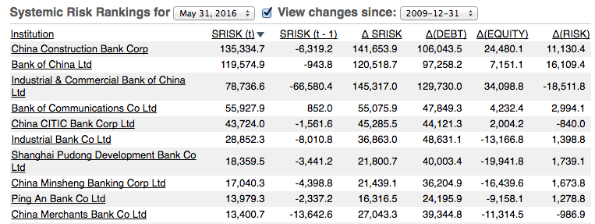
Decomposing Change in SRISK to pre-Brexit

Slide 33
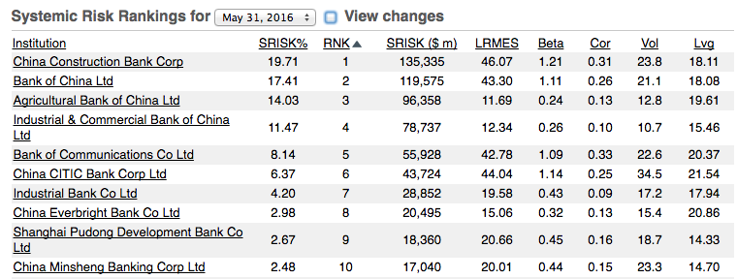
SRISK DETAILS

Slide 34
The Brexit effect

Slide 35
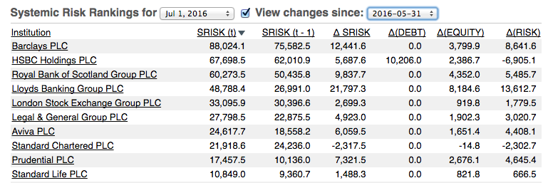
Decomposing Change in SRISK around the brexit
U.K. BANKS

Slide 36
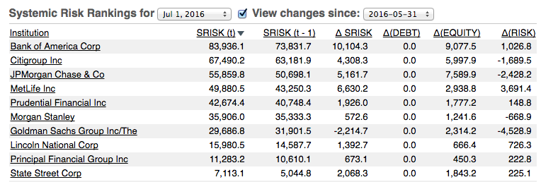
Decomposing Change in SRISK around the brexit
U.S. BANKS

Slide 37
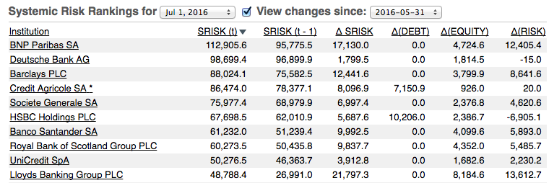
Decomposing Change in SRISK around the brexit
European BANKS

Slide 38
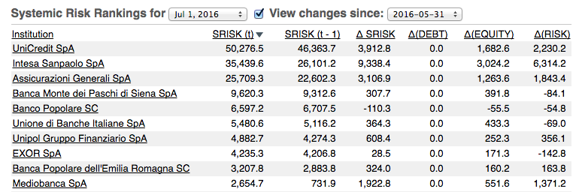
Decomposing Change in SRISK around the brexit italian BANKS

Slide 39
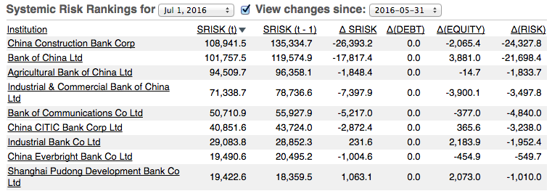
Decomposing Change in SRISK around the brexit chinese BANKS

Slide 40
CONCLUSION
Global financial sector health remains uneven across different regions
Diverging patterns: Leverage, leverage, leverage!
  US financial sector has been de-leveraging steadily
    TARP, stress tests and other measures appear to have recapitalized the banking sector well
  Europe looked as bad in 2011 as in 2008/9, but is on the mend
    European stress tests have failed to recapitalize the financial sector in economic terms
  Asia has been leveraging steadily, especially China
    Debt-based stimulus appears to be the culprit
    True risks understated as banks are state-owned with significant off-balance sheet debt (wealth management products)
Effect of Brexit: UK, US and European banks most severely affected

