Slide 1
DAG Inlining: A Decision Procedure for Hierarchical Programs
In: Programming Language Design and Implementation (PLDI) 2015
Akash Lal and Shaz Qadeer
Microsoft Research
"Corral Program Verifier" @ Microsoft Research

Slide 2
Does there exist a proof that establishes the absence of errors?
vs.
Does there exist a program execution that establishes the presence of an error?
Notes:
Let me start by setting the context of this work, before I get into the details. This work is about program verification Typically, program verification is about establishing a proof of correctness. But I am interested in finding bugs.

Slide 3
Bug Finding in Programs
Bounded Verification: Program explorations up to certain pre-defined bounds
Example, bound loop iterations and recursion depth
Bounded verification is directly relevant for bug-finding
Most important outcome of automated verification tools is bugs
Static Driver Verifier, F-Soft, Facebook Infer, …
Notes:
And I will do it using what we call Bounded Verification. The bound I will use is recursion bound. Bounded verification cannot be used for finding correctness proofs, but is still relevant for finding bugs. This gives focus: design tools to find bugs as fast as possible. This is important because that is what the industry appreciates, at least in the context of automated verification tools. Of course, correctness proofs is also important, but we are no where near delivering full automation in that context.

Slide 4
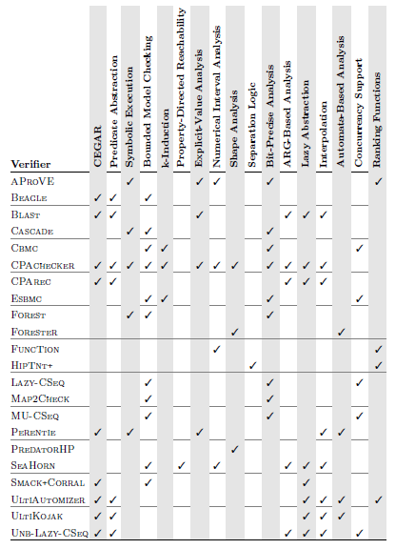
Bounded Verification
Build efficient decision procedures for Bounded Verification
Inspired by the success in Hardware verification
SV-COMP 2015
Notes:
It is not just me, but many others in the community are using bounded verification.

Slide 5
Bounded Verification done previously
Program + Bound
Single Proc. Program
VC-Gen
SMT Formula
Inline
Standard approach in all tools: Inline all procedures, generate a SAT/SMT constraint, invoke solver
Procedure Inlining causes exponential blowup
Notes:
The typical design for bounded verifiers is the following. This is important to understand. SMT solvers lie at the heart but one must have a way of converting a set of program behaviors to a logical formula.

Slide 6
Our Work: DAG Inlining
Standard Procedure Inlining
Program Call Graph
DAG Inlining
P0
P0
P0
P1
P1
P1
P1
P1
P2
P2
P2
P2
P2
P2
P2
…
…
2^{i} copies of P_{i}
DAG structure program dependent
Exponentially Blowup in Program Size
Potentially Exponential Savings!

Slide 7
Talk Outline
Problem definition
VC Generation Algorithms [Background]
Single-procedure programs
Multi-procedure programs
DAG Inlining Algorithm
Evaluation

Slide 8
Definitions
Hierarchical Programs: Sequential programs without loops and recursion
Reachability Modulo Theories (RMT): Find a terminating execution of a program whose operational semantics can be encoded in decidable logic.

Slide 9
Programming Language
// variables
var x: T
// functions
func f: T → T
// commands
x := expr
assume expr
call foo(x);
// procedures
procedure foo(args) {
LocalDecls;
Body;
}
// control
if(expr) { cmds; } else { cmds; }
while(*) { cmds; }
SMT
Example:
Linear arithmetic via the theory of linear arithmetic (LIA)
Non-linear arithmetic via uninterpreted functions (EUF)
Memory lookup using theory of arrays
Floating-point as reals or uninterpreted

Slide 10
Reachability Modulo Theories
Finding assertion failures is equivalent to finding terminating executions
var err: bool;
foo() {
err := e;
if(!err) return;
…
}
main() {
err := true;
call foo();
assume !err;
return;
}
foo() {
assert e;
…
}
main() {
call foo();
return;
}

Slide 11
Reachability Modulo Theories
RMT in hierarchical programs is decidable (NEXPTIME hard) [RP’13]
Can’t hide all sorts of complexity behind undecidability
Direct application to bounded verification
E.g., “Bounded Model Checking”
Relevant to unbounded verification
Checking inductive proofs (loop invariants) without pre-post conditions

Slide 12
Talk Outline
Problem definition
VC Generation Algorithms ← Solving RMT in Hierarchical programs
Single-procedure programs
Multi-procedure programs
DAG Inlining Algorithm
Evaluation

Slide 13
VC Generation: Single Procedure
procedure f(w: int)
returns (x: int, y: int)
{
start:
x := *;
y := x + w;
goto l1, l2;
l1:
x := x + 1;
goto l3;
l2:
x := x + 2;
goto l3;
l3:
assume !(x > y);
return;
}
VC-Gen: f ➔ ϕ_{f}(w, x, y)
Theorem: ϕ_{f}(w, x, y) holds iff f(w) can return (x,y)
Corollary: ϕ_{f} is SAT iff f has a terminating execution

Slide 14
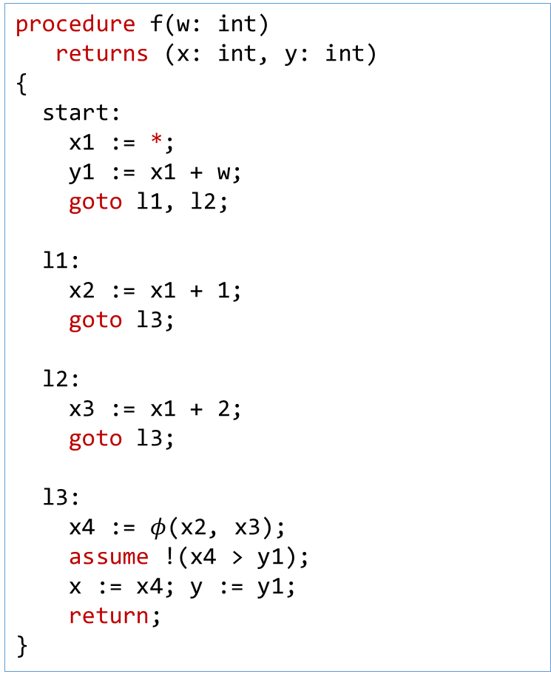
VC Generation
procedure f(w: int)
returns (x: int, y: int)
{
start:
x1 := *;
y1 := x1 + w;
goto l1, l2;
l1:
x2 := x1 + 1;
goto l3;
l2:
x3 := x1 + 2;
goto l3;
l3:
x4 := $φ$(x2, x3);
assume !(x4 > y1);
x := x4; y := y1;
return;
}
procedure f(w: int)
returns (x: int, y: int)
{
start:
x := *;
y := x + w;
goto l1, l2;
l1:
x := x + 1;
goto l3;
l2:
x := x + 2;
goto l3;
l3:
assume !(x > y);
return;
}
SSA

Slide 15
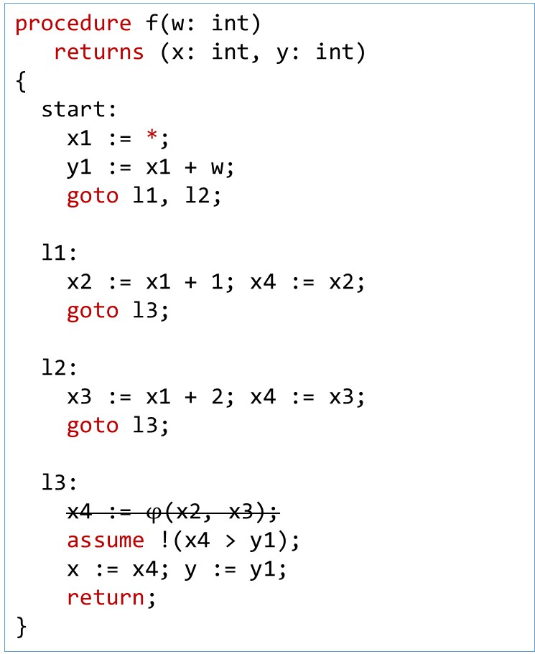
VC Generation
procedure f(w: int)
returns (x: int, y: int)
{
start:
x1 := *;
y1 := x1 + w;
goto l1, l2;
l1:
x2 := x1 + 1; x4 := x2;
goto l3;
l2:
x3 := x1 + 2; x4 := x3;
goto l3;
l3:
x4 := $φ$(x2, x3);
assume !(x4 > y1);
x := x4; y := y1;
return;
}
procedure f(w: int)
returns (x: int, y: int)
{
start:
x := *;
y := x + w;
goto l1, l2;
l1:
x := x + 1;
goto l3;
l2:
x := x + 2;
goto l3;
l3:
assume !(x > y);
return;
}
SSA

Slide 16
VC Generation
procedure f(w: int)
returns (x: int, y: int)
{
start:
assume y1 == x1 + w;
goto l1, l2;
l1:
assume x2 == x1 + 1; assume x4 == x2;
goto l3;
l2:
assume x3 == x1 + 2; assume x4 == x3;
goto l3;
l3:
assume !(x4 > y1);
assume x == x4; assume y == y1;
return;
}
procedure f(w: int)
returns (x: int, y: int)
{
start:
x := *;
y := x + w;
goto l1, l2;
l1:
x := x + 1;
goto l3;
l2:
x := x + 2;
goto l3;
l3:
assume !(x > y);
return;
}
SSA+Passify

Slide 17
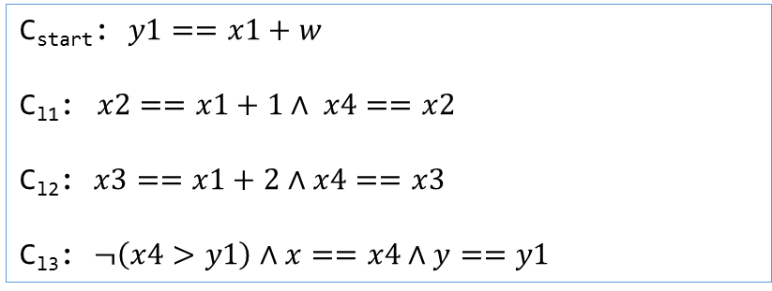
VC Generation
procedure f(w: int)
returns (x: int, y: int)
{
start:
assume y1 == x1 + w;
goto l1, l2;
l1:
assume x2 == x1 + 1; assume x4 == x2;
goto l3;
l2:
assume x3 == x1 + 2; assume x4 == x3;
goto l3;
l3:
assume !(x4 > y1);
assume x == x4; assume y == y1;
return;
}
Block constraints
C_{start}: $y1==x1+w$
C_{l1}:$x2==x1+1∧ x4==x2$
C_{l2}: $x3==x1+2∧x4==x3$
C_{l3}: $¬\left(x4>y1\right)∧x==x4∧y==y1$

Slide 18
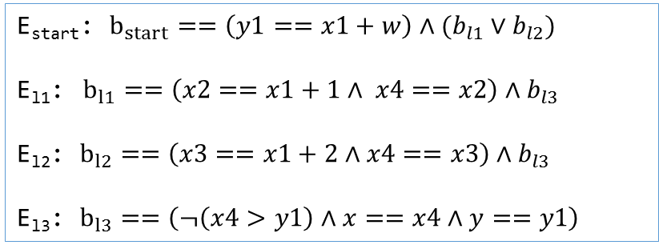
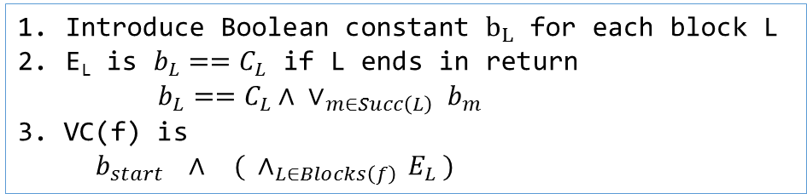
VC Generation
procedure f(w: int)
returns (x: int, y: int)
{
start:
assume y1 == x1 + w;
goto l1, l2;
l1:
assume x2 == x1 + 1; assume x4 == x2;
goto l3;
l2:
assume x3 == x1 + 2; assume x4 == x3;
goto l3;
l3:
assume !(x4 > y1);
assume x == x4; assume y == y1;
return;
}
Algorithm
Introduce Boolean constant $b_{L}$ for each block L
E_{L} is $b_{L}==C_{L}$ if L ends in return
$b_{L}==C_{L}∧ ∨_{m∈Succ\left(L\right)} b_{m}$
3. VC(f) is
$b_{start} ∧ { ( ∧}_{L∈Blocks\left(f\right)} E_{L} )$
Block constraints
E_{start}: $b_{start}==\left(y1==x1+w\right)∧(b_{l1}∨b_{l2})$
E_{l1}:$b_{l1}==\left(x2==x1+1∧ x4==x2\right)∧b_{l3}$
E_{l2}: $b_{l2}==\left(x3==x1+2∧x4==x3\right)∧b_{l3}$
E_{l3}: $b_{l3}==\left(¬\left(x4>y1\right)∧x==x4∧y==y1\right)$

Slide 19
VC Generation: Multiple Procedures
procedure f(v1: int, v2: int)
returns (r: int)
{
var c: bool;
goto l1, l2;
l1:
assume c;
call r := g(v1);
goto l3;
l2:
assume !c;
call r := g(v2);
goto l3;
l3:
return;
}
procedure g(a: int)
returns (b: int)
{
b := a + 1;
}

Slide 20
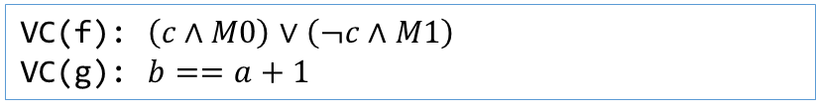
VC Generation: Multiple Procedures
procedure f(v1: int, v2: int)
returns (r: int)
{
var c: bool;
goto l1, l2;
l1:
assume c;
call r := g(v1); assume M0;
goto l3;
l2:
assume !c;
call r := g(v2); assume M1;
goto l3;
l3:
return;
}
procedure g(a: int)
returns (b: int)
{
b := a + 1;
}
VC(f): $\left(c∧M0\right)∨\left(¬c∧M1\right)$
VC(g): $b==a+1$
Algorithm
Introduce Boolean constant $M_{i}$ for each call

Slide 21
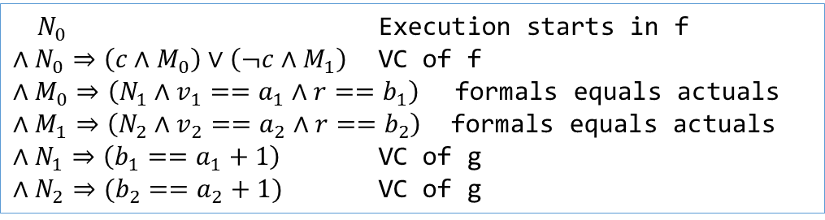
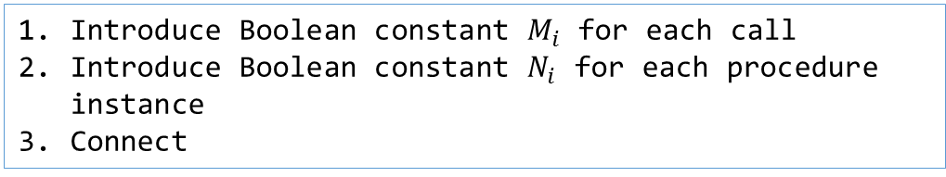
VC Generation: Multiple Procedures
procedure f(v1: int, v2: int)
returns (r: int)
{
var c: bool;
goto l1, l2;
l1:
assume c;
call r := g(v1); assume M0;
goto l3;
l2:
assume !c;
call r := g(v2); assume M1;
goto l3;
l3:
return;
}
procedure g(a: int)
returns (b: int)
{
b := a + 1;
}
$N_{0}$ Execution starts in f
$∧N_{0}⇒\left(c∧M_{0}\right)∨\left(¬c∧M_{1}\right)$ VC of f
$∧M_{0}⇒\left(N_{1}∧v_{1}==a_{1}∧r==b_{1}\right)$ formals equals actuals
$∧M_{1}⇒\left(N_{2}∧v_{2}==a_{2}∧r==b_{2}\right)$ formals equals actuals
$∧N_{1}⇒\left(b_{1}==a_{1}+1\right)$ VC of g
$∧N_{2}⇒(b_{2}==a_{2}+1)$ VC of g
Algorithm
Introduce Boolean constant $M_{i}$ for each call
Introduce Boolean constant $N_{i}$ for each procedure instance
Connect

Slide 22
VC Generation: Multiple Procedures
procedure f(v1: int, v2: int)
returns (r: int)
{
var c: bool;
goto l1, l2;
l1:
assume c;
call r := g(v1); assume M0;
goto l3;
l2:
assume !c;
call r := g(v2); assume M1;
goto l3;
l3:
return;
}
procedure g(a: int)
returns (b: int)
{
b := a + 1;
}
f
g
g
Algorithm
Introduce Boolean constant $M_{i}$ for each call
Introduce Boolean constant $N_{i}$ for each procedure instance
Connect

Slide 23
Micro Benchmark
var g: int;
procedure main() {
g := 0;
if(*) { call P₀(); }
else { call P₀(); }
}
procedure P_{i}() {
g := g + 1;
if(*) { call P_{i+1}(); }
else { call P_{i+1}(); }
}
procedure P_{N}() {
assert g == N;
}

Slide 24
DAG Inlining: Algorithm
Dynamic Procedure Instances: A procedure qualified by its call stack
procedure main()
{
if(…) { A: bar(); }
else { B: baz(); }
}
procedure bar()
{
C: foo();
}
procedure baz()
{
D: foo();
}
[A; C; foo]
[B; D; foo]
Disjoint instances: Two procedure instances that cannot be taken on the same execution

Slide 25
DAG Inlining: Algorithm
Theorem: Any two disjoint instances of the same procedure can be merged together when inlining.

Slide 26
DAG Inlining: Algorithm
procedure f(v1: int, v2: int)
returns (r: int)
{
var c: bool;
goto l1, l2;
l1:
assume c;
call r := g(v1);
goto l3;
l2:
assume !c;
call r := g(v2);
goto l3;
l3:
return;
}
Standard (Tree) Inlining
f
g
g
DAG Inlining
f
g

Slide 27
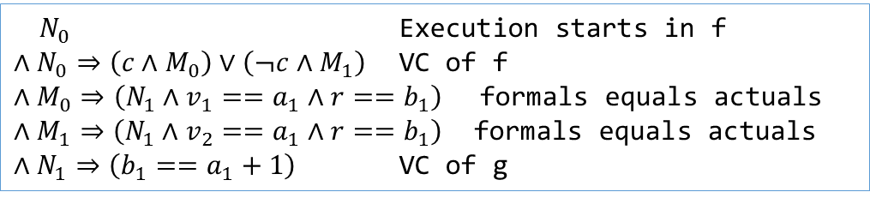

DAG Inlining: Algorithm
procedure f(v1: int, v2: int)
returns (r: int)
{
var c: bool;
goto l1, l2;
l1:
assume c;
call r := g(v1);
goto l3;
l2:
assume !c;
call r := g(v2);
goto l3;
l3:
return;
}
Standard (Tree) Inlining
$N_{0}$ Execution starts in f
$∧N_{0}⇒\left(c∧M_{0}\right)∨\left(¬c∧M_{1}\right)$ VC of f
$∧M_{0}⇒\left(N_{1}∧v_{1}==a_{1}∧r==b_{1}\right)$ formals equals actuals
$∧M_{1}⇒\left(N_{2}∧v_{2}==a_{2}∧r==b_{2}\right)$ formals equals actuals
$∧N_{1}⇒\left(b_{1}==a_{1}+1\right)$ VC of g
$∧N_{2}⇒(b_{2}==a_{2}+1)$ VC of g
DAG Inlining
$N_{0}$ Execution starts in f
$∧N_{0}⇒\left(c∧M_{0}\right)∨\left(¬c∧M_{1}\right)$ VC of f
$∧M_{0}⇒\left(N_{1}∧v_{1}==a_{1}∧r==b_{1}\right)$ formals equals actuals
$∧M_{1}⇒\left(N_{1}∧v_{2}==a_{1}∧r==b_{1}\right)$ formals equals actuals
$∧N_{1}⇒\left(b_{1}==a_{1}+1\right)$ VC of g
$$c⇒\left(r==v_{1}+1\right)∧¬c⇒(r==v_{2}+1 )$$

Slide 28
DAG Inlining: Algorithm
main
baz
bar
baz
bar
Disjoint([main; bar; foo], [main, baz, foo])
foo
foo
foo
foo
DAG Consistency: For each node n, all configurations
represented by n should be mutually disjoint
Disjoint(…)
Disjoint(…)
Algorithm: While inlining, keep merging with existing instances as long as the DAG is consistent

Slide 29
Optimal merging reduces to Graph Coloring
Entry
main
main
main
A
B
C
D
A
B
D
A
D
C
B
C
foo
foo
foo
foo
foo
foo
foo
foo
foo
A: foo();
B: foo();
A
C
A
C
A
C: foo();
D: foo();
BC
CD
AB
B
D
B
D
D
Exit
Optimal merging requires computation of maximal independent sets, which is equivalent to graph coloring
Control-Flow Graph
Conflict Graph:
Edge ⇒ not disjoint

Slide 30
Implementing the Algorithm
We can decide disjointness in linear time based on control flow
[A1; A2; A3; A4; foo]
[A1; A2; B1; B2; B3; B4; foo]
longest common prefix
These calls should not appear on the same path
in the CFG of Proc(A2)
Disjointness of procedure instances can be resolved by disjointness in a single CFG.

Slide 31
Implementing the Algorithm [See Paper]
Disjointness of two configurations in linear time
Deciding DAG consistency in quadratic time
Greedy graph coloring (8% off the optimal)
Overall: Less than 0.4% time spent in DAG operations

Slide 32
Experiments: Static Driver Verifier
Commercial tool, ships with Windows
Used internally and by third-party driver developers
Part of Windows Driver Certification program
Uses Corral, an RMT solver
Based on Tree Inlining, but:
Includes several optimizations over tree inlining
Total LOC: 800K
Total verification time: well over a month

Slide 33
Compression in Practice
Tree/DAG Sizes

Slide 34
Compression strategy
We use a greedy merging strategy: turns out to be around 8% off the optimal in practice

Slide 35
Results: Summary
Tree-1
DAG-1
Tree-2
DAG-2
Production Quality
Find more bugs in less time
Almost twice as fast as the production system

Slide 36
Results - 1
Number of instances: 619
Reduction in Timeouts: 64
5X speedup: 35
5X slowdown: 2

Slide 37
Results
Number of instances: 619
Reduction in Timeouts: 78
5X speedup: 45
5X slowdown: 1

Slide 38
Summary
Reachability in Hierarchical Programs is fundamental
Standard (Tree) inlining causes exponential blowup
Limits many BMC tools to small programs
DAG inlining refines the age-old idea of procedure inlining
Demonstrated significant speedups of a production system
Corral with DAG Inlining currently ships with the Static Driver Verifier
Found hundreds of bugs in real drivers

