Slide 1




Violation of Lepton Number, Lepton Flavour, Baryon Number and Lepton Universality in B and τ decays at BaBar and Belle
On behalf of the BaBar and Belle collaborations, CKM2016, Mumbai

Slide 2
Introduction/Motivation
No fundamental symmetry explains the conservation of Lepton Flavour and Lepton Number in the Standard Model.
New Physics models can enhance Lepton Flavour Violation LFV and Lepton Number Violation LNV up to current experimental limits at e⁺e⁻ colliders.
New Physics models can introduce different couplings to leptons and violate Lepton Universality (LUV).
In GUT theories, quarks and leptons are part of the same multiplets so baryon number B and lepton number L are expected to be violated in almost all models.
Experiments with higher mass leptons may be less precise than dedicated experiments but could see larger deviations.
Many LFV, LNV and Baryon Number Violation (BNV) searches are simple additions to core analyses (e.g. rare decays B⁰→l⁺l⁻ or FCNC in B⁻→K^{(*)}l⁺l⁻).

Slide 3
This Review
Lepton Flavour Violation:
Υ(2,3S)→eτ/μτ
B⁰→e⁺μ⁻, B→K*l⁺l’⁻, B→πe⁺μ⁻
B± →h± τ l and B⁰→ l⁺τ⁻
Lepton Number Violation:
B⁺→X⁻l⁺l⁺
Baryon Number Violation:
B→Λl⁺
Lepton Universality:
B→ D^{(*)}τυ / B→ D^{(*)}lυ ratio
B→ K^{(*)}e⁺e⁻ / K^{(*)}μ⁺μ⁻ ratio
τ Lepton Flavour Violation
τ Lepton Universality Status
Results from
2008-2016
No discussion of charm decays

Slide 4
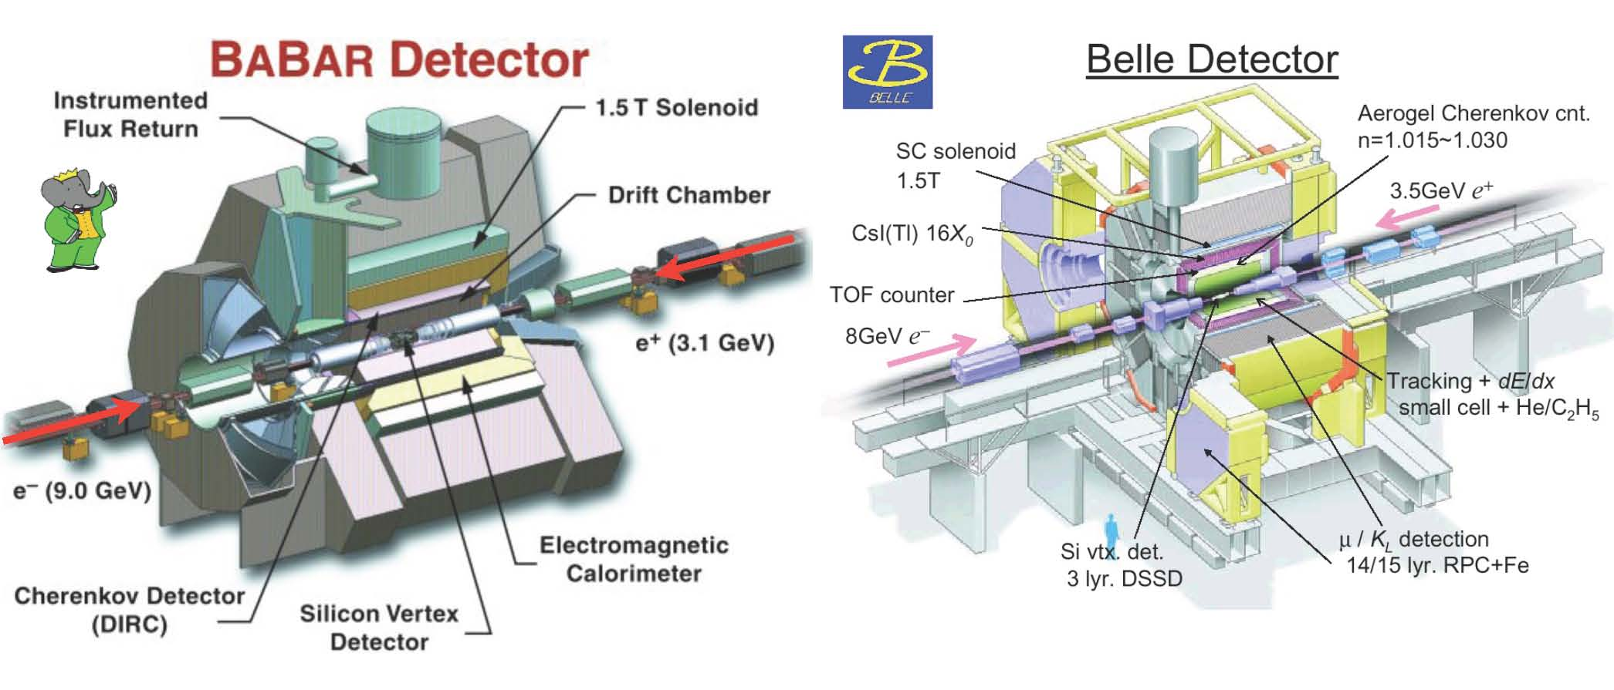
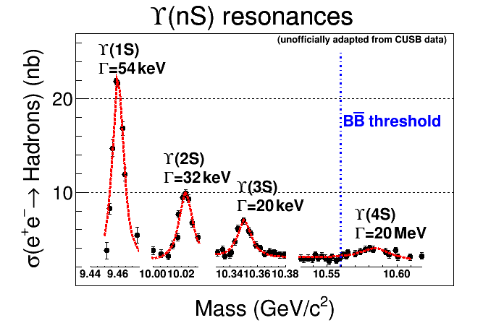
The BaBar and Belle Detectors
Common Features: asymmetric beam momenta, Υ(nS) production, low multiplicity, low background, π/K particle identification, hermetic, good muon and electron identification with wide coverage.

Slide 5
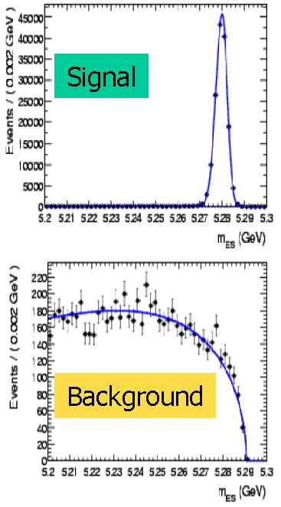
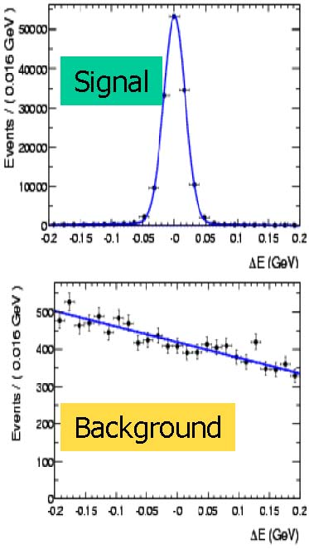
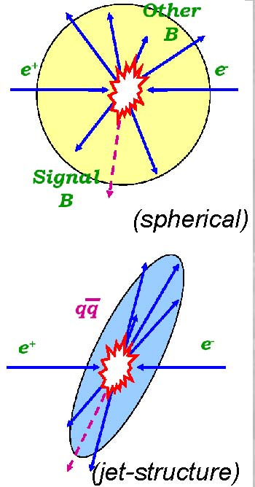
Typical Analysis Techniques
Event Topology
Plus Fisher Discriminants (F), Boosted Decision Trees (BDT), Neural Networks (NN) and unbinned Maximum Likelihood (ML) fits

Slide 6
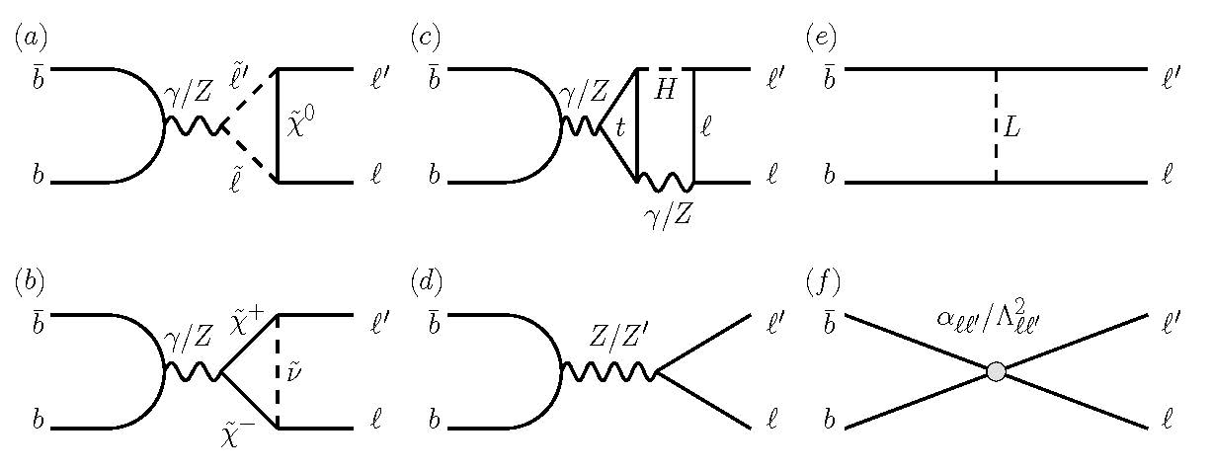
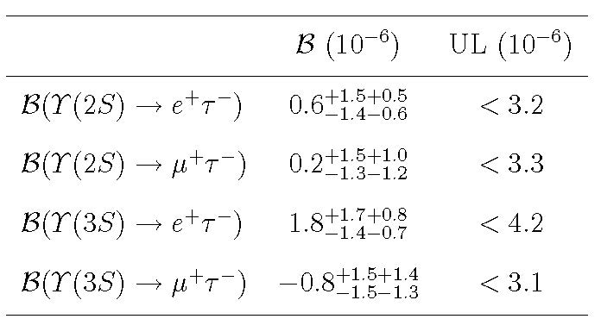
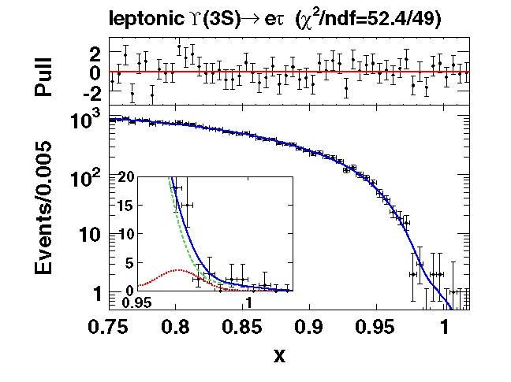
LFV in Υ(2,3S)→eτ/μτ
PRL 104, 151802 (2010)
CLEO (PRL 101 (2008) 201601: Υ(2S)→μτ < 1.44 x 10⁻⁵, Υ(3S)→μτ < 2.03 x 10⁻⁵
Theory:
SUSY loops
SUSY loops
SUSY Higgs doublet H
Anomalous Z or Z’
Leptoquark L
Contact interaction
Probes 1-10 TeV

Slide 7
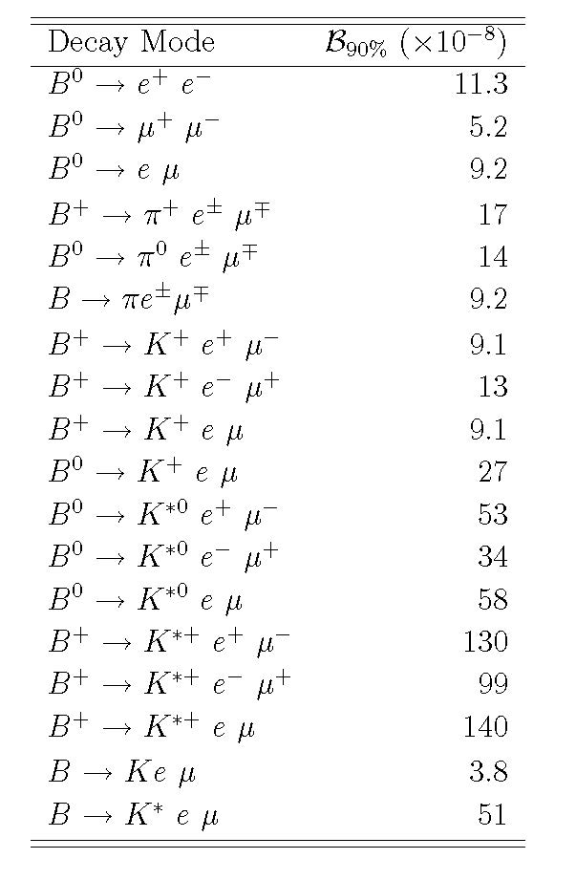
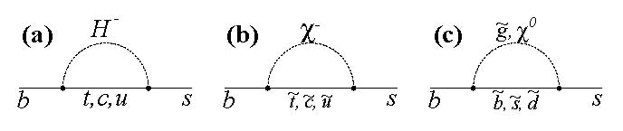
LFV in B⁰→e⁺μ⁻, B→K*l⁺l’⁻, B→πe⁺μ⁻
B⁰→e⁺μ⁻ : like D⁰→e⁺μ⁻, part of FCNC search.
PRD 77, 032007 (2008)
PRD 77, 091104 (2008)
B→K*l⁺l⁻ : FCNC, Branching Fractions, Polarisation, Asymmetries, Universality.
PRD 73, 092001 (2006)
PRD 85, 071103 (2012)
B→πe⁺μ⁻ : FCNC searches
PRL 99, 051801 (2007)
New Physics processes:

Slide 8
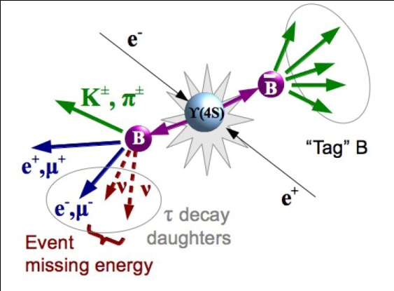
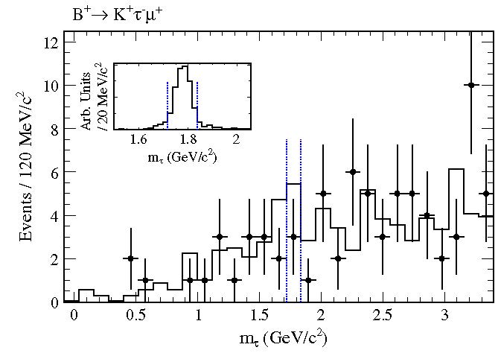

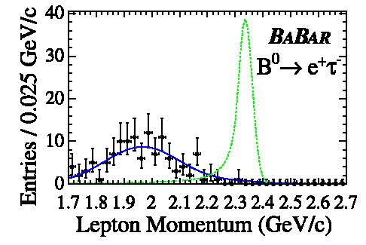
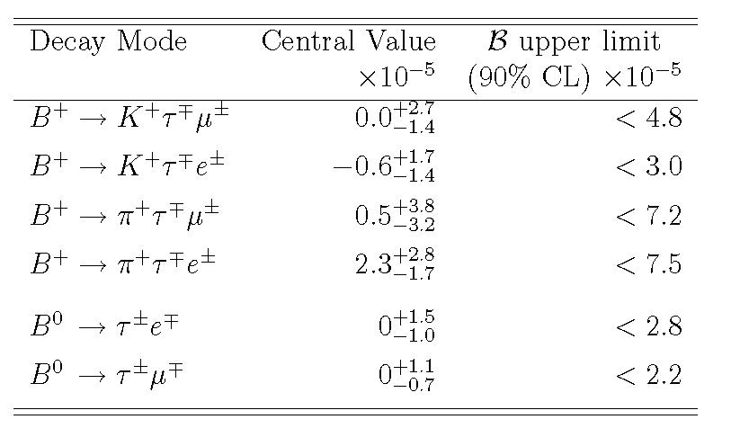
LFV in B± →h± τ l and B⁰→ l⁺τ⁻
PRD 86, 012004 (2012)
PRD 77, 091104 (2008)
Recoil method
MSSM prediction BF(B⁰ → l⁺τ⁻) ~2 x 10⁻¹⁰

Slide 9
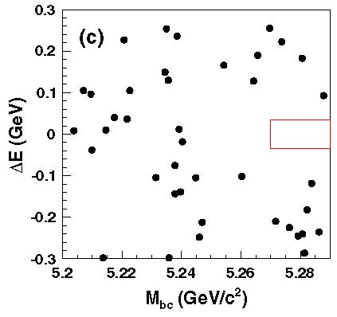
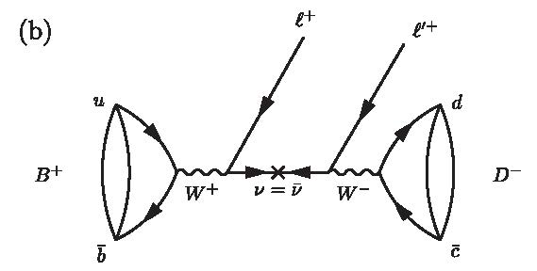
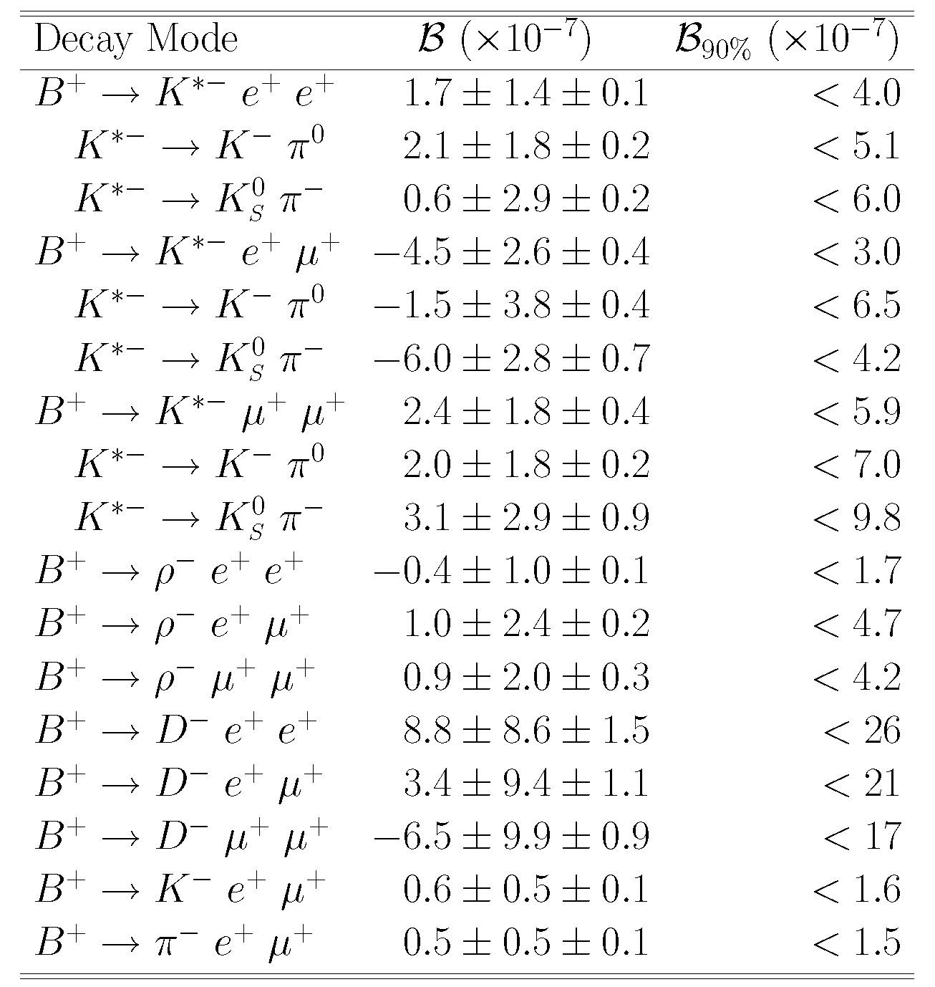
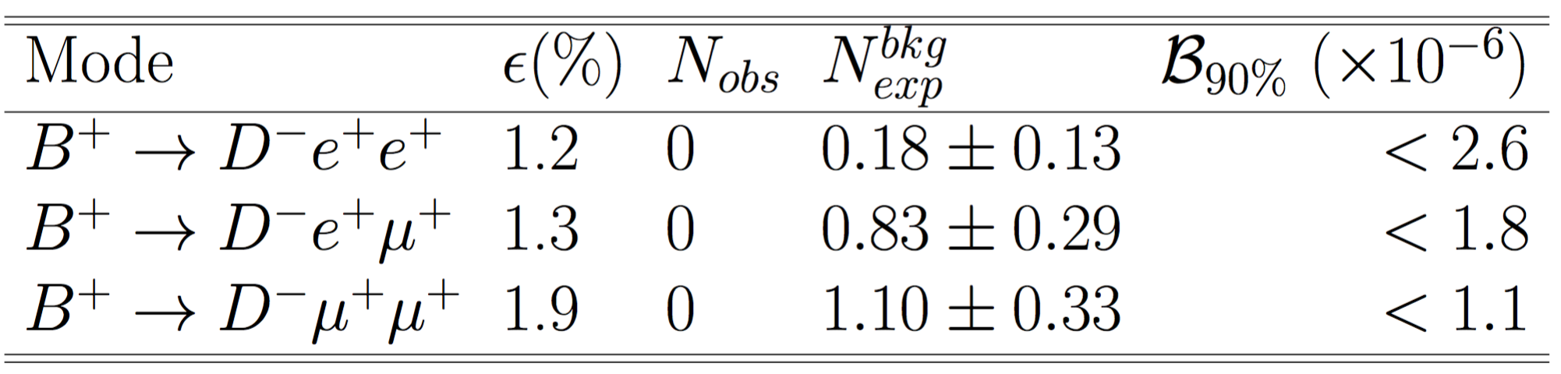
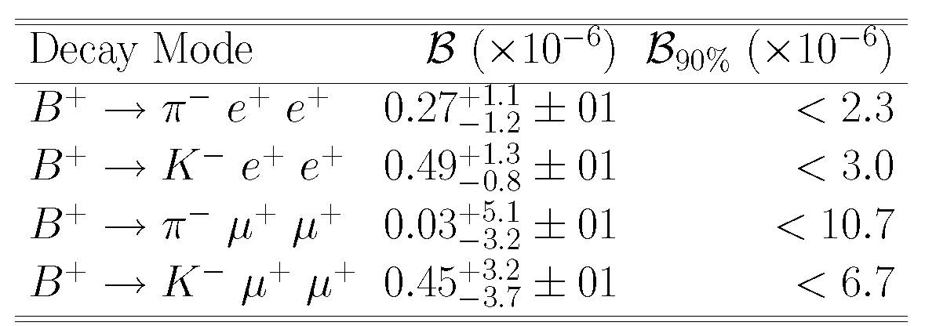
LNV and Majorana υ in B⁺→X⁻l⁺l⁺
PRD 89, 011102 (2014)
PRD 85, 071103 (2012)
PRD 84, 071106 (2011)
LNV search in B⁺→h⁻l⁺l⁺ (h=D/K/π, l=e/μ)
Possible mechanism: exchange of Majorana υ (ΔL=2) or 4th neutrino generation. But mass and coupling are unknown.
signal

Slide 10
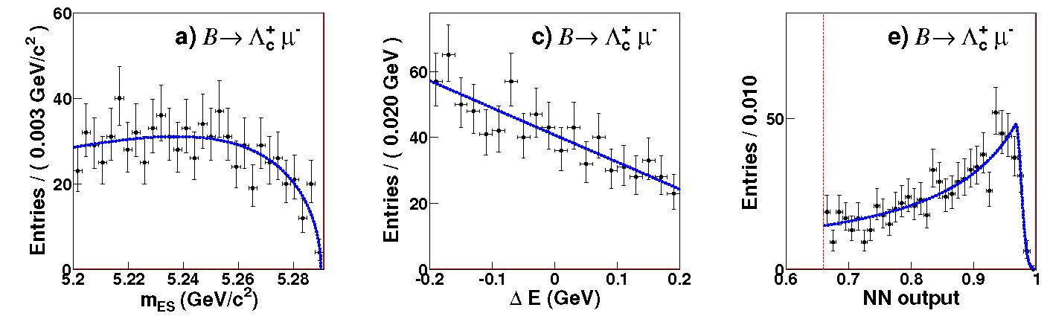
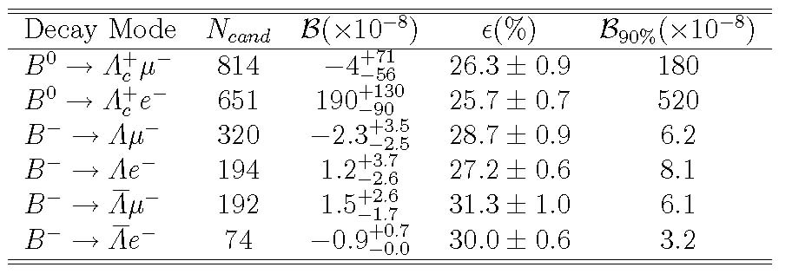
BNV and LNV in B→Λl⁺
PRD 83, 091101 (2011)
Violate both Baryon and Lepton Number conservation.
Expected to be highly suppressed (< 4 x 10⁻²⁹).
B⁻→Λ l⁻ violates (B-L).
Only look at electron and muon modes.
Λ⁺_{c}→pK⁻π⁺, Λ→pπ⁻. Constrain tracks to a vertex and mass compatible with Λ_{(c)}.
Use m_{ES}, ΔE, and neural net to identify signal.

Slide 11
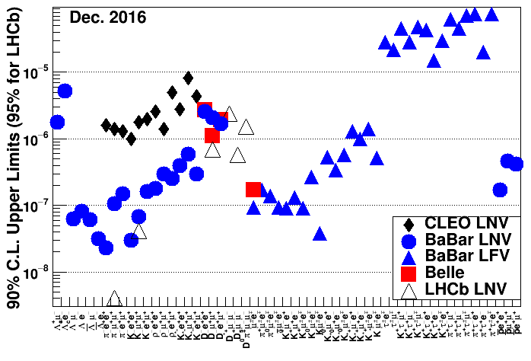
B-meson LFV and LNV Summary

Slide 12
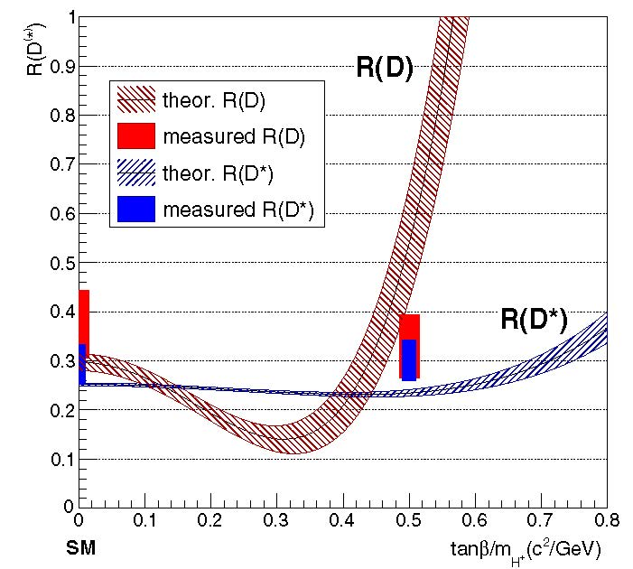
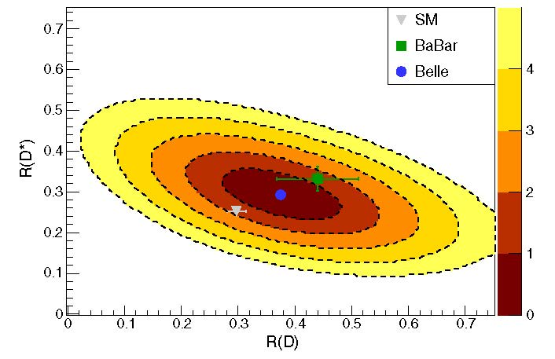
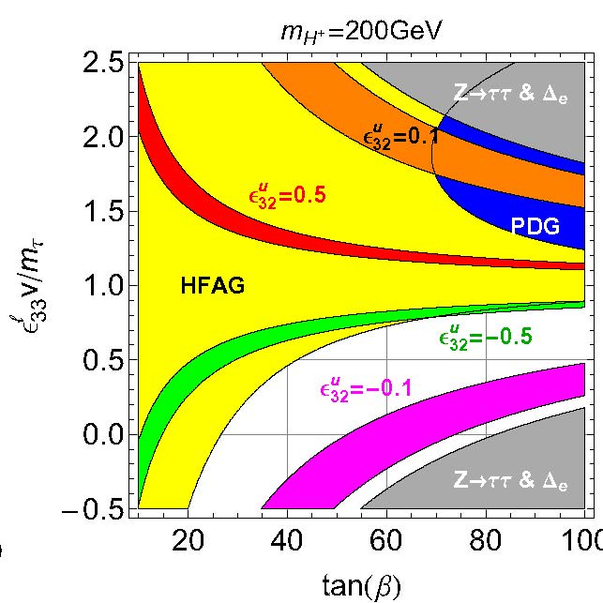
B→ D^{(*)}τυ / B→ D^{(*)}lυ ratio
PRD 94, 072007 (2016) ,PRD 92, 072014 (2015)
PRL 109, 101802 (2012), PRD 88 072012 (2013)
There are models available to account for discrepancies:
Leptoquarks
2HDM variations
….
Often interpreted in terms of SM plus a charged Higgs.
In disagreement with 2HDM Type II predictions
But couplings to leptons could be different.
Belle have used both hadronic (2015) and semileptonic (2016) tags
2HDM Type X model: A. Crivellin et al. PRL 116, 081801 (2016)
PRD 85, 094025 (2012)
LQCD for R_{SM}(D) similar

Slide 13
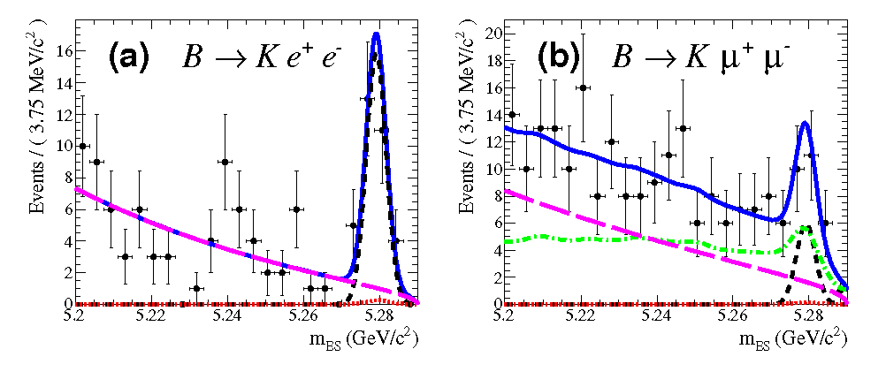
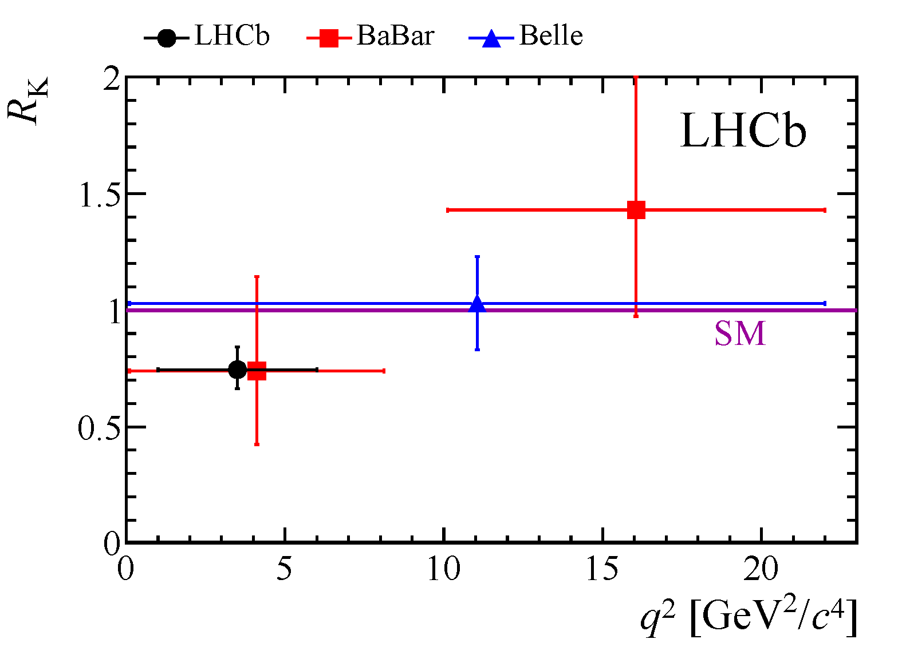

Lepton Universality in B→K l⁺ l⁻
PRD 86, 032012 (2012)
PRL 103, 171801 (2009)
To be submitted to PRD (2017)
An output from B→K^{(*)} l⁺ l⁻ angular analyses.
SM prediction R_{K} ≈ 1.0 ± ~0.01
Combine B⁰ and B⁺ decays.
Use 1.0<q²<6.0 GeV² region where theory uncertainties are lowest.
Results consistent between BaBar and Belle, SM and LHCb

Slide 14
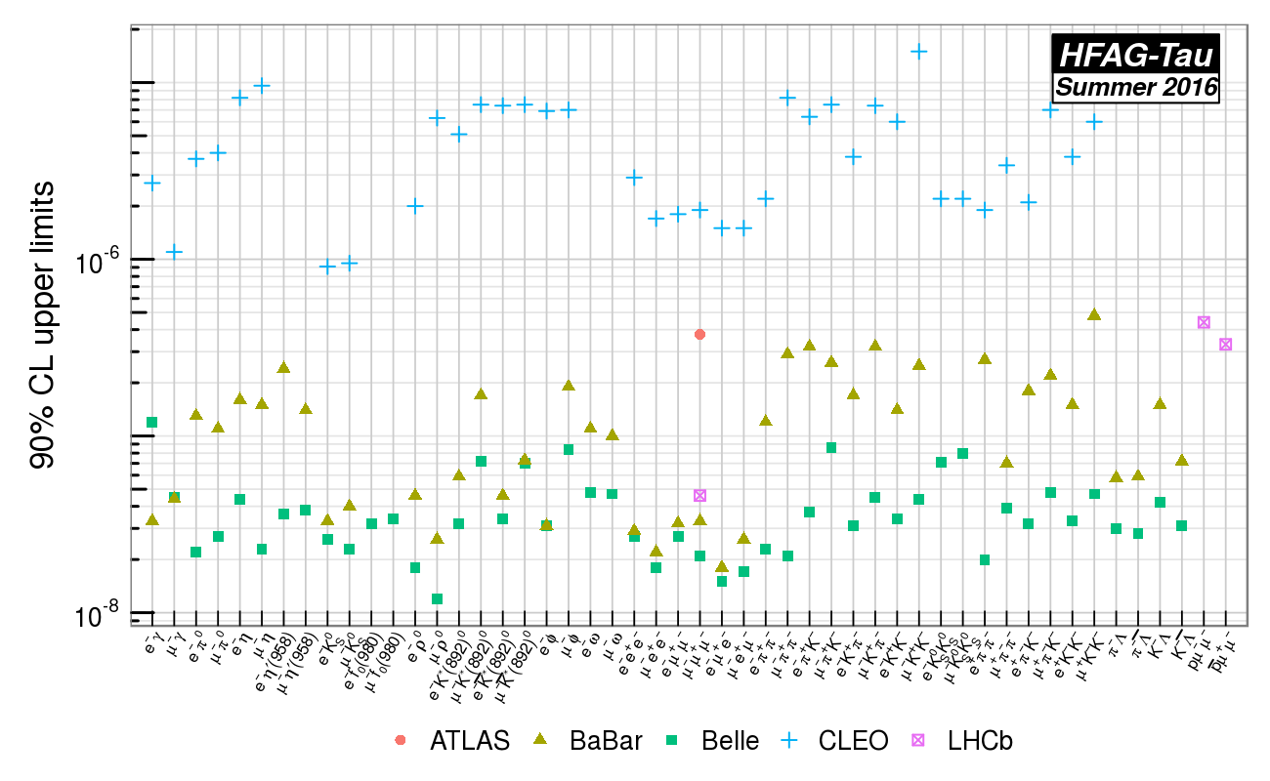
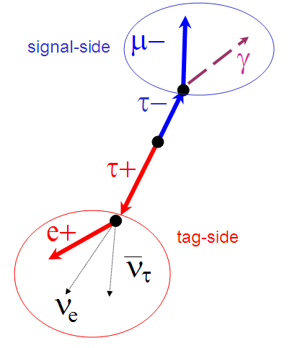
Tau LFV summary
Even with bounds on μ->eγ, some models predict τ->μγ accessible at current experimental sensitivities.
Different models predict different rates and hierarchies for the tau decays so need to measure as many decay modes as possible.
Some modes are background free (e.g τ→eee, τ⁻→l⁻h⁰); others are not (τ→μγ).
See HFAG summer 2016 summer for numbers
No LFV observed. Limits in the range 10⁻⁸ to 2x10⁻⁷

Slide 15
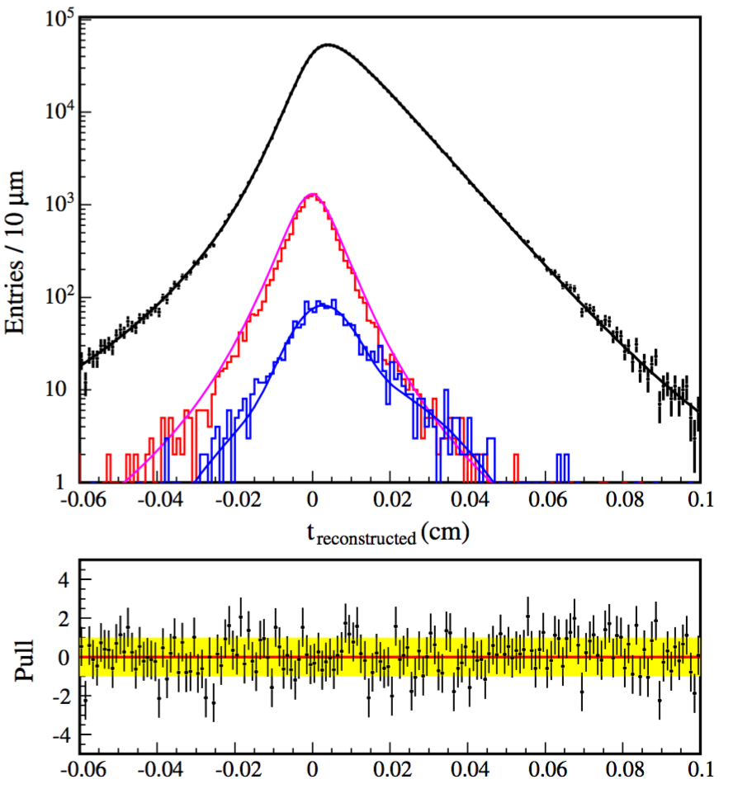
Tau Lepton Universality summary
PRL 112, 031801 (2014)
Little change since 2014. Belle 𝜏 lifetime measurement last significant update:
τ_{τ}= (290.13±0.53±0.33) x 10⁻¹⁵ s
Leptonic
processes
only
Leptonic + τ⁻→h⁻ν
See HFAG summer 2016 summer for more details

Slide 16
Conclusion
Lepton Number, Lepton Flavour, and Baryon Number Violation have not been seen.
Limits have improved by two orders of magnitude over the last decade.
Some of the more optimistic New Physics models and/or parameter space have been deprecated.
Many of the deviations continue to be seen at LHCb.
Some deviations from SM predictions in branching fraction ratios can be interpreted as Lepton Universality Violation.
Interesting time for LFV, LNV, LUV:
New dedicated experiments coming on line (e.g. mu2e, mu3e).
LHCb upgrade (50 fb⁻¹)
Belle II (50 ab⁻¹)

