Slide 1


Exclusive |V_{cb}| at Belle
Christoph Schwanda
Institute of High Energy Physics
Austrian Academy of Sciences
9th International Workshop on the
CKM Unitarity Triangle (CKM 2016)
Nov 28-Dec 2, 2016, TIFR Mumbai, India

Slide 2
Outline of this talk
Belle B⁰ → D^{*-}l⁺ν with hadronic tag
(CKM 2016 preliminary)
BELLE-CONF-1612
Belle B → Dl⁺ν with hadronic tag
Phys. Rev. D93, 032006 (2016)
HFAG summer 2016 averages
New !

Slide 3
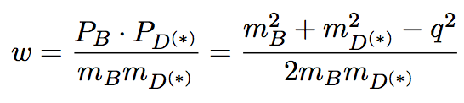


B → D^{(*)}lν decay width
B → D*lν
B → Dlν

Slide 4
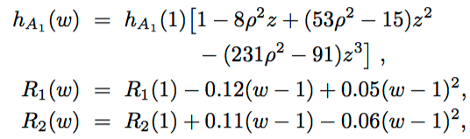


Form factor parameterizations
Caprini, Lellouch, Neubert [Nucl.Phys. B530, 153(1998)]
Boyd, Grinstein, Lebed [Phys. Rev. Lett. 74, 4603 (1995)]
B → D*lν
B → Dlν
Parameters: F(1), ρ², R₁(1), R₂(1)
G(1), ρ²
Parameters: coefficients a_{i,n}

Slide 5
Belle B⁰ → D^{*-}l⁺ν with hadronic tag
BELLE-CONF-1612 (preliminary)

Slide 6
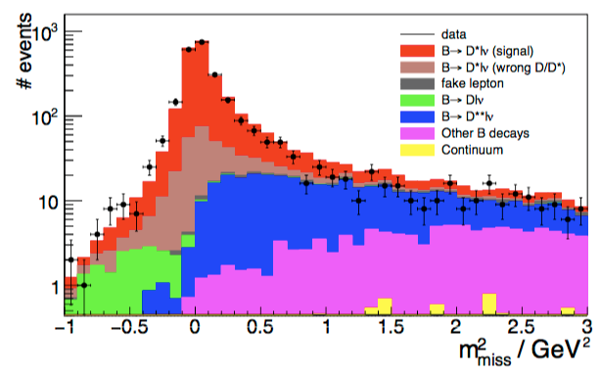
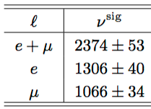

Event reconstruction and inclusive fit
Tag side: B_{tag} reconstructed in over 1100 hadronic modes, 0.2% efficiency for neutral B mesons
Signal side: B_{sig} assembled from an identified charged lepton (electron or muon) and a D^{*+} candidate
D⁰ → K⁻π⁺, K⁻π⁺π⁰, K⁻π⁺π⁻π⁺ (26.3%), D⁺ → K⁻π⁺π⁺ (9.4)%
D^{*+} → D⁰π⁺, D⁺π⁰ (98.4%)
Signal is extracted from the missing mass distribution by an unbinned maximum likelihood fit
Preliminary!
Largest syst: tag calibration

Slide 7
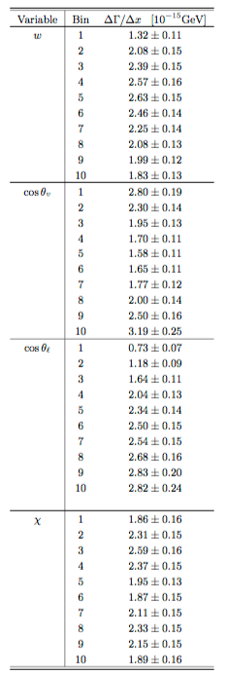
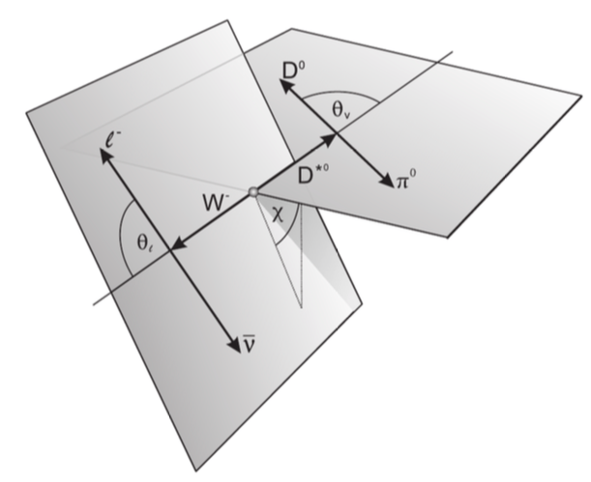
Differential fit result
Preliminary!
Yield is also extracted in 4x10 bins of w, cos θ_{l}, cos θ_{v} and χ
Overlapping samples → statistical correlations between partial widths, determined with bootstraping technique
Unfolding of resolution effect with the SVD algorithm [Nucl.Instr.Meth. A372, 469 (1996)]

Slide 8

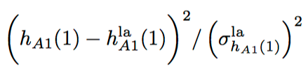
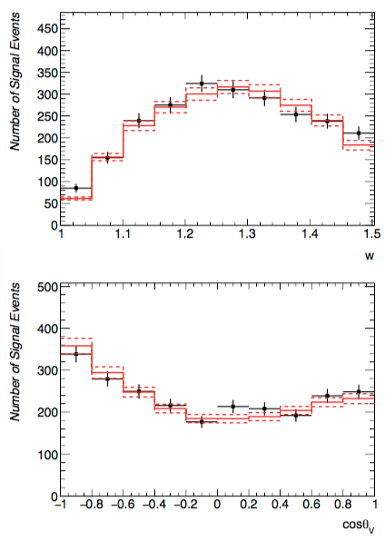
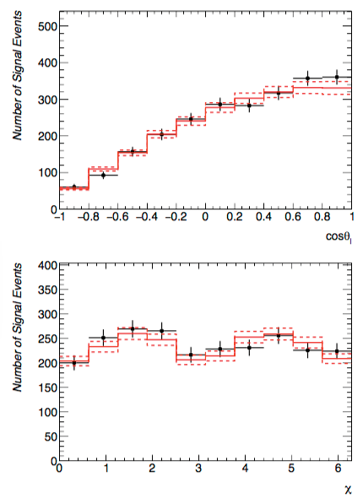
CLN fit to the differential widths
Points with error bars: Belle data,
red histogram: fit result, dashed histogram: Δχ²=1 contour

Slide 9
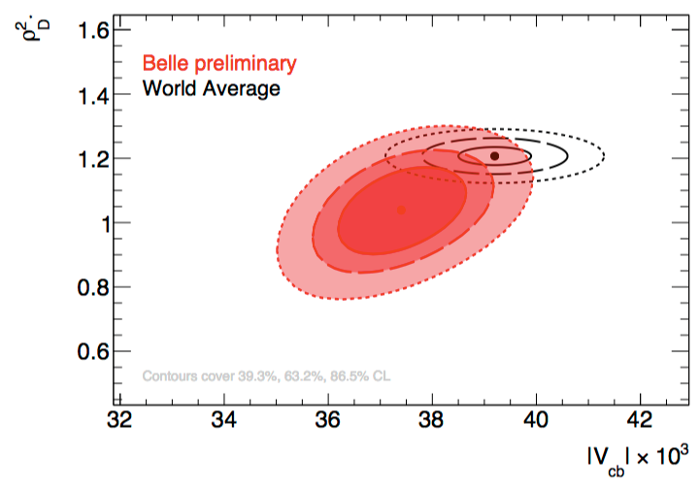
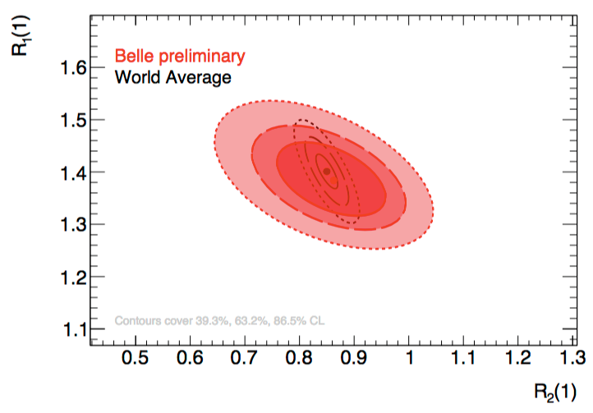
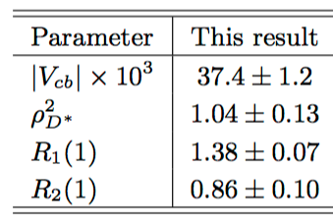
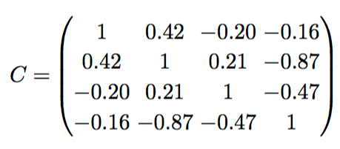
CLN fit to the differential widths (2)
χ² = 39.8 for 40-4 degrees of freedom
Preliminary!

Slide 10
Belle B → Dlν with hadronic tag
Phys. Rev. D93, 032006 (2016)

Slide 11
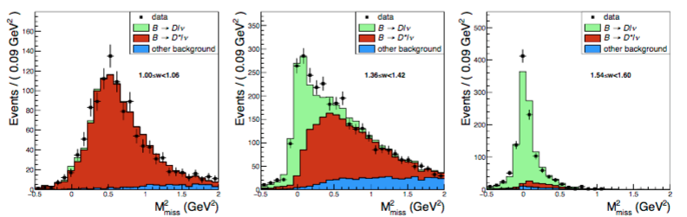
Event reconstruction
Identical event reconstruction method
10 D⁺ and 13 D⁰ modes are used on the signal side, covering 28.9% and 40.1% of the width
Signal extraction from M²_{miss} in 10 bins of w
16,992 +/- 192 signal events
(5150 +/- 95 neutral, 11,843 +/- 167 charged B events)

Slide 12
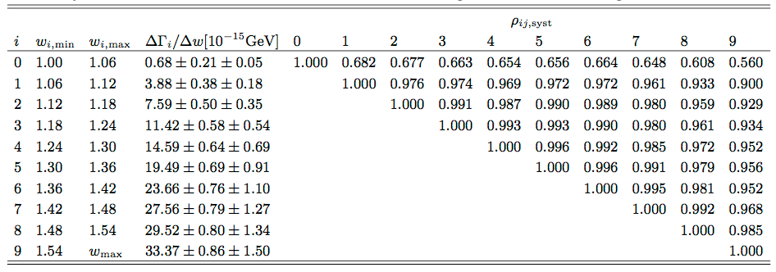
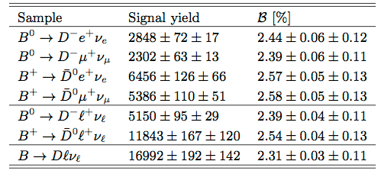
Differential width and branching fraction

Slide 13
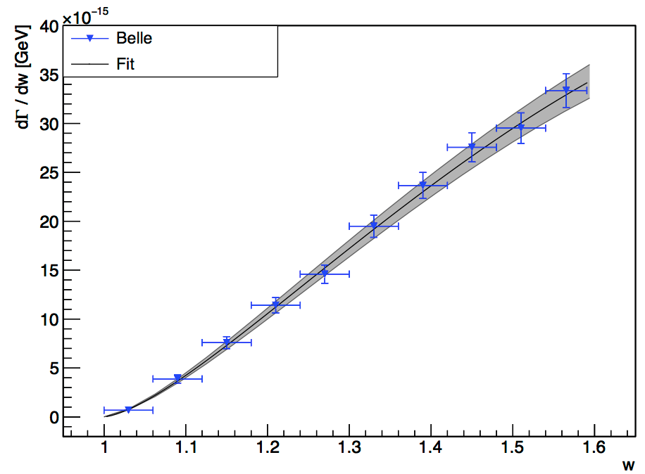
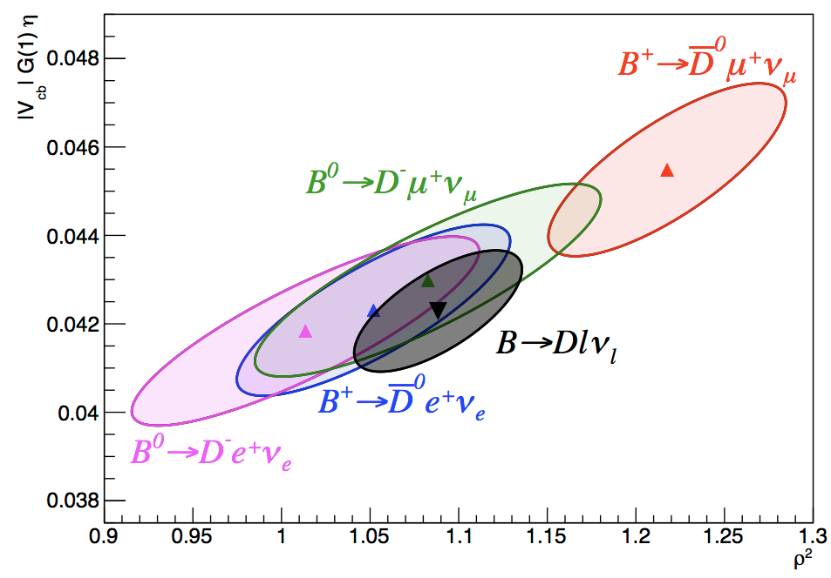
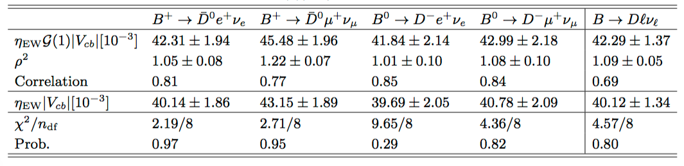
CLN fit to the differential widths

Slide 14
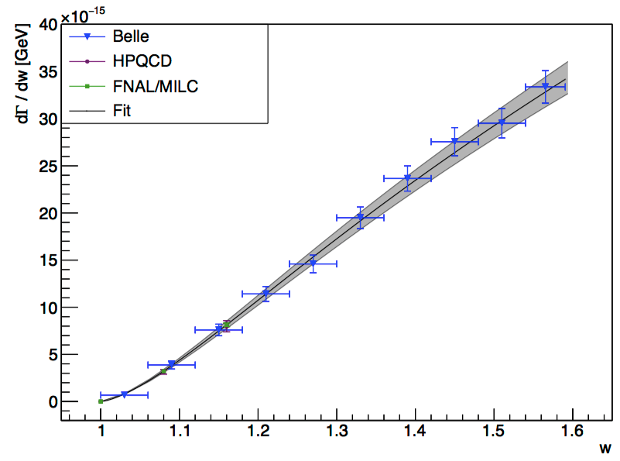
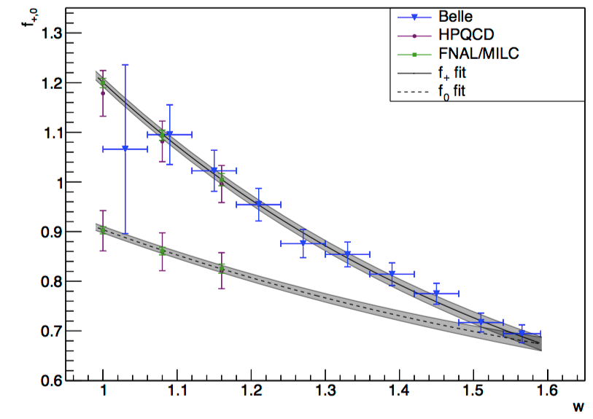
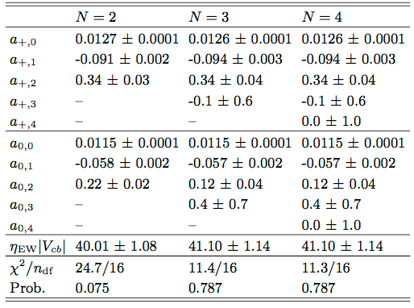
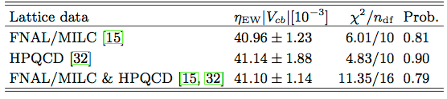
BGL fit to differential widths and lattice data

Slide 15
Summer 2016 HFAG results for |V_{cb}|exclusive

Slide 16
η_{EW}F(1)|V_{cb}| (B → D*lν)
η_{EW}F(1)|V_{cb}| = (35.61 +/- 0.11 +/- 0.41) x 10⁻³
[2014: η_{EW}F(1)|V_{cb}| = (35.81 +/- 0.11 +/- 0.44) x 10⁻³]

Slide 17
η_{EW}G(1)|V_{cb}| (B → Dlν)
η_{EW}G(1)|V_{cb}| = (41.57 +/- 0.45 +/- 0.89) x 10⁻³
[2014: η_{EW}G(1)|V_{cb}| = (42.65 +/- 0.72 +/- 1.35) x 10⁻³]

Slide 18
|V_{cb}| exclusive
B → D*lν
  η_{EW}F(1)|V_{cb}| = (35.61 +/- 0.11_{stat} +/- 0.41_{syst}) x 10⁻³
  η_{EW}F(1) = (0.920 +/- 0.014) [FNAL/MILC, PRD89, 114504]
  |V_{cb}| = (38.71 +/- 0.47_{exp} +/- 0.59_{th}) x 10⁻³
B → Dlν
  η_{EW}G(1)|V_{cb}| = (41.57 +/- 0.45 +/- 0.89) x 10⁻³
  G(1) = 1.0541 +/- 0.0083 [FNAL/MILC, PRD92, 034506]
  η_{EW} = 1.0066 +/- 0.0016 [NPB 196, 83]
  |V_{cb}| = (39.18 +/- 0.94_{exp} +/- 0.31_{th}) x 10⁻³

Slide 19
Branching fractions

Slide 20
Summary
Belle B⁰ → D^{*-}l⁺ν with hadronic tag [BELLE-CONF-1612]
  About 2400 reconstructed decays
  Br(B⁰ → D^{*-}l⁺ν) = (4.95 +/- 0.11_{stat} +/- 0.21_{syst})%
  CLN fit: |V_{cb}| = (37.4 +/- 1.2) x 10⁻³
Belle B → Dlν with hadronic tag [PRD93, 032006 (2016)]
  About 17,000 signal events (charged and neutral)
  Br(B⁰ → Dlν) = (2.31 +/- 0.03_{stat} +/- 0.11_{syst})%
  CLN fit: |V_{cb}| = (39.86 +/- 1.33) x 10⁻³
  BGL fit: |V_{cb}| = (40.83 +/- 1.13) x 10⁻³
HFAG summer 2016 averages
  B → D*lν: |V_{cb}| = (38.71 +/- 0.47_{exp} +/- 0.59_{th}) x 10⁻³
  B → Dlν: |V_{cb}| = (39.18 +/- 0.94_{exp} +/- 0.31_{th}) x 10⁻³

Slide 21
backup

Slide 22
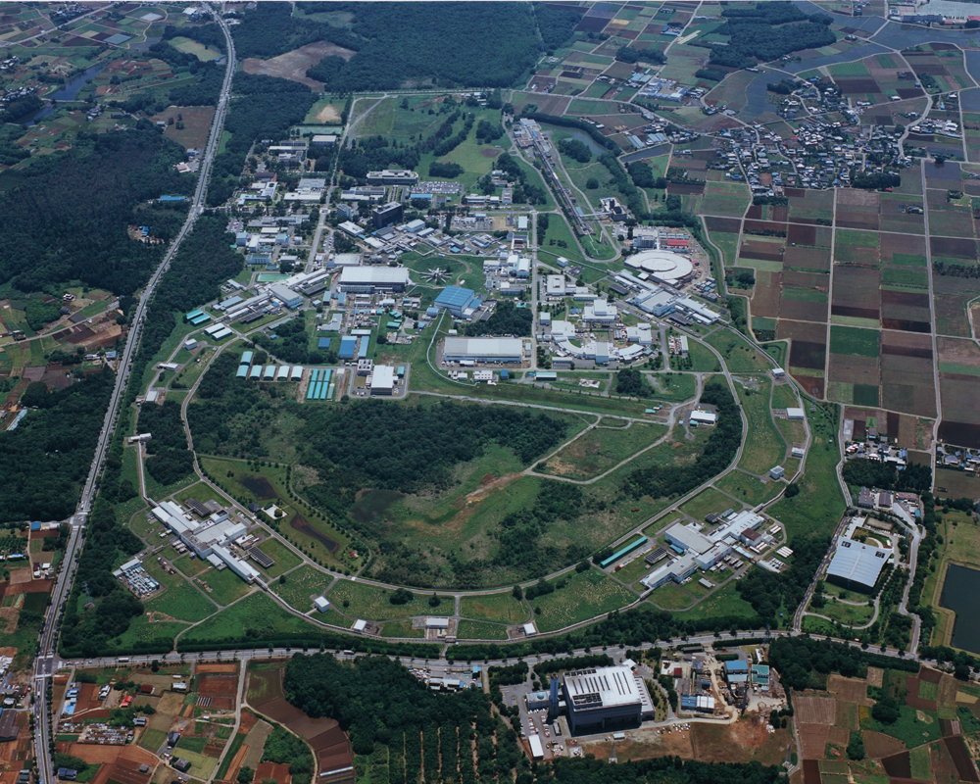
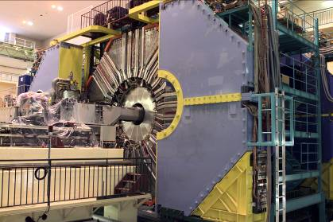
1999 – 2010: B factory at KEK (Japan)
Linac
KEKB double
ring e⁺e⁻ collider
e⁺e⁻ → Y(4S) → BB
Belle detector
World largest B meson sample
~771 million BB events
Over 450 Belle physics publications

Slide 23
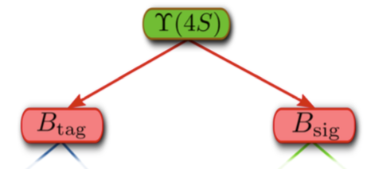
Tagging techniques for Y(4S) events
Tagging provides:
  Background suppression
  Information on B_{sig}
  (4-momentum)
PURITY
EFFICIENCY
Untagged
No requirement on B_{tag}
High efficiency,
low purity
Semileptonic tag
B_{tag} → D*lν
Efficiency ~O(0.2%)
Hadronic tag
B_{tag} → hadrons
Efficiency ~O(0.1%)

Slide 24
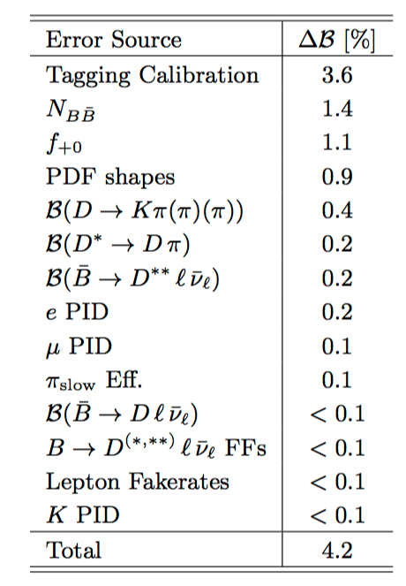
Systematic uncertainties on BR(B⁰ → D^{*-}l⁺ν)

