Slide 1
Study of Cross-Correlation functions in a Neutron star source GX 17+2
K. Sriram
Department of Astronomy
Osmania University
Wide Band Spectral and Timing Studies of Cosmic X-ray Sources
11 Jan 2017, TATA Institute of Fundamental Research
A. R. Rao and Malu S.

Slide 2
Introduction
Cross-correlation function (CCF) an important tool to understand the physical processes and geometry of accreting disk in XRBs.
Constrain time lags in various energy bands
Milli-second lags are reported in various XRBs, provides evidence for the process of Comptonization in Compton cloud/corona or Jet (Done et al. 2007; Reig and Kylafis 2015; Reig and Kylafis 2016)
Our previous study show that anti-correlated lags of the order of few tens to hundred seconds in both BH and NS XRB, indicates the presence of truncated accretion disk (Choudhury and Rao 2004; Sriram et al. 2007 Sriram et al. 2012)

Slide 3
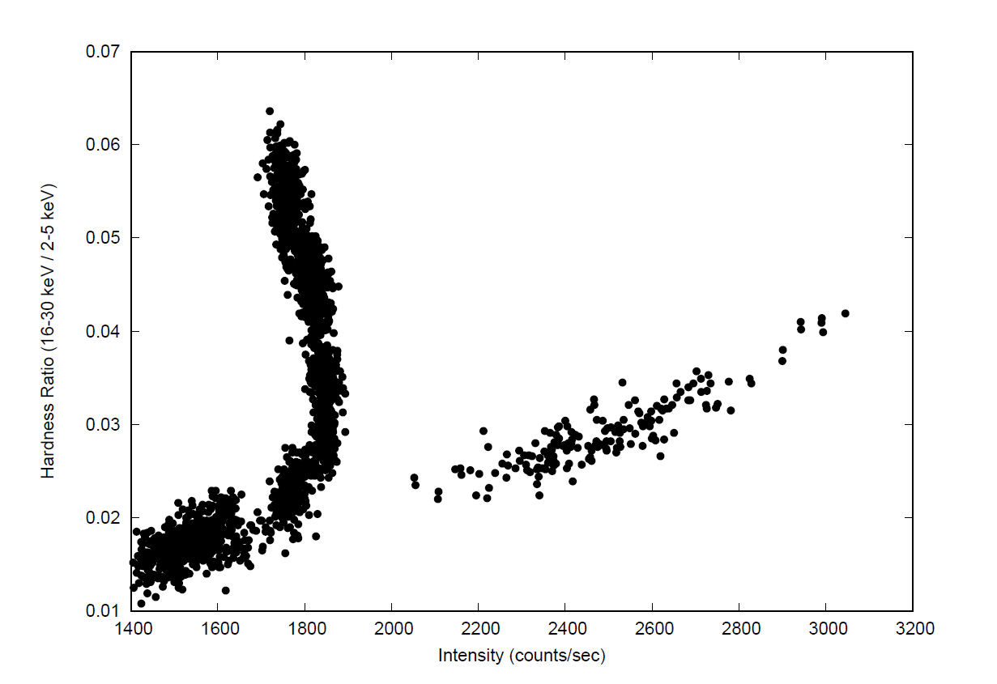
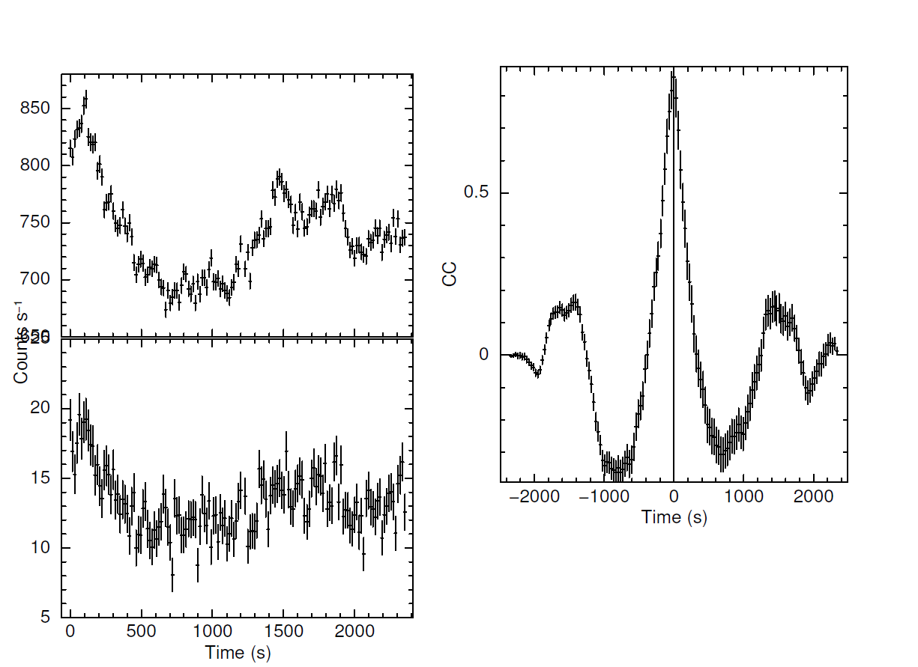
CCFs in GX 17+2, 2-5 keV and 16-30 keV
Sriram et al. Under preparation
Flaring Branch

Slide 4
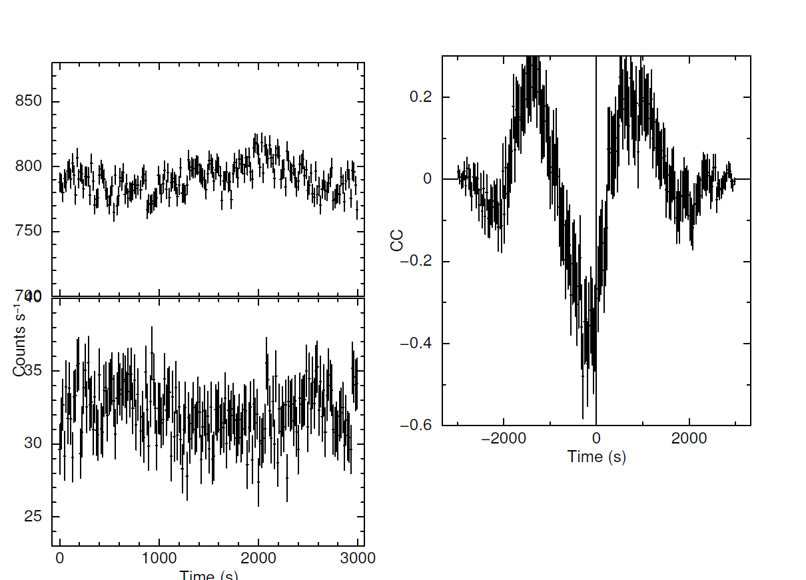
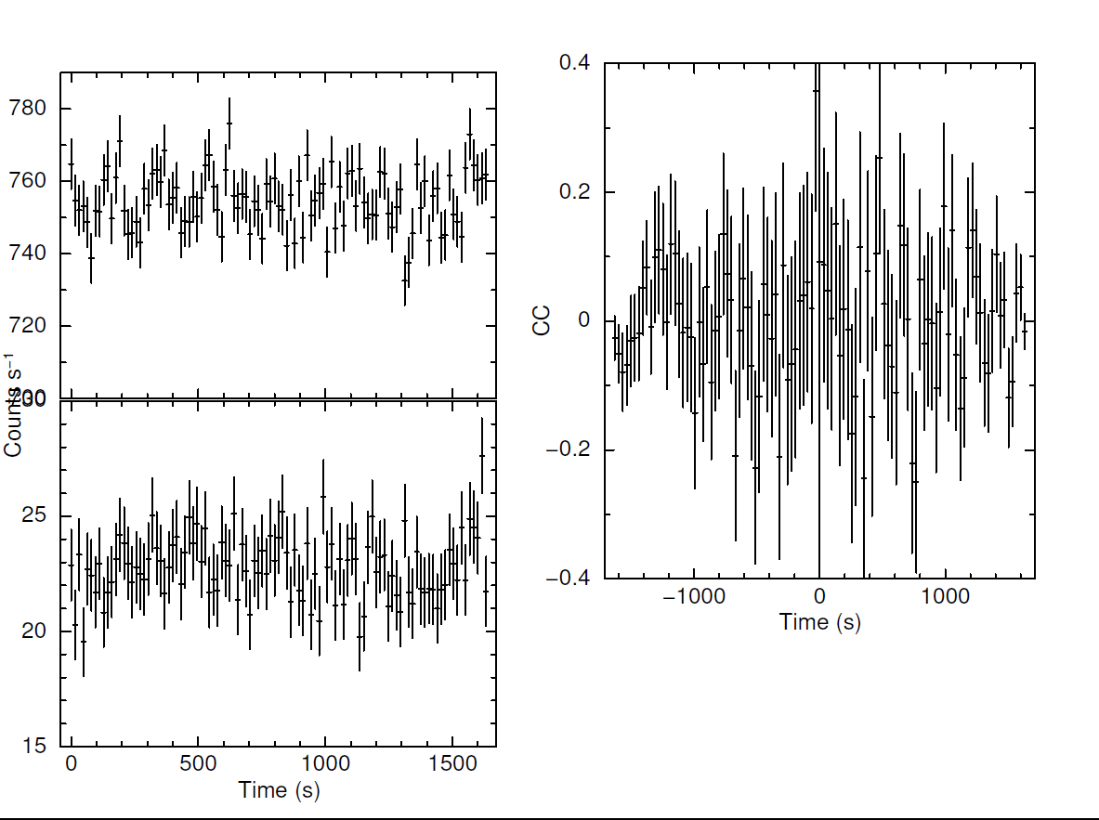
Un-Correlated and Anti-CCFs with lag

Slide 5
Conti..
Anti-correlated CCFs with/without lags are always associated with HB and NB
HB/NBs are associated hard tail and Jet (eg. Migliari et al. 2007; DiSalvo et al. 2002)
Is there any connection between observed lags and Jets?

Slide 6
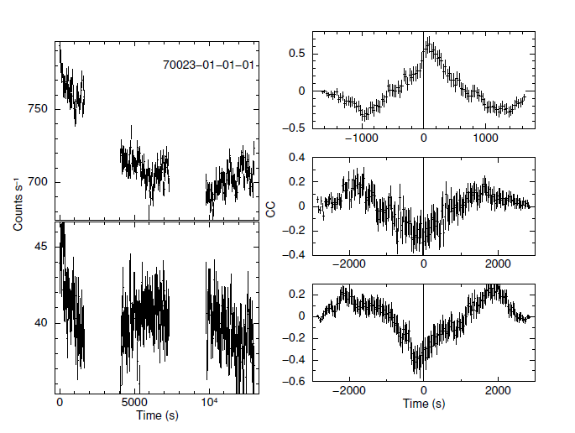
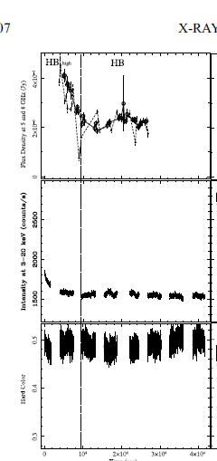
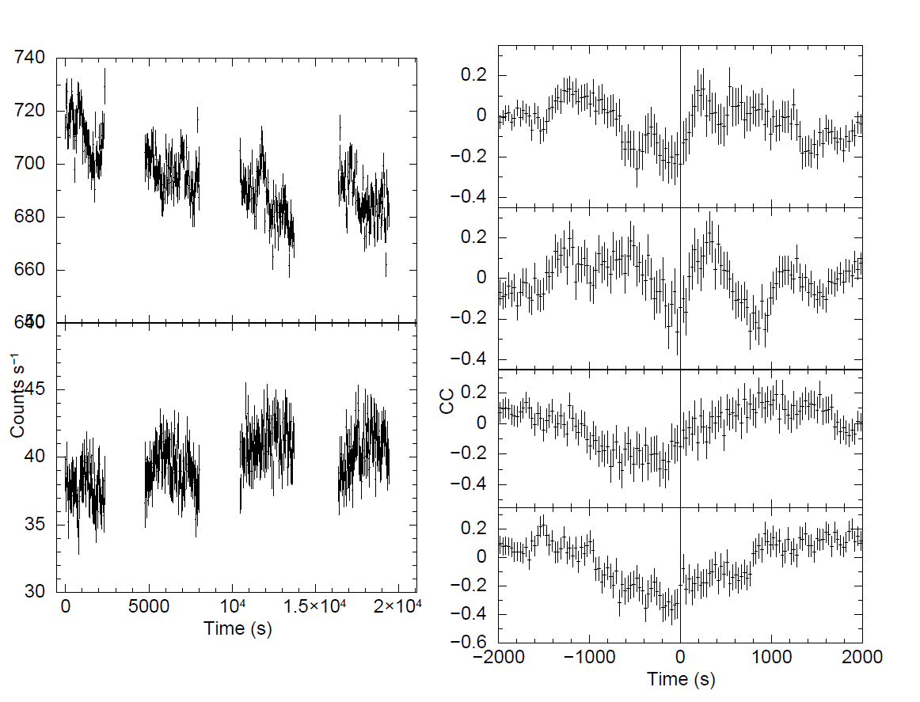
Simultaneous Radio and X-ray obs. Of GX 17+2, Migliari et al. 2007, ApJ

Slide 7
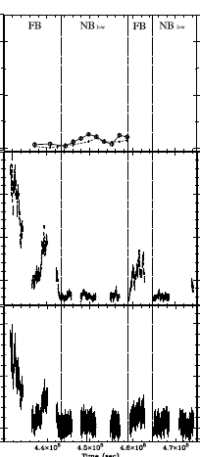
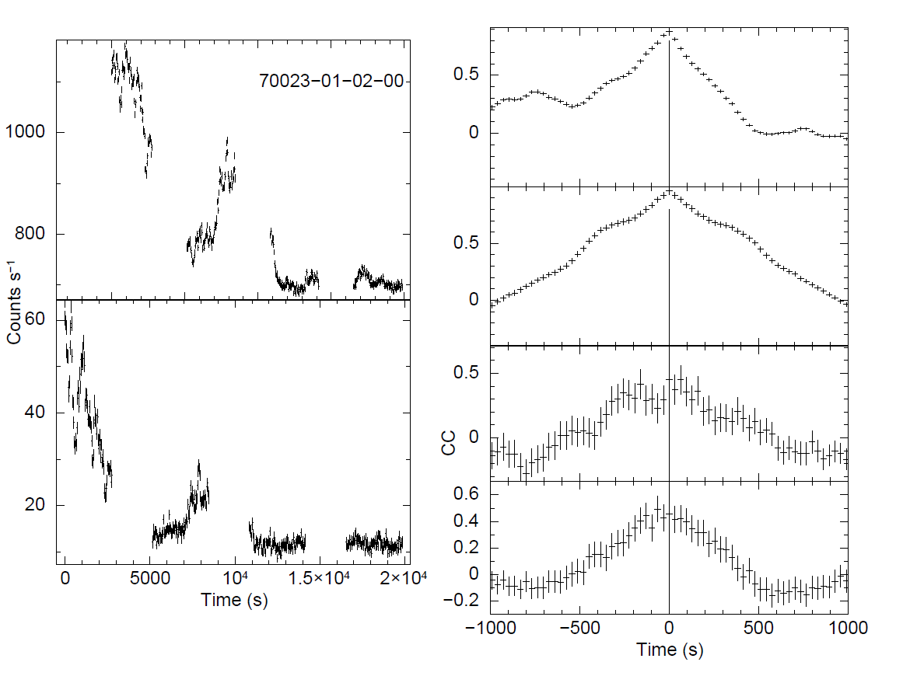
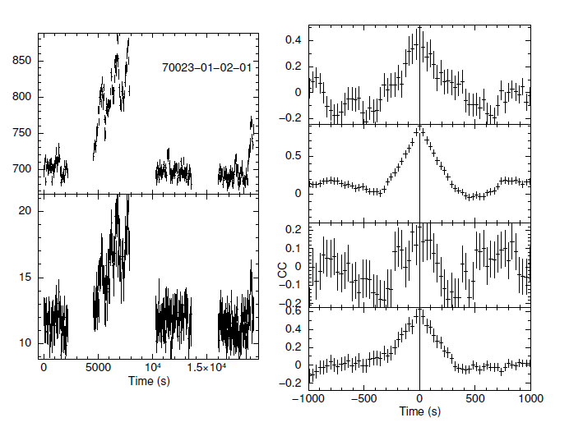
Migliari et al. 2007, ApJ

Slide 8
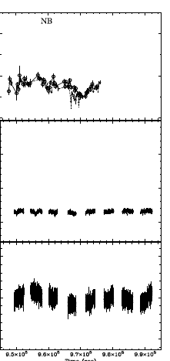
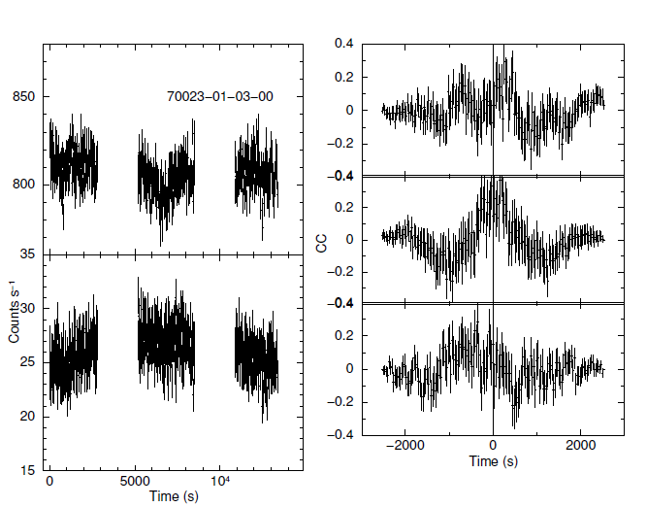
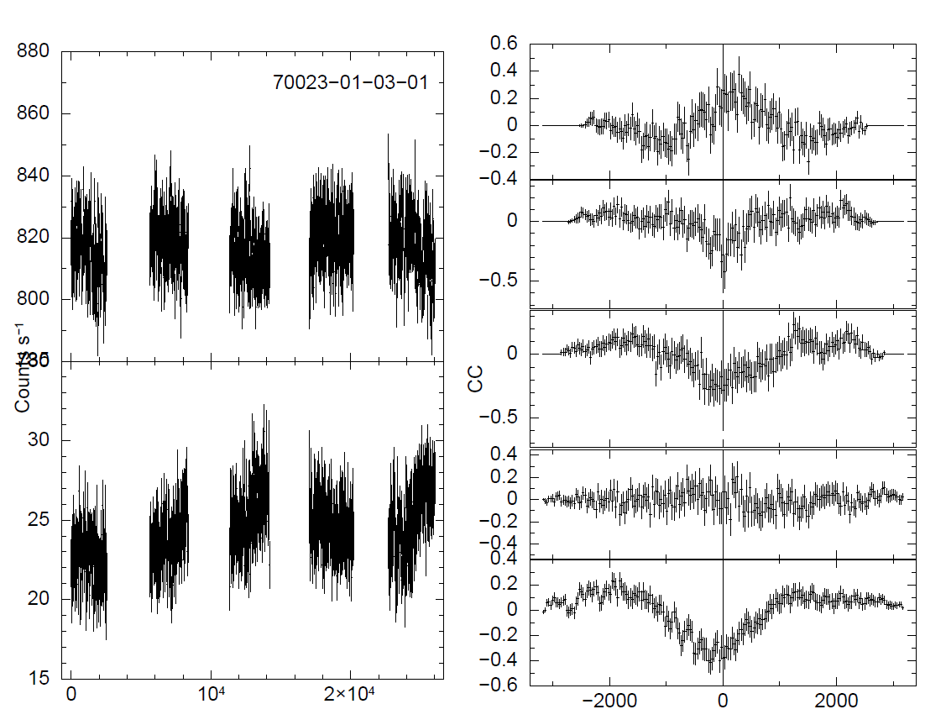
Migliari et al. 2007, ApJ

Slide 9
Results
Anti-correlated lags (hard and soft) are associated with HB and NB
Anti-correlated/Correlated lags of the order of 10 – 100 s were noticed
Association of lags with HB and NB indicate that the lags are probably connected to Jet
These lags cannot be reprocessing time scale (few milliseconds).
Lags could be the response times during which soft and hard emitting region are modifying in terms of physical size

Slide 10
Conclusion
Detected lags could be the signature of presence of jet.
If confirmed, lags can constrain the length of the jet
In order to explain the NS spectrum (i.e kT=2-3 keV, hard tail Gamma=1.8-3 and no cutoff upto 200-300 keV) Reig and Kylafis (2016) assumed a jet height =10⁵ R_{NS} i.e. 10⁶ Km
Assuming soft photons are Comptonized in jet and travelled along with jet and gets emitted after observed lag time
Above scenario indicate a presence of jet of length 0.2 AU (~3 X 10⁷ Km) assuming a lag time of 100s

Slide 11
Thank you!!!!

