Slide 1
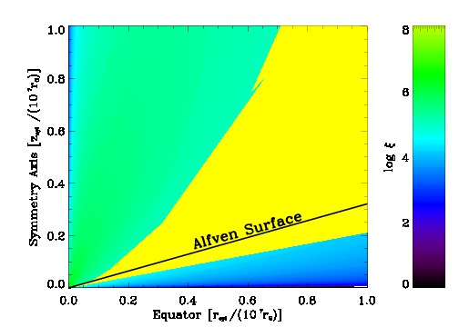




Magneto-centrifugal winds from accretion discs around black hole binaries
by
Susmita Chakravorty
from
Indian Institute of Science
with
Pierre-Olivier Petrucci, Jonathan Ferreira, Gilles Henri
as part of the
ANR-CHAOS collaboration
Institut de Planétologie et d'Astrophysique de Grenoble (IPAG)
Wide Band Spectral and Timing Studies of Cosmic X-ray Sources
11th January, 2017

Slide 2
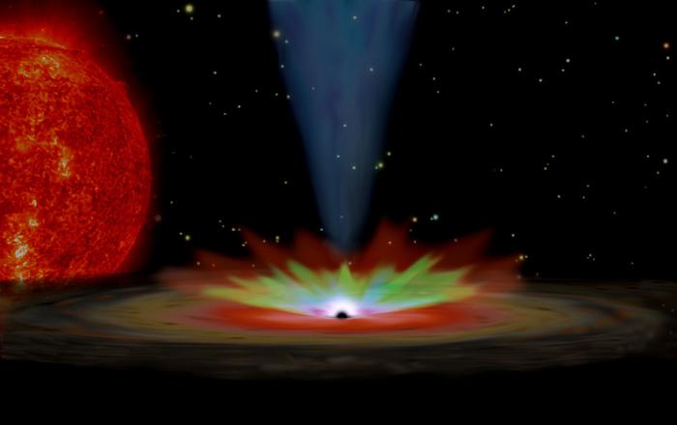
Study of the accretion disk winds
Accretion disk winds are common in all astrophysical systems which have them
~ Protoplanetary disks: Radiative driving, photoevaporating the the top disk layers
~ T-Tauri stars: Radiative driving, photoevaporating the the top layers of the circumstellar disk
~ Protostars/YSOs: Magnetic driving
~ Black hole and neutron star binaries: Thermal or Magnetic acceleration
~ Active Galactic Nuclei: Thermal, Radiative and/or Magnetic driving

Slide 3
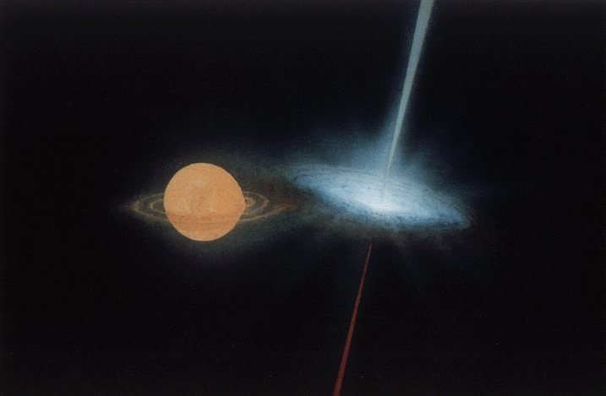
Black Hole X-ray binaries: Fun Facts
Jet
Companion Star
Wind
Accretion Disk

Slide 4
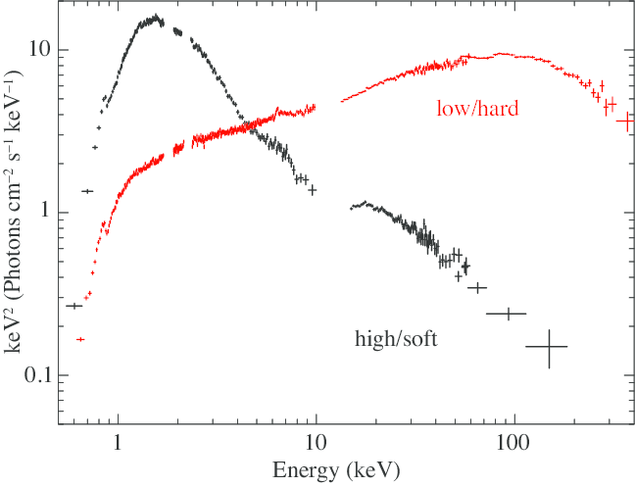
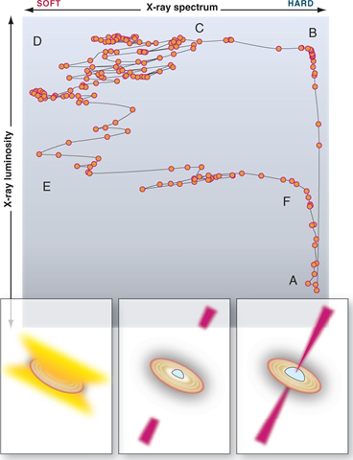
What do we see using X-ray spectra?
Thermal, blackbody-like emission from accretion disk
Non thermal (powerlaw) emission
possibly Comptonization of thermal photons
and/or jet
Soft
Fender 2012
X-ray Luminosity
CygX1 using Suzaku, Yamada, Shin'ya et al. PASJ 45 (2012)
Using a broad band telescope
Observing in ~ 1 – 100 keV
(e.g. Astrosat, RXTE, Suzaku)
Hardness
(Whether there is more power in high energy emission)
If we monitor the source for a long time
We see a “hysteresis”
How long? Days – Months

Slide 5
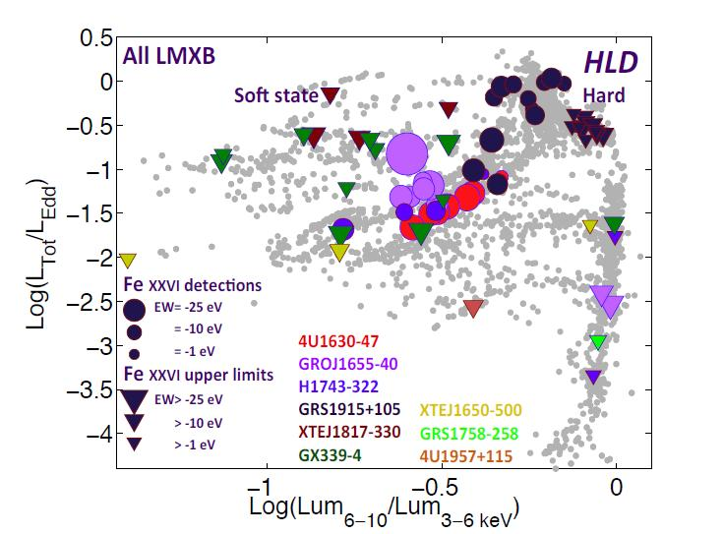
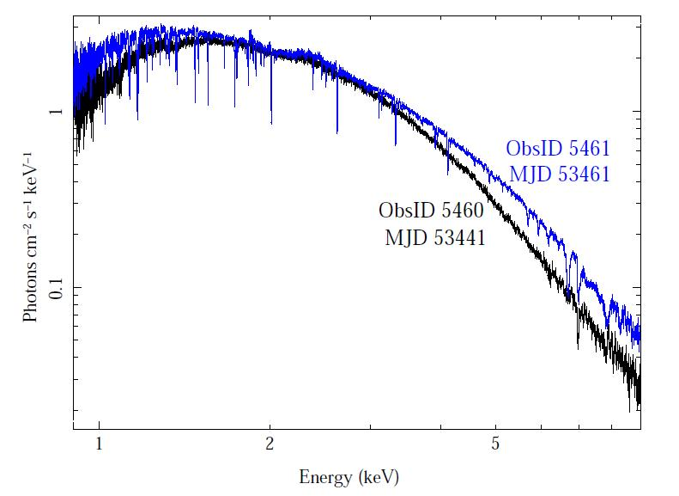
What do we see using X-ray spectra?
Thermal, blackbody-like emission from accretion disk
Non thermal (powerlaw) emission
possibly Comptonization of thermal photons
and/or jet
Soft
Using a high resolution telescope
Observing in ~ 1 – 10 keV
(e.g. Chandra, XMM-Newton)
CygX1 using Suzaku, Yamada, Shin'ya et al. PASJ 45 (2012)
Ponti et.al 2012
Using a broad band telescope
Observing in ~ 1 – 100 keV
(e.g. Astrosat, RXTE, Suzaku)
He-like Iron
Winds are observed only in the Soft state
Winds are equatorial – i.e. close to the surface of the accretion disk
H-like Iron
GROJ 1655, using Chandra, Neilsen & Homann, 2012

Slide 6
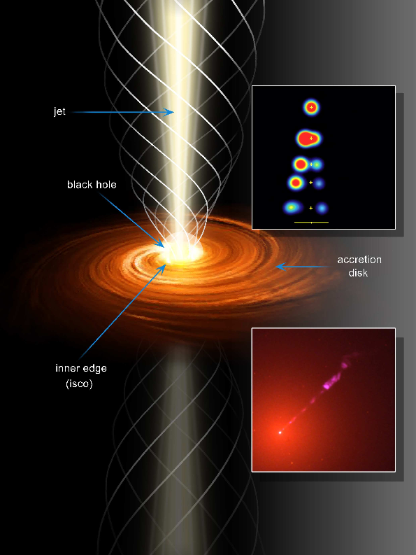
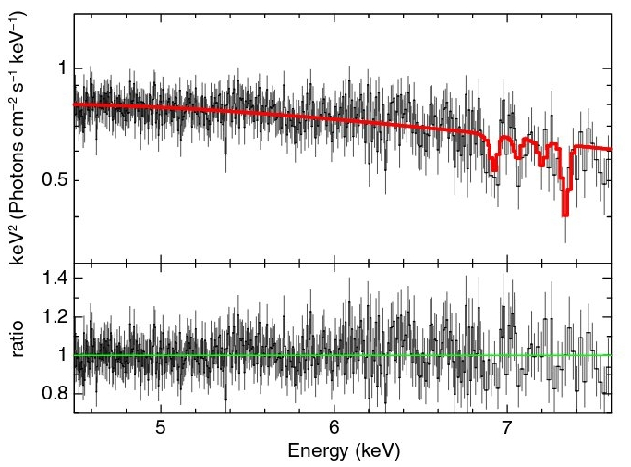
How are the winds accelerated?
We see the absorption lines when we see through the outflow
Some physical mechanism is lifting material off the accretion disk and accelerating it
Search for the accelerating physical mechanism is on
Magnetic fields:
We choose a particular class of MHD (magnetohydrodynamic) models of outflows
Jonathan Ferreira ++ (1997, 2004 etc.) – Jet/wind emitting disk
We show how well (or not) we explain BHB winds with them
Why magnetic fields?
MHD is the popular model for Jets
Can they also explain winds?
Successful attempts in case of AGN (super-massive black holes)
No attempts for BHBs.
Miller et.al. (2008) suggest MHD winds from spectra of GROJ 1655
~ they found very high densities
~ implying wind launched from close to the black hole
(but see Done et. al. arXiv:1612.09377)
King et.al. (2012) suggest very high velocity winds for IGR J17091-3624
~ FeXXV lines suggest ~ 9000 km/s
~ FeXXVI lines suggest ~ 15000 km/s
He-like Iron
FeXXV and FeXXVI lines
H-like Iron

Slide 7

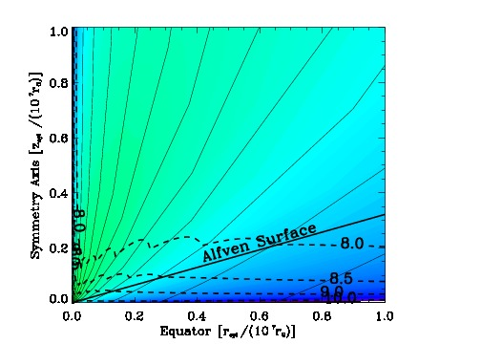
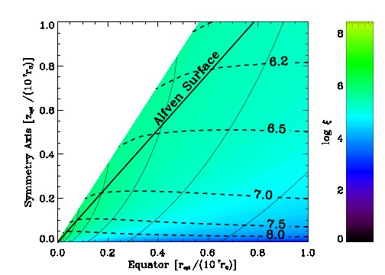
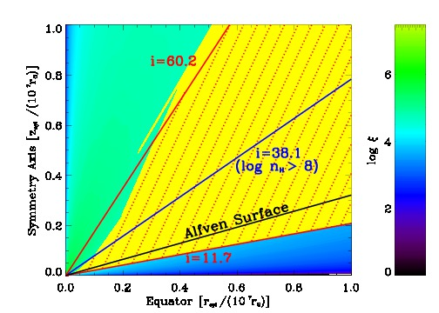

MHD winds from the
accretion disk: the ANR-Chaos project
Chakravorty+ 2016, A&A, 589A, 119
Jet Region
Wind
FeXXV lines
Pre computed
MHD model of outflow from the disk
(Ferreira 1997, Casse & Ferreira, 2000)
Predicts many physical quantities as a function of distance (r, z) from black hole
Gas density, Magnetic field, Gas velocity etc.
= h/r = 0.01
p = 0.1 (Ṁ_{acc} = r^{p})
= h/r = 0.001
p = 0.04 (Ṁ_{acc} = r^{p})
Outflow
The solutions are self similar.
Hence can spread out to large distances.
Disk aspect ratio ε (= h/r)
Ejection efficiency p (where Ṁ_{acc} = r^{p} )
The ejection or outflow of material is related to the accretion
Ejection Mechanism - **not** a free parameter (unlike ADIOS scenarios)
σ ~ 1/p, , V_{max} ~ p^{-1/2}

Slide 8
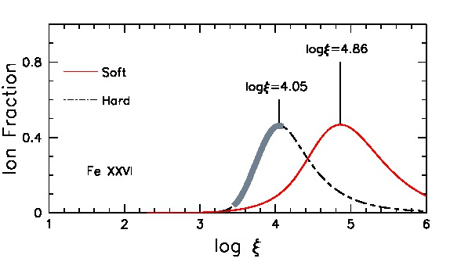
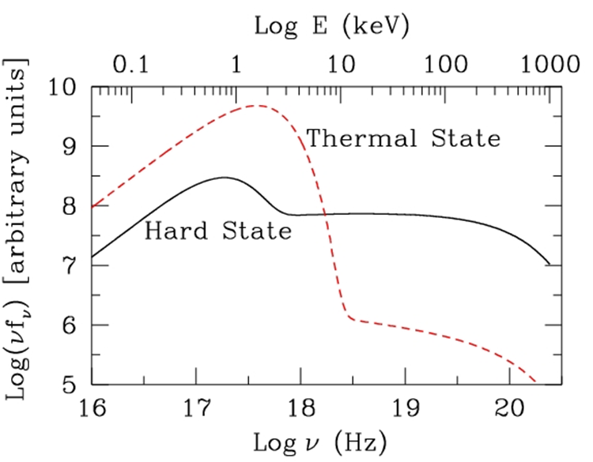
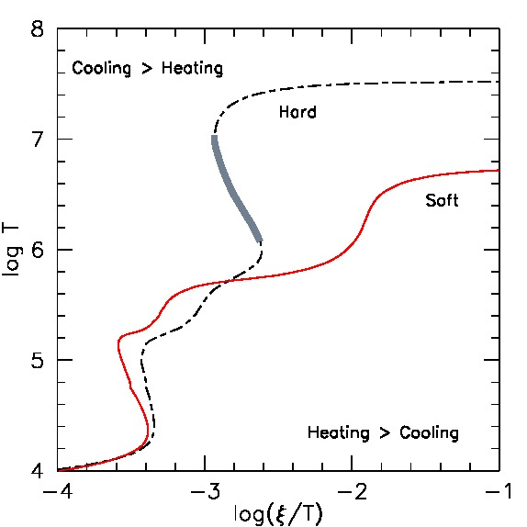
Deriving Atomic Physics Constraints
SED
Description of the light from the innermost part of the disk
Work out
Atomic Physics
of the gas
CLOUDY
ξ= L/nR²
(Disk dominated)
Soft state
Limits to be put on
MHD models
10M_{ʘ} black hole accreting at ~ 0.1 L_{Edd}.
Thermal –
Diskbb; r_{in} = 6 r_{g} → T_{in} = 0.56 keV
Powerlaw - Γ = 2.5
L_{disk}/L_{PL} = 0.8 in 2 – 20 keV
Hard –
Diskbb; r_{in} = 12 r_{g} → T_{in} = 0.33 keV
Powerlaw - Γ = 1.8
L_{disk}/L_{PL} = 0.2 in 2 – 20 keV
Scheme guided by Remillard & Mclintock, 2006
log ξ ≤ 4.86 for Soft SED
log ξ ≤ 3.4 for Hard SED
because 3.4 – 4.1 is thermodynamically unstable
Also see
Chakravorty+ 2013, MNRAS.436, 560

Slide 9
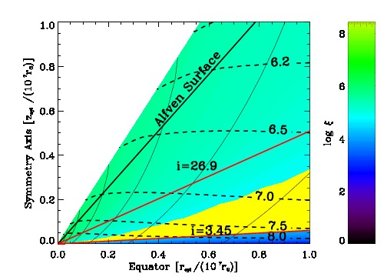
Find the wind region within the MHD model
Some reasonable physical limits on
Column density of the gas
N_{H} < 10²⁴ cm⁻²
Velocity of the gas in z direction
v_{z} > 0
Remember the Atomic Physics limits
log ξ ≤ 4.86 for Soft SED
log ξ ≤ 3.4 for Hard SED
because 3.4 – 4.1 is
thermodynamically unstable
SED
Description of the light from the innermost part of the disk
Illuminates the gas
Observable wind
via FeXXV, FeXXVI
and other absorption lines
Soft state
ξ= L/nR²

Slide 10

Only a small fraction of the outflow is observable wind
A Cold model with ε = h/r = 0.001 and p = 0.04

Slide 11
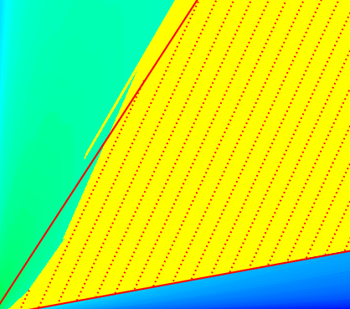
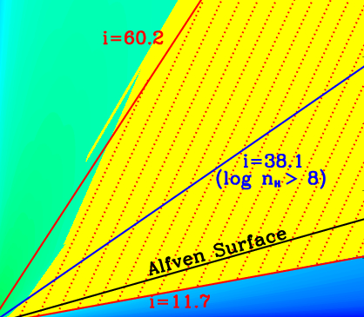
The “wind fraction” will depend on the MHD model
i = 60.2
A denser Warm model with ε = h/r = 0.01 and p = 0.1

Slide 12
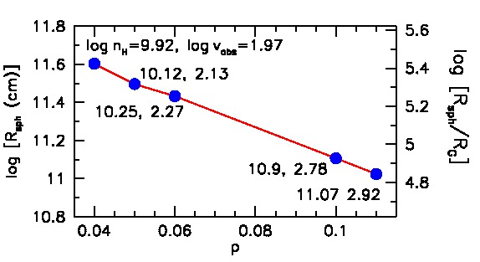
Cold vs warm magnetic solutions
Cold
= 0.001
p = 0.04
= 0.01
p = 0.10
Cold
Purely magnetic acceleration
Does not work
The wind is too far away
Density too low
Velocity too low
Warm
Disk surface is heated
Hence more material is
lifted off the disk
Magnetic acceleration follows
Works for “average” winds
Density < 10¹² cm⁻³,
Velocity ≤ 10³ Km/s
Velocity: very small !!
< observed values
Not acceptable.
X

Slide 13
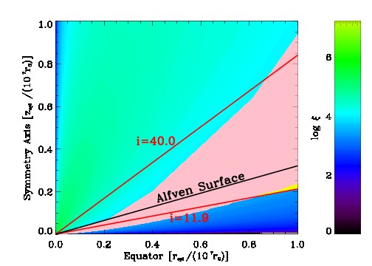
Why no winds in the hard state?
x
SED
Description of the light from the innermost part of the disk
Work out
Atomic Physics
of the gas
CLOUDY
Winds are observed only in the Soft state
Winds are equatorial – i.e. close to the surface of the accretion disk
log =3.4
Soft state
Ponti et.al 2012
Either because there is none or less material available material to lift
~ means that the underlying outflow solution has changed
Or because there are interesting atomic physics constraints which make them undetectable
Also see
Chakravorty+ 2013, MNRAS.436, 560

Slide 14
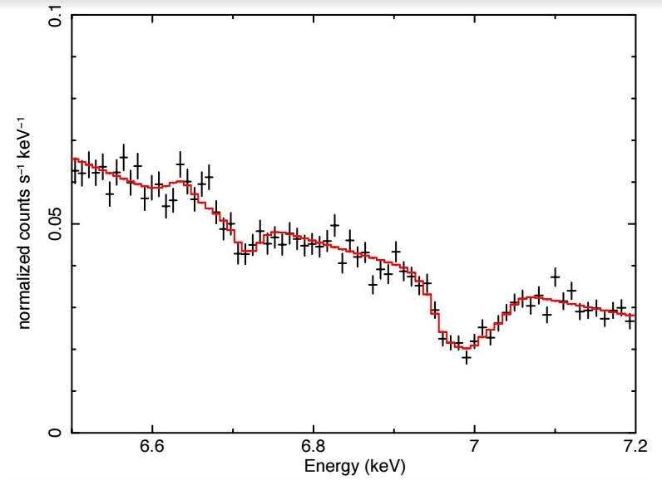
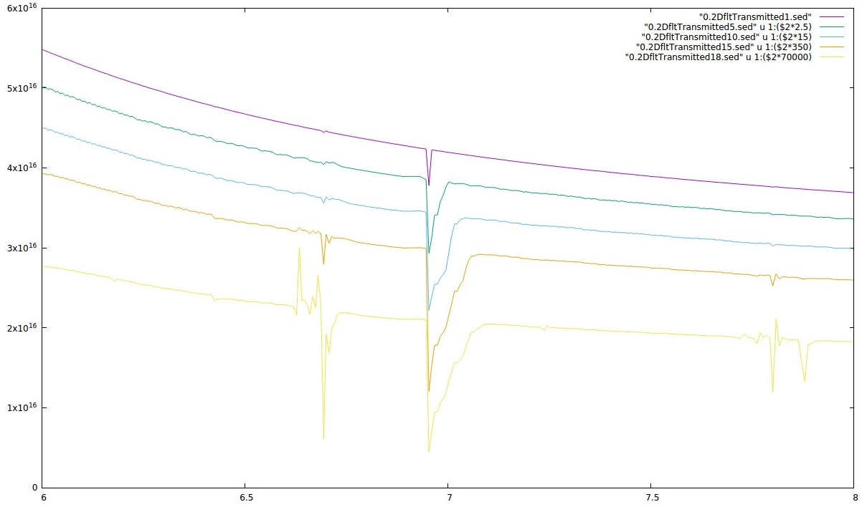
MHD winds from the accretion disk: Simulate spectra to fit to observations
Work in progress
Absorption spectra in terms of MHD parameters (p and ε) and i (inclination angle)
Fake Chandra data for 800ks of a F(3-10 keV) =2x10⁻⁹ ergs/s source.
Disk black body + Powerlaw
1 Gaussian for FeXXV line
2-3 Gaussian lines for the FeXXVI line
Box 1
5
10
15
18
FeXXV FeXXVI
6.5 7
E(keV)
600 – 800 km/s
~2500 km/s
300 km/s

Slide 15
MHD winds from the accretion disk: the ANR-Chaos project
Aim of the project
Can MHD models represent observed BHB winds
- correct ionization state of the gas
- with correct values of density, column density and velocity of the gas
Will the models explain
- the average winds (density < 10¹² cm⁻³, velocity ≤ 10³ Km/s )
- the extreme winds (density > 10¹² cm⁻³, velocity ~ 5 x 10³ Km/s )
~ will be a success over “thermal pressure” models
Can we explain that
winds are observed only in Soft state
winds seem to hug the accretion disk surface
We have devised ways to implement
~ self consistently correct ionization state
~ correct column density
We have ruled out Cold MHD solutions
Warm MHD solutions work
Disk surface heating lifts of gas
Magnetic acceleration follows
Works for “average” winds
Density < 10¹² cm⁻³, We are at par
Velocity ≤ 10³ Km/s with thermal pressure models
But what about “extreme” winds?
There is hope and we are working on it
Thermodynamic Instability conditions (used 1st time)
Explains absence of winds in Hard State
Explains why only Soft state has wind signatures
x
?
Work in progress
We are trying to generate absorption spectra in terms of MHD parameters (p and ε) and i (inclination angle)
Warm MHD model with high p will explain extreme winds
(ejection index)
We need MHD models with high ejection index p
Only Warm solutions can provide them
We do not yet have those models
we are building them
Reasonable extrapolations show
- we can easily reproduce the extreme winds
- This would be a success over the thermal pressure models
Thank you
Questions?

Slide 16
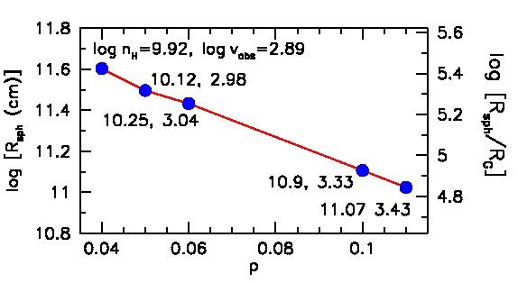
Extreme winds
For extreme winds we need to increase p
- p cannot be arbitrarily increased
- it is linked to accretion
- we still do not have a model with p > 0.11
In literature:
p ~ 0.5 required to explain AGN winds
p ~ 0.45 to explain YSO winds
We try a rough linear extrapolation for p=0.5
Puts the wind at 5x10³ R_{G}
Choice of ξ upperlimit decides the results we get.
We had chosen a rather stringent upperlimit, log ξ < 4.86
Relaxing to log ξ < 6 brings the wind closer by ~ 90 times
Wind at < 10³ R_{G}
Rough linear extrapolation on density and velocity - would depend on the MHD solution.
Extrapolating linearly – they would increase through about 2 orders of
magnitude.
at ~ 5 x 10³ R_{G}
If p = 0.5
at < 10³ R_{G}
If log ξ limit ~ 6
log n_{H} ~ 13, log v_{obs} ~ 4
log ξ = 3.4

Slide 17
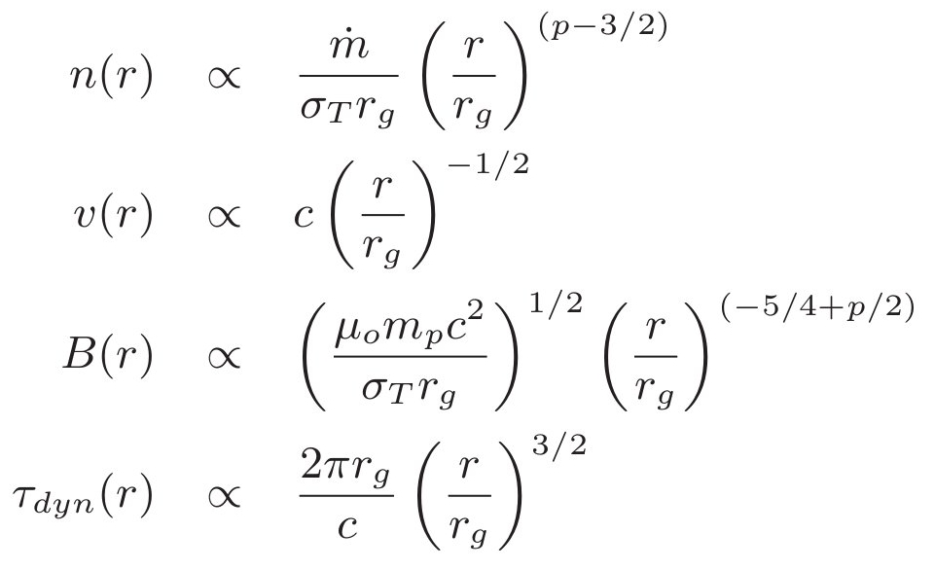
MHD winds from the
accretion disk: the ANR-Chaos project
Chakravorty+ 2016, A&A, 589A, 119
Pre computed
MHD model of outflow from the disk
(Ferreira 1997, Casse & Ferreira, 2000)
Predicts many physical quantities as a function of distance (r, z) from black hole
Gas density, Magnetic field, Gas velocity etc.
= h/r = 0.001
p = 0.04 (Ṁ_{acc} = r^{p})
The solutions are self similar.
Hence can spread out to large distances.
=
=
=
=
f(n)
f(v)
f(B)
f(dyn)
Disk aspect ratio ε (= h/r)
Ejection efficiency p (where Ṁ_{acc} = r^{p} )
The ejection or outflow of material is related to the accretion
Ejection Mechanism - **not** a free parameter (unlike ADIOS scenarios)
σ ~ 1/p, , V_{max} ~ p^{-1/2}

Slide 18
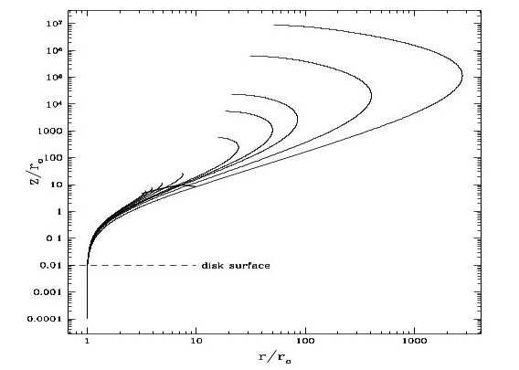
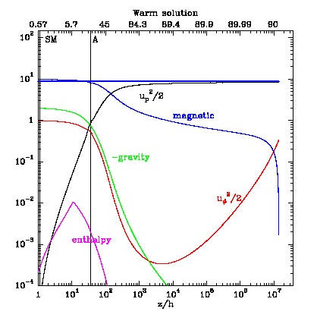
Some generic properties of the MHD outflow models
Alfven point
Slow magnetosonic point
i
p increases from 0.005 to 0.05
Alfven point
The magnetic field lines for different MHD models
as a function of ejection index “p”

