Slide 1
Act of Observation & Biology of Cancer
DR R A BADWE
Professor, Surgical Oncology and
Director
Tata Memorial Centre, Mumbai

Slide 2
Act of Observation
The State of what’s being observed remains unpredictable/superimposed when not observed
It collapses into one of the states by act of observation
In cancer what remains in a state of flux is whether tumour is metastatic or not
Do these two super-imposed states commit to one by act of observation/surgery?

Slide 3


Experimental Design : Three Interventions – Biopsy, Surgical Biopsy, Tumour Excision.
Surgical Intervention
-10 days to 0 Minutes
10-20 minutes
30-40 min
1st Biopsy before start of surgery
2nd Biopsy during Surgery
Tumour resected after surgery
A : Vascularized
Normoxic
B : Semi Vascularized
hypoxic
C : De-Vascularized
anoxic
RNA-Seq (at least 30 Million P.E Reads per sample)
32 tumors at time point A
1 in duplicate at time point C
8 patients in triplicates (A vs B vs C)
7 tumors, one normal

Slide 4
What Do We Expect?
As the surgical procedure progresses the magnitude of observation also increases
In between state A (normoxic) & C (anoxic) a graded change (hypoxia) should occur where fright, flight responses would be visible
In state C (anoxia) there would be complete withdrawal of all responses(?reversal to state A) : lost battle
All our understanding of tumour biology is based on sample A or C to date

Slide 5
De-regulated Genes
Over 2000 genes are deregulated
Normoxia vs Hypoxia 41
Hypoxia vs Anoxia 52
Normoxia vs Anoxia 11
Upregulated: PIGR, FOS, FOSB, DUSP1, EGR1, ATF3, CYR61, JUN & JUNB
Downregulated: NRCAM, GRB14, SFRP4 & CDSN

Slide 6
Normoxia vs Hypoxia
Gene Set Name | Genes in Gene Set (K) | Genes in Overlap (k) | k/K | p-value
TNFA SIGNALING VIA NFKB | 200 | 10 | 0.05 | 4.54E-13
EPITHELIAL MESENCHYMAL TRANSITION | 200 | 7 | 0.035 | 2.06E-08
ESTROGEN RESPONSE LATE | 200 | 6 | 0.03 | 5.51E-07
COAGULATION | 138 | 5 | 0.0362 | 2.03E-06
UV RESPONSE UP | 158 | 5 | 0.0316 | 3.95E-06
ESTROGEN RESPONSE EARLY | 200 | 5 | 0.025 | 1.24E-05
ADIPOGENESIS | 200 | 4 | 0.02 | 2.28E-04
HYPOXIA | 200 | 4 | 0.02 | 2.28E-04
KRAS SIGNALING UP | 200 | 4 | 0.02 | 2.28E-04
ANGIOGENESIS | 36 | 2 | 0.0556 | 1.32E-03

Slide 7
Conclusion
Hypoxia induces a metastatic phenotype on tumour cells
(Proliferation, invasion, motility, EMT, permissive immunological response, inflammation)

Slide 8
What kills the Host?
Metastasis: Growth of seedlings away from the primary organ of origin

Slide 9
Points to Ponder
How does this affect our understanding of the natural history of early breast cancer?
Can this be extrapolated to the timing of onset/autonomy of metastasis ?
Does Act of Observation during surgery changes the natural history of breast cancer?

Slide 10
Impact of surgery
Surgery vs No Surgery : unethical
The second best opportunity to make such comparison is offered within the tenets of screening trials

Slide 11
Impact of Surgery & Screening
Screen Control
Basic Assumption X early X early
Y late Y late
Early years All treated Late treated
Early allowed
to grow
Late years Majority treated Majority treated Early Late

Slide 12
Fisher’s Paradigm
Micro metastases pre-date clinical diagnosis
Event of loco-regional treatment does not impact on survival
Vs
SDA : Surgical Dissemination/Autonomy
Cancer 1977; 40:574-587

Slide 13
Impact of Surgery & Screening
First Few Years of Comparison is Surgery vs no Surgery
- Fisher’s Paradigm : Equal Mortality
- SDA hypothesis : Excess Mortality
Late Years of Comparison Early vs Late Surgery
- Fisher’s Paradigm : Lives Saved
- SDA hypothesis : Lives saved
SDA : Surgical dissemination/autonomy

Slide 14
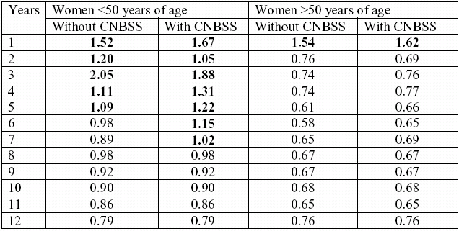
Breast Cancer Screening Trials

Slide 15
Screening trials in solid tumors
1. Breast Cancer
8 trials : Early excess mortality in all trials
2. Lung Cancer
6 trials : Early excess mortality in all trials
3. Cervical Cancer
Early excess mortality in VIA vs awareness
4. Prostate Cancer
3 trials : Excess mortality

Slide 16
Screening for Prostate Cancer (US study)
NEJM 2009, 360:1310-19,1320-28

Slide 17
Lung Cancer Screening Mayo Lung Project
Natl Cancer Inst 2000;92:1308–16]

Slide 18
Breast Cancer Screening Canadian Study
Ann Intern Med. 2002;137:305-312.

Slide 19
Cumulative Mortality of Cervix Cancer Screening (Mumbai Study)
Till end of 4th round

Slide 20
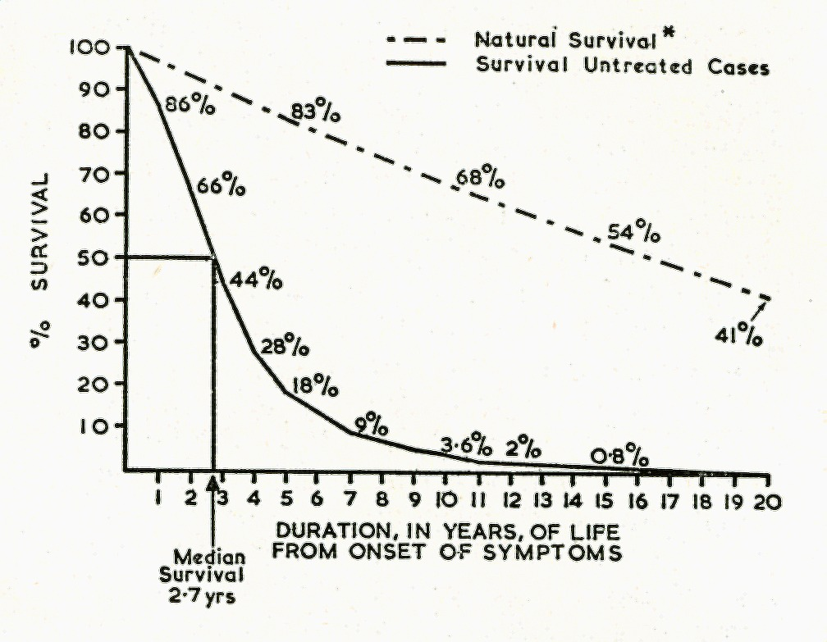
Natural History of Untreated Breast Cancer
Br Med J. 1962 Jul 28;5299:213-21

Slide 21
Act of Observation changes the Observed
Early surgery is superior to late surgery
Segregation between those who metastasize and those who don’t, is determined at the time of surgery (Act of Observation) and not prior to it
Tumour responds to the Act of Observation through Hypoxia

Slide 22
What happens during surgery?
The tumor changes from being completely vascularized to progressive de-vascularization to completely de-vascularized within the surgical time span (few minutes up to a few hours for most cancers)
The tissue oxygen tension drops precipitously
Cancer cells get disseminated ¹⁻³ through vascular and lymphatic routes throughout the surgical procedure
Weitz J, et al. Clin Cancer Res. 1998 ;4(2):343-8
Topal B, et al. Eur J Surg Oncol. 2005;31(5):506-11
Rolle A, et al. World Journal of Surgical Oncology 2005;3:18

Slide 23
Tweaking Events at the Time of Surgery

Slide 24
Single Injection Depot Progesterone Prior to Surgery in Women with Operable Breast Cancer: A Randomized Controlled Trial [NCT00123669]
PI: Dr R A Badwe
Co-Investigators
Hawaldar RW, Parmar V, Nadkarni MS, Shet T, Desai S, Gupta S, Jalali R, Vanmali V, Mittra I

Slide 25

Primary Progesterone for Operable Breast Cancer
Trial Schema
Inj. Hydroxy-Progesterone 500 mg IM
(day -4 to -14)
OBC
R
Sx
Adj Rx
Control
Stratification
Menopausal Status (Pre , Post)
Tumor Size
(<=2, 2-5, >5)

Slide 26
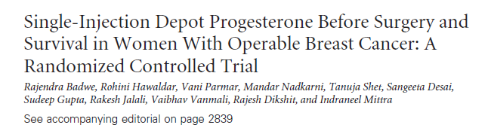

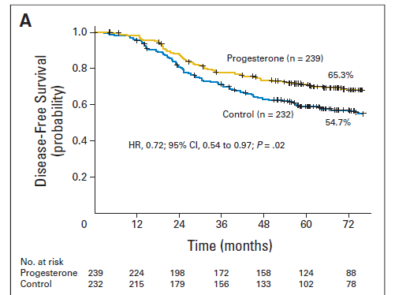
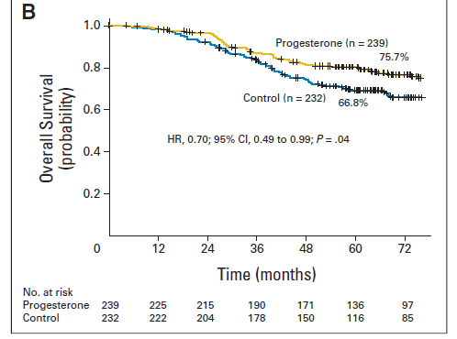

Slide 27
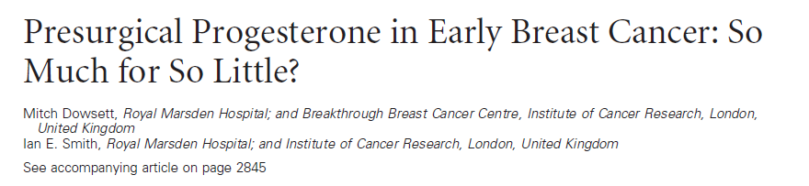


Slide 28
Primary Progesterone for Operable Breast Cancer Conclusion
A progestogenic milieu at the time of surgery significantly improved both disease-free and overall survival in women with node positive operable breast cancer
This could be a simple, inexpensive & life-saving intervention globally with the largest impact in the developing world where node positivity is high at presentation
This is the first RCT to show that ‘Events at the time of surgery influence long term outcome’. This novel short-term pre-operative window would be a promising, cost-effective avenue for research in solid tumours
Tumor can be pushed into complacency to prevent it from changing during the act of observation

Slide 29
Impact of Act of Observation on Incidence of Cancer

Slide 30
Impact of Surgery & Screening
Screen Control
Basic Assumption X early X early
Y late Y late
Early years All treated Late treated
Early allowed
to grow
Late years Majority treated Majority treated Early Late

Slide 31
Screening for Prostate Cancer (US study)
NEJM 2009, 360:1310-19,1320-28

Slide 32
Other Effect of Act of Observation in Screening Trials
Over-diagnosis at 10-25 yrs
Breast cancer 30%
Lung cancer 60%
Prostate cancer 70-90%

Slide 33
Incidence of Cancer
India US
Breast 30 120
Lung 10 70
Prostate 4 60

Slide 34
Conclusions
DNA is extremely sentient
Act of Observation increases the incidence of cancer and precision of observation is proportionate to the increase in the incidence
Act of observation decides who is to metastasize or NOT

Slide 35
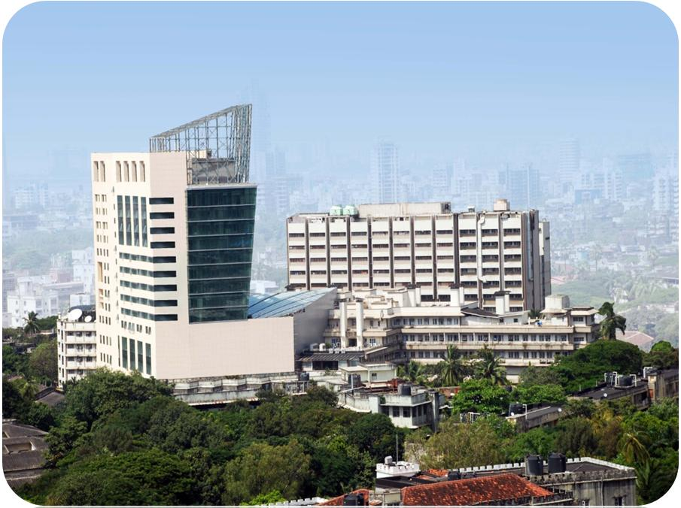
Homi Bhabha Faculty Block
Thank You
Photographed by : Medical Graphics Department , TMH
January , 2011

