Slide 1

PATENT / TECHNOLOGY
COMMERCIALIZATION

Slide 2
PATENT FILING PROCEDURES

Slide 3
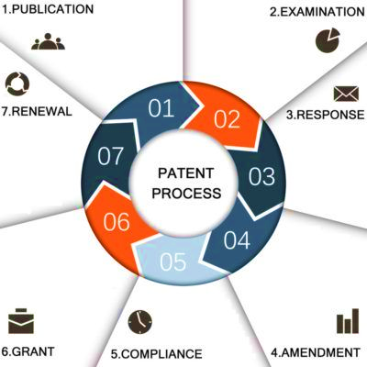
PATENT FILING PROCESS INDIA

Slide 4
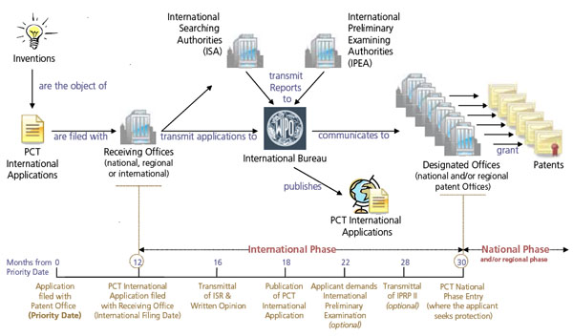
GLOBAL PATENT FILING PROCESS

Slide 5
PATENT COMMERCIALIZATION

Slide 6
HOW ACADEMIC INSTITUTIONS ARE DOING THIS IN INDIA
Direct Licensing of IP
Joint Ventures (Collaborative Development)
IP Sale

Slide 7
Main terms of IP licensing policy followed by academic institutions
LICENSING
Institute owns all the Intellectual Property that is produced by all its personnel’s (staff, students, research scholars and postdoctoral fellows).
Institute can always use the IP for academic and research purposes without soliciting the creator’s permission, irrespective of any license granted.
The type of license provided will depend on the nature of the innovation. Most of them encourages non exclusive licensing. Under certain exceptions, exclusive licensing is considered.
Revenues earned will be shared with the inventor(s) in a fixed ratio. Mostly 60-70% of the institute’s revenue from the royalties would go to the inventor.
Under certain circumstances, Institute can approach the licensee and terminate the exclusive license, and license it to someone else instead.

Slide 8
Royalty sharing models of some of the top Indian institutes
LICENSING
IIT-Bombay
a. Upto INR 100 lakhs, IIT-B gives 70% of the royalty charges to the inventors.
b. For the next 100 lakhs the institutes give 50%.
c. For revenues more than 200 lakhs the inventors only get 30% of the royalty.
IIT-Kharagpur
a. Upto INR 100 lakhs, IIT-K gives 65% of the royalty charges to the inventors.
b. For the next 100 lakhs the institutes give 45%.
c. For revenues more than 200 lakhs the inventors only get 25% of the royalty.
IIT-Delhi
IIT-D award roughly 60% of the royalties to inventors respectively.

Slide 9
LICENSING
In IIT-D and IIT-K, a fixed 10% of the revenue from royalties is directed towards promotion and upgradation of the invention, IP protection (which involves registrations, litigation and arbitration charges if required) and promotion of commercialization.

Slide 10
Licensing of Superficial Fluid Extraction Technology
LICENSING
This highly versatile technology outcome of a doctoral research at IIT-Bombay is used for extraction of natural products in food, pharmaceutical and chemical industries.
A complete technology package offering all aspects covering design, engineering, and commissioning has been licensed.
Devan Supercritica Pvt Ltd, Pune is the licensee of this technology since December 2004.
Over ten turnkey projects bassed on this technology have been executed both in india and abroad.
The total outlay has aggregated to over INR 20 crores.

Slide 11
Licensing of WebNC: Machininng Through the Internet
LICENSING
WebNC an internet bassed software enables integration of globally distributed product designers, process planers and remote CNC machines during collaborative product development and telemanufacturing.
It was licensed to Hytech Educational Equipment Pvt Ltd, Pune with exclusive rights with a payment per license sold.
The compay could not market this product successfully beyond one year. One of the reason for its failure was that the core software was supposed to be downloaded from the inventor’s website and some clients faced network and access problem.
This lead to poor response to licensing and after the intial year it was not succesfully licensed

Slide 12
JOINT VENTURES
Key Features of Joint Ventures for Commercialization of Technology
A large number of start-up companies are coming up around academic patents through joint ventures.
Joint ventures with academic institutions help companies in creating new knowledge which can in turn generate more revenue and profits.
Joint ventures with corporates help academic institutions in generating funds for research and development.

Slide 13
Licensing of Fuel Additive Technology
JOINT VENTURES
This technology was developed at IIT-Bombay through a collaborative development project sponsored by Abhitech Energycon Ltd.
This technology has been used to develop chemical formulation and marketed as “Thermal & Thermact Technology”, widely used in chemical and petroleum industry.
This technology was initially licensed to Abhitech Energycon Ltd. With exclusive rights for five years with an annual lump sum payment.
After five years, the license was renewed to the same company for another five years with an increased license and royalty money.

Slide 14
JOINT VENTURES
IIT-Bombay and Intellectual Ventures MOU for IP Commercialization
Intellectual Ventures and the Indian Institute of Technology Bombay have signed a Memorandum of Understanding that is expected to result in the wider dissemination and practical utilization of inventions generated by IIT Bombay faculty, students, and staff.
Intellectual Ventures will both license IITB inventions accepted under this program and work on a number of possible commercialization strategies for them.
Intellectual Ventures will pay IITB fees for such licensing and will also bear the patenting costs associated with these inventions.
This partnership is not exclusive and allows both IIT Bombay and Intellectual Ventures to engage with others for IP related matters.

Slide 15
JOINT VENTURES
Robert Bosch Center for Cyber-Physical Systems
Oxford University Innovation – Consulting (Technical, Academic, and Innovation), Clinical Outcome/Assessment Services
Spin Outs such as Bigtec from IISc
Start an Incubator with start-ups having specific technical focus areas
New Millennuim India Technology Leadership Initiative (NMITLI): Desoris with CDRI + NIPER + Lupin
SBIRI (Small Businesses), NAIP (National Agricultural Innovation), and Technology Business Incubators such as ones created at IIT Delhi, IIT Chennai, IT BHU, etc.

Slide 16
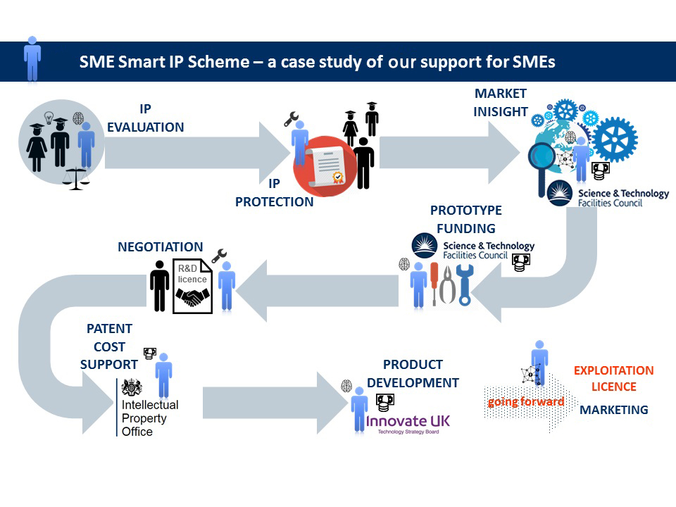
JOINT VENTURES
Another Exemplary Model Being Followed

Slide 17
TIFR
Offer Small-Upfront Costs for incentivizing licensing with higher royalty on actual commercialization.
File Provisionals -> Ask Inventors to Find potential Partners in 12 months -> File Complete + PCT basis previous step -> File National Phases only when a Partner is tied up with
US Filing is a Small-entity based filing and not a Large Entity
Be flexible on the terms – offer only non-exclusive licenses
Draft Patent Applications with some specific implementation use cases

Slide 18
TIFR
Set up an IP policy and process to streamline IP generation within the organization and have an in-house expert team to implement the same.
Setting up a Technology Transfer Office (TTO) is crucial for success of any licensing program given the fact that a good inventor is generally bad businessman.
Have 1-2 strong Marketing professionals willing to reach out to potential buyers/licensees rather than waiting to be approached. Defined reporting structure, fortnightly assessment/evaluation of efforts and level of progression on licensing process.
Explore Options of Incubating Startups in Key Tech Areas and Undertaking Funding/Commercialization Accordingly.

Slide 19
TIFR
Offer Technical Services Coupled with Technology Transfer/Licensing Processes
Enable services for testing and analysis, validation of technical processes, proof of concept, data analysis and visualization, precision fabrication, etc. (Spectroscopy, microscopy and analysis, chemical characterization, etc.)
Innovation Management Services
Split cost of IP Generation between TIFR and Inventor for better accountability / Split Ownership if required.

Slide 20
TIFR

Slide 21
TIFR

Slide 22
TIFR

