Slide 1
BITCOIN, Blockchain and Beyond
Hemant Adarkar, ASET Colloquium, 23rd Feb 2018

Slide 2
Somebody holds the “key” Steve Winwood, Can't Find My Way Home

Slide 3

bitcoin
It is the world’s first truly digital currency maintained as a decentralised ledger called blockchain on the peer to peer network

Slide 4
The problem - I
The root problem with conventional currency is all the trust that is required to make it work. The central banks must be trusted,
Not to debase the currency
With our privacy
Not to let identity thieves drain our account (security)
Hold and transfer electronically

Slide 5
Problem - II
The problem with conventional money transfer is that there are intermediaries, i.e. one or more banks and “networks”.
Can we have an open ledger?
Can we have a distributed ledger?
Can we have a secure, distributed ledger?
Today, the transactions lie in databases belonging to multiple banks.

Slide 6
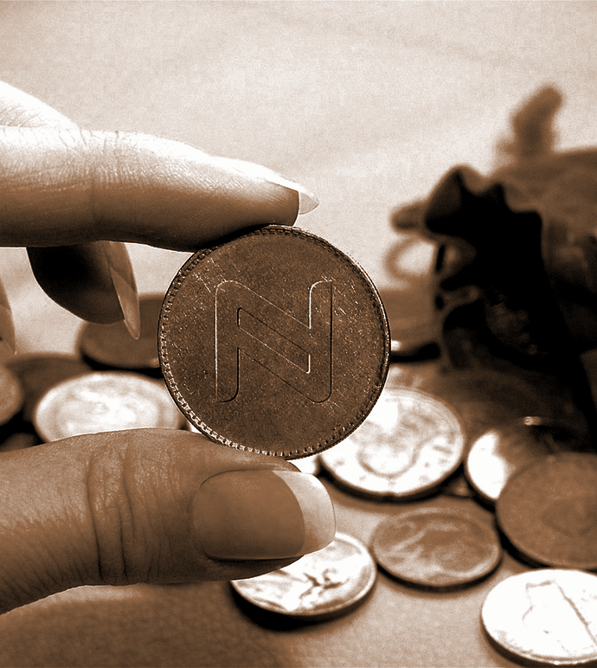
The solution
What is needed is an electronic payment system based on cryptographic proof instead of trust, allowing any two willing parties to transact directly with each other without the need for a trusted third party.
Satoshi Nakamoto : bitcoin.org/bitcoin.pdf

Slide 7
Original ideas
No central trust
White paper by Satoshi Nakamoto, https://bitcoin.org/bitcoin.pdf, 2008
W. Dai, http://www.weidai.com/bmoney.txt, 1998
Computational inputs for money creation and problem solving
Ergodic Literature and Cybertext

Slide 8
It all started with encryption
Symmetric encryption
Digital signatures
Hype
“Private” Key
Public - Private key
Private - Public key
Application
Acceptability
1970
2009
2018
Asymmetric encryption
Digital cash (Bitcoin)

Slide 9
Explanations: Encryption, the “key” Hashing Digital Signature

Slide 10
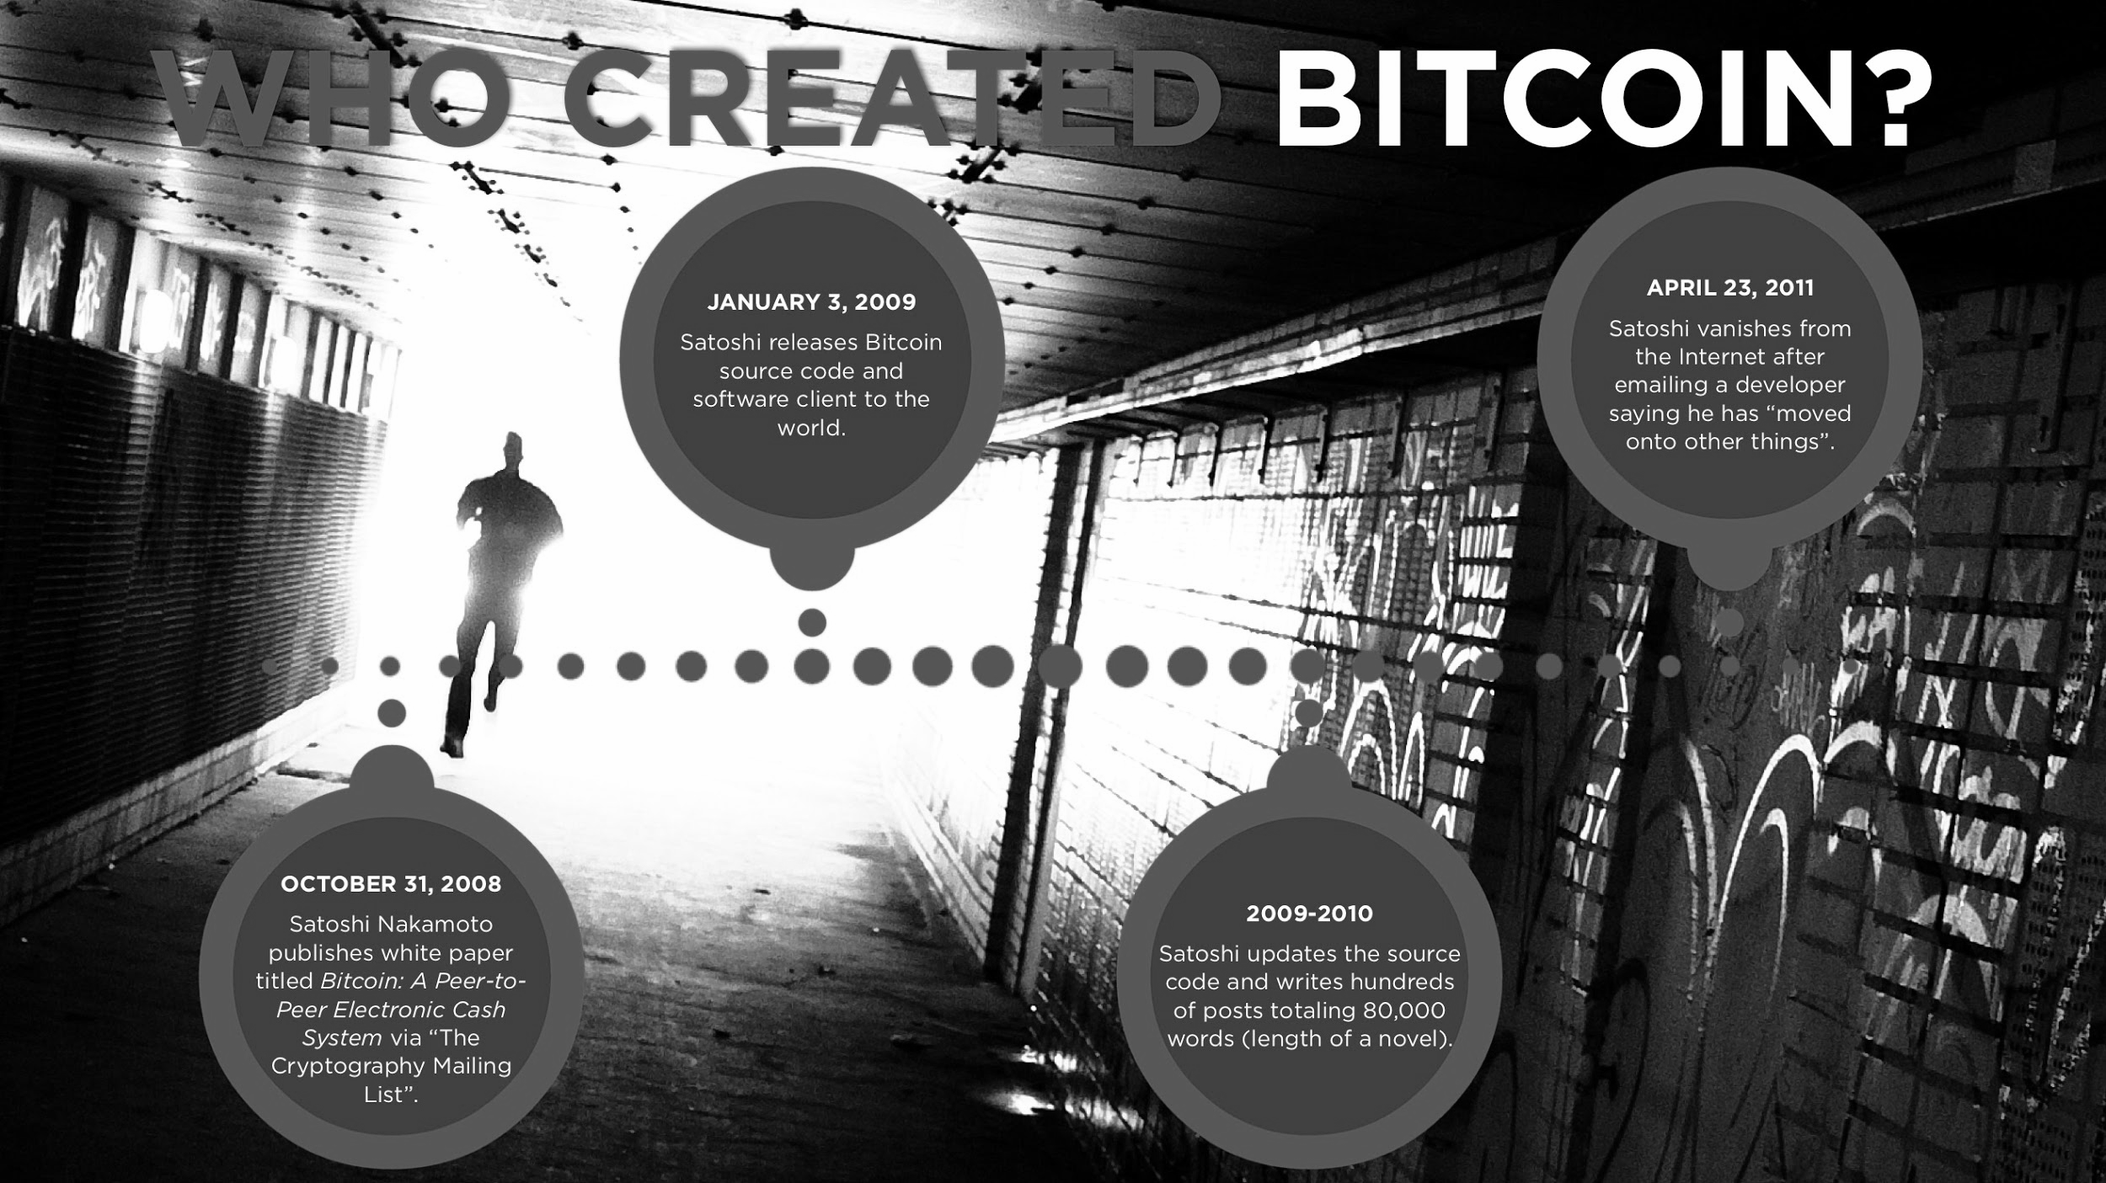
Notes:
Source : https://www.slideshare.net/winklevosscap/the-internet-of-money/3-WHO_CREATED_BITCOINOCTOBER_31_2008Satoshi

Slide 11
Who is Satoshi Nakamoto? Why did he disappear?
Several individuals as candidates
Samsung Toshiba Nakamichi Motorola
Johatsu and Kamikakushi
Fractional bitcoin unit – 1 Satoshi

Slide 12
bitcoin characteristics
Bitcoin is a protocol.The unit of account is "bitcoins."
Based on the blockchain: a growing general public ledger of cryptographically-signed transactions.
All transactions are public, but are not by default tied to anyone's real identity.
Transfer of bitcoins consists simply of adding a new, publicly accepted transaction to the blockchain.
Miners are awarded newly-minted bitcoins or transaction fees for successfully finding blocks.
Bitcoin is one of the applications of Block Chain

Slide 13
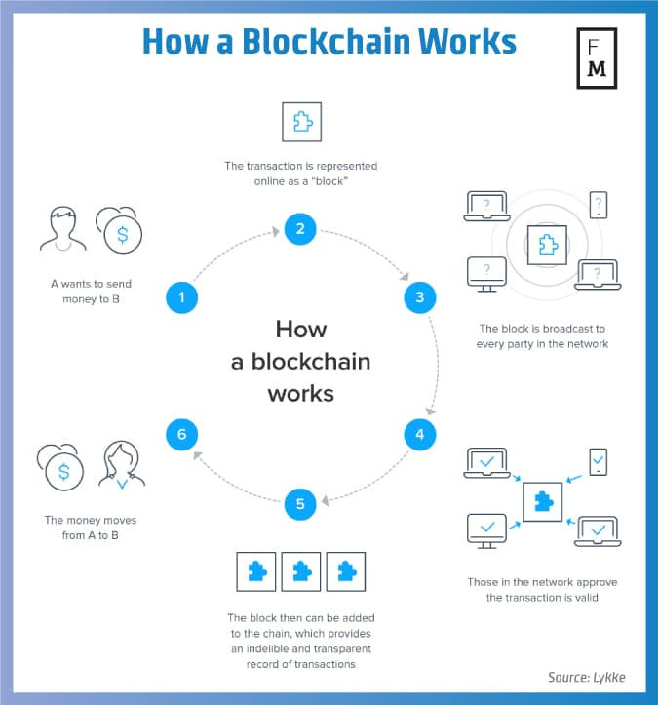

Slide 14
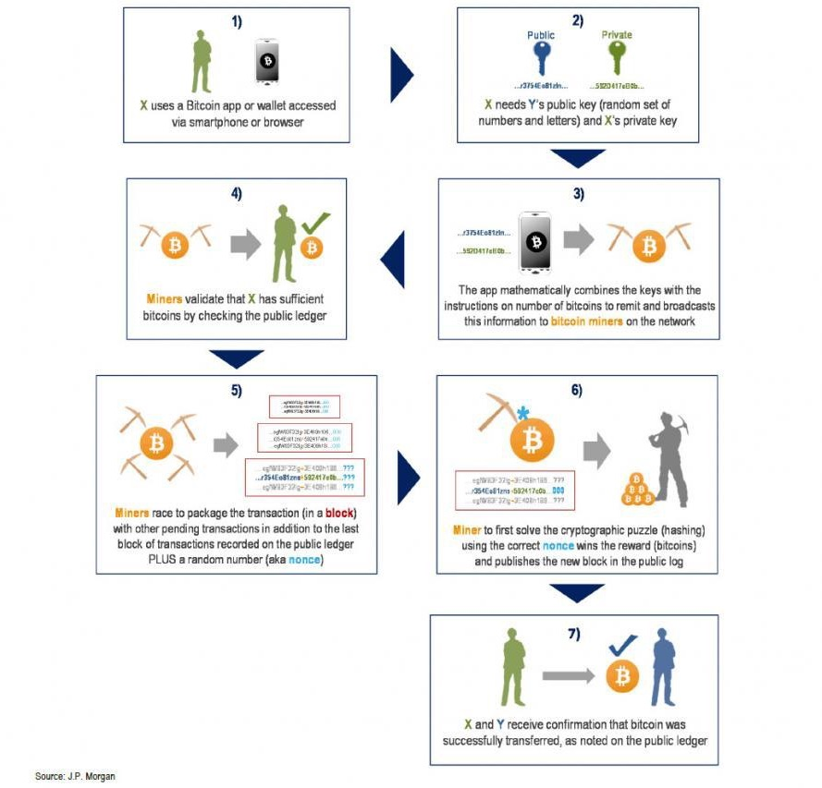
Transaction flow
X want to send some of her bitcoin to Y
X publishes her intention
Nodes scan the entire bitcoin network to validate that X
have the bitcoin that I want to send,
haven't already sent it to someone else.
Once that information is confirmed, the transaction gets included in a "block

Slide 15
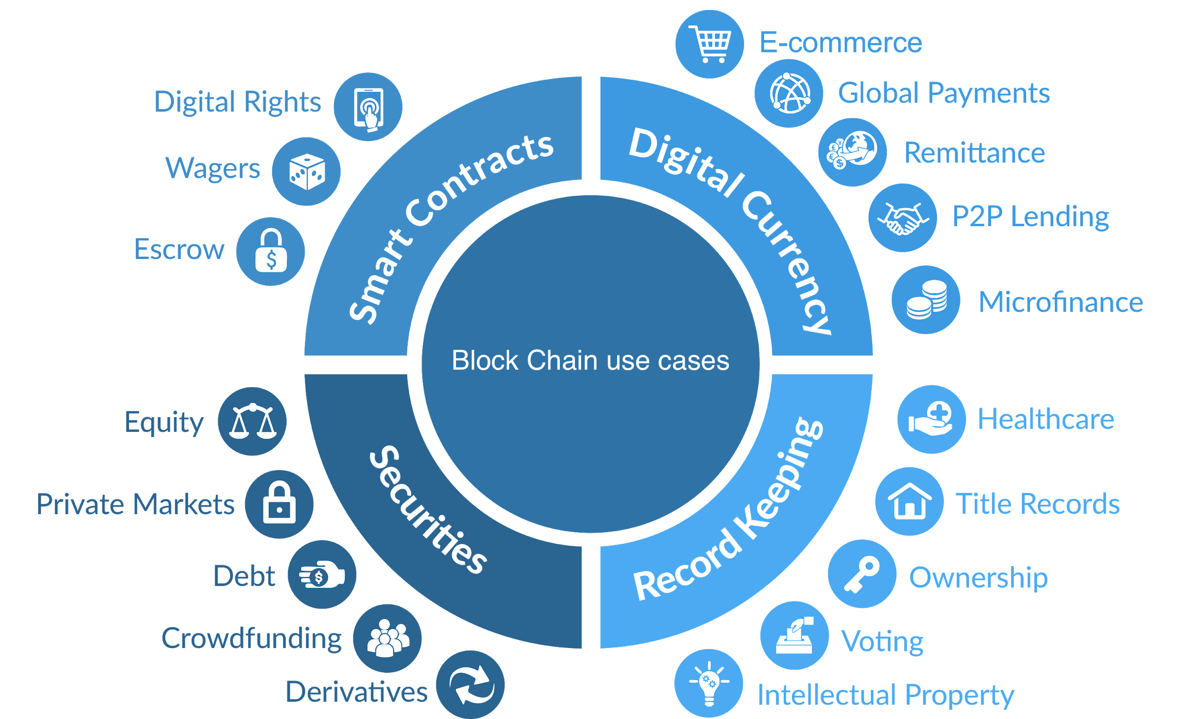
Block Chain applications

Slide 16

Why the hype?
Total Bitcoin supply capped at 21 million creating scarcity
Virality through the rise of social media
Worldwide interest and increasing acceptability
80% bitcoins have already been mined giving rise to FOMO on the next big thing

Slide 17
Issues
Complicated – computationally and conceptually
Energy hungry – mining utilizes electricity needed for 159 countries
Solution in search of a problem?

Slide 18
Questions?

