Slide 1
Revisiting flavour constraints
on high-scale SUSY
Sokratis Trifinopoulos
SUSY 2017, Tata Institute of Fundamental Research
Mumbai, 14 January 2017

Slide 2
Outline
Background and Motivation
Flavour models
Numerical analysis
Conclusions & Future outlook

Slide 3


Slide 4
Where to look for SUSY traces???
Unfortunately, there is no signal of SUSY in the LHC yet.
E.g. current bounds are set for i) squarks ~ 1.5 TeV, ii) sleptons ~ 400 GeV,
iii) gluino ~2 TeV and iv) chargino ~ 300 GeV.
SUSY could be just around the TeV corner OR not…
In the meantime, it is useful to extract any indirect information from low-energy probes.
Explaining the masses and mixing of fermions remains a fundamental open problem in theoretical physics and SUSY makes it even more challenging by doubling the number of flavoured degrees of freedom.
BUT, one could see this either as a problem or as an opportunity!
Atlas – Public Results
Flavour

Slide 5
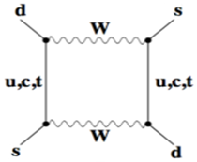
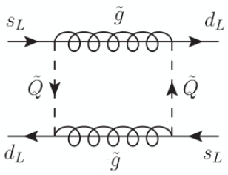
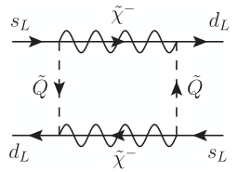
Flavour physics observables (room for NP)
ΔF=2 processes
Observable | Experiment | SM prediction | Exp/SM
ΔΜ_{Κ} | (5.292 ± 0.009) × 10⁻³ ps⁻¹
ε_{Κ} | (2.229 ± 0.010) × 10⁻³ | (1.91 ± 0.30) × 10⁻³ | 0.91 ± 0.18
ΔΜ_{Β} | (17.77 ± 0.12) ps⁻¹ | (18.3 ± 5.1) ps⁻¹ | 0.97 ± 0.27
[Altmannshofer, Buras, Gori, Paradisi, Straub] 0807.5039v2
SM:
MSSM:

Slide 6
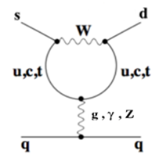
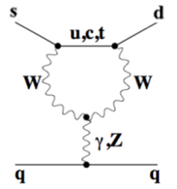
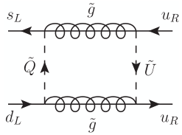
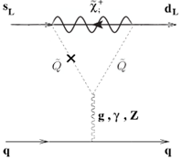
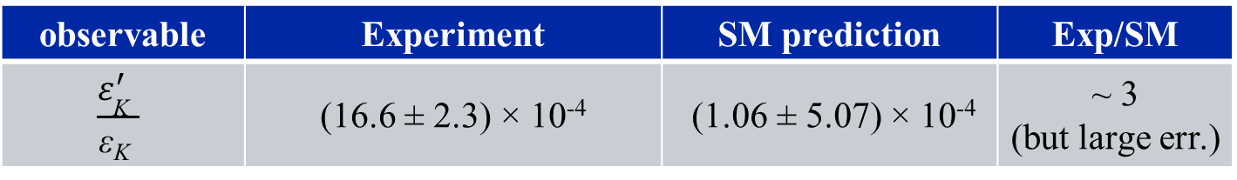
ΔF=1 four-quark processes
observable | Experiment | SM prediction | Exp/SM
$$\frac{ε_{\text{Κ}}^{′} }{\text{ε}\text{Κ} }$$ | (16.6 ± 2.3) × 10⁻⁴ | (1.06 ± 5.07) × 10⁻⁴ | ~ 3 (but large err.)
[Kitahara, Nierste, Tremper] 1607.06727v2
SM:
MSSM:

Slide 7
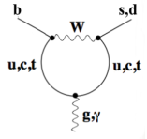
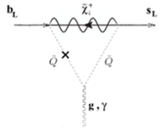
ΔF=1 radiative processes
observable | Experiment | SM prediction | Exp/SM
 | (3.52 ± 0.24) × 10⁻⁴ | (3.13 ± 0.23) × 10⁻⁴ | 1.12 ± 0.11
SM:
MSSM:
[Hurth, Isidori, Kamenik, Mescia] 0807.5039v2

Slide 8
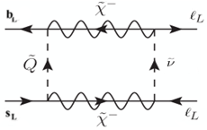
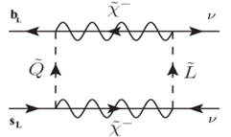
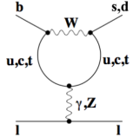
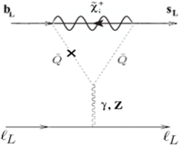
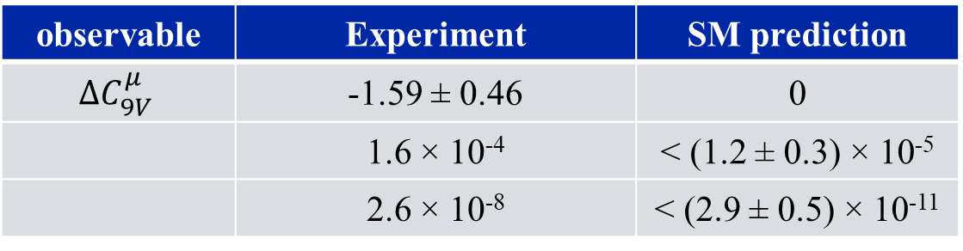
ΔF=1 semi-leptonic processes
observable | Experiment | SM prediction
$${ΔC}_{9V}^{μ}$$ | -1.59 ± 0.46 | 0
 | 1.6 × 10⁻⁴ | < (1.2 ± 0.3) × 10⁻⁵
 | 2.6 × 10⁻⁸ | < (2.9 ± 0.5) × 10⁻¹¹
MSSM:
SM:
[Altmannshofer, Stangl Straub] 1704.05435v1

Slide 9

Major tensions with the SM
The largest deviations from the SM arise in the observables $\frac{ε_{K}^{′}}{ε_{K}}$ and ${ΔC}_{9V}^{μ}$ ( see B-physics anomalies).
In the SM, we have:
While both and receive chiral enhancement, NP is favored as a modification of the coefficient of due to the additional 1/ω≈22.
$C_{9V}^{μ}$ in the SM is the Wilson coefficient of the operator:
.

Slide 10
Outline
Background and Motivation
Flavour models
Numerical analysis
Conclusions & Future outlook

Slide 11
Generalities: MSSM mass terms
The R-parity conserving superpotential of the MSSM takes the form:
The soft breaking terms are divided into the following classes:
Mass terms for the scalar fields:
Mass terms for the gauginos:
Trilinear couplings (A-terms) of the scalar fields:

Slide 12
Generalities: Diagonalization – Mass insertions δ
For instance, the down-squark mass matrix may be written as:
, where the mass matrices are in
general non-diagonal 3×3 block matrices. The fields and mix to give six squark mass eigenstates :
We parametrize the (very) small off-diagonal corrections by defining:
Any function of the diagonal masses can be then extended as follows:
[Colangelo, Isidori] 9808487v1

Slide 13
I. Minimal Flavor Violation
The MFV hypothesis formulates the small size of flavor-violating effects in terms of an approximate flavour symmetry:
that is only broken by spurion fields proportional to the SM Yukawa couplings. The soft breaking terms can be reconstructed as (convergent) series of invariant spurions,
and similarly for the slepton mass matrices and the A-terms. The b_{i} are coefficients of order .
[Colangelo, Nikolidakis, Smith] 0807.0801

Slide 14
I. MFV mass insertions
Keeping only the leading LFV terms, the MFV minimal version of the MSSM contains a total of 15 parameters:
The model contains then the following non-vanishing mass insertions:

Slide 15
II. U(2) flavour symmetry
A theoretically well-motivated alternative is the following approximate flavour symmetry (for the quark sector):
with the transformation properties of the fields charged under :
The symmetry is broken, in analogy to the MFV case, by the Yukawa matrices:

Slide 16
II. U(2) mass insertions
In first approximation, one discards the subleading spurions, the first two generations become degenerate and the squark mass matrices can be expressed in terms of a CKM-like parametrization:
In the limit , the model contains only LL mass insertions:
[Barbieri, Isidori, Jones-Perez, Lodone, Straub] 1105.2296

Slide 17
III. U(1) Froggatt-Nielsen flavour symmetry
We study a generic example of a holomorphic Froggatt-Nielsen model with the quark charges (and equivalently for the squarks):
The symmetry is spontaneously broken via one single familon θ carrying only a positive U(1) charge +1. For instance, the up-Yukawa coupling takes the form:
where α_{IJ} are order coefficients, θ₀ denotes the VEV and q_{I} , u_{I} and d_{I} are the above defined charges.

Slide 18
III. U(1) mass insertions
One can then write down the following soft breaking up to their respective order coefficients:
Depending on the choice of the accuracy, we may drop higher powers of ε and calculate the leading order mass insertions:
[Lalak, Pokorski, Ross] 1006.2375

Slide 19
IV. Disoriented A terms
In this scenario the flavor violation is mainly a product of the trilinear terms, which are written as:
Where are generic mixing angles, that do not respect exact proportionality to the CKM matrix elements. In specific realizations of the idea, the LR terms are dominating over the LL and the RR terms. Using the mass insertion formalism we may write:
[Giudice, Isidori, Paradisi] 1201.6204

Slide 20
Outline
Background and Motivation
SM flavor-changing processes
Numerical analysis
Conclusions & Future outlook

Slide 21
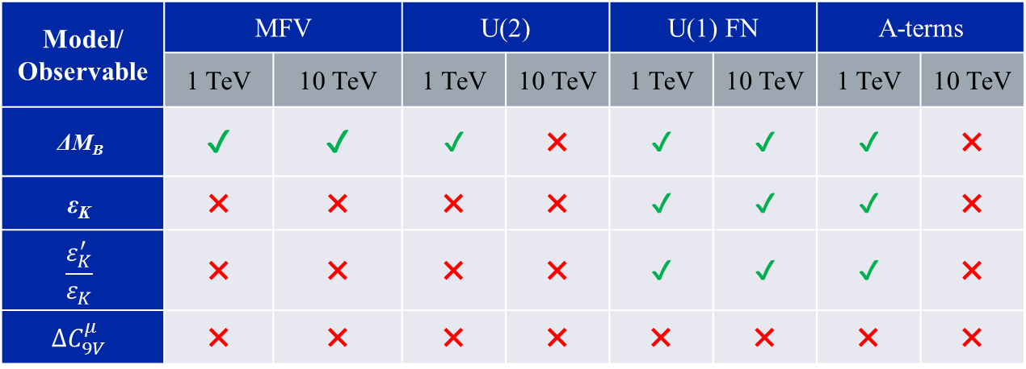
Results
We scan the parameter space of each model for the “SUSY around the TeV corner” optimistic scenario up until the energy of the ultimate decoupling of SUSY from flavour physics phenomena.
The following table gives a first, rough overview of the results:
Model/ Observable | MFV |  | U(2) |  | U(1) FN |  | A-terms
 | 1 TeV | 10 TeV | 1 TeV | 10 TeV | 1 TeV | 10 TeV | 1 TeV | 10 TeV
$$\text{ΔΜ}\text{B}$$ | ✔ | ✔ | ✔ | ✖ | ✔ | ✔ | ✔ | ✖
$$\text{ε}\text{Κ}$$ | ✖ | ✖ | ✖ | ✖ | ✔ | ✔ | ✔ | ✖
$$\frac{ε_{K}^{′}}{ε_{K}}$$ | ✖ | ✖ | ✖ | ✖ | ✔ | ✔ | ✔ | ✖
$${ΔC}_{9V}^{μ}$$ | ✖ | ✖ | ✖ | ✖ | ✖ | ✖ | ✖ | ✖

Slide 22
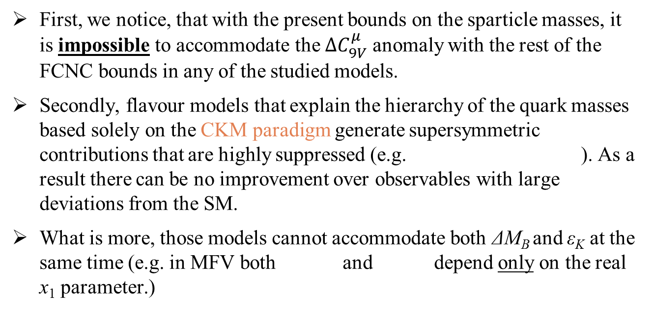
Things that cannot be done
First, we notice, that with the present bounds on the sparticle masses, it is impossible to accommodate the ${ΔC}_{9V}^{μ}$ anomaly with the rest of the FCNC bounds in any of the studied models.
Secondly, flavour models that explain the hierarchy of the quark masses based solely on the CKM paradigm generate supersymmetric contributions that are highly suppressed (e.g. ). As a result there can be no improvement over observables with large deviations from the SM.
What is more, those models cannot accommodate both $\text{ΔΜ}\text{B}$ and $\text{ε}\text{Κ}$ at the same time (e.g. in MFV both and depend only on the real x₁ parameter.)

Slide 23
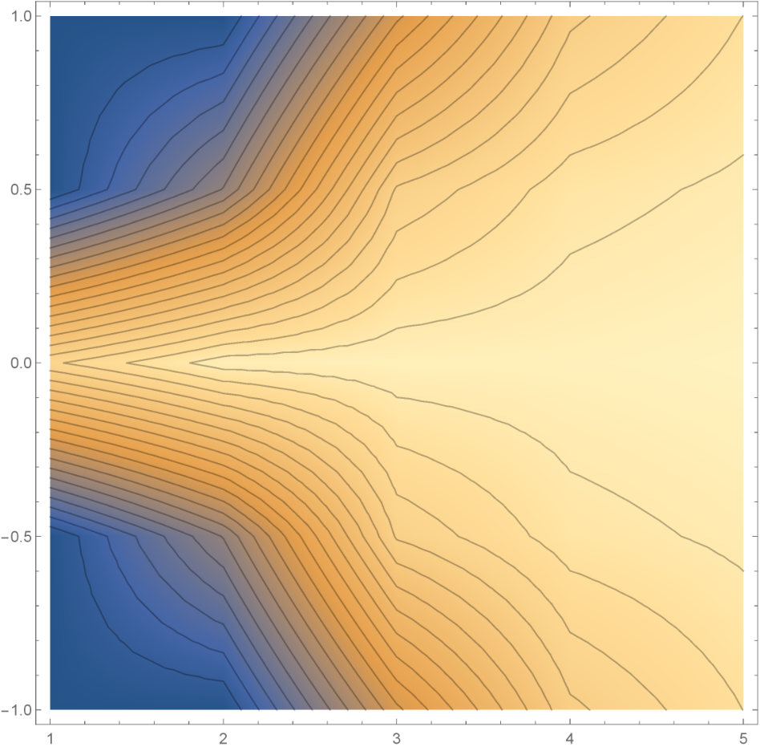
Things that are still possible!
On the other hand, less restricted flavor models like the U(1) FN symmetry, are still attractive even beyond the current bounds.
* is the overall mass scale of the sparticles, i.e. and for
, the masses are at their current bounds.

Slide 24
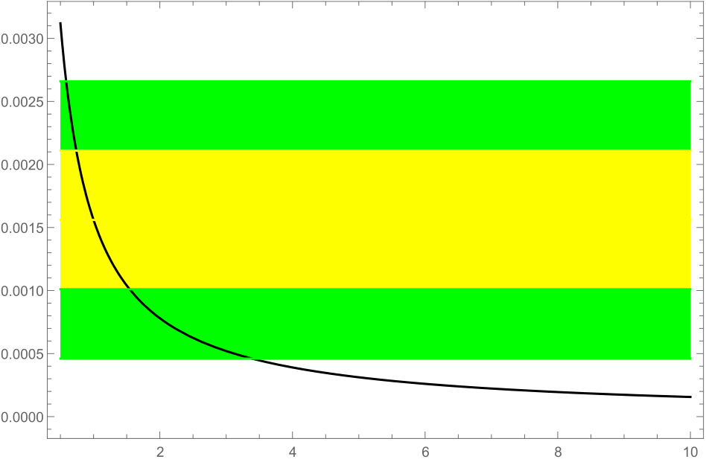
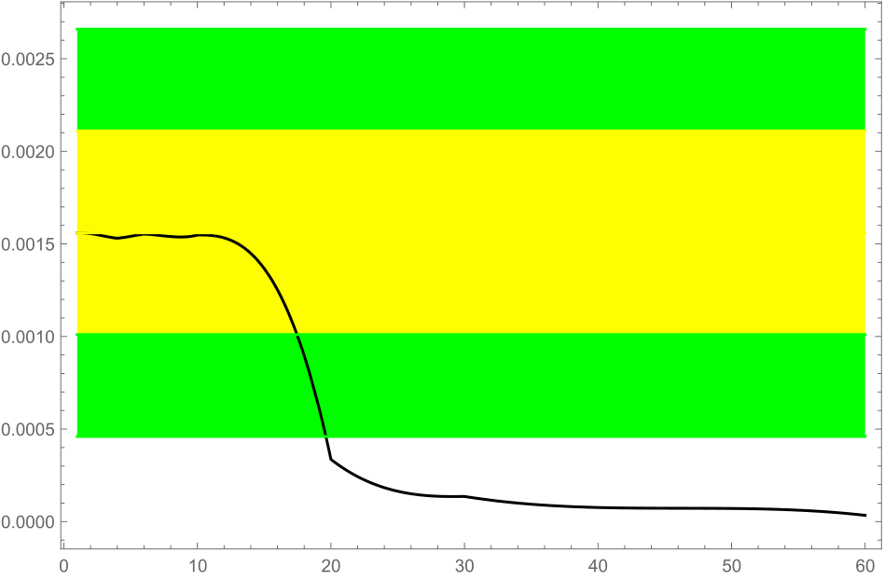
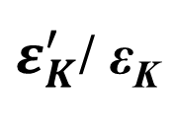


well beyond the TeV scale.
$ε_{K}^{′}$/ $\text{ε}\text{Κ}$
i) U(1) FN without CPV: ii) U(1) FN with CPV:
Similar results are valid for the disoriented A-terms scenario providing rather large trilinear couplings (above 10 TeV).
$$\frac{ε_{K}^{′}}{ε_{K}}$$
$$\frac{ε_{K}^{′}}{ε_{K}}$$

Slide 25
Outline
Background and Motivation
SM flavor-changing processes
Consistency of the EFT
Conclusions & Future outlook

Slide 26
Conclusions & Future outlook
In “pessimistic” scenarios, such as MFV or U(2), current bounds from direct searches prevent visible effects in flavor observables (with realistic precision).
Nevertheless, some observables have the potential to probe SUSY well beyond the reach of direct searches even for motivated flavour models.
⇒ WORTH TO IMPROVE ON SM ERRORS
As expected, there is no hope to account for B-physics anomalies.
Still in progress: More detailed analysis of the correlations between the different observables within the scope of the “promising” scenarios for the high-scale limit.

Slide 27
Thank you!!!!
QUESTIONS ???

