Slide 1

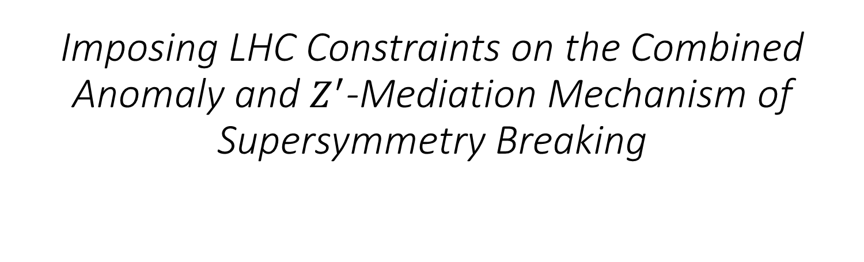
Imposing LHC Constraints on the Combined Anomaly and $Z^{′}$-Mediation Mechanism of Supersymmetry Breaking
Joydeep Roy
Department of Physics and Astronomy
Wayne State University
SUSY 2017, 11-15 December, 2017
Tata Institute of Fundamental Research, INDIA

Slide 2

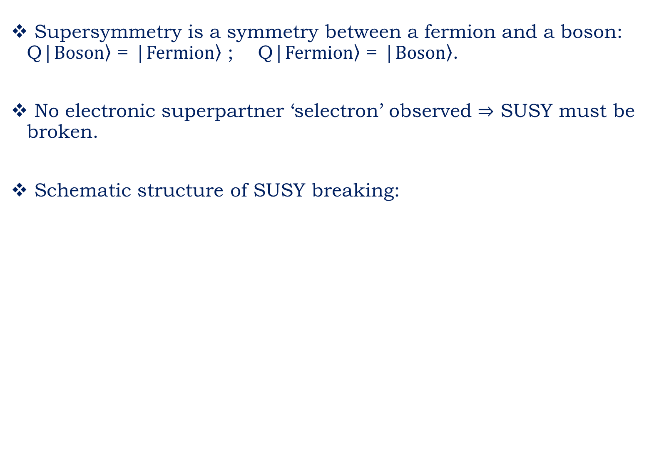
SUSY Breaking
Supersymmetry is a symmetry between a fermion and a boson: Q|$\left.Boson\right\rangle$ = |$\left.Fermion\right\rangle$ ; Q|$\left.Fermion\right\rangle$ = |$\left.Boson\right\rangle$.
No electronic superpartner ‘selectron’ observed $⇒$ SUSY must be broken.
Schematic structure of SUSY breaking:
Image taken from S. Martin arXiv:hep-ph/9709356v6

Slide 3
SUSY Breaking
To observe new particles at LHC we must know how the supersymmetry breakdown is “communicated”.
Several possible SUSY breaking mediation mechanisms:
Planck-scale-mediated supersymmetry breaking (PMSB)
Gauge-mediated supersymmetry breaking (GMSB)
Extra-dimensional supersymmetry breaking (“XMSB”)
Anomaly-mediated supersymmetry breaking (AMSB)

Slide 4
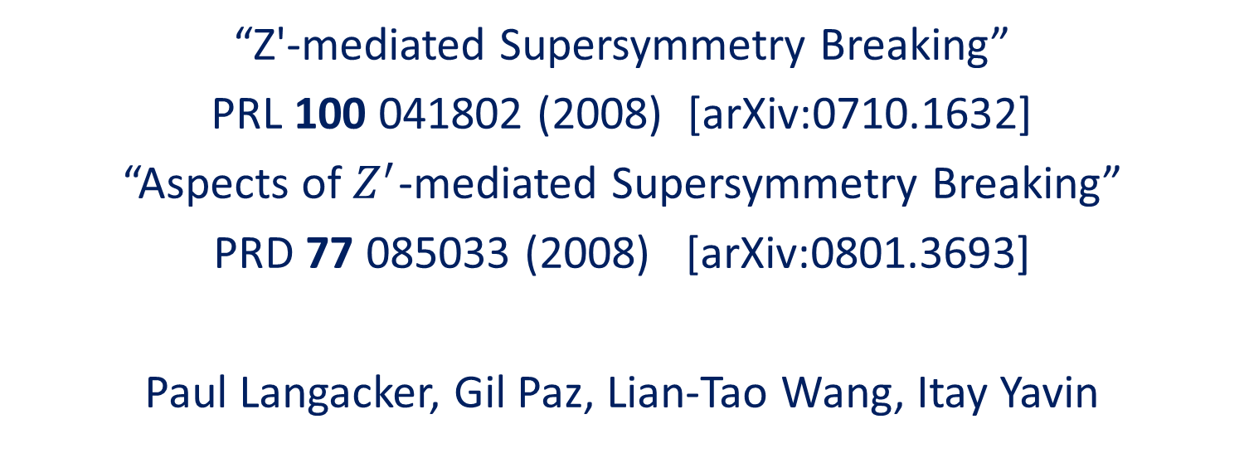
Previous work (2008)
“Z'-mediated Supersymmetry Breaking”
PRL 100 041802 (2008) [arXiv:0710.1632]
“Aspects of $Z^{′}$-mediated Supersymmetry Breaking”
PRD 77 085033 (2008) [arXiv:0801.3693]
Paul Langacker, Gil Paz, Lian-Tao Wang, Itay Yavin

Slide 5

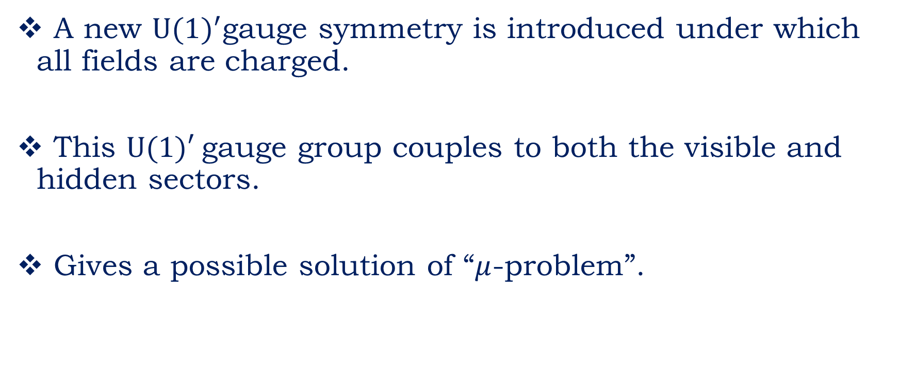
Motivation for $Z^{′}$- Mediation
A new ${U(1)}^{′}$gauge symmetry is introduced under which all fields are charged.
This U(1)′ gauge group couples to both the visible and hidden sectors.
Gives a possible solution of “$μ$-problem”.

Slide 6
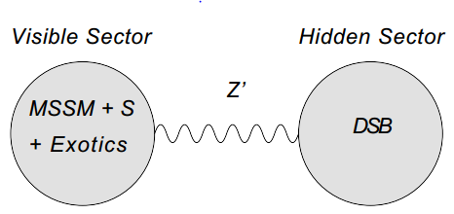


The $Z^{′}$Mediation
The schematic diagram of $Z^{′}$-mediation:
Image taken from Langacker et.al
PRL 100 041802 (2008)

Slide 7




The $Z^{′}$Mediation
Scalars get a mass at one loop
$$m_{{\tilde{f}}_{i}}^{2}\sim g_{Z^{′}}^{2}Q_{f_{i}}^{2}\frac{M_{{\tilde{Z}}^{′}}^{2}}{16π^{2}}log\left(\frac{Λ_{S}}{M_{{\tilde{Z}}^{′}}}\right)$$
${SU(3)}_{C}×{SU(2)}_{L}×{U(1)}_{Y}$ gauginos get mass at two loops
$M_{a}\sim g_{Z^{′}}^{2}g_{a}^{2}\frac{M_{{\tilde{Z}}^{′}}}{{(16π^{2})}^{2}}log\left(\frac{Λ_{S}}{M_{{\tilde{Z}}^{′}}}\right)$

Slide 8
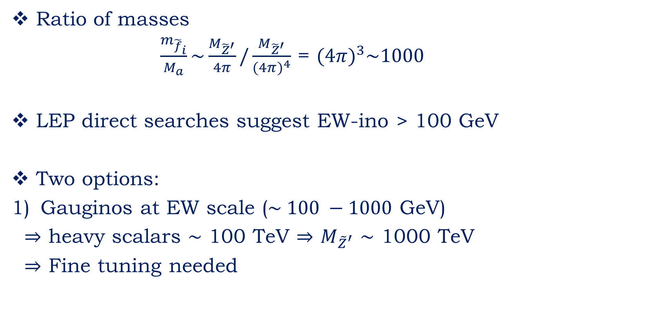

The $Z^{′}$Mediation(2008)
Ratio of masses
$\frac{m_{{\tilde{f}}_{i}}}{M_{a}}\sim \frac{M_{{\tilde{Z}}^{′}}}{4π}/\frac{M_{{\tilde{Z}}^{′}}}{({4π)}^{4}}$ = $({4π)}^{3}\sim 1000$
LEP direct searches suggest EW-ino > 100 GeV
Two options:
Gauginos at EW scale ($\sim 100 −1000$ GeV)
$⇒$ heavy scalars $\sim$ 100 TeV $⇒$ $M_{{\tilde{Z}}^{′}}$ $\sim$ 1000 TeV
$⇒$ Fine tuning needed

Slide 9
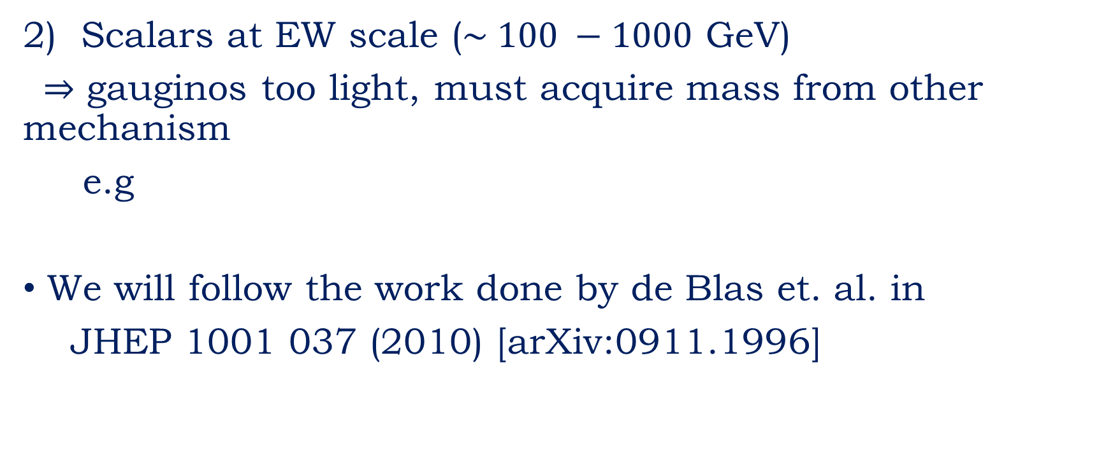


The $Z^{′}$Mediation
2) Scalars at EW scale ($\sim 100 −1000$ GeV)
$⇒$ gauginos too light, must acquire mass from other mechanism
e.g
We will follow the work done by de Blas et. al. in
JHEP 1001 037 (2010) [arXiv:0911.1996]
Combine “Anomaly & $Z^{′}$ mediation”

Slide 10
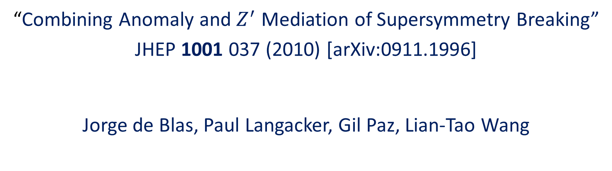
Previous work (2009)
“Combining Anomaly and $Z^{′}$ Mediation of Supersymmetry Breaking”
JHEP 1001 037 (2010) [arXiv:0911.1996]
Jorge de Blas, Paul Langacker, Gil Paz, Lian-Tao Wang

Slide 11
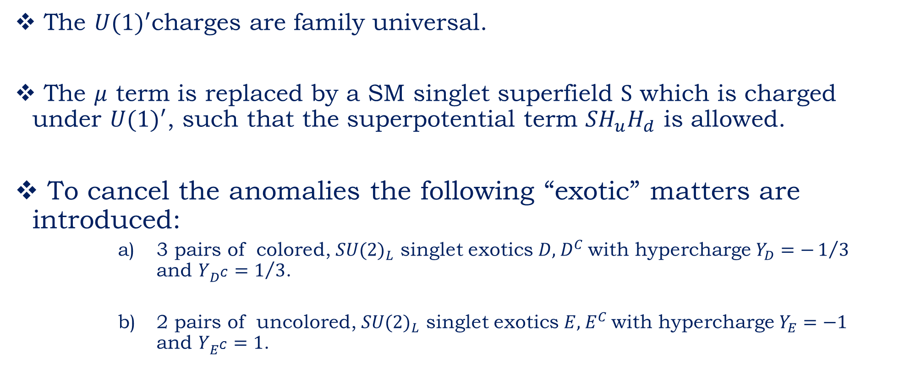

Some specifics of The $Z^{′}$Model
The ${U(1)}^{′}$charges are family universal.
The $μ$ term is replaced by a SM singlet superfield S which is charged under ${U(1)}^{′}$, such that the superpotential term $SH_{u}H_{d}$ is allowed.
To cancel the anomalies the following “exotic” matters are introduced:
3 pairs of colored, ${SU(2)}_{L}$ singlet exotics $D$, $D^{C}$ with hypercharge $Y_{D}=−1/3$ and $Y_{D^{C}}=1/3$.
2 pairs of uncolored, ${SU(2)}_{L}$ singlet exotics $E$, $E^{C}$ with hypercharge $Y_{E}=−1$ and $Y_{E^{C}}=1$.

Slide 12
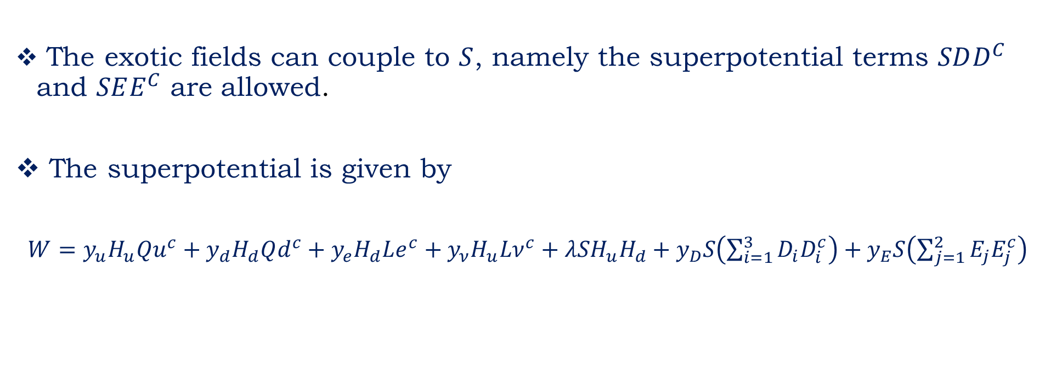

Some specifics of The $Z^{′}$Model
The exotic fields can couple to $S$, namely the superpotential terms $SDD^{C}$ and $SEE^{C}$ are allowed.
The superpotential is given by
$W=y_{u}H_{u}Qu^{c}+y_{d}H_{d}Qd^{c}+y_{e}H_{d}Le^{c}+y_{ν}H_{u}Lν^{c}+{λSH}_{u}H_{d}+y_{D}S\left(\sum_{i=1}^{3}{D_{i}D_{i}^{c}}\right)+y_{E}S\left(\sum_{j=1}^{2}{E_{j}E_{j}^{c}}\right)$

Slide 13
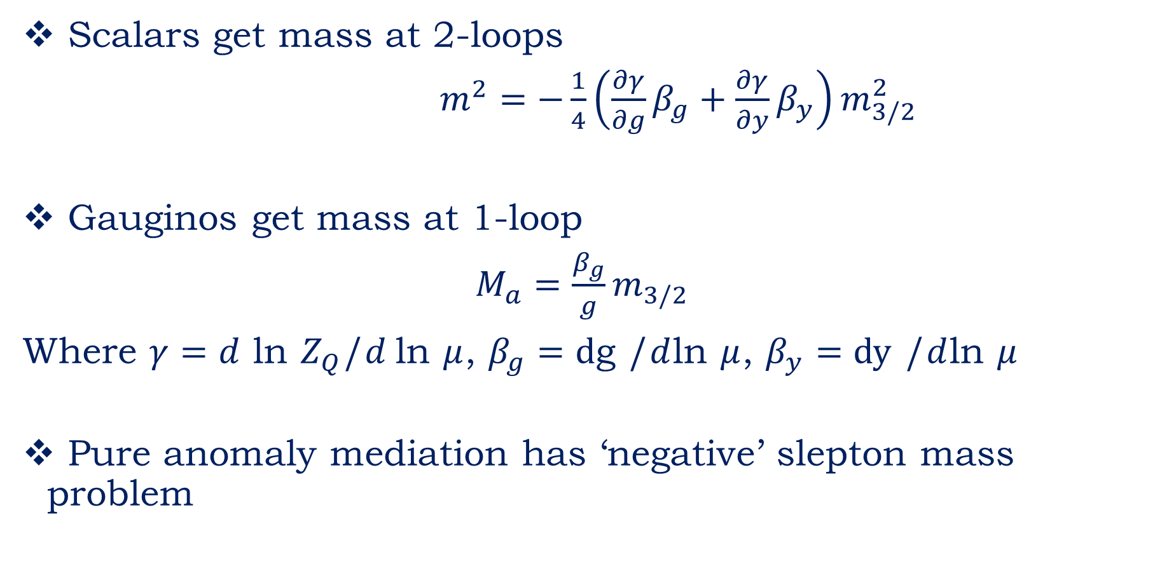
Anomaly Mediated SUSY Breaking (AMSB)
Scalars get mass at 2-loops
$m^{2}=−\frac{1}{4}\left(\frac{∂γ}{∂g}β_{g}+\frac{∂γ}{∂y}β_{y}\right)m_{3/2}^{2}$
Gauginos get mass at 1-loop
$M_{a}=\frac{β_{g}}{g}m_{3/2}$
Where $γ=d$ ln $Z_{Q}$/$d$ln $μ$, $β_{g}=d$g /$d$ln $μ$, $β_{y}=dy$ /$d$ln $μ$
Pure anomaly mediation has ‘negative’ slepton mass problem

Slide 14
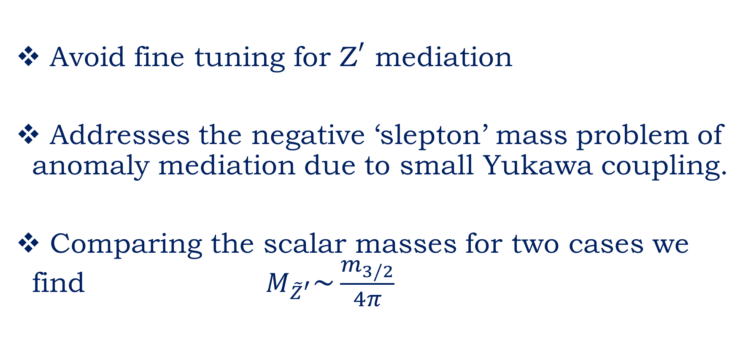
Combining $Z^{′}$and anomaly mediation
Avoid fine tuning for ${\text{Z}}^{′}$ mediation
Addresses the negative ‘slepton’ mass problem of anomaly mediation due to small Yukawa coupling.
Comparing the scalar masses for two cases we find $M_{{\tilde{Z}}^{′}}\sim \frac{m_{3/2}}{4π}$

Slide 15
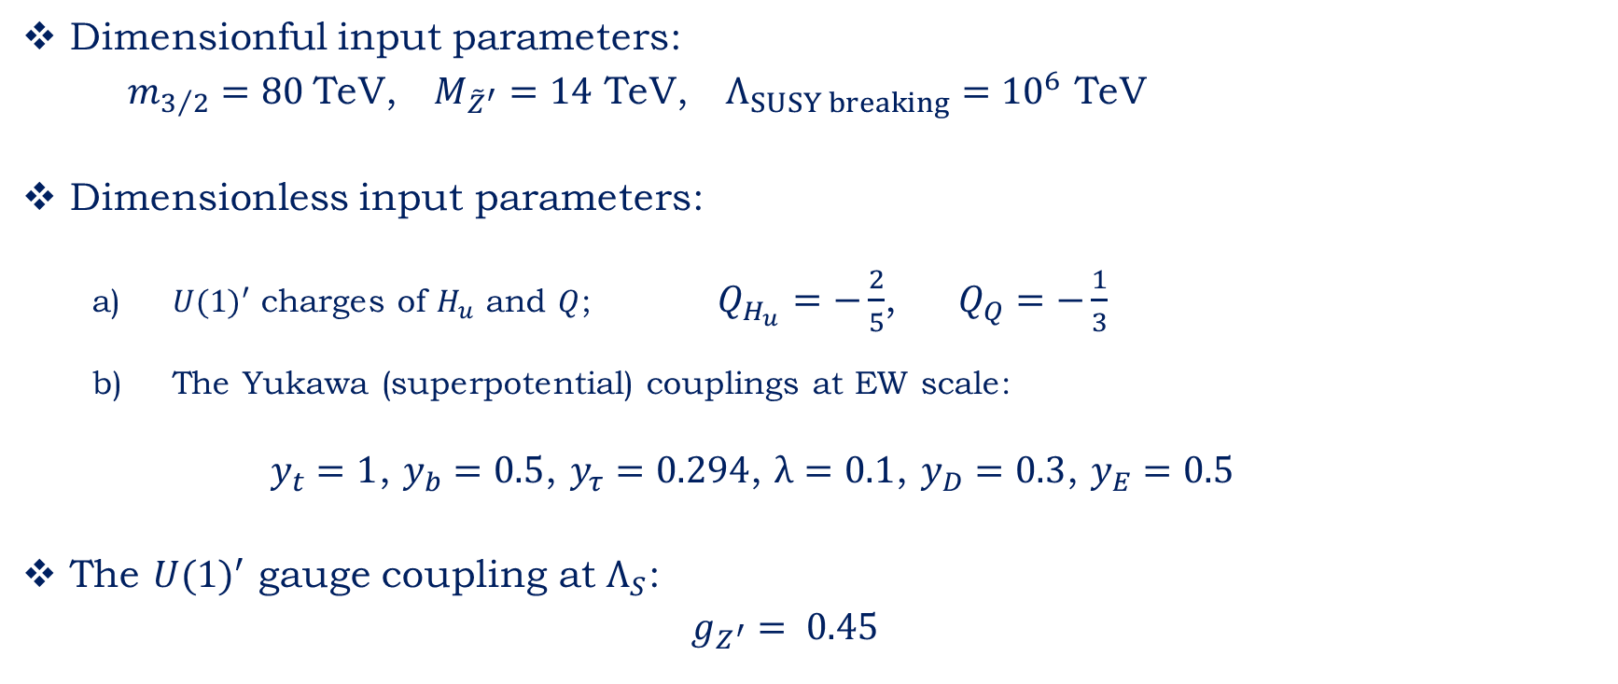
Specific Illustration point I: Inputs(2009)
Dimensionful input parameters:
$m_{3/2}=80$TeV, $M_{{\tilde{Z}}^{′}}=14$ TeV, $Λ_{SUSY breaking}={10}^{6}$ TeV
Dimensionless input parameters:
${U(1)}^{′}$ charges of $H_{u}$ and $Q$; $Q_{H_{u}}=−\frac{2}{5}$, $Q_{Q}=−\frac{1}{3}$
The Yukawa (superpotential) couplings at EW scale:
$y_{t}=1$, $y_{b}=0.5$, $y_{τ}=0.294$, $λ=0.1$, $y_{D}=0.3$, $y_{E}=0.5$
The ${U(1)}^{′}$ gauge coupling at $Λ_{S}$:
$g_{Z^{′}}= 0.45$

Slide 16



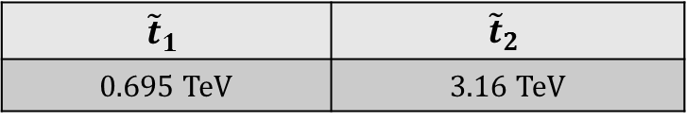
Specific Illustration point I: Results(2009)
Higgs particles including one loop radiative corrections:
Gauginos
Stops
$Z^{′}$ gauge boson $M_{Z^{′}}$=2.78 TeV
$$m_{h^{0}}$$ | $$m_{H_{1}^{0}}$$ | $$m_{H_{2}^{0}}$$
0.138 TeV | 2.79 TeV | 4.78 TeV
Wino | Gluino | Bino
0.279 TeV | 0.399 TeV | 1.17 TeV
$${\tilde{t}}_{1}$$ | $${\tilde{t}}_{2}$$
0.695 TeV | 3.16 TeV
$M_{Z^{′}}$=5.68 TeV and $m_{h^{0}}=0.142$ TeV
Illustration point II

Slide 17
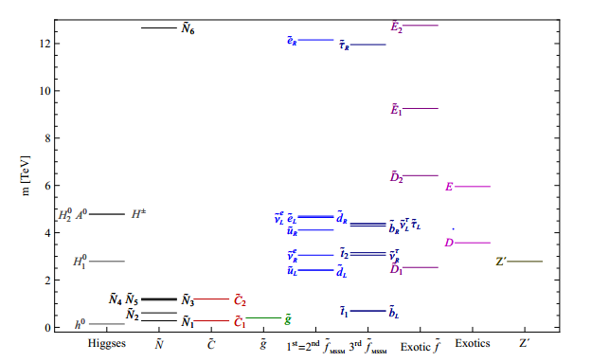
Results(2009)
Spectrum calculation for the illustration point

Slide 18
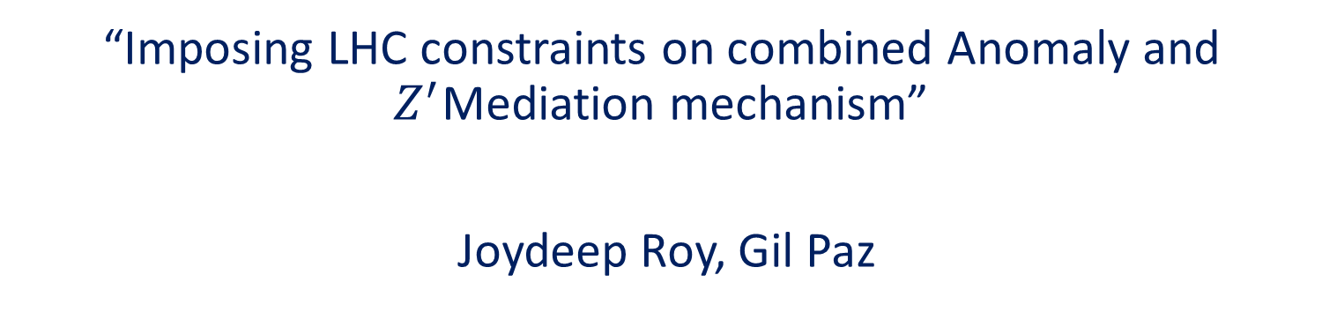
Present work
“Imposing LHC constraints on combined Anomaly and $Z^{′}$Mediation mechanism”
Joydeep Roy, Gil Paz

Slide 19
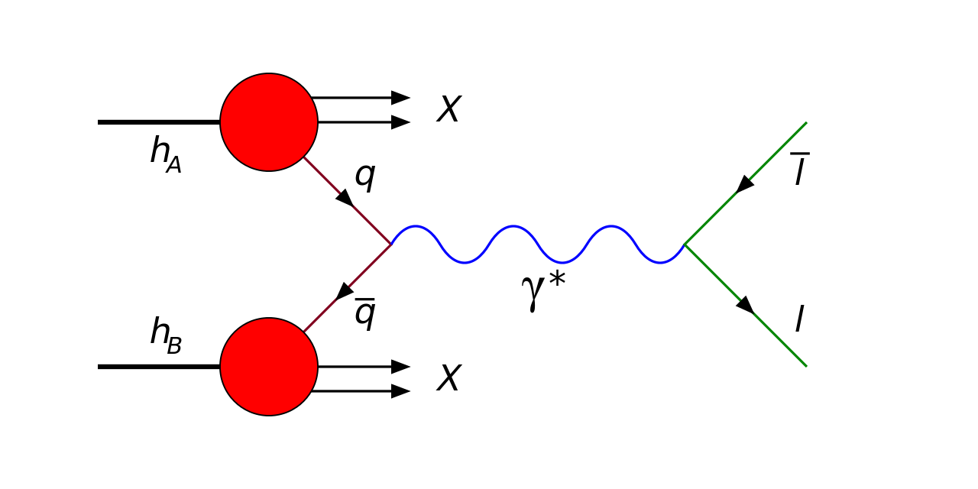



$Z^{′}$ Production & Decay
Leading Order (LO) Cross-section at LHC relevant for Drell-Yan process
$$σ_{l^{+}l^{−}}^{LO}=\frac{π}{48s}[c_{u}w_{u}\left(s,M_{Z^{′}}^{2}\right)+c_{d}w_{d}\left(s,M_{Z^{′}}^{2}\right)]$$
/$Z$/$Z^{′}$
Carena et. al PRD 70 093009 (2004)
Accomando et. al PRD 83 075012 (2011)

Slide 20


$Z^{′}$ Production & Decay
$σ_{l^{+}l^{−}}^{LO}=\frac{π}{48s}[c_{u}w_{u}\left(s,M_{Z^{′}}^{2}\right)+c_{d}w_{d}\left(s,M_{Z^{′}}^{2}\right)]$
with $c_{u,d}=\frac{g_{Z^{′}}^{2}}{2}[{\left(g_{V}^{u,d}\right) }^{2}+{\left(g_{A}^{u,d}\right) }^{2}$],
$g_{V,A}^{f}=ε_{L}^{f}±ε_{R}^{f}$
and $w_{u,d}=\int_{0}^{1}{{dx}_{1}f_{u,d}(x_{1})}\int_{0}^{1}{{dx}_{2}f_{\overline{u},\overline{d}}(x_{2})δ(\frac{M_{Z^{′}}^{2}}{s}−}x_{1}x_{2})$
Vector/Axial couplings
Chiral couplings
Hadronic structure functions

Slide 21
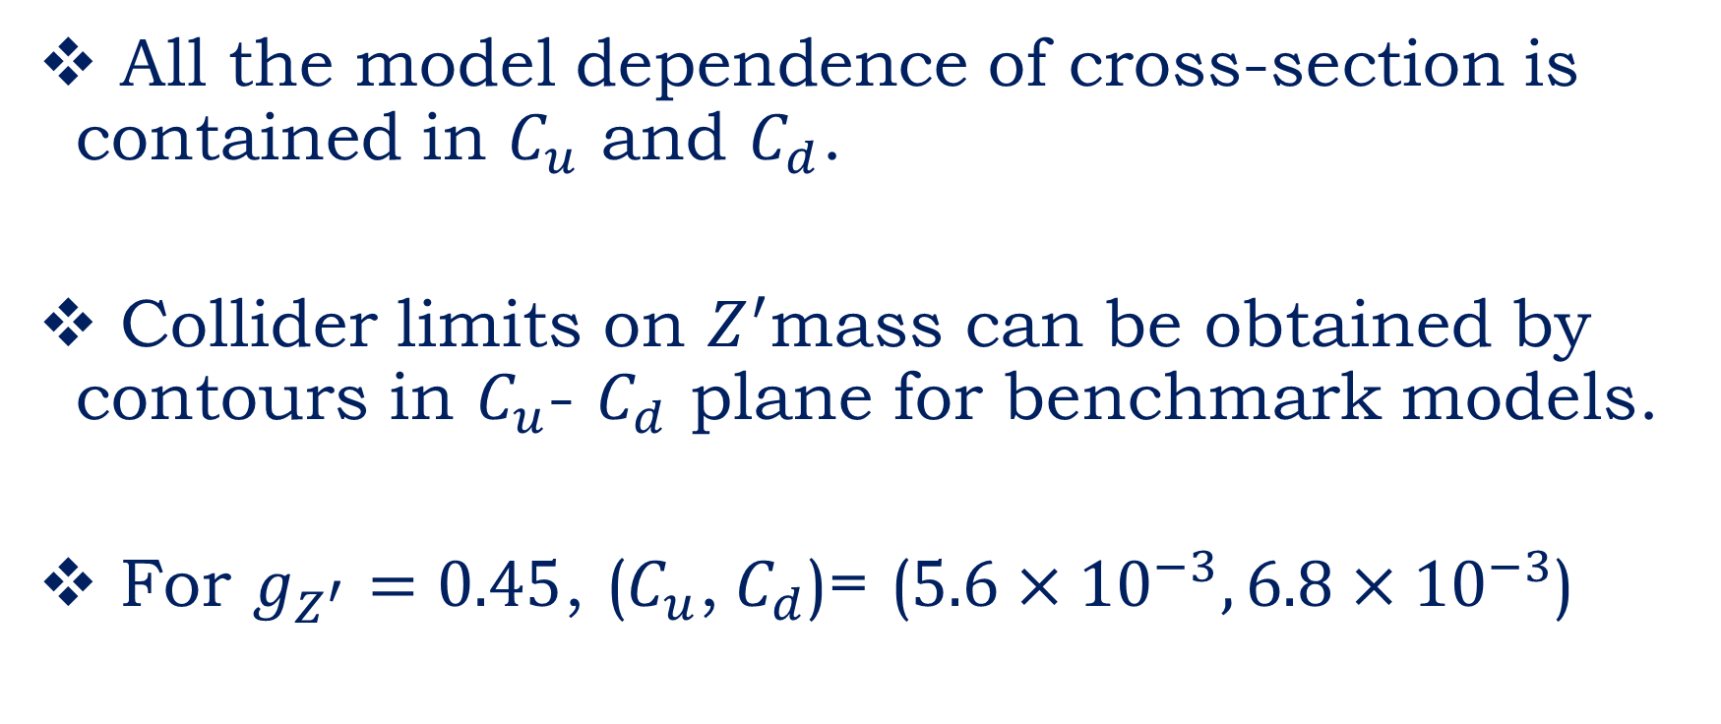
Constraints
All the model dependence of cross-section is contained in $C_{u}$ and $C_{d}$.
Collider limits on $Z^{′}$mass can be obtained by contours in $C_{u}$- $C_{d}$ plane for benchmark models.
For $g_{Z^{′}}=0.45$, ($C_{u}$, $C_{d}$)= ($5.6×{10}^{−3},6.8×{10}^{−3}$)

Slide 22
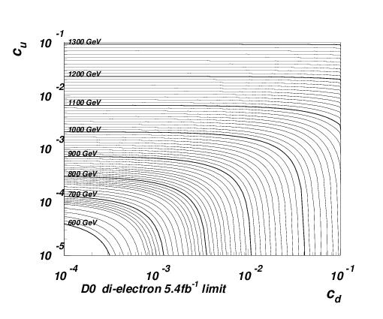

2010 Constraints
$${(c}_{u},c_{d})=(5.6×{10}^{−3},6.8×{10}^{−3})$$
Tevatron limits (2010)
$M_{Z^{′} }=2.78$ TeV
Data taken from D0 Collaboration (Phys.Lett. B 695 (2011)) and Image taken from Accomando et. al PRD 83 075012 (2011)

Slide 23
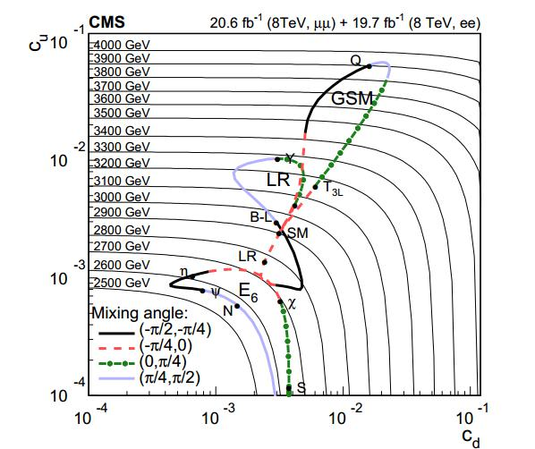



2014 $Z^{′}$ Constraints
$M_{Z^{′} }=5.68$ TeV
CMS limits (2014)
$M_{Z^{′} }=2.78$ TeV
Image taken from:
JHEP 04 (2015) 025

Slide 24

Our Result
$$σ_{l^{+}l^{−}}^{LO}=\frac{π}{6s}[c_{u}w_{u}\left(s,M_{Z^{′}}^{2}\right)+c_{d}w_{d}\left(s,M_{Z^{′}}^{2}\right)]$$
“A comment on the $Z^{′}$ Drell-Yan cross section”
Joydeep Roy, Gil Paz
arXiv:1711.02655v2

Slide 25
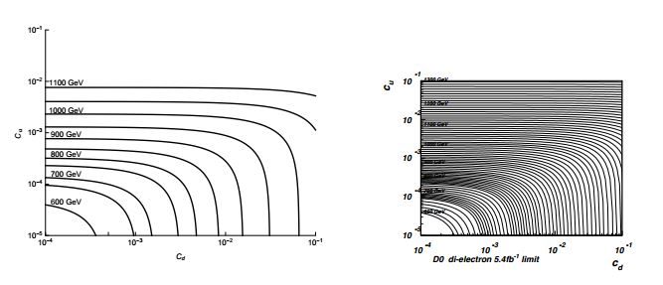
Our Result
Our analysis using D0 data
and correct factor 6
Accomando et. al analysis (2011)
using D0 data and wrong factor 48

Slide 26
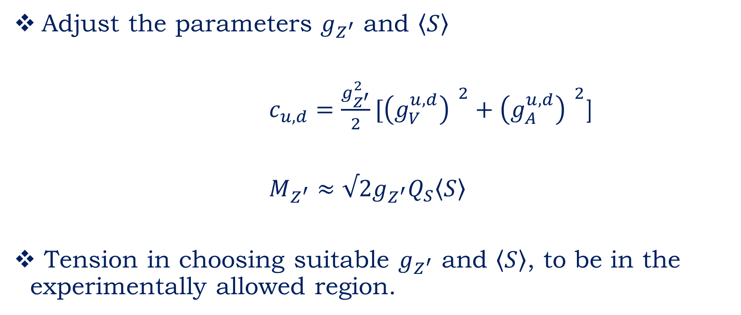
Summary of 𝑍′ constraint analysis
Adjust the parameters $g_{Z^{′}}$ and $\left\langle S\right\rangle$
$c_{u,d}=\frac{g_{Z^{′}}^{2}}{2}[{\left(g_{V}^{u,d}\right) }^{2}+{\left(g_{A}^{u,d}\right) }^{2}$]
$M_{Z^{′}}≈√2g_{Z^{′}}Q_{S}\left\langle S\right\rangle$
Tension in choosing suitable $g_{Z^{′}}$ and $\left\langle S\right\rangle$, to be in the experimentally allowed region.

Slide 27
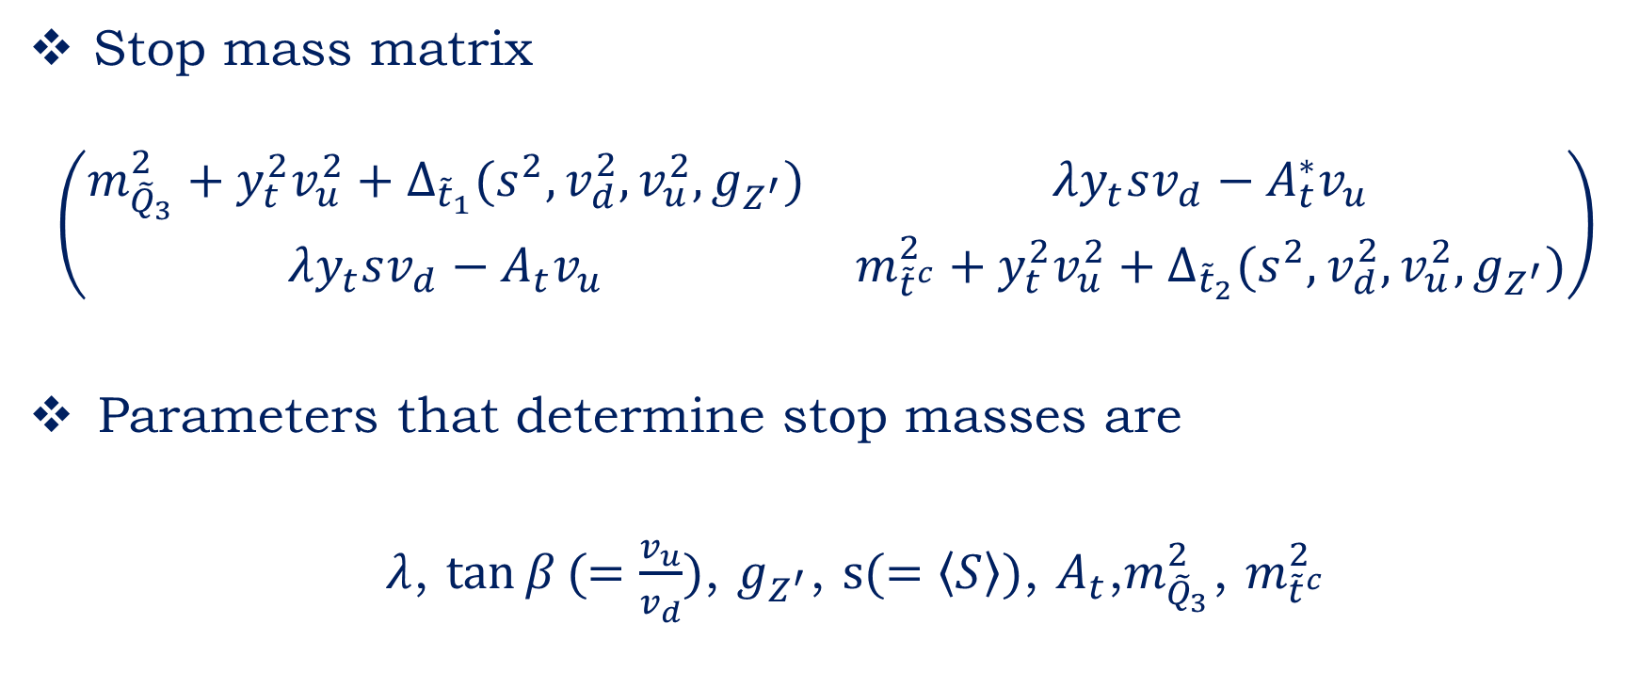
Stop mass constraints
Preliminary Results
Stop mass matrix
$$\left(\begin{matrix}m_{{\tilde{Q}}_{3}}^{2}+y_{t}^{2}v_{u}^{2}+∆_{{\tilde{t}}_{1}}(s^{2},v_{d}^{2},v_{u}^{2},g_{Z^{′}}) & λy_{t}sv_{d}−A_{t}^{∗}v_{u} \\ λy_{t}sv_{d}−A_{t}v_{u} & m_{{\tilde{t}}^{c}}^{2}+y_{t}^{2}v_{u}^{2}+∆_{{\tilde{t}}_{2}}(s^{2},v_{d}^{2},v_{u}^{2},g_{Z^{′}})\end{matrix}\right)$$
Parameters that determine stop masses are
$λ$, $\tan{β}(=\frac{v_{u}}{v_{d}})$, $g_{Z^{′}}$, $s(=\left\langle S\right\rangle )$, $A_{t}$,$m_{{\tilde{Q}}_{3}}^{2}$, $m_{{\tilde{t}}^{c}}^{2}$

Slide 28
Stop mass constraints
Preliminary Results
Current constraint of stop mass is > 950 GeV.
(Ref: ATLAS-CONF-2017-020)
Perform parameter scan to satisfy this constraint.

Slide 29
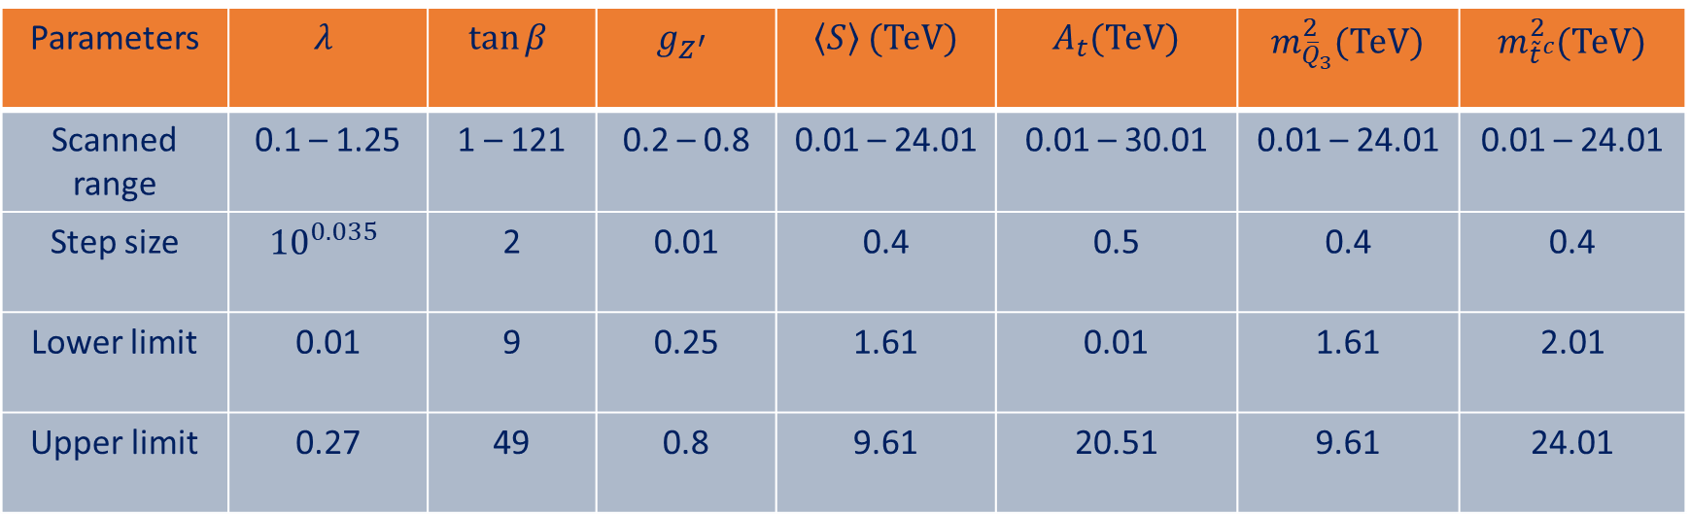
Stop mass constraints
Preliminary Results
Used more than 227000 combinations of parameters for the scan
Parameters | $$λ$$ | $$\tan{β}$$ | $$g_{Z^{′}}$$ | $\left\langle S\right\rangle$ (TeV) | $A_{t}$(TeV) | $m_{{\overline{Q}}_{3}}^{2}$(TeV) | $m_{{\tilde{t}}^{c}}^{2}$(TeV)
Scanned range | 0.1 – 1.25 | 1 – 121 | 0.2 – 0.8 | 0.01 – 24.01 | 0.01 – 30.01 | 0.01 – 24.01 | 0.01 – 24.01
Step size | $${10}^{0.035}$$ | 2 | 0.01 | 0.4 | 0.5 | 0.4 | 0.4
Lower limit | 0.01 | 9 | 0.25 | 1.61 | 0.01 | 1.61 | 2.01
Upper limit | 0.27 | 49 | 0.8 | 9.61 | 20.51 | 9.61 | 24.01
Parameter limits obtained from the parameter scan

Slide 30
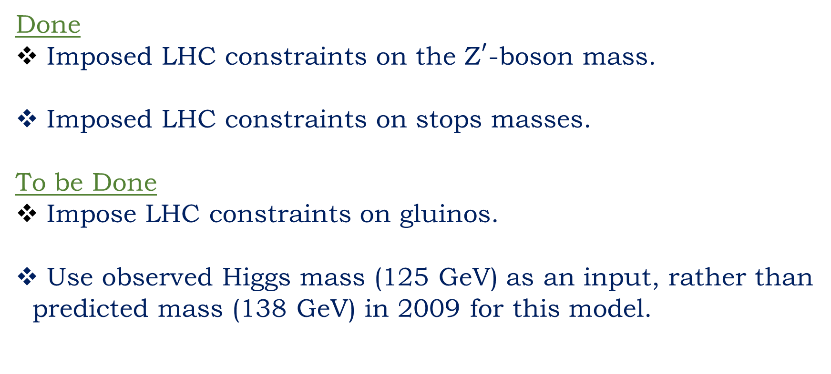
Outlook and future work
Done
Imposed LHC constraints on the ${\text{Z}}^{′}$-boson mass.
Imposed LHC constraints on stops masses.
To be Done
Impose LHC constraints on gluinos.
Use observed Higgs mass (125 GeV) as an input, rather than
predicted mass (138 GeV) in 2009 for this model.

Slide 31

Outlook and future work
?

