Slide 1
Requirement Driven Development of Innovative Computer Applications
By
Anil Rawat
Raja Ramanna Centre for Advanced Technology
rawat@rrcat.gov.in
25th May 2018

Slide 2
Outline
What am I going to attempt in this talk?
Talk about some practical implementations
Combinational Backfill Scheduling Algorithm
Cognitive OTP
Talk about some new ideas and initiatives
Machine learning application in networks
Proactive network security
Software Defined Network (SDN)

Slide 3
Job Scheduling Combinational Backfill Scheduling Algorithm

Slide 4
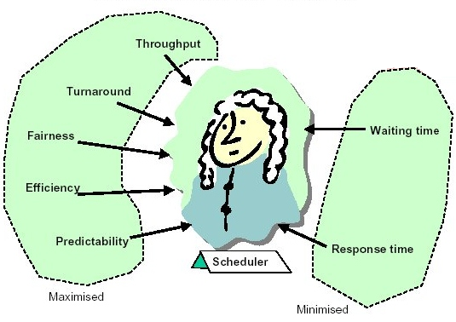
What is Job Scheduling
Method of fitting jobs on the available resources
Job Scheduling is usually required to Load Balance and share System Resources effectively
The job scheduler is concerned with:
Throughput
Turn around time
Response time
Fairness and
Waiting time

Slide 5
Resource Manager and Job Scheduler
Resource Manager:
Ensures effective and efficient use of available resources (Torque)
Job Scheduler:
Makes scheduling decisions by communicating with Resource Manager
(Maui)

Slide 6


Types of Scheduling Algorithms
Time sharing
Time sharing techniques are employed to ensure
that the time on a processor is divided into discrete
intervals or time slots which are assigned to
unique jobs.
Space sharing
It provides the requested resources to one particular
job until the job is completely executed. The main
advantage of space sharing algorithm are low overheads
and high parallel efficiencies.

Slide 7
Job Scheduling in Clusters
Job scheduling is a critical task on large-scale computing platforms. The job scheduling policy directly influences the satisfaction of both users and system administrators.
Administrators are always interested in maximizing resources utilization whereas users are interested in getting higher throughput and good response time for their jobs.
In Cluster environments different users execute computing jobs requiring varying execution time ranging from few minutes to couple of weeks. If jobs are not packed carefully, computing resources will lose computational time due to scheduling gaps.
Backfilling is a common practice to overcome this problem.

Slide 8
Backfilling in Clusters
Backfilling increases system utilization by running lower priority jobs in scheduling gaps before higher priority jobs.
We proposed a combinational approach for backfilling of non-preemptive parallel jobs in HPCCs.
In this approach the job scheduler picks a combination of jobs in waiting that can optimally pack the current backfill window.
It is observed that choosing a combination of jobs, instead of a single job through Firstfit or Bestfit gives the more optimal results for backfilling.

Slide 9
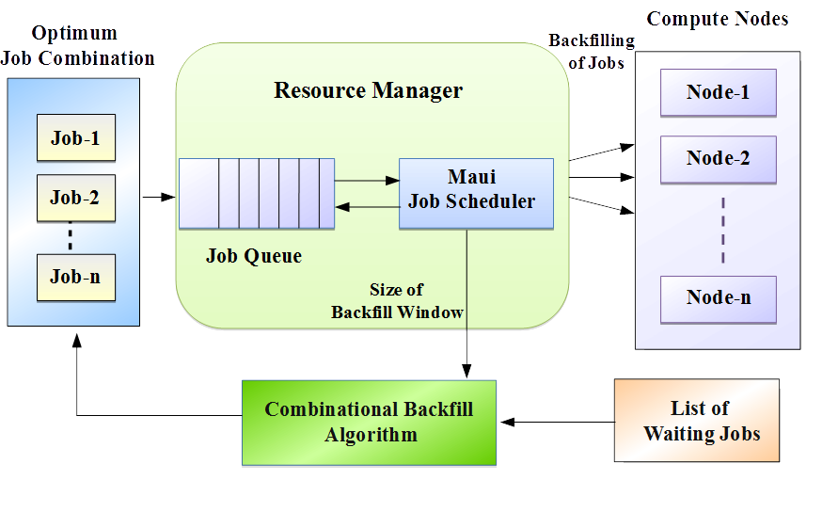
Workflow of Combinational Backfilling Approach
Notes:
9
9

Slide 10
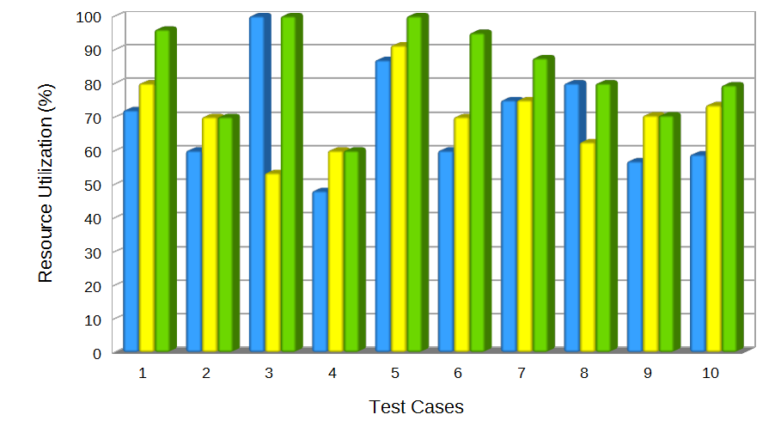
Results of Combinational Backfilling Approach
Firstfit
Bestfit
Combinational Approach
10
Notes:
10
10

Slide 11
First reporting:
Verma D.K.*, Rajan A.*, Paraye A.*, Rawat A.*
A Combinational Approach for Optimal Packing of Parallel Jobs in HPC Clusters
5th International Conference on Advanced Computing, Networking, and Informatics (ICACNI -2017)
Department of Computer Science & Engineering National Institute of Technology, Goa, India, Jun., 1-3, 2017

Slide 12
Cognitive OTP Novel technique to Establish Identity of a Person (Human) in Cyber Space

Slide 13
Conventional Techniques to Identify a Person
Using bio-metric identification – Photograph, IRIS, Finger Prints, Hand Geometry etc.
Using digital information – Passwords, OTP, Session Passwords, Time Window Based Passwords etc.
Ensuring human presence – Identify picture, use CAPTCHA, disintegrate passwords etc.
Limitations
Breakable
Vulnerable to theft
Need additional infrastructure (for bio-metric verification)
Not impeccable

Slide 14
Cognitive OTP
Assimilation of CAPTCHA, OTP and a user defined / user selected function
User produce a ‘Cognitive OTP’ by applying self defined function
User defined function pre-communicated to Authentication Server
Verification by Authentication Server

Slide 15
Simplified Steps for Identification of a Person in Cyber Space
Application Server sends a OTP through a CAPTCHA to User and also the Authentication Server
User generates ‘Cognitive OTP’ by applying his/her function
‘Cognitive OTP’ is sent to Authentication Server
Authentication Server verifies and communicates ‘Success’ or ‘Failure’ to the Application Server

Slide 16
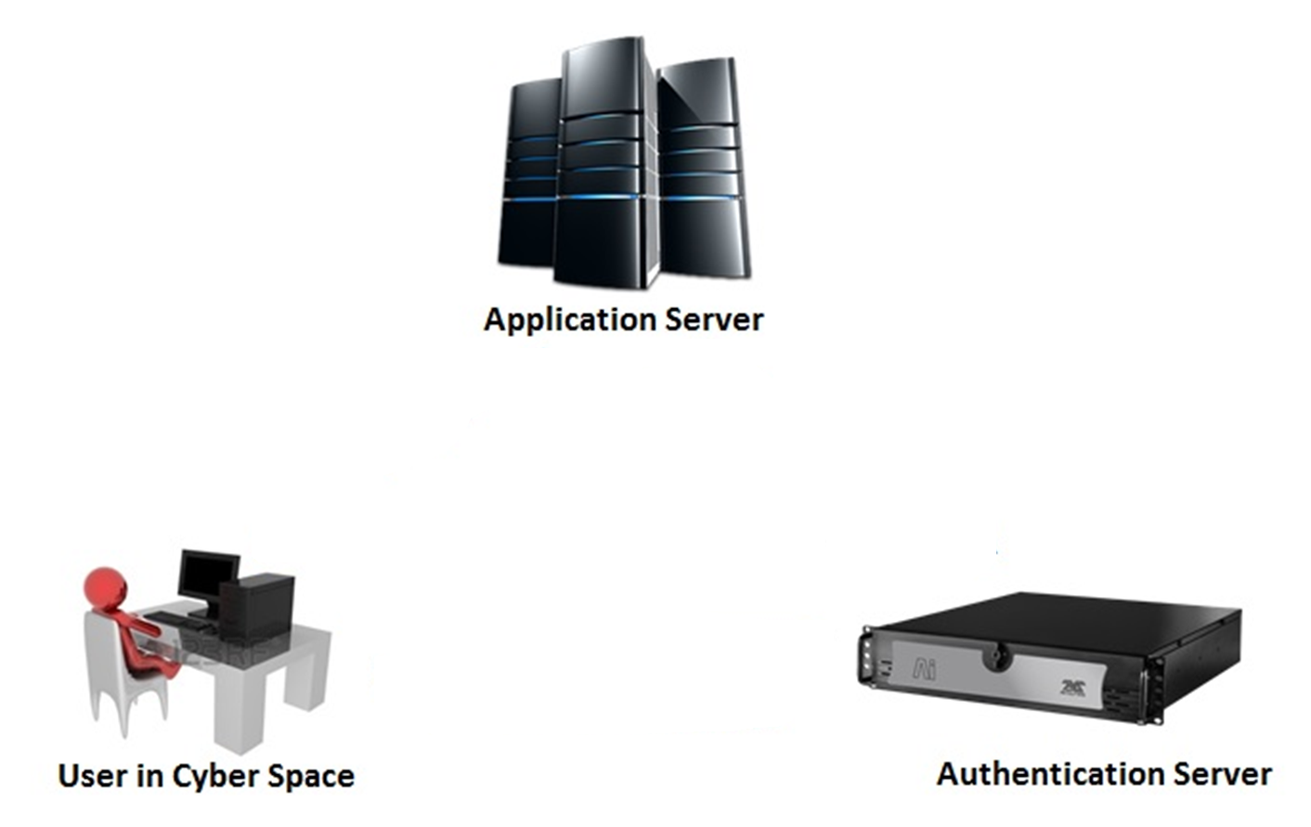
Simplified Depiction of ‘Cognitive OTP’ Based Authentication Scheme
1. OTP in CAPTCHA
2. OTP
4. Authentication Decision
3. Cognitive OTP = fn (OTP)
fn : User Defined Function

Slide 17
Summarily….
CAPTCHA ensures human at user end
OTP adds randomization
Function – User defined
User uses brain (neurons!) adding bio-metric dimension to produce ‘Cognitive OTP’
Scheme can be implemented with three players:
User (person to be identified)
Application Server
Authentication Server

Slide 18
First reporting:
Rawat A.
Cognitive OTP-novel technique to establish identity of a person (human) in cyber space
28th NORDUnet Conference
Uppsala University, Sweden, Sep., 23-25, 2014
Rawat A. User Authentication using Cognitive OTP
International Conference on Computer Security in a Nuclear World
IAEA, Vienna, Austria, Jun., 1-5, 2015

Slide 19
Network Related Problems Being explored for possible deeper investigation

Slide 20
IPSec to support Network Address Hopping (NAH)
Problem: IPSec does not support Network Address NAH. Privacy feature introduced in IPv6 by allowing changes to IP address after fixed time intervals. IPSec fails in such cases.
Idea: Make changes in IPSec to support NAH.
Advantage: Enhanced Security, sustain utility of IPSec

Slide 21
Zero Day Attacks Detection and Mitigation
Problem: Zero day attacks are the most difficult to detect and mitigate.
Idea: Apply deep learning techniques on traffic profiles to find new patterns and search Centre for Applied Internet Data Analysis (CAIDA) database to find traces of similar patterns in the test honeypot network.
Advantage: Improved attack detection and mitigation

Slide 22
Intrusion detection based on deep learning
Problem: Sophisticated tools are used now a days for intrusion into a network, by cleverly spanning the action for multiple days, thus escaping normal IDS tools.
Idea: Utilize deep learning techniques to discover patterns with intrusion characteristics on historic traffic profiles to find possible intrusion attempts.
Advantage: Improved security and mitigation of attacks

Slide 23
Session Duration based Network Traffic Engineering
Problem: In best effort Internet QoS may get affected if a constrained path with higher bandwidth for a duration lesser than required for the session is selected, although a path with required bandwidth exists for the required session duration.
Idea: Utilize historic traffic profiles for estimating best path with resources available for the estimated session duration.
Advantage: Seamless service until the session ends in the best effort Internet

Slide 24
Software Driven Networks ( SDN ) Possible Paradigm Shift In Network Technology

Slide 25
Software Defined Networking (SDN)
Considered as a tectonic shift in networking industry
Represents a transformation from traditional switching to a new programmable switching technology
An approach to build computer network that separates and abstracts elements (switches, routers etc.)

Slide 26
Software Defined Networking (SDN)
This architecture decouples the forwarding process of network packets (Data Plane) from the routing process (Control plane)
Enables the network control to become directly programmable and
The underlying infrastructure to be abstracted for applications and network services
The OpenFlow protocol is a foundational element for building SDN solutions

Slide 27
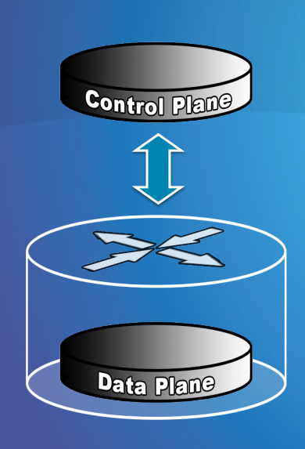
In other words – not all processing happens inside the same device
The control logic of data plane elements, such as switches and routers, etc. is shifted onto the control plane elements, like physical and logical SDN controllers
This simplifies the management of complex networks

Slide 28
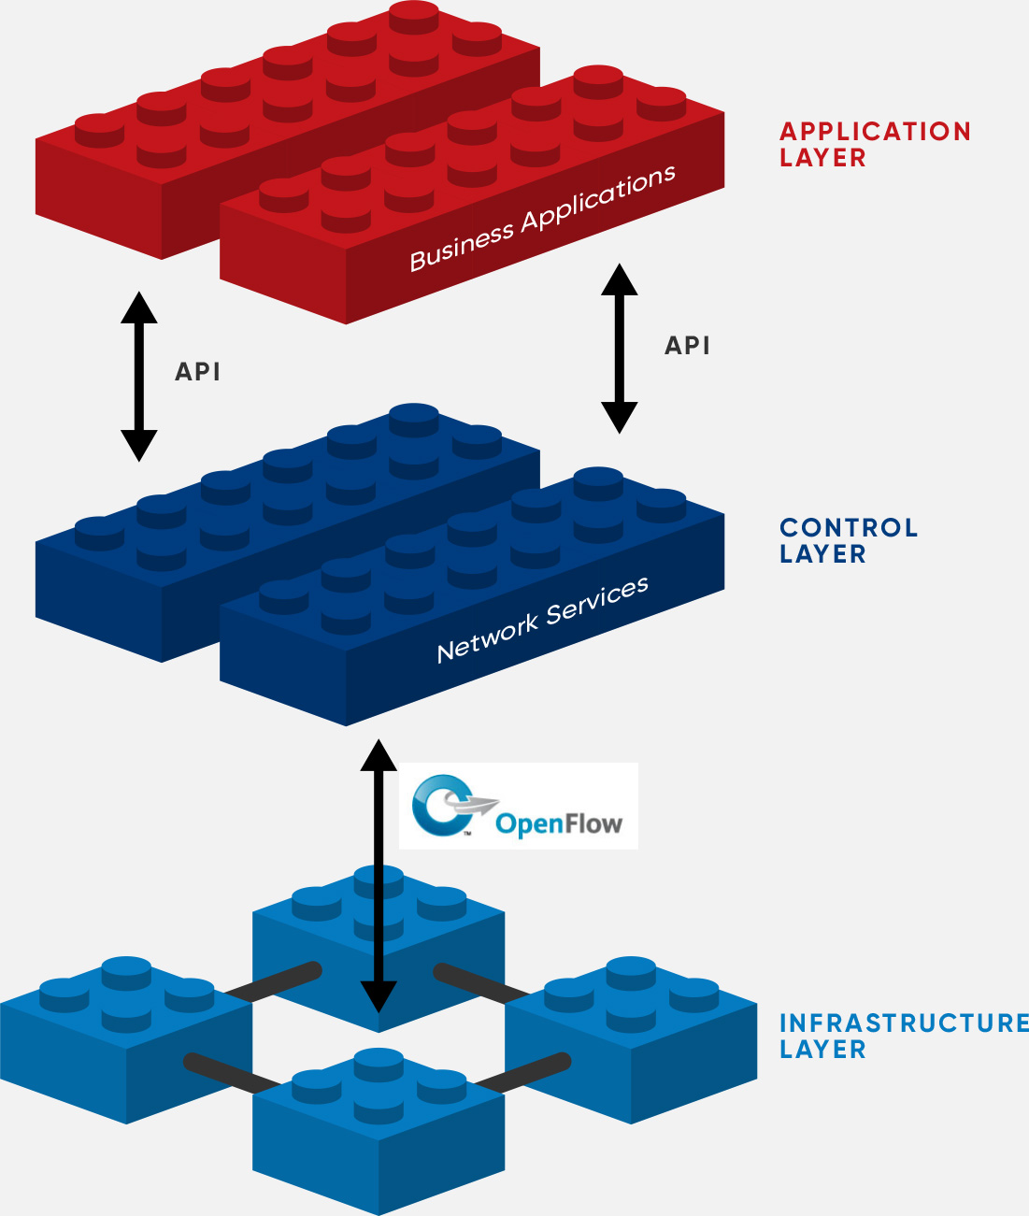
Another conceptual view of SDN

Slide 29
Traditional Computer Networks
Management plane:
Notes:
Maybe this is a better picture… though need some details of what happens in each plane… like in next slides… or, have both?

Slide 30
Software Defined Networking (SDN)
Logically-centralized control plane
OpenFlow – communication protocol
Dumb,
fast
Data Plane
SDN Switches

Slide 31
Typical Challenges
Heterogeneous Switches
Controller Delay and Overheads
Distributed Controllers
Plenty of room for bugs
Need for testing techniques

Slide 32
Other activities of Computer Division, RRCAT
Building, operating and managing computing resources (HPCC, sequential processing machines) for scientific applications (ADF, ANSYS, VORPAL, VASP, GROMACS, Orbit MPI etc.) porting of parallel and sequential applications on new computing resources
Campus network design, planning, operation and management (4000+ access points, eight OFC rings, multiple external connectivity links, network services and facilities)
Network security using multilevel DMZs, built using open source software tools, customization and deployment of PKI for in-house applications
Software development and deployment for information management systems and applications (RRCAT and DAE)

Slide 33
Resources:
Computing using HPCC (Aggregate computing power of 43 TeraFlops and another 200 TeraFlops machine is now in the pipeline) and sequential processing machines
IOTL – Inter Operability Test Lab for Computer Networks
Simulation tools
Adequate technical and scientific information resources (journals and books)

Slide 34


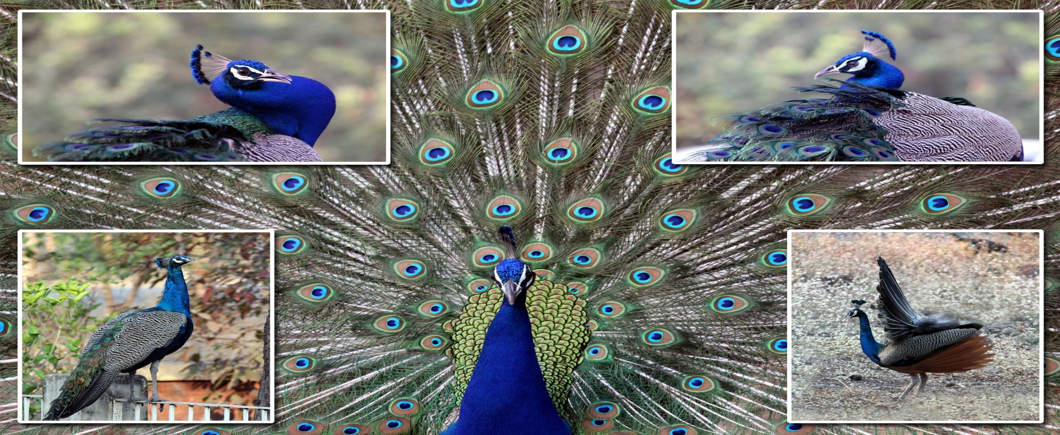
Thank you!

