Slide 2
India: Then and Now
 | 1951 | 2011
GDP at constant prices (1951=100) | 100 | 1,766
Per capita national product at constant prices | 100 | 511
Life expectancy at birth (years, est.) | 32 | 66
Infant mortality rate (per 1,00 live births, est.) | ~180 | 44
Total fertility rate (children per woman) | 5.9 | 2.4
Literacy rate male female | 9% 27% | 65% 82%
Population below poverty line rural urban | 47% 35% | 22% 20%
Households owning bicycle radio sewing machine | ~.4% ~.9% ~.1% | 46% 27% 19%
Table 1.2, Drèze and Sen, An Uncertain Glory (2013), 6

Slide 3
Indicators for World’s 16 Poorest Countries outside Sub-Saharan Africa
 | India | other 15 | India’s rank
GDP per capita (2011, constant 2005 dollars) | 3,203 | 2,112 | 1
Life expectancy at birth (years) | 65 | 67 | 9
Infant mortality rate (2011, per 1,00 live births) | 47 | 45 | 10
Under-5 mortality rate (2011, per 1,00 live births) | 61 | 56 | 10
Total fertility rate (children per woman) | 2.6 | 2.9 | 7
Access to improved sanitation (2010) | 34% | 57% | 13
Mean years of schooling (age 25+, 2011) | 4.4 | 5.0 | 11
Literacy rate (age 15-24, 2010) female male | 74% 88% | 79% 88% | 11 9
Children under 5 who are undernourished (2006-2010) underweight stunted | 43% 48% | 30% 41% | 15 13
Child immunization rates (2011) DPT measles | 72% 74% | 88% 87% | 13 11

Slide 4
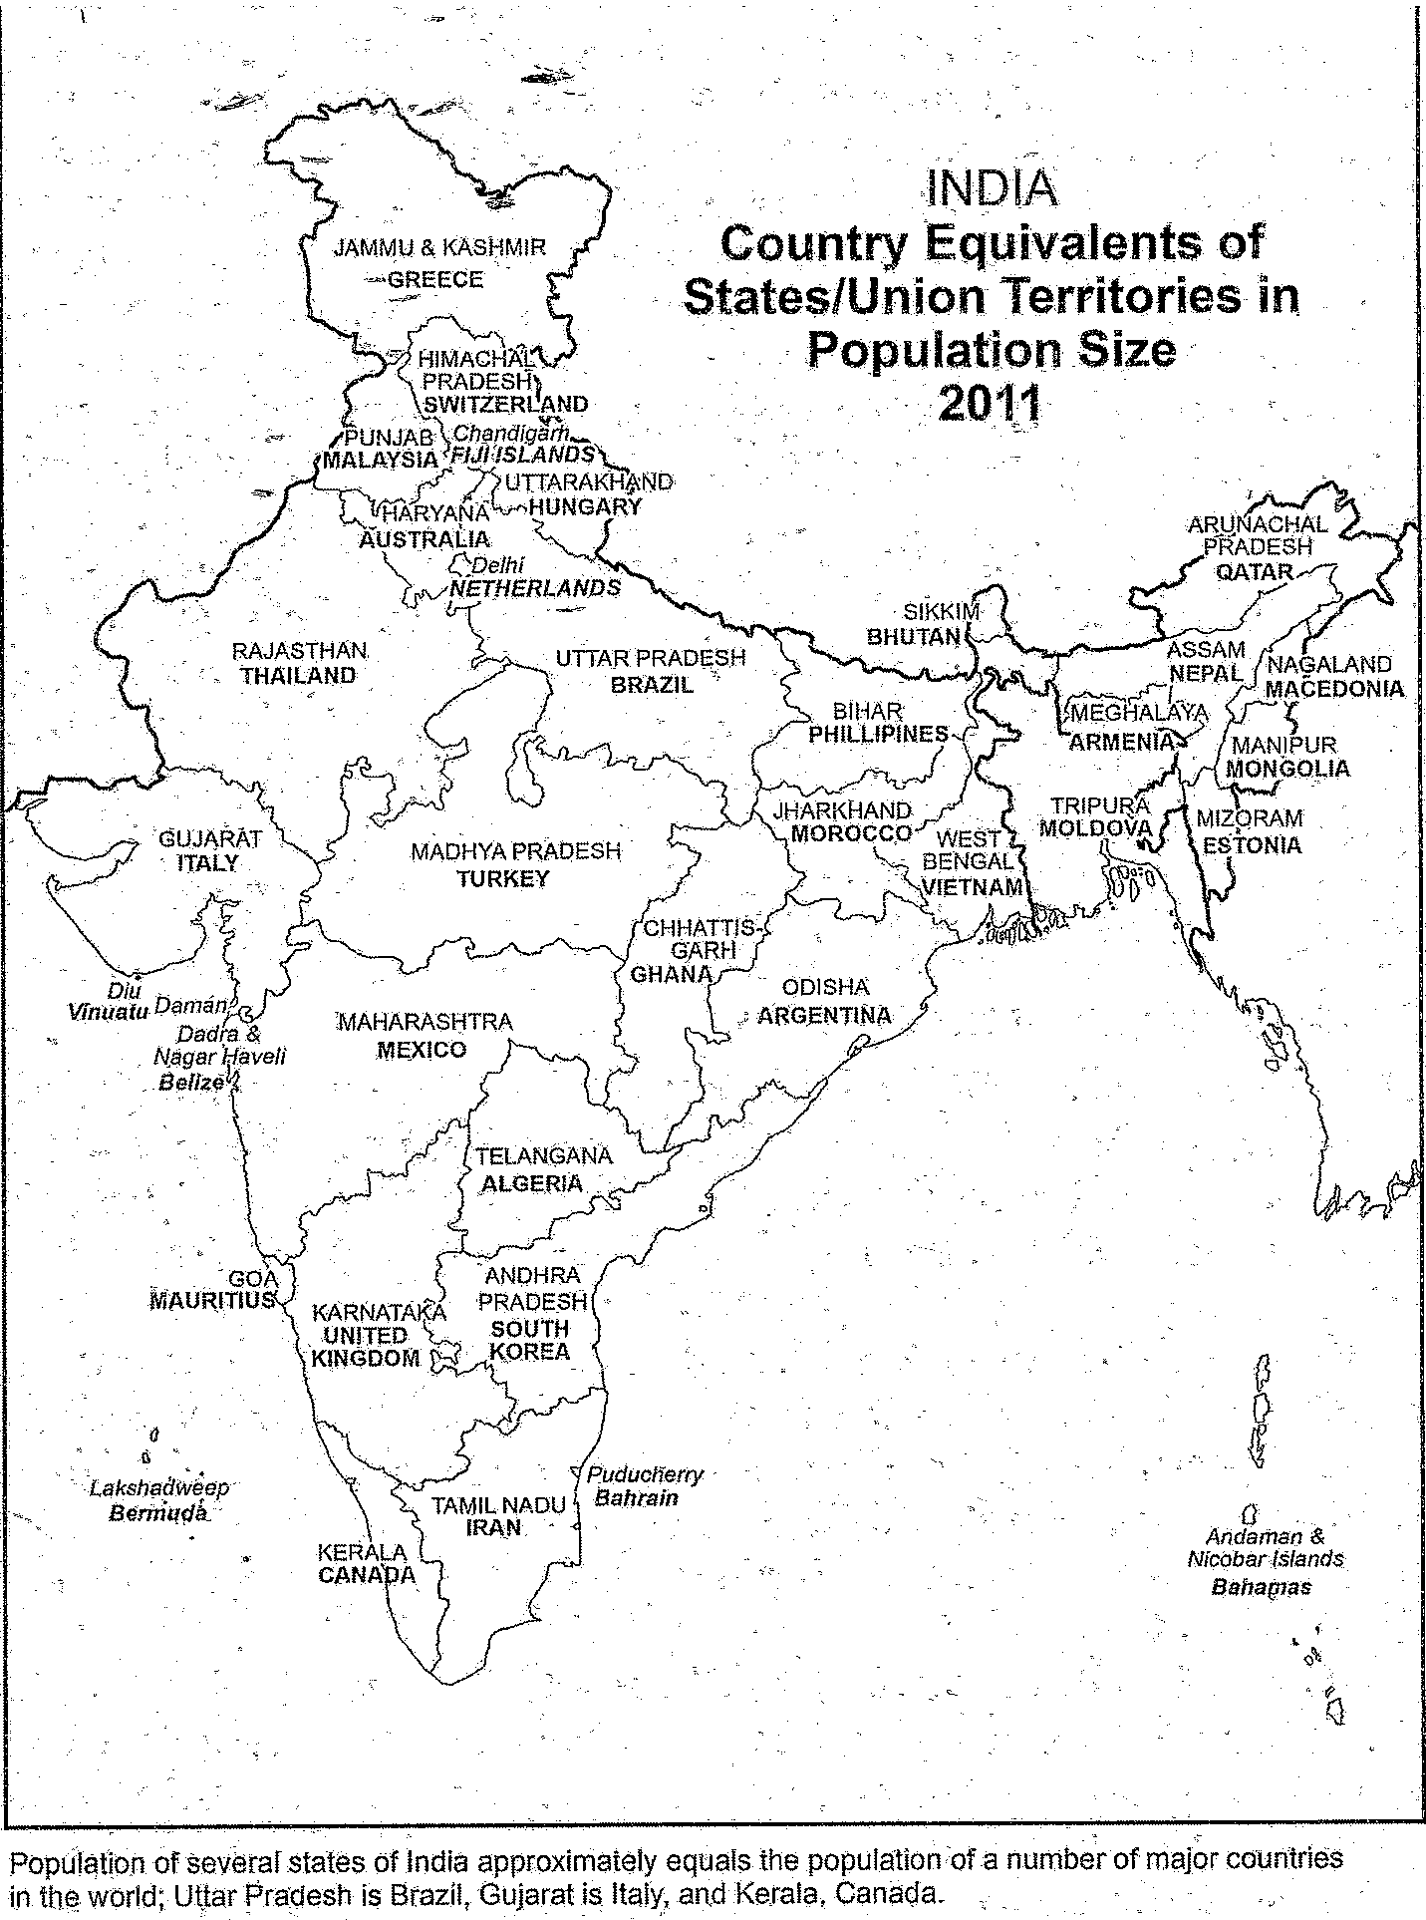
Map 2.6, Gopal Krishnan, The Vitality of India: A Regional Perspective (2017), 61

Slide 5
Dipesh Chakrabarty
University of Chicago

