Slide 1
TIFR’s Role in Modernizing Telecommunication in India
M V Pitke
March 1, 2019

Slide 2
Physics and Technology
Experimental Physics
Laboratories with complex instrumentation
Need for in-house development
Advanced signal processing,
Attempting to detect the almost undetectable
Ex: Gravity wave detection, Half life of Proton, etc
Benefit from other applications, health, nuclear electronics, etc.

Slide 3
Digital Technology at TIFR
Pioneering work in building digital processing for Cosmic Ray Lab
Digital circuits with many applications
Many University Labs decided to build their own digital computers
Illinois, Cambridge, Manchester, Goettingen, Pisa
TIFR decided build a digital computer (TIFRAC)
A massive effort that involved use of vacuum tubes and magnetic core memories, Slow, limited memory .
Only very rudimentary software tools.
Building Radio telescope was a great experience in Antenna design
The great experience helped undertake major national projects

Slide 4
Indigenous Development
Early 60s, the border dispute compelled us to undertake development of some critical components to strengthen our defence efforts.
TR Switches, PIN Diodes, etc
Interest in developing a digital mobile network for tactical applications became a technical challenge resulted in a major project

Slide 5
A Challenging Project
The AREN Project
A rugged digital mobile network for tactical communication, funded by DOE
All network elements mobile, the switches, terminals and digital UHF links
The core element, the Automatic Electronic Switch -AES was TIFR's responsibility
PDP11, limited memory 128K x16, primitive sw development tools, etc.
Powerful core switch network and a common channel interoffice signalling (before ss7)

Slide 6
First ‘All’ Mobile Network
Facilities for nomadic, mobile subscribers
User can set up the full network quickly to meet the operational requirement
An ‘Ad Hoc’ network in operation ahead of its time (1980)
Some original contributions, synchronization, signalling handling, duplicated control, conferencing, etc.
( This experience turned out to be very valuable for CDoT project)

Slide 7
The Initiative
Early 80s
1980: Government appoints Committee under chairmanship of Mr. Sarin (ex defence secretary) for setting up a factory for production of SPC controlled Electronic Telephone Exchanges.
Production Capacity of half a million lines per year
Digital switching in infancy
Attracted attention of the groups in TIFR, TRC in Delhi and Wescom in USA
Sam Pitroda keenly interested in India. His company was taken over by Rockwell, became a VP

Slide 8
State of Telecom Technology
State of Technology
Telecom Exchanges: Electromechanical - Strowger and Crosssbar
Only a few 'electronic' (ESS) i.e. computer controlled analog.
Serious problems, severe shortages of telephones, practically no automatic dialling
Expensive and difficult to maintain
Analog network architecture, partly digitized by PCM, limited facilities, only low speed data (< 2400bps)
Very limited service to rural areas
Archaic administration but very bright engineers!

Slide 9
Sarin Committee
H C Sarin (former defence secretary) appointed in 1981 to study modernization of Indian Telecom
Original plans for factory half million lines of ESS electronic switching systems (assumed to be analog)
Announcement of Sarin Committee encouraged Pitroda to visit India more often
Develop a circle of friends - politicians, press and academic
Our intervention resulted in the selection of Digital Switching technology (still in infancy then)) for the ESS factory

Slide 10
MNCs in India
AT&T, Alcatel, Ericsson, Siemens, NEC, and others
Fortunately unlike computers there was no Russian switching technology!
Alcatel was the most aggressive and negotiated a successful deal for a factory with E10B technology (83)
Very heavy fees for technology transfer (300 Cr?) which largely goes unutilized
Mismatch between product specs (designed for European urban traffic) and Indian requirements
No concern for rural requirements

Slide 11
Very favourable developments
The ideas of developing indigenous technology emerged in Chicago 80-81
Pitroda pioneered development of digital PBX with multi microprocessor control
Sale of company/technology gave him financial independence.
Waiting for the right opportunity
DOE's (esp. Dr PP Gupta's) interest in switching technology development
DOE funded the mobile switching project for defence at TIFR
G B Meemamsi had developed an analog electronic switch at TRC - a very remarkable effort.

Slide 12
Garnering Support
Presentation to Indira Gandhi and friendship with Rajiv Gandhi
Meeting top scientists and technologists
Articles in press
Handling misinformation in the press
Dealing with strong opposition of telecom buraucracy
Meetings with influential friends, politicians and journalists in Delhi and senior bureaucrats

Slide 13
The Project
Joint Project of DOE and DOT
Meeting of the Committee of Secretaries (Chaired by Prof MGK Menon) on July 7, 1983 (crucial commitment to set up factory)
Cabinet approval on Feb 25, 1984
Technology for ESS-3 Factory of 500,000 annual production capacity of switches of less than 10000 line capacity (to avoid clash with Alcatel E10B factory!)
April 26, 1984 Gadgil and Sanjeevi Rao announce at a press conference
Aug 9, 1984 Indira Gandhi announces in Lokh Sabha
Registered Scientific Society 'vested with total authority and flexibility outside Government norms to ensure dynamic operation’
Registered on August 25, 1984

Slide 14
The People
DOE and TIFR helped to hold on the AREN project team in anticipation of CDOT
Pitroda visits TIFR, addresses TIFR members
DOE delegation visits Chicago to prepare a plan and evaluation of technologies
Discussions with faculties of IITs, IISc, etc for participation
Study visits to explore the latest developments

Slide 15
Very Crucial Contribution by TIFR
TIFR was the model adopted for CDoT
Many active supporters!
Making available a talented team with experience in the state-of-the-art
Making available administrative and accounts staff for occasional consultation
Setting up the organization and structure and office procedures
Facilities, building maintenance, canteen, transport, etc.
Recruitment, selection and training of fresh candidates
Creating an environment for rapid project execution
Incurring expenditure for CDoT even before its incorporation!
Supported and nurtured PBX technology

Slide 16
The Plan
Get the best talent from all over India
Energize the Indian component and packaging industry
Remember, only less that 10% of all components are 'hitech‘
Import only 'raw technology' and essential components that are available from multiple sources
Launch development of CHILL (make DOT happy!) but get license for UNIX, the language for telecom technology
Develop low cost PC based systems for testing and managing manufacture
Consultation and help from Indians and others in USA who have knowledge and experience in niche areas
Collaborative relationship with leading Universities and R&D institutions

Slide 17
Advance Action
Before finalization of the product specs, etc
Presentations/meetings at IITs and Universities all over India
Recruitment drive, staff selection
Presentations to component manufacturers, Bangalore, Mumbai
Visits to component manufacturers, discuss quality issues, provide assistance
Design and fabrication of mechanical assemblies
Negotiations with organizations (like ITI) for staff on deputation

Slide 18
The Technology
Basic architecture finalized after several brainstorming sessions of the joint TIFR and TRC team
A family of digital PCM TDM systems for a range of applications
State-of-the-art technology meeting CCITT standards
Low power consumption, using CMOS logic
RAX operation in non-AC, fanless environment with irregular power supply
Distributed switching, non-blocking from 128 ports up to 16000 ports, 40,000 with concentration
High traffic handling, redundancy beyond 8 ports
Automated Maintenance, Diagnostics and Recovery
Remote administration and maintenance capability
Standard PCBs and racks

Slide 19
Provide a Total Solution
Systems easy to install, operate, maintain, and manufacture
Simple packaging, with standard PCBs, convection cooled
Standard frames, racks and cabinets
Special package for low cost, small scale manufacture
Vendor Development
Documentation
Training
Technology transfer package

Slide 20
Implementation Strategy
No new buildings, use rented space
Rather than moving people, move work closer to the people
Make fullest use of existing base, component manufacture, packaging, R&D institutions
Start immediately with PBX as a separte product
Use128 port module when it is ready (RAX)
This gives us time for stabilizing hardware and reliability
Time for completion: 36 months
Total budget: Rs 36 Crore ($36million)
Two locations: Delhi and Bangalore
In Delhi, two top floors of the almost empty ITDC Hotel Akbar

Slide 21
Reliability of Indian Components
Several manufacturers with excellent products
Reliability problems
Lack of demand
Invited experts in component industry fro USA
Arranged visits and discussions at factories to find solutions

Slide 22
The PBX - First Product
Launched on August 29, 1985 at Bangalore
Manufacturers Conference for Technology Transfer
Technology transferred to 48+ manufacturers
Support for local component industry
First product from Meltron installed at the Indian Express Offices at Nariman point

Slide 23
Kittur Field Trial - The RAX (Rural Automatic Exchange)
A version of 128 port module as a stand alone small telephone exchange
Installed with help from DOT engineers at Kittur, a small town near Belgaum in Karnataka
Inaugurated on July 21 1986, was instant success.
Provided international dialling facility not available in Belgaum
Our experience with the defence project helped us make it rugged and reliable
Brought good quality moder digital telephony to a village for the first time

Slide 24
The Main Exchange - MAX
More complex hardware
Much more complex Software
10,000 line MAX ready in Aug 1987 for trials in the laboratory
16000 port MAX cut over in Aug 89 at Ulsoor in Bangalore
Started manufacture and delivery to DOT
More than 52 million lines delivered to DOT by 2000

Slide 25
CDOT Parallels
Three groups started around the same time
Brazil Tropico family - Very limited Success
Could not withstand pressures from MNCs (probably)
S Korea TDX family - Very successful, Developed at ETRI, the leading R&D Centre. Technology transfer to many companies, successful competition with foreign companies.
Probably 30+ million line
India CDOT family - Most successful - 55 million lines, several manufacturers This was possible only due to the strong support and trust of DOT
According to CK Prahalad CDOT is one of the only two key successes, the other being the milk revolution

Slide 26
Emulating CDOT
36 Crores, 36 months become an attractive norm
I have given away several copies of CDOT bylaws!
CDAC- Centre for Development of Advanced Computing
PARAM, PADMA, Supercomputers?
CMET- Centre for Materials...?
There was one for railways just next to CDOT office

Slide 27
Key Factors in CDOT’s Success
There were some common values that were behind CDOT's success. These include:
Open, egalitarian culture
Well defined authority and responsibility
Transparency
Peer evaluation
People sensitive

Slide 28
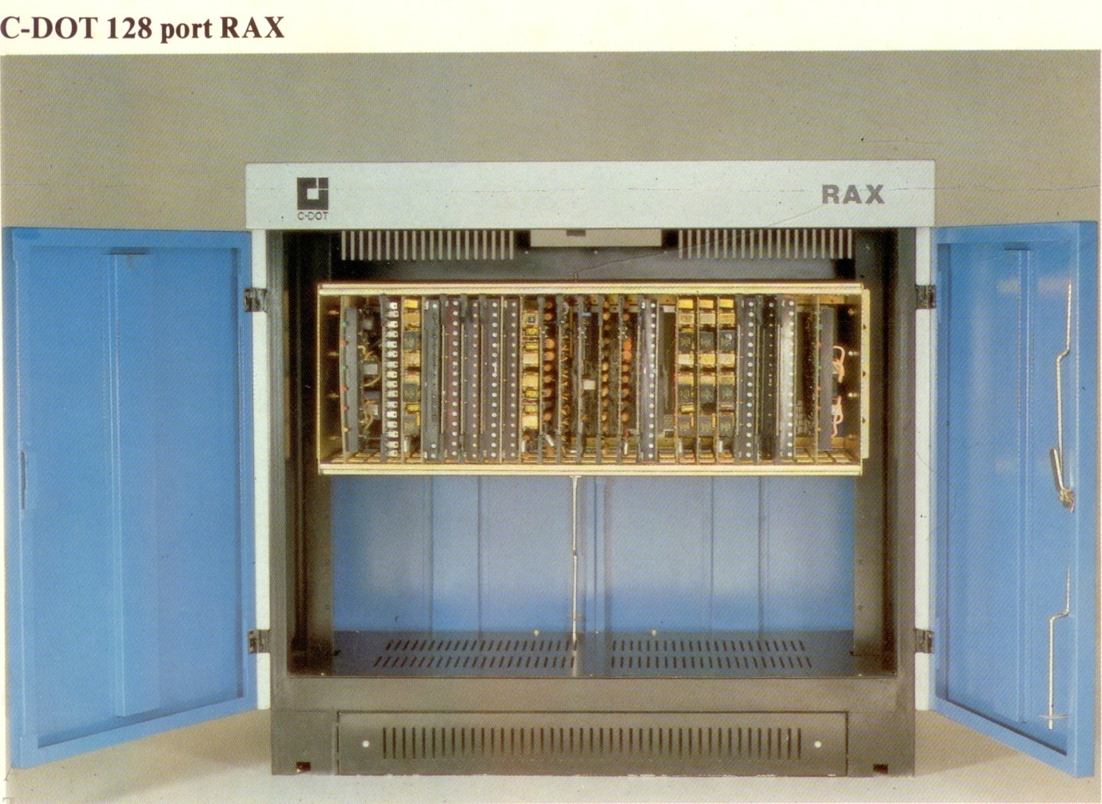

Slide 29
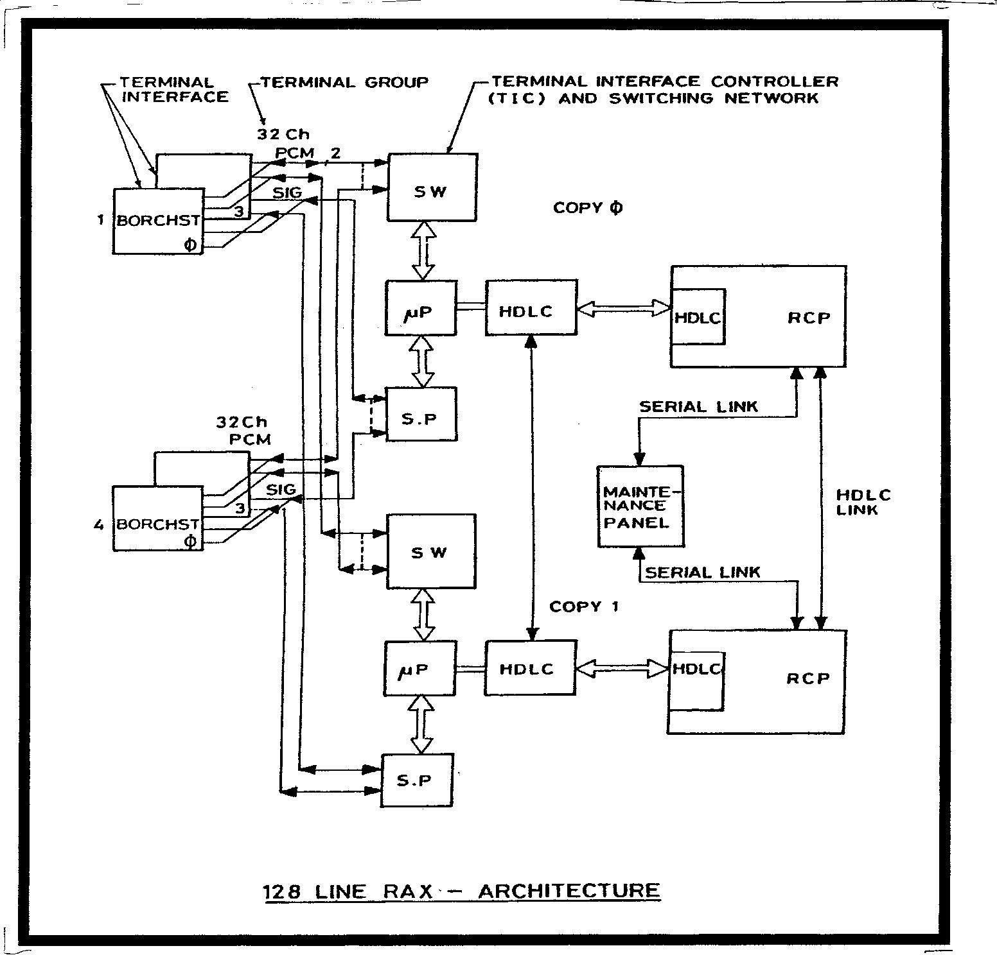

Slide 30
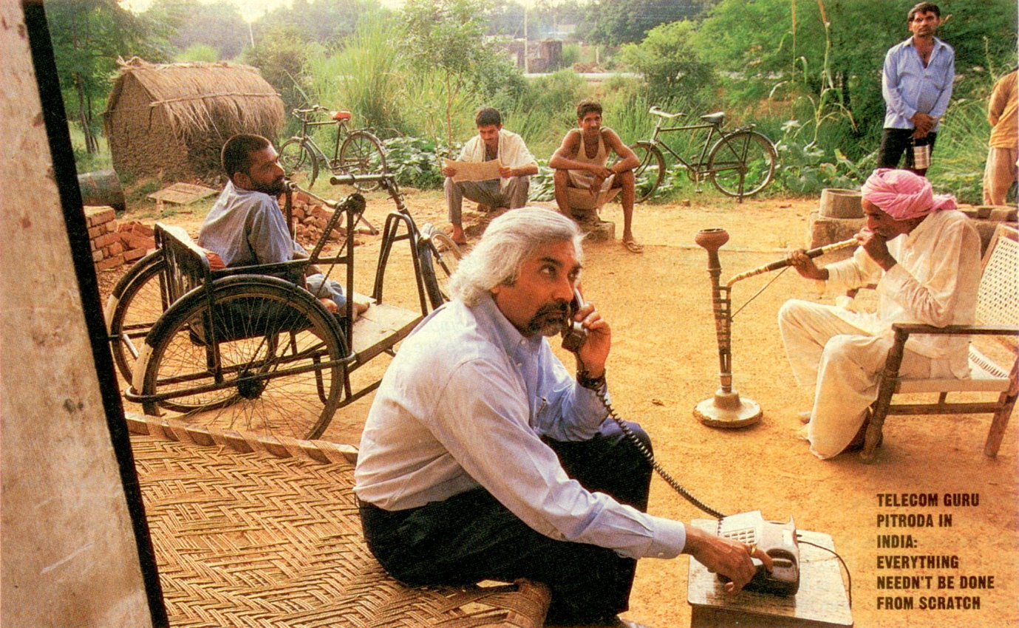

Slide 31
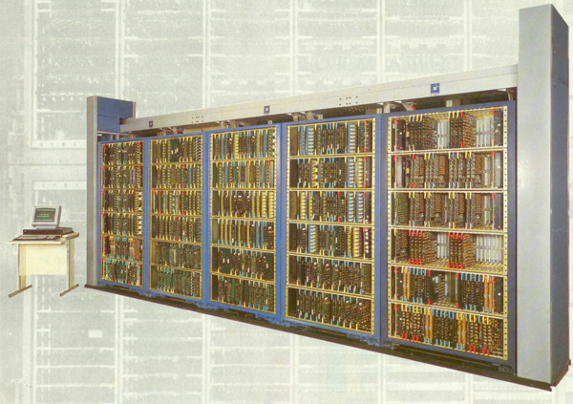

Slide 32
New Developments
IP and Wireless, the key drivers
Transformation of the network architecture
Network centric for multiservice world changes to
Service centric to multiservice world
IEEE Standards dominate over ITU standards

Slide 33
New role of Software
The software defined switch and the software defined network
Softswitch --- Port all the central office software on a powerful platform
A million line switch for a big state ?
Benefit from very low cost fibres and powerful processors
One Service Provider has probably used this model which has resulted in reducing the cost

Slide 34
New Generations of networks
4G and 5G
Larger and larger Bandwidths 100 + Mbps ?
Very Low Latency (old telephony)
Mm Wave and THz transmission

Slide 35
CDOT Impact
Gave confidence. From ‘Can do’ to ‘Will DO’ !
India becomes a Telecom Hub
You can develop complex systems/products with small teams and low investment using the new development tools
A number of entrepreneurs built their own businesses with CDOT technology
Technology is generic. It was used to diversify into new electronics based ventures.

Slide 36
A suggestion for the young generation
Communication Technology has opened vast opportunities for invention and innovation.
If you have any new idea, then please try to develop it yourself. DO NOT take any expert’s advice ! You are the best judge !
Best Wishes !

