Slide 1


Potential of Supercapacitors in Novel Power Converters as Semi-ideal Lossless Voltage Droppers
Thilanga Ariyarathna
Dilini Jayananda
Nihal Kularatna
D. Alistair Steyn-Ross

Slide 2
Comparison of Practical Devices

Slide 3
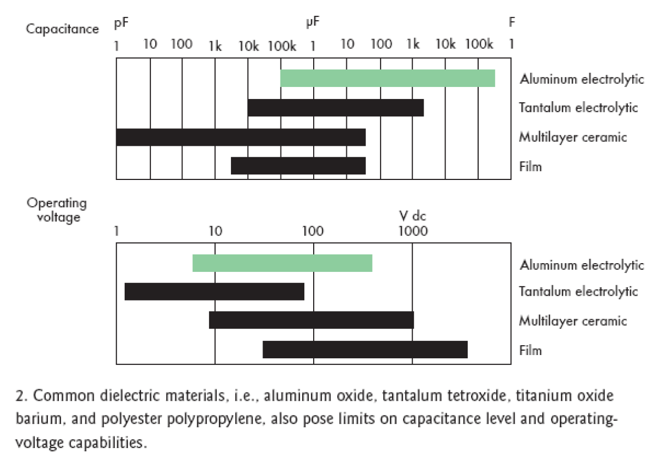
Normal capacitors and their limits
Capacitors Vs Supercapacitors
Physical Comparison of Supercapacitors (SC) and Electrolytic Capacitors
Typically, in SCs we get approximately one million times bigger capacitance, but at the penalty of very low DC voltage rating
Source: Dirjish,.M., Ultracapacitors branch out to wider markets, Electronic Design , On line ed, Nov 17, 2008

Slide 4
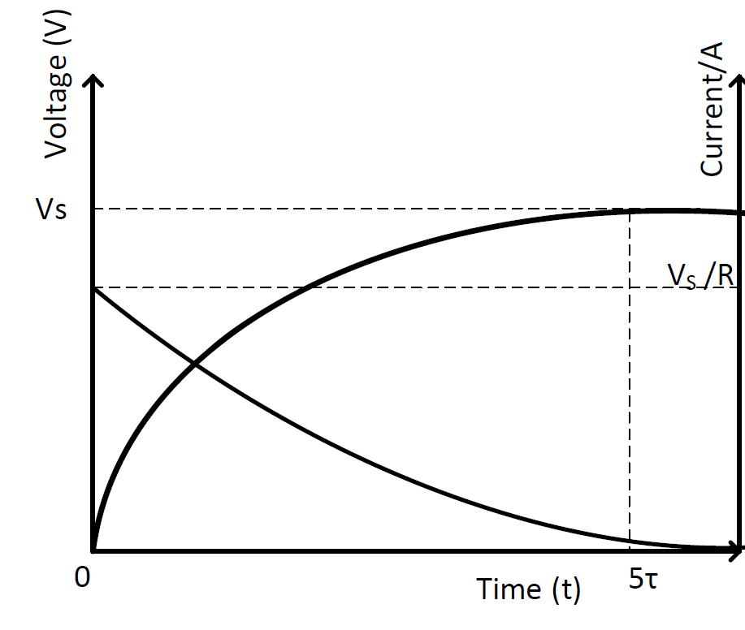
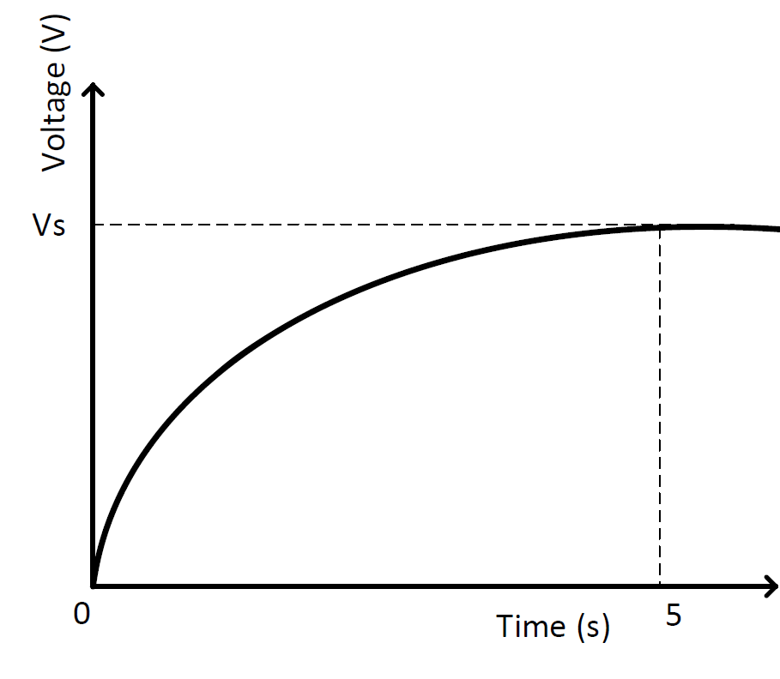
Simple RC Loop
Let us replace C by a SC to 1F
charging time will be 5 sec (previously it was 5 micro-seconds)

Slide 5
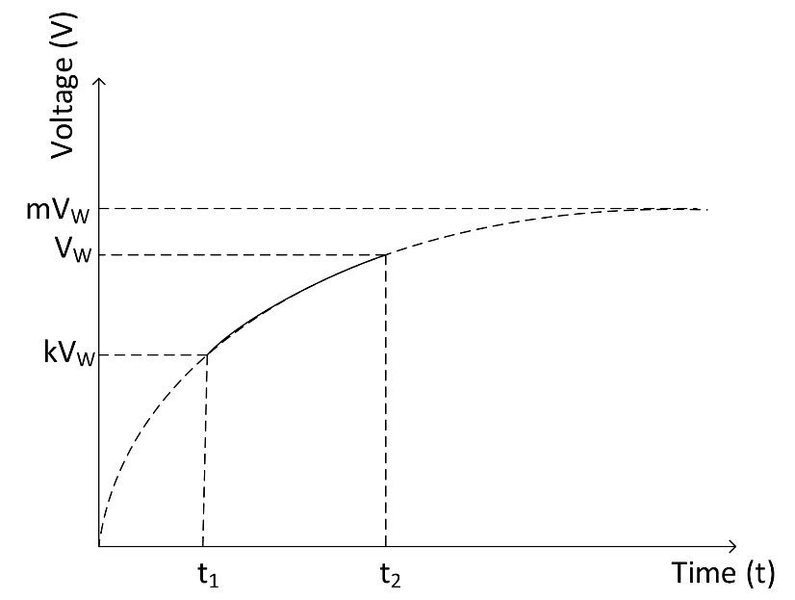
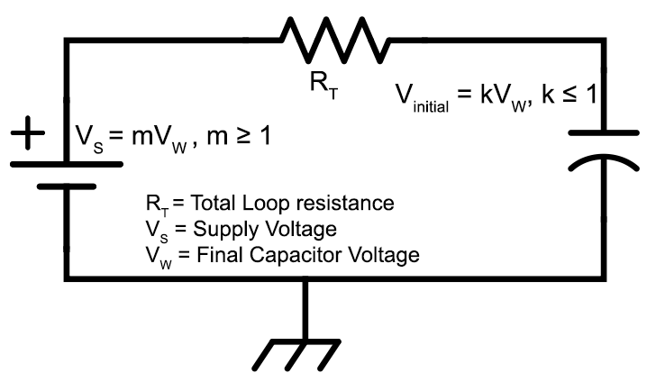
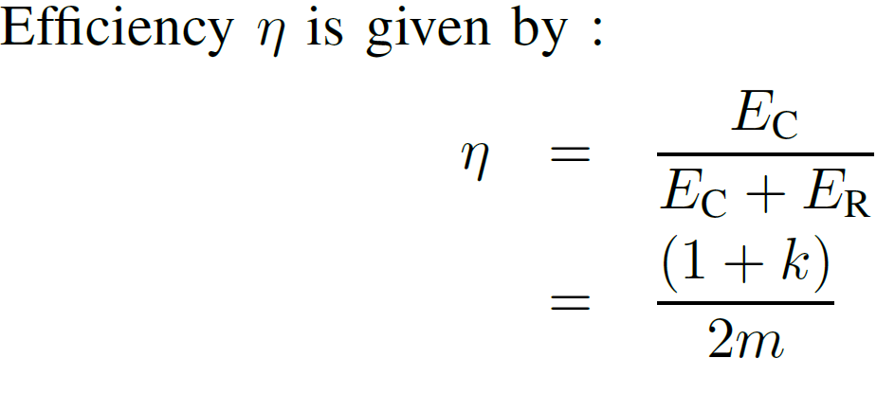
Generalized Case
If a fully discharged capacitor is pumped with a charge of Q coulombs, it stores ½QV while dissipating the same amount of energy in the loop resistance.
SC is pre-charged to kV_{W}
V_{S} is higher than V_{W} by a factor of m

Slide 6
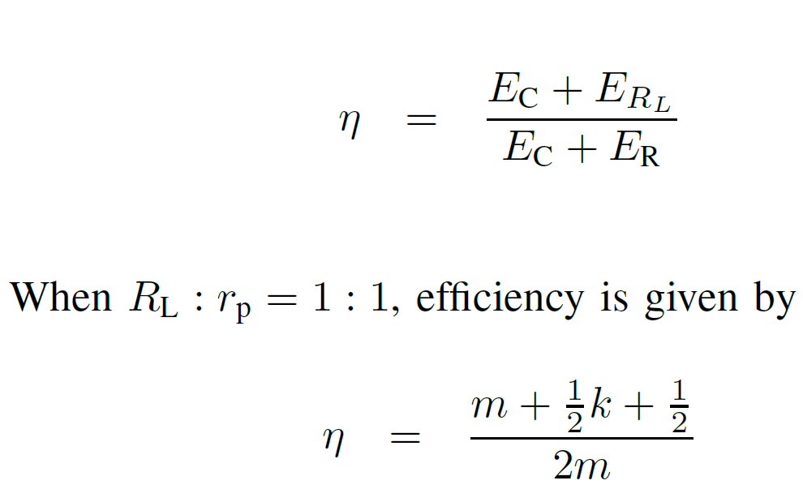
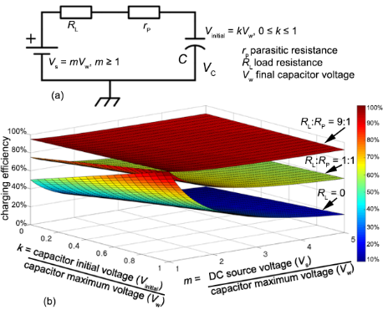
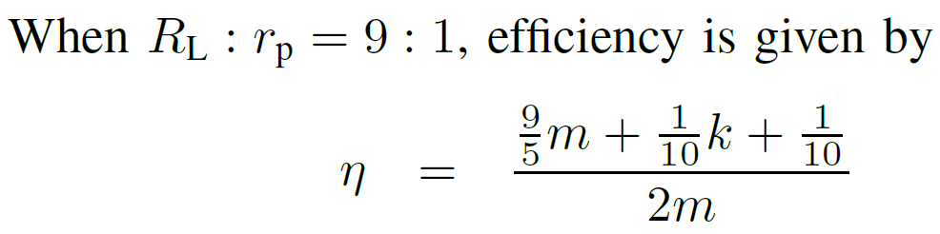
Loss Circumvention of RC Loop
Useful resistance can be a heater, DC-DC converter, inverter or a lamp load

Slide 7
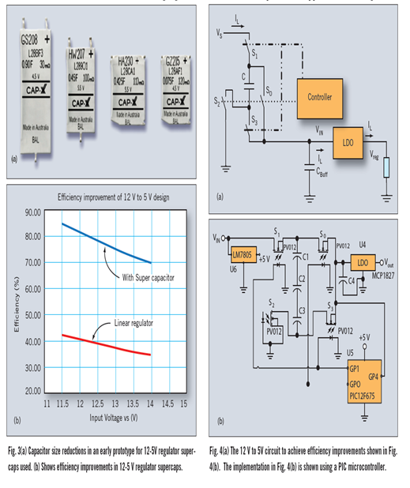
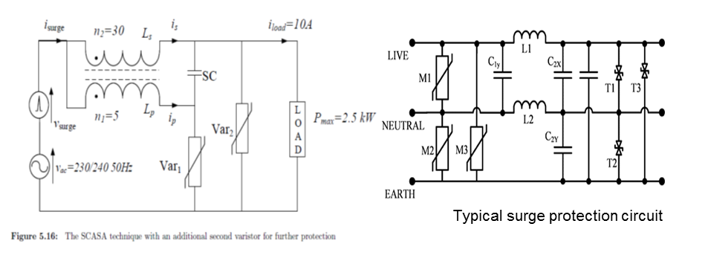
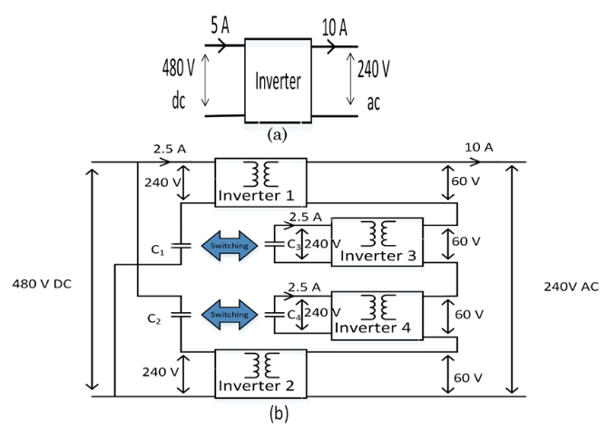
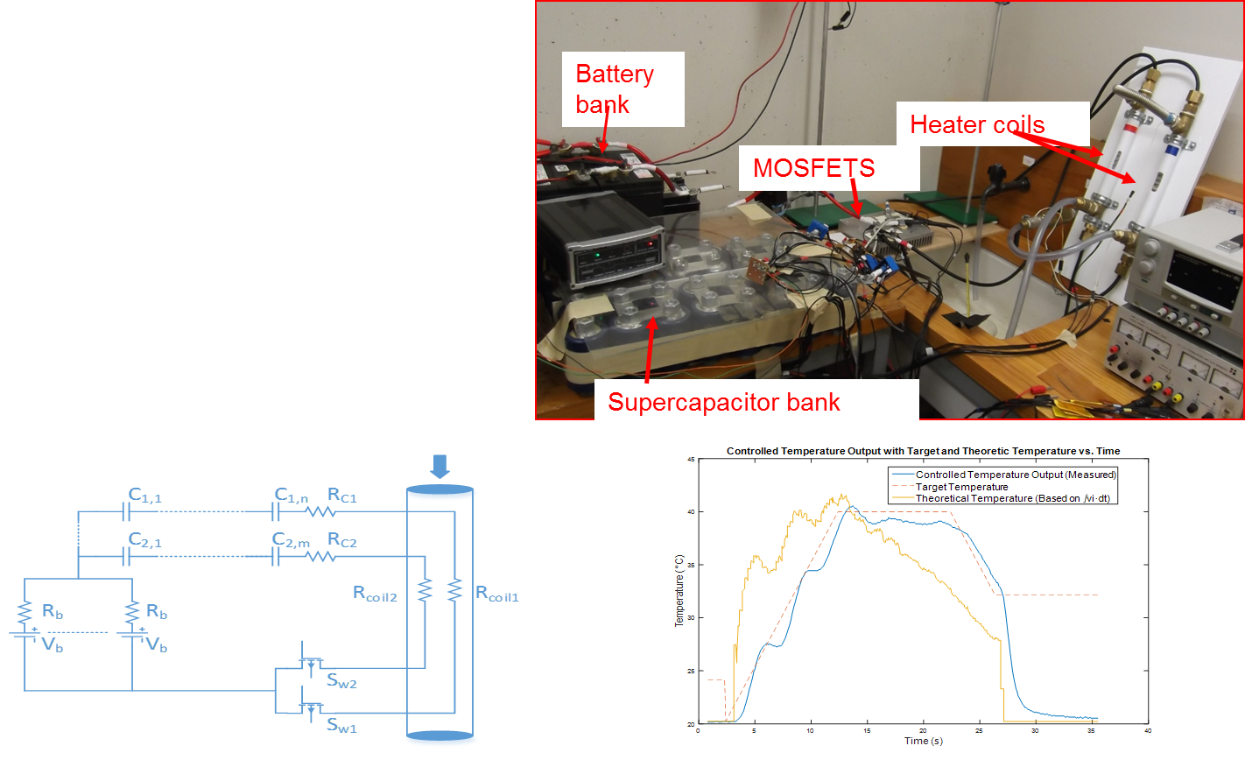
SC Assisted Techniques
SCALDO : low dropout regulator
SCASA : surge absorber
SCAHDI : high density inverter
SCATMA : temperature modification apparatus
SCALED : LED

Slide 8
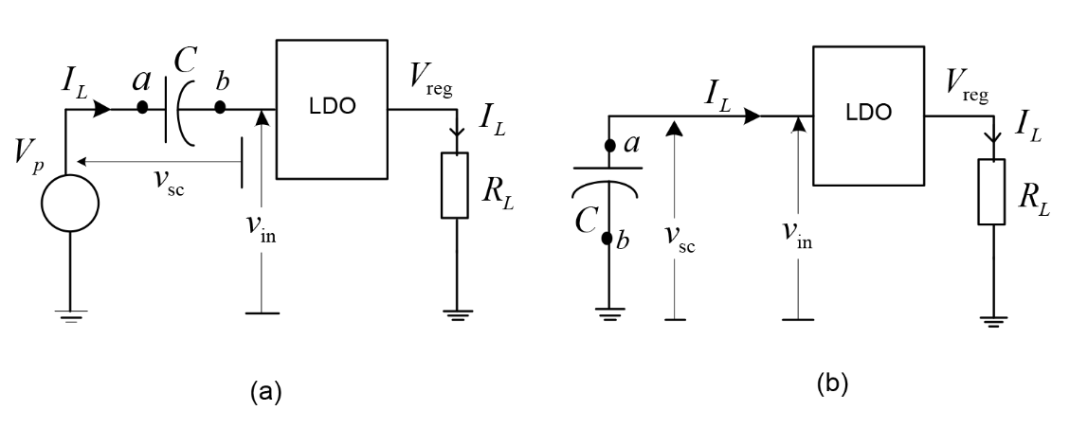
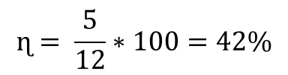
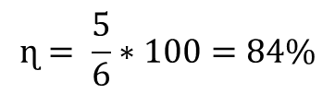
Circumventing the Resistive Losses in a RC Charging Loop: the SCALDO Technique
Useful load
$$ɳ= \frac{5}{12}∗100=42\%$$
Advantages
Load receives the low noise and high current slew rate capable DC output of a linear regulator.
Switching frequency is extremely low
Eliminating typical RFI/ EMI issues
Output currents ranging from mA to over 100 A
Simply achieving DC-UPS capability within the converter
$$ɳ= \frac{5}{6}∗100=84\%$$

Slide 9
Why SCALDO is not a variation of Switched Capacitor Converter
A capacitor does not get directly charged from the input DC source during any phase of a SCALDO converter.
SCALDO runs at extra low frequencies such as Millihertz to Hertz only
In SCALDO a very large capacitor is used in one operational phase, as a semi-ideal lossless voltage dropper, which concept is never used in switched capacitor converters.

Slide 10
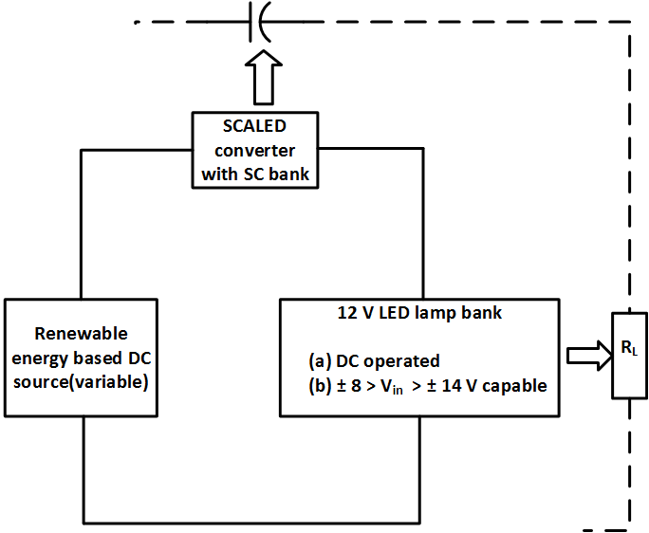
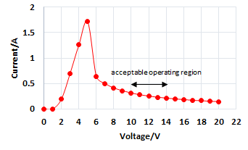
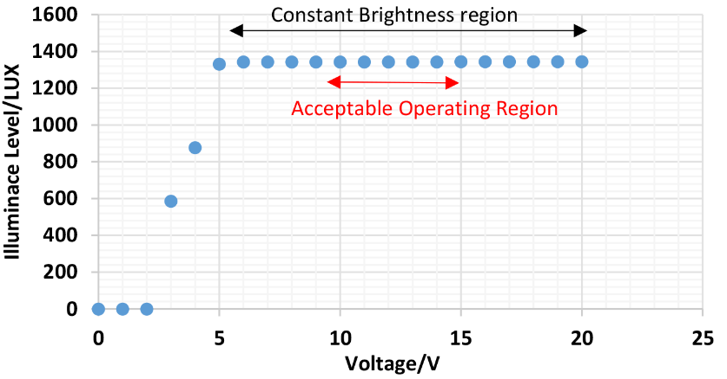
SCALED
SC banks are used for short term energy storage providing DC-UPS capability
Combining a SCALDO type linear regulator to buffer unsafe voltages to low voltage LED lamps
Higher ETEE
No RFI/ EMI issues within the converter system
Potentially a new MMPT approach using the linear regulator in the charging loop
To cater for wider DC - voltage fluctuations of the renewable source

Slide 11

Conclusion
By re- looking at the simple RC loop (a C replaced by a SC), we can come up with a world of new power converters and other power electronic circuit topologies.
SCA Techniques at UOW is a clear example ^{[1]}.
This is only the tip of the iceberg.
[1] Kularatna N, “Supercapacitors improve the performance of Linear Power-Management Circuits”, IEEE Power Electronics Magazine, March 2016, pp.45-59.

Slide 12
Thank you!

