Slide 1
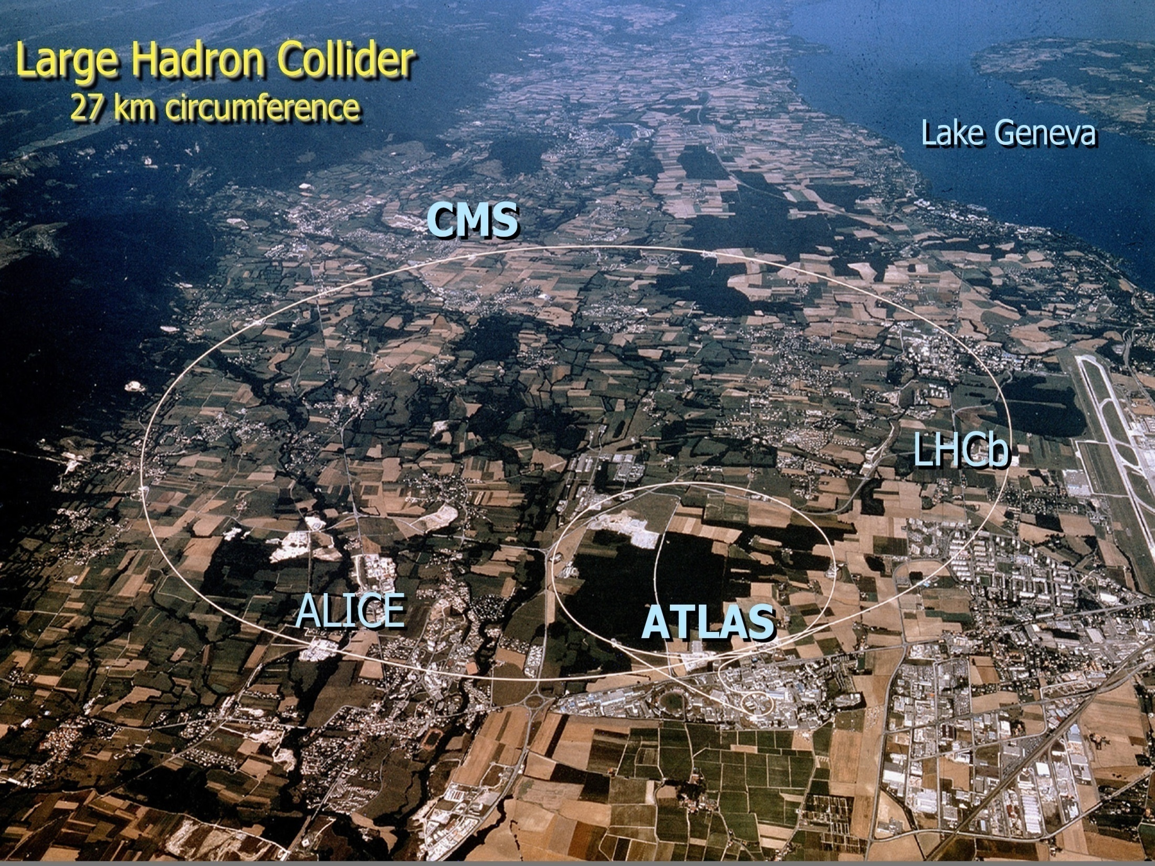
LEVARAGING COLLABORATION FOR INDIAN SCIENCE AND INDUSTRY

Slide 2
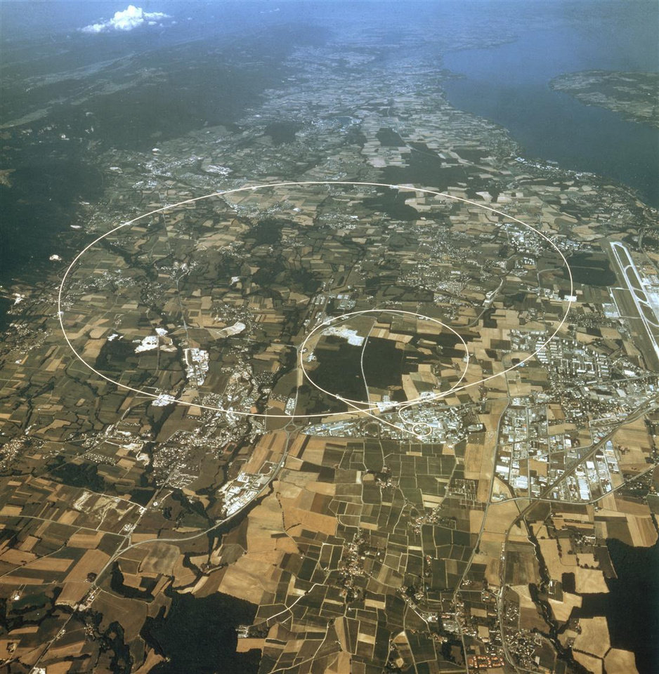
Why collaboration?
How collaborations have facilitated Scientific advancements and finding engineering solutions?
Spin off technologies in pursuing science at extremes?
Learnings from collaborations which will hold us in good stead?
Industry always says “we are here to compete!”, what are we to gain ?
Longevity of mega Science Projects – issues and opportunities?
Looking into the future ... ?

