Slide 1
Exploring the Phase Diagram with Susceptibility Scaling Functions: Epic Voyage or Just Another Bad Trip
Roy A. Lacey
Stony Brook University
Roy.Lacey@Stonybrook.edu

Slide 2

Prof. Rajiv V. Gavai
S. Datta, R. V. Gavai and S. Gupta, QM 2012
We have benefitted immensely from your invaluable contributions to science and education via your;
  Hard work
  Scientific creativity
  Scientific innovations
  Bold and creative proposals
  Well written & clear manuscripts
You will always be remembered for your accomplishments. Thank you for your years of hard work and dedication to our field of research, and congrats on your “retirement”!

Slide 3
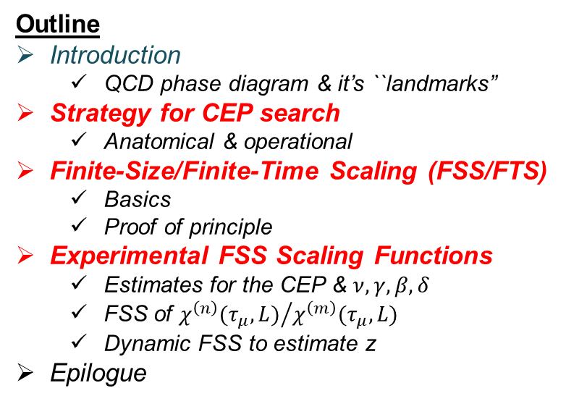
Exploring the Phase Diagram with Susceptibility Scaling Functions: Epic Voyage or Just Another Bad Trip
Roy A. Lacey
Stony Brook University
Roy.Lacey@Stonybrook.edu
Outline
Introduction
  QCD phase diagram & it’s ``landmarks”
Strategy for CEP search
  Anatomical & operational
Finite-Size/Finite-Time Scaling (FSS/FTS)
  Basics
  Proof of principle
Experimental FSS Scaling Functions
  Estimates for the CEP & $ν, γ, β, δ$
  FSS of ${χ^{\left(n\right)}(τ_{μ},L)}/{χ^{\left(m\right)}(τ_{μ},L)}$
  Dynamic FSS to estimate z
Epilogue
Takeaway messages;
  The critical end point (CEP) exists and is characterizable
  Several measurements give hints for characterization of the CEP;
    Viscous attenuation of flow
    Critical fluctuations of net-protons
    Compressibility via femtoscopic measurements
  Finite-Size Susceptibility Scaling functions are essential for identification and characterization of the CEP

Slide 4
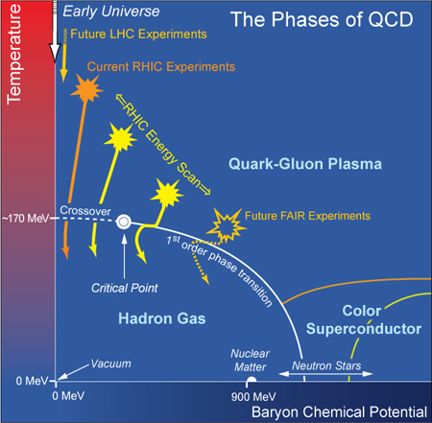
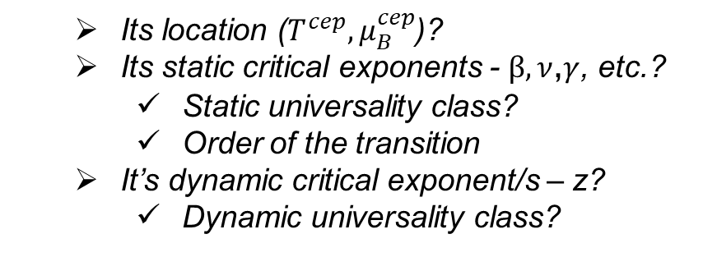

QCD Phase Diagram
Quantitative study of the QCD phase diagram is a major focus of our field
$$m_{s}>m_{s}^{crit}>m_{u,d}$$
If the CEP exists, what is;
  Its location ($T^{cep}{, μ}_{B}^{cep}$)?
  Its static critical exponents - $β,ν$,$γ$, etc.?
    Static universality class?
    Order of the transition
  It’s dynamic critical exponent/s – z?
    Dynamic universality class?
M. A. Halasz, et. al.
Phys. Rev. D 58, 096007 (1998)
All are required to fully characterize the CEP!

Slide 5
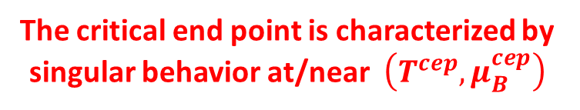

Exploration strategy - Anatomical(
The critical end point is characterized by singular behavior at/near $\left(T^{cep}, μ_{B}^{cep}\right)$
J. Cleymans et al., Phys. Rev. C73, 034905
Andronic et al., Acta. Phys.Polon. B40, 1005 (2009)
3D-Ising Universality Class
If reaction trajectories pass through the critical region, it can;
Influence baryon number susceptibility and the associated critical fluctuations
  The freezeout and the critical region should not be too far apart
Influence baryon number susceptibility and the associated expansion dynamics
  The freezeout and the critical region do not have to be similarly close
Vary the beam energy ($\sqrt{s_{NN}}$ ) to explore the (${T, μ}_{B}$)-plane for anomalous transitions which signal the CEP

Slide 6

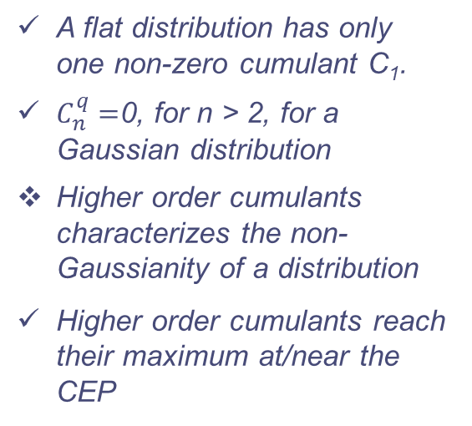





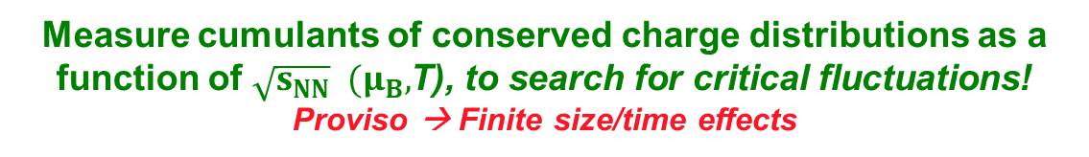



Exploration strategy – Critical fluctuations
Anomalous transitions near the CEP lead to critical fluctuations of the conserved charges (q = Q, B, S)
Cumulants often used to
Characterize distribution
The moments of these distributions grow as powers of
$$C_{1}^{q}=\left\langle N\right\rangle$$
$$C_{2}^{q}=\left\langle {\left(δN\right)}^{2}\right\rangle$$
$$C_{3}^{q}=\left\langle {\left(δN\right)}^{3}\right\rangle$$
$$δN=\left(N−\left\langle N\right\rangle \right)$$
$$C_{4}^{q}=\left\langle {\left(δN\right)}^{4}\right\rangle −{\left\langle {\left(δN\right)}^{2}\right\rangle }^{2}$$
Stephanov, Rajagopal, Shuryak, PRL.81, 4816 (98)
A flat distribution has only one non-zero cumulant C₁.
$C_{n}^{q}=$0, for n > 2, for a Gaussian distribution
Higher order cumulants characterizes the non-Gaussianity of a distribution
Higher order cumulants reach their maximum at/near the CEP
$${M=C}_{1}^{B}$$
$${σ^{2}=C}_{2}^{B}$$
$${S=\frac{C_{3}^{B}}{{\left(σ^{2}\right)}^{3/2}}}_{}^{}$$
$${κ=\frac{C_{4}^{B}}{{\left(σ^{2}\right)}^{2}}}_{}^{}$$
**Fluctuations can be
expressed as a ratio
of susceptibilities**
Measure cumulants of conserved charge distributions as a function of $\sqrt{s_{NN}} (μ_{B},$T), to search for critical fluctuations!
Proviso → Finite size/time effects

Slide 7

Exploration strategy – Critical fluctuations
$$κ_{T}^{}∝\frac{\left\langle N^{2}\right\rangle −{\left\langle N\right\rangle }^{2}}{\left\langle N\right\rangle }=\frac{C_{2}}{C_{1}}$$
Non-monotonic patterns for cumulants or susceptibility ratios could signal the CEP
Dependence on reaction trajectory
The freezeout and the critical region should not be too far apart
Holographic QCD phase diagram with critical point
The singular contributions to baryon number susceptibility ratios are universal features for phase transitions and the existence of the CEP!
Proviso → Finite size/time effects

Slide 8
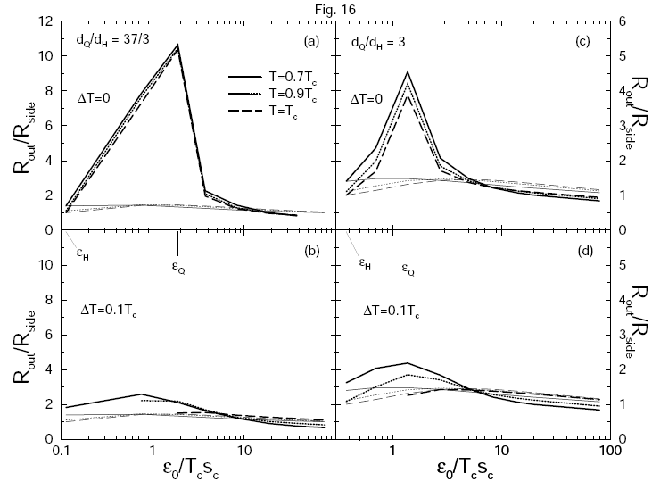
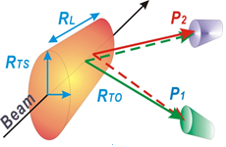
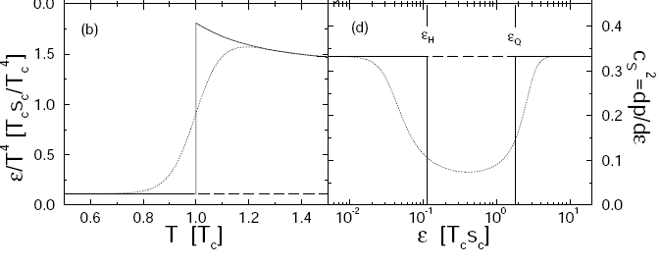
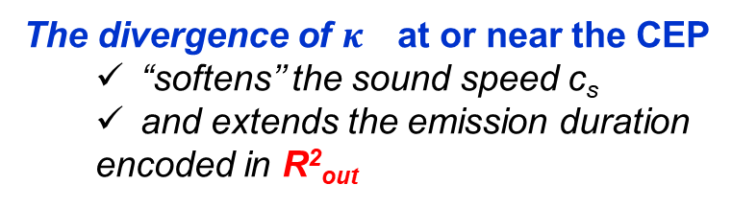




Exploration strategy - Dynamics
Dirk Rischke and Miklos Gyulassy
Nucl.Phys.A608:479-512,1996
The radii of the “fireball” encode
space-time information related to
the expansion dynamics
$H_{2}$O
$c_{s}^{2}=\frac{1}{ρκ_{s}}$
$$\frac{κ_{s}}{κ_{T}}=\frac{c_{V}}{c_{P}}$$
The divergence of $κ_{}$at or near the CEP
  “softens’’ the sound speed c_{s}
  and extends the emission duration
  encoded in R²_{out}
Compressibility, which influences the expansion dynamics, shows a power law divergences at/near the CEP –> influence?
  The freezeout and the critical region do not have to be close
(R²_{out} - R²_{side}) sensitive to $κ_{}$
Measure (R²_{out} - R²_{side}) as a function of $\sqrt{s_{NN}} [μ_{B}, T]$, to search for non-monotonic signature signaling the CEP!
Proviso → Finite size/time effects

Slide 9
Finite-Size effects strongly influence characterization of the CEP
Collision systems are small and short-lived!
Significant signal attenuation
Shifts the CEP to a new pseudocritical point
Finite-size effects on the sixth order cumulant
-- 3D Ising model
E. Fraga et. al.
J. Phys.G 38:085101, 2011
Pan Xue et al arXiv:1604.06858
Displacement of pseudo-CEP & pseudo-first-order transition lines due to finite-size
FSE on temp
dependence
of minimum
~ L^{2.5n}
A flawless measurement, sensitive to FSE, cannot locate and characterize the CEP directly

Slide 10
Basics of the Finite-Size Effect
Illustration
large L
T > T_{c}
small L
L characterizes the system size
T close to T_{c}
note change in peak heights,
positions & widths
→ The curse of Finite-Size Effects (FSE)
In addition to signal attenuation, only a pseudo-critical point (shifted from the genuine CEP) can be observed!

Slide 11

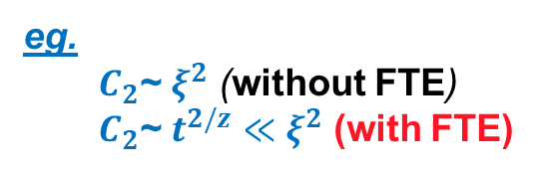
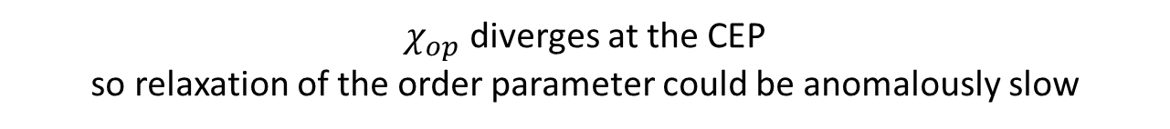

Basics of the Finite-Time Effect
$χ_{op}$ diverges at the CEP
so relaxation of the order parameter could be anomalously slow
z is the dynamic
critical exponent
Consequence
$$t_{eq}\sim ξ^{z}≡τ^{−νz}$$
$$ξ_{}\sim t^{1/z}$$
Non-linear dynamics →
Multiple slow modes
z_{T} ~ 3, z_{v} ~ 2, z_{s} ~ -0.8
z_{s} < 0 - Critical speeding up
z > 0 - Critical slowing down
Y. Minami - Phys.Rev. D83 (2011) 094019
Significant signal attenuation for
short-lived processes
with z_{T} ~ 3 or z_{v} ~ 2
eg.
  $C_{2}$~ $ξ^{2}$ (without FTE)
  $C_{2}$~ $t^{2/z}$ $≪$ $ξ^{2}$ (with FTE)
**Note that observables driven by thermoacoustic
coupling would not be similarly affected**
FTE complicate the search for the CEP in short-lived systems.
FTE is influenced by L and could depend on the specific observable
    associated z

Slide 12
Anatomy of search strategy - Summary
Inconvenient truths:
  Finite-size and finite-time effects complicate the search for the CEP, as well as its characterization.
    They impose non-negligible constraints on the growth of ξ.
  The observation of a non-monotonic experimental signature, while instructive, would not be sufficient to identify and characterize the CEP.
    One should not associate the onset of non-monotonic CEP-driven signatures with the actual location of the CEP.
Solution?
Leverage susceptibility scaling functions to locate and characterize the CEP
  This is an excellent experimental approach to characterize the CEP!

Slide 13
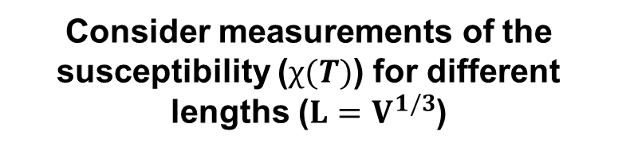
Finite-Size effects can aid characterization of the CEP
Finite-size effects lead to characteristic dependencies of the peak heights, widths & positions on L, which
scale with the critical exponents.
Consider measurements of the
susceptibility ($χ(T)$) for different
lengths ($L=V^{1/3}$)
Scaling Function
M. Suzuki, Prog. Theor. Phys. 58, 1142, 1977
Data collapse onto a single curve, confirms the expected non-singular scaling function
The scaling of these dependencies give access to the CEP’s location, critical exponents and a non-singular scaling function.

Slide 14
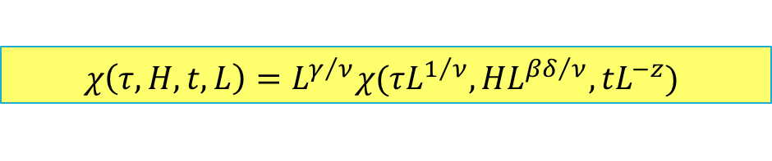

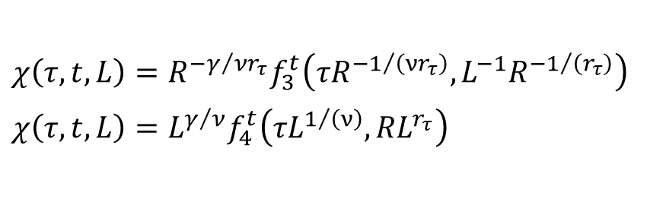
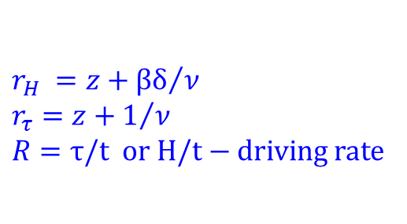


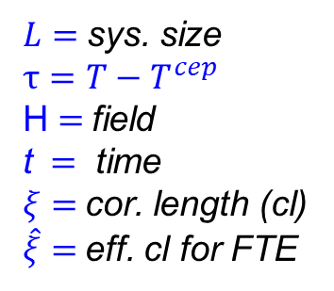
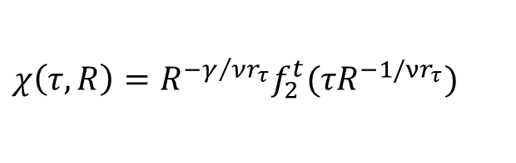
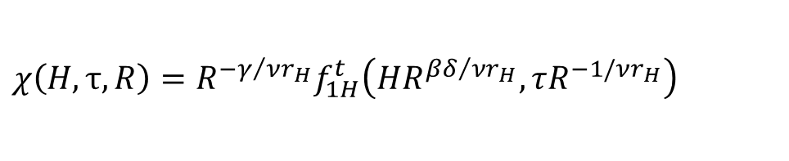
Finite-Time-Scaling (FSS) - Anatomical(
$L=$sys. size
$$τ=T−T^{cep}$$
H $=$field
t $=$ time
$ξ=$cor. length (cl)
$\hat{ξ}=$eff. cl for FTE
Generalized Finite-Size-Finite-Time Scaling form for $χ$
$$χ\left(τ,H, t,L\right)=L^{γ/ν}χ(τL^{1/ν},HL^{{βδ}/ν},tL^{−z})$$
Finite-Time Scaling
In finite-time scaling there is a driving of rate R, that imposes a finite controllable time-scale on the system, that restricts its natural evolution and thus its scaling
$$ξ>L>\hat{ξ}$$
Field driving
$$χ\left(H, τ, R\right)=R^{{−γ}/{νr_{H}}}f_{1H}^{t}\left({HR}^{{βδ}/{νr_{H}}},τR^{−1/νr_{H}}\right)$$
$$r_{H} =z+{βδ}/ν \\ r_{τ}=z+1/ν$$
$$R=\text{τ}\text{/}\text{t} \text{or} \text{H}\text{/}\text{t}\text{ − }\text{driving} \text{rate}$$
Temperature driving
$$χ\left(τ,R\right)=R^{−γ/{νr_{τ}}}f_{2}^{t}(τR^{−1/νr_{τ}})$$
Finite-Time-Finite-Size (Temp. driving)
$R_{KZ}\left(L\right)=L^{−r_{τ}}$ for $\hat{ξ}$ at frozen $\hat{τ}$
$$χ\left(τ,t, L\right)=R^{−γ/{νr_{τ}}}f_{3}^{t}\left(τR^{−1/{\left(νr_{τ}\right)}}, L^{−1}R^{−1/{\left(r_{τ}\right)}}\right)$$
$$χ\left(τ,t, L\right)=L^{γ/ν}f_{4}^{t}\left(τL^{1/{\left(ν\right)}}, {RL}^{r_{τ}}\right)$$
Non Equilb. for ${R> R}_{KZ}\left(L\right)$
An observation of Finite-Time Scaling of susceptibility measurements would give access to the CEP’s location and the critical exponents (static & dynamic)

Slide 15
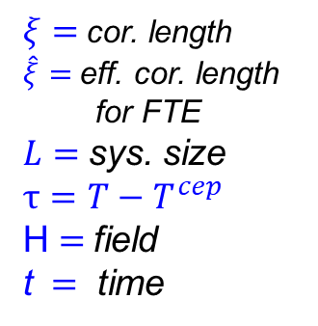
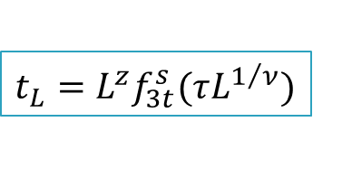
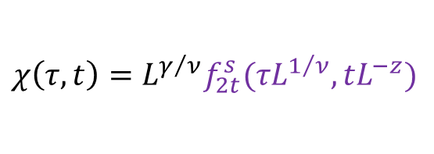
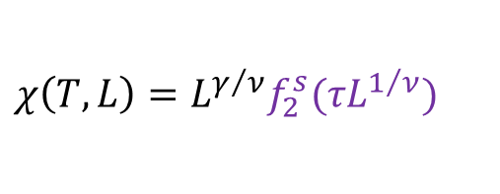
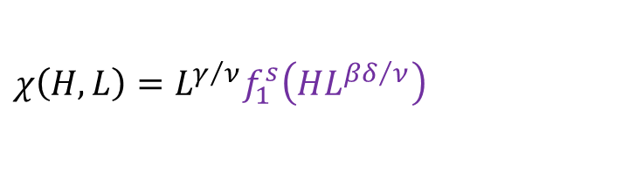

Finite-Size-Scaling (FSS) - Anatomical(
Generalized Finite-Size-Finite-Time Scaling form for $χ$
$$χ\left(τ,H, t,L\right)=L^{γ/ν}χ(τL^{1/ν},HL^{{βδ}/ν},tL^{−z})$$
$ξ=$cor. length
$\hat{ξ}=$eff. cor. length
for FTE
$L=$sys. size
$$τ=T−T^{cep}$$
H $=$field
t $=$ time
Finite-Size Scaling
For $ξ>\hat{ξ}>L$
$$χ\left(H, L\right)=L^{γ/ν}f_{1}^{s}\left(HL^{{βδ}/ν}\right)$$
$$χ\left(τ, t\right)=L^{γ/ν}f_{2t}^{s}(τL^{1/ν},tL^{−z})$$
dynamic finite-size scaling form for the correlation time
$$χ\left(T,L\right)=L^{γ/ν}f_{2}^{s}(τL^{1/ν})$$
$${t_{L}=L}^{z}f_{3t}^{s}(τL^{1/ν})$$
An observation of Finite-Size Scaling of susceptibility measurements would give access to the CEP’s location and the critical exponents

Slide 16




Finite-Size Scaling Functions
$$χ(H,L)=L^{γ/ν}P_{χ}({HL}^{βδ/ν})$$
$$χ^{}$$
$${χL}^{−γ/ν}$$
$${HL}^{βδ/ν}$$
Finite-Size Scaling functions validate the CEP’s location and the associated critical exponents.

Slide 17
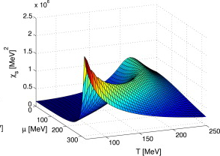




FSS - Proof of Principle
E. Fraga et. al. J. Phys.G 38:085101, 2011
$$τ_{T}=T^{cep}\left(V\right)−T^{cep}\left(∞\right)\sim L^{−1/υ}$$
$$T^{cep}\left(∞\right)$$
$$τ_{μ}=μ^{cep}\left(V\right)−μ^{cep}\left(∞\right)\sim L^{−βδ/υ}$$
Finite Size Scaling confirms the CEP’s infinite-volume location and it’s associated critical exponents.
$$μ^{cep}\left(∞\right)$$
Apply similar idea to data?

Slide 18
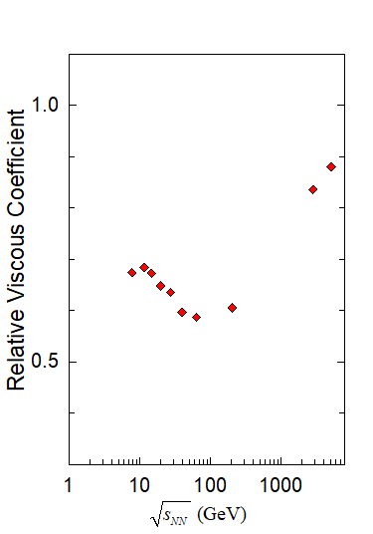
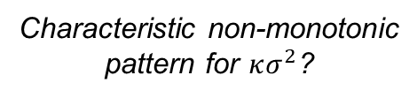
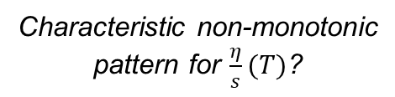
Experimental hints for the CEP
Au+Au & Pb+Pb
10-40%
Au+Au
large L
small L
Characteristic non-monotonic
pattern for $\frac{η}{s}(T)$?
Characteristic non-monotonic
pattern for $κσ^{2}$?
Non-monotonic signatures signaling the CEP and the influence of Finite Size effects?

Slide 19



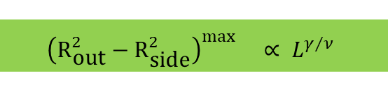

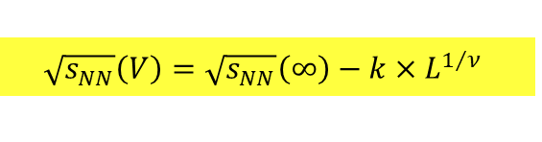


$$Finite Size Scaling of the Succeptiblity proxy$$
Phys.Rev.Lett. 114 (2015) no.14, 142301
$$\sqrt{s_{NN}}\left(V\right)=\sqrt{s_{NN}}\left(∞\right)−k×L^{1/ν}$$
$${\left(R_{\text{out}}^{2}−R_{\text{side}}^{2}\right)}^{\max{}}∝ L^{γ/ν}$$
$$\bar{R}≡L$$
$$\sqrt{s_{NN}}\left(∞\right)\sim{48.0} \text{GeV}$$
$$T^{cep}\left(∞\right)$$
$$ν\sim{0}.63$$
$\sqrt{s_{NN}}\left(CEP\right)\sim{48.0} \text{GeV}$
The extracted critical exponents ($ν$ and $γ$) validate
    the 3D Ising model (static) universality class
    2nd order phase transition for the CEP

Slide 20



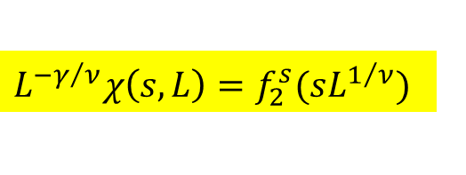
$$Succeptiblity Scaling Function$$
$$L^{{−γ}/ν}χ\left(s,L\right)=f_{2}^{s}(sL^{1/ν})$$
$$\bar{R}≡L$$
s= $\left(\sqrt{s}−\sqrt{s_{CEP}}\right)$/$\sqrt{s_{CEP}}$
Data collapse onto a single curve, confirms the expected non-singular scaling function.

Slide 21
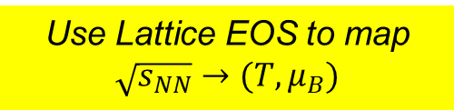

$$Mapping \sqrt{s_{NN}} to ({T, μ}_{B})$$
Karsch et. al
Use Lattice EOS to map $\sqrt{s_{NN}}→(T,μ_{B})$
Note that $\left(μ_{B}^{f}, T^{f}\right)$ is not strongly dependent on L

Slide 22







$$Finite Size Scaling of the Succeptiblity proxy (μ_{B})$$
Karsch et. al
$$τ_{μ}=μ^{cep}\left(V\right)−μ^{cep}\left(∞\right)\sim L^{−βδ/υ}$$
Strong Vol. dependence
$$μ^{cep}\left(∞\right)$$
Mapping $\sqrt{s_{NN}}→(T,μ_{B})$
$\sqrt{s_{NN}}\left(CEP\right)\sim{48.0} \text{GeV}$
$$μ_{B}^{cep}\sim{90} \text{MeV} (V→∞)$$
$$T^{cep}\sim{155} \text{MeV}\text{, }μ_{B}^{cep}\sim{90} \text{MeV} (V→∞)$$
$$δ\sim{4.8}$$
$$β\sim{0}.33$$
Further validation of the CEP and the critical exponents
→ 3D Ising universality class

Slide 23

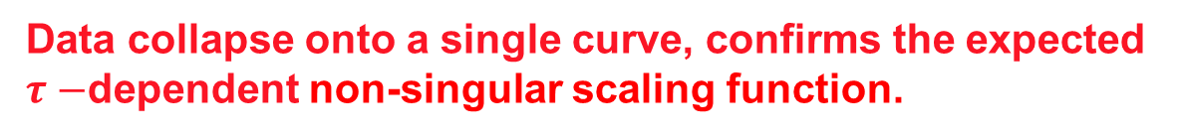

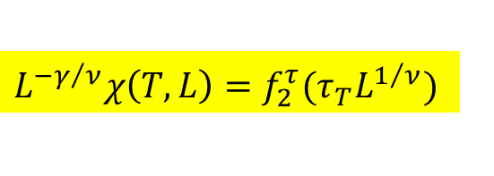
$$Succeptiblity Scaling Function −T$$
$$L^{{−γ}/ν}χ\left(T,L\right)=f_{2}^{τ}(τ_{T}L^{1/ν})$$
Temp
driven
$τ_{T}$= $\left(T−T_{CEP}\right)$/ $T_{CEP}$
Data collapse onto a single curve, confirms the expected $τ−$dependent non-singular scaling function.

Slide 24


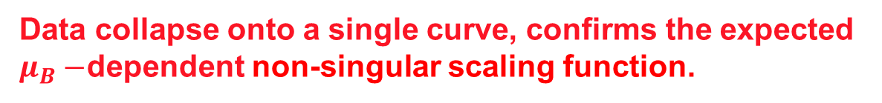

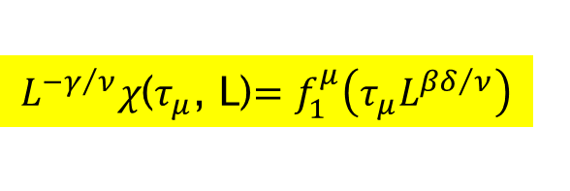
$Succeptiblity Scaling Function$ - $μ_{B}$
$L^{{−γ}/ν}χ$($τ_{μ}$, L)$=f_{1}^{μ}\left(τ_{μ}L^{{βδ}/ν}\right)$
Field
driven
$${ μ}_{B}^{CEP}\sim 90 MeV$$
$τ_{μ}$= $\left(μ−{ μ}_{B}^{CEP}\right)$/${ μ}_{B}^{CEP}$
Data collapse onto a single curve, confirms the expected $μ_{B}−$dependent non-singular scaling function.

Slide 25


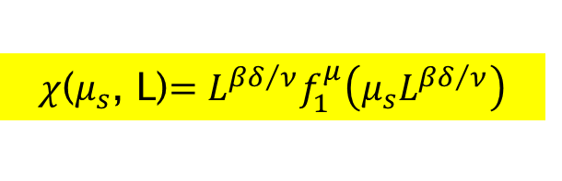
$$Succeptiblity Scaling Function$$
$χ$($μ_{s}$, L)$=L^{{βδ}/ν}f_{1}^{μ}\left(μ_{s}L^{{βδ}/ν}\right)$
Field
driven
$$\bar{R}≡L$$
Use $\sqrt{s}$as a proxy for $μ_{B}$ →${ μ}_{B}^{CEP}\sim 90 MeV$
Data collapse onto a single curve, confirms the expected non-singular scaling function.

Slide 26
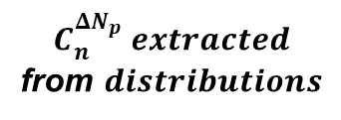
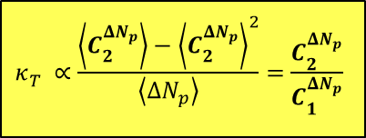
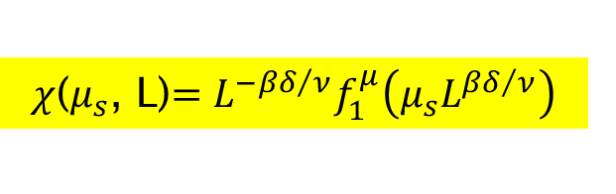
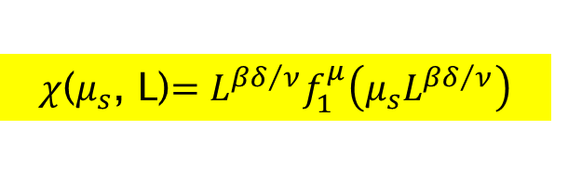
$$C_{n}^{{ΔN}_{p}} extracted$$
from $distributions$
$$Scaling Function for Net baryon Succeptiblity ratio$$
$χ$($μ_{s}$, L)$=L^{{−βδ}/ν}f_{1}^{μ}\left(μ_{s}L^{{βδ}/ν}\right)$
(STAR) Phys.Rev.Lett. 112 (2014) 032302
$χ$($μ_{s}$, L)$=L^{{βδ}/ν}f_{1}^{μ}\left(μ_{s}L^{{βδ}/ν}\right)$
$$κ_{T}^{}∝\frac{\left\langle C_{2}^{{ΔN}_{p}}\right\rangle −{\left\langle C_{2}^{{ΔN}_{p}}\right\rangle }^{2}}{\left\langle {ΔN}_{p}\right\rangle }=\frac{C_{2}^{{ΔN}_{p}}}{C_{1}^{{ΔN}_{p}}}$$
Data collapse onto a single curve, confirms the expected non-singular scaling function.

Slide 27
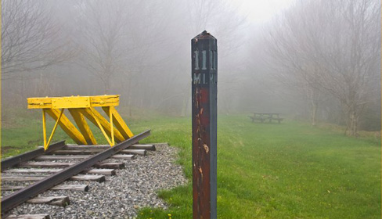
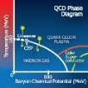



Accomplishment
Strong experimental indication for the CEP and its location
  New Data from RHIC (BES-II) together with theoretical modeling, are essential for sharpening characterization of the CEP and the coexistence regions of the phase diagram
(Dynamic) Finite-Size Scalig analysis
3D Ising Model (static) universality class for CEP
2nd order phase transition
$$β\sim{0}.33$$
$$T^{cep}\sim{155}\text{MeV}\text{, }μ_{B}^{cep}\sim{90} \text{MeV}$$
$$z\sim{0}.87$$
Landmark validated
Crossover validated
Deconfinement
validated
(Static) Universality
class validated
Model H dynamic
Universality class?
Other implications!
Excitation functions for more systems are especially important

Slide 28
End

