Slide 1
ASET Colloquium
Home away Home Centres in India and its impact on treatment of pediatric cancer
Anil Nair
St. Jude India ChildCare Centres
7 February 2020

Slide 2
Current Landscape of Treatment of Pediatric Oncology
A G E N D A
About St. Jude India ChildCare Centres
Scaling Up

Slide 3


In India, other neoplasms and leukemia form the largest types of pediatric cancer
>50% of incidence are other neoplasms, which though treated by Oncologists, are largely benign
Leukemia forms ~one-third of the prevalence pool
Notes: Incidence: Number of new cancer cases added every year; Prevalence: Number of existing cancer cases
Source: Global Burden of Disease- IHME

Slide 4





Cancer prevalence is growing at ~3.5% in India however pediatric cancer prevalence
has seen a slow decline in recent years
Registered prevalence in 15+ age group is increasing at
~4% while prevalence in 0-15 age group is declining
The decline is consistent across <5 and 5-15 years however 15-19 age group is observing marginal growth
1.8
1.7
1.6
1.5
1.3
Notes: Incidence: Number of new cancer cases added every year Prevalence: Number of cancer cases existing at any given point of time (considered at the start of the year in this analysis) Source: Global Burden of Disease- IHME
8

Slide 5






The registered prevalence of pediatric cancer cases is expected to continue to fall in
future owing to shift in age-cohort due to declining birth rates in India
India’s population cohort shifting towards 15+ age
group (expected to be ~75% by 2025)
Registered prevalence is expected to fall to ~120K by 2024
140
132
129
122
118
Note: P- Projected
Source: IHME, Population Pyramid
9

Slide 6

1 Pediatric cancer does not have any specific etiology - developed countries have 2-
3X higher incidence rates compared to India, due to better awareness
R E G I S T E R E D P R E V A L E N C E
Quotes from reports
“…there is up to 50% under reporting of the
diagnosis of AML”
-CMC Vellore
“…nearly 1 in 2 cancer cases are undiagnosed…undiagnosed cases could account for more than half of the total in Africa, South Central Asia and the Pacific Islands”
-Business Standard
“…only 20-30% of cancers are diagnosed in Stages I and II”
-Indian Express
Incidence rates in developed countries are 2-3 times higher than in India
Note: Other neoplasms (containing benign cancers have been excluded)
Source: Global Burden of Disease, IHME; Population pyramid, UN

Slide 7
~70% of children in India are from lower income category (with HH income of <INR
15,000 per month)
2
L O W E R I N C O M E
Number of children/household
 | Low income | High income
Total number of households (in lacs) | 1125 | 1376
Number of children/household | 2.2 | ~1
Total number of children (in lacs) | 2475 | 1376
% of total children | 67% | 33%
“…only 20-30% of the patients can afford to pay for their treatment” - Senior Consultant, Bai Jerbai Hospital
~70-80% of the beds in Govt./funded hospitals are “general” beds
Note: Lower income category: Monthly household income <15k
Source: Census of India 2011, TMH Annual Report 17-18, AIIMS Annual Report 17-18

Slide 8
Diagnosis rate in FY 2024 expected to be ~50% overall
3
D I A G N O S I S
Diagnosis rate in FY 2012 was ~35% (overall, LI~60%)…
…Experts suggest improvement to ~50%
 | TMH, | RCC, | BRAIRCH
 | Mumbai | TVM | , Delhi | Total
New cases of cancer registered ¹ (Low Income, all age- groups) | 23,019 | 14,985 | 9,059 | 47,063
Total cancer incidence in LI ² |  |  |  | 562,500
A. % of LI cancer incidence registered at hospital | 4% | 3% | 2% | 9%
LI Pediatric patients diagnosed ³ | 1,159 | 492 | 655 | 2,306
“…20% patients drop out after first
consultation and 25% after second.”
-Director, Homi Bhaba
“…only 5 out of 10 patients visiting my clinic go for confirmatory tests.”
-Director, Sarvodaya Hospital
“…only 55% patients reach cancer center to get actual diagnosis done.”
-President, Molecular Oncology Society
Projected total LI pediatric diagnosed (assuming same % as A)
25,622
“…typical diagnosis rate in India is 45-55%.”
Diagnosis of pediatric cancer (as % of LI pediatric cancer incidence)
~60%
“Diagnosis rate increases y-o-y due to better awareness and facilities”
-Senior Consultant, Bai Jerbai Hospital
Note: LI= Lower Income category
Source: 1) Annual reports (2012-2013), 2) GBD- IHME, 3) HBCR 2012

Slide 9
Treatment rate in FY 2024 expected to be ~25% overall
4
T R E A T M E N T
~25% of total LI patients seek treatment (~50% of 50%)
Expert opinions
“…only 30% of the patients complete the
treatment.”
-Director, Homi Bhaba
“…only 2 out of 10 patients visiting my clinic actually seek treatment.”
-Director, Sarvodaya Hospital
“…around 25% of the patients drop-off before
starting the treatment.”
-President, Molecular Oncology Society
“…abandonment rate today has been reduced to
20%.”
-Senior Consultant, Bai Jerbai Hospital
 | Total patients diagnosed | Total patients | % Pediatric patients treated
Top 4 Hospitals | (FY 2012) | treated (FY12) | (FY 2012)
TMH, Mumbai | 25,541 | 10,136 | 40%
PGIMER, Chandigarh | 17,182 | 11,136 | 65%
RCC, Trivandrum | 23,206 | 13,544 | 58%
BBCI, Guwahati | 22,562 | 7,882 | 35%
Total | 88,491 | 42,698 | ~50%
Note: LI= Lower Income category
Source: HBCR 2012, Global Burden of Disease, IHME

Slide 10







Huge drop offs across patient continuum; only ~12% of total pediatric cancer cases need to avail of a Home Away Home
Addressable
market
1
Actual Prevalence
2
Registered prevalence*
3
Lower income
4
5
Diagnosis
Treatment
>240,000
50%
120,000
70%
84,000
70%
~60,000
55%
~32,000*
Underdiagnosed cancer cases due to lack of
Economic reasons:
awareness
Cost of logistics
Easier to birth one more child
Cheap and widely spread diagnostic tests lead to relatively high diagnostic rates
Social reasons
Higher number of children in low income households
Lack of education
Lack of
awareness
Major reason for drop-offs is lack of awareness and cost of logistics involved in shifting to a new place for treatment
* Number for FY 2024; Prevalence: Number of cancer cases existing at any given point of time (considered at the start of the year in this analysis); *Registered in cancer hospitals/ clinics/ labs Source: 1), 2), 3) Expert calls
10

Slide 11








The estimated need for FY 2024 is ~32,000 patients….
Will increase to ~44,000 patients if age group 15-19 years considered
Addressable market expected to increase in future due to better diagnosis owing to increased awareness and better access to healthcare centres
32
26
28
Uttar Pradesh and Bihar expected to have maximum cancer patients in coming 5 years
22
23
Top 6 states account for 50% of the total patient pool
Note: P- Projected
Source: IHME, Bain analysis

Slide 12
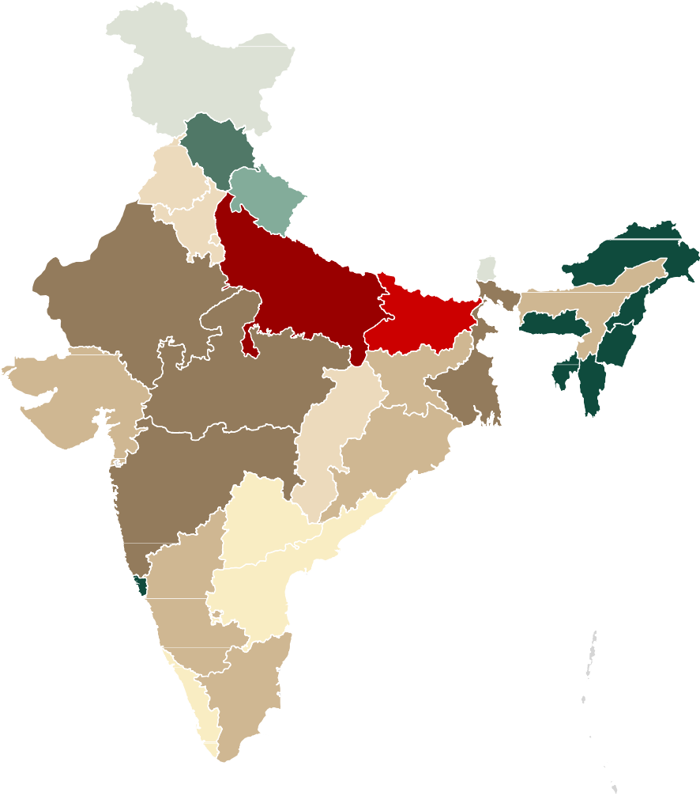
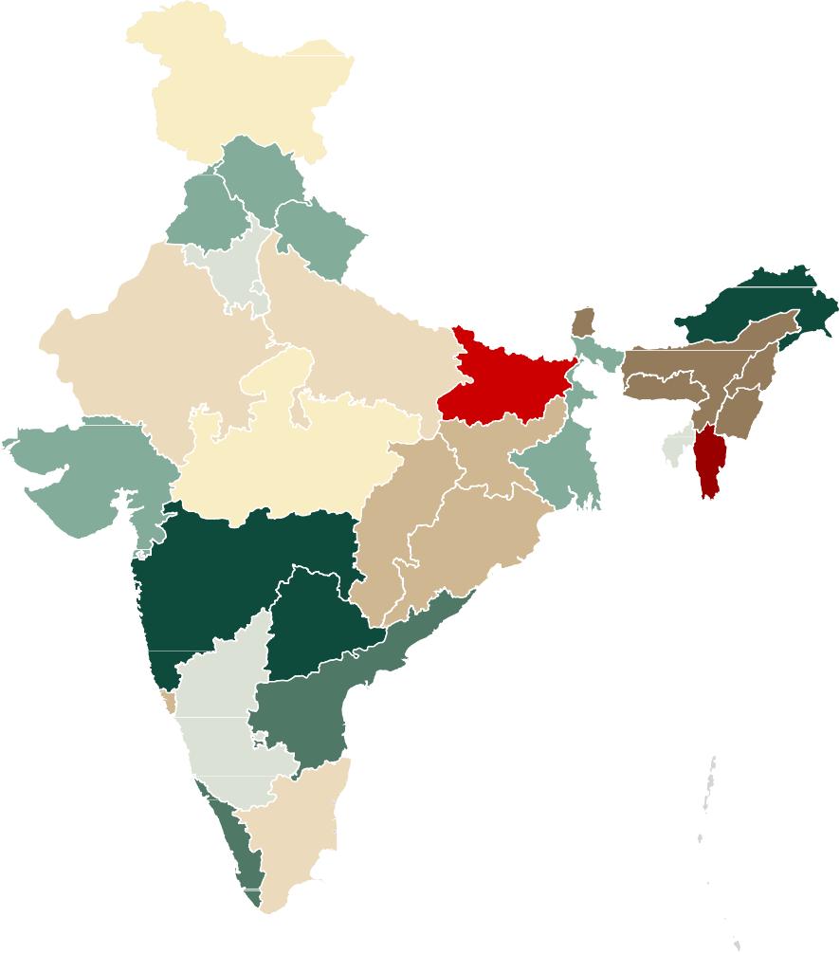
Top 6 states to account for over 50% cases of pediatric cancer cases in 2024;
Incidence rates vary with proportion of children and reporting practices
Prevalence is in line with population size of states
Eastern states have higher incidence rates
Incidence rates of pediatric cancer per 100K of population (2024P)
Prevalence of pediatric
cancer (2024P)
15k-25k | 1.75k-2.25k |  | 5.5-7.0 | 3.2-3.6
10k-15k | 1k-1.75k |  | 5.0-5.5 | 3.0-3.2
5k-10k | 750-1k |  | 4.5-5.0 | 2.0-3.0
3k-5k | 500-750 |  | 4.0-4.5 | 1.5-2.0
2.25k-3k | 0-500 |  | 3.6-4.0 | 0-1.5

Slide 13

In India, patients travel from their home state to seek pediatric cancer care driven by
reputation of the center/WOM, ease of funding and distance from home state
Reputation of the centre Ease of funding
“Doctors in West Bengal refer to southern hospitals due to better reputation of hospitals” – Apollo hospital, Chennai
“…older hospitals have better funding facilities along with NGOs which facilitate the funding towards the needy” – Apollo Hospital, Chennai
“..our hospital saw a two-fold jump in number of patients after getting associated with TMH” – BBCI, Guwahati
“…patients from south don’t migrate because each state has well- developed schemes” – Adyar Cancer Institute, Chennai
“…West Bengal cancer centres have had a very poor reputation since last 10-15 years” – Saroj Gupta Hospital, Kolkata
“…migration is seen from north because most of the units there are private” – TMH
Distance from home town
Capacity at home town
“…we have seen more influx of patients due to opening up of a centre in
Varanasi” - TMH
“ …~half of the children are migrating to different places from UP because
of lack of centres”- Cankids
“…people prefer going to nearest cancer centre” – Adyar Cancer Institute, Chennai
“…people from North migrate because they don’t have many centres there” – Adyar Cancer Institute, Chennai
“…Hospital Out of Pocket Expenditures (HOPE) is a major factor which drives migration” – Apollo Hospital, Chennai
“…central and eastern India have few cancer centres” - TMH
Source: Doctor interviews

Slide 14





Top 10 hospitals account for ~8,500 patient load which is 40% of the patients whose
treatment centers are identified
A
Hospital Name
Region
Bed capacity⁴
Est. Year
Funding
SGCCRI | Saroj Gupta Cancer Centre & Research Institute | Kolkata | 311 | 1973 | 50-70% beds free
KGMU | King George's Medical University | Lucknow | 4000* | 1903 | FF
GCRI | Gujarat Cancer & Research Institute | Ahmedabad | 650 | 1972 | FF (RCC)
MCS | Mahavir Cancer Sansthan | Patna | 400 | 1998 | FF up to 18 years
BBCI | Dr. B. Borooah Cancer Institute | Guwahati | 230 | 1973 | FF
KMIO | Kidwai Memorial Institute of Oncology | Bangalore | 480 | 1957 | FF for BPL, 40- 60% cheaper for others
RCC | Regional Cancer Centre | Trivandrum | 265 | 1980 | FF
PGIMER | Post Graduate Institute of Medical Education and Research | Chandigarh | 1948 | 1962 | FF
BRAIRCH | AIIMS Delhi | Delhi | 200 | 1973 | FF
TMH | Tata Memorial Hospital | Mumbai | 627 | 1941 | FF
Note: 1. ~5K patients are treated in very small private hospitals or small civil/district hospitals 2. Other major hospital includes ~30 hospitals like AIIMS Bhubaneshwar, Safdarjung, Nizam’s Institute, Bhagwan Mahaveer, SCB Cuttack, etc. – Details in Appendix; 3. Minor hospitals includes smaller charitable/private hospitals providing subsidized treatment such as KEM, Nair Hospital in Mumbai Source: Expert calls, secondary research
Note: ⁴ Bed capacity indicates total capacity across all departments
*bed strength across all campuses
Fully funded centres
Partially funded centres

Slide 15


12 major centers catering to low-income category patients expected to
come up in the next 5 years with a capacity to treat ~2,500 patients…
B
N O N E X H A U S T I V E
Sr. no | Name of Center | Location |  | Planned total Capacity (# beds) | Pediatric capacity (number of patients) | Planned completion timeline |  | Funding | Owner/ Management
1 | MPMMCC / HBCH | Varanasi |  | 352 | 500-1000 | TBD |  | Similar to TMH | TMC*
2 | HBCH | Sangrur |  | TBD | TBD | TBD |  | Similar to TMH | TMC*
3 | HBCHRC | Vizag |  | TBD | 300 | TBD |  | Similar to TMH | TMC*
4 | Chittranjan | Kolkata |  | 600 | 100-150 | 2022 |  | Free for BPL | Chittranjan
5 | HCG | Kolkata |  | 200 | 100-150 | 2022 |  | Partially funded | HCG
6 | National Cancer Institute | Jhajjar |  | 710 | TBD | 2020 |  | Fully funded | AIIMS
7 | AIIMS Raebareli | Raebareli |  | 750 | 100-150 | 2020 |  | Fully funded | AIIMS
8 | AIIMS Mangalagiri (Guntur) | Mangalagiri |  | 750 | 100-150 | 2020 |  | Fully funded | AIIMS
9 | AIIMS Nagpur | Nagpur |  | 750 | 100-150 | 2020 |  | Fully funded | AIIMS
10 | AIIMS Gorakhpur | Gorakhpur |  | 750 | 100-150 | 2020 |  | Fully funded | AIIMS
11 | AIIMS Bathinda | Bhatinda |  | 750 | 100-150 | 2020 |  | Fully funded | AIIMS
12 | AIIMS Kalyani | Kalyani |  | 750 | 100-150 | 2020 |  | Fully funded | AIIMS
 |  |  |  | ~6500 | ~2500
Note: *TMC- Tata Memorial Centre- Grant- in- Aid institution under DAE, Govt. of India
Source: Expert calls, secondary research

Slide 16
Current Landscape of Treatment of Pediatric Oncology
A G E N D A
About St. Jude India ChildCare Centres
Scaling Up

Slide 17
About St. Jude India ChildCare Centres

Slide 18
St. Judes aims to bridge the gap between world-class cost effective treatment centres and holistic support necessary for completing cancer treatment successfully.
Every child suffering from cancer, irrespective of economic status, deserves to get the best chance of surviving the disease and leading a full, healthy, happy life. St. Judes provides this chance through its well-established model of cost-free and holistic care during child's treatment.
St. Judes began in 2006 when our founders, Shyama and Nihal Kaviratne, discovered a huge unmet need: lack of safe and hygienic place to stay for families who bring their child diagnosed with cancer to bigger cities from smaller towns, remote villages and other backwards districts for treatment.
1

Slide 19
Our core purpose is to ensure that children suffering from cancer and travelling to cities for cancer treatment have access to:
  A hygienic and safe Place to Stay for the entire duration of treatment which could go upto 24 months
  Cooking facilities with individual stoves for the mothers to cook for the children
  Hygienic environment to ensure their compromised immunity does not lead to infections
  Nutritious Ration replenished every week
  Daily Transport to and from the hospital for treatment
  Teachers to ensure Education, Art, Music, Yoga and other creative activities
  Recreational facilities and Counselling sessions to cope with the stress of treatment
  Skill Development and empowerment programmes for parents
  Follow up and reminder services to ensure treatment is not abandoned

Slide 20
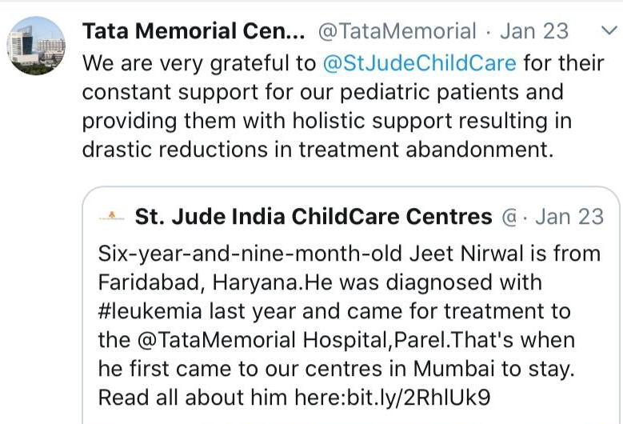
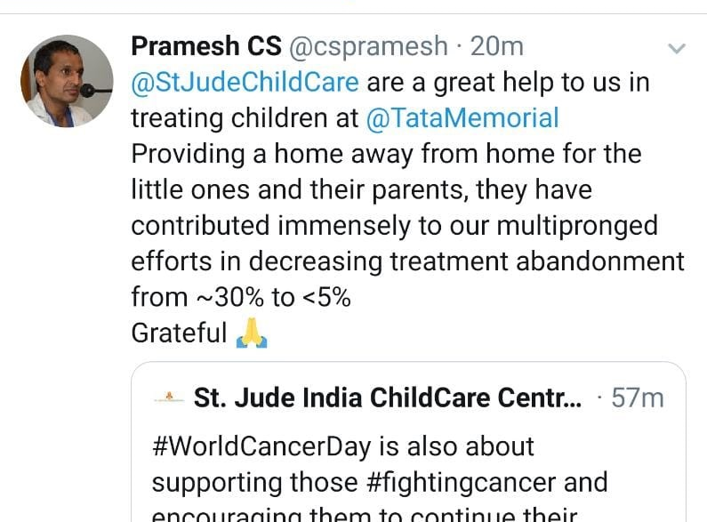
Our greatest impact has been in ensuring that children do not abandon treatment and are less prone to infection during treatment

Slide 21
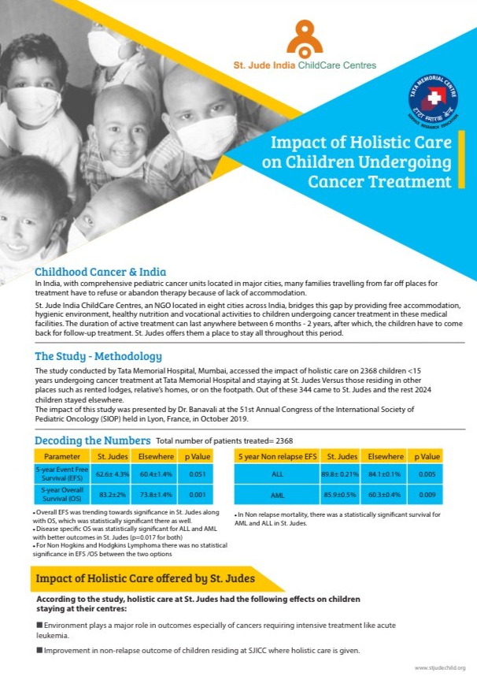
A study by Tata Memorial Hospital concluded children staying at St. Judes have a better survival rate
Dr. Banavali, Director - Academics and Professor of Paediatric and Medical Oncology, Tata Memorial Hospital presented the findings at the 51st Annual Congress of the International Society of Pediatric Oncology (SIOP) held in Lyon, France, in October 2019.

Slide 22

The strongest endorsement of work comes from our partner hospitals…

Slide 23
We are present in 9 cities across India providing shelter to 477 families every day
Over 1922 children stayed with us in the last 12 months.
Our families come from across the country including 31 of the 50 most backward districts identified by the Government of India.
We aim to manage require 1000 units by 2024 providing shelter over 4000 families each year.
We would need to add another 523 units in the next 5 years, of which 222 units will be on stream at the new campus in Kharghar by 2022
City | 2019 | 2024 (Projected)
Mumbai | 225 | 465
Delhi | 42 | 122
Kolkata | 62 | 112
Varanasi | 18 | 50
Vellore | 22 | 48
Guwahati | 24 | 48
Jaipur | 40 | 40
Chennai | 24 | 24
Vishakhapatnam | - | 24
Bengaluru | - | 24
Chandigarh | - | 24
Hyderabad | 20 | 20
Total | 477 | 1001
Children supported in a year | 1922 | 4000

Slide 24
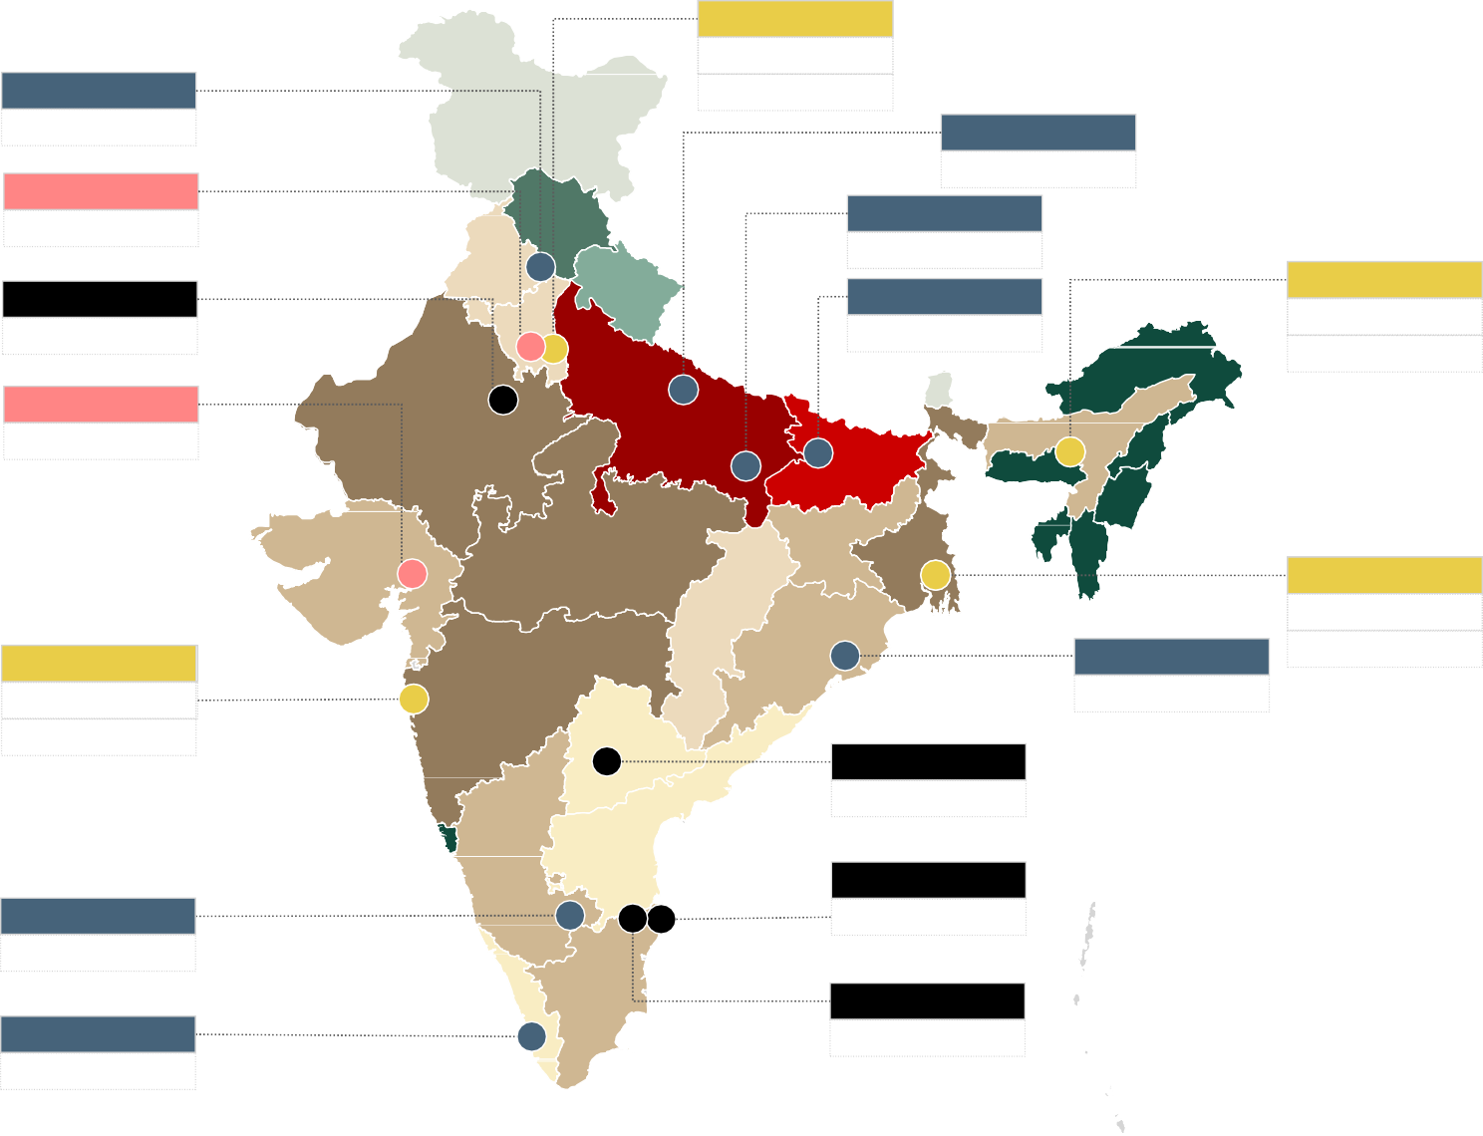
By 2024, St. Judes aims to support 1000 families every day
# Beds in 2019
Delhi 42
160-170
Delhi
# Beds needed in 2024
Chandigarh 35-40
42
Lucknow 30-35
Varanasi 20-25
Patna 30-35
Jhajjar 5-10
Guwahati 24
50-60
Jaipur 40
Guwahati
24
Ahmedabad 15-20
Kolkata 36
120-130
Kolkata
36
Mumbai 225
350-400
Bhubaneshwar 30-35
Mumbai
225
Hyderabad 19
Chennai 24
Pursue opportunistically New centres
Expansion Existing centres
Bangalore 25-30
Vellore 22
Prevalence of pediatric cancer (2024P)
15k-25k
10k-15k
5k-10k
3k-5k
2.25k-3k
Trivandrum 35-40
1.75k-2.25k
1k-1.75k
750-1k
500-750
0-500
Note: Business as usual centers to continue with existing facility in 2024 as well
Source: SJICC data, Bain analysis

Slide 25
Awards & Recognition
India's Top 10 NGOs to Work For and India’s Best Workplaces for Women 2019 – Great Place to Work Institute
GuideStar India Champion Level Platinum Certification (Legal and Financial Compliances)
Highest CRISIL Rating for Voluntary Organisations: 1A
Marico ‘Innovation for India’ Award for the Social Category
‘QIMPRO Gold Standard Healthcare Award
‘Vocational Service Award for Outstanding Service to Humanity’ - Rotary Club of Bombay North.
Americares Spirit of Humanity Award for Excellence in Child Health

Slide 26
St. Judes aims to double our capacity in Mumbai with a new facility in Kharghar
In November 2019, at the invitation of Tata Memorial Hospital (TMH), St. Judes signed an MOU with The Advanced Centre for Treatment, Research & Education in Cancer (ACTREC) the R&D satellite of TMH to set up a 222 unit facility within the campus.
The 60 acre campus at ACTREC will the hub for cancer treatment in South Asia and will have capacity of 900 beds, easing the burden of the over-burdened Tata Memorial Hospital in Parel, besides adding significantly to the existing capacity in the public sector for the treatment of cancer patients.
The proposed St. Judes facility will support over 34,000 persons with shelter, nutrition, counselling and transport facilities over a 20 year period

Slide 27
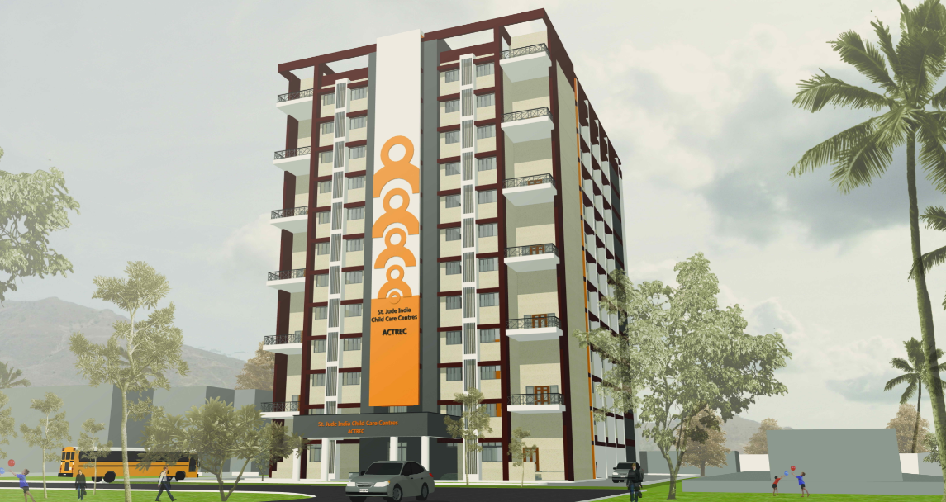
Thank you
Contact : Anil.nair@stjudechild.org | 9871916608

