Slide 1
Probing neutron star physics with heavy-ion collisions and via gravitational waves
Ajit M. Srivastava
Institute of Physics
Bhubaneswar, India

Slide 2
Outline:
1. Interesting phases of QCD: CFL phase, also: nucleon superfluidity
How to probe? Look for superfluid vortices.
Qualitative effects on flow power spectrum. New focus for FAIR, NICA: Very low energy collisions to get nucleon superfluidity
3. Probing these phases with extremely accurate Pulsar observations:
Extreme sensitivity to structure of neutron star
4. Density fluctuations during phase transitions: Change in moment of inertia (MI) and Quadrupole moment Q: Pulsar glitches, Gravitational waves. P. Bagchi, A. Das, B. Layek, AMS, PLB 747, 120 (2015).
5. Next: Use extreme sensitivity of pulsar to external GWs
Pulsars as remotely stationed Weber GW detectors:
Learning about GW sources as well as Pulsar interior properties.
A. Das, S.S. Dave, O. Ganguly, AMS, PLB 791, 167 (2019).
Re-visiting past gravitational wave events via pulsars:
M. Biswal, S. S. Dave, AMS, arXiv:1909.0447
7. Outlook: importance of extra-galactic pulsar observations

Slide 3
Interesting QCD phases at high baryon density:
At ultra-high baryon density – very large chemical potential.
asymptotic freedom makes Perturbative calculations reliable.
One-gluon exchange: quark-quark interaction attractive
in 3* channel
Cooper problem: Any attractive interaction destabilizes Fermi surface
BCS pairing of quarks in 3* channel: Color Superconductivity
Quark Cooper pair: , α,β color, i,j, flavor, a,b spin
Consider most symmetric case: all three flavors masssless
(not unreasonable for very high chemical potential)

Slide 4
Color-Flavor Locked (CFL) phase:
color antisymmetric, spin antisymmetric, flavor antisymmetric:
pairing pattern:
Note: This is invariant under equal and opposite
rotations of color and (vector) flavor:
Leads to following spontaneous symmetry breaking
Color SU(3) spontaneously broken
U(1)_{B} to Z₂ breaking leads to superfluidity
This leads to string defects: Superfluid vortices
This is superfluidity at extremely high baryon densities. However :
At much lower densities also we have a superfluid phase

Slide 5
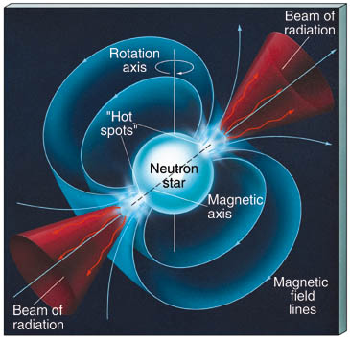
Nucleon superfluidity is believed to exist in the interiors of neutron stars. Strong support from pulsar glitches
Observations:
Pulsars are rapidly Rotating neutron stars,
detected by their periodic pulses (E.M. waves),
Beamed emission from the magnetic poles of the neutron star.
Superfluid phase in the interior allows for vortex lattice to form.
Vortices are pinned at the interface with crust.
Superfluid vortices play fundamental role in determining rotational
properties of neutrons star, hence pulsar timings.
Phenomenon of glitches explained by vortex depinning from crust.
Sudden transfer of angular moment from superfluid to outer crust
Leads to glitches in pulsar timing.
Only theoretically investigated so far
These have never been seen in any experiment.

Slide 6
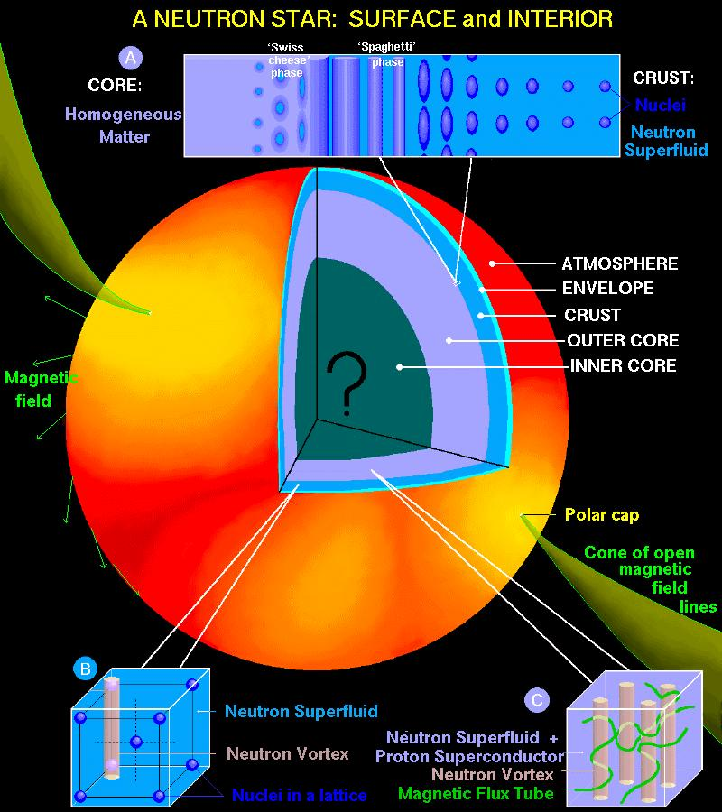
(from
Internet)
Inner Core:
Size ~ 1 Km
QCD phases:
QGP, CFL, etc.
0.2 km
1 km
9 km
Outer Core:
Size ~ 9 Km
Superfluid
Phases of
Nucleons
Superfluid
Vortices play
Important role
in glitches
1 km

Slide 7
Proposal 1: Very low energy collisions of neutron rich nuclei (possibly superheavy, near neutron dripline) may create bulk phase of nucleon superfluidity.
Possible at FAIR and NICA, At RHIC (BES) ?
This is a suggestion for another direction:
Surely QGP search is very exciting and novel:
But so is the search for the superfluid phase of nucleons, and
the associated vortices which are believed to play crucial role
in pulsar dynamics
Our signals can detect nucleon superfluid vortices and
investigate their properties under direct experimental control.
Very important for understanding of neutron star properties.
Nucleon superfluid transition temperautre: 0.2 MeV to 5 MeV
Density ρ ∼ 10⁻⁴ρ₀ , ρ₀ is nuclear saturation density
Such temperatures/densities are within reach at FAIR and NICA:

Slide 8
Collisions of Au on Au with the FOPI-facility at GSI Darmstadt.
E/A 150 250 400 MeV/A (incident)
T 17.2 ± 3.4 26.2 ± 5.1 36.7 ± 7.5 MeV
(results from blast model fit)
Freezeout density =
0.4 x nuclear saturation density
nucl-ex/9610009
Au-Au collisions at E/A = 50, 100, 150, and 200 MeV,
at heavy-ion synchrotron SIS,
T ~ 4-5 MeV is reached (nucl-ex/9801006)
Such low energy collisions or, a more dilute system
quite likely to give lower T and correct ρ for superfluid transition
UrQMD simulations in Progress : 1 GeV collision

Slide 9
How to probe these phases:
Only possible in the cores of Neutron stars and in low energy
heavy-ion collisions
Proposal: Avoid model dependence:
Focus on universal properties, even without knowing the
order of phase transition, or if the transition is a crossover
Focus on symmetry breaking pattern and the underlying
topology of the vacuum manifold (order parameter space)
Spontaneous symmetry breaking transitions invariably lead to
Existence of topological defects.
During transition, network of topological defects forms
By: Dominantly via a Non-equilibrium process of
Domain coalescence, known as the Kibble mechanism
This leads to universal predictions of statistical
properties of resulting topological defect network.

Slide 10
In heavy-ion collisions:
If any vortices result, they will dramatically modify the flow
Pattern, directly detectable as momentum anisotropy of hadrons.
We investigate qualitative patterns in flow with vortices.
This can establish nucleon superfluid vortices and
investigate their properties under direct experimental control.
Very important for understanding of neutron star properties.
Observing Color superconducting phases in heavy-ion collisions:
Relatively higher energy collisions, (at CBM, NICA), may create
Color superconducting phases.
Due to universal nature of vortex formation, results for nucleon superfluid vortices also apply to vortex formation in CFL phase, with appropriate scaling of correlation length.

Slide 11
Properties of CFL vortices:
Correlation length:
(Iida and Baym, PRD 66, (2002) 014015)
Velocity profile:
For r < ξ
For r > ξ
Results shown for 2 flavors, T_{c} = 50 MeV, μ_{q} = 500 MeV, T = 25 MeV
Resulting ξ = 0.7 fm, v₀ = 0.3
Same velocity profile holds for nucleon superfluid vortices,
For that case, T_{c} = 0.3-5 MeV, ξ ∼ 1 fm

Slide 12
Estimates of probability of formation of CFL vortices:
In central (rapidity) region, the flow pattern is 2-dimensional
Topological arguments (using Kibble mechanism) show: Probability of formation of CFL vortices at the junction of correlation domains in 2-D is 0.25
For correlation length of 0.7 – 1 fm, in heavy-ion collisions, with
radius of order 2-3 fm, the resulting high density QGP region has about 10-15 domains
Resulting number of CFL (or nucleonic) vortices is about 2-4
We simulate hydrodynamical flow with few vortices and
study resulting flow pattern
Qualitative patterns seen in flow anisotropies:
Analysis can reveal underlying vortex properties, hence can help
identify the corresponding symmetry breaking transition

Slide 13
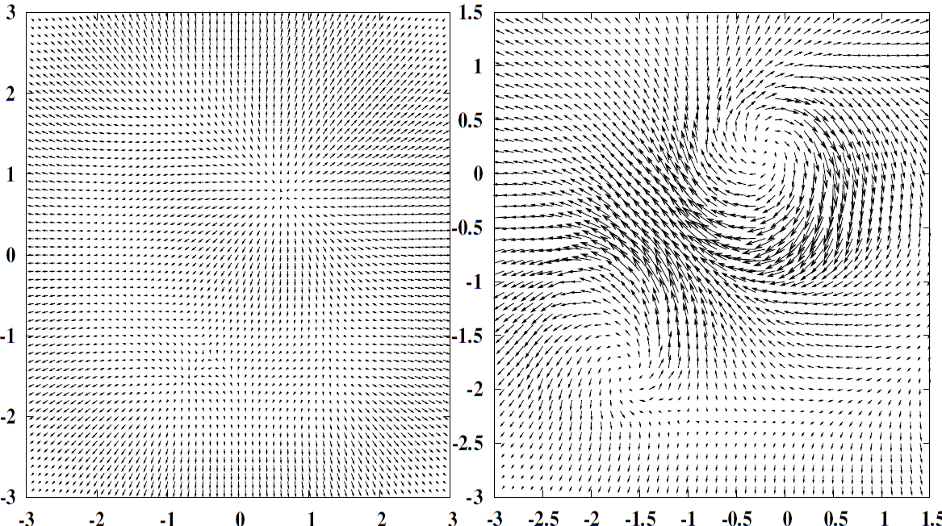
Results of relativistic hydrodynamics simulations with two-fluid
picture of superfluid (normal component and superfluid component)
Arpan Das, Shreyansh Dave, Somnath De, AMS,
Mod. Phys. Lett. A32, 1750170 (2017)
Velocity profile at central rapidity without (left) and
with (right) vortices: τ–τ₀ = 0.84 fm/c

Slide 14
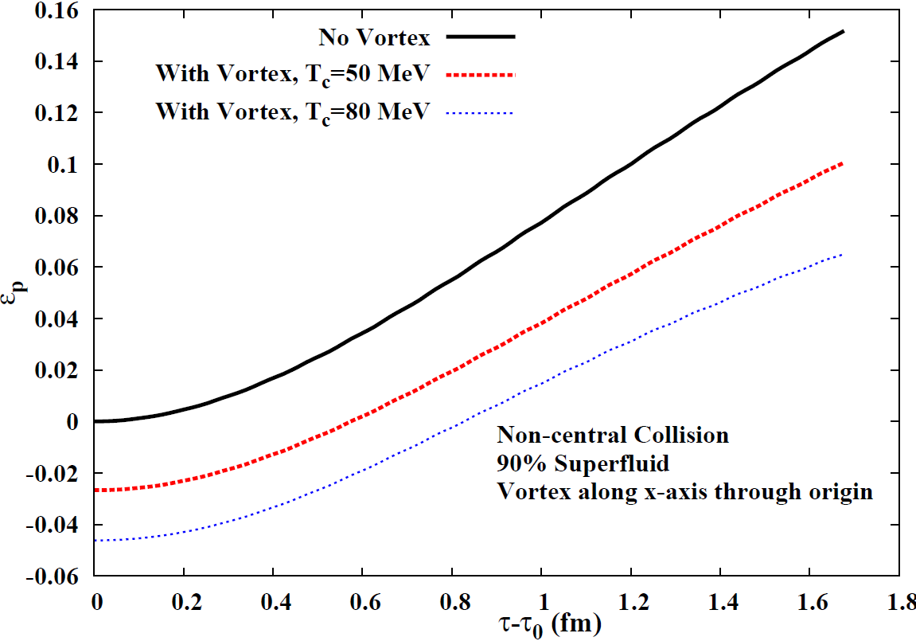
Strong negative elliptic flow due to vortices
T=25 MeV
ξ = 0.7 fm,v₀=0.3
ξ = 0.4 fm,v₀=0.5

Slide 15
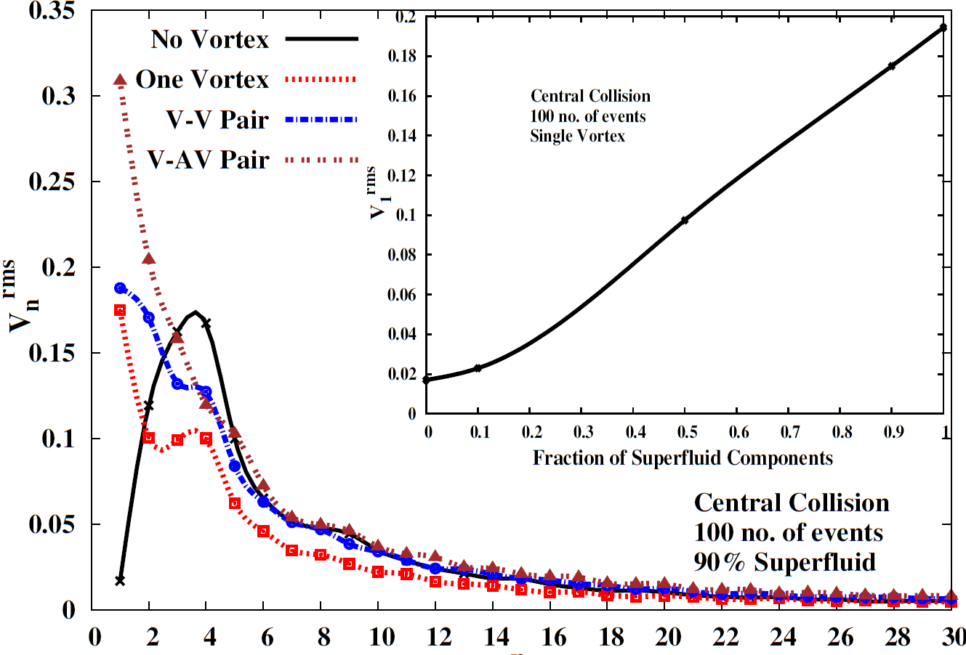
Strong directed flow in the presence of vortices

Slide 16
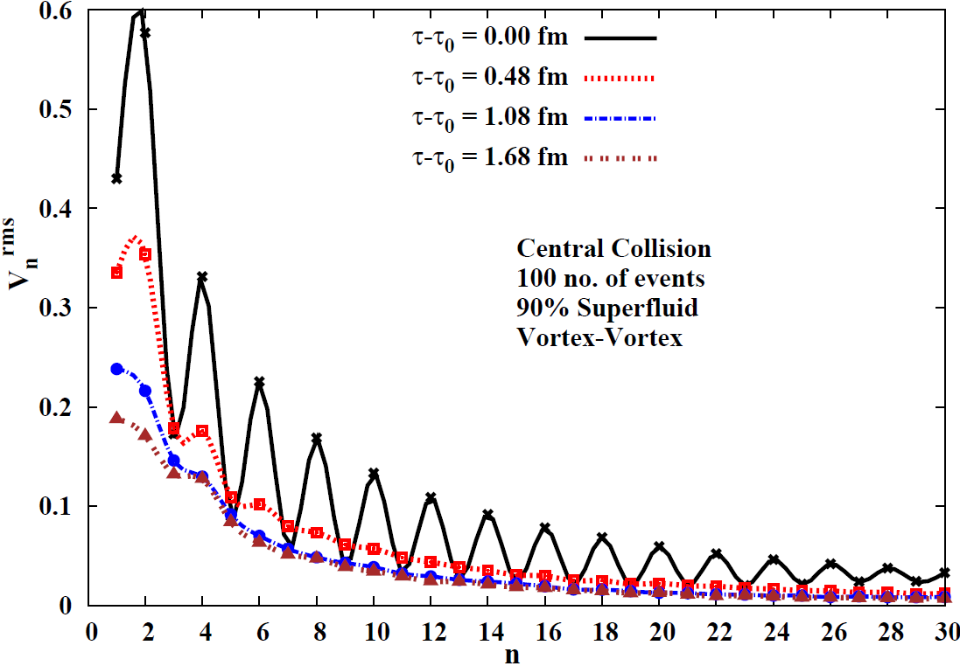
In certain cases: different powers in even-odd harmonics in
The presence of vortices during initial stages: Could be probed by
Thermal photon elliptic flow, or peripheral collisions

Slide 17
Signals from Pulsars: rotating neutron stars
Observations: Extremely precise measurements of
Pulsar timings (recall: first detection of gravitational waves)
Glitches : Sudden increase in rotational frequency,
Slow relaxation, over several months
Present understanding in terms
of crustquakes, or transfer of angular momentum due to
de-pinning of clusters of
superfluid vortices
Relatively recent observations:
Anti-glitches : sudden slowing
down of rotation
De-pinning of vortices cannot
account for these anti-glitches

Slide 18
Pulsars are incredibly accurate clocks
Example: period of the first discovered "millisecond pulsar" is:
P = 0.00155780644887275 sec
It is slowing down at a rate of 1.051054 x 10 ⁻¹⁹ sec/sec
The slowing-down rate is slowing down at a rate of:
0.98 x 10 ⁻³¹ /sec
Pulsar: J0437-4715
P = 0.005757451936712637 sec
Error of 1.7 x 10⁻¹⁷ sec.
Our work: use this incredible precision for detecting
changes occurring in the configuration of a neutron star.

Slide 19
Proposal 2: Signals of phase transitions from Neutron stars
Partha Bagchi, Arpan Das, Biswanath Layek, AMS, PLB, 747, 120 (2015)
Use extreme accuracy of pulsar timings to probe various
phase transitions occurring inside the pulsar core, for example:
Transitions to exotic phase of QCD, or nucleonic superfluidity
We used association of Phase transitions with density fluctuations:
Density fluctuations inevitably arise during phase transitions:
First order transition:
random bubble nucleations lead to density
fluctuations, with typical distance scales of inter-bubble separation
Second order transition, or smooth cross-over:
Density fluctuations with size scale of correlation domains, scale invariant density fluctuations in critical regime
In any transition/cross-over: large scale density fluctuations inevitably arise if topological defects are produced

Slide 20
Any density fluctuations in the neutron star will have
Observational effects:
If density fluctuations arise in the core of a pulsar, it will affect
its moment of inertia (MI) and quadrupole moment Q:
Can be detected by precision measurements of pulse shape/timing
Changes in MI and Q are completely generic
They happen for all types of density fluctuations produced
in phase transitions.
Further: these changes in MI and Q can have both signs, + and –
Implications of phase transition in the pulsar core:
Rapid changes in Pulsar timings and Gravitational waves

Slide 21
Implications of these density fluctuation induced changes:
Change in diagonal components of MI:
This will result in rapid changes in rotation of pulsar.
As density fluctuations dissipate away, leading to a uniform
new phase in the core, some part of change in MI will Be restored,
But not fully.
This is exactly the pattern of glitches and anti-glitches
where often only few percent of the change in rotation is recovered.
Also, as we find changes of both + and – sign, glitches and
anti-glitches are both naturally accommodated in this picture.
(no such uniform explanation present in the literature for both).

Slide 22
Transient changes in the off-diagonal components of MI and Q
These are distinctive predictions of our model.
Changes in Off-diagonal components will lead to wobbling of
star (on top of any present initially).
This will lead to modulation of pulse intensity
as the direction of radiation emission wobbles.
Thus, our model predicts that in association with
rapid changes in pulsar timings, there should
be modulation in pulse intensities.
This is distinctive prediction of our model.
Vortex de-pinning model cannot lead to off-diagonal components of MI (all vortices point along the rotation axis).

Slide 23
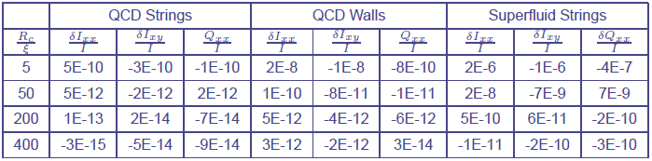
Fractional change of various components of MI and Q caused by
Density fluctuations due to string and /or domain wall network.
The results are obtained by varying the core size Rc, while keeping
The correlation length ξ = 10 fm fixed
As Rc is increased, fractional changes in various moment components
Seem to stabilize, with values ranging from 10⁻¹⁴ to 10⁻¹⁰.
Interestingly: Superfluid leads to much larger changes even with
small energy density changes of order 0.1 MeV/fm³. This is due
To larger region (~few Km) undergoing superfluid transition

Slide 24
Rapid changes in quadrupole moment Q will lead to gravitational waves.
Note: small value of Q/I arising from density fluctuations
(about 10⁻¹⁰) is more than compensated by the very short time
scale of microseconds.
Gravitational wave power ~
Fastest time scale for conventional mechanism of gravitational wave
emission is milliseconds (from rotation), with Q/I of order 1/1000.
Here Q/I is about 10⁻¹⁰, but time scale is at most microseconds.
In fact, for topological defect induced density fluctuations, the
time scale can be much shorter as defect network coarsens very
fast.
Thus density fluctuations arising during phase transitions in
compact astrophysical objects, like neutron stars, may provide
a new source of gravitational radiation.

Slide 25
Power in the gravitational wave:
I₀ is the MI of the pulsar, is the change in quadrupole
Moment occurring in time interval
in our model, about 4-8 orders of
magnitude smaller than the usual
value for deformed neutron star.
However, here is at least 3 orders of magnitude shorter that
the conventional case of fastest pulsar (millisecond pulsar). This
more than compensates for the smallness of quadrupole moment.
Strain amplitude from a pulsar r distance away:

Slide 26
These values of strain and power are well within the reach of LIGO.
However, LIGO is tuned for optimum frequency in kilo Hz regime.
It has possibilities of upgrades for Mega Hz frequency
(if motivated by physics considerations, no other
known astrophysical sources require Mega Hz frequency).
Important to have these upgrades.
This can open up new possibilities for very short time dynamics
happening inside neutron star cores.
It is the accuracy of pulsar observations which allows for precision
measurement of very tiny density fluctuations.

Slide 27
Proposal 3: Pulsars as Weber gravitational wave detectors:
Arpan Das, Shreyansh S. Dave, Oindirla Ganguly, AMS,
PLB, 791, 167 (2019)
So far we discussed internal changes in the pulsar affecting its
pulse timing etc. Now we discuss changes due to external influence.
A gravitational wave passing through a pulsar will cause (very) tiny deformations in the pulsar shape, affecting its rotation.
This will affect the extremely accurately measured spin rate of the pulsar.
It will also affect the pulse profile due to development of the
Off-diagonal components of moment of inertia tensor
(Here Due to external GW wave,
depending on GW source direction w.r.t pulsar spin).
Effect most pronounced at resonance.
May be detectable by accurate observations of the pulsar signal.
Resonance likely with Pulsar EOS and Tidal Deformability constrained by recent BNS merger event

Slide 28
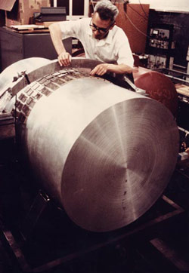
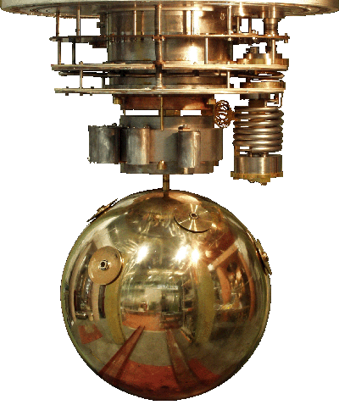
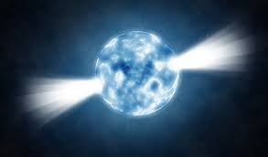
The pulsar, thus, acts as a
Remotely stationed Weber detector
of gravitational waves whose signal can be monitored on earth.

Slide 29
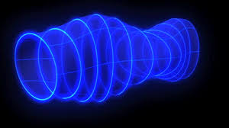
Pulsars as Weber gravitational wave detectors:
In our earlier work, we discussed internal dynamics of pulsar (e.g. phase transition) leading to its deformations.
Now consider a pulsar under influence of external gravitational
waves (GW) , coming, say, from a merger event far away.
For simplicity, take a spherical pulsar to begin with
Pulsar
M,R
Gravitational wave

Slide 30
Under the influence of external gravitational wave, the pulsar
will undergo quadrupolar deformations
Deformation of neutron star in the
Tidal field E_{ij} of gravitational wave
is given by
Q_{ij} = - λ _{d} E_{ij}
Q_{ij} = -λ_{d} E_{ij}
M,R
λ_{d} is the tidal deformability :
k₂ is the second Love number with its value for a neutron star
lying in the range k₂ ~ 0.05 – 0.15 (constrained by recent BNS merger observations).
Directly probes, equation of state of the neutron star interior and and its mass-radius relationship (M/R)

Slide 31
E_{ij} = R_{i0j0} (R_{μνλρ} being the Riemann curvature tensor) can
be written in terms of GW strain amplitude for a specific polarization
in transverse traceless (TT) gauge
Where
The suffixes ‘+’ and ‘x’
denote two different
Polarizations of GW

Slide 32
Denoting h₊ by h , the amplitude of resulting E_{ij} is given by
λ is the GW wavelength
Resulting change in the quadrupole moment tensor of the
neutron star is given by
Q_{ij} = - λ _{d} E_{ij}
For simplicity, we take the initial NS configuration to be spherically
symmetric, and the deformation to be ellipsoidal, with the dimension
in the direction of GW propagation remaining unchanged.
Using the above value of Q_{ij} we can calculate changes in the moment
of inertia tensor I_{ij} of the NS

Slide 33
Resulting change in the moment of inertia of neutron star is
We take sample values with M = M_{o}
and R = 10 km
.
Highest sensitivity will be reached for smallest values of λ (above
equations valid for static case, this requires λ to be much larger
than NS radius, range of frequencies we consider are below kHz)
As a typical astrophysical source of GW, we take binary neutron
Star (BNS) merger, such as the one detected by LIGO/Virgo
The highest value of GW frequency being about 1 kHz.
Then, we get (with k₂ = 0.1 as a sample value)

Slide 34
LIGO-Virgo detected BNS merger event:
Peak signal strength h ~ 10⁻¹⁹
Source distance from earth ~ about 130 million light years.
The Detector neutron star (pulsar) could be very close to it,
Suppose it was at 100 light year distance from the BNS merger
(Note: Most neutron stars/pulsars are in globular clusters
With very dense cores, so very likely case).
Then the GW strength at the pulsar will be h ~ 10⁻¹³
Resulting fractional change in moment of inertia (for the
Relevant component), hence change in spin rate, will be
If detector pulsar was 10000 light years away from BNS merger:
This number will be ~ 10⁻¹⁷

Slide 35
Such fractional changes in the spin rate of pulsars should be
Detectable by precision measurements of the pulses
For millisecond pulsars, accuracy of pulse timings have been
measured to an accuracy better than 10⁻¹⁵ - 10⁻¹⁷ seconds.
Note: Such remarkable accuracy for pulse timings typically
requires folding over large number of pulses, for a short
GW pulse is it possible?
Important: Neutron star acting as a Weber detector at resonance
will exhibit Ringing effect.
(This is how Weber detector achieves very high accuracy).
Thus, even for a GW pulse its effects will be present in the pulsar
signal for a much larger duration, hence folding should be
Possible.

Slide 36
Possibility of Resonant Enhancement:
Above estimates for pulsar spin rate changes did not account
for resonance, which can dramatically increase the effects of GW.
For example: Resonant tidal deformations from orbiting binaries
Can lead to rupture of NS crust. It has been argued that viscous
Effects may not be very dominant for the relevant time scales.
More precisely, one needs to know the quality factor Q for NS interior
For specific modes, the resonant frequencies of NS can be in the
Range of 100 Hz to 1 kHz.
Note, this is precisely the range relevant for a typical BNS merger
GW source, also for BH mergers of suitable masses.
Thus: the possibility remains that resonance effects may lead to
Significant enhancement of the effect of GW on NS spin rate change

Slide 37
Resonant Enhancement:.......
However, resonance enhancement generally requires sustained
Signal, which is unlikely for the case of a burst of GW
Again, we recall: for Weber detector, use of material of very high
Quality factor (with Q factor of order 10⁶ ) was important.
This is not only for resonant enhancement effect,
Also, even for a short GW pulse, there is strong Ringing effect
for a Weber detector operating at resonance
which helps in enhancing signal to noise ratio.
Due to this ringing effect, the detector continues to vibrate in
The resonance mode for significant time even after the passing
Of the GW pulse through the detector (due to energy absorbed
From the pulse in the resonant mode).
For example: for a GW pulse lasting a few ms, the resonant bar
Can continue to ring for time of order 10 minutes with same
Frequency, thereby allowing separation between noise and signal

Slide 38
Resonant enhancement for NS:
Thus, if the pulsar continues to ring for significant time after the
GW pulse has passed through it, then the radio pulses will
Continue to retain this “definite frequency signal” hidden within.
Note: We need to know the Q factor for NS interior
Folding of many pulses may be able to separate this
Ringing signal.
Both these effects: resonant enhancement, and the Ringing
Effect, may significantly improve the accuracy of detection
of the effect of GW on pulsar signals. Then these pulsars
Can become additional detectors of GW located in space.
Of course, if one is lucky then some GW source may be close
To the pulsar being observed. The GW signal may be very strong
On the pulsar, hence strongly affecting its pulses which can
Be observed on earth.
However, most pulsars, especially millisecond pulsars, are
Within our galaxy, so chances of this is very small, may be
1 in 3000 years.

Slide 39
Pulsars: A family of remotely stationed Weber detectors:
What we have argued is that the pulsars spread out in space may
act as GW detectors.
They detect GW, then communicate this detection to earth based
“Pulsar Observatories” by their pulses carrying the imprints of
GW (arising from tiny deformations in NS configuration from GW).
These imprints have extremely high degree of fidelity (so: signal transmission from pulsar detector to earth has high quality)
What is needed is to have very accurate measurements of pulsar
Timings of far away pulsars.
Reaching out for extra galactic pulsars will be very important.
Possibility of some GW source close to the pulsar, while being
Very far away from us, will show the real strength of this technique.
Important: Even if GW event is directly detected at earth, these
Pulsars can provide additional detections, helping in accurate
Triangulation of source location. Crucial for Black Hole mergers.

Slide 40
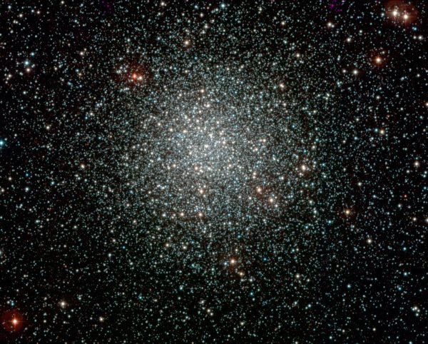
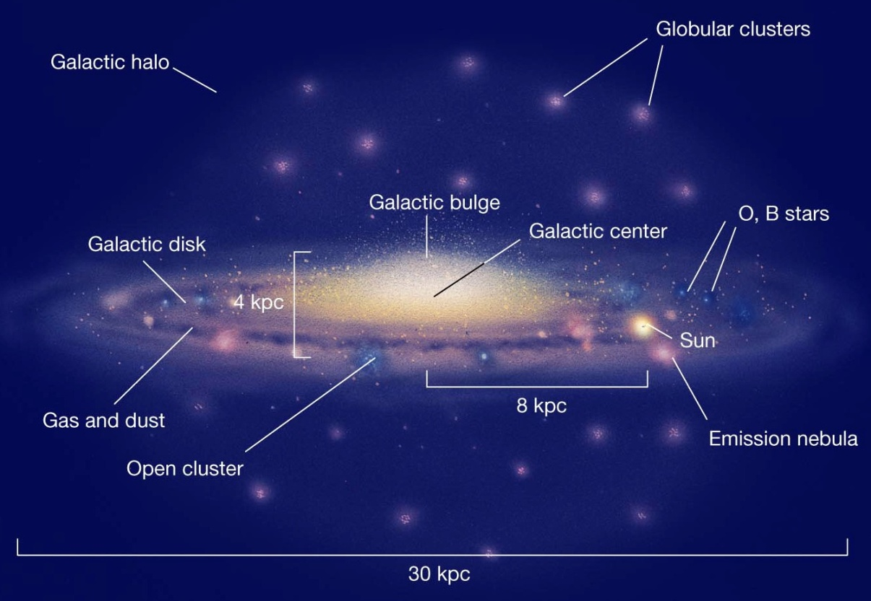
Pulsars in the neighbourhood of GW sources can provide us a
family of remote detectors all of which can be monitored on earth
GW source:
e.g. neutron
star merger
A globular cluster
Milky Way
Pulse with
GW imprint
Pulsar
detector

Slide 41
Now consider: cases when gravitational waves have already reached earth in past, either detected, or missed:
For past GW events, Pulsar mediated signals will reach us in future at precisely determined times:
Opportunity to revisit those events in future, possibly several times.
Minati Biswal, Shreyansh S. Dave, AMS, arXiv:1909.0447
Far away
GW source
Denotes locations of Pulsar
detectors which will detect GW
at different times.
These modified pulses will reach us in future at predicted times:
Revisit past GW events

Slide 42
Consider the case of those GW events which have already been detected on earth, or the GW signal has passed earth in past, without detection.
Those GW waves will also reach pulsars, say in our galaxy, and
Will modify their pulses
pulsar
B
A
C
Earth
GW
source
The modified pulse of the pulsar will carry the imprints of the original GW signal, which will reach us much later
(total path Being A + B)
This will reach us much after the arrival of the original GW signal
Which was along the path C.

Slide 43
Knowing the GW source, and the date of detection of GW on earth,
One can determine for each specific pulsars, when its
GW-Perturbed signals will reach us on earth.
Remarkable possibility of re-visiting the past GW events
If it works, it will be important: Ability to look at events
which occurred in far past
It will allow repeated source of information about the GW source
with same signal coming again and again from different pulsars
As well as properties of NS and its interiors
(specific to the Pulsar whose signal is being observed)
It will allow multiple detectors, located at astrophysical distance
Scales, which can be used for accurate localization of GW source.
This will be of crucial importance for events like BH mergers where
No other signals are emitted except GW.
Localization not very accurate with only GW detectors on earth

Slide 44
An important feature of pulsar detectors:
Depending on source direction w.r.t pulsar spin, Pulse Profile will
be modified. In principle, single pulsar observation will have
detailed information about source direction
May also enable detection of any circularly polarized
Components in the incoming gravitational wave.
(e.g. from fluid circulation in core collapsed supernova)
Not easy with conventional detectors
Gravitational wave

Slide 45
We analyzed specific GW events detected by LIGO/Virgo
and have identified specific pulsars whose perturbed signals will
reach us, say, within next 50 years: Example:
GW source Pulsar Signal arrival time mean time
mm/dd/year max time
GW170814 J0437-4715 1/14/2035 2038-2043
(BH-BH)
Closest and brightest pulsar known, T ~ 5 ms, distance ~ 500 ly
X-ray, in binary with white dwarf, Pictor constellation (South)
Past Supernova events as GW sources:
Estimated GW strain from a type-II supernova (even for a type 1A
Supernova) can reach as high as 10⁻²⁰ at a distance of 10 kpc.
We have analyzed recorded supernova events, GWs from these will leave imprints on the pulsars will perturbed signal arrival dates.
Example:
SN1604 J1759-1956 3/1/2020 2039-2060

Slide 46
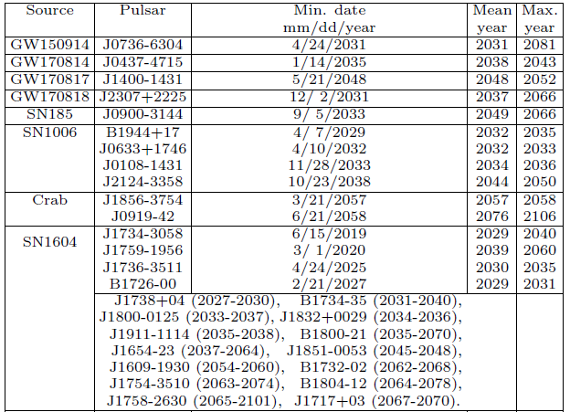
Table I: GW signal arrival dates for next 50 years
(1054)

Slide 47
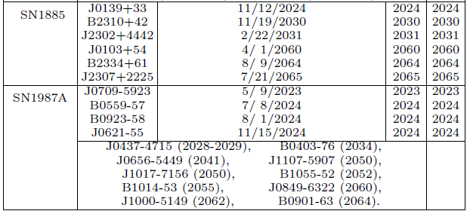
Table I: GW signal arrival dates for next 50 years
date of earliest signal arrival is given here in days and months, even
though the error estimates are in years. It only reﬂects exactly known
date of the GW source, and illustrates the possibility that with more
accurate observations (source and pulsar locations), in principle, a
very precise date of signal arrival on earth could be predicted.

Slide 48
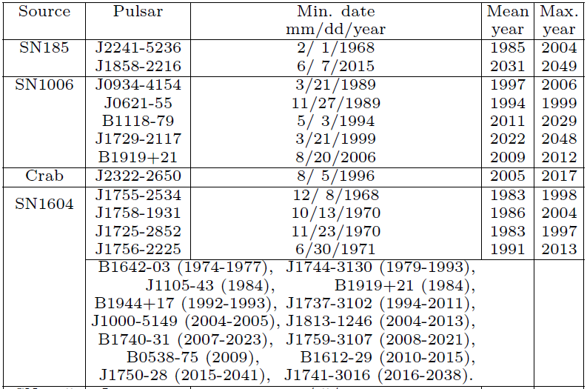
Table II: GW signal arrival dates for past 50 years

Slide 49
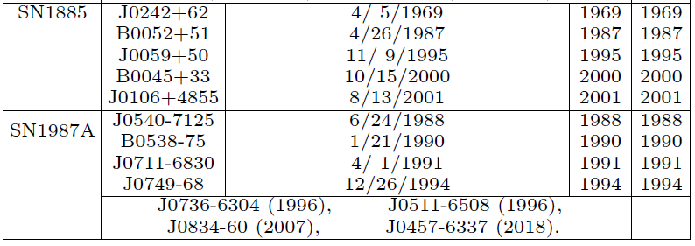
Table II: GW signal arrival dates for past 50 years

Slide 50
Table II: GW signal arrival dates for past 50 years
How far back in past we can go?
just from the size of the Milky Way, we note that the oldest GW signals one can detect at present using galactic pulsars are those which passed by earth about 200,000 years ago.

Slide 51
Concluding remarks
Pulsar measurements extremely accurate, can detect tiny changes
in pulsar structure, either due to internal dynamics, or due to GWs
Pulsars very far away can act as remotely stationed Weber detectors
of gravitational waves.
Important to accurately measure signals of pulsars in other galaxies.
Reaching out for extra galactic pulsars will be very important.
Possibility of some GW source close to the pulsar, while being
very far away from us, will show the real strength of this technique.
Note: for very distant pulsars, timing errors large due to
inter-galactic medium changes. This is important for long time
stability of signal. But for a GW pulse, it may not be important.
For past GW events, Pulsar mediated signals will reach us in
future at precisely determined times:
Opportunity to revisit those events.

Slide 52
Important to emphasize, various estimates we have made are
crude, it is not very clear if the effects are observable with
Present level of accuracy of pulsar measurements.
However, for past GW events recorded on earth:
The prediction of Dates on which “perturbed-signals” from pulsars
will reach earth is beyond question (apart from error estimates
in timing).
It is just trigonometry
It is then worth the effort that we focus on improving accuracy
of predicted dates and attempt to make best possible
measurements of pulses at those times.
After all, we do not know Neutron stars interiors so well
They just might surprise us pleasantly.
Not doing anything on those dates just does not seem right

Slide 53
THANK YOU

Slide 54
Inner Crust region:
Superfluid ¹S₀ phase appears in the inner crust region:
Extending from ρ ∼ 4 x 10¹¹ g/cm³ to 2 x 10¹⁴ g/cm³
For the ³P₂ channel, the interaction becomes strongly attractive only at higher density, this occurs in the core of the neutron star.
This phase is quite like the superlfuid phase of ³He
Allows for non-trivial order parameter, and hence associated
topological defects.
Even though nucleon superfluid vortices play crucial role in understanding of pulsar glitches,
Only theoretically investigated so far
These have never been seen in any experiment.

Slide 55
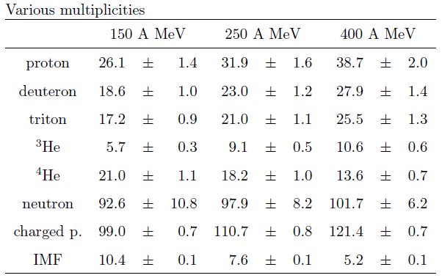
Collisions of Au on Au with the FOPI-facility at GSI Darmstadt.
E/A 150 250 400 MeV/A (incident)
T 17.2 ± 3.4 26.2 ± 5.1 36.7 ± 7.5 MeV
(results from blast model fit)
Freezeout density =
0.4 x nuclear saturation density
nucl-ex/9610009
Intermediate mass fragments z>2
Au-Au collisions at E/A = 50, 100, 150, and 200 MeV, at heavy-ion
synchrotron SIS, T ~ 4-5 MeV is reached (nucl-ex/9801006)
Such low energy collisions or, a more dilute system quite likely to give lower T and correct ρ for superfluid transition
UrQMD simulations in Progress : 1 GeV collision

Slide 56

Tidal deformability (T. Hinderer, Astrophys. J. 677, 1216 (2008))
Deformation of neutron star in the tidal field E_{ij} of gravitational
wave is given by
Q_{ij} = - λ _{d} E_{ij}
Τidal Deformability λ_{d} is related to the second Love number k₂
For polytropic pressure-density relation:
Where K is a constant and n is the polytropic index,numerical results
(for 0.5 <= n <= 1.0, and 0.1 <= (M/R) <=0.24) can be fitted by
the formula:

Slide 57
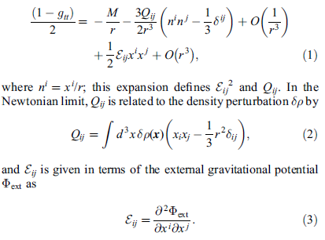
Tidal field of external gravitational potential:

