Slide 1
The Blind in STEM
- A Reality Check
Presentation By
The XRCVC Team
Xavier’s Resource Centre for the Visually Challenged (XRCVC),
St. Xavier’s College, Mumbai

Slide 2

SCIENCE – STUDY OF THE VISIBLE OR INVISIBLE?
IS SIGHT INTEGRAL TO STUDYING STEM?
Presented by: XRCVC, St. Xavier’s College Mumbai

Slide 3
Hoby Wedler –PhD, Chemist, UC Davis University
“I hear what you're saying about chemistry being a visual science, but who can see atoms anyway.
Chemistry is really something that happens in our mind and yet, when we're working in the lab, maybe we need to see a color change to know that something happened, but that's something an assistant can tell me about.
I don't need necessarily to be able to see to think about and understand science and understand chemistry”.
Presented by: XRCVC, St. Xavier’s College Mumbai

Slide 4
Understanding Blindness and Low vision
Presented by: XRCVC, St. Xavier’s College Mumbai

Slide 5
Hello, How Are you?

Slide 6
Hello, How Are you?

Slide 7
Is it impossible?
Possible?
Difficult?
What Changes?
Are all of them the same?
Range of Conditions
Presented by: XRCVC, St. Xavier’s College Mumbai

Slide 8
Understanding The world of Blind and Low vision
Presented by: XRCVC, St. Xavier’s College Mumbai

Slide 9
Key Principles to Navigate
Sensory Substitution
Multi Sensory Approach
Presented by: XRCVC, St. Xavier’s College Mumbai

Slide 10
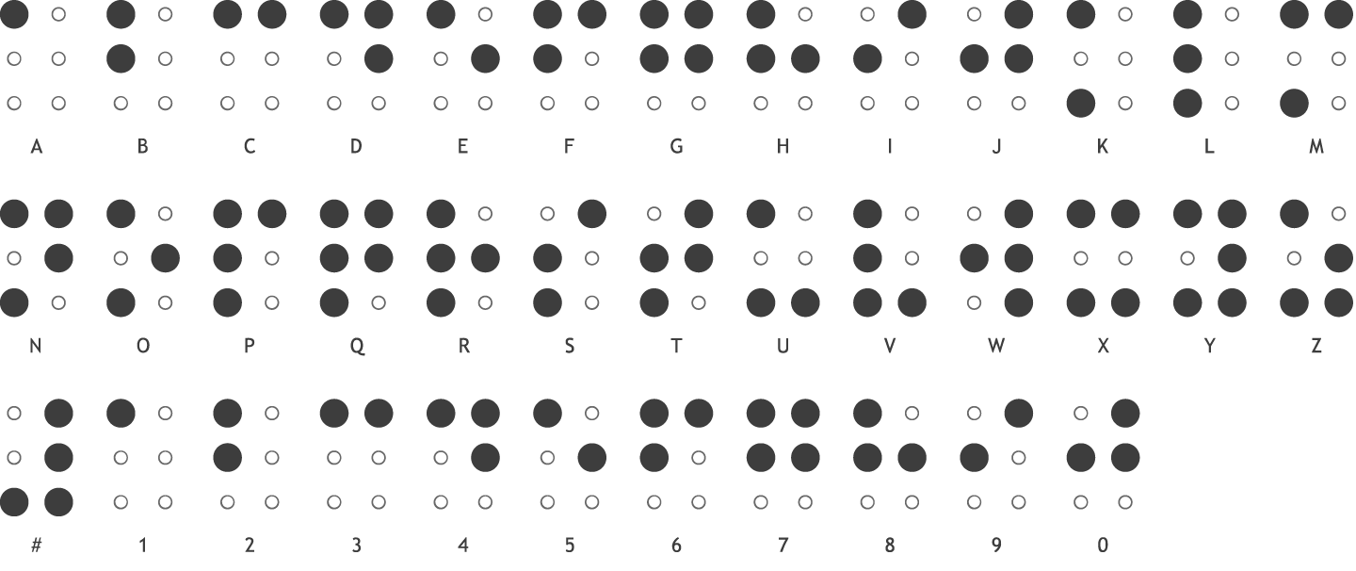
Reading & Writing: Braille, Screen Reader, Screen Magnifier
Totally Blind - Screen Reader, Braille (Hardcopy/ Refreshable Display)
Presented by: XRCVC, St. Xavier’s College Mumbai

Slide 11
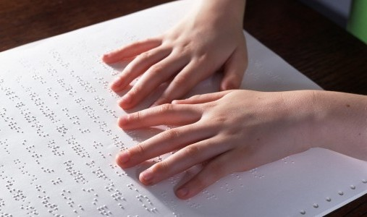
Video for Refreshable Braille Display
Presented by: XRCVC, St. Xavier’s College Mumbai

Slide 12
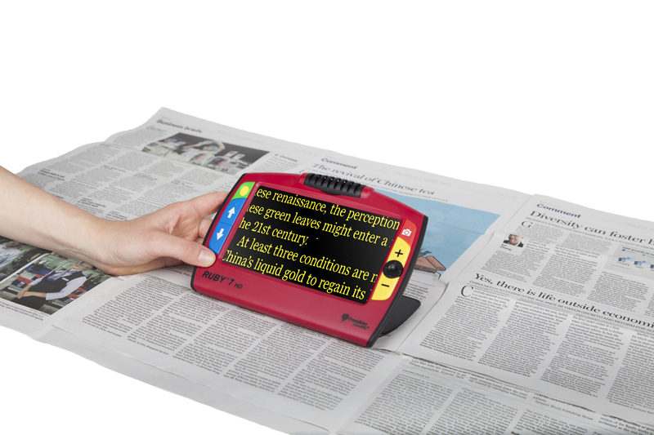
How do PwD access Material?
Low Vision – Video Magnifier, Screen Magnifiers
Presented by: XRCVC, St. Xavier’s College Mumbai

Slide 13
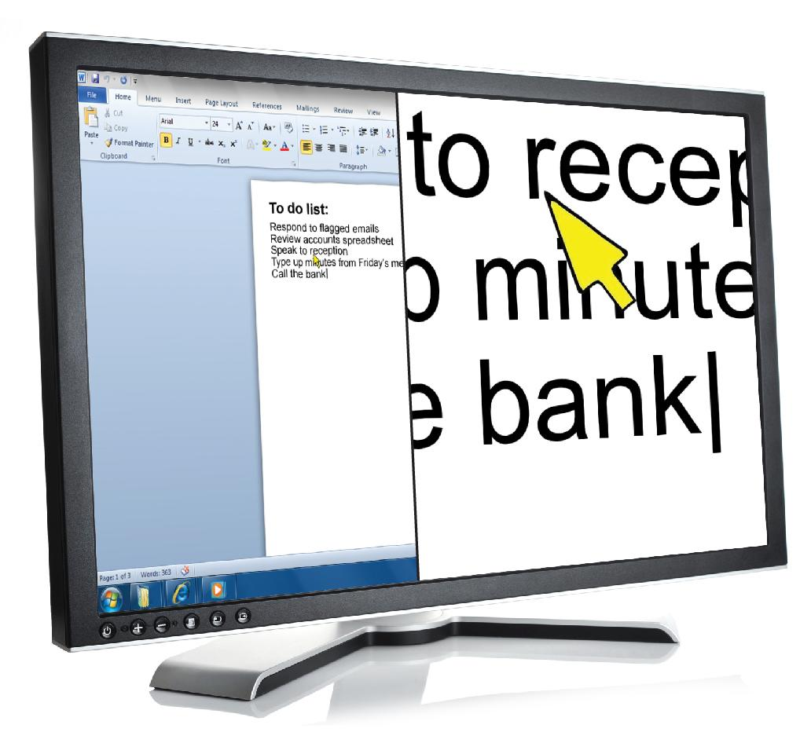
Screen Magnifiers
Presented by: XRCVC, St. Xavier’s College Mumbai

Slide 14
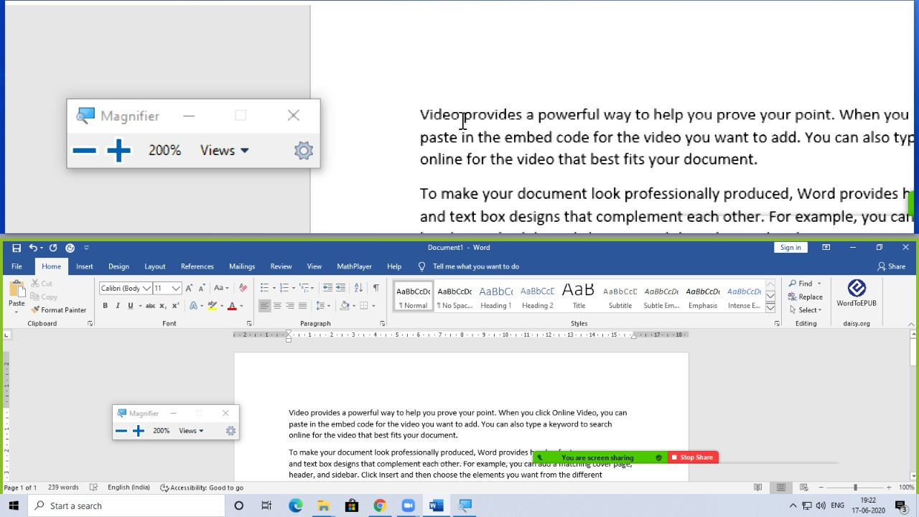
Screen Magnifiers
Presented by: XRCVC, St. Xavier’s College Mumbai

Slide 15
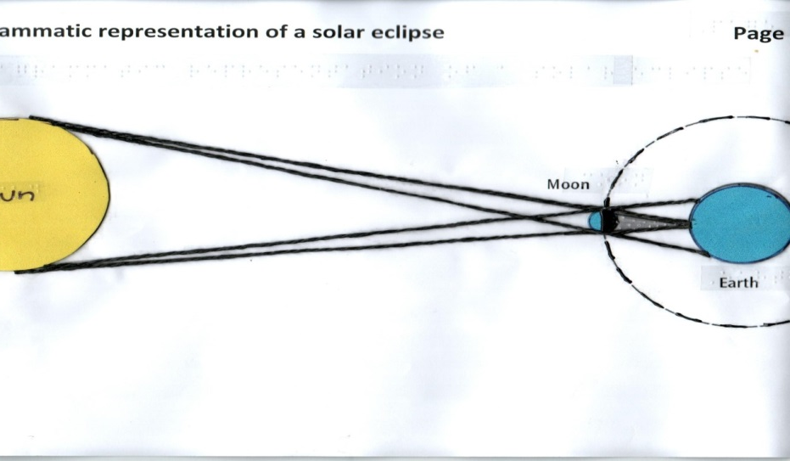
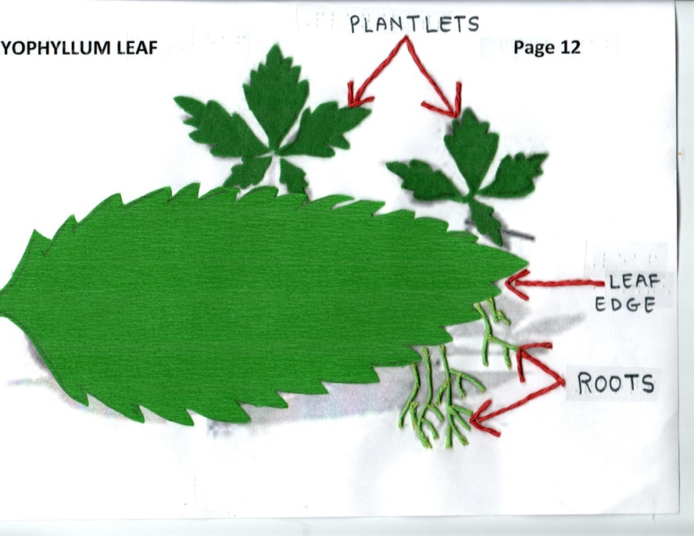
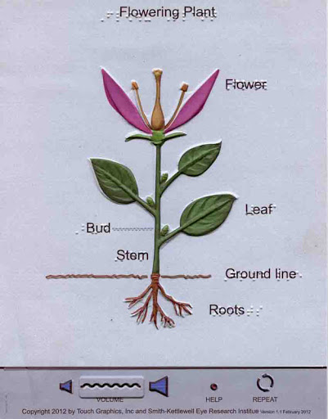
Visuals and Graphics: Tactile Diagrams, Graphs and Models
Presented by: XRCVC, St. Xavier’s College Mumbai

Slide 16
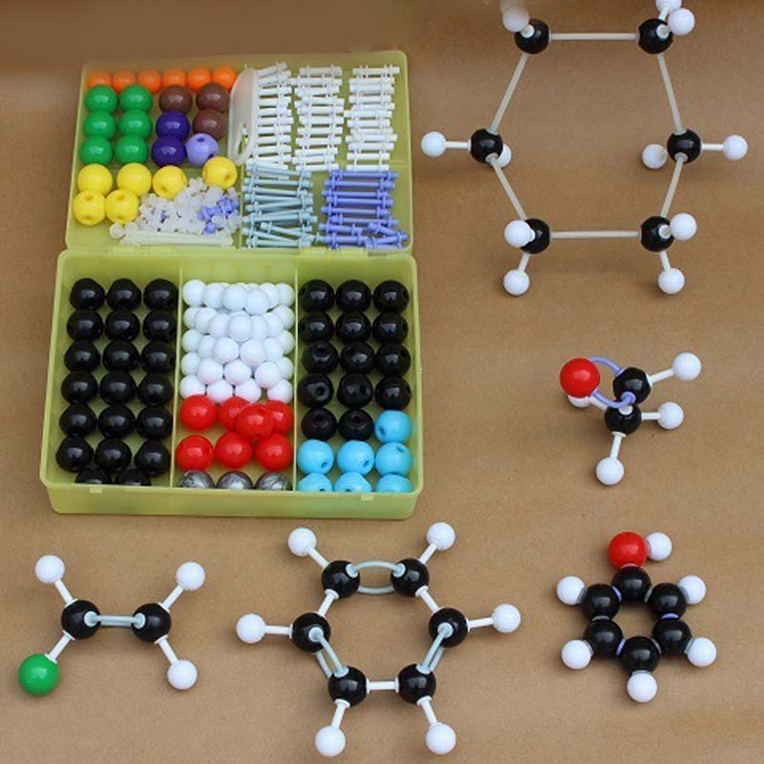
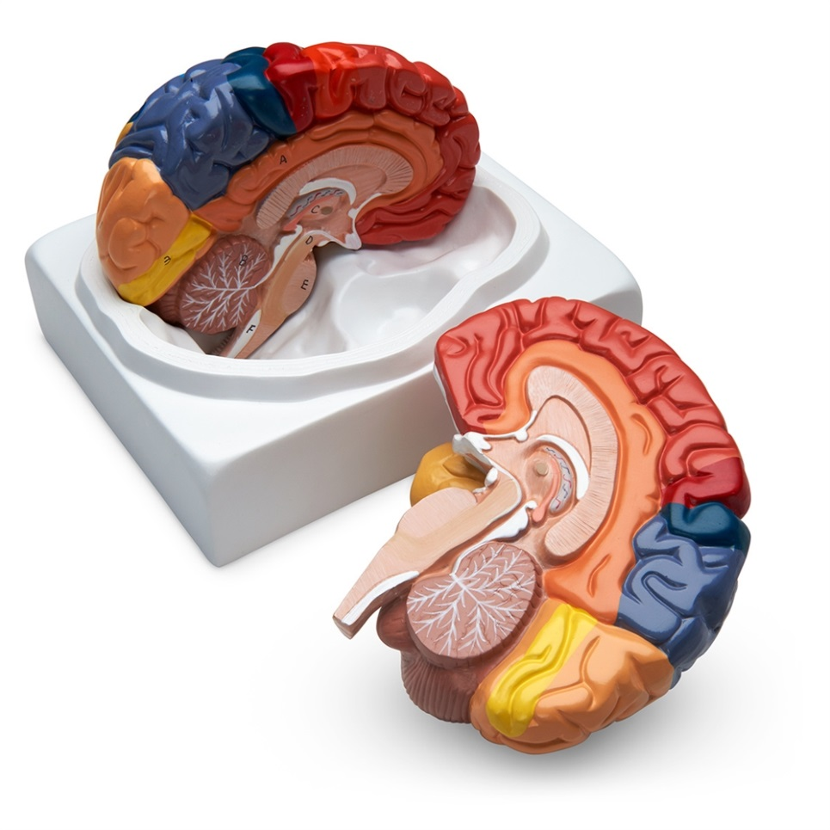
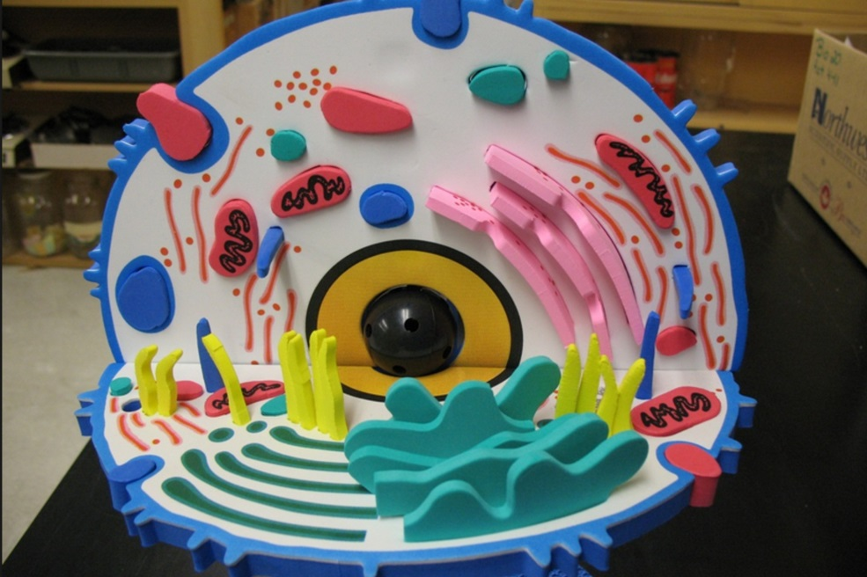
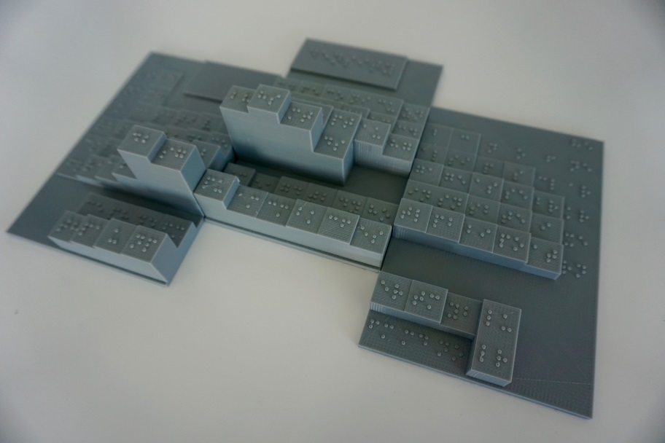

Slide 17
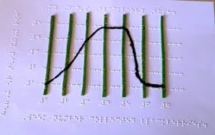
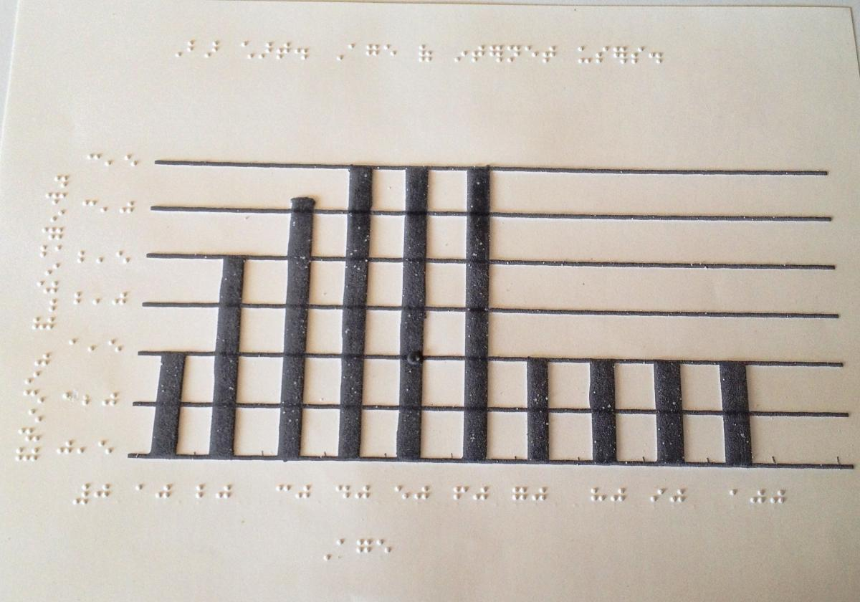
Desmos
Audio Graphing Calculator
Presented by: XRCVC, St. Xavier’s College Mumbai

Slide 18
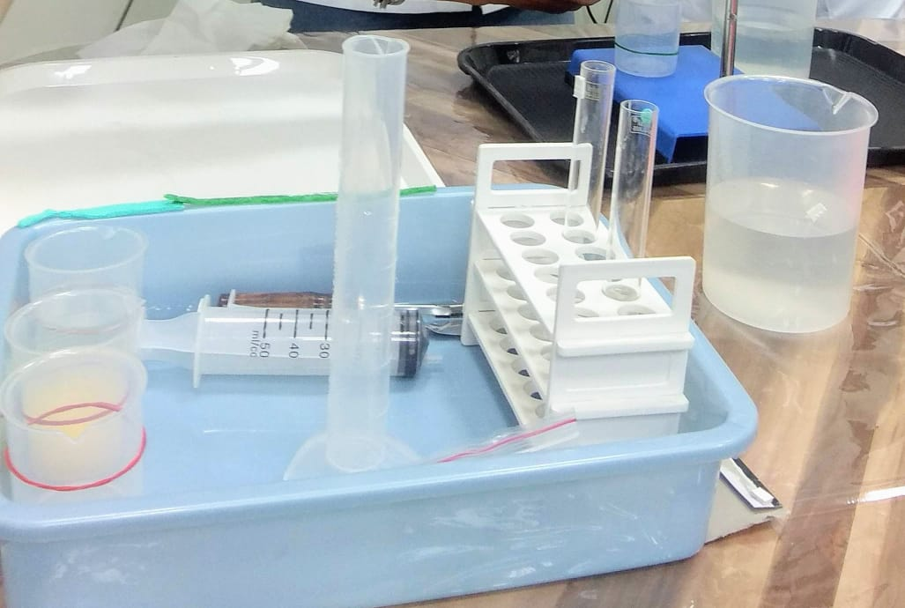
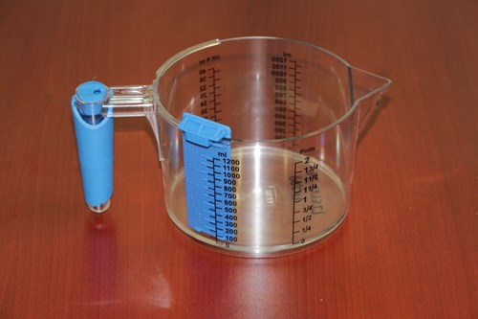
Movement & Lab work: Use of touch, Sound, Smell
White Cane/Smart Cane to move around
Work Station: Definition of work space, trays, boxes etc
Identification of Materials & Solutions: Tactile Labels, Audio Labels, Markings, Different Shaped Containers, Use of Spoon instead of spatula
Presented by: XRCVC, St. Xavier’s College Mumbai

Slide 19
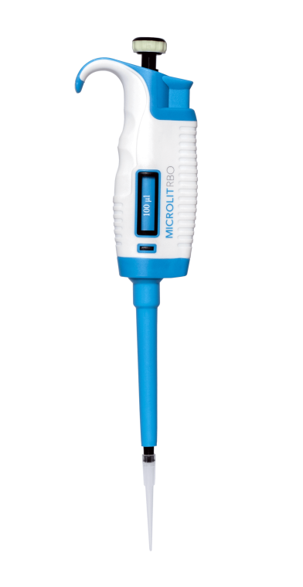
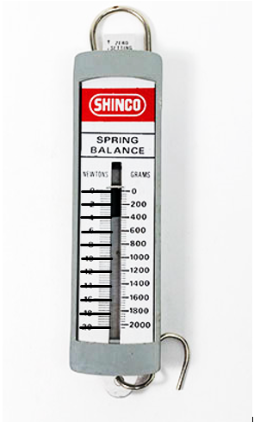
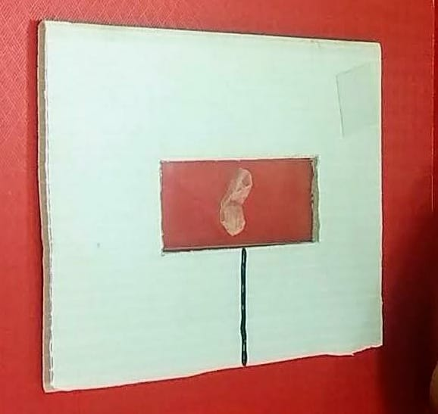
Tactile measuring instruments – Fixed volume Pipettes, tactile markings on spring balance
Use and Study of Specimens – Slide guide, Tactile diagrams, Models, Enlarged images of microscopic slides
Journal work – same method as reading and writing shown above
Presented by: XRCVC, St. Xavier’s College Mumbai

Slide 20
Visual Element that cant be substituted
Lab Assistant as AI reader of Visual Element
Scope for Technology Innovations to make Lab environment Accessible for all
Presented by: XRCVC, St. Xavier’s College Mumbai

Slide 21
How Do research teams operate?
Do all researchers do hands on work?
Do you need to be doing something in its minutest point to be able to guide knowledge in the field of study?
Presented by: XRCVC, St. Xavier’s College Mumbai

Slide 22
François Huber (July 2, 1750 – December 22, 1831), Swiss entomologist who specialized in honey bees. His pioneering work was recognized all across Europe and based on thorough observation with the help of several assistants due to his blindness.
Jacob Bolotin (January 3, 1888 – April 1, 1924) was the world's first totally blind physician. Chicago Medical School, graduated with honors at 24, and became the world's first totally blind physician fully licensed to practice medicine. He was particularly recognized for his expertise on diseases of the heart and lungs.
Abraham Nemeth (October 16, 1918 – October 2, 2013 American mathematician and inventor. He was Professor of Mathematics at the University of Detroit Mercy in Detroit, Michigan. Inventor of Nemeth Braille Code
Dr Geerat Veremji- Marine Biologists, McArthur Fellow, Currently a Distinguished Prof at University of UC Davis Expertise in study of Shells with extensive field work across the globe. – His use of touch enabled him study shell patterns otherwise invisible to the naked eye
Wanda Diaz Merced, Astronomer – Currently working with South African Astronomical Observatory. Use of Sound to study Visual Data- Sonification - Use of sound to examine the extremely strong low-frequency regions or bass line, , they noted resonances characteristic of electrically charged gases like the solar wind
Kent Cullers, Optical Physicist, Since 1985 Cullers has led Search for Extraterrestrial Intelligence Institute (SETI) in Mountain View, California, Targeted Search Signal Detection team, where he develops, evaluates, and implements complex algorithms that allow scientists to sift through radio signals originating from distant star systems. Cullers is also a leader in the rarified field of envisioning and designing advanced radio telescopes that scan wider and wider swaths of the skies
Mr. Kartik Swahney- Computer Scientist- Currently working with Microsoft
Ms. Kritika Purohit – Physiotherapist, Currently having her private practices in Virar
Presented by: XRCVC, St. Xavier’s College Mumbai

Slide 23
Scientific temper & Capacity are a matter of the intellect
What does Physical Disability have to do with their pursuit?
We have never insisted on only right or left handed writing.
So why insist on science being done only through sight?
As Scientists the more data types we can build, the more chance we give to invention and discoveries.
Then why fear alternate data sets if we want to discover new things?
Why let our biases stand in the way of individual careers or great scientific discoveries?
INCLUSION IS NOT ONLY ABOUT CREATING ACCESS BUT ALSO THE PATH TO GREATER SCIENTIFIC KNOWLEDGE- JOIN US IN THIS JOURNEY
Presented by: XRCVC, St. Xavier’s College Mumbai

