Slide 1

Higgs Production at NNLL´ + NNLO using
Rapidity-Dependent Jet Vetoes.
Free Meson Seminar, TIFR
Shireen Gangal
TIFR, Mumbai
Based on: SG, J. Gaunt (CERN), F. Tackmann (DESY), E. Vryondiou (CERN): JHEP 2005 054.
J. Gaunt, SG, M. Stahlhofen (U. Freiburg), F. Tackmann : JHEP 1702 026.

Slide 2
Plan of Talk
Rapidity Dependent Jet Vetoes.
Soft Collinear Effective Theory (SCET).
Factorization and Resummation for H+0-jet cross section.
Beam and Soft Functions at 2 – loops.
NNLL’ + NNLO Results.
5/29/2020

Slide 3
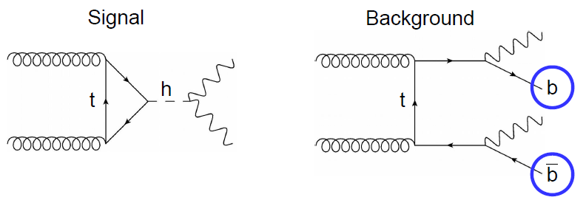
Introduction
Jet vetoes are important at the LHC. Eg: Separating signal from background.
Experimental analyses impose jet selection cuts, vetoes and separate data into exclusive jet bins.
eg: $H→WW$: Jet binning into 0-jet, 1-jet, 2-jet.
0-jet bin: Hard jets with $p_{T}^{jet}> p_{T}^{cut}\sim 20−30$GeV are vetoed.
Number of jets distinguish different Higgs production modes.
Any such Higgs measurement requires theory input:
Precise theory predictions of exclusive jet cross sections.
Reliable uncertainty estimates accounting for jet vetoes.

Slide 4
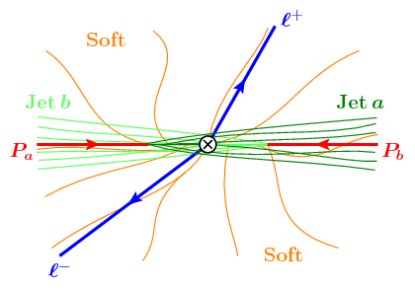
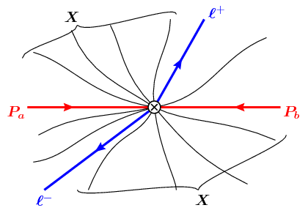
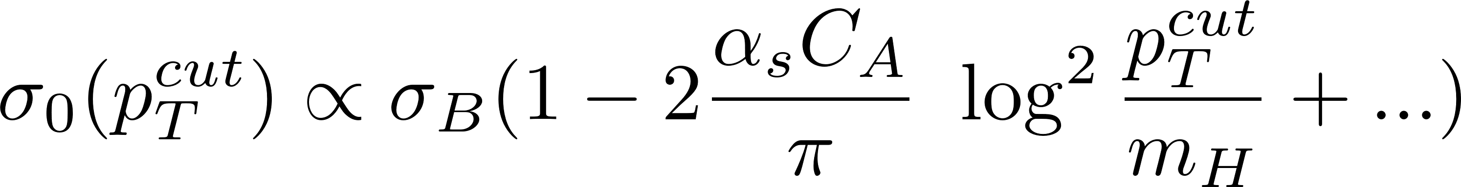
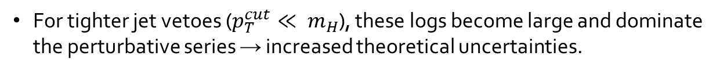

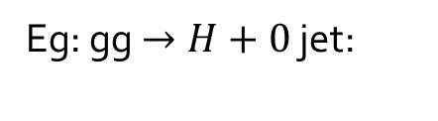
Introduction
Jet selection cuts and vetoes on additional emissions induce Sudakov double logarithms. For ${p_{T}^{jet}< p}_{T}^{cut}: α_{s}^{n}\log^{m}[\frac{p_{T}^{cut}}{m_{H}}]$.
Veto
Eg: gg $→H+0$ jet:
For tighter jet vetoes ($p_{T}^{cut}≪ m_{H}$), these logs become large and dominate the perturbative series → increased theoretical uncertainties.
These logs must be systematically resumed to obtain reliable theory predictions.

Slide 5
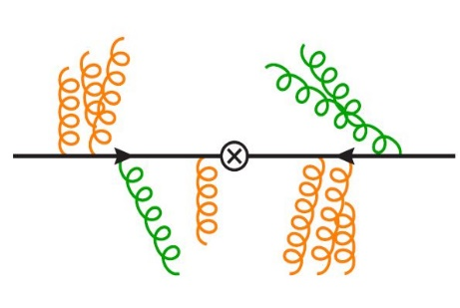
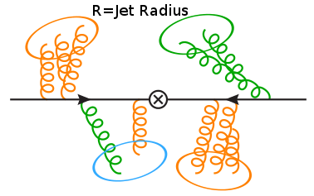
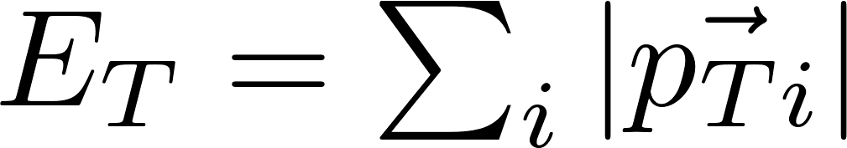
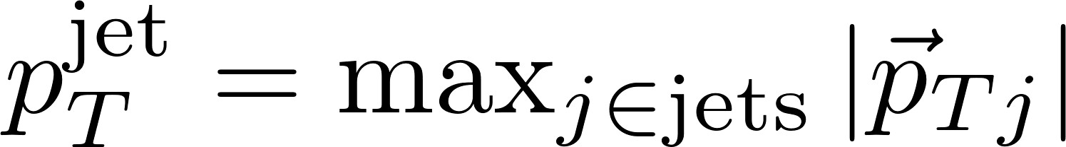
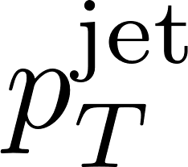
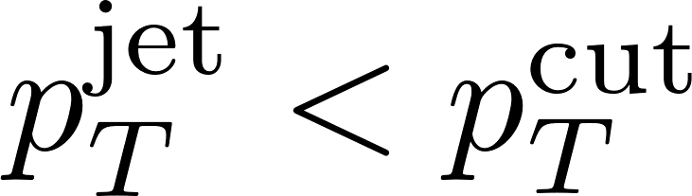
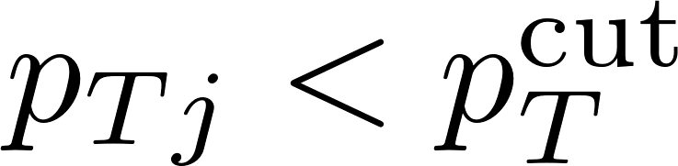
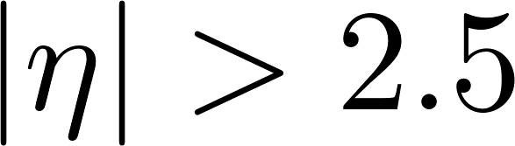
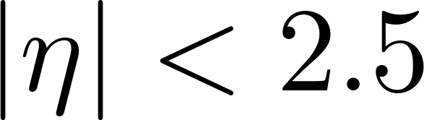
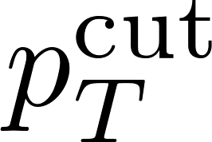
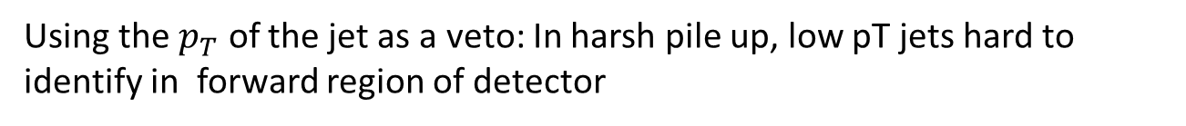
Types of Jet vetoes
Global Veto: Restricts sum of all Emissions.
Local Veto: restrict (local chunks of) individual emissions.
as a jet veto: Requiring vetoes any event having atleast one jet with .
Using the $p_{T}$ of the jet as a veto: In harsh pile up, low pT jets hard to identify in forward region of detector
.
Can try to get around this by vetoing only jets with .
Or raise everywhere : Cannot impose tight vetoes on central jets.

Slide 6
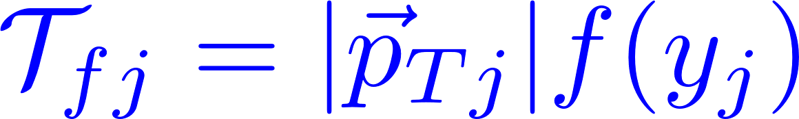
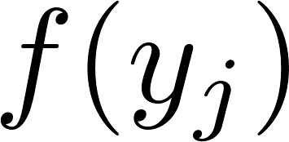
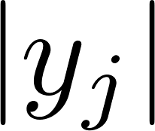
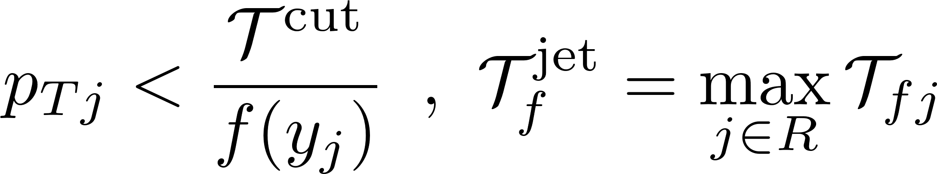
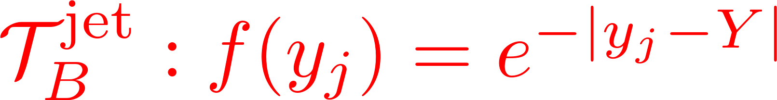
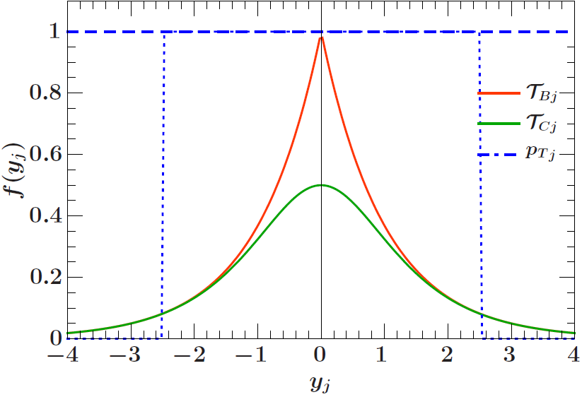
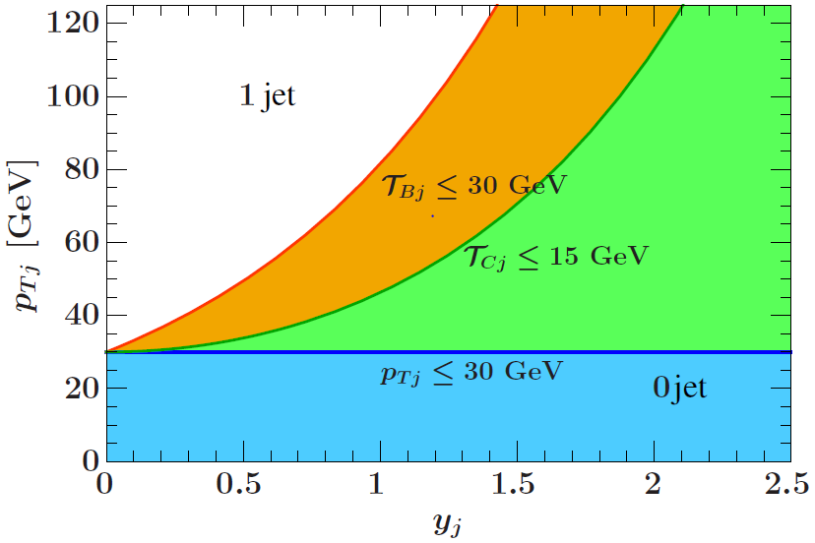
Rapidity-dependent Jet Vetoes
Use a different jet veto that depends smoothly on the rapidity of jets.
: decreasing function of . Tight veto at small rapidity and loose at large rapidity.
Tackmann, Walsh, Zuberi ‘12 ,
SG, Stahlhofen, Tackmann ’14.
Two observables:
5/29/2020

Slide 7
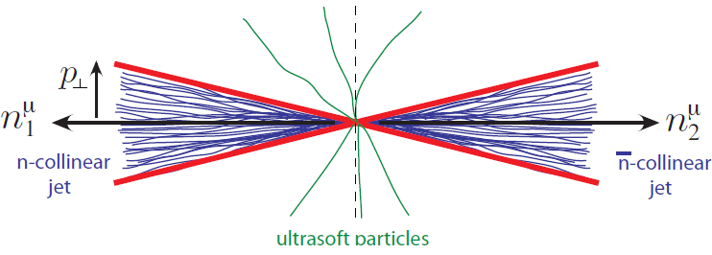
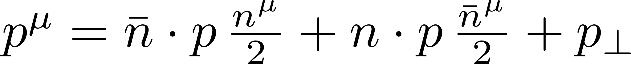
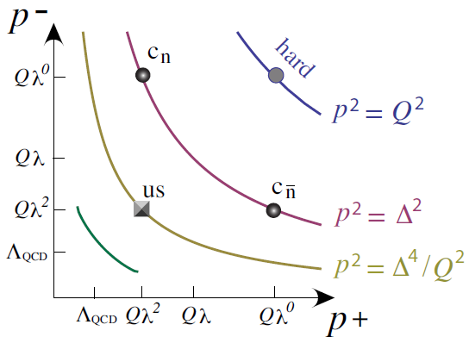
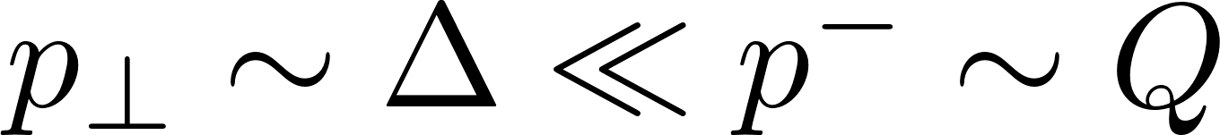
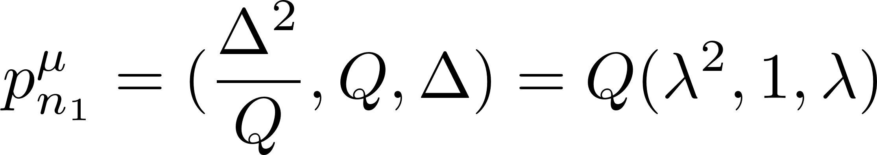
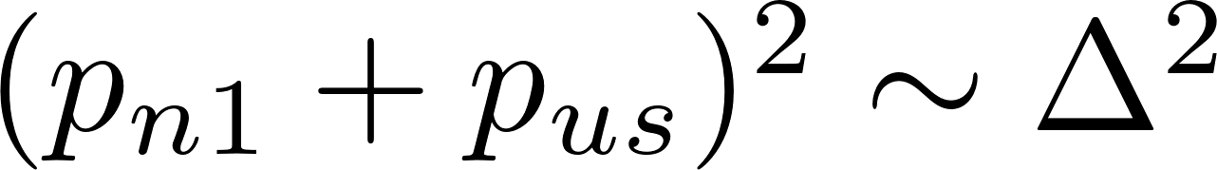
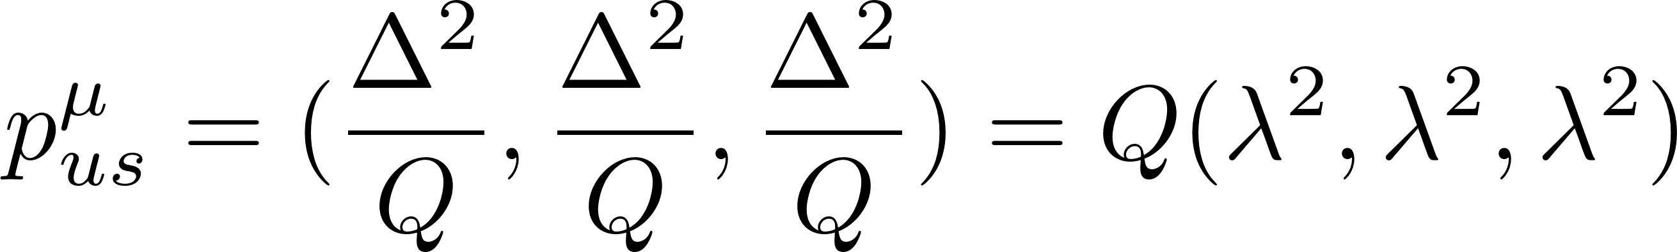



Soft Collinear Effective Theory
SCET: Low Energy d.o.f : Soft and Collinear Modes.
$$p^{−}$$
$$p^{+}$$
SCET I Momentum Regions: $e^{+}e^{−}→$ 2 jets

Slide 8
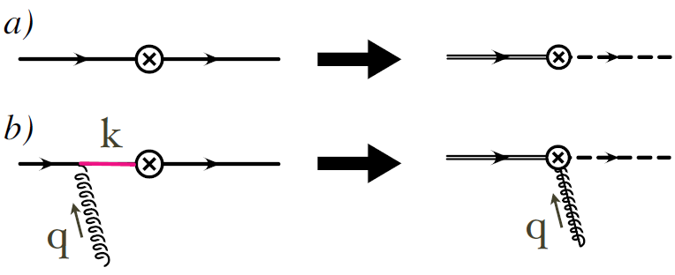
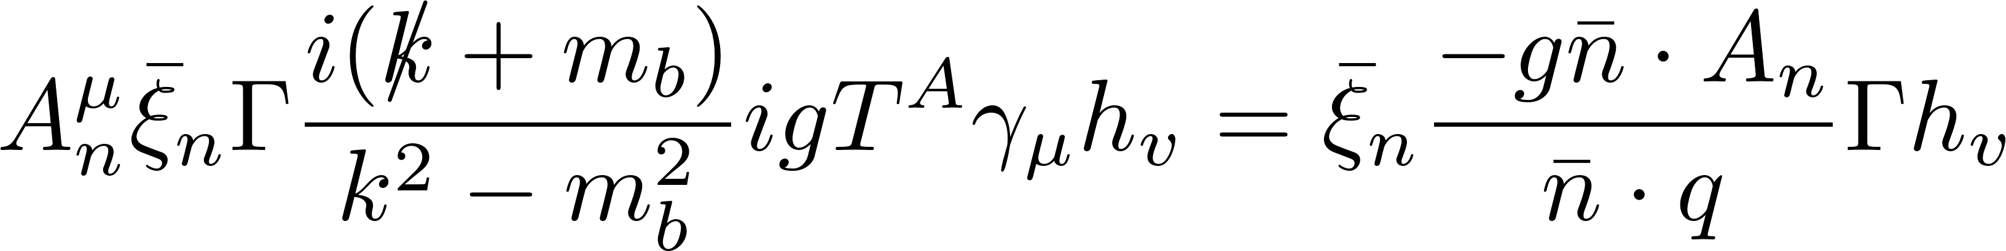
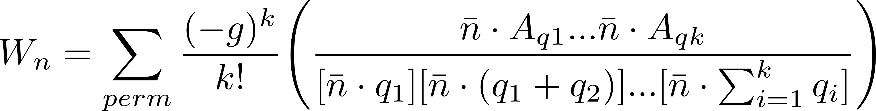
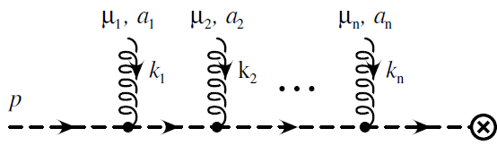
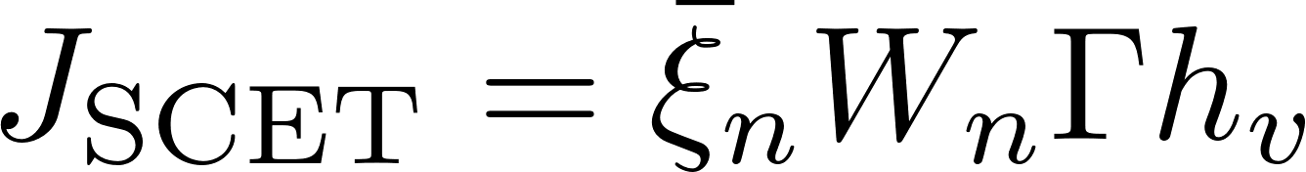
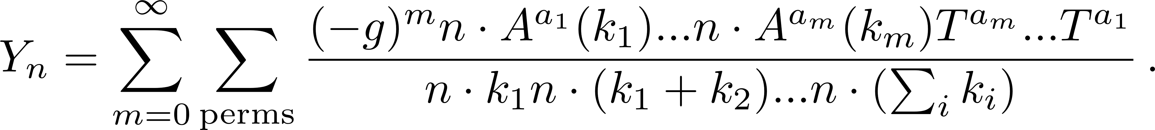

Wilson Lines and Factorization
Decoupling of ultrasoft gluons
by field redefinitions:
Ultrasoft Wilson Line:
Eg: $e^{+}e^{−}→$ 2 jets:

Slide 9
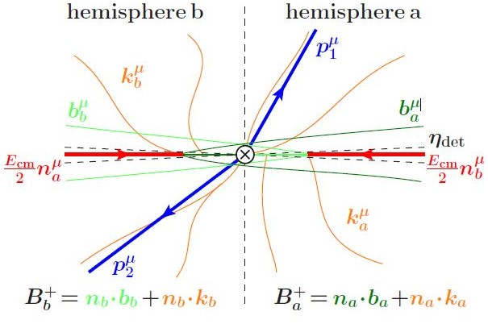
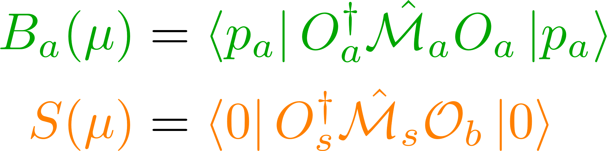

Factorization for H+0- jet
(Tackmann, Walsh, Zuberi ’12)
(Stewart, Tackmann, Waalewijn ’09)
$$\sim O_{a}O_{s}O_{b}$$
Measurement Function

Slide 10
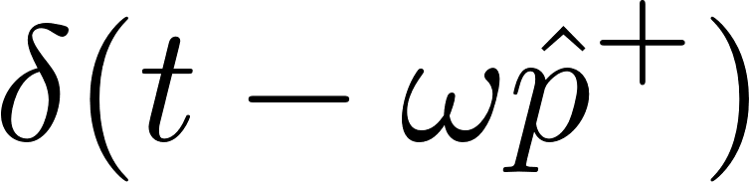
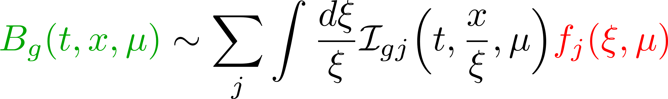
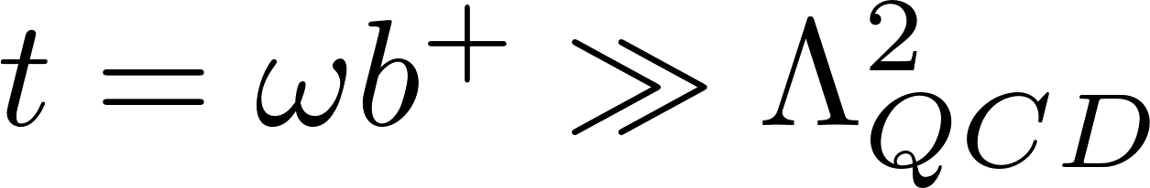
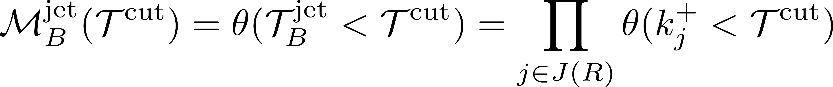
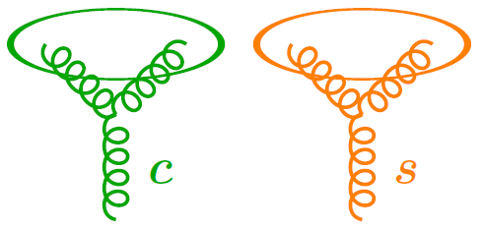
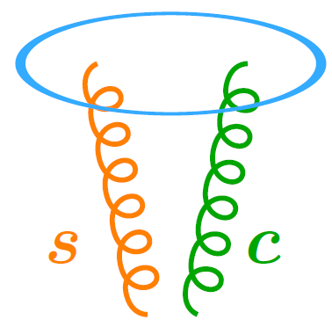
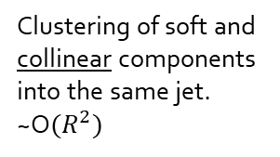

Factorization in SCET
Stewart, Tackmann, Waalewijn ’10
$$ω/P^{−}$$
Virtuality-dependent Beam Functions
Measures plus momentum of parton entering the operator.
For :
Measurement function:
Soft Collinear factorization implies:
(Tackmann, Walsh, Zuberi ’12)
clustering within each collinear and soft sector.
Clustering of soft and collinear components into the same jet. ~O$(R^{2})$

Slide 11
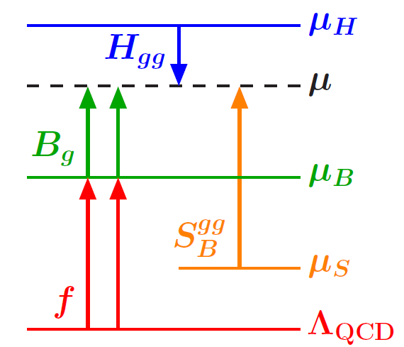
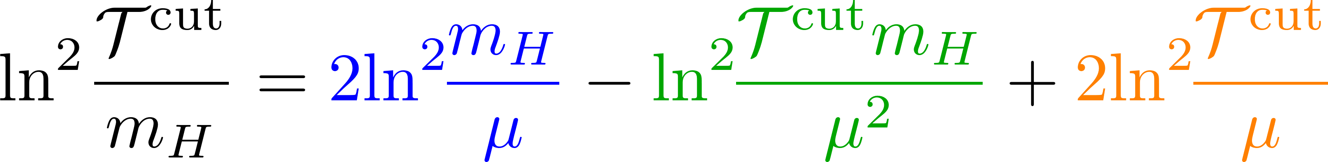
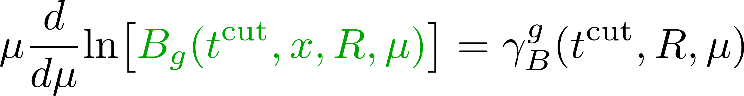


Resummation in SCET
Natural Scale choice:
Beam Function RGE:
H,B,S factors
U factors

Slide 12



Resumming to NNLL’
We need finite parts of 2-loop beam and soft functions: Need to take into account the effects of clustering corrections.
Jet Dependent Measurement Function:
Inclusive 2 loop Beam and soft function calculation available.
Compute difference to the reference (jet-algorithm indep) beam or soft function.
Global reference measurement we use coincide with jet-dependent at 1 loop.
Consider only double real emission amplitudes.
Beam Functions:

Slide 13



2-loop Beam Function
J. Gaunt, M.Stahlhofen, F.Tackmann ‘14
Consider double real amplitudes: $𝒜\left({k_{1},k}_{2}, x\right)= 𝒜_{A}({k_{1},k}_{2}, x$) + $𝒜_{B}({k_{1},k}_{2}, x)$
Obtained by taking soft limit of one of the partons $𝒜_{A}{=𝒜}_{i}^{S(1)}𝒜_{ij}^{B(1)}$
“Uncorrelated emission”
“Correlated emission”
$Ln(R)$, ${Ln}^{2}(R)$
Use the additional measurement constrain:

Slide 14



2-loop Beam Function
Integration of $𝒜_{A}$with ($1−θ(ΔR<R))$: Done Analytically. Result as divergent as $1/ε^{2}$ and $R^{2}/ε$.
Integration of $𝒜_{B}$: Expand in small $ΔR$limit to extract log R terms analytically.
F(R), g(R) and h(x) : determined numerically by integrating amplitude for values of x and R and then fitting.
Correlated Contribution
Expansion of
$${(1−x)}^{−1−2ε}$$
Uncorrelated Contribution
Three 1D functions determined numerically: f(R), g(R ) in correlated and h(x) in uncorrelated. One 2D function of x and R determined numerically.

Slide 15


2-loop Soft Function
Treat Abelian ($C_{F}C_{F}$) uncorrelated piece in different way to Abelian ($C_{F}C_{A}$ , $C_{F}T_{F}$) .
SG, Gaunt, Stahlhofen, Tackmann ‘17
Results proportional to $R^{2}/ε$ and O($R^{4}$).

Slide 16




2-loop Soft Function
$C_{F}C_{A}$ , $C_{f}T_{f}n_{f}$ channel: Correction computed via difference from inclusive soft.
Captures remaining $1/ε$ divergence. Same for
Finite, numerically integrate.
terms analytically
Computed by integrating numerically

Slide 17
Ingredients at NNLL’
Hard Function at 2 Loops:
Harlander, Kant, ‘05
Berger, Marcantonini, Stewart et al ‘11
Beam Function at 2 Loops:
Soft Function at 2 Loops:

Slide 18



Ingredients at NNLL’
Anom. Dim for Soft
And Beam Functions:
Correction terms of O($R^{2}$) from uncorrelated emissions :
Stewart, Tackmann, Walsh
et al ’13
Banfi, Monini, Salam et al ‘12

Slide 19




Non Singular at NLO
The full H+0-jet cross section:
Nonsingular corrections using NLO subtraction method:
Resummation region: Logs are resummed using canonical scaling:
Fixed Order region: Resummation is turned off to get the right FO cross section at large
Transition region: Profiles for $μ_{B}, μ_{S}$ provide smooth transition from resummation to fixed-order region

Slide 20


Non Singular at NNLO
Full NNLO inclu. cross section
NLO H + 1 jet cross section
Catani, Grazzini: HNNLO

Slide 21




Uncertainties using Profile Scale Variations
Central Profile Scales:
Stewart, Tackmann, Walsh
et al ’13
Total Uncertainty in 0-jet cross section:
Fixed Order:

Slide 22



Uncertainties using Profile Scale Variations
Resummation Uncertainty :
SG, Tackmann, Stahlhofen ’14
Stewart, Tackmann, Walsh et al ’13

Slide 23



H+0-jet cross section at NNLL’ + NNLO

Slide 24



H+0-jet cross section at NNLL’ + NNLO

Slide 25



Effects of Underlying Event and Hadronisation

Slide 26



Effects of Underlying Event and Hadronisation

Slide 27

Summary.
Rapidity-dependent Jet vetoes : Efficient to veto central jets.
Can avoid experimental and theoretical limitations of traditional jet veto like .
Can provide complementary ways to perform jet binning.
Computed corrections to inclusive 2-loop beam and soft functions due to jet clustering effects for all parton and color channels.
Computed H+ 0-jet cross section at NNLL’ + NNLO for Rapidity - dependent jet vetoes.
Precision of resummation to same level as .
The cross sections with Rapidity dependent jet vetoes have a reduced sensitivity to underlying event and hadronisation effects compared to that with a .
Future Directions: Drell Yan cross section at NNLL’ + NNLO.

Slide 28
Back Up Slides

Slide 29






H+0-jet NLL’ + NLO for
SG, Tackmann, Stahlhofen ’14
Good Convergence and reduced Uncertainties from NLL to NLL’ + NLO.
At Tcut = 25 GeV, 20% uncertainty for
NLL’ + NLO
(Comparable to $p_{T}^{cut}$).
Comparison of our NLL'+ NLO predictions in bins of
with the ATLAS measurements in the
$H →γγ$ analysis.
Notes:
Details abt the H-> gg plot.

Slide 30




Beam and Soft Functions
Momentum of parton before Hard interaction.
The beam function depends on t ~ ${ω b}^{+}\sim −p_{⊥}^{2}$ , which is the
negative of the quark’s transverse virtuality
BF operator in position space:
BF operator in momentum space
PDF operator

Slide 31


State of the art for H+ 0-jet pT veto ?
Jo Gaunt’s talk
Goal : to obtain NNLL’ + NNLO precision for $T_{B}$ and $T_{c}$:
Our Results

